Slide 1
Week 3 – Day 1

Slide 2
Phonemic Awareness
Phoneme Categorization
Listen to the ending sounds in these words: last, send, rest.
Two of the words end with /st/. One does not.
That’s right, the words last and rest end with /st/.
The word send does not end with /st/. It does not belong.
Guided Practice:
Say the words.
Have children identify the word that does not end with the chosen blend.
Listen for /nd/: band, back, land.
Listen for /nk/: sink, hunk, hand.
Listen for /mp/: lamp, last, jump.
Listen for /nt/: help, ant, sent
Listen for /sk/: ask, list, desk

Slide 3
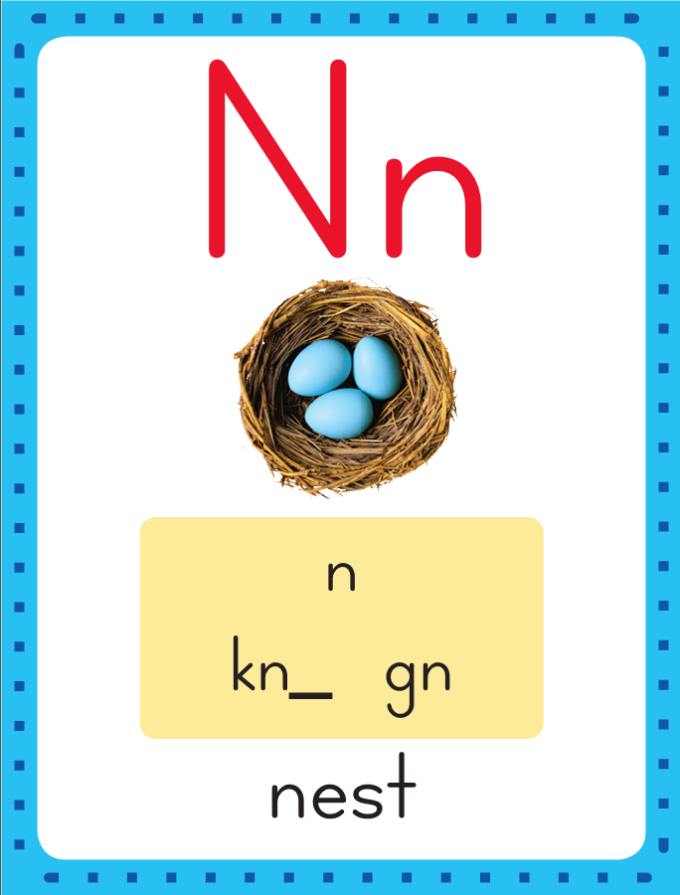
Introduce End Blends
Ending Consonant Blends
/nk/
/nd/
/nt/
/sk/
/mp/
This is the Nest Sound-Spelling Card.
The last two sounds are /st/.
They are spelled with the letters st. Say it with me: /st/. These are the sounds at the end of the word nest. Listen /n/ /e/ /st/.

Slide 4
Introduce End Blends
st st st st st
nk nk nk nk nk
nd nd nd nd nd
sk sk sk sk sk
mp mp mp mp mp
Have children practice connecting the letters s and t to the sounds /st/ by writing them.
Now do it with me. Say /st/ as I write the letters s and t.
This time, write the letters s and t five times as you say the /st/ sounds. Repeat for nk, nd, sk, mp.

Slide 5
Blending Words with End Blends
v

Slide 6
Blending Words with End Blends
v
e

Slide 7
Blending Words with End Blends
v
e
s
t

Slide 8
Blending Words with End Blends
v
e
s
t

Slide 9
Blending Words with End Blends
h

Slide 10
Blending Words with End Blends
h
a

Slide 11
Blending Words with End Blends
h
a
n
d

Slide 12
Blending Words with End Blends
h
a
n
d

Slide 13
Blending Words with End Blends
p

Slide 14
Blending Words with End Blends
p
i

Slide 15
Blending Words with End Blends
p
i
nk

Slide 16
Blending Words with End Blends
p
i
nk

Slide 17
Blending Words with End Blends
v

Slide 18
Blending Words with End Blends
v
e

Slide 19
Blending Words with End Blends
v
e
n
t

Slide 20
Blending Words with End Blends
v
e
n
t

Slide 21
Blending Words with End Blends
c
l

Slide 22
Blending Words with End Blends
c
l
a

Slide 23
Blending Words with End Blends
c
l
a
m
p

Slide 24
Blending Words with End Blends
c
l
a
m
p

Slide 25
Blending Words with End Blends
d

Slide 26
Blending Words with End Blends
d
e

Slide 27
Blending Words with End Blends
d
e
s
k

Slide 28
Blending Words with End Blends
d
e
s
k

Slide 29
nd st pl u
a nk tr nt
cr i sk mp
o sp e cl

Slide 30
a

Slide 31
and

Slide 32
and n

Slide 33
and ne

Slide 34
and nest

Slide 35
and nest s

Slide 36
and nest sa

Slide 37
and nest sand

Slide 38
and nest sand l

Slide 39
and nest sand la

Slide 40
and nest sand last

Slide 41
and nest sand last
pl

Slide 42
and nest sand last
pla

Slide 43
and nest sand last
plant

Slide 44
and nest sand last
plant e

Slide 45
and nest sand last
plant end

Slide 46
and nest sand last
plant end tr

Slide 47
and nest sand last
plant end tru

Slide 48
and nest sand last
plant end trunk

Slide 49
and nest sand last
plant end trunk a

Slide 50
and nest sand last
plant end trunk ant

Slide 51
and nest sand last
plant end trunk ant
m

Slide 52
and nest sand last
plant end trunk ant
mu

Slide 53
and nest sand last
plant end trunk ant
must

Slide 54
and nest sand last
plant end trunk ant
must h

Slide 55
and nest sand last
plant end trunk ant
must hu

Slide 56
and nest sand last
plant end trunk ant
must hunt

Slide 57
and nest sand last
plant end trunk ant
must hunt w

Slide 58
and nest sand last
plant end trunk ant
must hunt we

Slide 59
and nest sand last
plant end trunk ant
must hunt went

Slide 60
and nest sand last
plant end trunk ant
must hunt went a

Slide 61
and nest sand last
plant end trunk ant
must hunt went ask

Slide 62
Internal Sounding Out
crisp

Slide 63
Internal Sounding Out
crisp mask

Slide 64
Internal Sounding Out
crisp mask bump

Slide 65
Internal Sounding Out
crisp mask bump
jump

Slide 66
Internal Sounding Out
crisp mask bump
jump romp

Slide 67
Internal Sounding Out
crisp mask bump
jump romp stomp

Slide 68
Internal Sounding Out
crisp mask bump
jump romp stomp
blink

Slide 69
Internal Sounding Out
crisp mask bump
jump romp stomp
blink desk

Slide 70
Internal Sounding Out
crisp mask bump
jump romp stomp
blink desk spent

Slide 71
Internal Sounding Out
crisp mask bump
jump romp stomp
blink desk spent
clump

Slide 72
Internal Sounding Out
crisp mask bump
jump romp stomp
blink desk spent
clump trust

Slide 73
Internal Sounding Out
crisp mask bump
jump romp stomp
blink desk spent
clump trust stand

Slide 74
An

Slide 75
An ant

Slide 76
An ant is

Slide 77
An ant is not

Slide 78
An ant is not fast.

Slide 79
An ant is not fast.
Is

Slide 80
An ant is not fast.
Is the

Slide 81
An ant is not fast.
Is the test

Slide 82
An ant is not fast.
Is the test on

Slide 83
An ant is not fast.
Is the test on the

Slide 84
An ant is not fast.
Is the test on the desk?

Slide 85
An ant is not fast.
Is the test on the desk?
The

Slide 86
An ant is not fast.
Is the test on the desk?
The skunk

Slide 87
An ant is not fast.
Is the test on the desk?
The skunk is

Slide 88
An ant is not fast.
Is the test on the desk?
The skunk is in

Slide 89
An ant is not fast.
Is the test on the desk?
The skunk is in the

Slide 90
An ant is not fast.
Is the test on the desk?
The skunk is in the tent!

Slide 91
Spelling / Dictation
1.
2.
3.
4.
5.
send
fast
sink
lend
past

Slide 92
High Frequency
Words

Slide 93
Read, Spell, Write
eat
What do you like to eat?

Slide 94
Read, Spell, Write
no
No, you can not go.

Slide 95
Read, Spell, Write
of
The trunk has lots of stuff in it.

Slide 96
Read, Spell, Write
under
The third dog hid under the bed.

Slide 97
Read, Spell, Write
who
Who is it?

Slide 98
Have children read the sentences. Prompt them to identify the high-frequency words in connected text and to blend the decodable words.
What do you like to eat?
No, you can not go.
The trunk has lots of stuff in it.
The dog hid under the bed.
Who is it?

Slide 99
Grammar
Writers use an apostrophe and the letter s at the end of many nouns to say that someone or something owns something.
Meg’s dog is wet!
The dog’s bed is red.
Meg’s and dog’s are possessive nouns.
In the first sentence the dog belongs to Meg.
In the second sentence the bed belongs to the dog.

Slide 100
Grammar
Work with a partner to circle the possessive noun in each sentence.
Then underline what item is owned.
The hen’s eggs are in the nest.
The duck’s bill is wet.

Slide 101
Grammar
Work with a partner to circle the possessive noun in each sentence.
Then underline what item is owned.
The hen’s eggs are in the nest.
The duck’s bill is wet.

Slide 102
Week 3 – Day 2

Slide 103
Phonemic Awareness
Phoneme Categorization
Listen as I say the sounds in a word: /b/ /e/ /s/ /t/.
Now I will blend the sounds together and say the word: /beeest/, best.
Let’s say the word together: best.
Guided Practice:
I am going to say some words sound by sound. Blend the sounds together to say the word.
/s/ /a/ /n/ /d/ /j/ /u/ /n/ /k/ /m/ /i/ /n/ /t/
/a/ /s/ /k/ /p/ /a/ /s/ /t/ /l/ /a/ /m/ /p/

Slide 104
Review End Blends
s
k

Slide 105
Review End Blends
s
k

Slide 106
Review End Blends
d

Slide 107
Review End Blends
d
i

Slide 108
Review End Blends
d
i
s
k

Slide 109
Review End Blends
d
i
s
k

Slide 110
Review End Blends
m

Slide 111
Review End Blends
m
a

Slide 112
Review End Blends
m
a
s
k

Slide 113
Review End Blends
m
a
s
k

Slide 114
Review End Blends
n
d

Slide 115
Review End Blends
n
d

Slide 116
Review End Blends
h

Slide 117
Review End Blends
h
a

Slide 118
Review End Blends
h
a
n
d

Slide 119
Review End Blends
h
a
n
d

Slide 120
Review End Blends
n
k

Slide 121
Review End Blends
n
k

Slide 122
Review End Blends
j

Slide 123
Review End Blends
j
u

Slide 124
Review End Blends
j
u
n
k

Slide 125
Review End Blends
j
u
n
k

Slide 126
Review End Blends
n
t

Slide 127
Review End Blends
n
t

Slide 128
Review End Blends
p

Slide 129
Review End Blends
p
u

Slide 130
Review End Blends
p
u
n
t

Slide 131
Review End Blends
p
u
n
t

Slide 132
Review End Blends
s
t

Slide 133
Review End Blends
s
t

Slide 134
Review End Blends
f

Slide 135
Review End Blends
f
a

Slide 136
Review End Blends
f
a
s
t

Slide 137
Review End Blends
f
a
s
t

Slide 138
Review End Blends
m
p

Slide 139
Review End Blends
m
p

Slide 140
Review End Blends
j

Slide 141
Review End Blends
j
u

Slide 142
Review End Blends
j
u
m
p

Slide 143
Review End Blends
j
u
m
p

Slide 144
Blend Words with End Blends
l

Slide 145
Blend Words with End Blends
l
a

Slide 146
Blend Words with End Blends
l
a
m
p

Slide 147
Blend Words with End Blends
l
a
m
p

Slide 148
Blend Words with End Blends
p

Slide 149
Blend Words with End Blends
p
o

Slide 150
Blend Words with End Blends
p
o
n
d

Slide 151
Blend Words with End Blends
p
o
n
d

Slide 152
Blend Words with End Blends
l

Slide 153
Blend Words with End Blends
l
a

Slide 154
Blend Words with End Blends
l
a
s
t

Slide 155
Blend Words with End Blends
l
a
s
t

Slide 156
Blend Words with End Blends
m

Slide 157
Blend Words with End Blends
m
i

Slide 158
Blend Words with End Blends
m
i
n
t

Slide 159
Blend Words with End Blends
m
i
n
t

Slide 160
Blend Words with End Blends
d

Slide 161
Blend Words with End Blends
d
e

Slide 162
Blend Words with End Blends
d
e
s
k

Slide 163
Blend Words with End Blends
d
e
s
k

Slide 164
Internal Sounding Out
fast

Slide 165
Internal Sounding Out
fast bend

Slide 166
Internal Sounding Out
fast bend junk

Slide 167
Internal Sounding Out
fast bend junk hint

Slide 168
Internal Sounding Out
fast bend junk hint
task

Slide 169
Internal Sounding Out
fast bend junk hint
task ramp

Slide 170
Internal Sounding Out
fast bend junk hint
task ramp blast

Slide 171
Internal Sounding Out
fast bend junk hint
task ramp blast
clump

Slide 172
Internal Sounding Out
fast bend junk hint
task ramp blast
clump grunt

Slide 173
Internal Sounding Out
fast bend junk hint
task ramp blast
clump grunt stand

Slide 174
Build Words with r-blends and s-blends
p
e
s
t
What is the new word we made?
Let’s blend all the sounds and read the word.
Change the e to a.

Slide 175
Build Words with r-blends and s-blends
p
a
s
t
What is the new word we made?
Let’s blend all the sounds and read the word.
Change the p to l.

Slide 176
Build Words with r-blends and s-blends
l
a
s
t
What is the new word we made?
Let’s blend all the sounds and read the word.
Change the st to nd.

Slide 177
Build Words with r-blends and s-blends
l
a
n
d
What is the new word we made?
Let’s blend all the sounds and read the word.
Change the a to e.

Slide 178
Build Words with r-blends and s-blends
l
e
n
d
What is the new word we made?
Let’s blend all the sounds and read the word.
Change the d to t.

Slide 179
Build Words with r-blends and s-blends
l
e
n
t
What is the new word we made?
Let’s blend all the sounds and read the word.
Change the l to s.

Slide 180
Build Words with r-blends and s-blends
s
e
n
t
What is the new word we made?
Let’s blend all the sounds and read the word.
Change the t to d.

Slide 181
Build Words with r-blends and s-blends
s
e
n
d
What is the new word we made?
Let’s blend all the sounds and read the word.
Change the e to a.

Slide 182
Build Words with r-blends and s-blends
s
a
n
d
What is the new word we made?
Let’s blend all the sounds and read the word.
Remove the n..

Slide 183
Build Words with r-blends and s-blends
s
a
d
What is the new word we made?
Let’s blend all the sounds and read the word.
Change the s to h.

Slide 184
Build Words with r-blends and s-blends
h
a
d
What is the new word we made?
Let’s blend all the sounds and read the word.
Add a n before the d.

Slide 185
Build Words with r-blends and s-blends
h
a
n
d
What is the new word we made?
Let’s blend all the sounds and read the word.
Change the h to b..

Slide 186
Build Words with r-blends and s-blends
b
a
n
d
What is the new word we made?
Let’s blend all the sounds and read the word.
Add a r after the b.

Slide 187
Build Words with r-blends and s-blends
b
r
a
n
d
What is the new word we made?
Let’s blend all the sounds and read the word.
Change the br to l.

Slide 188
Build Words with r-blends and s-blends
l
a
n
d
What is the new word we made?
Let’s blend all the sounds and read the word.
Change the nd to st.

Slide 189
Build Words with r-blends and s-blends
l
a
s
t
What is the new word we made?
Let’s blend all the sounds and read the word.
Change the l to f.

Slide 190
Build Words with r-blends and s-blends
f
a
s
t
What is the new word we made?
Let’s blend all the sounds and read the word.
Remove the s.

Slide 191
Build Words with r-blends and s-blends
f
a
t
What is the new word we made?
Let’s blend all the sounds and read the word.
Change the a to i.

Slide 192
Build Words with End Blends
f
i
s
t
What is the new word we made?
Let’s blend all the sounds and read the word.
Change the f to m..

Slide 193
Build Words with End Blends
m
i
s
t
What is the new word we made?
Let’s blend all the sounds and read the word.
Change the st to nk.

Slide 194
Build Words with End Blends
m
i
n
k
What is the new word we made?
Let’s blend all the sounds and read the word.
Change the m to p.

Slide 195
Build Words with End Blends
p
i
n
k
What is the new word we made?
Let’s blend all the sounds and read the word.

Slide 196
Structural Analysis
Adding –ing to an action word makes it tell
about something that is happening now.
Can I bend? I am bending (Bend as you say it.)
bend
bending
Each syllable in a word has one vowel sound.
Say the word bend and have children tell how many syllables they hear.
Then say bending, and have children clap the syllables.
Point out that adding –ing to bend adds a syllable.

Slide 197
Structural Analysis
jump
yell
hunt
rest
ask
bump
spell
Add –ing to each word and then use each word in a sentence.

Slide 198
bend
last
pink

Slide 199
send
send
send
fast
fast
fast
sink
sink
sink
send
send
send
past
past
past
wink
wink
wink

Slide 200
High Frequency
Words

Slide 201
Read, Spell, Write
eat
What do you like to eat?

Slide 202
Read, Spell, Write
no
No, you can not go.

Slide 203
Read, Spell, Write
of
The trunk has lots of stuff in it.

Slide 204
Read, Spell, Write
under
The third dog hid under the bed.

Slide 205
Read, Spell, Write
who
Who is it?

Slide 206
Grammar
Writers use a possessive noun to say that someone or something owns something.
To form a possessive noun, the writer adds an apostrophe and the letter s.
The kid’s tent is up.
Ken’s dog spots a frog.
Work in pairs to identify each possessive noun and what is owned.
Have partners write a sentence about each other using a possessive.

Slide 207
Grammar
Work with a partner to circle the possessive noun in each sentence.
Then underline what item is owned.
The hen’s eggs are in the nest.
The duck’s bill is wet.

Slide 208
Grammar
Work with a partner to circle the possessive noun in each sentence.
Then underline what item is owned.
The hen’s eggs are in the nest.
The duck’s bill is wet.

Slide 209
Week 3 – Day 3

Slide 210
Phonemic Awareness
Phoneme Substitution
I am going to say a word: /b/ /a/ /n/ /d/, band
Now I will change a sound to make a new word.
Change the /a/ to /e/. The vowel sound of the new word is /e/.
The new word is /b/ /e/ /n/ /d/, bend.
Guided Practice:
Say the first word in each pair and the sound substitution. Listen to each word I say. Then we will change a sound to make a new word.
tank/sank hint/tint lost/cost
hunt/hunk limp/lamp send/sent
band/sand past/pest blend/blonde

Slide 211
Blending Words with End Blends
s
t

Slide 212
Blending Words with End Blends
s
t
u

Slide 213
Blending Words with End Blends
s
t
u
m
p

Slide 214
Blending Words with End Blends
s
t
u
m
p

Slide 215
Blending Words with End Blends
e

Slide 216
Blending Words with End Blends
e
n
d

Slide 217
Blending Words with End Blends
e
n
d

Slide 218
Blending Words with End Blends
s

Slide 219
Blending Words with End Blends
s
u

Slide 220
Blending Words with End Blends
s
u
n
k

Slide 221
Blending Words with End Blends
s
u
n
k

Slide 222
Blending Words with End Blends
d
r

Slide 223
Blending Words with End Blends
d
r
i

Slide 224
Blending Words with End Blends
d
r
i
n
k

Slide 225
Blending Words with End Blends
d
r
i
n
k

Slide 226
r

Slide 227
re

Slide 228
rest

Slide 229
rest p

Slide 230
rest po

Slide 231
rest pond

Slide 232
rest pond j

Slide 233
rest pond ju

Slide 234
rest pond jump

Slide 235
rest pond jump a

Slide 236
rest pond jump ant

Slide 237
rest pond jump ant
a

Slide 238
rest pond jump ant
and

Slide 239
rest pond jump ant
and l

Slide 240
rest pond jump ant
and la

Slide 241
rest pond jump ant
and land

Slide 242
rest pond jump ant
and land r

Slide 243
rest pond jump ant
and land re

Slide 244
rest pond jump ant
and land rent

Slide 245
rest pond jump ant
and land rent d

Slide 246
rest pond jump ant
and land rent du

Slide 247
rest pond jump ant
and land rent dusk

Slide 248
rest pond jump ant
and land rent dusk
br

Slide 249
rest pond jump ant
and land rent dusk
bra

Slide 250
rest pond jump ant
and land rent dusk
brand

Slide 251
rest pond jump ant
and land rent dusk
brand d

Slide 252
rest pond jump ant
and land rent dusk
brand di

Slide 253
rest pond jump ant
and land rent dusk
brand disk

Slide 254
rest pond jump ant
and land rent dusk
brand disk p

Slide 255
rest pond jump ant
and land rent dusk
brand disk pa

Slide 256
rest pond jump ant
and land rent dusk
brand disk past

Slide 257
Internal Sounding Out
hunting

Slide 258
Internal Sounding Out
hunting bending

Slide 259
Internal Sounding Out
hunting bending
printing

Slide 260
Internal Sounding Out
hunting bending
printing jumping

Slide 261
Internal Sounding Out
hunting bending
printing jumping
drinking

Slide 262
Internal Sounding Out
hunting bending
printing jumping
drinking planting

Slide 263
Internal Sounding Out
asking

Slide 264
Internal Sounding Out
asking standing

Slide 265
Internal Sounding Out
asking standing
sweated

Slide 266
Internal Sounding Out
asking standing
sweated buzzed

Slide 267
Internal Sounding Out
asking standing
sweated buzzed
stuffed

Slide 268
Internal Sounding Out
asking standing
sweated buzzed
stuffed it’s

Slide 269
Ask

Slide 270
Ask Gus

Slide 271
Ask Gus to

Slide 272
Ask Gus to dust

Slide 273
Ask Gus to dust the

Slide 274
Ask Gus to dust the lamp.

Slide 275
Ask Gus to dust the lamp.
Fix

Slide 276
Ask Gus to dust the lamp.
Fix the

Slide 277
Ask Gus to dust the lamp.
Fix the tent

Slide 278
Ask Gus to dust the lamp.
Fix the tent and

Slide 279
Ask Gus to dust the lamp.
Fix the tent and we

Slide 280
Ask Gus to dust the lamp.
Fix the tent and we can

Slide 281
Ask Gus to dust the lamp.
Fix the tent and we can go

Slide 282
Ask Gus to dust the lamp.
Fix the tent and we can go camping.

Slide 285
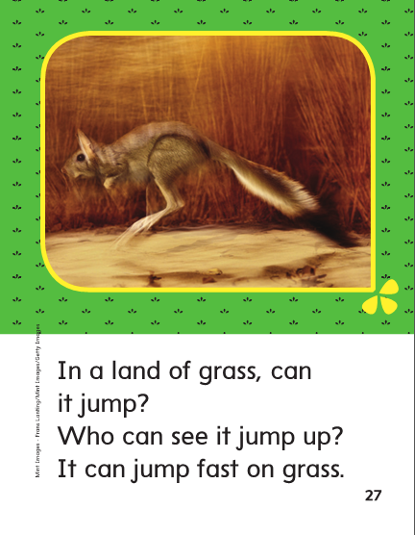

Slide 286
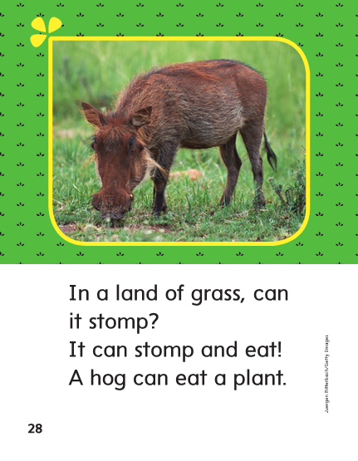

Slide 288
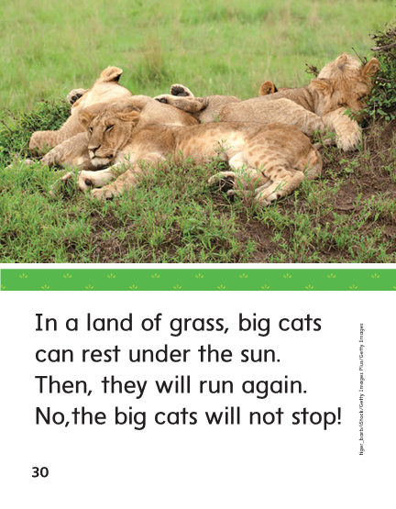

Slide 289
Structural Analysis
The letters –ing at the end of jumping mean that
the action is taking place now. I am jumping.
jump
jumping
Listen closely to hear what is different when I read these two words.

Slide 290
Structural Analysis
Read and blend the words.
blink plant
blinking planting
mend camp
mending camping
bust
busting
Remember each syllable in a word has a vowel sound. Adding letters –ing at the end of a word adds a syllable.

Slide 291
-end
-ast
-ink

Slide 292
lend
of
lend
fast
who
fast
sink
sink
send
send
past
of
past
wink
who
wink

Slide 293
High Frequency
Words

Slide 294
Read, Spell, Write
eat
What do you like to eat?

Slide 295
Read, Spell, Write
no
No, you can not go.

Slide 296
Read, Spell, Write
of
The trunk has lots of stuff in it.

Slide 297
Read, Spell, Write
under
The third dog hid under the bed.

Slide 298
Read, Spell, Write
who
Who is it?

Slide 299
Build Fluency: Word Automaticity
A frog can eat a lot if bugs.
Who is under the mask?.
No, I do not like it.

Slide 300
Grammar
A possessive noun tells who or what owns something.
Identify the possessive noun in this sentence.
A turtle’s head pops out!
Which word tells who or what has something?
What belongs to the turtle?

Slide 301
Grammar
A possessive noun tells who or what owns something.
Identify the possessive noun in this sentence.
The shark’s teeth are sharp.
Which word tells who or what has something?
What belongs to the shark?
Write another sentence with a possessive noun.

Slide 302
Week 3 – Day 4

Slide 303
Phonemic Awareness
Phoneme Categorization
Listen as I say three words: ramp, clank, blimp.
I hear the same end sounds /mp/ in ramp and blimp.
Clank does not end with /mp/. Clank does not belong.
Guided Practice:
Have children practice identifying the word that does not belong.
lump, limp, land slant, mist, hunt
pink, blank, jump desk, list, dust

Slide 304
Build Words with End Blends
s
i
n
k
What is the new word we made?
Let’s blend all the sounds and read the word.
Change the s to r.

Slide 305
Build Words with End Blends
r
i
n
k
What is the new word we made?
Let’s blend all the sounds and read the word.
Change the n to s.

Slide 306
Build Words with End Blends
r
i
s
k
What is the new word we made?
Let’s blend all the sounds and read the word.
Change the r to d.

Slide 307
Build Words with End Blends
d
i
s
k
What is the new word we made?
Let’s blend all the sounds and read the word.
Change the sk to nt.

Slide 308
Build Words with End Blends
d
e
s
k
What is the new word we made?
Let’s blend all the sounds and read the word.
Change the i to e.

Slide 309
Build Words with End Blends
d
e
n
t
What is the new word we made?
Let’s blend all the sounds and read the word.
Change the d to w.

Slide 310
Build Words with End Blends
w
e
n
t
What is the new word we made?
Let’s blend all the sounds and read the word.
Remove the n.

Slide 311
Build Words with End Blends
w
e
t
What is the new word we made?
Let’s blend all the sounds and read the word.
Change the w to l.

Slide 312
Build Words with End Blends
l
e
t
What is the new word we made?
Let’s blend all the sounds and read the word.
Add a n before the t.

Slide 313
Build Words with End Blends
l
e
n
t
What is the new word we made?
Let’s blend all the sounds and read the word.
Change the e to i.

Slide 314
Build Words with End Blends
l
i
n
t
What is the new word we made?
Let’s blend all the sounds and read the word.
Remove the n.

Slide 315
Build Words with End Blends
l
i
t
What is the new word we made?
Let’s blend all the sounds and read the word.
Change the t to p.

Slide 316
Build Words with End Blends
l
i
p
What is the new word we made?
Let’s blend all the sounds and read the word.
Add a m before the p .

Slide 317
Build Words with End Blends
l
i
m
p
What is the new word we made?
Let’s blend all the sounds and read the word.
Add a b before the l .

Slide 318
Build Words with End Blends
b
l
i
m
p
What is the new word we made?
Let’s blend all the sounds and read the word.

Slide 319
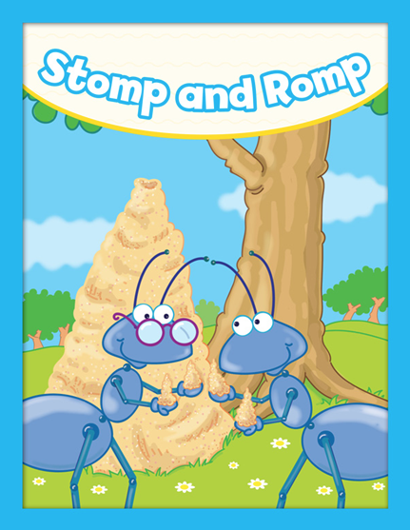

Slide 320
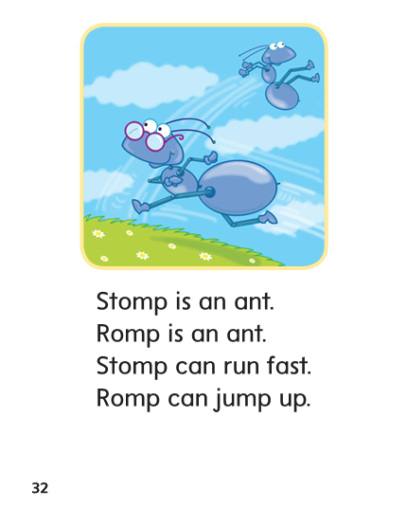

Slide 321
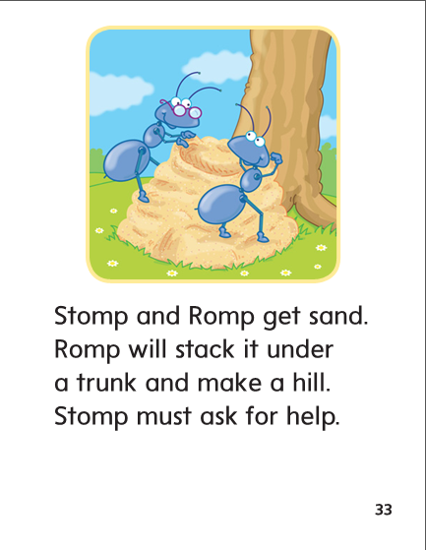

Slide 322
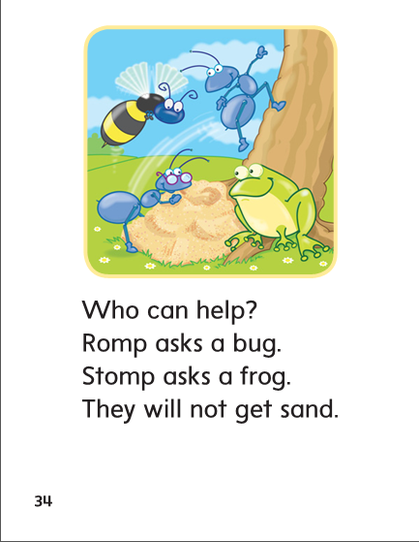

Slide 323
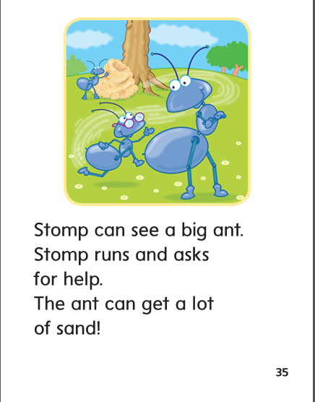

Slide 324
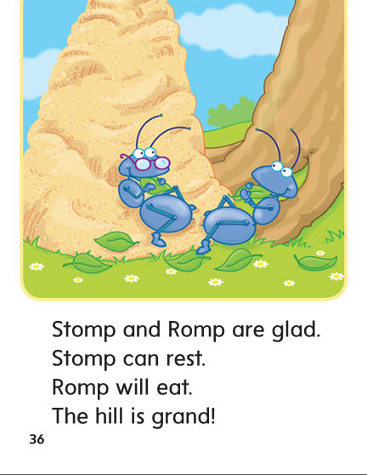

Slide 325
Structural Analysis
The letters –ing at the end of drink mean that
the action is taking place now. I am drinking.
Adding –ing to a word adds a syllable.
drink
drinking
Listen closely to hear what is different when I read these two words.

Slide 326
Structural Analysis
spend
list
print
trust
spell
stomp
Have children work in pairs to construct words that tell about actions happening now by adding –ing.
Have children read the new words aloud and write sentences with each word.

Slide 327
High Frequency
Words

Slide 328
Read, Spell, Write
eat
What do you like to eat?

Slide 329
Read, Spell, Write
no
No, you can not go.

Slide 330
Read, Spell, Write
of
The trunk has lots of stuff in it.

Slide 331
Read, Spell, Write
under
The third dog hid under the bed.

Slide 332
Read, Spell, Write
who
Who is it?

Slide 333
Grammar
A possessive noun shows that someone or something owns something.
Hold up a book and say: This book belongs to me.
How can you use a possessive noun to say this book belongs to me?
The lion’s teeth are sharp.
The shark’s home is the ocean.
Identify the possessive noun and identify what belongs to whom.

Slide 334
Week 3 – Day 5

Slide 335
Phonemic Awareness
Phoneme Blending
Listen as I say a group of sounds. Then blend those sounds to form a word.
/h/ /a/ /n/ /d/ /l/ /a/ /n/ /d/ /l/ /a/ /s/ /t/ /l/ /i/ /n/ /k/
Phoneme Segmentation
Now I am going to say a word. I want you to say each sound in the word.
ant pant fast pest
tusk frost spend

Slide 336
Blend and Build Words with End Blends
Read and say these words:
hand
trunk
tent
fast
dusk
lamp

Slide 337
Blend and Build Words with End Blends
l
i
n
k
What is the new word we made?
Let’s blend all the sounds and read the word.
Add a c in front of the l.

Slide 338
Blend and Build Words with End Blends
c
l
i
n
k
What is the new word we made?
Let’s blend all the sounds and read the word.
Change the i to a.

Slide 339
Blend and Build Words with End Blends
c
l
a
n
k
What is the new word we made?
Let’s blend all the sounds and read the word.
Change cl to a b .

Slide 340
Blend and Build Words with End Blends
b
a
n
k
What is the new word we made?
Let’s blend all the sounds and read the word.
Change k to d .

Slide 341
Blend and Build Words with End Blends
b
a
n
d
What is the new word we made?
Let’s blend all the sounds and read the word.
Change a to e .

Slide 342
Blend and Build Words with End Blends
b
e
n
d
What is the new word we made?
Let’s blend all the sounds and read the word.
Change d to t .

Slide 343
Blend and Build Words with End Blends
b
e
n
t
What is the new word we made?
Let’s blend all the sounds and read the word.
Change n to s.

Slide 344
Blend and Build Words with End Blends
b
e
s
t
What is the new word we made?
Let’s blend all the sounds and read the word.
Remove the s.

Slide 345
Blend and Build Words with End Blends
b
e
t
What is the new word we made?
Let’s blend all the sounds and read the word.
Change the b to n.

Slide 346
Blend and Build Words with End Blends
n
e
t
What is the new word we made?
Let’s blend all the sounds and read the word.
Add an s in front of the t.

Slide 347
Blend and Build Words with End Blends
n
e
s
t
What is the new word we made?
Let’s blend all the sounds and read the word.
Change the n to r.

Slide 348
Blend and Build Words with End Blends
r
e
s
t
What is the new word we made?
Let’s blend all the sounds and read the word.
Change the r to w.

Slide 349
Blend and Build Words with End Blends
w
e
s
t
What is the new word we made?
Let’s blend all the sounds and read the word.

Slide 350
Word Automaticity
rest

Slide 351
dusk

Slide 352
hunting

Slide 353
drinking

Slide 354
sweated

Slide 355
pond

Slide 356
rent

Slide 357
bending

Slide 358
planting

Slide 359
buzzed

Slide 360
jump

Slide 361
brand

Slide 362
printing

Slide 363
asking

Slide 364
stuffed

Slide 365
and

Slide 366
bank

Slide 367
jumping

Slide 368
standing

Slide 369
it’s

Slide 370
land

Slide 371
past

Slide 372
Structural Analysis
Have children explain when the –ing ending is used.
Have children write words with –ing.
1. ____________
2. ____________
3. ____________
4. ____________
5. ____________
Landing
Ending
Jumping
Buzzing
smelling

Slide 373
High Frequency
Words

Slide 374
Read, Spell, Write
eat
What do you like to eat?

Slide 375
Read, Spell, Write
no
No, you can not go.

Slide 376
Read, Spell, Write
of
The trunk has lots of stuff in it.

Slide 377
Read, Spell, Write
under
The third dog hid under the bed.

Slide 378
Read, Spell, Write
who
Who is it?

Slide 379
Grammar
Have children describe what possessive nouns are and how they are used.
Have children identify the possessive noun:
There’s the skunk’s den!

Slide 380
Grammar
Ask: How do I know if a word is a possessive noun?
_______ dog is lost.
This is ________ snack.
Have children work in pairs to complete each sentence with a possessive noun.

