Slide 1
Chapter 1 Review
Addition Strategies

Slide 2
How many emojis are there? Write the number.
4 emojis and 3 more emojis
____emojis
7

Slide 3
How many gumballs are there? Write the number.
5 gumballs and 2 more gumballs
____gumballs
7

Slide 4
6 cars and 3 more cars
6 + 3= ___
9

Slide 5
2 stickers and 4 more stickers
2 + 4= ___
6

Slide 6
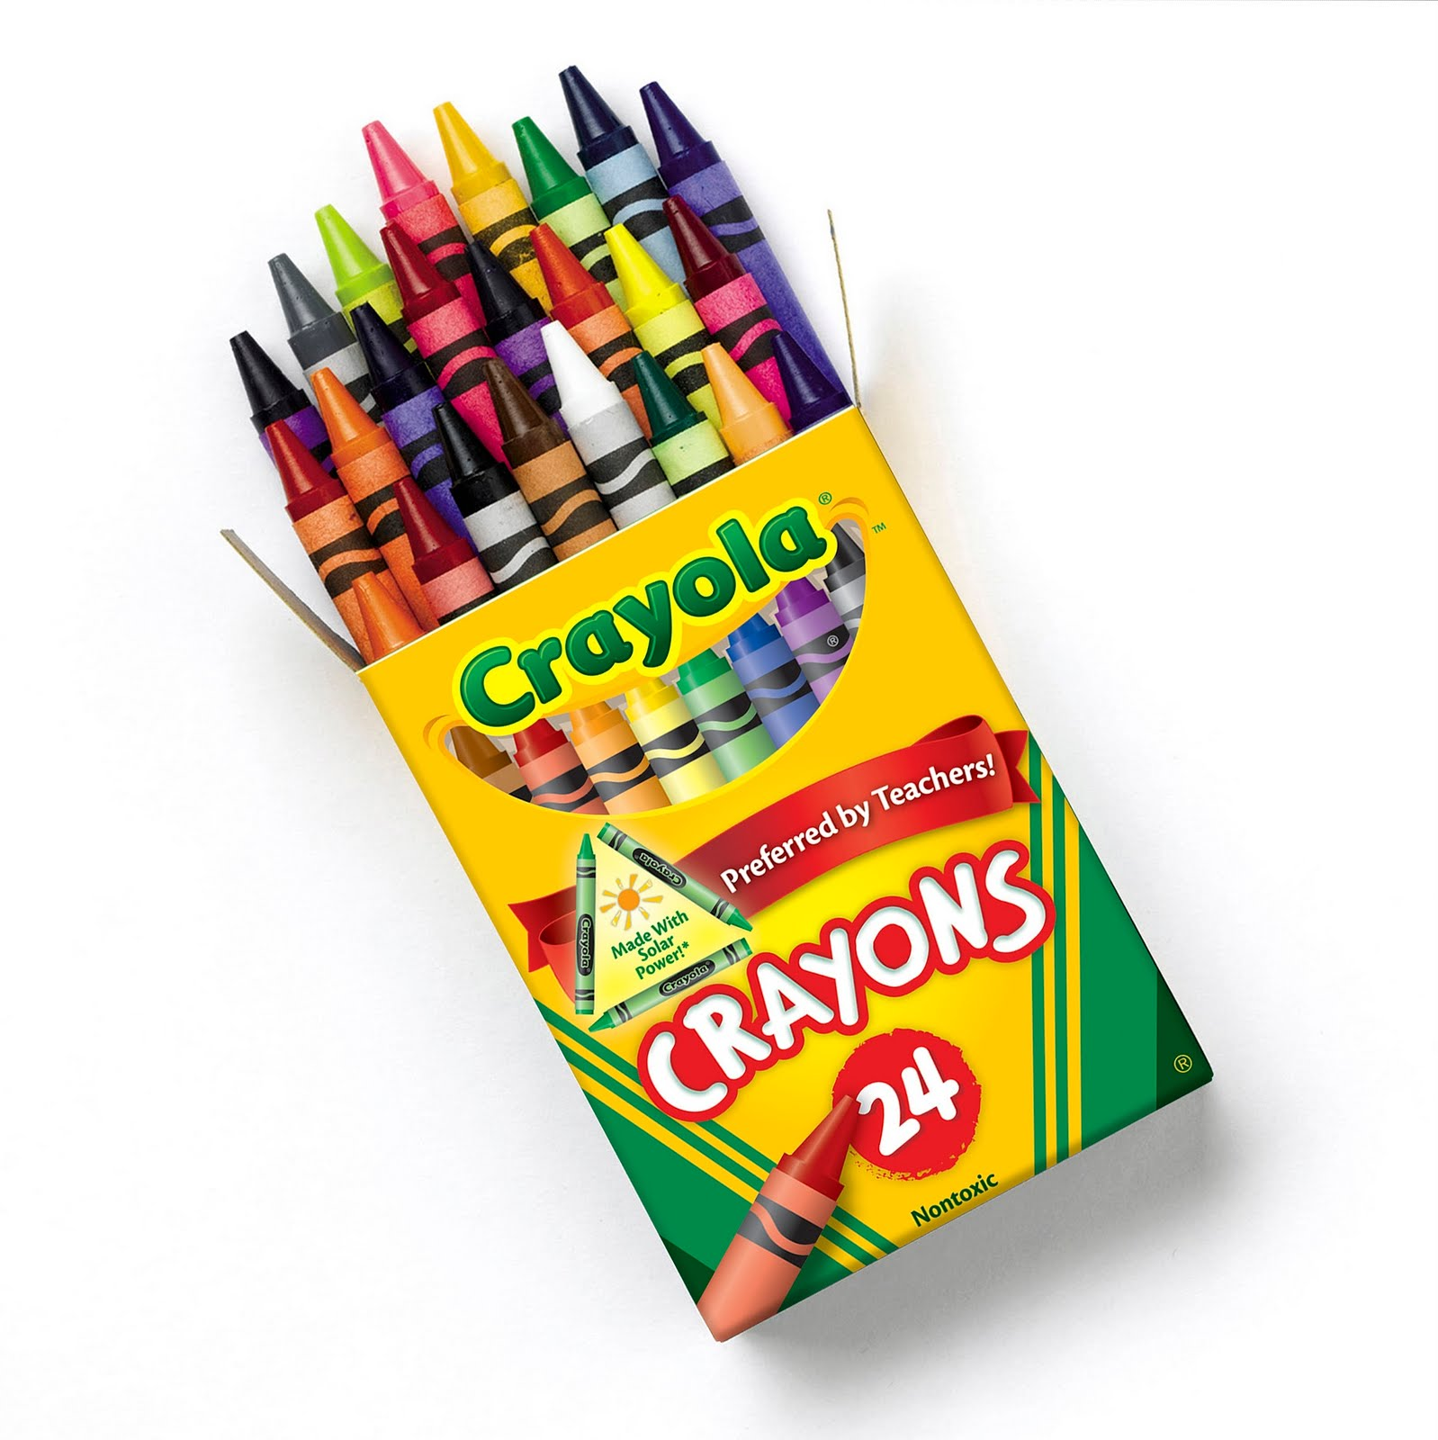
There are 5 purple crayons and 3 green crayons. How many crayons are there?
____ + ____ = ____
____ crayons
5
3
8
8

Slide 7
There are 2 baseballs and 8 soccer balls. How many sport balls are there?
____ + ____ = ____
____ sport balls
2
8
10
10

Slide 8
Use the picture to write each part. Write the sum.
____+ ____ = ____
2
0
2

Slide 9
Write the sum.
____+ ____ = ____
0
6
6

Slide 10
Use the picture to write each part. Write the sum.
____+ ____ = ____
0
4
4

Slide 11
Color to match. Write the sum.
Change the order of the addends. Color to match. Write the addition sentence.
3 + 1 = ___ ___ + ___ = ___
4
1
3
4

Slide 12
Color to match. Write the sum.
Change the order of the addends. Color to match. Write the addition sentence.
1 + 2 = ___ ___ + ___ = ___
3
2
1
3

Slide 13
Write the sums.
4 + 3 = ___
3 + 4 = ___
7
7

Slide 14
Write the sums.
7 + 3 = ___
3 + 7 = ___
10
10

Slide 15
Kevin has 5 apples. 3 of the apples are red. The rest are green. How many apples are green?
3
2
5

Slide 16
Three dogs are playing in the park. Four more dogs come to the park. How many dogs are at the park playing?
3
4
7

Slide 17
Billy has some candy. He got 2 more pieces. All together he has 8 pieces of candy. How many pieces of candy did he start with?
6
2
8

Slide 18
Lets practice adding on our 120s chart.
Write different addition problems on the board. Use addition problems written horizontally and vertically.

Slide 19
Just Dance!
https://www.youtube.com/watch?v=O9oye-AUVsU

