Slide 1
Chapter 10 Review
Represent Data

Slide 2
Create A Picture Graph:
Favorite Power Ranger
Red
Blue
Pink
Yellow
Black
Power Rangers
Each stands for 1 child.

Slide 4
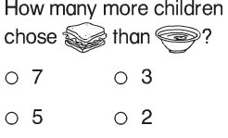

Slide 5
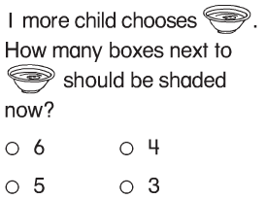

Slide 8
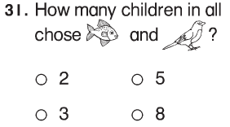

Slide 9
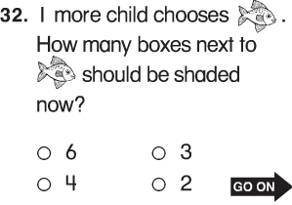

Slide 10
How many sheep are on the farm?
4

Slide 11
Is the sentence true? Choose Yes or No.
* There are more horses than sheep.
Yes or
No

Slide 12
Are there more black cars or white cars?
Black

Slide 13
Circle the snack the most children chose.

Slide 14
Circle the snack the fewest children chose.

Slide 15
8
How many children have a pet?

Slide 16
8
8
5
How many children do not have a pet?

Slide 17
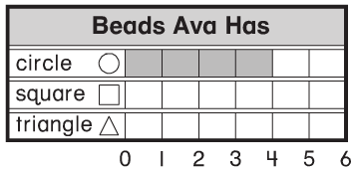
4
2
10

Slide 18
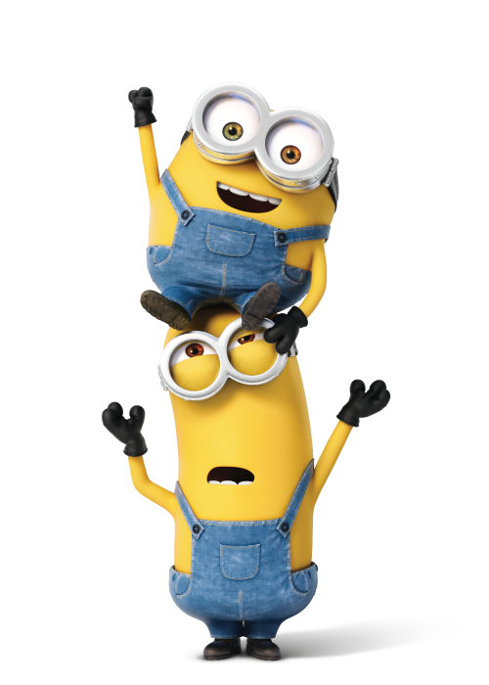
Guess What?!
Minions 3

