Slide 1
Unit 3: Addition Strategies Review

Slide 2
What is the sum?
5 + 3 =
8

Slide 3
What is the sum?
7 + 4 =
11

Slide 4
What is the sum?
8 + 1 =
9

Slide 5
Count on. What is the sum?
4
+6
10

Slide 6
Count on. What is the sum?
6 + 1 =
7

Slide 7
What is the sum?
2 + 8 + 4 =
14

Slide 8
What is the sum?
4
4
+6
14

Slide 9
What is the sum of 3 + 6 + 2?
12
13
11
8

Slide 10
Abbi has 5 cookies. Tony has 3 cookies. Ziva has 6 cookies. How many cookies do they have altogehter?
cookies
14

Slide 11
Karen has 3 purple bouncy balls. She has 7 green bouncy balls. She also has 2 blue bouncy balls. How many bouncy balls does Karen have?
9
3
7
12

Slide 12
Add. Change the order of the addends. Add again.
9
+1 +
1
9
10
10

Slide 13
Add. Change the order of the addends. Add again.
7
+5 +
5
7
12
12

Slide 14
Add. Change the order of the addends. Add again.
4
+3 +
3
4
7
7

Slide 15
Which shows the same addends in a different order?
8 + 3 = 11
6 + 3 = 9
3 + 8 = 11
3 + 7 = 10
8 + 2 = 10

Slide 16
Which addition sentence matches the picture?
2 + 2 = 4
3 + 3 =6
4 + 4 = 8
5 + 5 = 10

Slide 17
What doubles fact does the picture show?
+ =
5
5
10

Slide 18
Boston wants to find this sum?
6 + 7 =
How can Boston use doubles to find the sum?
+ + 1 =
13
6
6
13

Slide 19
Brooke wants to find this sum?
4 + 5 =
How can Brooke use doubles to find the sum?
+ + 1 =
9
4
4
9

Slide 20
Which doubles fact helps you solve
8 + 9 = 17?
7 + 7 = 14
6 + 6 = 12
8 + 8 = 16
5 + 5 = 10

Slide 21
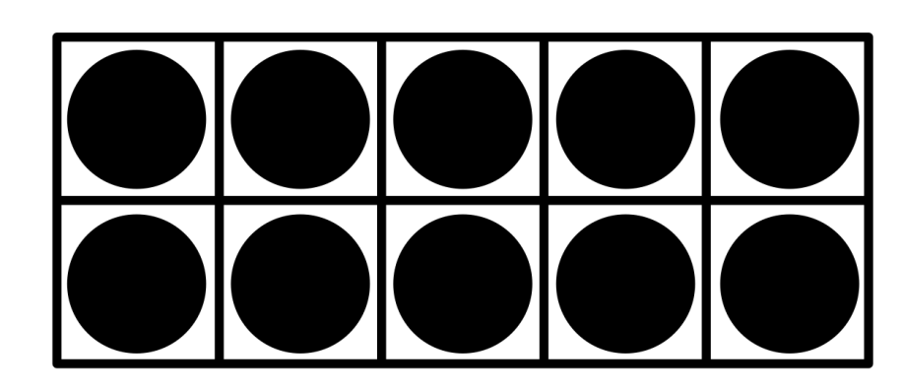
What number sentence does this model show?
12
10 + 2 =

Slide 22
What number sentence does this model show?
10 + 3 = 13
10 + 5 = 15
5 + 5 = 10
4 + 3 = 7

Slide 23
What number sentence does this model show? Write your answer.
10 + 3 = 13

Slide 24
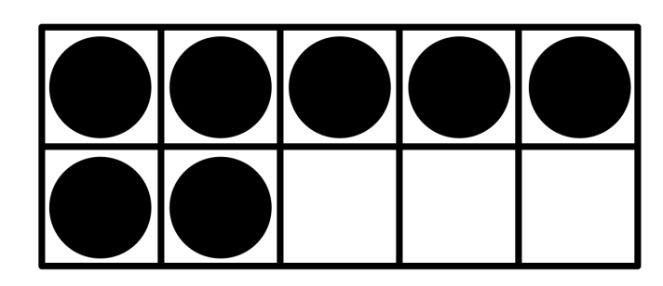
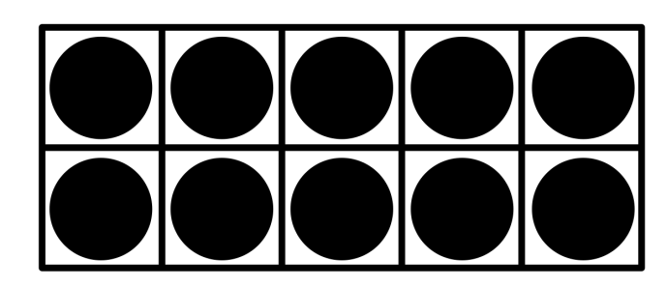
Which shows a way to make a ten to solve 7 + 5?
7 + 3 + 2
7 + 5 + 2
5 + 2 + 2
2 + 7 + 2

Slide 25
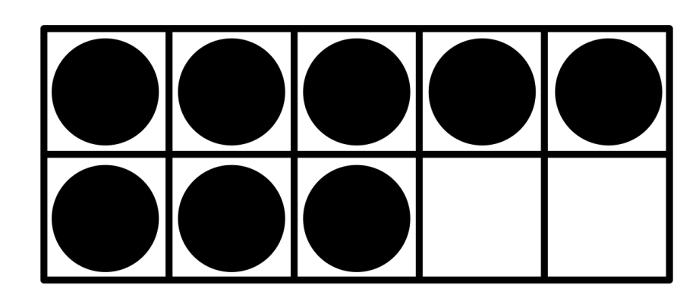
Make a ten to add. Draw to show your work. Write the sum.
8 + 3 =
?
11
8 + 3 =

