Slide 1
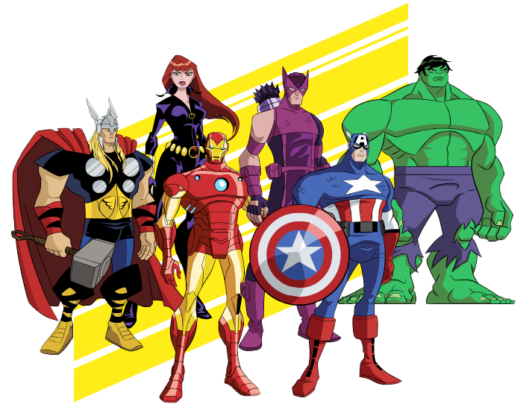
Chapter 4 Review
Subtraction Strategies

Slide 2
Thor’s hammers
Count Back. Write the number that is 3 less.
7 – 3 = _____
4

Slide 3
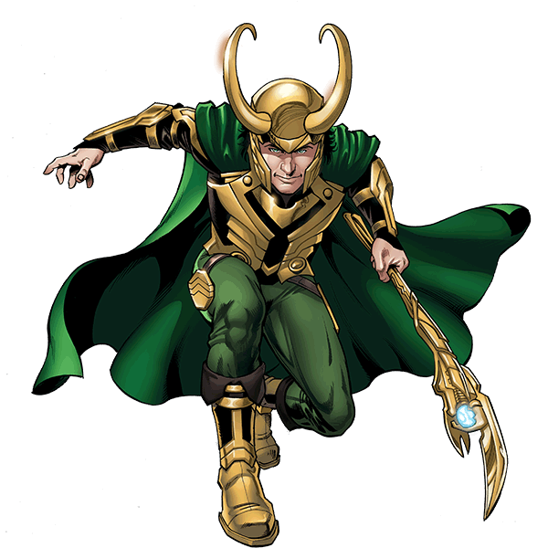
Captain America and Iron Man have 9 candy bars. Loki eats 2 of the candy bars. How many candy bars are left?
9 – 2 = _____
7

Slide 4
Count back
10 – 1 = _____
9

Slide 5
Count back
5 – 2 = _____
3

Slide 6
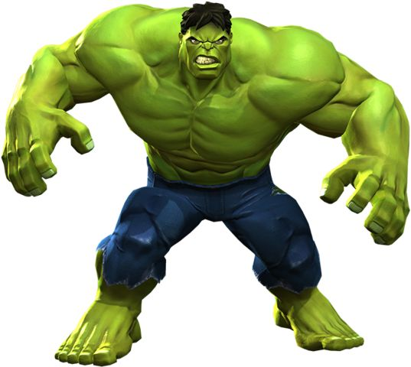
Hulk had 5 cubes. Thor gave him more cubes. Now Hulk has 12 cubes. How many cubes did Thor give to him?
5 + _____ = 12
Hulk had 12 cubes. He gave Spider-Man 5. How many
Cubes does Hulk have now?
12 – 5 = ____
7
7

Slide 7
What is 8 – 6?
6 + _____ = 8
8 – 6 = _____
2
2

Slide 8
What is 10 – 4?
4 + _____ = 10
10 – 4 = _____
6
6

Slide 9
What is 9 – 4?
4 + _____ = 9
9 – 4 = _____
5
5

Slide 10
Iron Man has 13 pencils in a cup. He takes some pencils out. There are 6 pencils left in the cup. How many pencils does he take out?
____ + ____ = _____
6
7
13

Slide 11
Make a ten
Black Widow has 13 crayons. Hulk breaks 9 of the crayons. How many crayons does Black Widow have left?
____ - ____ = _____
13
9
4

Slide 12
Make a ten
____ - ____ = _____
11
5
6

Slide 13
Break Apart to subtract
____ - ____ = _____ OR ____ - ____ - ____ = ____
12
3
9
12
2
1
9

Slide 14
Break Apart to subtract
____ - ____ = _____ OR ____ - ____ - ____ = ____
14
6
8
14
4
2
8

Slide 15
Use subtraction strategies
Hawkeye had 13 stickers. He gave 9 stickers away. How many stickers does he have now?
Use any subtraction strategy
____ - ____ = _____
13
9
4

Slide 16
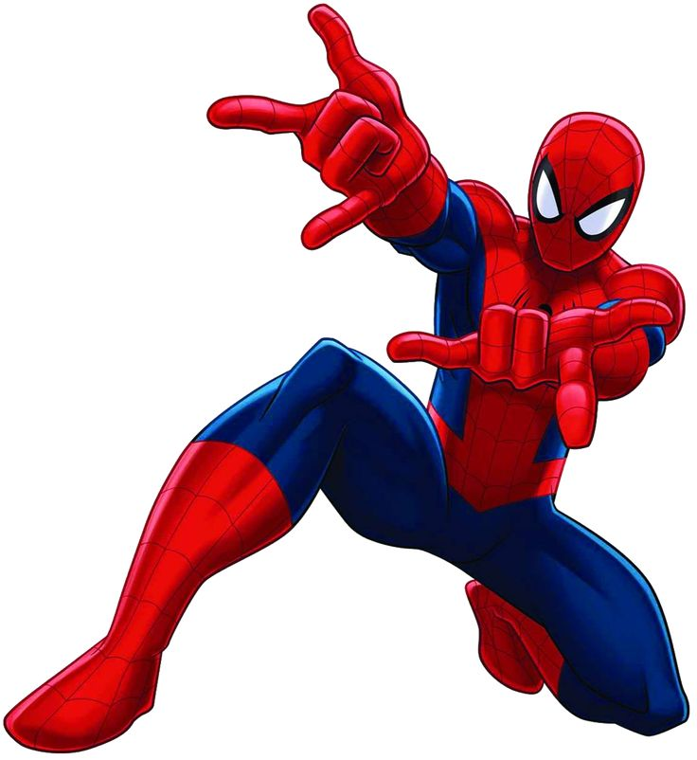
Use subtraction strategies
Spider-Man has 14 action figures. Some action figures get broken. 8 action figures are not broken. How many action figures are broken?
Use any subtraction strategy
____ - ____ = _____
14
6
8

Slide 17
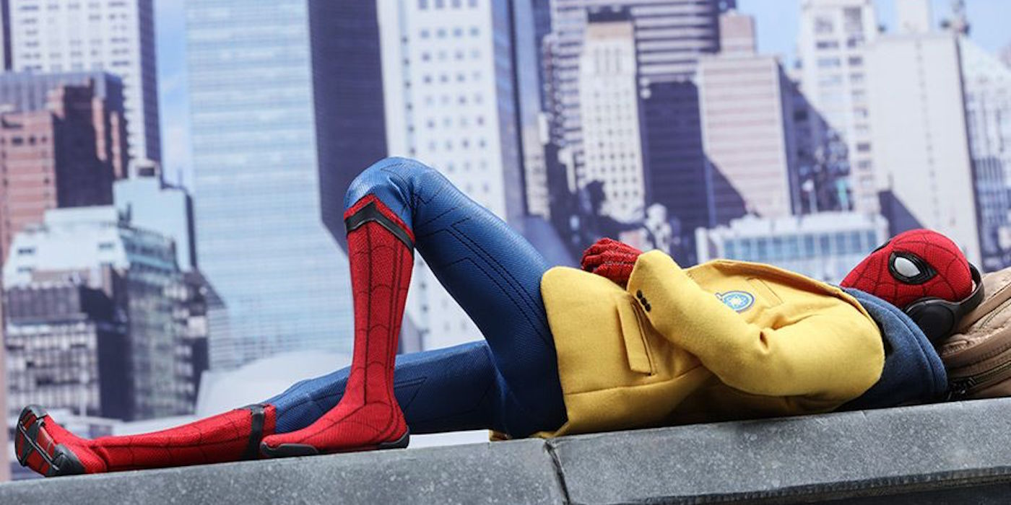
Spider-Man
Spider-Man

