Slide 1
Chapter 6
Tens and Ones

Slide 2
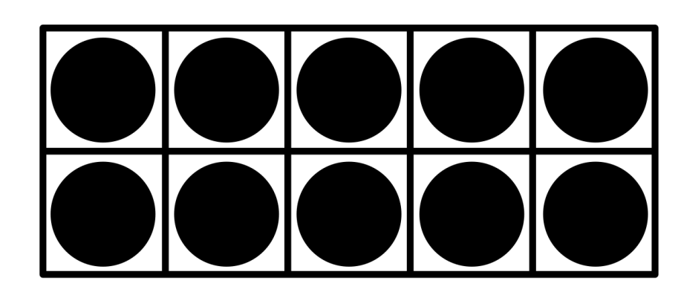
Which shows the same number?
A. 10 + 2
B. 10 - 2
C. 10 + 1
D. 10 - 1

Slide 3
Which shows the same number?
A. 10 + 4
B. 10 + 5
C. 10 - 4
D. 10 - 5

Slide 4
Write the number in two different ways.
A. 10 + 4
C. 10 - 4
1
6
_____ ten _____ ones
_____ + _____
10
6

Slide 5
Write the number in two different ways.
A. 10 + 4
C. 10 - 4
1
8
_____ ten _____ ones
_____ + _____
10
8

Slide 6
Count by tens.
What are the next two numbers?
32, 42, 52, ____, ____
C. 10 - 4
62
72

Slide 7
72
Count by tens.
What number is missing?
51, 61, 71, ____, 91
81
A. 72
B. 81
C. 66
D. 50

Slide 8
72
Count forward.
What number is missing?
110, 111, 112, ____, 114
113
A. 100
B. 131
C. 113
D. 109

Slide 9
72
Count forward.
What are the next three numbers?
73, ___, ___, ___
A. 100
74
75
76
B. 131
C. 113
D. 109

Slide 10
What number does the model show?
A. 100
64
B. 131
C. 113
D. 109

Slide 11
What number does the model show?
A. 100
80
B. 131
C. 113
D. 109

Slide 12
What number does the model show?
A. 100
46
B. 131
C. 113
D. 109

Slide 13
What number does the model show?
A. 100
57
B. 131
C. 113
D. 109

Slide 14
What number does the model show?
A. 100
60
B. 131
C. 113
D. 109

Slide 15
What number does the model show?
A. 100
106
B. 131
C. 113
D. 109

Slide 16
What number does the model show?
A. 100
101
B. 131
C. 113
D. 109

Slide 17
What number does the model show?
A. 100
109
B. 131
C. 113
D. 109

Slide 18
What number does the model show?
A. 100
113
B. 131
C. 113
D. 109

Slide 19
What number does the model show?
A. 100
116
B. 131
C. 113
D. 109

Slide 20
How many tens and ones are shown?
A. 2 tens 6 ones
B. 3 tens 5 ones
B. 131
C. 3 tens 6 ones
C. 113
D. 3 tens 7 ones
D. 109

Slide 21
How many tens and ones are shown?
C. 113
4
8
____ tens ____ones
D. 109

Slide 22
How many tens and ones are shown?
6
0
____ tens ____ones
D. 109

Slide 23
Write how many tens and ones.
18
1
8
____ tens ____ones
D. 109

Slide 24
Write how many tens and ones.
12
1
2
____ tens ____ones
D. 109

Slide 25
Good Luck on the Test!!
Minion Clip
D. 109

