Slide 1
Chapter 8

Slide 2
How many tens are in the sum?
20 + 40 =
60

Slide 3
What is the sum?
50 + 30 =
80

Slide 4
What is the sum?
40 + 60 =
100

Slide 5
What is the sum?
6 + 5 = _____
17
11
14
10

Slide 6
What is the difference?
13 - 3 = _____
19
16
11
10

Slide 7
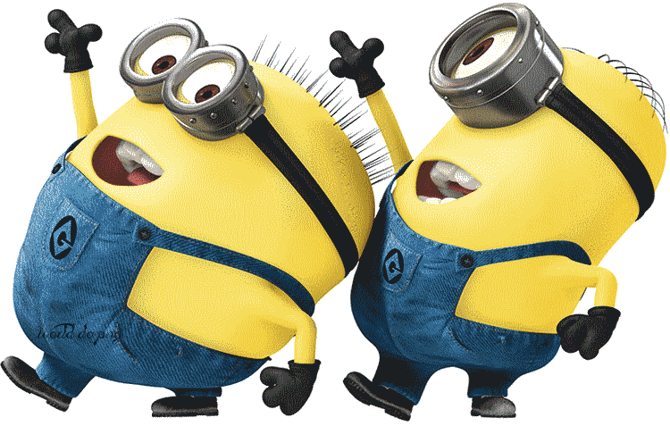
What is the sum?
10
+ 4
14
9
4
13

Slide 8
How many tens are in the difference?
60 – 50 = ?
11tens
7 tens
1 ten
10 tens

Slide 9
How many tens are in the difference?
80 – 50 = _____
50
30
20
10

Slide 10
What is the difference?
70 – 10 = _____
60
80
70
6

Slide 11
What is the sum?
14 + 10 = _____
10
14
21
24

Slide 12
Count on by ones. What is the sum?
13 + 5 = _____
17
18
8
10

Slide 13
Count on by tens. What is the sum?
42 + 30 = _____
72
42
12
90

Slide 14
How many tens and ones are in the sum?
50 + 31= ____
_____ tens and _____ ones
81
8
1

Slide 15
How many tens and ones are in the sum?
43 + 10= ____
_____ tens and _____ ones
53
5
3

Slide 16
Shauntel has 10 flowers. She collects 12 more flowers. How many flowers does Shauntel have?
_____ flowers
22

Slide 17
Kevin sees 15 worms. Bob sees 20 worms. How many worms do they see?
_____ worms
35

Slide 18
Use the hundred chart. Count on by ones. What is the sum?
45 + 4 = _____
49

Slide 19
Use the hundred chart. Count on by tens. What is the sum?
23 + 30 = _____
53

Slide 20
Make a ten. What is the sum?
18 + 5 = _____
23

Slide 21
Make a ten. What is the sum?
66 + 8 = _____
74

Slide 22
What is the sum?
40
+ 24
64

Slide 23
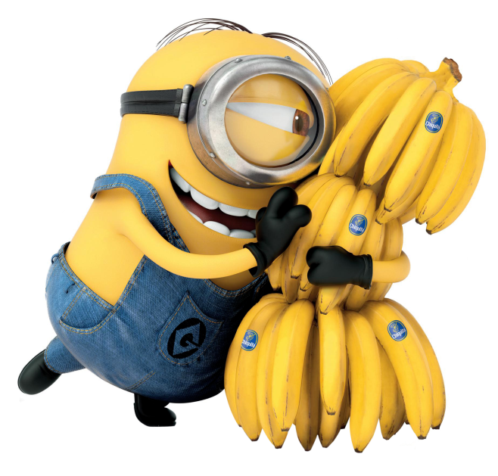
What is the difference?
24
- 2
22

Slide 24
Video Clip:
Ninja Turtles

