Slide 1
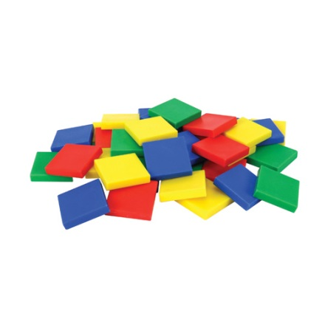
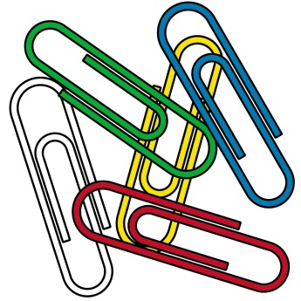
Chapter 9 Review
Measurement

Slide 2
Question #1:
A blue ribbon is longer than the green ribbon.
The green ribbon is longer than a red ribbon.
Which is correct?
A
B
C
D

Slide 3
Question #2
A purple line is shorter than the black line.
The black line is longer than a yellow line.
Which is correct?
A
B
D
C

Slide 4
Question #3
Which shows the ropes in order from longest to shortest?
A
B
C
D

Slide 5
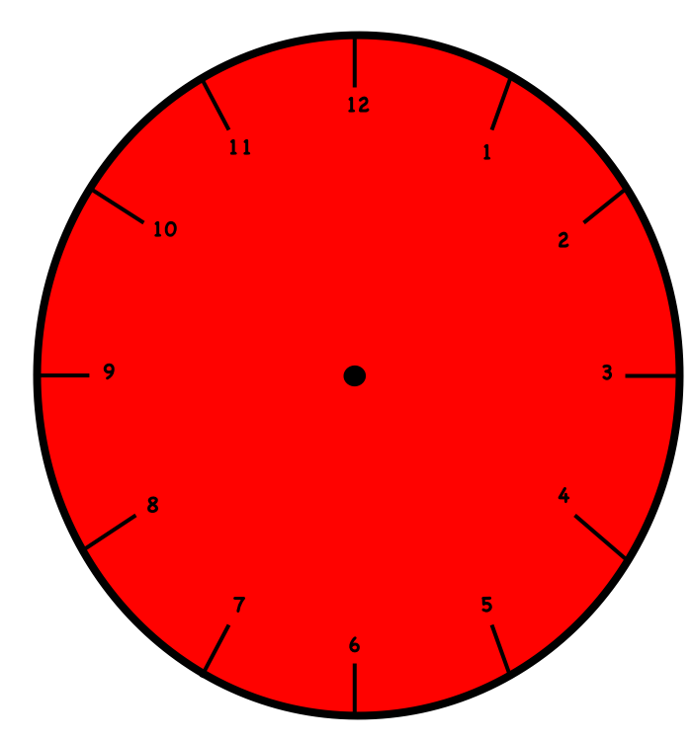
Question #4
What is the time?
Half past 6:00 Half past 7:00

Slide 6
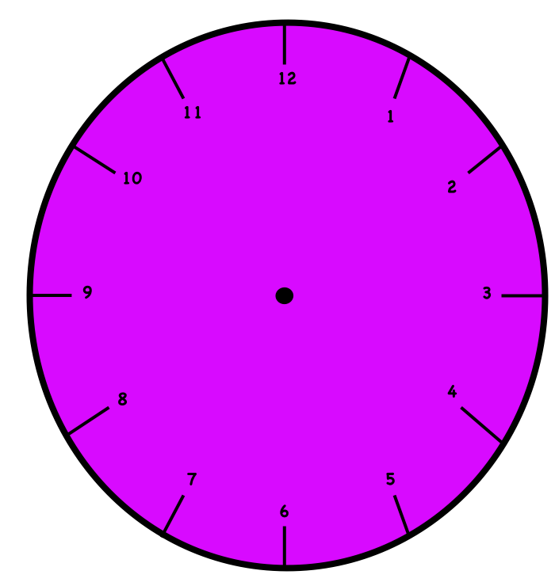
Question #5
Look at the hour hand.
What time is it?
2:00
4:00
3:00
5:00

Slide 7
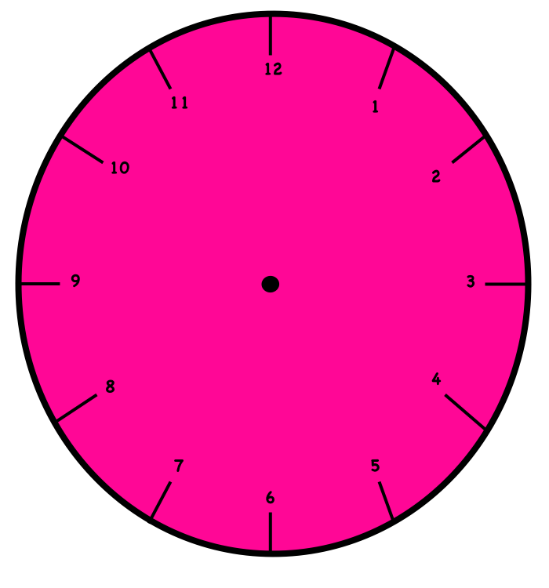
Question #6
Look at the hour hand.
What time is it?
10:00
9:00
12:00
11:00

Slide 8
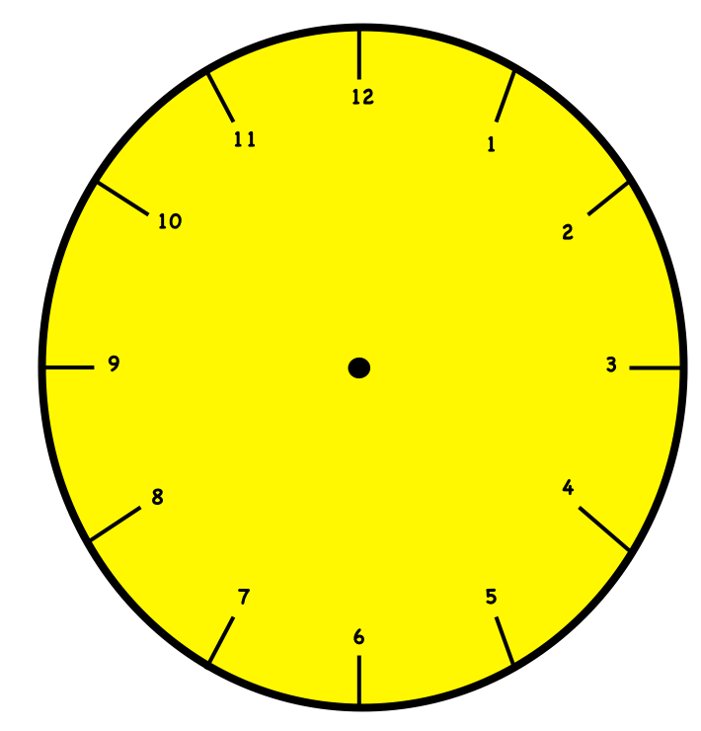
Question #7
What time is it?
5:30
4:30
6:30
7:30

Slide 9
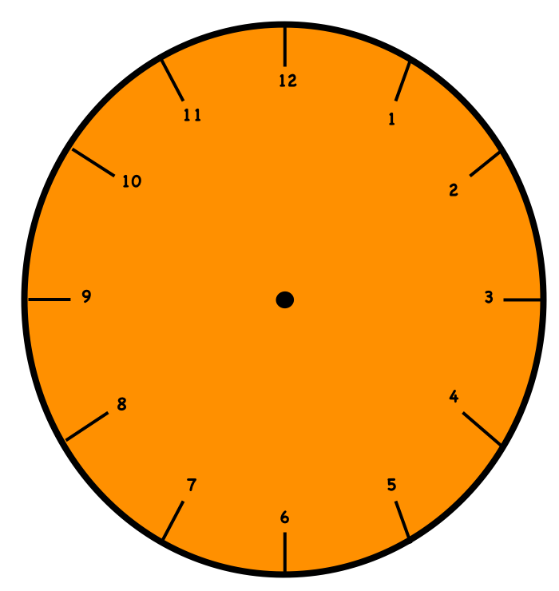
Question #8
Look at the hour hand.
What is the time?
2:00
half past 2:00
half past 3:00
3:00

Slide 10
Question #9
Clue 1: A pink line is shorter than a blue line.
Clue 2: The blue line is shorter than a green line.
So, the pink line is than the green line.
shorter
longer

Slide 11
Question #10
Boston measures a ribbon with
About how long is the ribbon?
about

