Slide 1
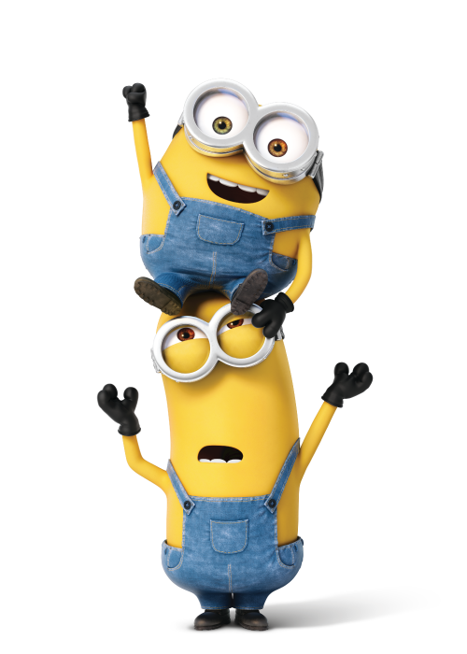
Sight Word Fitness

Slide 2
had

Slide 3
he

Slide 4
see

Slide 5
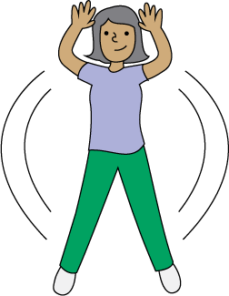
jumping jacks

Slide 6
the

Slide 7
what

Slide 8
have

Slide 9
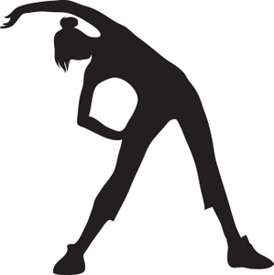
stretch and reach

Slide 10
is

Slide 11
and

Slide 12
look

Slide 13
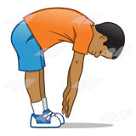
touch the ground

Slide 14
was

Slide 15
up

Slide 16
I

Slide 17
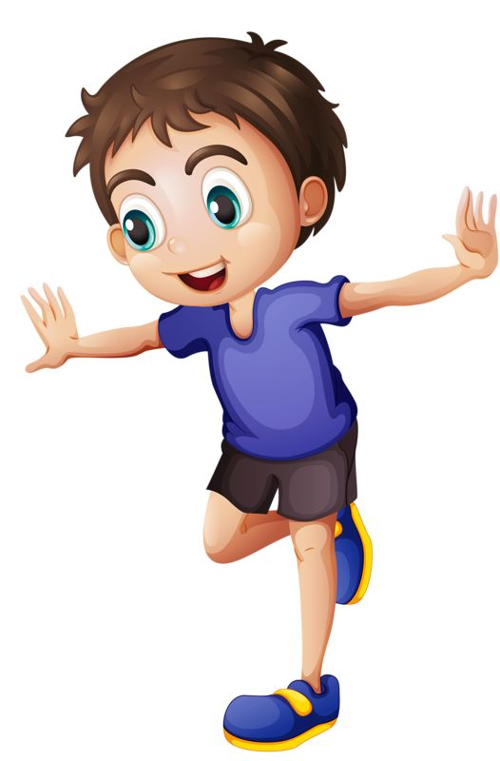
hop on one foot

Slide 18
can

Slide 19
said

Slide 20
has

Slide 21
as

Slide 22
a

Slide 23
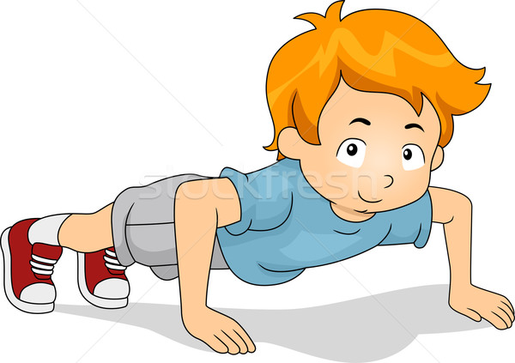
push ups

Slide 24
in

Slide 25
at

Slide 26
on

Slide 27
of

Slide 28
him

Slide 29
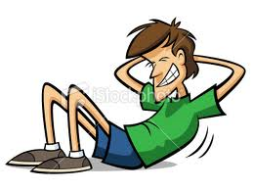
crunches

Slide 30
it

Slide 31
did

Slide 32
to

