Slide 1
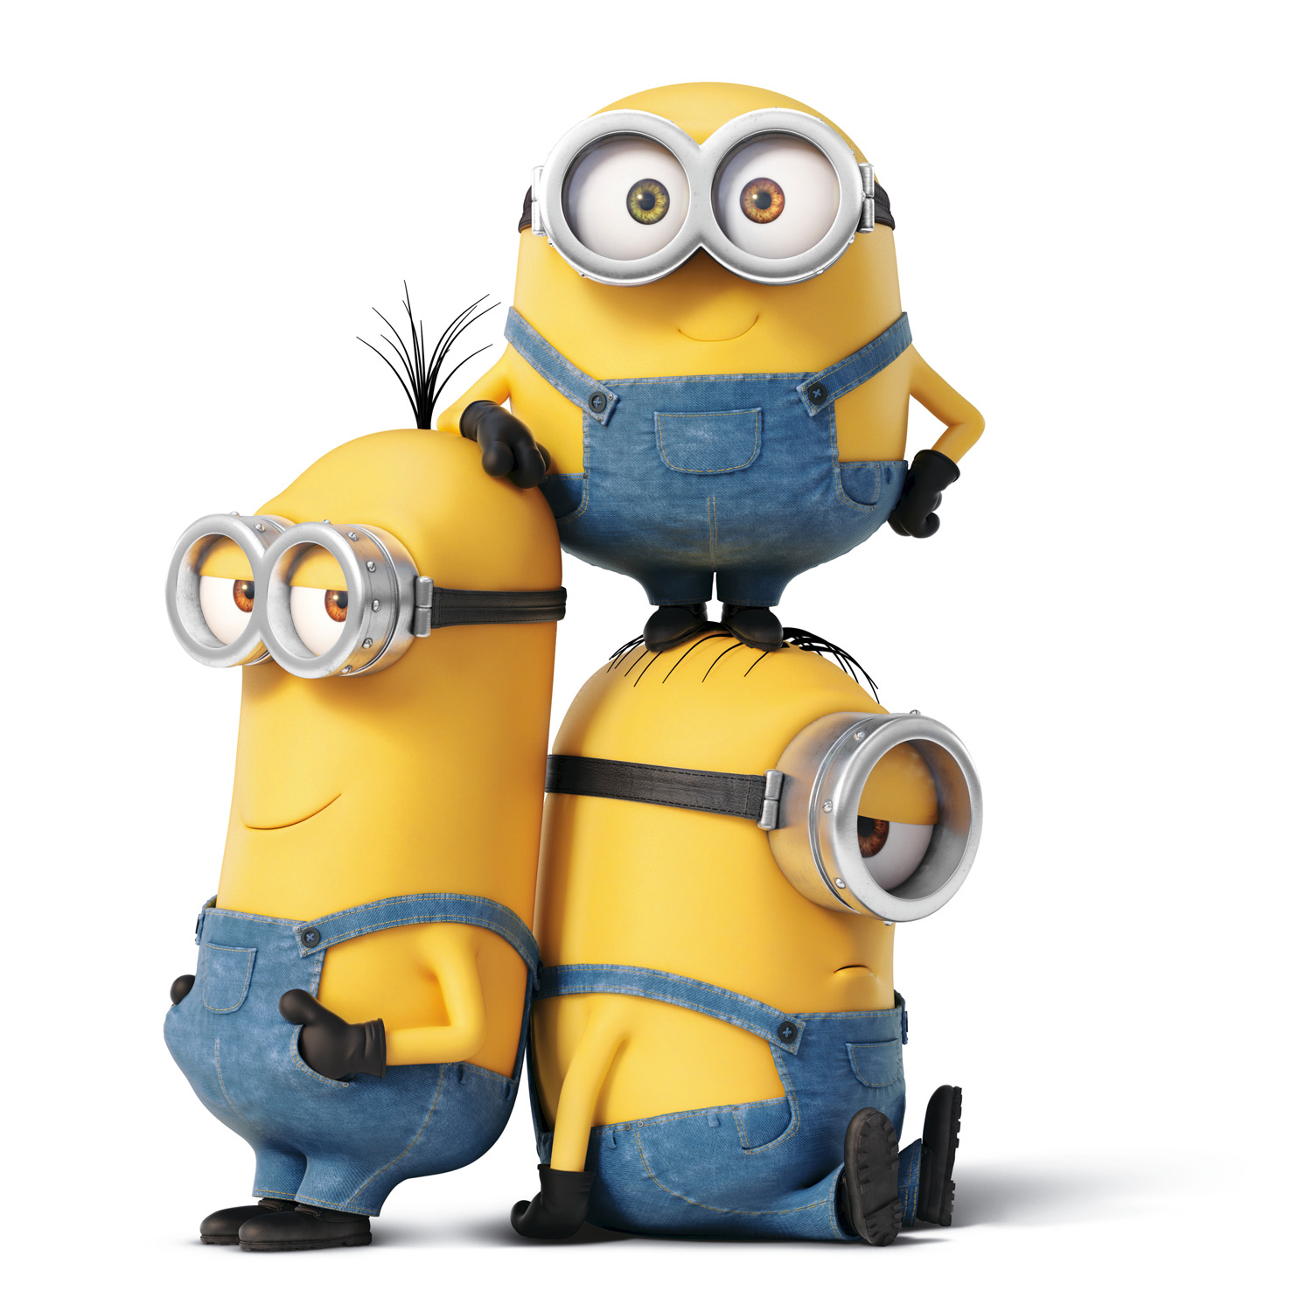
Sight Word Fitness

Slide 2
when

Slide 3
down

Slide 4
they

Slide 5
jumping jacks

Slide 6
his

Slide 7
that

Slide 8
were

Slide 9
high five

Slide 10
you

Slide 11
this

Slide 12
then

Slide 13
touch the ground

Slide 14
like

Slide 15
if

Slide 16
but

Slide 17
balance on one foot

Slide 18
for

Slide 19
make

Slide 20
get

Slide 21
she

Slide 22
we

Slide 23
jog in place

Slide 24
her

Slide 25
go

Slide 26
out

Slide 27
all

Slide 28
do

Slide 29
squats

Slide 30
will

Slide 31
an

Slide 32
with

