Slide 1
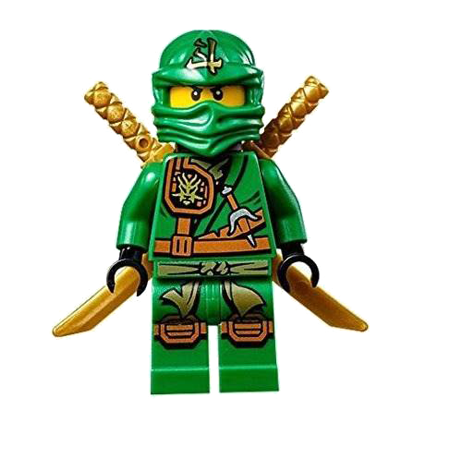
Sight Word Fitness Quarter 3

Slide 2
than

Slide 3
by

Slide 4
many

Slide 5
jumping jacks

Slide 6
when

Slide 7
which

Slide 8
some

Slide 9
lunges

Slide 10
way

Slide 11
made

Slide 12
no

Slide 13
elbow to knee

Slide 14
who

Slide 15
her

Slide 16
all

Slide 17
run in place

Slide 18
day

Slide 19
that

Slide 20
them

Slide 21
long

Slide 22
now

Slide 23
push ups

Slide 24
water

Slide 25
time

Slide 26
of

Slide 27
from

Slide 28
so

Slide 29
crunches

Slide 30
how

Slide 31
people

Slide 32
these

