Slide 1
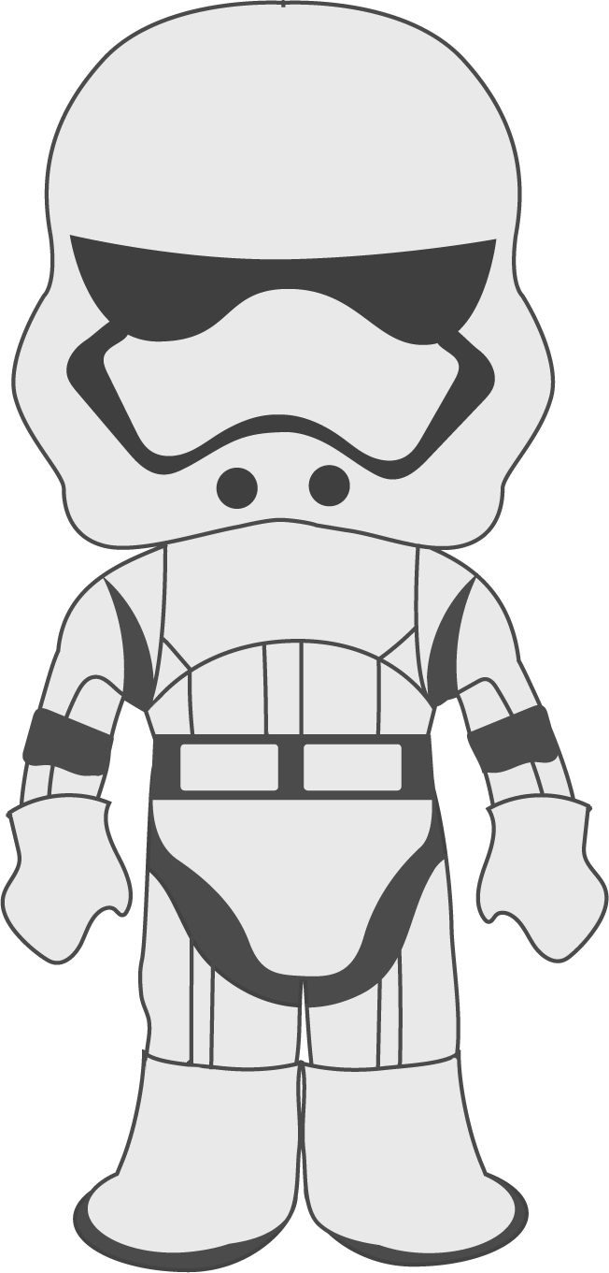
Sight Word Fitness
Quarter 4

Slide 2
number
Our class is number one!

Slide 3
his
That is his toy.

Slide 4
as
I’m as tall as Bob.

Slide 5
did
Did you see that?

Slide 6
had
I had a cookie.

Slide 7
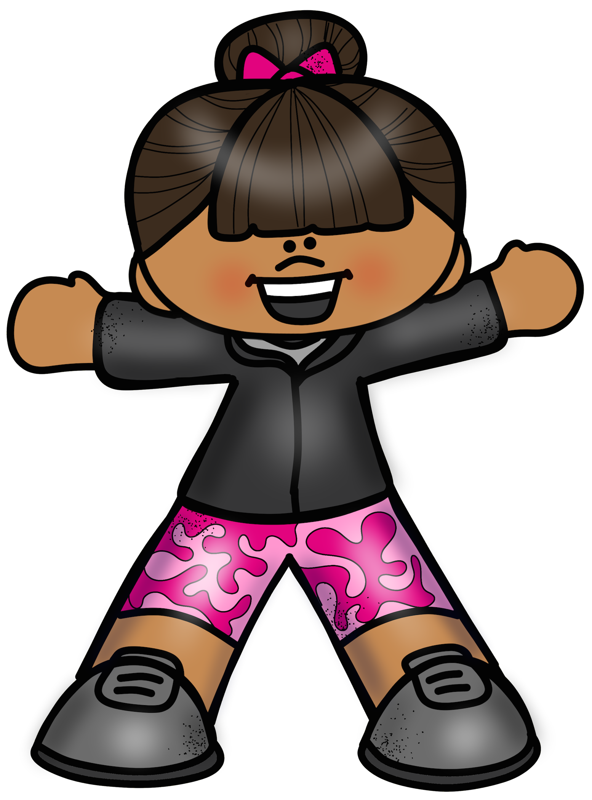
jumping jacks

Slide 8
on
I wrote on my paper.

Slide 9
your
Your number is two.

Slide 10
write
Write your name down.

Slide 11
been
Have you been good?

Slide 12
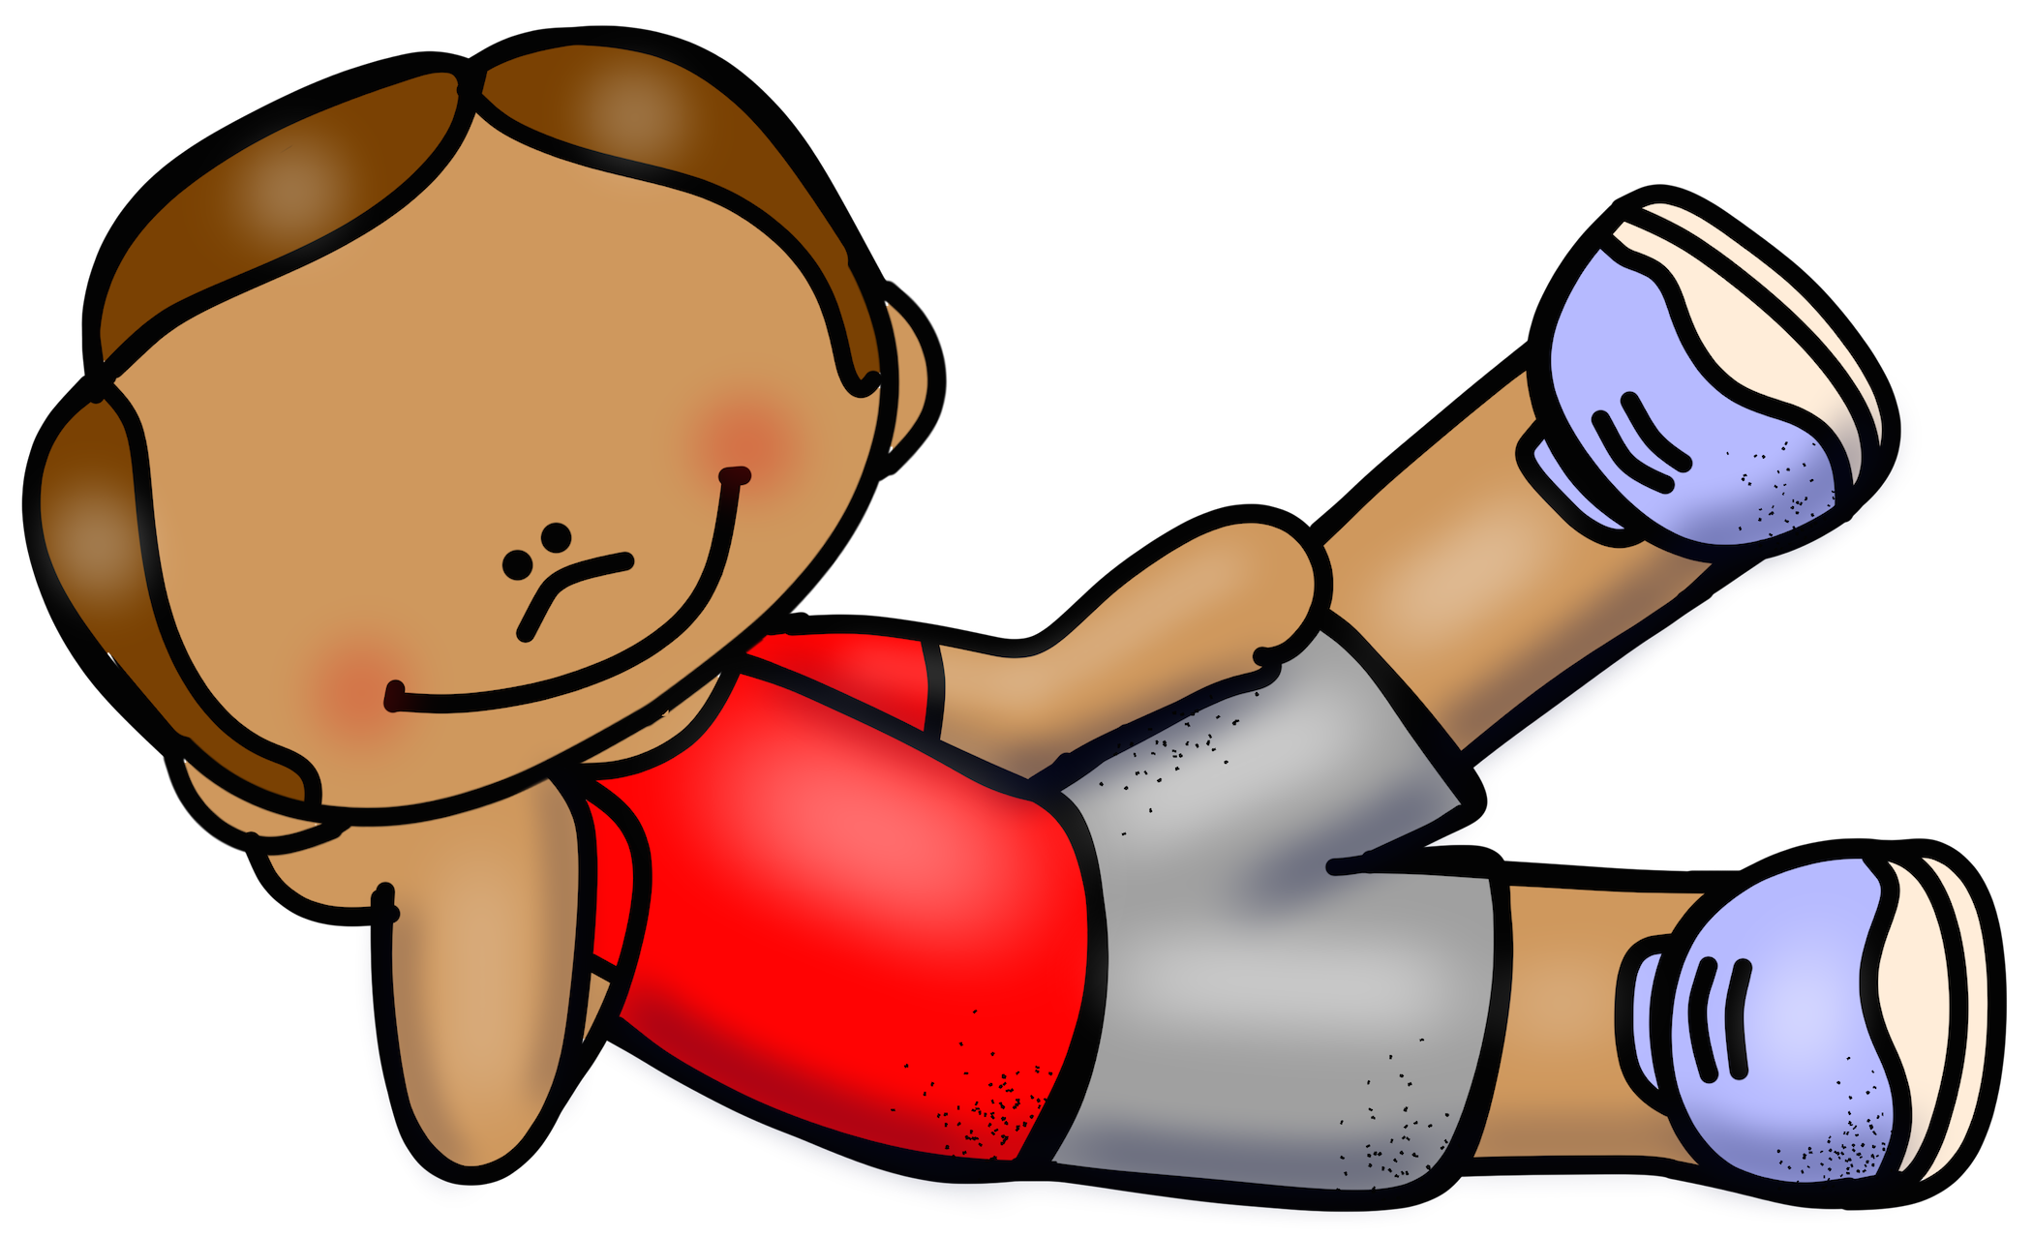
leg lifts

Slide 13
their
Their pencils are blue.

Slide 14
called
I called you on the phone.

Slide 15
oil
Oil is black.

Slide 16
words
Have you practiced your words?

Slide 17
first
First you need to write your name.

Slide 18
elbow to knee

Slide 19
part
The car needs a new part.

Slide 20
would
Would you like some water?

Slide 21
were
Where were you?

Slide 22
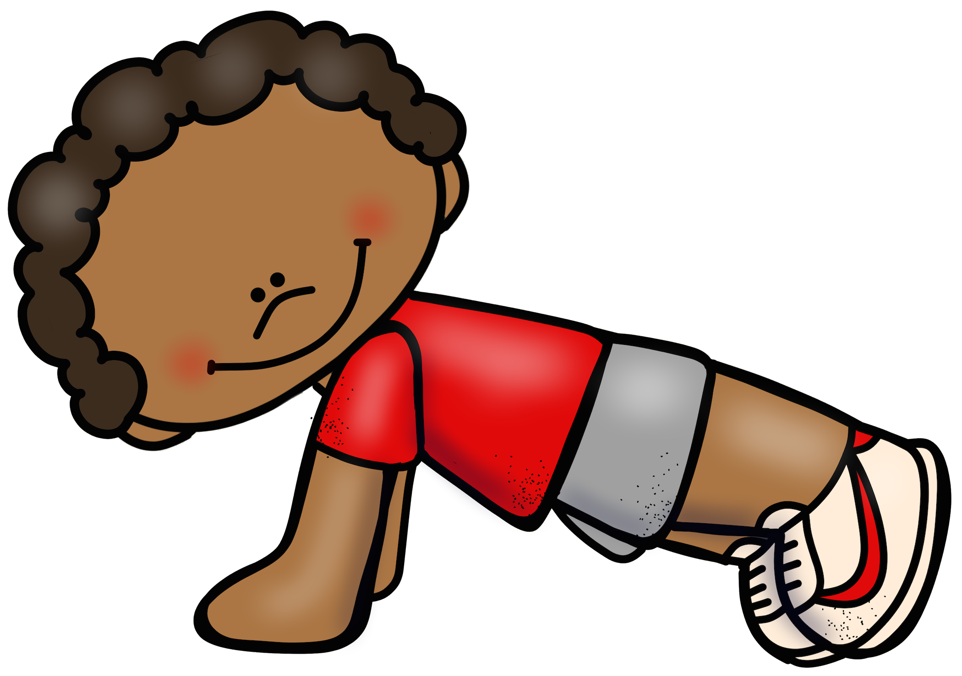
push ups

Slide 23
find
I hope I find my ball.

Slide 24
more
Can I have some more?

Slide 25
each
We each get one.

Slide 26
into
Let’s go into the shop.

Slide 27
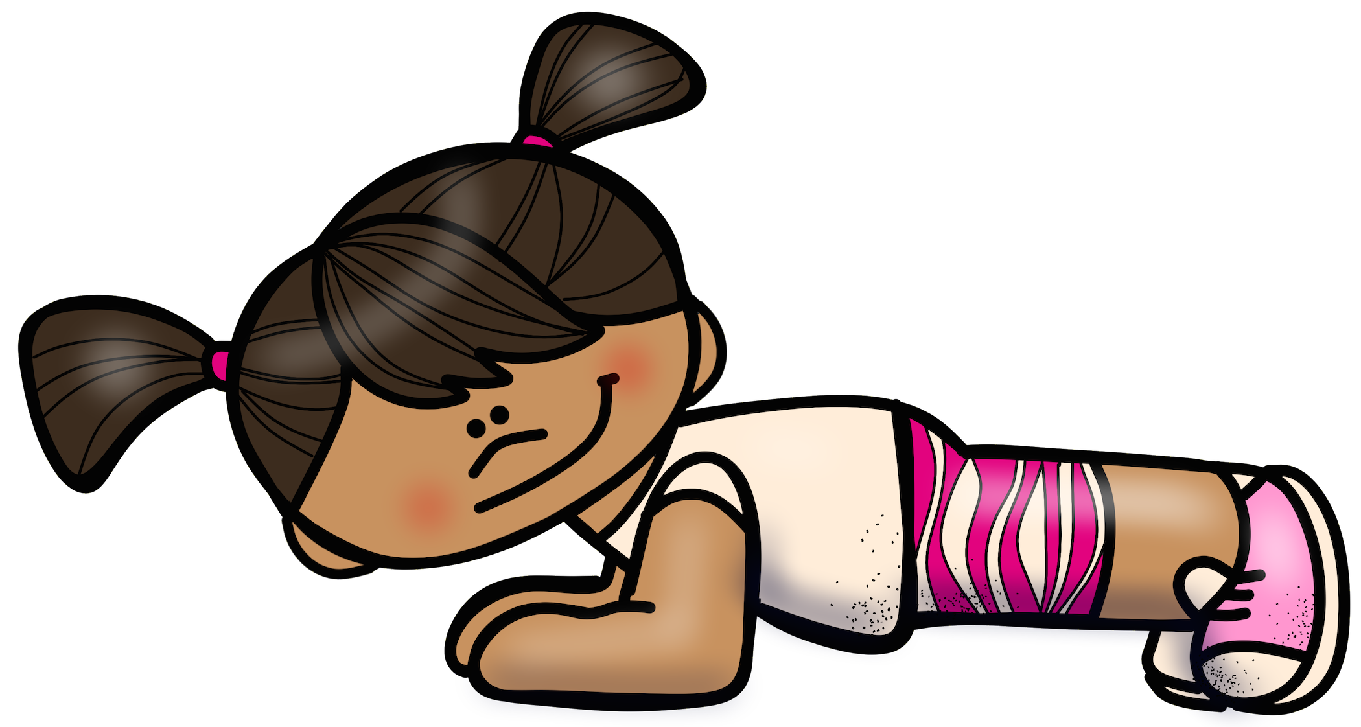
plank

Slide 28
other
Let’s play the other game.

Slide 29
or
Do you want one or two?

Slide 30
may
May I use the bathroom?

Slide 31
about
The story is about fairies.

Slide 32
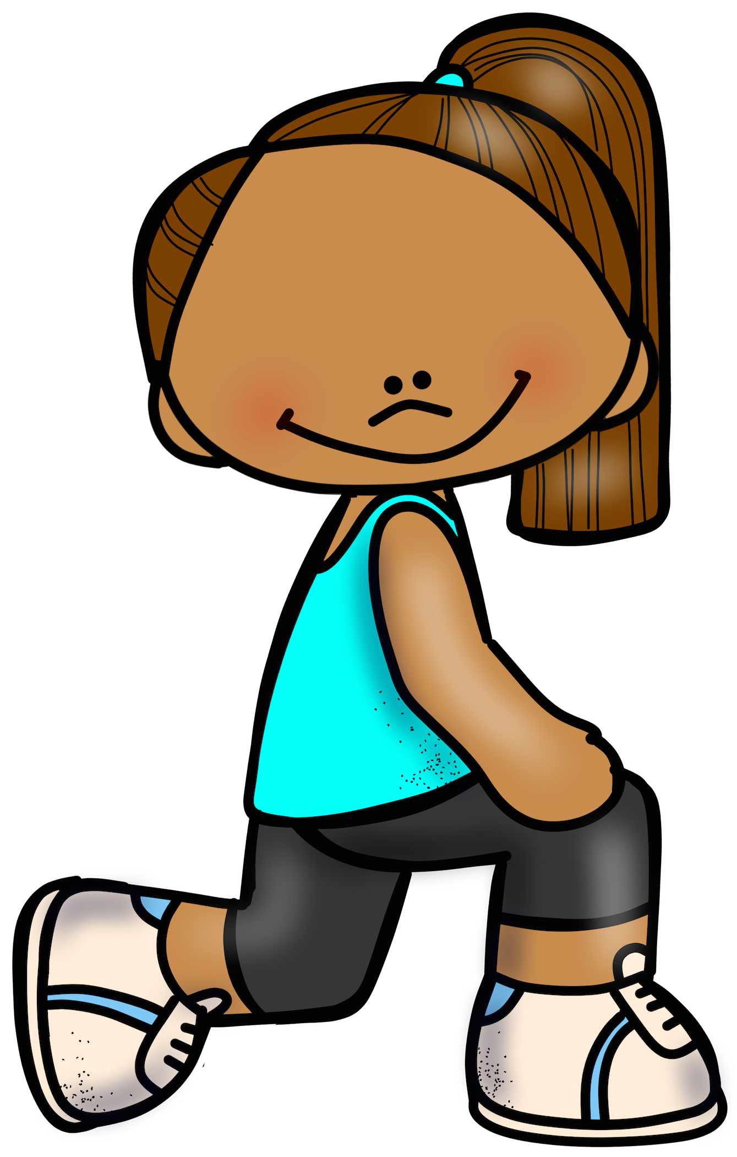
lunges

Slide 33
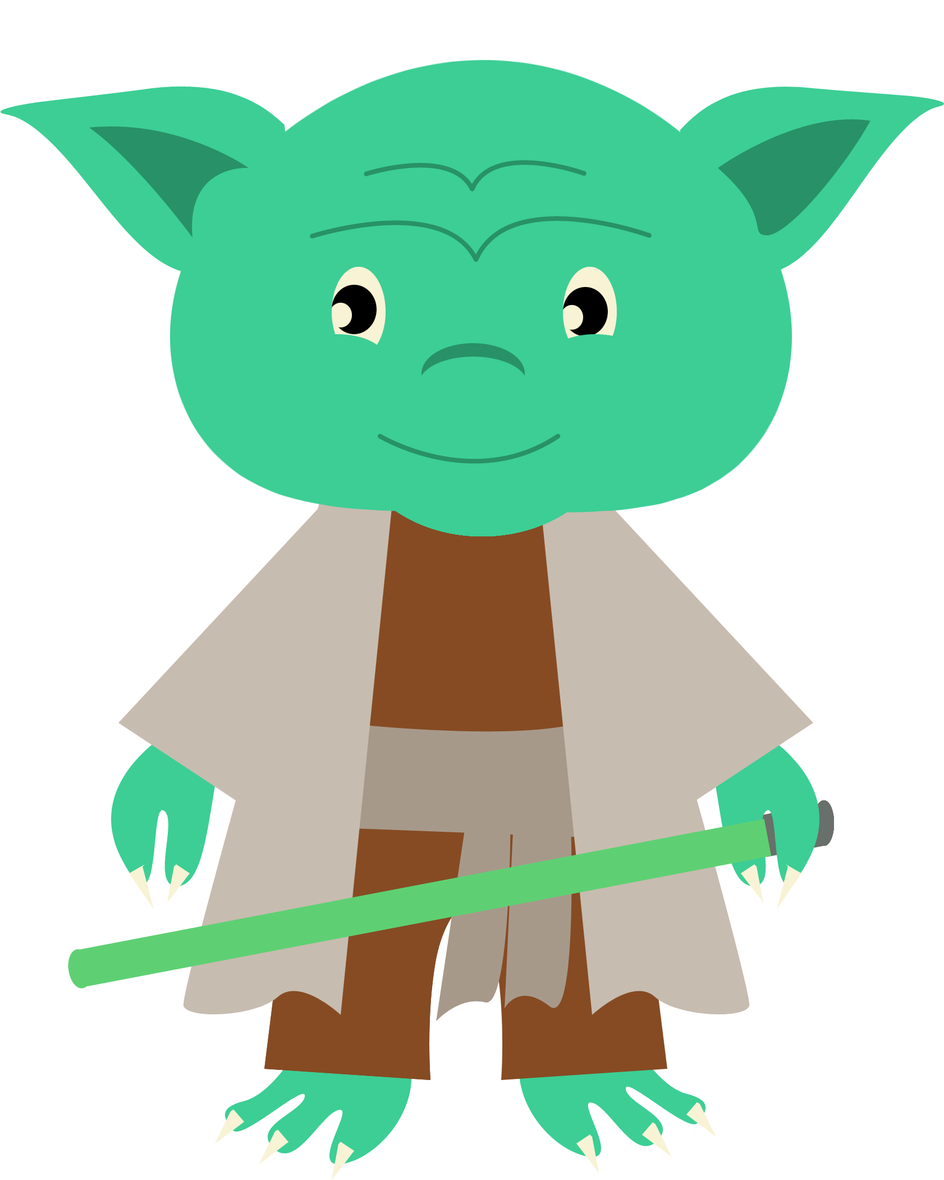
MAY THE
FORCE
BE WITH YOU

