Slide 1
Start Smart Week 2 Day 5

Slide 2
Track the print as you read the Daily Warm-Up.
Read sentences and invite children to chime in.
Circle the m’s in Hmmm.
Point out the repeated letters at the end of the word. Words that are written differently are read in a special way.
Circle the word not.
The word not is in italics.
Jack saw a giant!
Prairie dogs are not dogs!
Hmmm…
Underline the ellipsis.
Three dots mean there is a pause or there is more to come.
Remember that a sentence is made up of a group of related words
and that it starts with a capital letter and ends with a punctuation mark.
Have partners discuss: What surprised you when you heard the selections?

Slide 3
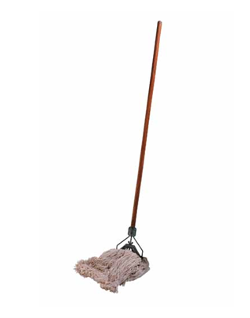
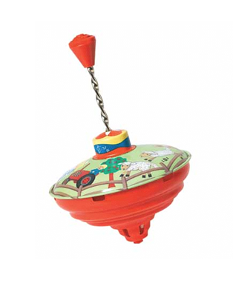
Phonological Awareness
Model:
Look at these two Photo Cards.
I will say the name of each card, then you will repeat the name:
mop
top
The words mop and top rhyme because they both end in /op/.
Listen /m/ /op/, mop; /t/ /op/, top.
Both mop and top end in /op/. So, they rhyme. Rhyming words end in the same sounds.

Slide 4
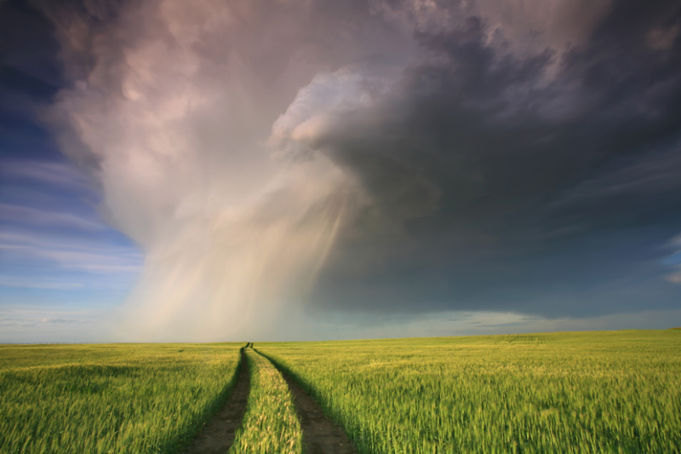
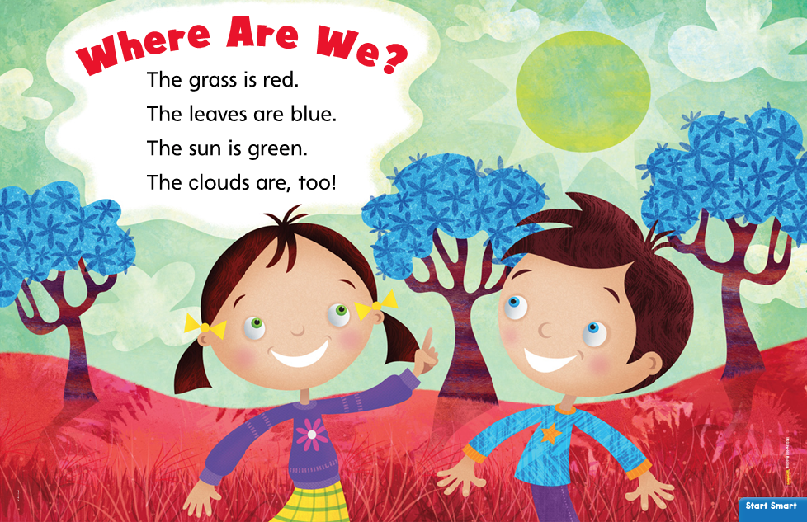
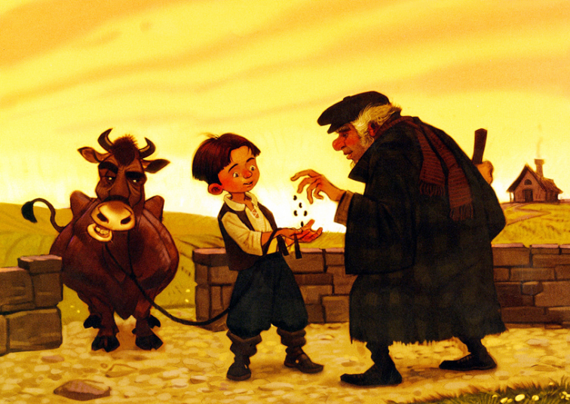
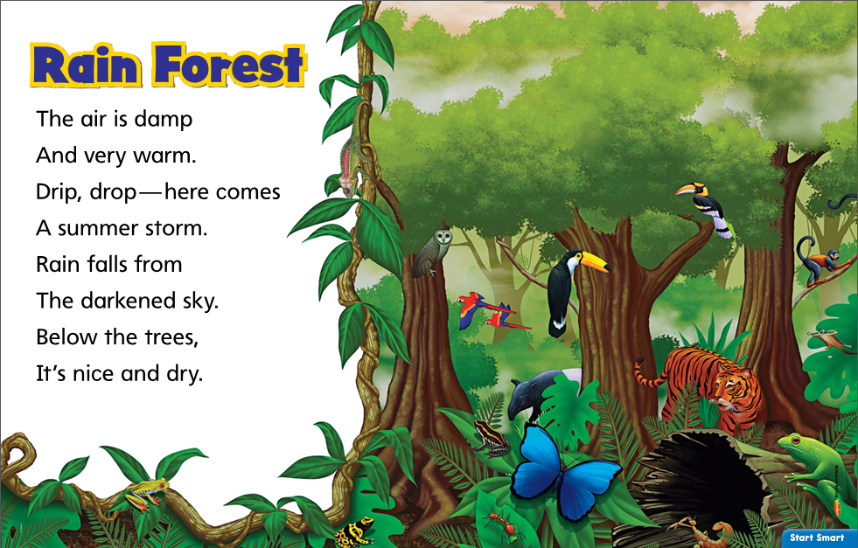
Listening Comprehension-Text Connections
All of these selections have an interesting setting, or place where the action happens. It is something that connects all of these texts.
“Let’s Explore”
What is it that connects these selections together?
Jack and the Beanstalk

Slide 5
Listening Comprehension-Text Connections
Now you will think about how these two selections are different.
“Let’s Explore”

Slide 6
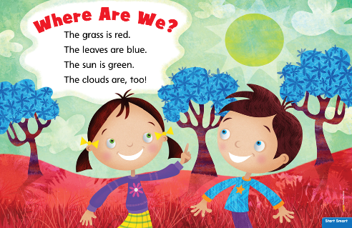
“Let’s Explore”
1.___________
2.___________
3.___________
1.___________
2.___________
3.___________
What is different about these two selections?

Slide 7
Independent Writing
“Rain Forest” and “Jack and the Beanstalk” both _____________________________________________________.
“Rainforest” and “Let’s Explore!” are different because __________________
__________________________.
Jack and the Beanstalk
Jack and the Beanstalk
What do they
have in common?
What is different about them?
_____________
_____________
_____________
_____________
_____________
_____________
_____________
_____________

