Slide 1
Week 1

Slide 2
Start Smart
Day 1

Slide 3
Track the print as you read the Daily Warm-Up.
Explain to children that we read from left to right and from the top to the bottom of the page.
Welcome to Grade 1.
My name is __________.
What is your name?
Have children talk to a partner and introduce themselves:
Hi, My name is ____________. What is your name?
Point out children’s names on desk name cards, attendance charts, and other places they appear.

Slide 4
Phonemic Awareness
Model: I will say three words: mop, man, milk.
What sound is the same in mop, man, and milk?
The beginning, or first, sound in mop, man, and milk is the same.
They all begin with the /m/ sound.
Have children identify the same sound in drum, him, team.
Guided
Practice: Have children identify the same sound in a word group.
Do the first one with them.
I will say three words.
Tell me the sound you hear that is the same in all three words.
sad, say, six mitt, make, men mat, moon, mail
safe, soup, sit sun, soap, suit us, yes, toss

Slide 5
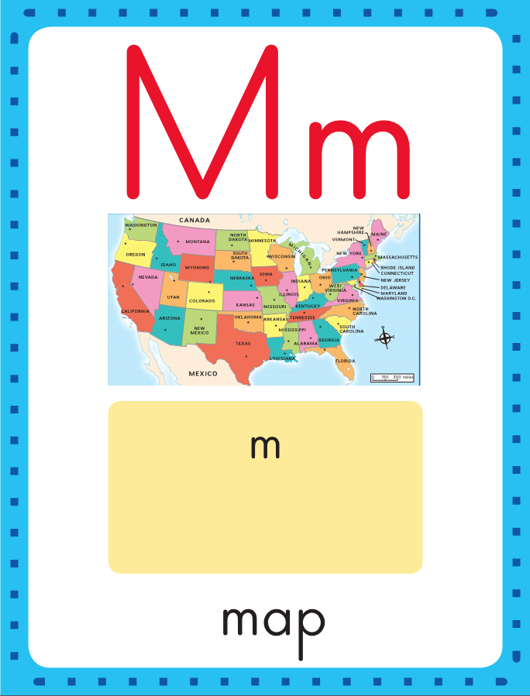
Phonics
This is the map sound spelling card.
The sound is /m/.
The /m/ sound is spelled with the letter m.
Say it with me: /mmm/.
This is the sound at the beginning of the word map.
Listen: /mmmap/, map.

Slide 6
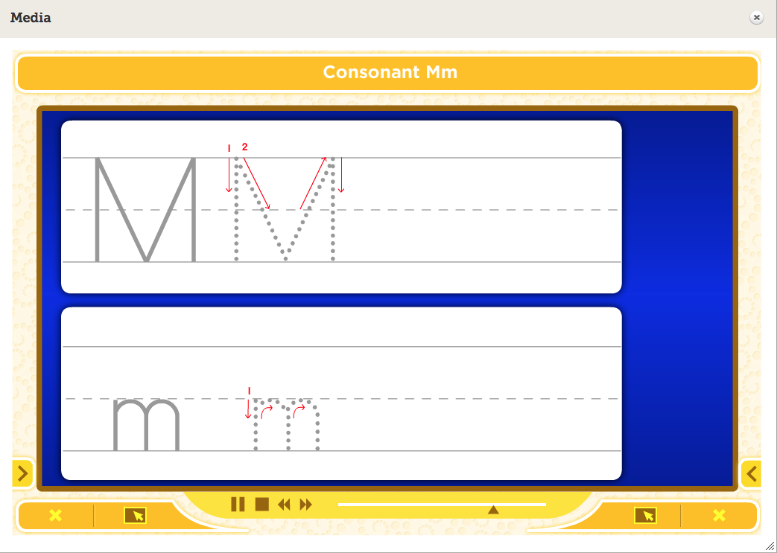
Watch as I write the letter m. I will say /m/ as I write the letter several times.

Slide 7
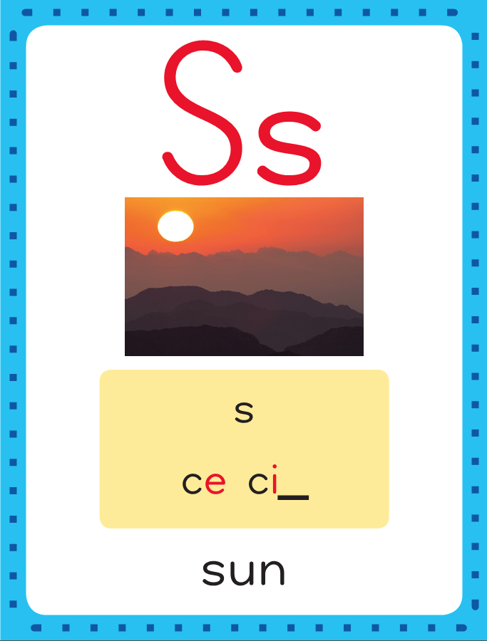
This is the sun sound spelling card.
The sound is /s/.
The /s/ sound is spelled with the letter s.
Say it with me: /sss/.
This is the sound at the beginning of the word sun.
Listen: /sssun/, sun.

Slide 8
Watch as I write the letter s. I will say /s/ as I write the letter several times.

Slide 9
Now do it with me. Say /m/ as I write the letter m. Say /s/ as I write the letter s. This time, write the letter m five times as you say the /m/ sound. Write the letter s five times as you say /s/.
m m m m m
s s s s s

Slide 10
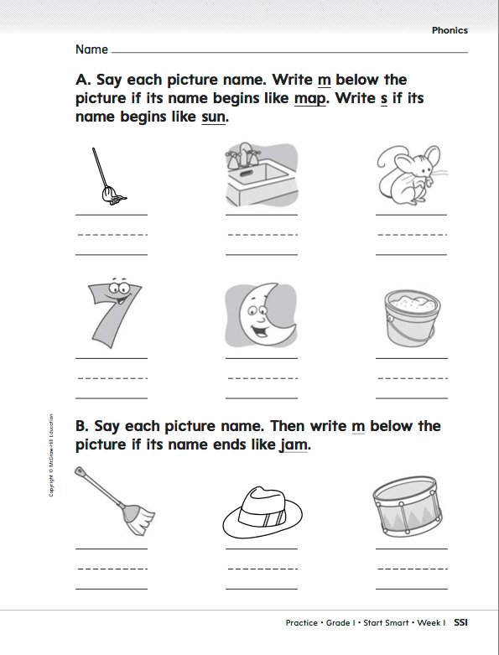

Slide 11
This is the alphabet. It contains 26 letters.
You will learn how to read and spell words with these letters.
Sing “Alphabet Song” with children as you point to each letter. Sing it again; stop on the letters m and s. What’s the letter’s name? What’s the sound?

Slide 12
High-Frequency Words
Read, Spell, Write routine
Read:
Point to and say the word like.
This is the like.
Say it with me: like.
I like to play outside.
Read:
Point to and say the word I.
This is the I.
Say it with me: I.
I can read.
like
Spell:
The word like is spelled l-i-k-e.
Spell it with me.
I
Spell:
The word l is spelled l.
Spell it with me.
Point out that I is also a letter.
Write:
Let’s write the word in the air as we say each letter: l-i-k-e.
Write:
Let’s write the word in the air as we say each letter: l.
Have children work in pairs to make up sentences using the words.

Slide 13
Share the Rhyme
Build Background
Talk with children about starting school in a new class. Engage children in a discussion about class procedures and rules.
Then ask if they know the names of the other children.
Tell them you are going to read aloud a rhyme to help them learn everyone’s name.
Rhyming words are words that have the same ending sound.

Slide 14
Have children chorally chant the rhyme.
Play the “Game of Names”.
Point to a child and say: Is this ___________? Let’s wave to ____________.
Say hello to ___________. Have children say: Hello, _____________.

Slide 15
Shared Writing
Ask children to name the different ways the friends greet one another in “The Game.” Make a list of their answers.
Write the sentences and reread them together.
List of how friends greet one another:
1._______________
2._______________
3._______________
4._______________
5._______________
6._______________
In “The Game,”
one way they greet someone is _______________. I know this because. _______________.

Slide 16
Start Smart
Day 2

Slide 17
Track the print as you read the Daily Warm-Up.
Explain to children that sentences are made up of words.
The Daily Warm-Up has three sentences.
Point to and read each word in the first sentence.
Ask: How many words are in this sentence?
Today we will read a story.
It is about goats.
Can you tell me what a goat is?
Have partners take turns asking and answering questions.

Slide 18
Phonemic Awareness
Model:
I am going to say a word and then say the first, or beginning, sound in the word.
Listen: at, /aaat/.
The sound at the beginning of at is /a/.
Say the sound with me: /aaa/.
Now listen for the middle sound in a word.
Listen: mat, /mmmaaat?
The middle sound in mat is /a/.
Say the sound with me: /aaa/.
Repeat with /m/ and /s/, using the words men and sit.

Slide 19
Phonemic Awareness
Guided Practice:
Have children practice isolating initial /a/, /m/, and /s/.
Stretch the target sound as you say each word.
Listen to these words.
Say the first, or beginning, sound you hear.
am, milk, at, safe, mad, sit
Now say the middle sound you hear in these words.
sat, map, men, sad, run, bag

Slide 20
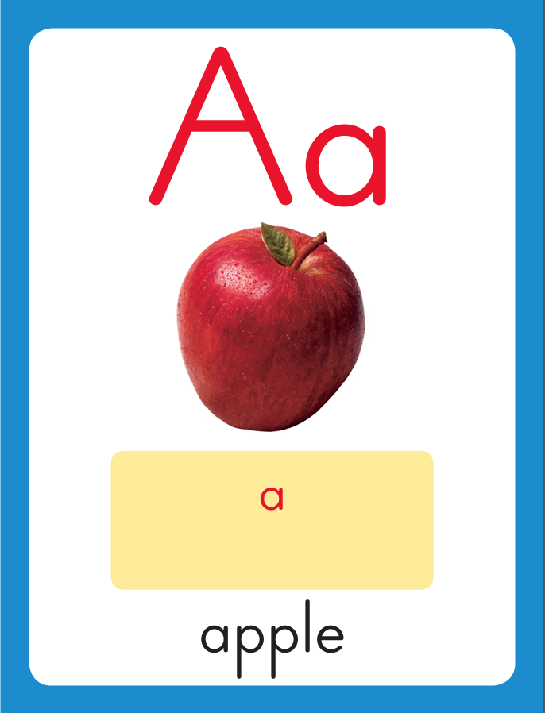
Phonics
This is the apple sound spelling card.
The sound is /a/.
The /a/ sound is spelled with the letter a.
Say it with me: /aaa/.
This is the sound at the beginning of the word apple.
Listen: /aaapel/, apple.

Slide 21
Watch as I write the letter a. I will say /a/ as I write the letter several times.

Slide 22
Now do it with me. Say /a/ as I write the letter a. Write the letter a five times as you say /a/.
a a a a a

Slide 23
Sing “Alphabet Song” with children as you point to each letter. Sing it again; stop on the letter a. What’s the letter’s name? What’s the sound?

Slide 24
Highlight the difference between a letter and a word.
a, m, s, am, Sam
Point out that a, m, and s are letters. Explain that am and Sam are words.
What’s the first letter in am?
How many letters are in the word?
What’s the first letter in Sam?

Slide 25
Build Fluency: Sound Spellings
a
m
s
Each day you will review the sound-spellings you have learned as a warm-up.
Chorally say each sound. Repeat and vary the pace.

Slide 26
Blend Words with Short a
a
Model:
Point to the letter, tapping under it.
Then say: Sound?
Have the children chorally say the sound /a/.

Slide 27
a
m
Model:
Point to the letter, tapping under it.
Then say: Sound?
Have the children chorally say the sound/m/.

Slide 28
a
m
Point just to the left of am.
Then say: blend?
Sweep under a and m.
Have the children chorally blend the sounds /aaammm/
as you sweep your finger under the letters.
Point just to the left of am,
Say: Word?
Slide your hand quickly under the word. am.
Model:

Slide 29
s
Guided Practice:
Point to the letter, tapping under it.
Then say: Sound?
Have children chorally say /s/.

Slide 30
s
a
Point to the letter, tapping under it.
Then say: Sound?
Have the children chorally say /a/.
Point just to the left of sa.
Then say: Blend?
Sweep under s and a.
Have children chorally blend the sounds /sssaaa/
as you sweep your finger under the letters.
Guided Practice:

Slide 31
s
a
m
Point to the letter, tapping under it.
Then say: Sound?
Have children chorally say /m/.
Point just to the left of Sam.
Then say: Blend?
Sweep under s, a, m.
Have children chorally blend the sound /sssaaam/
as you sweep your finger under the letters.
Point just to the left of Sam.
Say: Word?
Slide your hand quickly under the word. Sam.
Guided Practice:

Slide 32
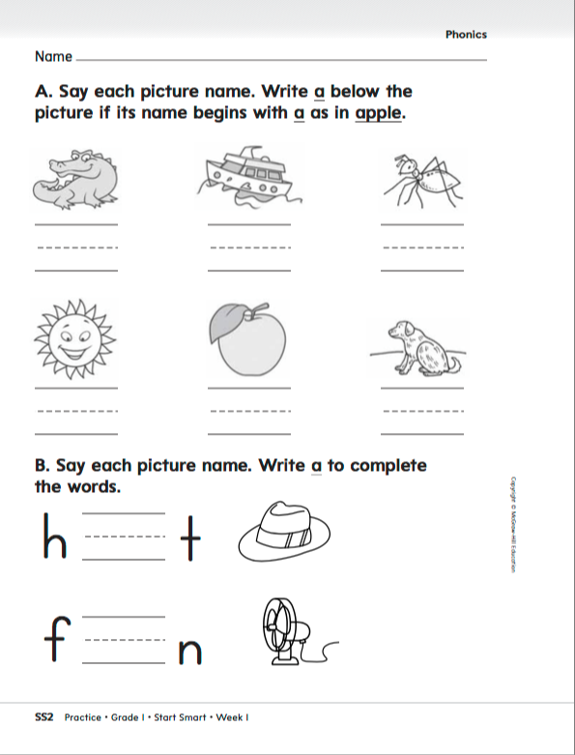

Slide 33
High-Frequency Words
do
Read:
Point to and say the word do.
This is the word do.
Say it with me: do.
What will we do today?
Read:
Point to and say the word to.
This is the word to.
Say it with me: to.
We will go to the park.
to
Spell:
The word do is spelled d-o.
Spell it with me.
Spell:
The word to is spelled t-o.
Spell it with me.
you
Write:
Let’s write the word in the air as we say each letter: d-o.
Write:
Let’s write the word in the air as we say each letter: t-o.
Have children work in pairs to make up sentences using the words.

Slide 34
High-Frequency Words
practice
Read:
Point to and say the word I.
This is the word I.
Say it with me: I.
I like school.
Read:
Point to and say the word like.
This is the word like.
Say it with me: like.
We like to play.
I
Spell:
The word I is spelled I.
Spell it with me.
like
Spell:
The word like is spelled l-i-k-e.
Spell it with me.
Write:
Let’s write the word in the air as we say each letter: I.
Write:
Let’s write the word in the air as we say each letter: l-i-k-e.

Slide 35
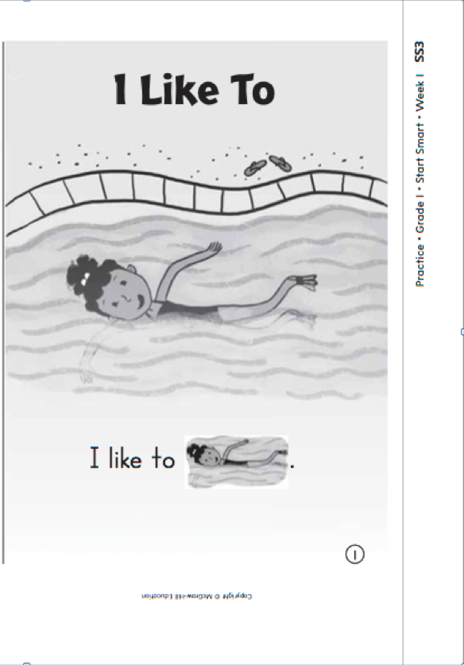
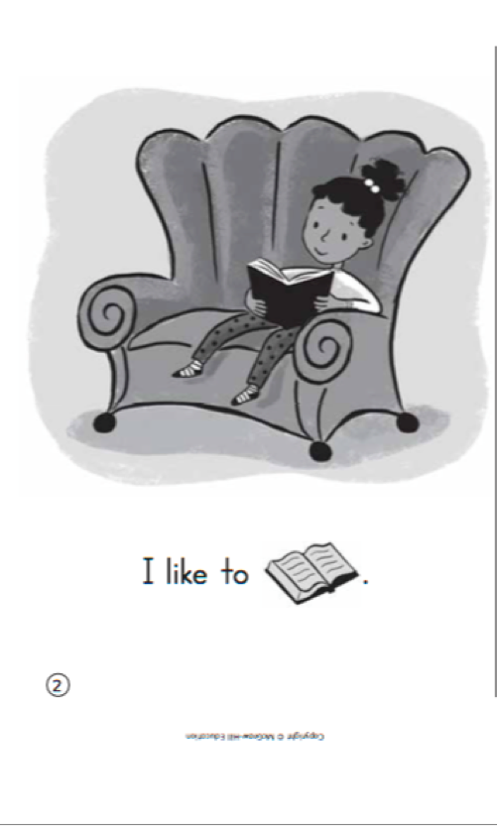

Slide 36
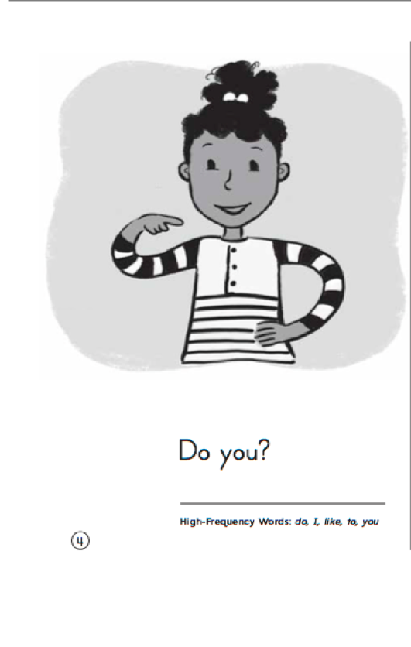
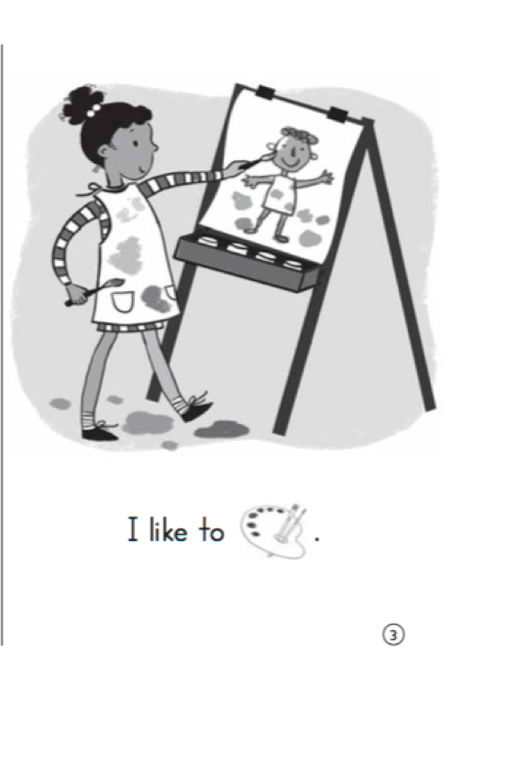

Slide 37
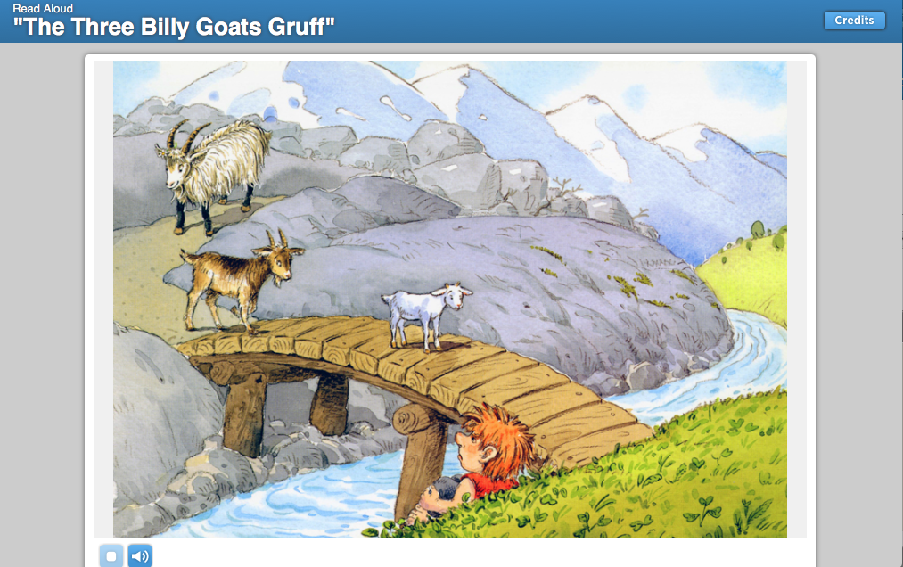
Listening Comprehension
The title of the story can help us figure out what the story might be about.
I think this story will be about three goats and what happens to them.
Fiction:
Tells about things that did not really happen.
Have a beginning, a middle, and an end
Have characters
Remember to stop and ask questions as you listen to the story.

Slide 38
Details give important information in a story. Some details tell about people or animals and other details tell what happens in a story.

Slide 40
Respond to Literature
Discuss story details with children.
Ask: Who crosses the bridge first?
What does the troll say?
What does the troll do?
What happens to the troll?
Ask children to tell about their favorite parts of the story and why they liked those parts.

Slide 41
Shared Writing
Write the sentences and reread them together.
Guide children to discuss the billy goat characters.
Make a list of children’s ideas. Read the list together.
Describe the billy goat characters.
1._______________
2._______________
3._______________
4._______________
5._______________
6._______________
In “The Three Billy Goats Gruff,” the billy goats are
_________________.
I know this because __________________
__________________.

Slide 42
Start Smart
Day 3

Slide 43
Track the print as you read the Daily Warm-Up.
Explain to children that sentences are made up of words.
Have children take turns pointing to one word in the sentence.
Circle and read aloud the first word in the first sentence.
Point to and name each letter in the word.
Repeat for other words in the sentence.
We can read.
We like to read with friends.
What do you like to read?
Have partners take turns asking and answering questions.

Slide 44
Phonological Awareness
Model:
I am going to say a word in parts,
I want you to listen carefully.
Then I will put the sounds together to say the word as a whole.
Listen: /sss/ /at/.
Now listen as I put the sounds together: /sssaaat?, sat.
The word is sat.
Let’s try another one: /sss/ /ad/.
Listen as I put the sounds together: /sssaaad?, sad.
The word is sad.

Slide 45
Phonological Awareness
Guided Practice:
Your turn: I’ll say the sounds and you put them together into a word.
/s/ /ok/ /s/ /un/ /s/ /and/ /s/ /et/
/m/ /at/ /m/ /an/ /m/ /op/ /m/ /ud/
/f/ /at/ /f/ /an/ /f/ /un/ /f/ /ish/
/b/ /at/ /b/ /ag/ /p/ /an/ /p/ /at/

Slide 46
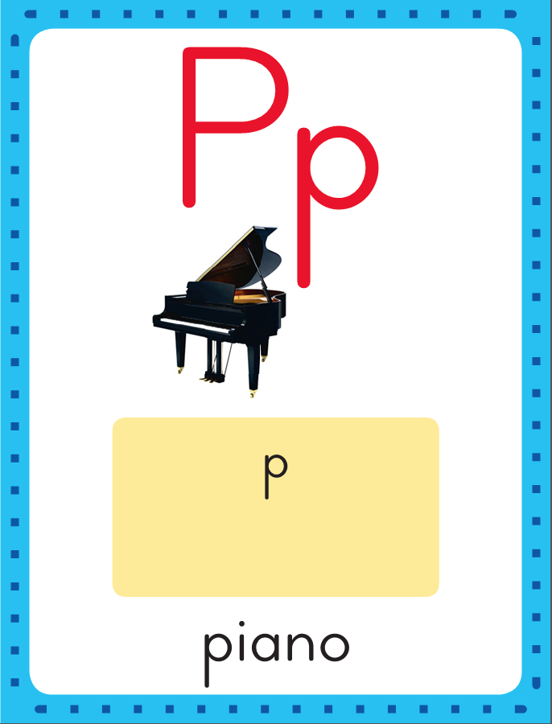
Phonics
This is the piano sound spelling card.
The sound is /p/.
The /p/ sound is spelled with the letter p.
Say it with me: /p/.
This is the sound at the beginning of the word piano.
Listen: /p/ /p/ /p/, piano.

Slide 47
Watch as I write the letter p. I will say /p/ as I write the letter several times.

Slide 48
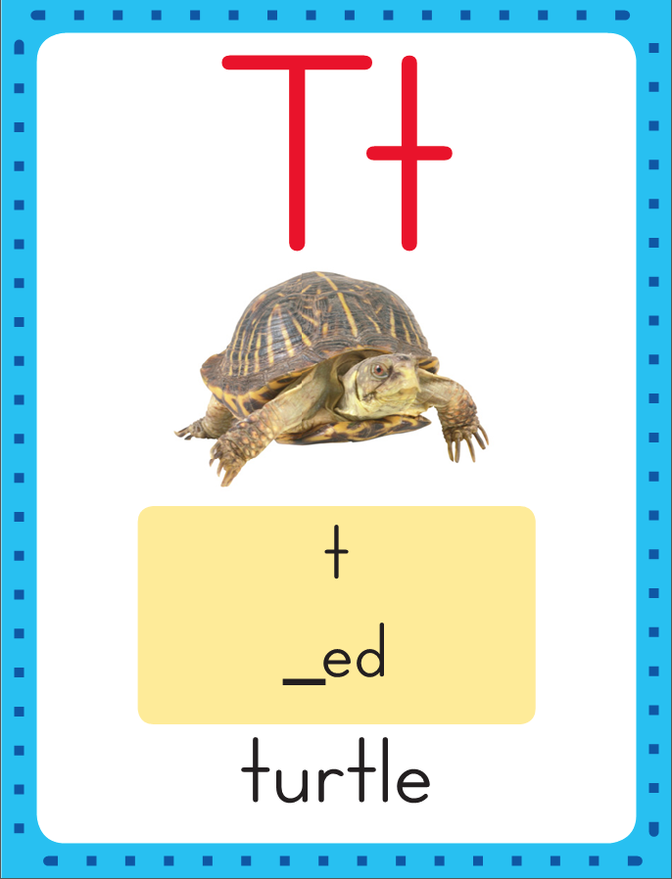
Phonics
This is the turtle sound spelling card.
The sound is /t/.
The /t/ sound is spelled with the letter t.
Say it with me: /t/.
This is the sound at the beginning of the word turtle.
Listen: /t/ /t/ /t/, turtle.

Slide 49
Watch as I write the letter t. I will say /t/ as I write the letter several times.

Slide 50
Now do it with me. Say /p/ as I write the letter p. Say /t/ as I write the letter t. This time, write the letter p five times as you say the /p/ sound. Write the letter t five times as you say /t/.
p p p p p
t t t t t

Slide 51
Build Fluency: Sound Spellings
m
Each day you will review the sound-spellings you have learned as a warm-up.
Chorally say each sound. Repeat and vary the pace.

Slide 52
s

Slide 53
t

Slide 54
a

Slide 55
p

Slide 56
Blend Words with /p/ p, /t/ t
p
Model:
Sound

Slide 57
Blend Words with /p/ p, /t/ t
p
a
Model:
Sound
Blend

Slide 58
Blend Words with /p/ p, /t/ t
p
a
t
Model:
Sound
Blend

Slide 59
Blend Words with /p/ p, /t/ t
p
a
t
Model:
Word

Slide 60
Blend Words with /p/ p, /t/ t
t
Model:
Sound

Slide 61
Blend Words with /p/ p, /t/ t
t
a
Model:
Sound
Blend

Slide 62
Blend Words with /p/ p, /t/ t
t
a
p
Model:
Sound
Blend

Slide 63
Blend Words with /p/ p, /t/ t
t
a
p
Model:
Word

Slide 64
Blend Words with /p/ p, /t/ t
s
Model:
Sound

Slide 65
Blend Words with /p/ p, /t/ t
s
a
Model:
Sound
Blend

Slide 66
Blend Words with /p/ p, /t/ t
s
a
t
Model:
Sound
Blend

Slide 67
Blend Words with /p/ p, /t/ t
s
a
t
Model:
Word

Slide 68
Blend Words with /p/ p, /t/ t
m
Model:
Sound

Slide 69
Blend Words with /p/ p, /t/ t
m
a
Model:
Sound
Blend

Slide 70
Blend Words with /p/ p, /t/ t
m
a
p
Model:
Sound
Blend

Slide 71
Blend Words with /p/ p, /t/ t
m
a
p
Model:
Word

Slide 72
a

Slide 73
at

Slide 74
at a

Slide 75
at am

Slide 76
at am
a

Slide 77
at am
at

Slide 78
at am
at s

Slide 79
at am
at sa

Slide 80
at am
at sat

Slide 81
at am
at sat m

Slide 82
at am
at sat ma

Slide 83
at am
at sat mat

Slide 84
at am
at sat mat
a

Slide 85
at am
at sat mat
am

Slide 86
at am
at sat mat
am S

Slide 87
at am
at sat mat
am Sa

Slide 88
at am
at sat mat
am Sam

Slide 89
at am
at sat mat
am Sam P

Slide 90
at am
at sat mat
am Sam Pa

Slide 91
at am
at sat mat
am Sam Pam

Slide 92
Pam

Slide 93
Pam sat.

Slide 94
Pam sat.
I

Slide 95
Pam sat.
I am

Slide 96
Pam sat.
I am Sam.

Slide 97
High-Frequency Words
he
Read:
Point to and say the word he.
This is the word he.
Say it with me: he.
He jumps up and down.
Read:
Point to and say the word can.
This is the word can.
Say it with me: can.
We can run outside.
can
Spell:
The word he is spelled h-e.
Spell it with me.
Spell:
The word can is spelled c-a-n.
Spell it with me.
you
Write:
Let’s write the word in the air as we say each letter: h-e.
Write:
Let’s write the word in the air as we say each letter: c-a-n.

Slide 98
High-Frequency Words
I
to
like
you
do
Work in pairs to make sentences using the words.

Slide 99
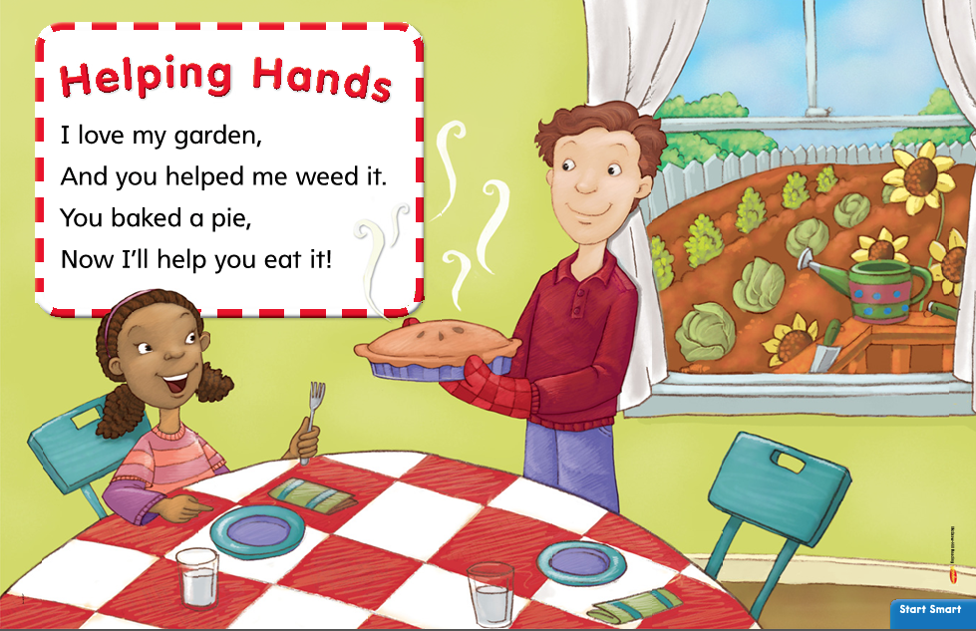
This is a rhyme about how two friends help each other.
Listening Comprehension
Stress the words weed it and eat it.
Point out that the two phrases are like rhyming words because they both end with the word it.
Listen to find out who helps each other and how?
Repeat the reading several times.

Slide 100
Remember a rhyme is different from a story.
Why do you think the rhyme is called “Helping Hands”?
Who do you help and why?

Slide 101
Interactive Writing
Write the sentences and reread them together.
Ask children to talk about the ways the two people
helped each other in “Helping Hands”.
How did the two people help each other in
“Helping Hands”?
1._______________
2._______________
3._______________
4._______________
5._______________
6._______________
In “Helping Hands,”
I think the most helpful thing was
______________________________________.
I think this because
______________________________________.

