Slide 1
Week 1 cont.

Slide 2
Start Smart
Day 4

Slide 3
Track the print as you read the Daily Warm-up.
Invite children to chime in.
Circle the two question marks.
These sentences ask questions.
Words in a sentence are separated by spaces.
Point out the spaces between words..
Name each capital letter in the Daily Warm-Up
Today we will learn about elephants.
What do you know about elephants?
What would you like to learn?
Have partners say what they know about elephants and what they would like to learn.
I know that elephants _______________________________.
I want to learn ______________________________________.

Slide 4
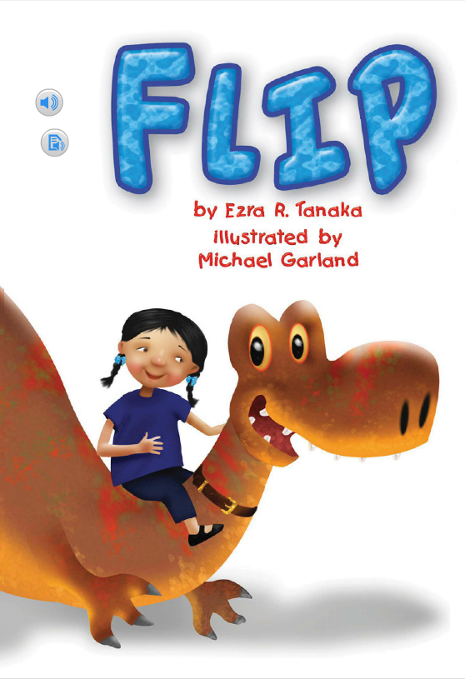
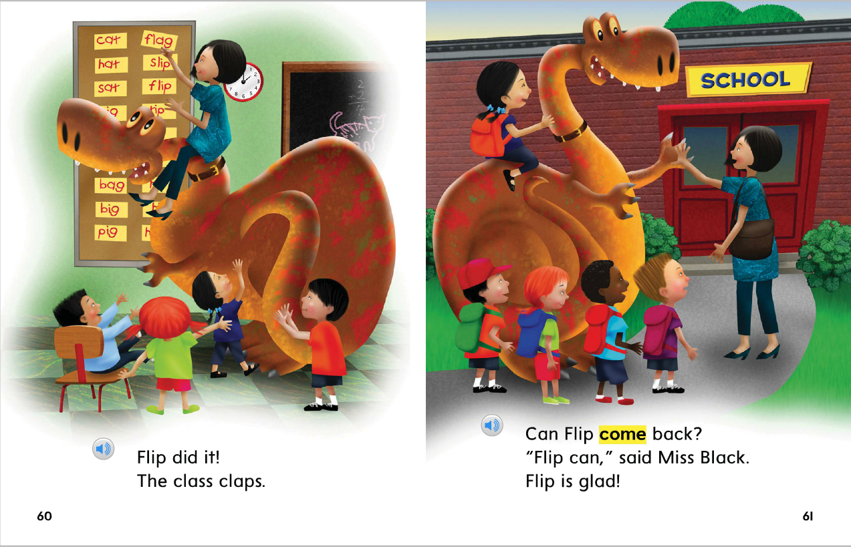
When we read books, we read the left page first. After we read the left page, we read the right page.
Concepts of Print
Sentences begin with capital letters.
We read the pages in the front of the book before the end.
We read the words in sentences from the left to the right and we read sentences from top to bottom on a page.

Slide 5
Phonological Awareness
Syllable Segmentation
Model:
Show children how to segment a word into syllables.
Then model how to count the syllables in a word.
I am going to say a word.
Then I will clap the syllables, or word parts, that I hear.
Remember that each syllable has only one vowel sound.
Listen: pancake, pan (clap) cake (clap)
The word pancake has two syllables, or word parts.
Clap the syllables with me as we say the word pancake:
pan (clap) cake (clap).
You clapped two times because pancake has two syllables.

Slide 6
Phonological Awareness
Syllable Segmentation
Guided Practice:
Have children segment each word into syllables
and count the number of syllables in a word.
Listen to these words. Clap the syllables in each word. Count how many syllables you hear.
little Sunday funny book together
running mop teacher student listen
elephant tomato hop rabbit animal

Slide 7
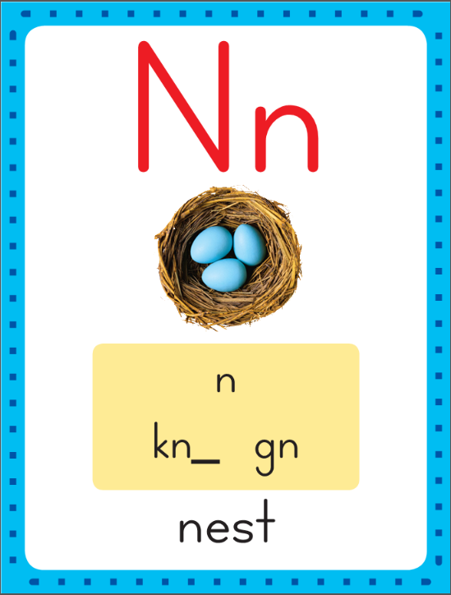
Phonics
This is the nest sound spelling card.
The sound is /n/.
The /n/ sound is spelled with the letter n.
Say it with me: /nnn/.
This is the sound at the beginning of the word nest.
Listen: /nnnest/, nest.

Slide 8
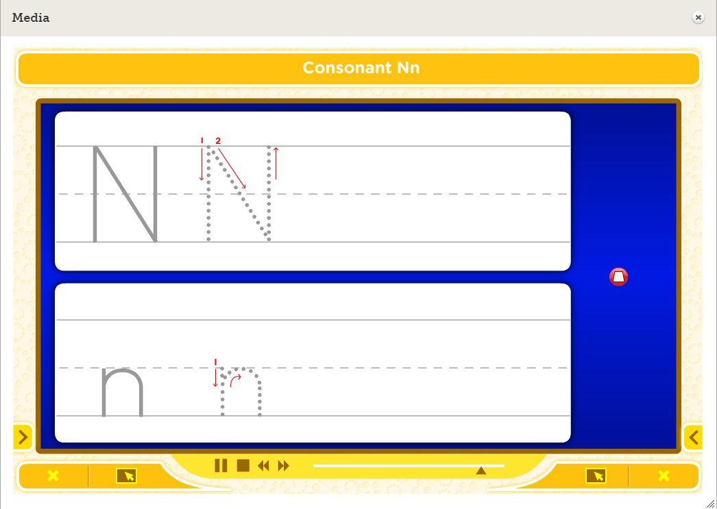
Watch as I write the letter n. I will say /n/ as I write the letter several times.

Slide 9
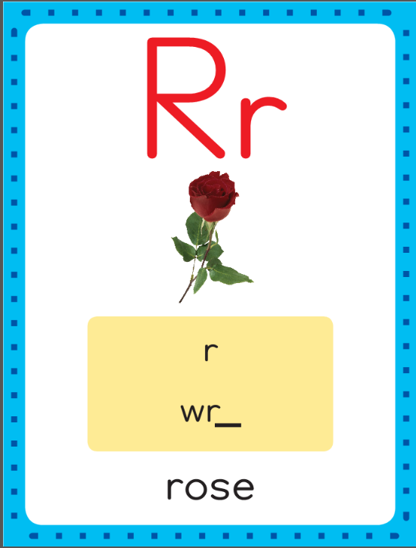
Phonics
This is the rose sound spelling card.
The sound is /r/.
The /r/ sound is spelled with the letter r.
Say it with me: /rrr/.
This is the sound at the beginning of the word rose.
Listen: /rrroz/, rose.

Slide 10
Watch as I write the letter r. I will say /r/ as I write the letter several times.

Slide 11
Now do it with me. Say /n/ as I write the letter n. Say /r/ as I write the letter r. This time, write the letter n five times as you say the /n/ sound. Write the letter r five times as you say /r/.
n n n n n
r r r r r

Slide 12
Build Fluency: Sound Spellings
a
Each day you will review the sound-spellings you have learned as a warm-up.
Chorally say each sound. Repeat and vary the pace.

Slide 13
m

Slide 14
n

Slide 15
p

Slide 16
r

Slide 17
s

Slide 18
t

Slide 19
Blend Words with /n/ n, /r/ r
r
Model:
Sound

Slide 20
Blend Words with /n/ n, /r/ r
r
a
Model:
Sound
Blend

Slide 21
Blend Words with /n/ n, /r/ r
r
a
n
Model:
Sound
Blend

Slide 22
Blend Words with /n/ n, /r/ r
r
a
n
Model:
Word

Slide 23
Blend Words with /n/ n, /r/ r
n
Model:
Sound

Slide 24
Blend Words with /n/ n, /r/ r
n
a
Model:
Sound
Blend

Slide 25
Blend Words with /n/ n, /r/ r
n
a
p
Model:
Sound
Blend

Slide 26
Blend Words with /n/ n, /r/ r
n
a
p
Model:
Word

Slide 27
Blend Words with /n/ n, /r/ r
r
Model:
Sound

Slide 28
Blend Words with /n/ n, /r/ r
r
a
Model:
Sound
Blend

Slide 29
Blend Words with /n/ n, /r/ r
r
a
t
Model:
Sound
Blend

Slide 30
Blend Words with /n/ n, /r/ r
r
a
t
Model:
Word

Slide 31
Blend Words with /n/ n, /r/ r
m
Model:
Sound

Slide 32
Blend Words with /n/ n, /r/ r
m
a
Model:
Sound
Blend

Slide 33
Blend Words with /n/ n, /r/ r
m
a
n
Model:
Sound
Blend

Slide 34
Blend Words with /n/ n, /r/ r
m
a
n
Model:
Word

Slide 35
a

Slide 36
an

Slide 37
an m

Slide 38
an ma

Slide 39
an man

Slide 40
an man r

Slide 41
an man ra

Slide 42
an man ran

Slide 43
an man ran p

Slide 44
an man ran pa

Slide 45
an man ran pan

Slide 46
an man ran pan
a

Slide 47
an man ran pan
at

Slide 48
an man ran pan
at r

Slide 49
an man ran pan
at ra

Slide 50
an man ran pan
at rat

Slide 51
an man ran pan
at rat P

Slide 52
an man ran pan
at rat Pa

Slide 53
an man ran pan
at rat Pat

Slide 54
an man ran pan
at rat Pat N

Slide 55
an man ran pan
at rat Pat Na

Slide 56
an man ran pan
at rat Pat Nat

Slide 57
a

Slide 58
am

Slide 59
am r

Slide 60
am ra

Slide 61
am ram

Slide 62
am ram P

Slide 63
am ram Pa

Slide 64
am ram Pam

Slide 65
am ram Pam S

Slide 66
am ram Pam Sa

Slide 67
am ram Pam Sam

Slide 68
am ram Pam Sam
m

Slide 69
am ram Pam Sam
ma

Slide 70
am ram Pam Sam
map

Slide 71
am ram Pam Sam
map r

Slide 72
am ram Pam Sam
map ra

Slide 73
am ram Pam Sam
map rap

Slide 74
am ram Pam Sam
map rap n

Slide 75
am ram Pam Sam
map rap na

Slide 76
am ram Pam Sam
map rap nap

Slide 77
am ram Pam Sam
map rap nap t

Slide 78
am ram Pam Sam
map rap nap ta

Slide 79
am ram Pam Sam
map rap nap tap

Slide 80
Sam

Slide 81
Sam ran.

Slide 82
Sam ran.
I

Slide 83
Sam ran.
I can

Slide 84
Sam ran.
I can nap.

Slide 85
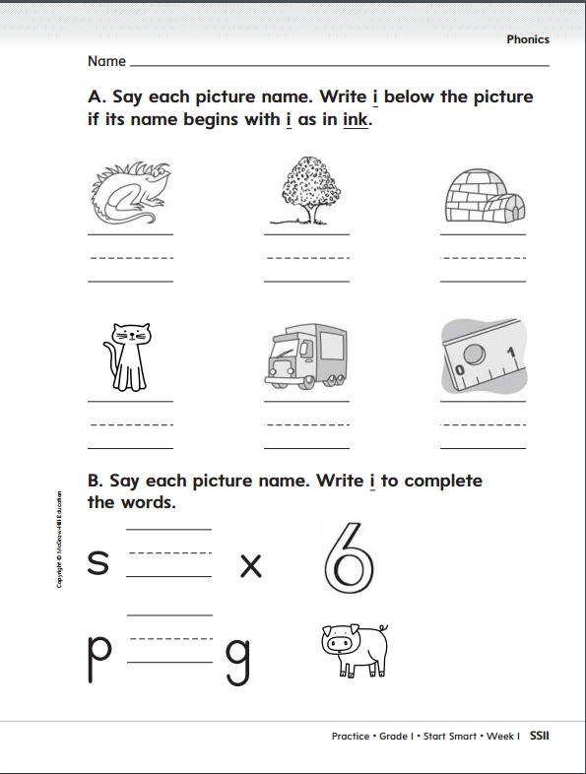

Slide 86
High-Frequency Words
go
Read:
Point to and say the word go.
This is the word go.
Say it with me: go.
We go to the store.
Read:
Point to and say the word a.
This is the word a.
Say it with me: a.
He reads a book.
a
Spell:
The word go is spelled g-o.
Spell it with go.
Spell:
The word a is spelled a.
Spell it with me.
has
Write:
Let’s write the word in the air as we say each letter: g-o.
Write:
Let’s write the word in the air as we say each letter: a.

Slide 87
High-Frequency Words
I
to
can
like
you
do
he
Work in pairs to make sentences using the words.

Slide 88
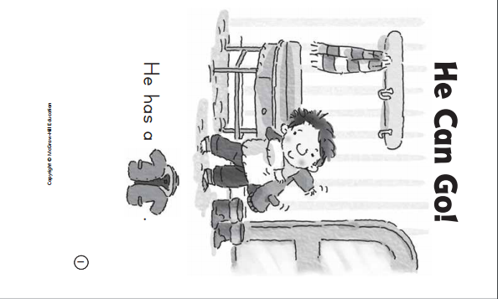
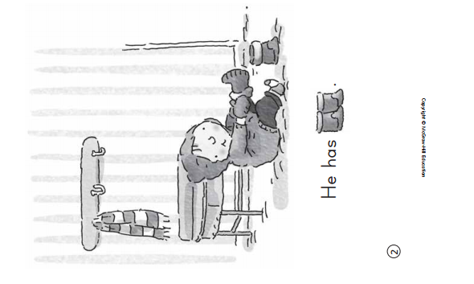

Slide 89
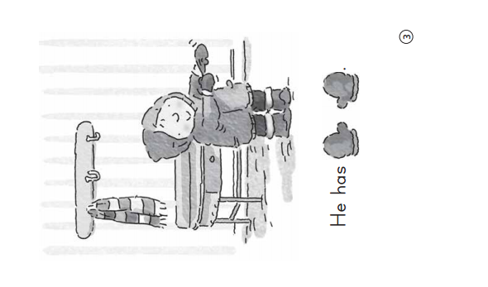
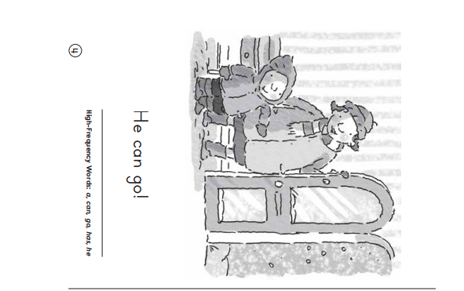

Slide 90
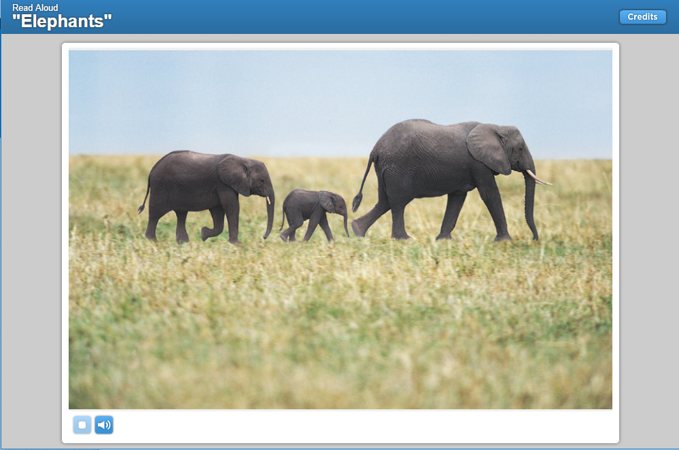
Listening Comprehension
The title of the story can help us figure out what the story might be about.
I think this selection might give me information about real elephants.
Informational Text:
Gives facts about real people, places, animals, or events.
Includes details that give important information
Remember to stop and ask questions as you listen to the story.

Slide 91
Details give important information in a story. Some details can describe what something looks like or what something does.
Listen for important details about elephants as you read the selection.

Slide 92
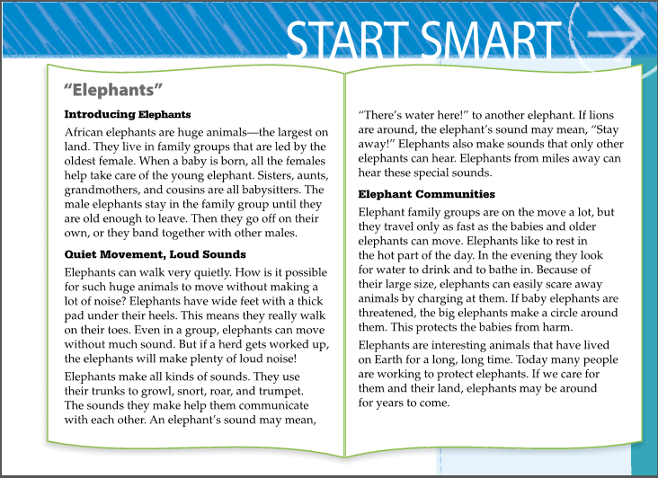
I wonder what else I’ll learn about elephants. I’ll ask myself this question: Do elephants live alone or in groups? Then I’ll keep reading to find the answer to my question.
Elephants are the largest land animals.

Slide 93
Respond to Literature
Discuss story details with children.
Ask:
Who leads a group of elephants?
Why can elephants walk quietly?
What sounds do elephants make?
How do elephants protect their babies?
Ask children to share what they think is the most interesting fact they learned.

Slide 94
Interactive Writing
Write the sentences and reread them together.
Ask children to talk about the interesting details they learned about elephants. List their ideas on chart paper.
Interesting details we learned about elephants:
1._______________
2._______________
3._______________
4._______________
5._______________
6._______________
In “Elephants,” I learned that an elephant has
______________________________________.
Elephants can
______________________________________.

Slide 95
Start Smart
Day 5

Slide 96
Track the print as you read the Daily Warm-up.
Invite children to chime in.
Remind children that this week they read “The Three Billy Goats Gruff” and “Elephants”
How many words are in the first sentence?.
Circle the word I in the first sentence and have children read the word aloud.
Point out the word I is always capitalized.
Circle the period.
Explain that telling sentences end with a period.
You and I read two stories.
Which story did you like better?
Why did you like the story?
Have partners discuss which story they liked better and why.

Slide 97
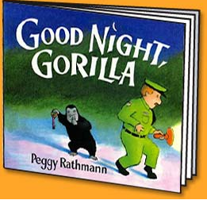
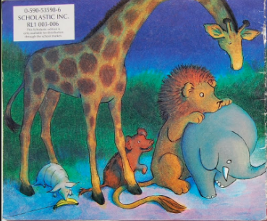
Concepts of Print
Front Cover
Back Cover
Which cover is this?
Which cover is this?
Use other books to ask which is the front cover and which is the back.

Slide 98
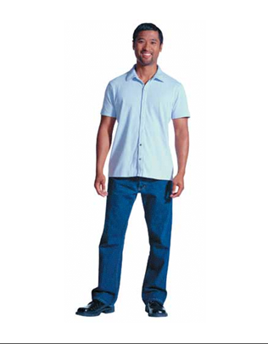
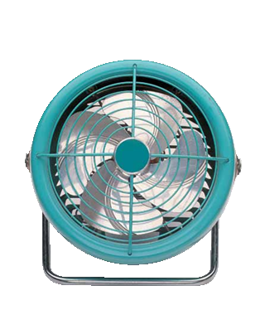
Phonological Awareness
Rhyme
Model:
Look at these two photo cards.
I will say the name of each card, then you will repeat the name: man, fan.
The word man and fan rhyme because they both end in /an/. Listen: /m/ /an/, man; /f/ /an/, fan. Both man and fan end in /an/. They rhyme.
Rhyming words end in the same sounds.

Slide 99
Phonological Awareness
Rhyme
Model:
Now I will try to make other words that rhyme with man and fan. To do so, I need to think of other words that end in /an/.
Listen as I try one: ran, /rrr/ /an/.
The word ran rhymes with man and fan because it also ends in /an/:
ran, fan, man

Slide 100
Phonological Awareness
Rhyme
Guided Practice:
Say each word pair. Ask children to identify which words rhyme and why.
Listen to these word pairs. If the words rhyme, say the words. I will ask you why they rhyme. If the words don’t rhyme, remain silent.
man/ran map/tap mat/hop
sad/bat sock/lock run/sun
hat/bat bit/sit hot/hit
Have children generate words that rhyme with each rhyming pair.

Slide 101
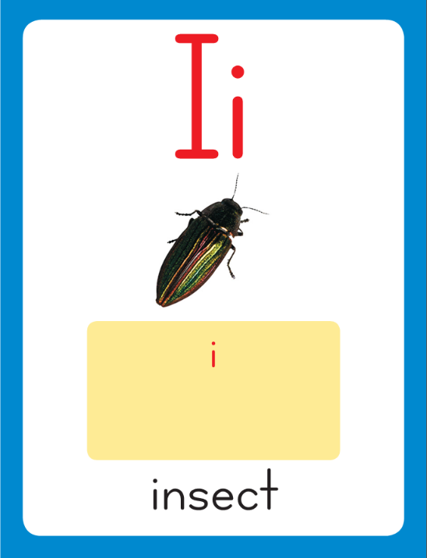
Phonics
This is the insect sound spelling card.
The sound is /i/.
The /i/ sound is spelled with the letter i.
Say it with me: /iii/.
This is the sound at the beginning of the word insect.
Listen: /nnnest/, nest.

Slide 102
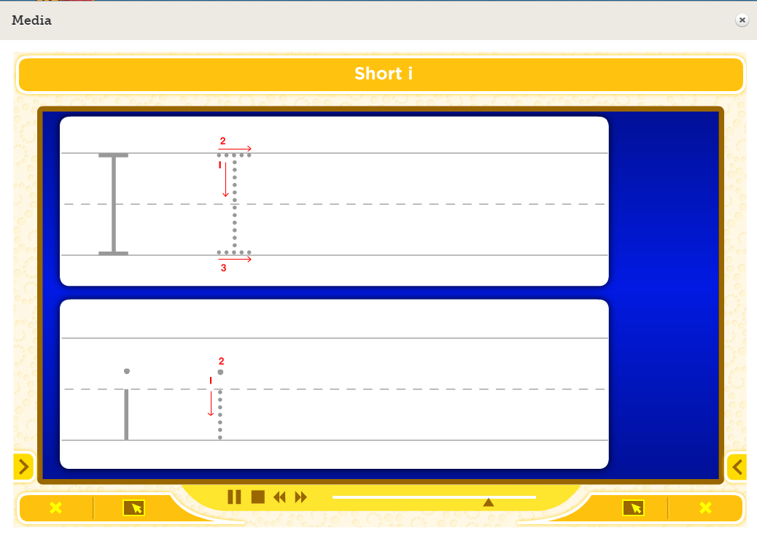
Watch as I write the letter i. I will say /i/ as I write the letter several times.

Slide 103
Now do it with me. Say /i/ as I write the letter i. Write the letter i five times as you say /i/.
i i i i i

Slide 104
m

Slide 105
mi

Slide 106
miss

Slide 107
miss
p

Slide 108
miss
pa

Slide 109
miss
pass

Slide 110
miss
pass
m

Slide 111
miss
pass
mi

Slide 112
miss
pass
mitt

Slide 113
Build Fluency: Sound Spellings
a
Each day you will review the sound-spellings you have learned as a warm-up.
Chorally say each sound. Repeat and vary the pace.

Slide 114
i

Slide 115
m

Slide 116
n

Slide 117
p

Slide 118
r

Slide 119
s

Slide 120
t

Slide 121
Blend Words with Short i
i
Model:
Sound

Slide 122
Blend Words with Short i
i
n
Model:
Sound
Blend

Slide 123
Blend Words with Short i
i
n
Model:
Word

Slide 124
Blend Words with Short i
p
Model:
Sound

Slide 125
Blend Words with Short i
p
i
Model:
Sound
Blend

Slide 126
Blend Words with Short i
p
i
n
Model:
Sound
Blend

Slide 127
Blend Words with Short i
p
i
n
Model:
Word

Slide 128
Blend Words with Short i
s
Model:
Sound

Slide 129
Blend Words with Short i
s
i
Model:
Sound
Blend

Slide 130
Blend Words with Short i
s
i
t
Model:
Sound
Blend

Slide 131
Blend Words with Short i
s
i
t
Model:
Word

Slide 132
Blend Words with Short i
i
Model:
Sound

Slide 133
Blend Words with Short i
i
t
Model:
Sound
Blend

Slide 134
Blend Words with Short i
i
t
Model:
Word

Slide 135
i

Slide 136
in

Slide 137
in p

Slide 138
in pi

Slide 139
in pin

Slide 140
in pin t

Slide 141
in pin ti

Slide 142
in pin tin

Slide 143
in pin tin
i

Slide 144
in pin tin
it

Slide 145
in pin tin
it p

Slide 146
in pin tin
it pi

Slide 147
in pin tin
it pit

Slide 148
in pin tin
it pit s

Slide 149
in pin tin
it pit si

Slide 150
in pin tin
it pit sit

Slide 151
in pin tin
it pit sit s

Slide 152
in pin tin
it pit sit sa

Slide 153
in pin tin
it pit sit sat

Slide 154
r

Slide 155
ri

Slide 156
rip

Slide 157
rip t

Slide 158
rip ti

Slide 159
rip tip

Slide 160
rip tip n

Slide 161
rip tip ni

Slide 162
rip tip nip

Slide 163
rip tip nip n

Slide 164
rip tip nip na

Slide 165
rip tip nip nap

Slide 166
rip tip nip nap
p

Slide 167
rip tip nip nap
pa

Slide 168
rip tip nip nap
pass

Slide 169
rip tip nip nap
pass m

Slide 170
rip tip nip nap
pass mi

Slide 171
rip tip nip nap
pass miss

Slide 172
rip tip nip nap
pass miss m

Slide 173
rip tip nip nap
pass miss mi

Slide 174
rip tip nip nap
pass miss mitt

Slide 175
Tim

Slide 176
Tim can

Slide 177
Tim can sit.

Slide 178
Tim can sit.
I

Slide 179
Tim can sit.
I see

Slide 180
Tim can sit.
I see a

Slide 181
Tim can sit.
I see a pin.

Slide 182
High-Frequency Words
I
to
can
like
you
go
do
he
a
has
Use the Read, Spell, Write Routine to review these High- Frequency Words.
Have partners work together to create sentences using as many of the high-frequency words as they can.

Slide 183
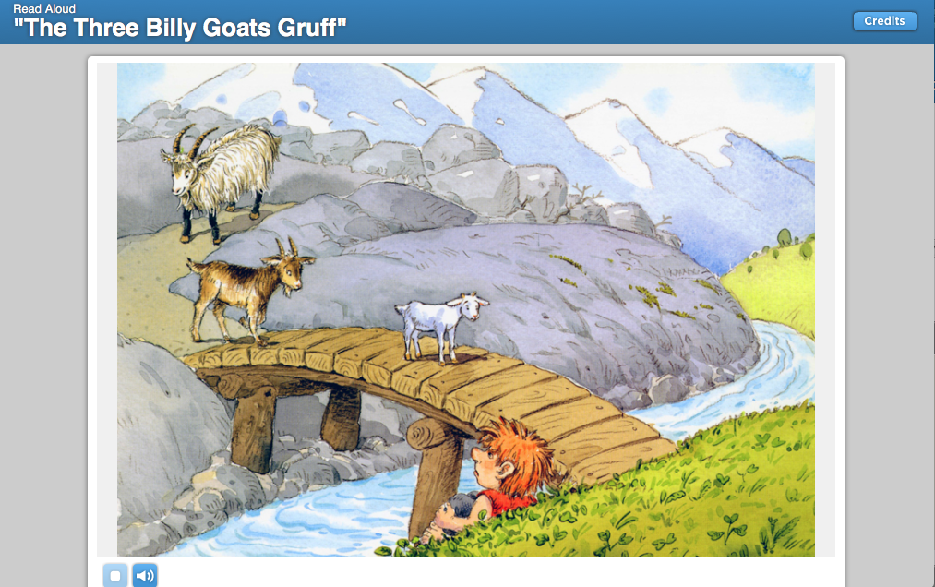
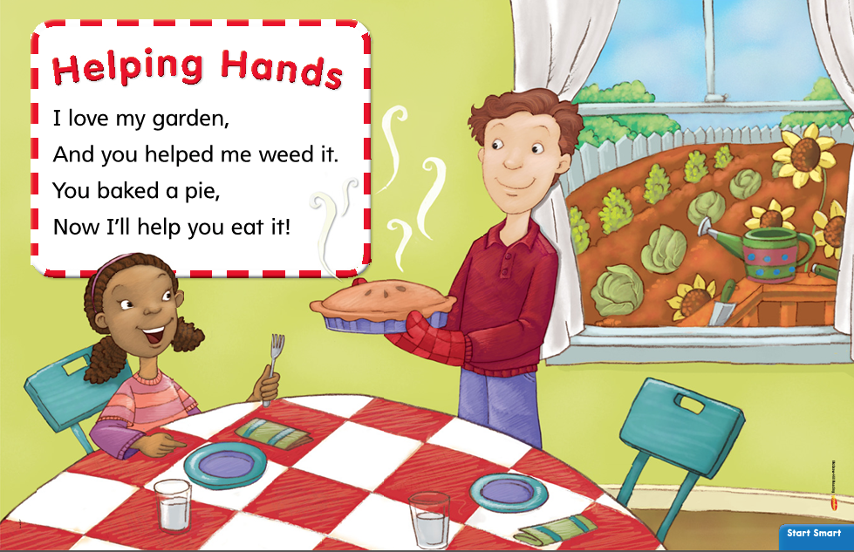
Listening Comprehension – Text Connections
Each selection you have read during the week is about working together or helping each other. All of these selections have people or animals that work together.

Slide 184
Listening Comprehension – Text Connections
Now they will think how two of the selections are different.
Remind children that, in both selections, animals and people help each other, but now, they are to find what is different about them.
I know one difference is that “Elephants” gives information
and “Helping Hands” is a poem.
In “Helping Hands,” I read about how two people help each other. In the second line of the poem, it says that the man helped the girl in her garden. In both selections, they are working together, but they are working together in different ways.
In “Elephants,” I read about how elephants help each other to survive. In the first section, I read that all female elephants in a group help take care of a young elephant.

Slide 185
1. A poem
2.
3.
4.
5.
1. Gives information
2.
3.
4.
5.

Slide 186
Interactive Writing
Write the sentences and reread them together.
Ask children to talk about the interesting details they learned about elephants. List their ideas on chart paper.
Which story did you like better, “Elephants” or “The Three Billy Goats Gruff”?
Why?
1._______________
2._______________
3._______________
4._______________
5._______________
6._______________
I liked reading
___________________better.
One reason is because __________
______________________________________.

