Slide 1
Week 2

Slide 2
Start Smart
Day 1

Slide 3
Track the print as you read the Daily Warm-Up.
Explain to children that we read from left to right and from the top to the bottom of the page.
Circle the first letters and have children name the letters.
Point to the first word in each sentence
Let’s talk about colors.
What color is grass?
What color is the sun?
Review: We read words in sentences from left to right and top to bottom. Have children finger-point as they echo-read.
Reread sentences and emphasize the return sweep by moving your finger from the last word in a line to the first word in the next line. Have children model how to go from one sentence to the next. Help them use their fingers to move down the page as they come to the end of the last line. Remember that sentences begin with capital letters.

Slide 4
Phonological Awareness
Model: I am going to say a word in parts. Listen carefully.
Then I will put the sounds together to say the word as a whole.
Listen: /fff/ /it/.
Now listen as I put the sounds together. /fffiiit/, fit. The word is fit.
Let’s try another one: /fff/ /ish/
Listen as I put the sounds together: /fffiiish/. Fish. The word is fish.

Slide 5
Phonological Awareness
Guided Practice:
Have children practice blending onsets and rimes.
/f/ /an/ /f/ /at/ /f/ /iks/ /f/ /il/ /m/ /ap/
/m/ /at/ /m/ /is/ /m/ /iks/ /s/ /at/ /s/ /ad/
/s/ /ik/ /s/ /ip/ /k/ /at/ /k/ /an/ /d/ /ish/
/d/ /ig/ /h/ /it/ /h/ /at/ /t/ /ip/ /p/ /in/

Slide 6
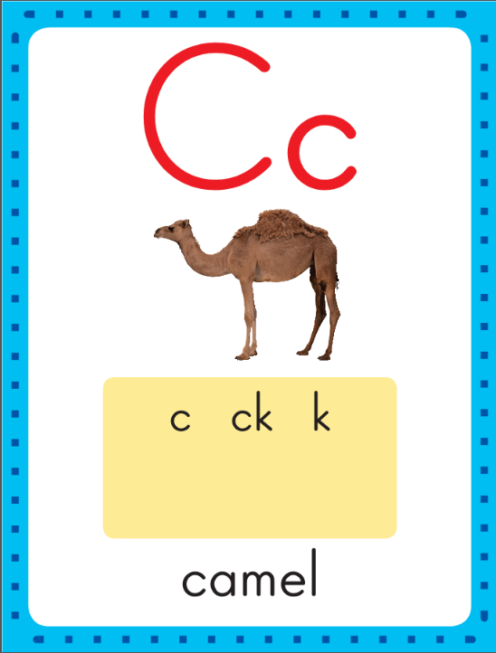
Phonics
This is the camel sound spelling card.
The sound is /k/.
The /k/ sound is spelled with the letter c.
Say it with me: /k/.
This is the sound at the beginning of the word camel.
Listen: /k/ /k/ /k/, camel.

Slide 7
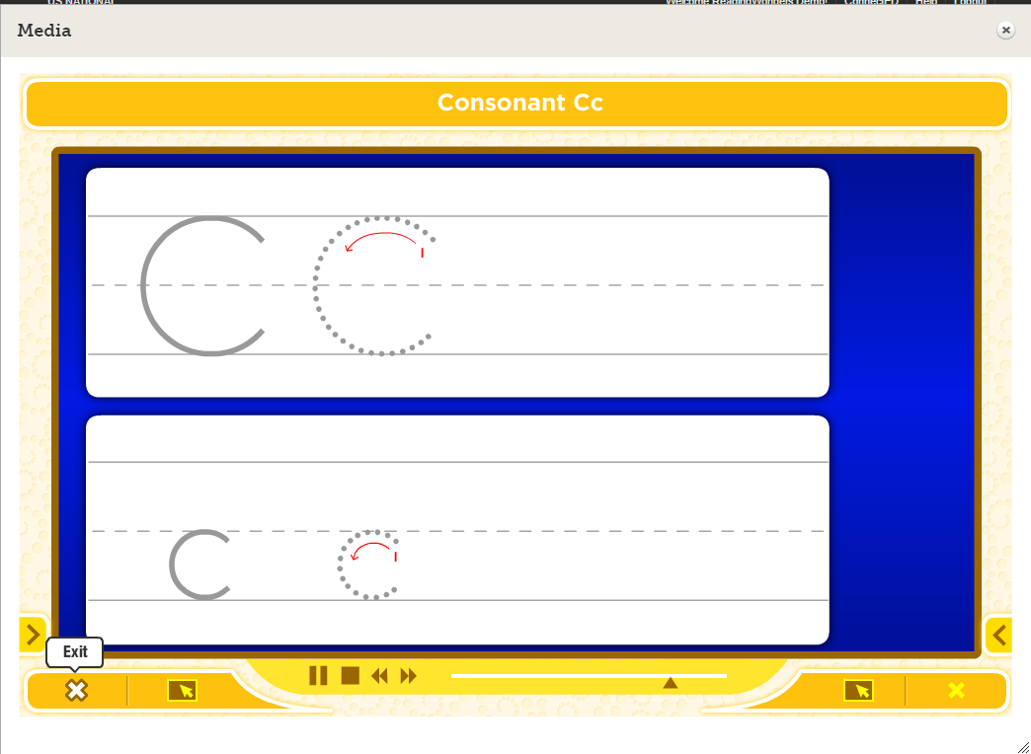
Watch as I write the letter c. I will say /k/ as I write the letter several times.

Slide 8
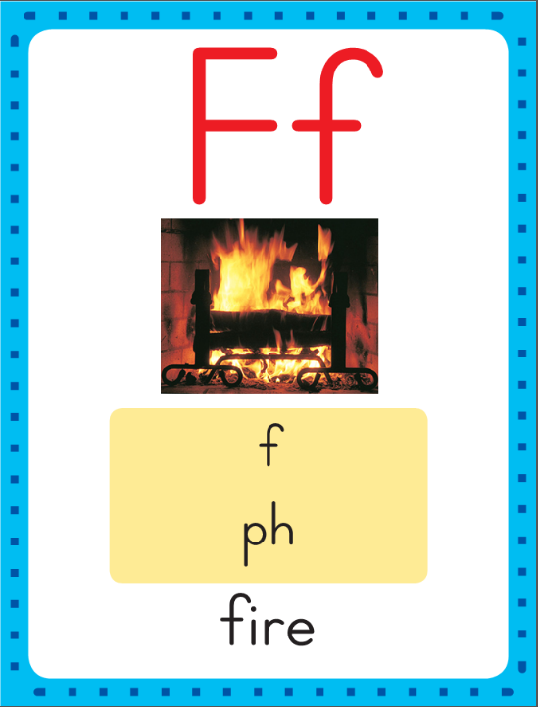
Phonics
This is the fire sound spelling card.
The sound is /f/.
The /f/ sound is spelled with the letter f.
Say it with me: /fff/.
This is the sound at the beginning of the word fire.
Listen: /fffir/, map.

Slide 9
Watch as I write the letter f. I will say /f/ as I write the letter several times.

Slide 10
Now do it with me. Say /k/ as I write the letter c. Say /f/ as I write the letter f. This time, write the letter c five times as you say the /k/ sound. Write the letter f five times as you say /f/.
c c c c c
f f f f f

Slide 11
Build Fluency: Sound Spellings
a
Each day you will review the sound-spellings you have learned as a warm-up.
Chorally say each sound. Repeat and vary the pace.

Slide 12
c

Slide 13
f

Slide 14
i

Slide 15
m

Slide 16
n

Slide 17
p

Slide 18
r

Slide 19
s

Slide 20
t

Slide 21
Blend Words with /k/ c, /f/ f
f
Model:
Sound

Slide 22
Blend Words with /n/ n, /r/ r
f
a
Model:
Sound
Blend

Slide 23
Blend Words with /n/ n, /r/ r
f
a
n
Model:
Sound
Blend

Slide 24
Blend Words with /n/ n, /r/ r
f
a
n
Model:
Word

Slide 25
Blend Words with /k/ c, /f/ f
c
Model:
Sound

Slide 26
Blend Words with /n/ n, /r/ r
c
a
Model:
Sound
Blend

Slide 27
Blend Words with /n/ n, /r/ r
c
a
n
Model:
Sound
Blend

Slide 28
Blend Words with /n/ n, /r/ r
c
a
n
Model:
Word

Slide 29
Blend Words with /k/ c, /f/ f
f
Model:
Sound

Slide 30
Blend Words with /n/ n, /r/ r
f
a
Model:
Sound
Blend

Slide 31
Blend Words with /n/ n, /r/ r
f
a
t
Model:
Sound
Blend

Slide 32
Blend Words with /n/ n, /r/ r
f
a
t
Model:
Word

Slide 33
Blend Words with /k/ c, /f/ f
c
Model:
Sound

Slide 34
Blend Words with /n/ n, /r/ r
c
a
Model:
Sound
Blend

Slide 35
Blend Words with /n/ n, /r/ r
c
a
t
Model:
Sound
Blend

Slide 36
Blend Words with /n/ n, /r/ r
c
a
t
Model:
Word

Slide 37
a

Slide 38
an

Slide 39
an c

Slide 40
an ca

Slide 41
an can

Slide 42
an can f

Slide 43
an can fa

Slide 44
an can fan

Slide 45
an can fan p

Slide 46
an can fan pa

Slide 47
an can fan pan

Slide 48
an can fan pan
a

Slide 49
an can fan pan
at

Slide 50
an can fan pan
at c

Slide 51
an can fan pan
at ca

Slide 52
an can fan pan
at cat

Slide 53
an can fan pan
at cat f

Slide 54
an can fan pan
at cat fa

Slide 55
an can fan pan
at cat fat

Slide 56
an can fan pan
at cat fat m

Slide 57
an can fan pan
at cat fat ma

Slide 58
an can fan pan
at cat fat mat

Slide 59
He

Slide 60
He has

Slide 61
He has a

Slide 62
He has a fan.

Slide 63
He has a fan.
A

Slide 64
He has a fan.
A cat

Slide 65
He has a fan.
A cat can

Slide 66
He has a fan.
A cat can nap.

Slide 67
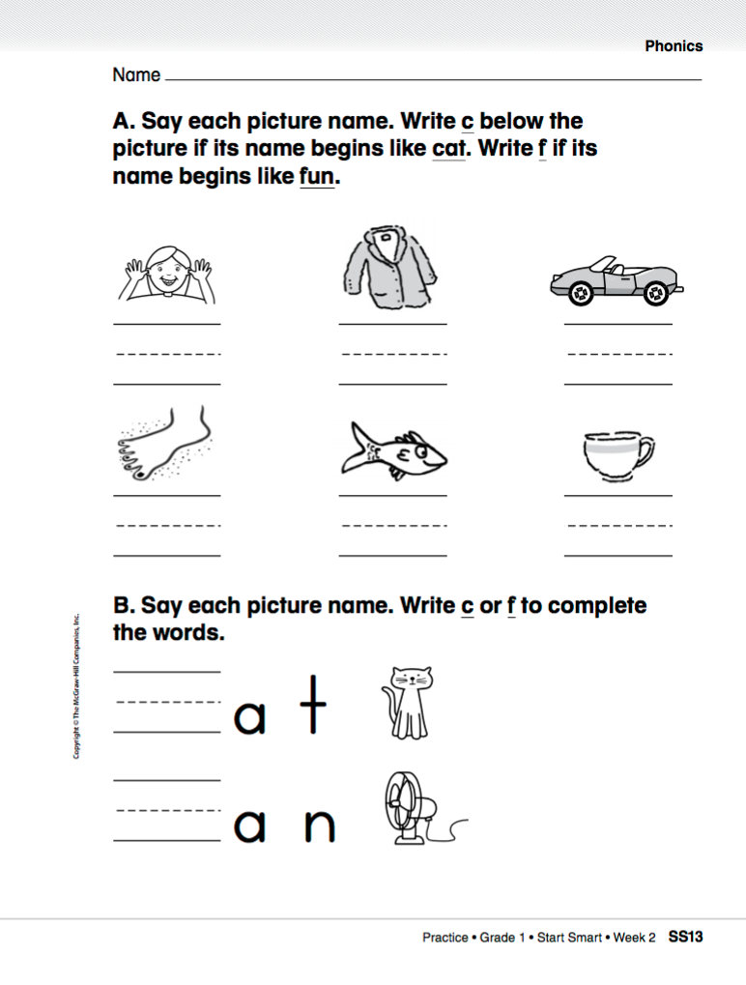

Slide 68
High-Frequency Words
is
Read:
Point to and say the word is.
This is the word is.
Say it with me: is.
My shirt is blue.
Read:
Point to and say the word this.
This is the word this.
Say it with me: this.
This is my dog, Bo.
this
Spell:
The word is is spelled i-s.
Spell it with me.
Spell:
The word this is spelled this.
Spell it with me.
Write:
Let’s write the word in the air as we say each letter: i-s.
Write:
Let’s write the word in the air as we say each letter: t-h-i-s.

Slide 69
High-Frequency Words
I
you
a
like
he
has
do
can
Have children work in pairs to make up sentences.
to
go

Slide 70
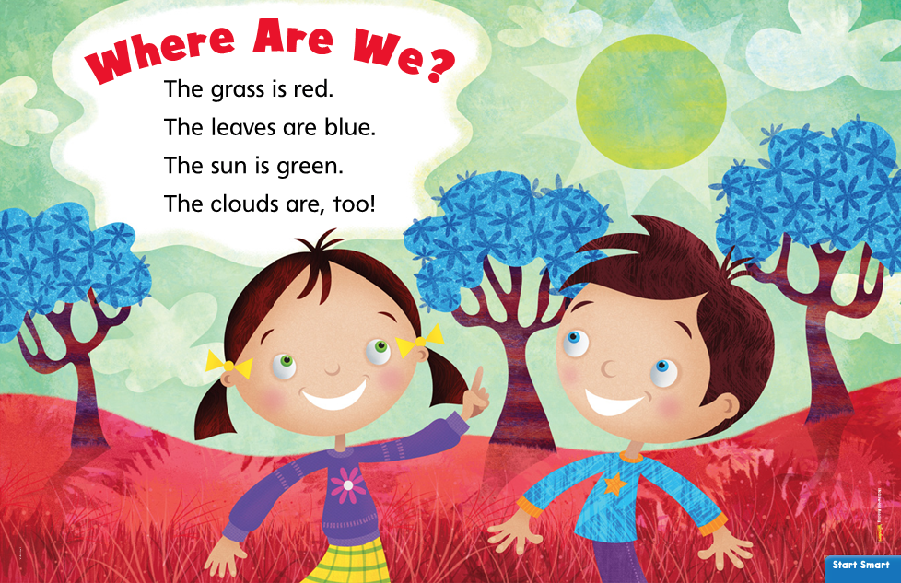
Repeat the reading several times, asking children to join in.
Listening Comprehension
Share the Rhyme
If you could make up the perfect place, what would it be like? What would you see there? You are going to read aloud a rhyme about a make-believe place.

Slide 71
How is a rhyme different from a story?
Have children chorally chant the rhyme. Repeat the rhyme and substitute in other objects for grass, leaves, sun, and clouds. Ask what is red, blue, and green in the children’s make-believe place. Reread the rhyme and ask children to supply other object names to describe their own make-believe places.

Slide 72
Shared Writing
Write the sentences and reread them together.
Ask children to talk about the interesting details they learned about elephants. List their ideas on chart paper.
How do you know the place in
“Where Are We?” is make-believe.
In “Where Are We? the ____________ is ___________.
This is make-believe because ________________.
The ______________ are _______________.
What is make-believe
Why is it make-believe
For example: In “Where Are We?” the grass is red. This is make-believe because grass is not red.

Slide 73
Start Smart
Day 2

Slide 74
Track the print as you read the Daily Warm-Up.
Explain to children that we read from left to right and from the top to the bottom of the page.
Underline words and mark the space between them.
Point to the space between the words.
I know about Jack.
He meets a giant.
What is a giant?
Review: that we always capitalize the word I. Review that telling sentences end with a period.
Have partners discuss: What is a giant? Prompt children as needed.
Ask: Would you like to meet a giant? Why or why not?

Slide 75
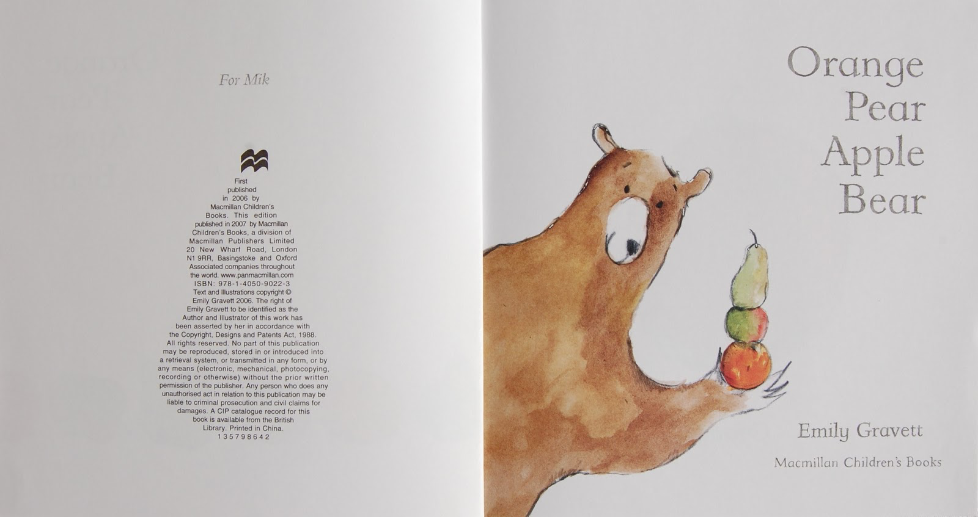
Concept of Print
This is the title of the book
This is the title page
This is name of the author

Slide 76
Phonemic Awareness
Model:
I am going to say a word and then say the first, or beginning, sound in the word.
Listen: dog. The beginning sound in dog is /d/.
Say the sound with me: /d/.
Now listen to the last, or ending, sound in a word.
Listen: sad.
The ending sound in sad is /d/. Say the sound with me: /d/.
Repeat with the /h/ sound using the words hat and him.

Slide 77
Phonemic Awareness
Guided Practice:
Have children practice isolating initial and final sounds. Listen to these words.
Say the first, or beginning, sound you hear.
duck nose horse door hop nice
Now say the last, or ending, sound you hear in these words.
sit run map bed fan read

Slide 78
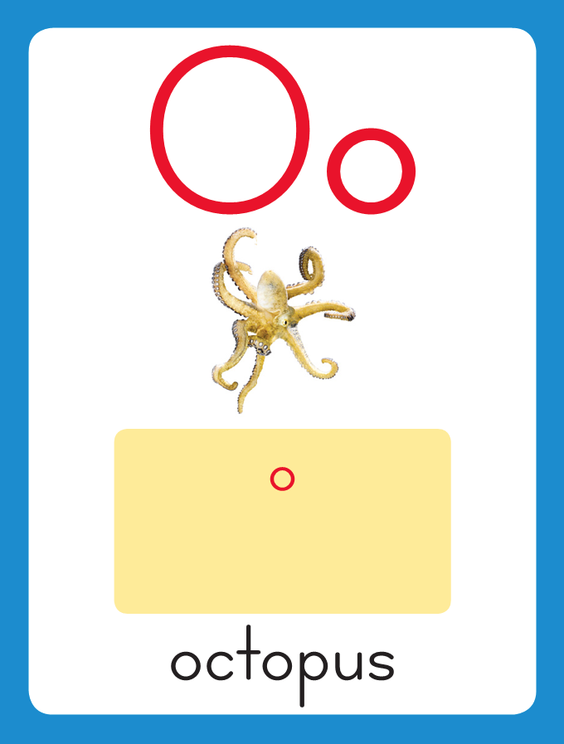
Phonics
This is the octopus sound spelling card.
The sound is /o/.
The /o/ sound is spelled with the letter o.
Say it with me: /ooo/.
This is the sound at the beginning of the word octopus.
Listen: /ooo/, octopus..

Slide 79
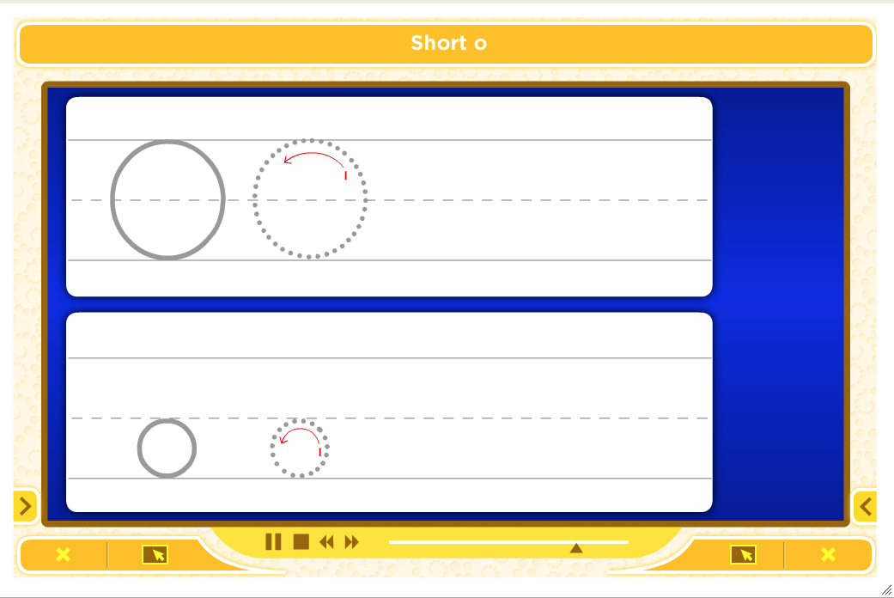
Watch as I write the letter o. I will say /o/ as I write the letter several times.

Slide 80
Now do it with me. Say /o/ as I write the letter o. Write the letter o five times as you say /o/.
o o o o o

Slide 81
Build Fluency: Sound Spellings
o
Each day you will review the sound-spellings you have learned as a warm-up.
Chorally say each sound. Repeat and vary the pace.

Slide 82
c

Slide 83
f

Slide 84
i

Slide 85
m

Slide 86
n

Slide 87
o

Slide 88
p

Slide 89
r

Slide 90
s

Slide 91
t

Slide 92
Blend Words with Short o
o
Model:
Sound

Slide 93
Blend Words with Short o
o
n
Model:
Sound
Blend

Slide 94
Blend Words with Short o
o
n
Model:
Word

Slide 95
Blend Words with Short o
m
Model:
Sound

Slide 96
Blend Words with Short o
m
o
Model:
Sound
Blend

Slide 97
Blend Words with Short o
m
o
p
Model:
Sound
Blend

Slide 98
Blend Words with Short o
m
o
p
Model:
Word

Slide 99
Blend Words with Short o
t
Model:
Sound

Slide 100
Blend Words with Short o
t
o
Model:
Sound
Blend

Slide 101
Blend Words with Short o
t
o
p
Model:
Sound
Blend

Slide 102
Blend Words with Short o
t
o
p
Model:
Word

Slide 103
Blend Words with Short o
n
Model:
Sound

Slide 104
Blend Words with Short o
n
o
Model:
Sound
Blend

Slide 105
Blend Words with Short o
n
o
t
Model:
Sound
Blend

Slide 106
Blend Words with Short o
n
o
t
Model:
Word

Slide 107
o

Slide 108
on

Slide 109
on m

Slide 110
on mo

Slide 111
on mop

Slide 112
on mop t

Slide 113
on mop to

Slide 114
on mop top

Slide 115
on mop top t

Slide 116
on mop top ta

Slide 117
on mop top tap

Slide 118
on mop top tap
n

Slide 119
on mop top tap
no

Slide 120
on mop top tap
not

Slide 121
on mop top tap
not p

Slide 122
on mop top tap
not po

Slide 123
on mop top tap
not pot

Slide 124
on mop top tap
not pot c

Slide 125
on mop top tap
not pot co

Slide 126
on mop top tap
not pot cot

Slide 127
on mop top tap
not pot cot c

Slide 128
on mop top tap
not pot cot ca

Slide 129
on mop top tap
not pot cot cat

Slide 130
i

Slide 131
in

Slide 132
in a

Slide 133
in an

Slide 134
in an a

Slide 135
in an am

Slide 136
in an am a

Slide 137
in an am at

Slide 138
in an am at
f

Slide 139
in an am at
fa

Slide 140
in an am at
fan

Slide 141
in an am at
fan f

Slide 142
in an am at
fan fi

Slide 143
in an am at
fan fin

Slide 144
in an am at
fan fin m

Slide 145
in an am at
fan fin ma

Slide 146
in an am at
fan fin map

Slide 147
in an am at
fan fin map m

Slide 148
in an am at
fan fin map mo

Slide 149
in an am at
fan fin map mop

Slide 150
I

Slide 151
I can

Slide 152
I can do

Slide 153
I can do a

Slide 154
I can do a lot.

Slide 155
I can do a lot.
I

Slide 156
I can do a lot.
I am

Slide 157
I can do a lot.
I am on

Slide 158
I can do a lot.
I am on top.

Slide 159
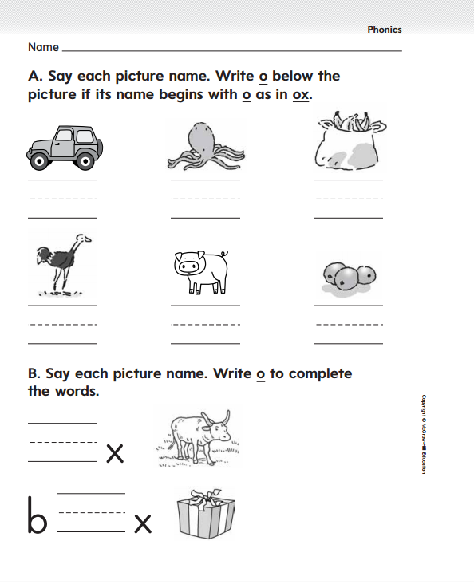

Slide 160
High-Frequency Words
my
Read:
Point to and say the word my.
This is the word my.
Say it with me: my.
My hair is brown.
Read:
Point to and say the word look.
This is the word look.
Say it with me: look.
Look at my new hat!.
look
Spell:
The word is my spelled m-y.
Spell it with me.
Spell:
The word look is spelled l-o-o-k.
Spell it with me.
little
Write:
Let’s write the word in the air as we say each letter: m-y.
Write:
Let’s write the word in the air as we say each letter: l-o-o-k..

Slide 161
High-Frequency Words
I
you
a
like
he
has
do
can
this
to
go
is

Slide 162
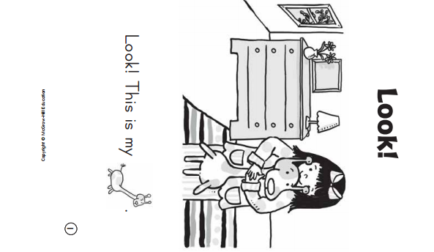
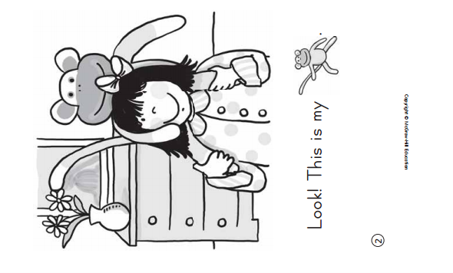

Slide 163
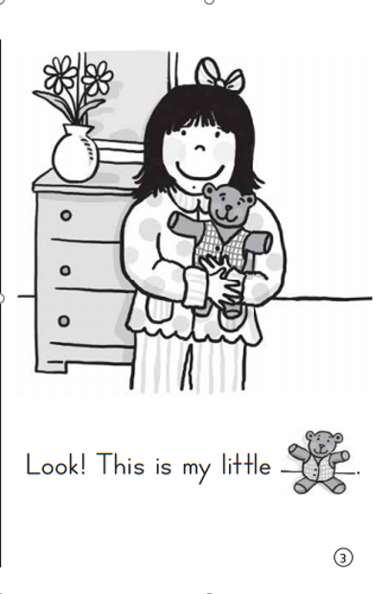
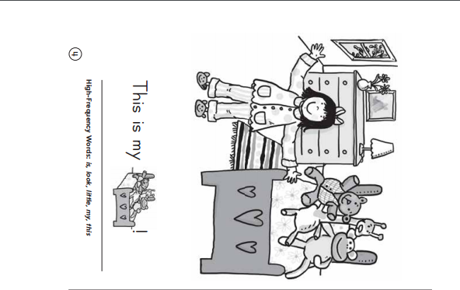

Slide 164
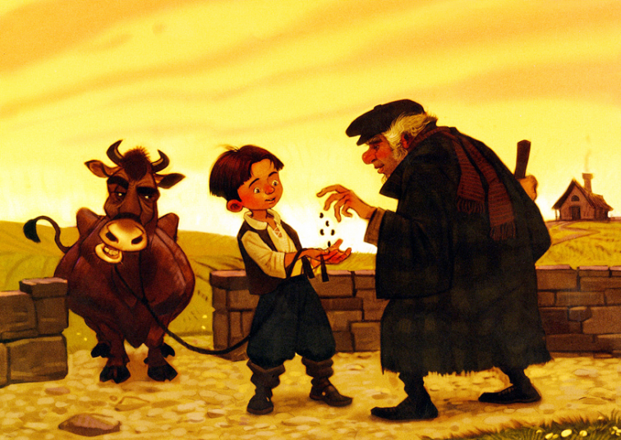
Rereading can help them understand a story.
Listening Comprehension
Read the Read Aloud
The title of the story can help us figure out what the story might be about.
I think this story might be about a boy names Jack and his beanstalk.
(a stalk is a plant that beans grow on)
Jack and the Beanstalk
Fiction:
1. Tell about things that did no really happen.
2. Have a beginning, middle, and an end.
3. Have characters.

Slide 165
Details give important information about a story.

Slide 166
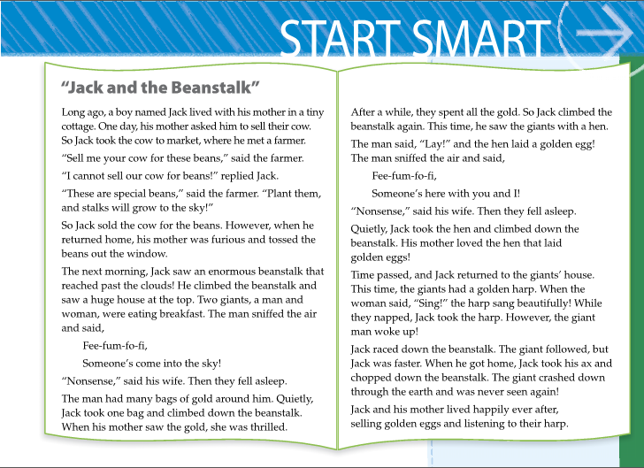
Reread the first six paragraphs of the story to help children recall details:
Who is this story about?
What does Jack sell?
What does he get?
What happens to the bean?

Slide 167
Respond to Literature
Who lives at the top of the beanstalk?
Jack and the Beanstalk
Why does Jack chop down the beanstalk?
What does Jack take from them?
Discuss whether they think Jack was right to take the gold, the hen, and the harp?

Slide 168
Shared Writing
Write the sentences and reread them together.
Ask children to describe things mentioned in “Jack and the Beanstalk”.
Make a list of children’s responses and read the list together.
Make a list of things mentioned in
“Jack and the Beanstalk”
In “Jack and the Beanstalk,” the ___________ is ___________. The ________
______are ________________.
The _____________ is _______
____________. The _________
are ____________________.
_____________________
_____________________
_____________________
_____________________
_____________________
_____________________
For example: In “Jack and the Beanstalk,”
the eggs are golden.

Slide 169
Start Smart
Day 3

Slide 170
Underline out and forest. Count the letters in each word and compare the lengths.
Track the print as you read the Daily Warm-Up.
Read sentences and invite children to chime in.
Circle the capital letter at the beginning of each first word and the punctuation mark at the end of each sentence.
What is a rain forest?
We will read about it.
We will find out!
Remember that sentences are groups of words. A sentence begins with a capital letter and ends with a punctuation mark.
Have partners discuss: What is a rain forest? Have them draw picture to show their ideas.

Slide 171
Phonological Awareness
Model:
I am going to say a word. Then I will clap the syllables, or word parts, that I hear. Remember that each syllable has only one vowel sound.
Listen: bas (clap) ket (clap). The word basket has two syllables, or word parts.
Clap the syllables with me as we say the word basket: bas (clap) ket (clap). You clapped two times because basket has two syllables.

Slide 172
Phonological Awareness
Guided Practice:
Have children segment each word into syllables and count the number of syllables.
Listen to these words. Clap the syllables in each word. Count how many syllables you hear.
basketball Monday silly tomorrow
yesterday desk chalkboard rhinoceros
potato California cafeteria tumble

Slide 173
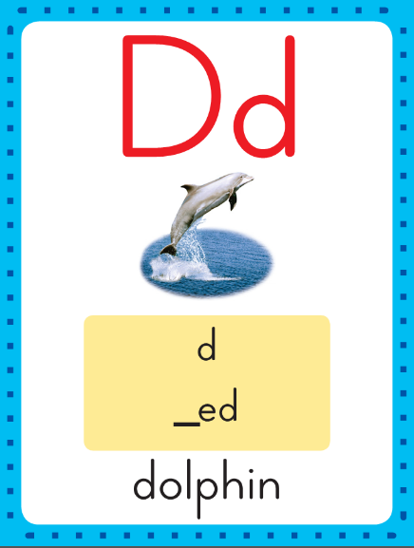
Phonics
This is the dolphin sound spelling card.
The sound is /d/.
The /d/ sound is spelled with the letter d.
Say it with me: /d/.
This is the sound at the beginning of the word dolphin.
Listen: /d/ /d/ /d/
Dolphin.

Slide 174
Watch as I write the letter d. I will say /d/ as I write the letter several times.

Slide 175
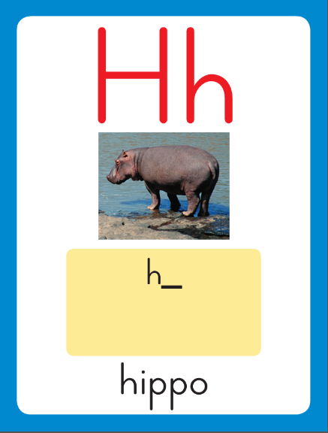
Phonics
This is the hippo sound spelling card.
The sound is /h/.
The /h/ sound is spelled with the letter h.
Say it with me: /h/.
This is the sound at the beginning of the word hippo.
Listen: /h/ /h/ /h/
hippo.

Slide 176
Watch as I write the letter h. I will say /h/ as I write the letter several times.

Slide 177
Now do it with me. Say /d/ as I write the letter d. Write the letter d five times as you say /d/.
Say /h/ as I write the letter h. Write the letter h five times as you say /h/.
d d d d d
h h h h h

Slide 178
i
Sometimes the letter s at the end of a word /z/ sound.

Slide 179
is
Sometimes the letter s at the end of a word /z/ sound.

Slide 180
is
h
Sometimes the letter s at the end of a word /z/ sound.

Slide 181
is
hi
Sometimes the letter s at the end of a word /z/ sound.

Slide 182
is
his
Sometimes the letter s at the end of a word /z/ sound.

Slide 183
is
his
Sometimes the letter s at the end of a word /z/ sound.

Slide 184
a
has
Sometimes the letter s at the end of a word /z/ sound.

Slide 185
as
Sometimes the letter s at the end of a word /z/ sound.

Slide 186
as
h
Sometimes the letter s at the end of a word /z/ sound.

Slide 187
as
ha
Sometimes the letter s at the end of a word /z/ sound.

Slide 188
as
has
Sometimes the letter s at the end of a word /z/ sound.

Slide 189
Build Fluency: Sound Spellings
a
Each day you will review the sound-spellings you have learned as a warm-up.
Chorally say each sound. Repeat and vary the pace.

Slide 190
c

Slide 191
d

Slide 192
f

Slide 193
h

Slide 194
i

Slide 195
m

Slide 196
n

Slide 197
o

Slide 198
p

Slide 199
r

Slide 200
s

Slide 201
t

Slide 202
Blend Words with /d/ d, /h/ h
h
Model:
Sound

Slide 203
Blend Words with /d/ d, /h/ h
h
a
Model:
Sound
Blend

Slide 204
Blend Words with /d/ d, /h/ h
h
a
d
Model:
Sound
Blend

Slide 205
Blend Words with /d/ d, /h/ h
h
a
d
Model:
Word

Slide 206
Blend Words with /d/ d, /h/ h
d
Model:
Sound

Slide 207
Blend Words with /d/ d, /h/ h
d
a
Model:
Sound
Blend

Slide 208
Blend Words with /d/ d, /h/ h
d
a
d
Model:
Sound
Blend

Slide 209
Blend Words with /d/ d, /h/ h
d
a
d
Model:
Word

Slide 210
Blend Words with /d/ d, /h/ h
h
Model:
Sound

Slide 211
Blend Words with /d/ d, /h/ h
h
i
Model:
Sound
Blend

Slide 212
Blend Words with /d/ d, /h/ h
h
i
p
Model:
Sound
Blend

Slide 213
Blend Words with /d/ d, /h/ h
h
i
p
Model:
Word

Slide 214
Blend Words with /d/ d, /h/ h
d
Model:
Sound

Slide 215
Blend Words with /d/ d, /h/ h
d
i
Model:
Sound
Blend

Slide 216
Blend Words with /d/ d, /h/ h
d
i
p
Model:
Sound
Blend

Slide 217
Blend Words with /d/ d, /h/ h
d
i
p
Model:
Word

Slide 218
d

Slide 219
di

Slide 220
did

Slide 221
did h

Slide 222
did hi

Slide 223
did hid

Slide 224
did hid h

Slide 225
did hid hi

Slide 226
did hid hip

Slide 227
did hid hip d

Slide 228
did hid hip di

Slide 229
did hid hip dip

Slide 230
did hid hip dip
d

Slide 231
did hid hip dip
da

Slide 232
did hid hip dip
dad

Slide 233
did hid hip dip
dad s

Slide 234
did hid hip dip
dad sa

Slide 235
did hid hip dip
dad sad

Slide 236
did hid hip dip
dad sad h

Slide 237
did hid hip dip
dad sad ha

Slide 238
did hid hip dip
dad sad ham

Slide 239
did hid hip dip
dad sad ham h

Slide 240
did hid hip dip
dad sad ham hi

Slide 241
did hid hip dip
dad sad ham him

Slide 242
a

Slide 243
an

Slide 244
an r

Slide 245
an ra

Slide 246
an ran

Slide 247
an ran f

Slide 248
an ran fa

Slide 249
an ran fan

Slide 250
an ran fan D

Slide 251
an ran fan Da

Slide 252
an ran fan Dan

Slide 253
an ran fan Dan
h

Slide 254
an ran fan Dan
ha

Slide 255
an ran fan Dan
hat

Slide 256
an ran fan Dan
hat h

Slide 257
an ran fan Dan
hat hi

Slide 258
an ran fan Dan
hat hit

Slide 259
an ran fan Dan
hat hit h

Slide 260
an ran fan Dan
hat hit ho

Slide 261
an ran fan Dan
hat hit hot

Slide 262
an ran fan Dan
hat hit hot d

Slide 263
an ran fan Dan
hat hit hot do

Slide 264
an ran fan Dan
hat hit hot dot

Slide 265
I

Slide 266
I see

Slide 267
I see him.

Slide 268
I see him.
Can

Slide 269
I see him.
Can Dan?

Slide 270
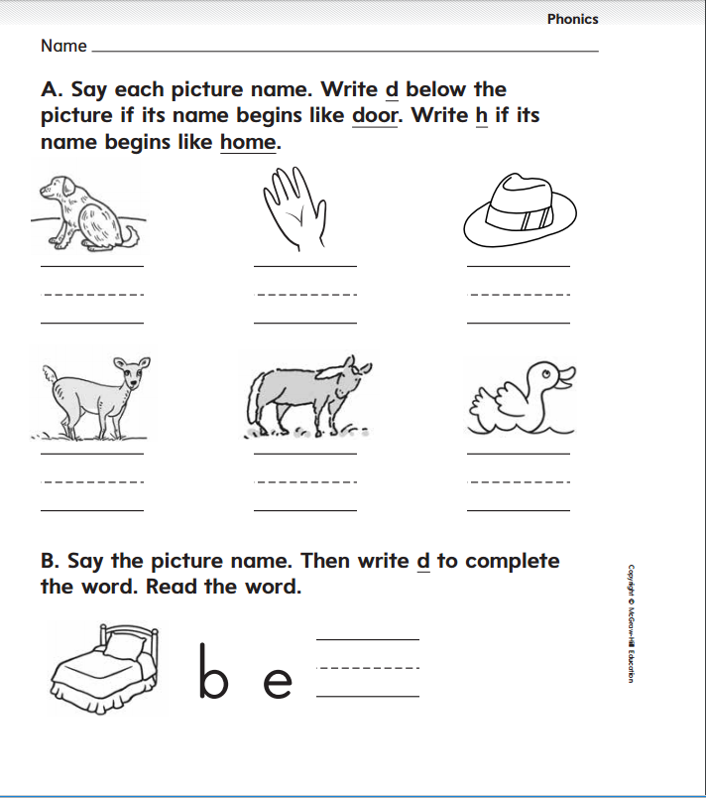

Slide 271
High-Frequency Words
where
Read:
Point to and say the word where.
This is the word where.
Say it with me: where.
Where is my pencil?.
Read:
Point to and say the word here.
This is the word here.
Say it with me: here.
Here it is!
here
Spell:
The word is where spelled w-h-e-r-e.
Spell it with me.
Spell:
The word here is spelled h-e-r-e.
Spell it with me.
Write:
Let’s write the word in the air as we say each letter: w-h-e-r-e..
Write:
Let’s write the word in the air as we say each letter: h-e-r-e..

Slide 272
High-Frequency Words
I
you
a
like
he
has
do
can
this
to
go
is

Slide 273
High-Frequency Words
my
look
little

Slide 274
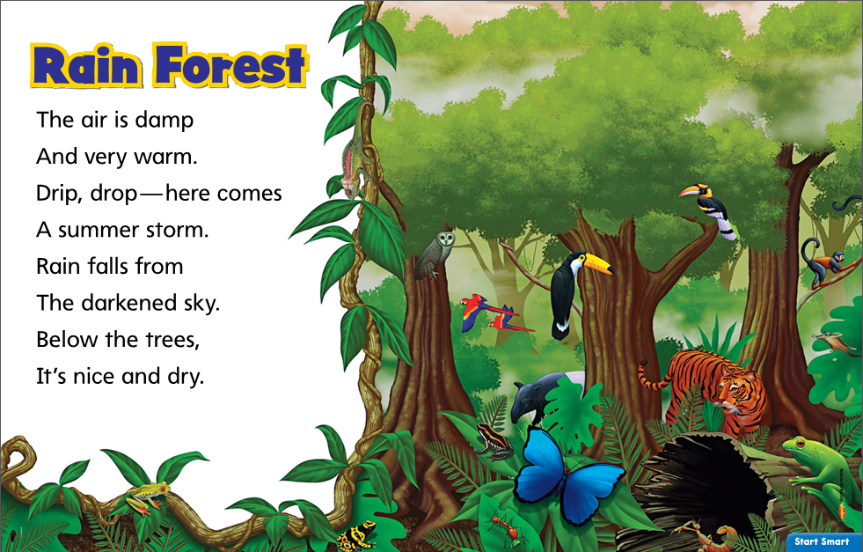
Listening Comprehension
Do you think it rains a lot in a rain forest?
What animals might you see there?
Jack and the Beanstalk
Remember rhyming words are words that have the same ending sounds, such as sky and dry.

Slide 275
Respond
How is this rhyme different from a story?
Jack and the Beanstalk
What words help children imagine that they can hear the rain?
Why is it nice and dry below the trees during the summer storm?
Have students chorally chant the rhyme.

Slide 276
Shared Writing
Write the sentences and reread them together.
Describe the rain forest in the poem “Rain Forest”
In “Rain Forest,” the ___________ is ___________. The ________
______are ________________.
The _____________ is _______
____________. The _________
are ____________________.
_____________________
_____________________
_____________________
_____________________
_____________________
_____________________

Slide 277
Start Smart
Day 4

Slide 278
Circle the first letter and the end punctuation mark of each sentence.
Track the print as you read the Daily Warm-Up.
Read sentences and invite children to chime in.
Point to the first and last words in each sentence.
“Look at the frog,” I said.
“It has red eyes!”
“Is it a tree frog?”
Circle the quotation marks in the first sentence.
Quotation Marks tell the exact words that someone says.
Remember that a sentence begins with a capital letter and ends with a punctuation mark.
Have partners ask about frogs. Where might you see frogs and what do frogs look like?
What do you think a tree frog is?

Slide 279
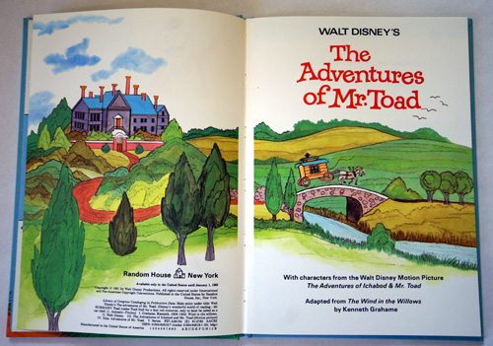
Point to and read aloud the book title and author’s name.
Concept of Print
This is the Title Page.
This page has the name of the book and the author.
Where is the title page in the book?

Slide 280
Phonemic Awareness
Model:
I am going to say a word sound by sound.
Then I will put the sounds together to say the word as a whole.
Listen carefully.
The beginning sound is /e/. The ending sound is /g/.
Listen as I put the sounds together: /eeeg/, egg. The wored is egg.
Let’s try another one.
The beginning sound is /m/.
The middle sound is /e/.
The ending sound is /n/.
Listen as I put the sounds together: /mmmeeennn/, men. The word is men.
.

Slide 281
Phonemic Awareness
Guided Practice:
Listen to these sounds. Put them together to make a word.
/a/ /t/ /s/ /a/ /t/ /m/ /a/ /t/
/a/ /n/ /f/ /a/ /n/ /m/ /a/ /n/
/s/ /a/ /k/ /m/ /o/ /p/ /m/ /a/ /p/
/m/ /e/ /t/ /s/ /e/ /t/ /l/ /e/ /t/
/d/ /a/ /d/ /b/ /a/ /d/ /b/ /a/ /g/
/p/ /e/ /n/ /t/ /e/ /n/ /d/ /e/ /n/

Slide 282
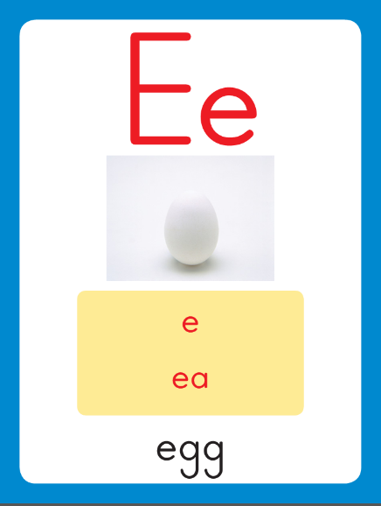
Phonics
This is the egg sound spelling card.
The sound is /e/.
The /e/ sound is spelled with the letter e.
Say it with me: /eee/.
This is the sound at the beginning of the word egg.
Listen: /eeeg/
egg.

Slide 283
Watch as I write the letter e. I will say /e/ as I write the letter several times.

Slide 284
Now do it with me. Say /e/ as I write the letter e. Write the letter e five times as you say /e/.
e e e e e

Slide 285
Build Fluency: Sound Spellings
a
Each day you will review the sound-spellings you have learned as a warm-up.
Chorally say each sound. Repeat and vary the pace.

Slide 286
c

Slide 287
d

Slide 288
e

Slide 289
f

Slide 290
h

Slide 291
i

Slide 292
m

Slide 293
n

Slide 294
o

Slide 295
p

Slide 296
r

Slide 297
s

Slide 298
t

Slide 299
Blend Words with short e
m
Model:
Sound

Slide 300
Blend Words with short e
m
e
Model:
Sound
Blend

Slide 301
Blend Words with short e
m
e
n
Model:
Sound
Blend

Slide 302
Blend Words with short e
m
e
n
Model:
Word

Slide 303
Blend Words with short e
m
Model:
Sound

Slide 304
Blend Words with short e
m
e
Model:
Sound
Blend

Slide 305
Blend Words with short e
m
e
t
Model:
Sound
Blend

Slide 306
Blend Words with short e
m
e
t
Model:
Word

Slide 307
Blend Words with short e
h
Model:
Sound

Slide 308
Blend Words with short e
h
e
Model:
Sound
Blend

Slide 309
Blend Words with short e
h
e
n
Model:
Sound
Blend

Slide 310
Blend Words with short e
h
e
n
Model:
Word

Slide 311
Blend Words with short e
t
Model:
Sound

Slide 312
Blend Words with short e
t
e
Model:
Sound
Blend

Slide 313
Blend Words with short e
t
e
n
Model:
Sound
Blend

Slide 314
Blend Words with short e
t
e
n
Model:
Word

Slide 315
E

Slide 316
Ed

Slide 317
Ed r

Slide 318
Ed re

Slide 319
Ed red

Slide 320
Ed red f

Slide 321
Ed red fe

Slide 322
Ed red fed

Slide 323
Ed red fed T

Slide 324
Ed red fed Te

Slide 325
Ed red fed Ted

Slide 326
Ed red fed Ted
m

Slide 327
Ed red fed Ted
me

Slide 328
Ed red fed Ted
met

Slide 329
Ed red fed Ted
met m

Slide 330
Ed red fed Ted
met ma

Slide 331
Ed red fed Ted
met mat

Slide 332
Ed red fed Ted
met mat p

Slide 333
Ed red fed Ted
met mat pe

Slide 334
Ed red fed Ted
met mat pet

Slide 335
Ed red fed Ted
met mat pet t

Slide 336
Ed red fed Ted
met mat pet te

Slide 337
Ed red fed Ted
met mat pet ten

Slide 338
n

Slide 339
ne

Slide 340
net

Slide 341
net n

Slide 342
net no

Slide 343
net not

Slide 344
net not m

Slide 345
net not me

Slide 346
net not men

Slide 347
net not men m

Slide 348
net not men ma

Slide 349
net not men man

Slide 350
net not men man
s

Slide 351
net not men man
se

Slide 352
net not men man
set

Slide 353
net not men man
set s

Slide 354
net not men man
set sa

Slide 355
net not men man
set sat

Slide 356
net not men man
set sat p

Slide 357
net not men man
set sat pi

Slide 358
net not men man
set sat pin

Slide 359
net not men man
set sat pin p

Slide 360
net not men man
set sat pin pe

Slide 361
net not men man
set sat pin pen

Slide 362
The

Slide 363
The hen

Slide 364
The hen is

Slide 365
The hen is red.

Slide 366
The hen is red.
I

Slide 367
The hen is red.
I like

Slide 368
The hen is red.
I like my

Slide 369
The hen is red.
I like my pet

Slide 370
The hen is red.
I like my pet cat.

Slide 371
High-Frequency Words
play
Read:
Point to and say the word play.
This is the word play.
Say it with me: play.
Will you play with me?
Read:
Point to and say the word the.
This is the word the.
Say it with me: the.
The book is mine.
the
Spell:
The word is play spelled p-l-a-y.
Spell it with me.
Spell:
The word the is spelled t-h-e.
Spell it with me.
we
Write:
Let’s write the word in the air as we say each letter: p-l-a-y...
Write:
Let’s write the word in the air as we say each letter: t-h-e.

Slide 372
High-Frequency Words
I
you
a
like
he
has
do
can
this
to
go
is

Slide 373
High-Frequency Words
my
here
look
little
where

Slide 374
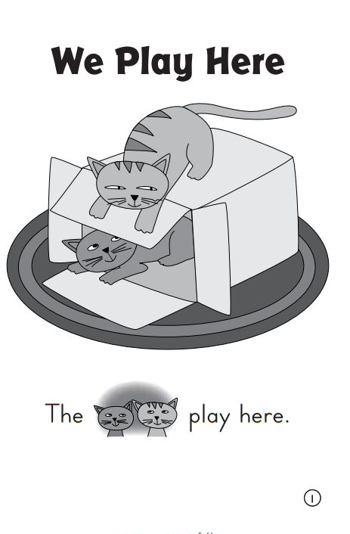
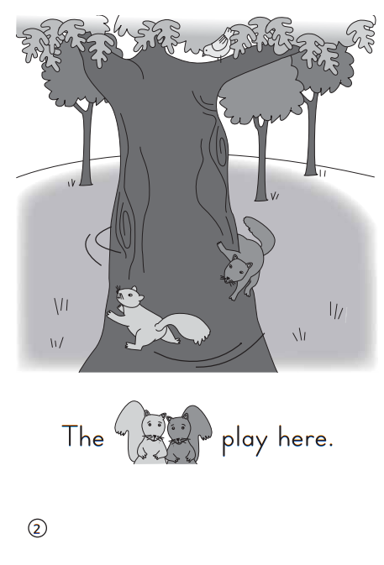

Slide 375
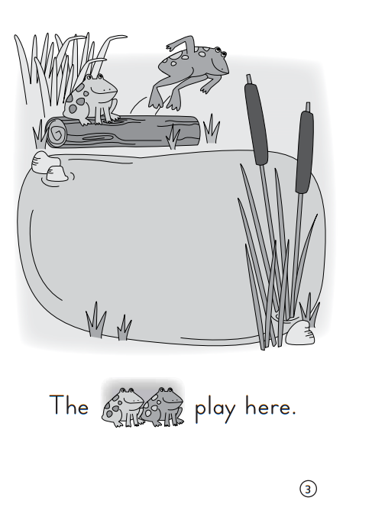
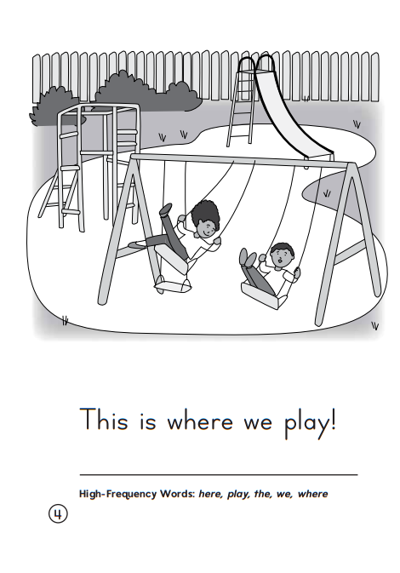

Slide 376
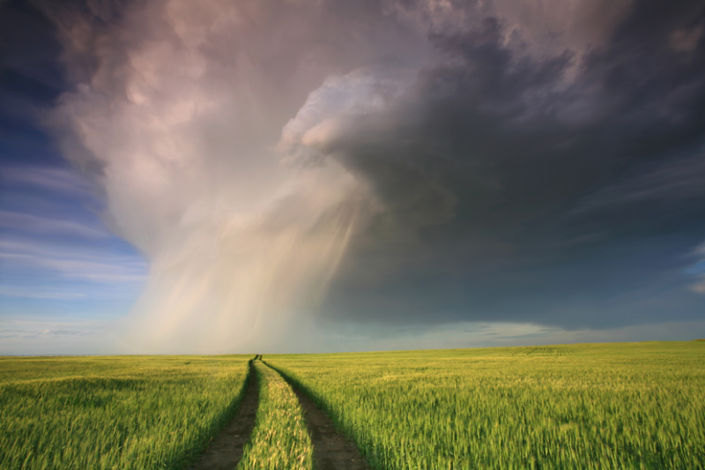
Listening Comprehension
Informational Text:
Gives facts about real people, places, animals, or events.
Includes details that give important information.

Slide 377
The title of a selection can help us figure out what the selection might be about.
I think we will explore, or find out more about, something or some place in this selection.
What is the land in a prairie covered with?
Is the summer hot or cold?
Do wheat and corn grow in a prairie?
What animals live there?
Details give important information. They can describe a place and what grows or lives in that place. Listen for important details about places.
Rereading can help you understand details in a text.
As you listen to me read, you can ask me to stop, go back, and reread to help you remember or understand details.

Slide 378
Respond to Literature
Discuss selection details with children.
What three places did we explore?
What is one important detail you learned about each place?
Which place would you like to visit? Why?

Slide 379
Shared Writing
Write the sentences and reread them together.
Name plants and animals that live in each place, according to “Let’s Explore”
An animal in the __________ is __________. A plant in the ___________ is ____________.
An animal in the __________ is __________. A plant in the ___________ is ____________.
Prairie
Tundra
Rain Forest

Slide 380
Start Smart
Day 5

Slide 381
Track the print as you read the Daily Warm-Up.
Read sentences and invite children to chime in.
Circle the m’s in Hmmm.
Point out the repeated letters at the end of the word. Words that are written differently are read in a special way.
Circle the word not.
The word not is in italics.
Jack saw a giant!
Prairie dogs are not dogs!
Hmmm…
Underline the ellipsis.
Three dots mean there is a pause or there is more to come.
Remember that a sentence is made up of a group of related words
and that it starts with a capital letter and ends with a punctuation mark.
Have partners discuss: What surprised you when you heard the selections?

Slide 382
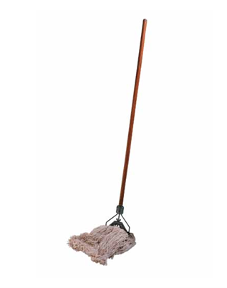
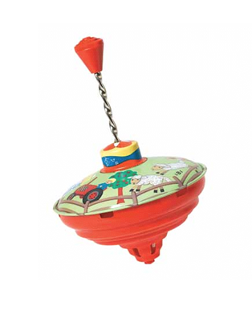
Phonological Awareness
Model:
Look at these two Photo Cards.
I will say the name of each card, then you will repeat the name:
mop
top
The words mop and top rhyme because they both end in /op/.
Listen /m/ /op/, mop; /t/ /op/, top.
Both mop and top end in /op/. So, they rhyme. Rhyming words end in the same sounds.

Slide 383
Phonological Awareness
Now I will try to make other words that rhyme with mop and top. To do so, I need to think of words that end in /op/.
Listen as I try one: /h/ /op/, hop. The word hop rhymes with mop and top because it also ends in /op/. Mop, top, hop.
mop
top

Slide 384
Phonological Awareness
Identify if the words rhyme and how you know..
Listen to these word pairs. If the words rhyme, say the words. I will then ask you why they rhyme. Think about what sounds the two words have in common at the end.
not/lot rob/job mop/cat
dot/hot bag/pig sock/lock
rod/red bit/sit sad/mad
Now listen as I say the words again. Let’s think of other words that rhyme with the words.

Slide 385
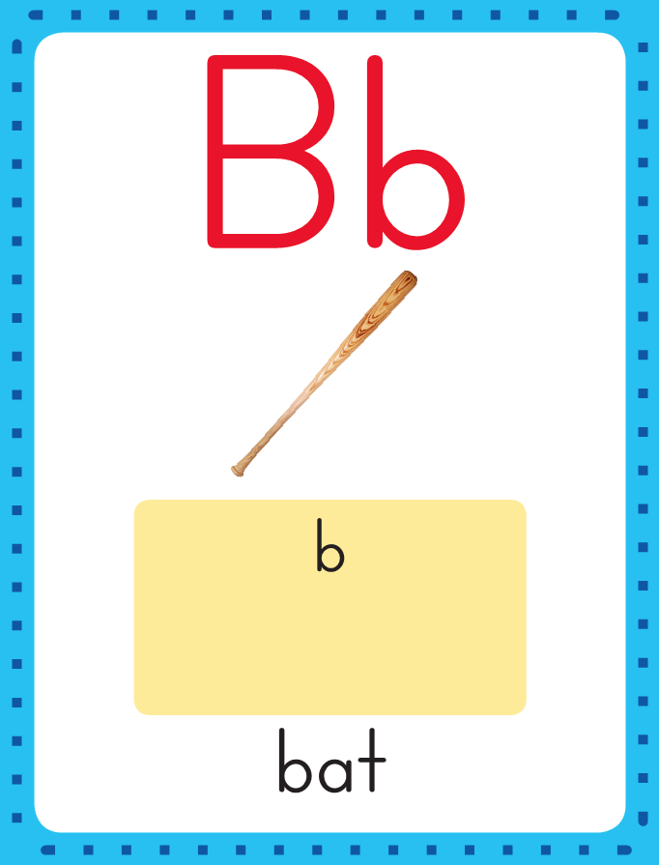
Phonics
This is the bat sound spelling card.
The sound is /b/.
The /b/ sound is spelled with the letter b.
Say it with me: /b/.
This is the sound at the beginning of the word dolphin.
Listen: /b/ /b/ /b/
bat.

Slide 386
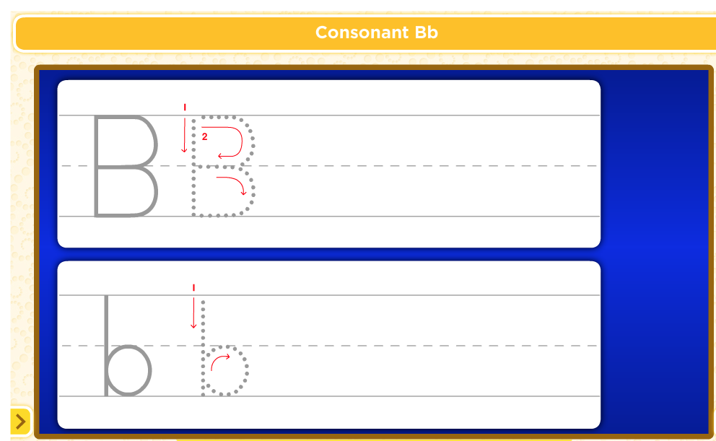
Watch as I write the letter b. I will say /b/ as I write the letter several times.

Slide 387
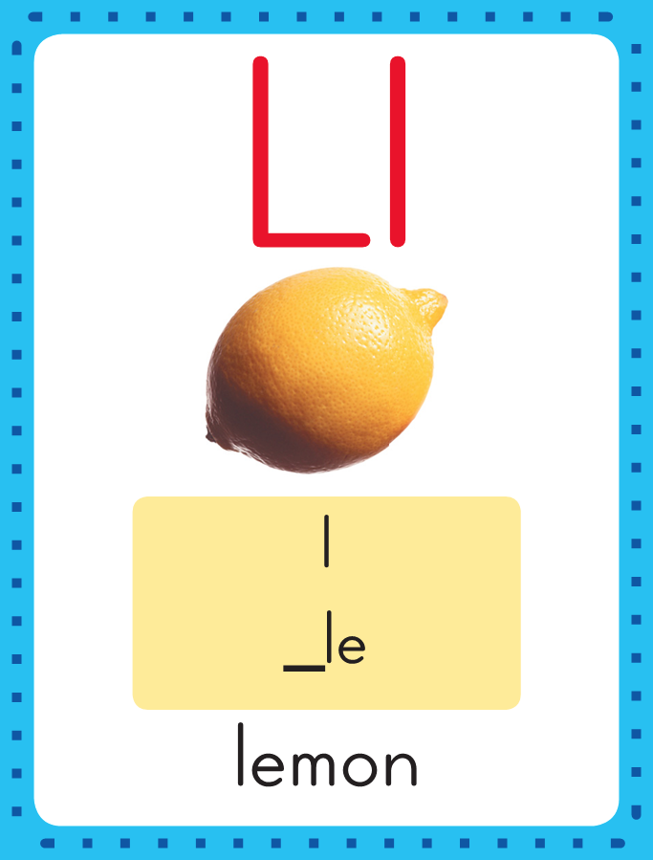
Phonics
This is the lemon sound spelling card.
The sound is /l/.
The /l/ sound is spelled with the letter l.
Say it with me: /l/.
This is the sound at the beginning of the word lemon.
Listen: /l/ /l/ /l/
lemon.

Slide 388
Watch as I write the letter l. I will say /l/ as I write the letter several times.

Slide 389
Now do it with me. Say /d/ as I write the letter d. Write the letter d five times as you say /d/.
Say /h/ as I write the letter h. Write the letter h five times as you say /h/.
b b b b b
l l l l l

Slide 390
f

Slide 391
fe

Slide 392
fell
The last sound is /l/, but it is spelled with two ll’s instead of one.

Slide 393
fell
b

Slide 394
fell
be

Slide 395
fell
bell

Slide 396
fell
Bell
t

Slide 397
fell
bell
te

Slide 398
fell
bell
tell

Slide 399
fell
bell
tell
s

Slide 400
fell
bell
tell
se

Slide 401
fell
bell
tell
sell

Slide 402
f

Slide 403
fi

Slide 404
fill

Slide 405
Fill
h

Slide 406
fill
hi

Slide 407
fill
hill

Slide 408
fill
hill
p

Slide 409
fill
hill
pi

Slide 410
fill
hill
pill

Slide 411
Build Fluency: Sound Spellings
a
Each day you will review the sound-spellings you have learned as a warm-up.
Chorally say each sound. Repeat and vary the pace.

Slide 412
b

Slide 413
c

Slide 414
d

Slide 415
e

Slide 416
f

Slide 417
h

Slide 418
i

Slide 419
l

Slide 420
m

Slide 421
n

Slide 422
o

Slide 423
p

Slide 424
r

Slide 425
s

Slide 426
t

Slide 427
Blend Words with /b/ b, /l/ l
l
Model:
Sound

Slide 428
Blend Words with /b/ b, /l/ l
l
i
Model:
Sound
Blend

Slide 429
Blend Words with /b/ b, /l/ l
l
i
d
Model:
Sound
Blend

Slide 430
Blend Words with /b/ b, /l/ l
l
i
d
Model:
Word

Slide 431
Blend Words with /b/ b, /l/ l
b
Model:
Sound

Slide 432
Blend Words with /b/ b, /l/ l
b
a
Model:
Sound
Blend

Slide 433
Blend Words with /b/ b, /l/ l
b
a
t
Model:
Sound
Blend

Slide 434
Blend Words with /b/ b, /l/ l
b
a
t
Model:
Word

Slide 435
Blend Words with /b/ b, /l/ l
l
Model:
Sound

Slide 436
Blend Words with /b/ b, /l/ l
l
i
Model:
Sound
Blend

Slide 437
Blend Words with /b/ b, /l/ l
l
i
p
Model:
Sound
Blend

Slide 438
Blend Words with /b/ b, /l/ l
l
i
p
Model:
Word

Slide 439
Blend Words with /b/ b, /l/ l
b
Model:
Sound

Slide 440
Blend Words with /b/ b, /l/ l
b
i
Model:
Sound
Blend

Slide 441
Blend Words with /b/ b, /l/ l
b
i
ll
Model:
Sound
Blend

Slide 442
Blend Words with /b/ b, /l/ l
b
i
ll
Model:
Word

Slide 443
b

Slide 444
ba

Slide 445
bat

Slide 446
bat s

Slide 447
bat sa

Slide 448
bat sat

Slide 449
bat sat b

Slide 450
bat sat bi

Slide 451
bat sat bit

Slide 452
bat sat bit h

Slide 453
bat sat bit hi

Slide 454
bat sat bit hit

Slide 455
bat sat bit hit
l

Slide 456
bat sat bit hit
li

Slide 457
bat sat bit hit
lip

Slide 458
bat sat bit hit
lip l

Slide 459
bat sat bit hit
lip li

Slide 460
bat sat bit hit
lip lid

Slide 461
bat sat bit hit
lip lid r

Slide 462
bat sat bit hit
lip lid ri

Slide 463
bat sat bit hit
lip lid rid

Slide 464
bat sat bit hit
lip lid rid r

Slide 465
bat sat bit hit
lip lid rid ri

Slide 466
bat sat bit hit
lip lid rid rip

Slide 467
h

Slide 468
ha

Slide 469
had

Slide 470
had h

Slide 471
had ha

Slide 472
had hat

Slide 473
had hat h

Slide 474
had hat ho

Slide 475
had hat hot

Slide 476
had hat hot l

Slide 477
had hat hot lo

Slide 478
had hat hot lot

Slide 479
had hat hot lot
b

Slide 480
had hat hot lot
be

Slide 481
had hat hot lot
bell

Slide 482
had hat hot lot
bell t

Slide 483
had hat hot lot
bell te

Slide 484
had hat hot lot
bell tell

Slide 485
had hat hot lot
bell tell s

Slide 486
had hat hot lot
bell tell se

Slide 487
had hat hot lot
bell tell sell

Slide 488
had hat hot lot
bell tell sell f

Slide 489
had hat hot lot
bell tell sell fe

Slide 490
had hat hot lot
bell tell sell fell

Slide 491
Bill

Slide 492
Bill is

Slide 493
Bill is at

Slide 494
Bill is at bat.

Slide 495
Bill is at bat.
Where

Slide 496
Bill is at bat.
Where is

Slide 497
Bill is at bat.
Where is the

Slide 498
Bill is at bat.
Where is the lid?

Slide 499
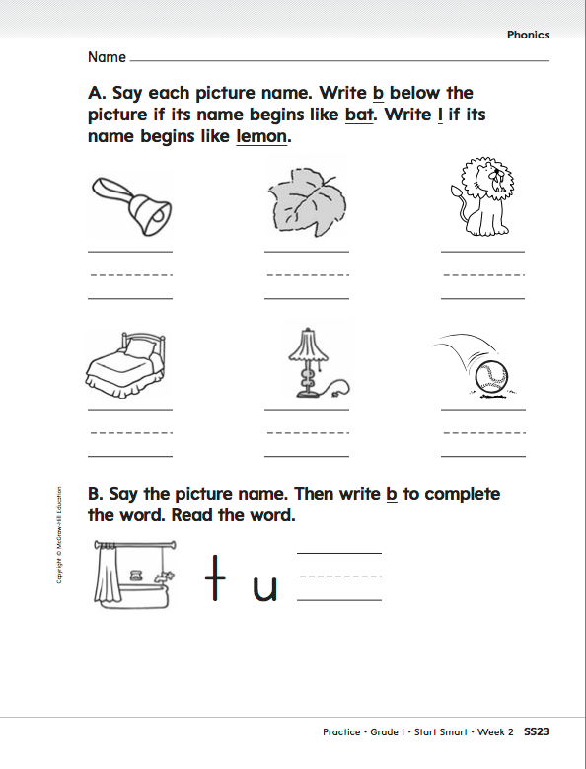

Slide 500
High-Frequency Words
this
little
the
is
where
and
my
here
we
look
play
Use the High-Frequency Word Routine to review these words:
Read, Spell, Write
Challenge children to use the words in sentences

Slide 501
Listening Comprehension-Text Connections
All of these selections have an interesting setting, or place where the action happens. It is something that connects all of these texts.
“Let’s Explore”
What is it that connects these selections together?
Jack and the Beanstalk

Slide 502
Listening Comprehension-Text Connections
Now you will think about how these two selections are different.
“Let’s Explore”

Slide 503
“Let’s Explore”
1.___________
2.___________
3.___________
1.___________
2.___________
3.___________
What is different about these two selections?

Slide 504
Independent Writing
“Rain Forest” and “Jack and the Beanstalk” both _____________________________________________________.
“Rainforest” and “Let’s Explore!” are different because __________________
__________________________.
Jack and the Beanstalk
Jack and the Beanstalk
What do they
have in common?
What is different about them?
_____________
_____________
_____________
_____________
_____________
_____________
_____________
_____________

