Slide 1
Week 3

Slide 2
Start Smart
Day 1

Slide 3
Track the print as you read the Daily Warm-Up.
Read aloud the exact words being said, and have children echo-read.
Help children read each sentence using the proper intonation based on the end mark.
Circle the word I.
The word I is always spelled with a capital I.
Circle and identify the punctuation mark at the end of each sentence.
I see a bike.
It is big!
We can ride it together.
Have partners describe bikes.
Ask questions, such as: Do you like to ride bikes?
Where do you ride?

Slide 4
Phonemic Awareness
Model:
I am going to say a word sound by sound.
I want you to listen carefully.
Then I will put the sounds together to say the word as a whole.
Let’s try one.
The beginning sound is /k/.
The ending sound is /e/.
Listen as I put the sounds together: /keee/, key
The word is key.
Let’s try another one:
The beginning sound is /b/.
The middle sound is /a/.
The ending sound is /k/.
Listen as I put the sounds together: /baaak/, back.
The word is back.

Slide 5
Phonemic Awareness
Model:
Have children practice blending words.
Guide practice with the first word.
Listen to these sounds.
Put them together to make a word.
/k/ /i/ /s/ /k/ /i/ /t/
/k/ /i/ /d/ /k/ /e/ /p/
/k/ /i/ /k/ /l/ /o/ /k/
/p/ /a/ /k/ /s/ /i/ /k/

Slide 6
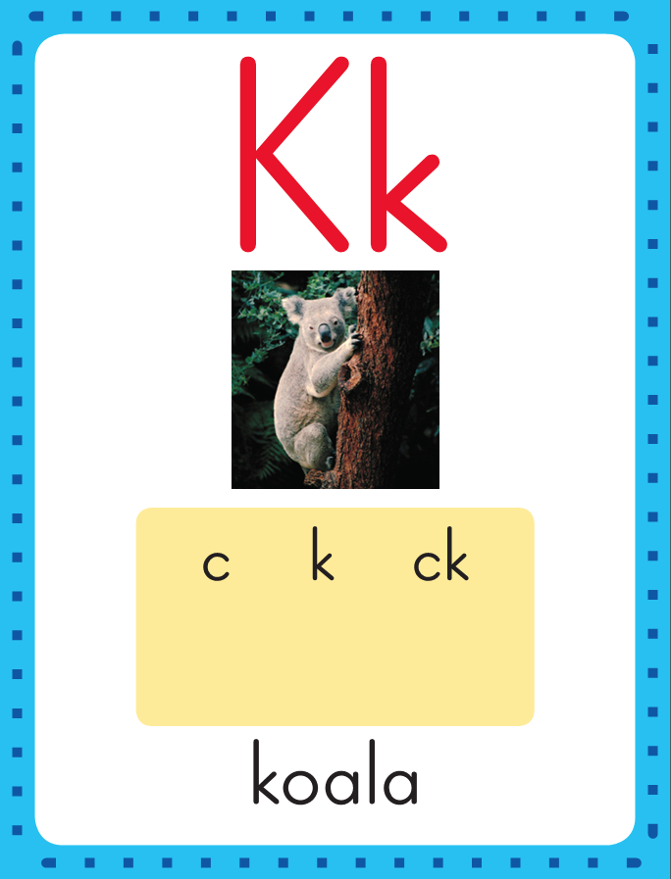
Phonics
This is the Koala sound spelling card.
The sound is /k/.
The /k/ sound is spelled with the letter c. The /k/ sound can also be spelled with the letter k. The /k/ sound can also be spelled ck.
Say it with me: /k/.
This is the sound at the beginning of the word koala.
Listen: /k/ /k/ /k/, koala.

Slide 7
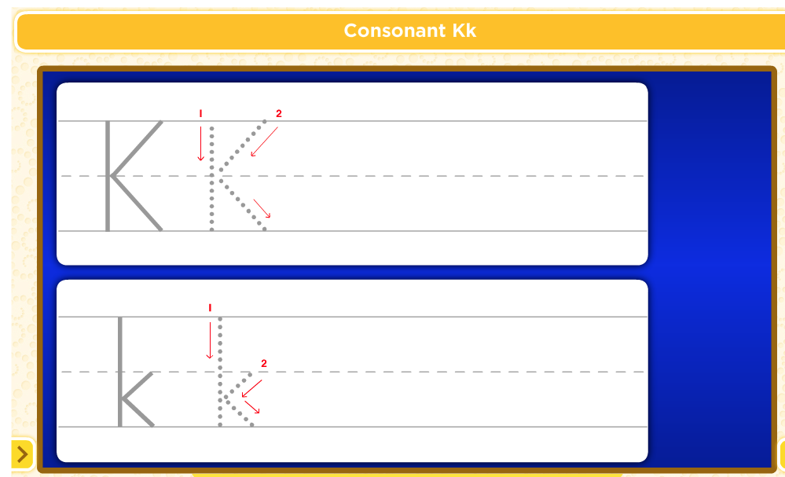
Watch as I write the letter k. I will say /k/ as I write the letter several times.
Watch as I write the letters ck. I will say /k/ as I write the letters several times.

Slide 8
Now do it with me. Say /k/ as I write the letter k. Write the letter k five times as you say /k/.
Say /k/ as I write the letter ck. Write the letter ck five times as you say /k/.
k k k k k
ck ck ck ck ck

Slide 9
sn

Slide 10
sna

Slide 11
snack

Slide 12
snack
sn

Slide 13
snack
sna

Slide 14
snack
snap

Slide 15
snack
snap
st

Slide 16
snack
snap
sti

Slide 17
snack
snap
stick

Slide 18
snack
snap
stick
st

Slide 19
snack
snap
stick
sta

Slide 20
snack
snap
stick
stack

Slide 21
snack
snap
stick
stack
sp

Slide 22
snack
snap
stick
stack
spo

Slide 23
snack
snap
stick
stack
spot

Slide 24
snack
snap
stick
stack
spot
sp

Slide 25
snack
snap
stick
stack
spot
spi

Slide 26
snack
snap
stick
stack
spot
spin

Slide 27
Build Fluency: Sound Spellings
a
Each day you will review the sound-spellings you have learned as a warm-up.
Chorally say each sound. Repeat and vary the pace.

Slide 28
b

Slide 29
c

Slide 30
ck

Slide 31
d

Slide 32
e

Slide 33
f

Slide 34
h

Slide 35
i

Slide 36
k

Slide 37
l

Slide 38
m

Slide 39
n

Slide 40
o

Slide 41
Blend Words with /k/ k, ck
k
Model:
Sound

Slide 42
Blend Words with /k/ k, ck
k
i
Model:
Sound
Blend

Slide 43
Blend Words with /k/ k, ck
k
i
ck
Model:
Sound
Blend

Slide 44
Blend Words with /k/ k, ck
k
i
ck
Model:
Word

Slide 45
Blend Words with /k/ k, ck
k
Model:
Sound

Slide 46
Blend Words with /k/ k, ck
k
i
Model:
Sound
Blend

Slide 47
Blend Words with /k/ k, ck
k
i
t
Model:
Sound
Blend

Slide 48
Blend Words with /k/ k, ck
k
i
t
Model:
Word

Slide 49
Blend Words with /k/ k, ck
s
Model:
Sound

Slide 50
Blend Words with /k/ k, ck
s
i
Model:
Sound
Blend

Slide 51
Blend Words with /k/ k, ck
s
i
ck
Model:
Sound
Blend

Slide 52
Blend Words with /k/ k, ck
s
i
ck
Model:
Word

Slide 53
Blend Words with /k/ k, ck
l
Model:
Sound

Slide 54
Blend Words with /k/ k, ck
l
o
Model:
Sound
Blend

Slide 55
Blend Words with /k/ k, ck
l
o
ck
Model:
Sound
Blend

Slide 56
Blend Words with /k/ k, ck
l
o
ck
Model:
Word

Slide 57
k

Slide 58
ki

Slide 59
kit

Slide 60
kit s

Slide 61
kit si

Slide 62
kit sit

Slide 63
kit sit k

Slide 64
kit sit ki

Slide 65
kit sit kid

Slide 66
kit sit kid l

Slide 67
kit sit kid li

Slide 68
kit sit kid lid

Slide 69
kit sit kid lid
k

Slide 70
kit sit kid lid
ki

Slide 71
kit sit kid lid
kick

Slide 72
kit sit kid lid
kick s

Slide 73
kit sit kid lid
kick si

Slide 74
kit sit kid lid
kick sick

Slide 75
kit sit kid lid
kick sick s

Slide 76
kit sit kid lid
kick sick sa

Slide 77
kit sit kid lid
kick sick sack

Slide 78
kit sit kid lid
kick sick sack s

Slide 79
kit sit kid lid
kick sick sack so

Slide 80
kit sit kid lid
kick sick sack sock

Slide 81
p

Slide 82
pi

Slide 83
pick

Slide 84
pick p

Slide 85
pick pa

Slide 86
pick pack

Slide 87
pick pack r

Slide 88
pick pack ro

Slide 89
pick pack rock

Slide 90
pick pack rock l

Slide 91
pick pack rock lo

Slide 92
pick pack rock lock

Slide 93
pick pack rock lock
st

Slide 94
pick pack rock lock
sti

Slide 95
pick pack rock lock
stick

Slide 96
pick pack rock lock
stick st

Slide 97
pick pack rock lock
stick sta

Slide 98
pick pack rock lock
stick stack

Slide 99
pick pack rock lock
stick stack sn

Slide 100
pick pack rock lock
stick stack sna

Slide 101
pick pack rock lock
stick stack snack

Slide 102
pick pack rock lock
stick stack snack sn

Slide 103
pick pack rock lock
stick stack snack sna

Slide 104
pick pack rock lock
stick stack snack snap

Slide 105
Kick

Slide 106
Kick it.

Slide 107
Kick it.
I

Slide 108
Kick it.
I am

Slide 109
Kick it.
I am not

Slide 110
Kick it.
I am not sick.

Slide 111
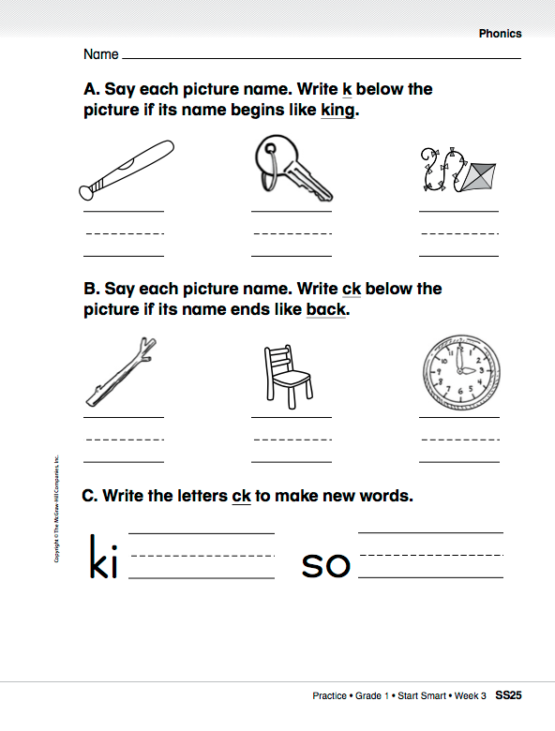

Slide 112
High-Frequency Words
are
Read:
Point to and say the word are.
This is the word are.
Say it with me: are.
We are in the classroom.
Read:
Point to and say the word me.
This is the word me.
Say it with me: me.
My friend gave me a book.
me
Spell:
The word are is spelled
a-r-e.
Spell it with me.
Spell:
The word me is spelled m-e.
Spell it with me.
Write:
Let’s write the word in the air as we say each letter: a-r-e.
Write:
Let’s write the word in the air as we say each letter: m-e.

Slide 113
Have partners make up sentences using the words.
I
you
a
like
he
has
do
can
this
to
go
is

Slide 114
Have partners make up sentences using the words.
my
here
we
look
play
little
the
where

Slide 115
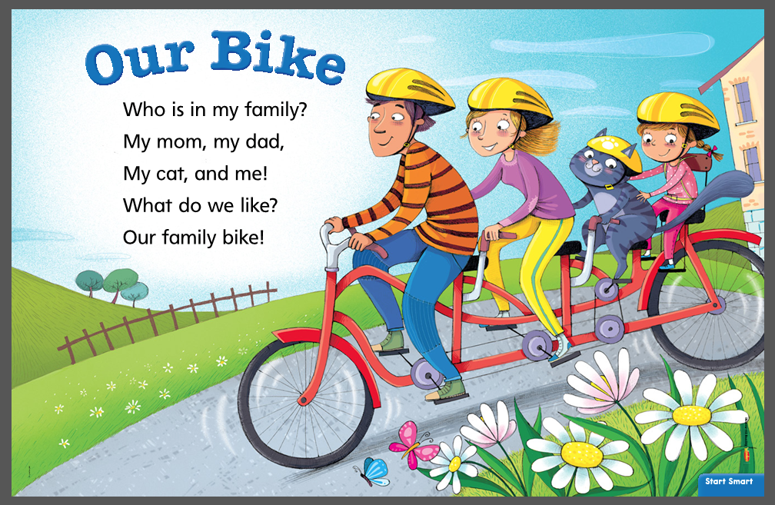
Repeat the reading several times, asking the children to join in.
Listening Comprehension
Share the Rhyme
What do some families do together?
What do you like to do with your family?
Rhyming words are words that have the same ending sounds, such as like and bike, which both end end in /ik/.

Slide 116
Have children chorally chant the rhyme.
Listening Comprehension
Respond
How is this rhyme different from a story?
Talk About It: Ask children to tell how many seats they would need for a family bike.
What do you like to do together with your family?

Slide 117
Shared Writing
What does the family in “Our Bike” like to do together?
Name things we can
do together in class.
The family can _______
______________________
_____________________.
Our class can ________
______________________
______________________
______________
_________________
2. _______________
_________________
3. _______________
_________________
4. _______________
_________________

Slide 118
Start Smart
Day 2

Slide 119
Track the print as you read the Daily Warm-Up.
Point to each word as you read the sentences again. Invite children to chime in.
How many sentences are in the Daily Warm-Up?
Circle and name the capital letter that begins each sentence and then circle and name the punctuation mark at the end.
A hare is fast.
A tortoise is slow.
Who will win the race?
Have partners discuss hares and tortoises.
A hare is a rabbit and a tortoise is a turtle.
Prompt as needed. For example, ask: Do you know a story about a hare and a tortoise? What happens in the story? Who will win the race?

Slide 120
Phonemic Awareness
Model:
I am going to say a word sound by sound.
I want you to listen carefully.
Then I will put the sounds together to say the word as a whole.
Let’s try one.
The beginning sound is /u/.
The ending sound is /p/.
Listen as I put the sounds together: /uuup/, up.
The word is up.
Let’s try another one:
The beginning sound is /b/.
The middle sound is /u/.
The ending sound is /s/.
Listen as I put the sounds together: /buuusss/, bus.
The word is bus.

Slide 121
Phonemic Awareness
Guided Practice:
Have children practice blending words.
Guide practice with the first word.
Listen to these sounds.
Put them together to make a word.
/u/ /s/ /f/ /u/ /n/
/t/ /u/ /b/ /h/ /u/ /t/
/s/ /u/ /n/ /p/ /u/ /p/
/b/ /u/ /g/ /b/ /u/ /n/

Slide 122
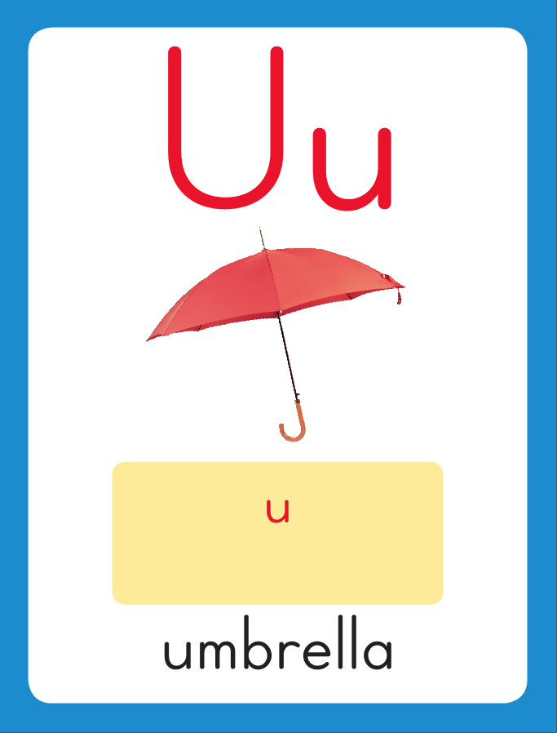
Phonics
This is the Umbrella sound spelling card.
The sound is /u/.
The /u/ sound is spelled with the letter u. Say it with me: /uuu/. This is the sound at the beginning of the word umbrella.
Listen: /u/ /u/ /u/, umbrella.

Slide 123
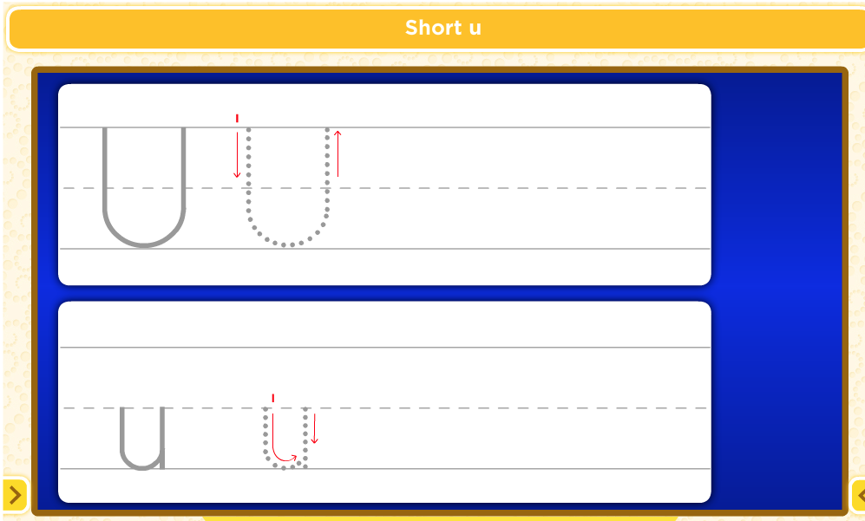
Watch as I write the letter U. I will say /U/ as I write the letter several times.

Slide 124
Now do it with me. Say /u/ as I write the letter u. Write the letter u five times as you say /u/.
u u u u u

Slide 125
Build Fluency: Sound Spellings
a
Each day you will review the sound-spellings you have learned as a warm-up.
Chorally say each sound. Repeat and vary the pace.

Slide 126
b

Slide 127
c

Slide 128
ck

Slide 129
d

Slide 130
e

Slide 131
f

Slide 132
h

Slide 133
i

Slide 134
k

Slide 135
l

Slide 136
m

Slide 137
n

Slide 138
o

Slide 139
p

Slide 140
r

Slide 141
s

Slide 142
t

Slide 143
u

Slide 144
Blend Words with /Short u
u
Model:
Sound

Slide 145
Blend Words with /Short u
u
p
Model:
Sound
Blend

Slide 146
Blend Words with /Short u
u
p
Model:
Word

Slide 147
Blend Words with /Short u
c
Model:
Sound

Slide 148
Blend Words with /Short u
c
u
Model:
Sound
Blend

Slide 149
Blend Words with /Short u
c
u
p
Model:
Sound
Blend

Slide 150
Blend Words with /Short u
c
u
p
Model:
Word

Slide 151
Blend Words with /Short u
s
Model:
Sound

Slide 152
Blend Words with /Short u
s
u
Model:
Sound
Blend

Slide 153
Blend Words with /Short u
s
u
n
Model:
Sound
Blend

Slide 154
Blend Words with /Short u
s
u
n
Model:
Word

Slide 155
Blend Words with /Short u
b
Model:
Sound

Slide 156
Blend Words with /Short u
b
u
Model:
Sound
Blend

Slide 157
Blend Words with /Short u
b
u
s
Model:
Sound
Blend

Slide 158
Blend Words with /Short u
b
u
s
Model:
Word

Slide 159
u

Slide 160
up

Slide 161
up u

Slide 162
up us

Slide 163
up us b

Slide 164
up us b

Slide 165
up us bu

Slide 166
up us bus

Slide 167
up us bus G

Slide 168
up us bus Gu

Slide 169
up us bus Gus

Slide 170
up us bus Gus
f

Slide 171
up us bus Gus
fu

Slide 172
up us bus Gus
fun

Slide 173
up us bus Gus
fun s

Slide 174
up us bus Gus
fun su

Slide 175
up us bus Gus
fun sun

Slide 176
up us bus Gus
fun sun r

Slide 177
up us bus Gus
fun sun ru

Slide 178
up us bus Gus
fun sun run

Slide 179
up us bus Gus
fun sun run b

Slide 180
up us bus Gus
fun sun run bu

Slide 181
up us bus Gus
fun sun run bun

Slide 182
c

Slide 183
cu

Slide 184
cup

Slide 185
cup c

Slide 186
cup cu

Slide 187
cup cut

Slide 188
cup cut b

Slide 189
cup cut bu

Slide 190
cup cut but

Slide 191
cup cut but b

Slide 192
cup cut but be

Slide 193
cup cut but bet

Slide 194
cup cut but bet
h

Slide 195
cup cut but bet
hu

Slide 196
cup cut but bet
hut

Slide 197
cup cut but bet
hut h

Slide 198
cup cut but bet
hut ha

Slide 199
cup cut but bet
hut hat

Slide 200
cup cut but bet
hut hat h

Slide 201
cup cut but bet
hut hat hi

Slide 202
cup cut but bet
hut hat hit

Slide 203
cup cut but bet
hut hat hit h

Slide 204
cup cut but bet
hut hat hit ho

Slide 205
cup cut but bet
hut hat hit hot

Slide 206
It

Slide 207
It is

Slide 208
It is fun.

Slide 209
It is fun.
Pick

Slide 210
It is fun.
Pick it

Slide 211
It is fun.
Pick it up.

Slide 212
High-Frequency Words
she
Read:
Point to and say the word she.
This is the word she.
Say it with me: she.
She plays soccer.
Read:
Point to and say the word with.
This is the word with.
Say it with me: with.
I eat crackers with cheese.
with
Spell:
The word she is spelled
s-h-e.
Spell it with me.
Spell:
The word with is spelled w-i-t-h.
Spell it with me.
for
Write:
Let’s write the word in the air as we say each letter: s-h-e.
Write:
Let’s write the word in the air as we say each letter: w-i-t-h.

Slide 213
Have partners make up sentences using the words.
I
you
a
like
he
has
do
can
this
to
go
is

Slide 214
Have partners make up sentences using the words.
my
here
we
look
play
are
little
the
me
where

Slide 215
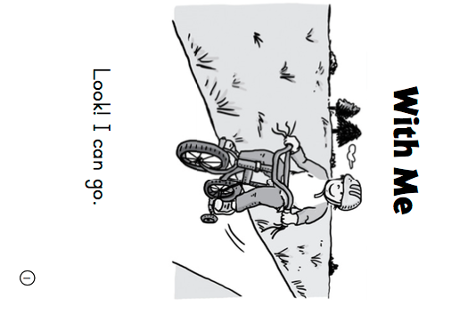
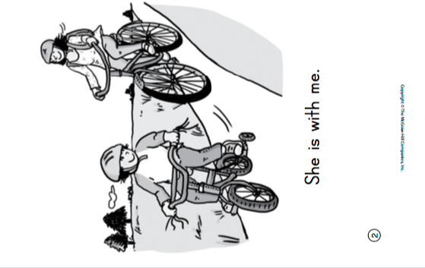

Slide 216
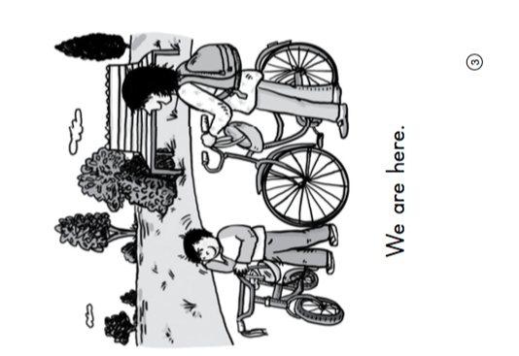
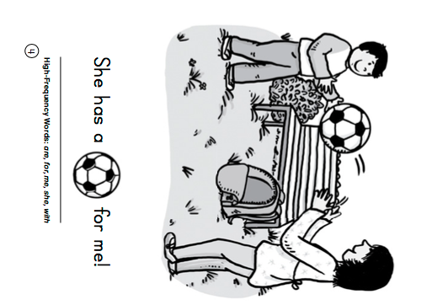

Slide 217
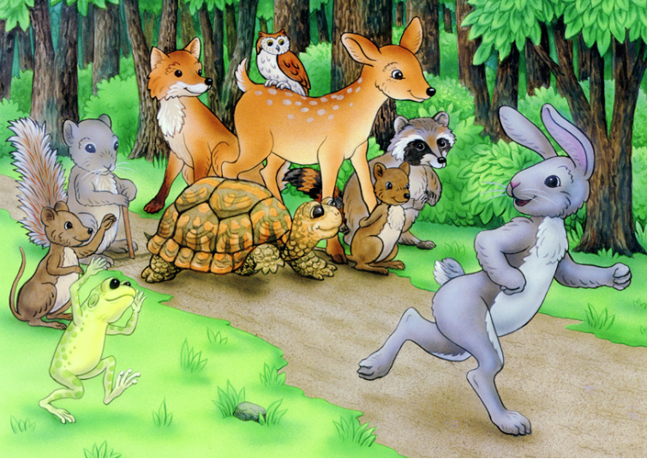
Fiction Stories:
Tell about things that did not really happen.
Have a beginning, a middle, and an end.
Have characters.
Listening Comprehension
Visualize: Close your eyes and picture in your minds details from the story.
The Tortoise and the Hare

Slide 218
Listen for important details as you listen to the story read aloud.

Slide 219
Who is soft spoken and shy?
Who is loud and boastful?
Who runs fast?
Listening Comprehension
Visualize: Close your eyes and picture in your minds details from the story.
The Tortoise and the Hare

Slide 220
Respond
Talk About It – Discuss story details with children. Ask: Who wins the race? Why? Were you surprised by the ending? Ask children to discuss their favorite parts of the story.

Slide 221
Shared Writing
Describe the characters in “The Tortoise and the Hare”.
In “The Tortoise and the Hare,” the tortoise is___________________.
The hare is ___________
_____________________.
Tortoise
Hare

Slide 222
Start Smart
Day 3

Slide 223
Track the print as you read the Daily Warm-Up.
Point to each word as you read the sentences again. Have children echo-read.
Circle the first word in the sentence.
Underline the last word in the sentence.
Count the number of sentences?
What’s a rocket ship?
Where will it take us?
Let’s find out!
Have partners describe rocket ships and where they go.
Ask questions, such as: Have you ever seen a rocket ship?
Where did it go?
Would you like to fly to the moon?
What other things fly high in the sky?

Slide 224
Phonemic Awareness
Model:
I am going to say a word.
Then I will say it sound by sound. Listen carefully.
The word is am.
Listen as I stretch the sounds: /aaammm/.
Now I will say the sounds in the word am, one at a time.
I will place one counter in each box of the Response Board
as I move from sound to sound.
Watch: /aaa/ /mmm/ The word has two sounds: /a/ /m/.

Slide 225
Phonemic Awareness
Model:
I am going to say a word.
Then I will say it sound by sound. Listen carefully.
The word is sat.
Listen as I stretch the sounds: /sssaaat/.
Now I will say the sounds in the word sat, one at a time.
I will place one counter in each box of the Response Board
as I move from sound to sound.
Watch: /sss/ /aaa/ /t/ The word sat has three
sounds: /s/ /a/ /t/.

Slide 226
Phonemic Awareness
Guided Practice:
Now it’s your turn.
I will say a word.
Stretch the word with me.
Then place one counter in each box for each sound you hear.
at mat sat rat
an man fan ran
egg leg beg bag
set wet get red

Slide 227
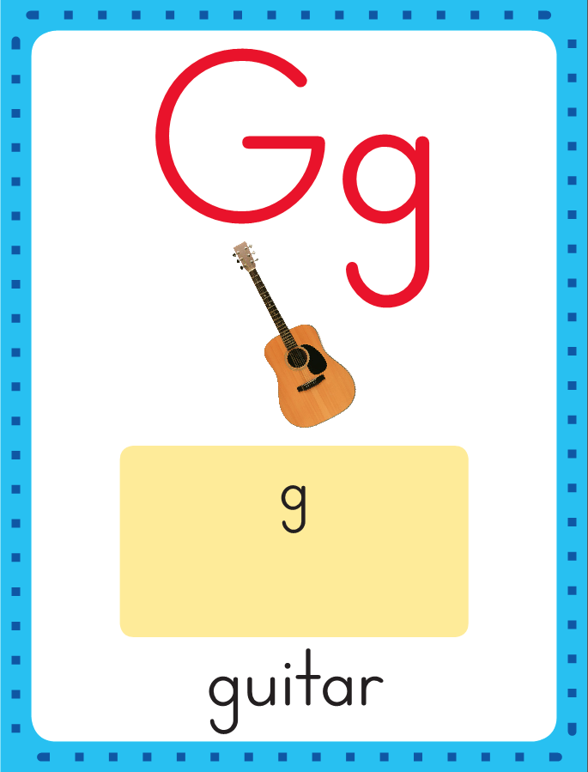
Phonics
This is the Guitar sound spelling card.
The sound is /g/.
The /g/ sound is spelled with the letter g. Say it with me: /g/. This is the sound at the beginning of the word guitar.
Listen: /g/ /g/ /g/, guitar.

Slide 228
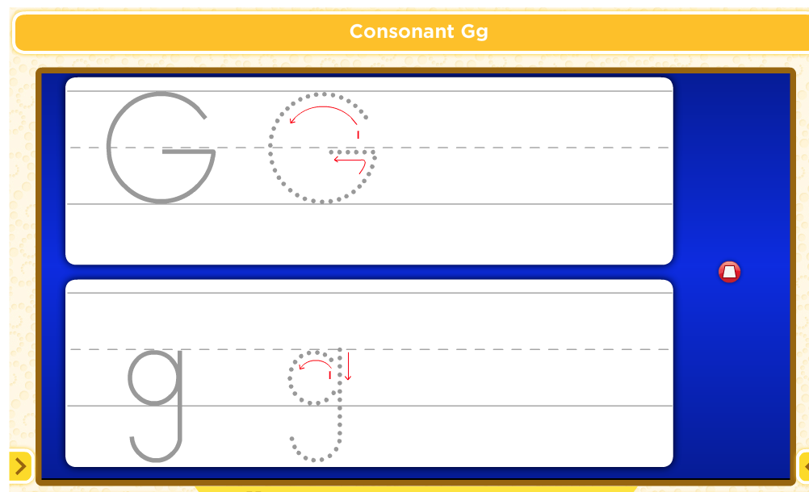
Watch as I write the letter g. I will say /g/ as I write the letter several times.

Slide 229
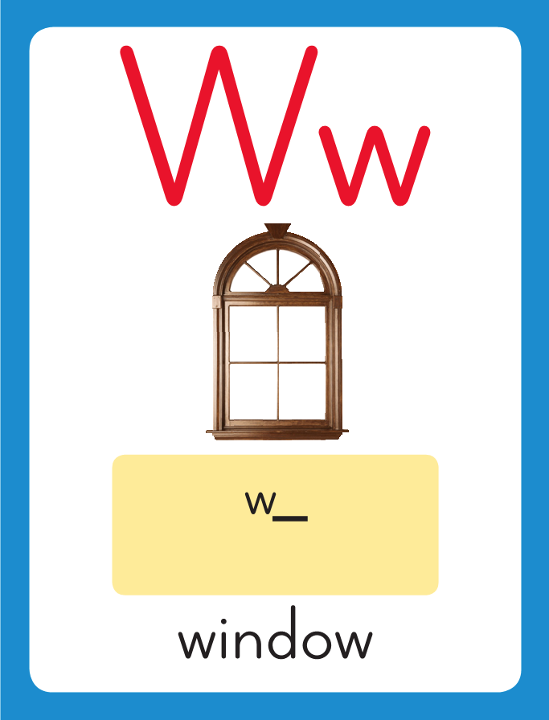
Phonics
This is the Window sound spelling card.
The sound is /w/.
The /w/ sound is spelled with the letter w. Say it with me: /w/. This is the sound at the beginning of the word window.
Listen: /w/ /w/ /w/, window.

Slide 230
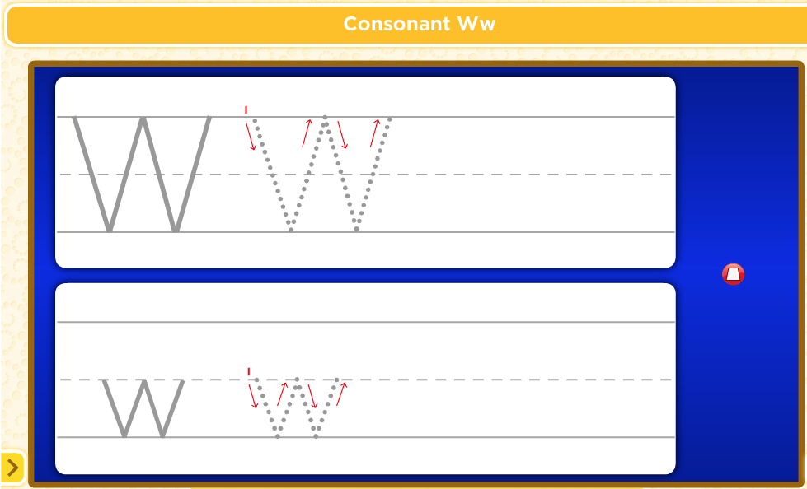
Watch as I write the letter w. I will say /w/ as I write the letter several times.

Slide 231
Now do it with me. Say /g/ as I write the letter g. Write the letter g five times as you say /g/.
Say /w/ as I write the letter w. Write the letter w five times as you say /w/.
g g g g g
w w w w w

Slide 232
Build Fluency: Sound Spellings
a
Each day you will review the sound-spellings you have learned as a warm-up.
Chorally say each sound. Repeat and vary the pace.

Slide 233
b

Slide 234
c

Slide 235
ck

Slide 236
d

Slide 237
e

Slide 238
f

Slide 239
g

Slide 240
h

Slide 241
i

Slide 242
k

Slide 243
l

Slide 244
m

Slide 245
n

Slide 246
o

Slide 247
p

Slide 248
r

Slide 249
s

Slide 250
t

Slide 251
u

Slide 252
w

Slide 253
Blend Words with /g/ g, /w/ w
g
Model:
Sound

Slide 254
Blend Words with /g/ g, /w/ w
g
e
Model:
Sound
Blend

Slide 255
Blend Words with /g/ g, /w/ w
g
e
t
Model:
Sound
Blend

Slide 256
Blend Words with /g/ g, /w/ w
g
e
t
Model:
Word

Slide 257
Blend Words with /g/ g, /w/ w
w
Model:
Sound

Slide 258
Blend Words with /g/ g, /w/ w
w
e
Model:
Sound
Blend

Slide 259
Blend Words with /g/ g, /w/ w
w
e
t
Model:
Sound
Blend

Slide 260
Blend Words with /g/ g, /w/ w
w
e
t
Model:
Word

Slide 261
Blend Words with /g/ g, /w/ w
g
Model:
Sound

Slide 262
Blend Words with /g/ g, /w/ w
g
u
Model:
Sound
Blend

Slide 263
Blend Words with /g/ g, /w/ w
g
u
m
Model:
Sound
Blend

Slide 264
Blend Words with /g/ g, /w/ w
g
u
m
Model:
Word

Slide 265
Blend Words with /g/ g, /w/ w
b
Model:
Sound

Slide 266
Blend Words with /g/ g, /w/ w
b
a
Model:
Sound
Blend

Slide 267
Blend Words with /g/ g, /w/ w
b
a
g
Model:
Sound
Blend

Slide 268
Blend Words with /g/ g, /w/ w
b
a
g
Model:
Word

Slide 269
Blend Words with /g/ g, /w/ w
w
Model:
Sound

Slide 270
Blend Words with /g/ g, /w/ w
w
i
Model:
Sound
Blend

Slide 271
Blend Words with /g/ g, /w/ w
w
i
n
Model:
Sound
Blend

Slide 272
Blend Words with /g/ g, /w/ w
w
i
n
Model:
Word

Slide 273
e

Slide 274
egg

Slide 275
egg b

Slide 276
egg be

Slide 277
egg beg

Slide 278
egg beg l

Slide 279
egg beg le

Slide 280
egg beg leg

Slide 281
egg beg leg l

Slide 282
egg beg leg le

Slide 283
egg beg leg let

Slide 284
egg beg leg let
w

Slide 285
egg beg leg let
we

Slide 286
egg beg leg let
wet

Slide 287
egg beg leg let
wet g

Slide 288
egg beg leg let
wet ge

Slide 289
egg beg leg let
wet get

Slide 290
egg beg leg let
wet get m

Slide 291
egg beg leg let
wet get me

Slide 292
egg beg leg let
wet get met

Slide 293
egg beg leg let
wet get met m

Slide 294
egg beg leg let
wet get met me

Slide 295
egg beg leg let
wet get met men

Slide 296
w

Slide 297
wa

Slide 298
wag

Slide 299
wag b

Slide 300
wag ba

Slide 301
wag bag

Slide 302
wag bag w

Slide 303
wag bag wi

Slide 304
wag bag win

Slide 305
wag bag win p

Slide 306
wag bag win pi

Slide 307
wag bag win pin

Slide 308
wag bag win pin
g

Slide 309
wag bag win pin
gu

Slide 310
wag bag win pin
gum

Slide 311
wag bag win pin
gum f

Slide 312
wag bag win pin
gum fu

Slide 313
wag bag win pin
gum fun

Slide 314
wag bag win pin
gum fun g

Slide 315
wag bag win pin
gum fun go

Slide 316
wag bag win pin
gum fun got

Slide 317
wag bag win pin
gum fun got h

Slide 318
wag bag win pin
gum fun got ho

Slide 319
wag bag win pin
gum fun got hot

Slide 320
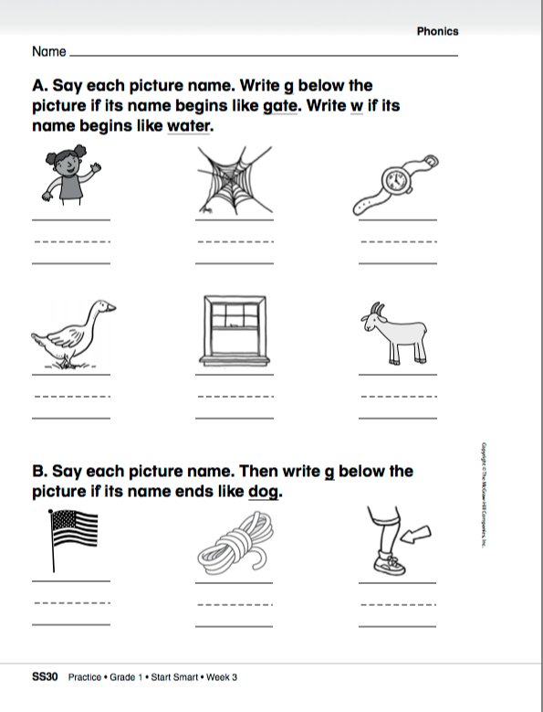

Slide 321
High-Frequency Words
and
Read:
Point to and say the word and.
This is the word and.
Say it with me: and.
I like rice and beans.
Read:
Point to and say the word have.
This is the word have.
Say it with me: have.
They have fast bikes.
have
Spell:
The word and is spelled
a-n-d.
Spell it with me.
Spell:
The word have is spelled h-a-v-e.
Spell it with me.
Write:
Let’s write the word in the air as we say each letter: a-n-d.
Write:
Let’s write the word in the air as we say each letter: h-a-v-e.

Slide 322
Have partners make up sentences using the words.
I
you
a
like
he
has
do
can
this
to
go
is

Slide 323
Have partners make up sentences using the words.
my
here
we
look
play
are
little
the
me
where
she

Slide 324
Have partners make up sentences using the words.
with
for

Slide 325
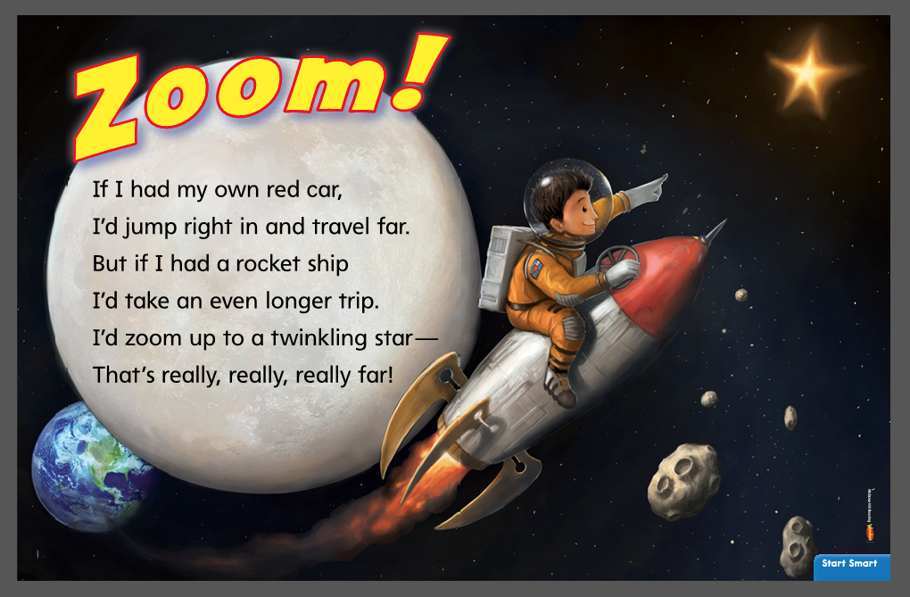
Listening Comprehension
Rocket ships go into space. What might you see if you took a rocket ship into space?
Reread aloud several times, asking children to join in.
Rhyming words have the same ending sounds,
such as ship and trip, which both end in /ip/.

Slide 326
Respond
How is this rhyme different from a story?
Have children chorally chant the rhyme.
Ask children what they would do if they had their own car. Then ask what they would do with a rocket ship. Finally, ask what other kinds of transportation they might like to have and why.

Slide 327
Interactive Writing
Name things that the main character in the poem “Zoom!” wants to do.
Brainstorm
_____________
_____________
_____________
In “Zoom!” the boy wants to ____________
_____________________
____________________.
He wants to do it in a
____________________.

