Slide 1
Start Smart Week 3 cont.

Slide 2
Start Smart
Day 4

Slide 3
Track the print and emphasize the return sweep as you reread the Daily Warm-Up.
Invite children to chime in.
Circle and say the word bus.
Circle and say the word get. What letters stand for the word get?
Challenge: What written words stand for ride and bike?
I like a bike.
I like a bus, too.
How do you get around?
Have partners discuss the question, How do you get around?
Have them say: “I get around. I _____________________.”

Slide 4
Phonemic Awareness
Model:
I am going to say a word.
Then I will say it sound by sound. Listen carefully.
The word is van.
Listen as I stretch the sounds: /vvvaaannn/.
Now I will say the sounds in the word van, one at a time.
I will place one counter in each box of the Response Board
as I move from sound to sound.
Watch: /vvv/ /aaa/ /nnn/ The word van has three sounds: /v/ /a/ /n/.

Slide 5
Phonemic Awareness
Guided Practice:
Now it’s your turn.
I will say a word.
Stretch the word with me.
Place one counter in each box for each sound you hear.
up fun sun rug
at mat vet get
it fit bit us

Slide 6
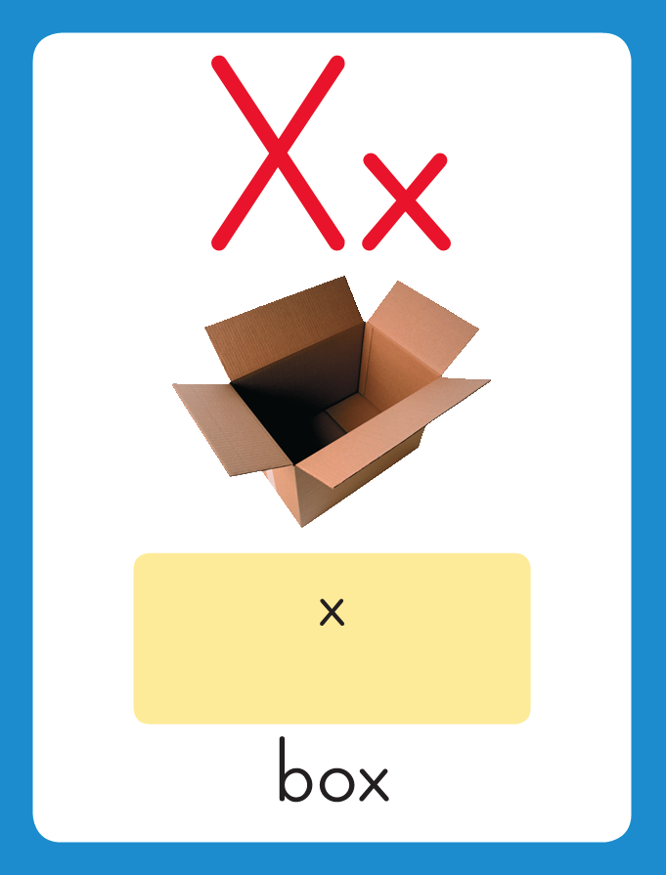
Phonics
This is the Box sound spelling card.
The sounds are /ks/.
The /ks/ sounds are spelled with the letter x. Say it with me: /ks/. These are the sounds at the end of the word box.
Listen: /boks/, box.

Slide 7
Watch as I write the letter x. I will say /ks/ as I write the letter several times.

Slide 8
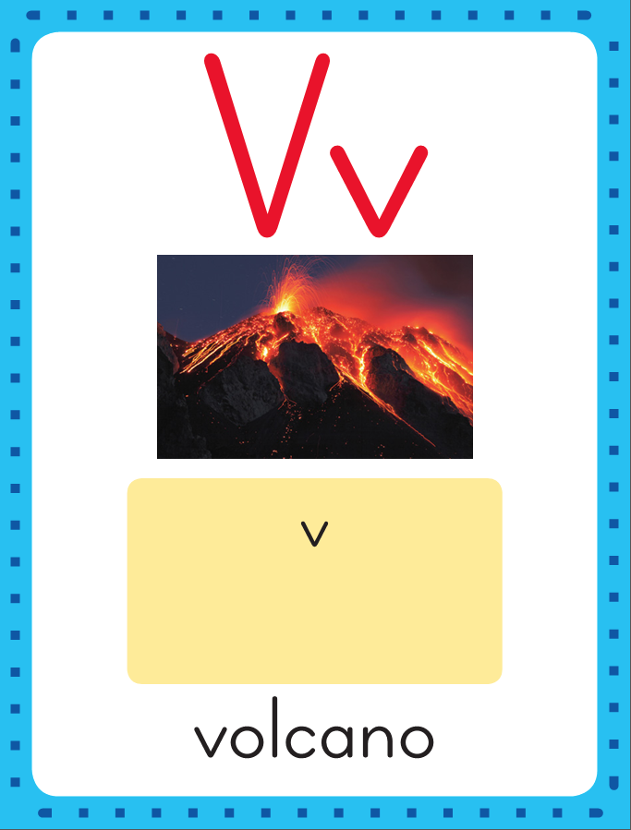
Phonics
This is the Volcano sound spelling card.
The sound is /v/.
The /v/ sound is spelled with the letter v. Say it with me: /v/. This is the sound at the beginning of the word volcano.
Listen: /v/ /v/ /v/, volcano.

Slide 9
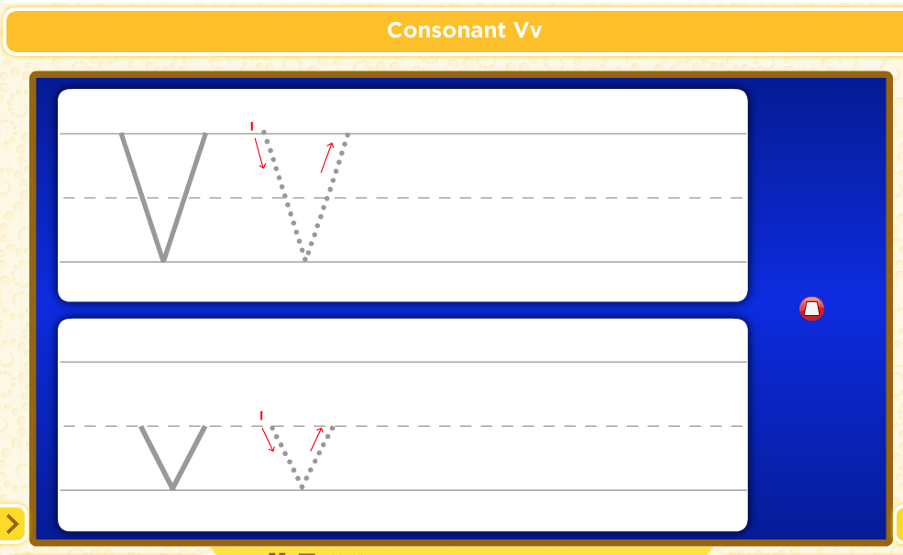
Watch as I write the letterv. I will say /v/ as I write the letter several times.

Slide 10
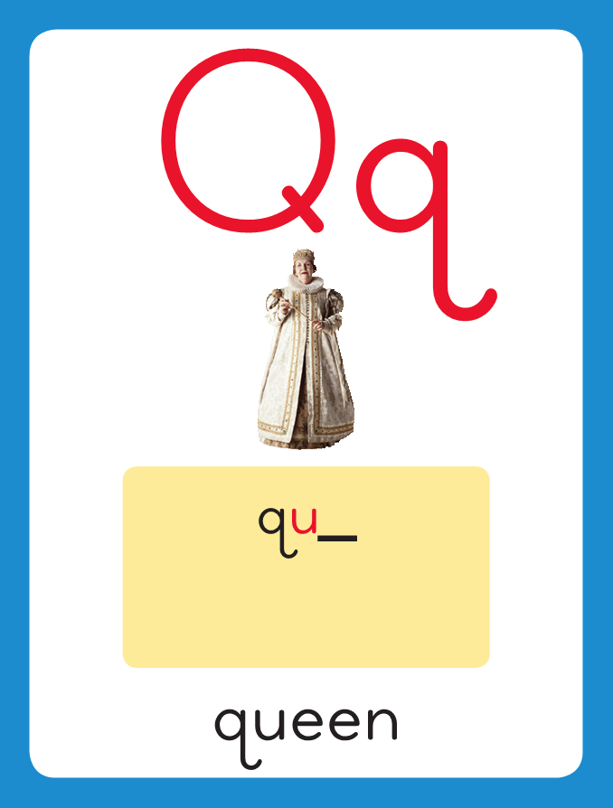
Phonics
This is the Queen sound spelling card.
The sounds are /kw/.
The /kw/ sounds are spelled with the letter qu. Say it with me: /kw/. These are the sounds at the beginning of the word queen.
Listen: /kw/ /kw/ /kw/, queen.

Slide 11
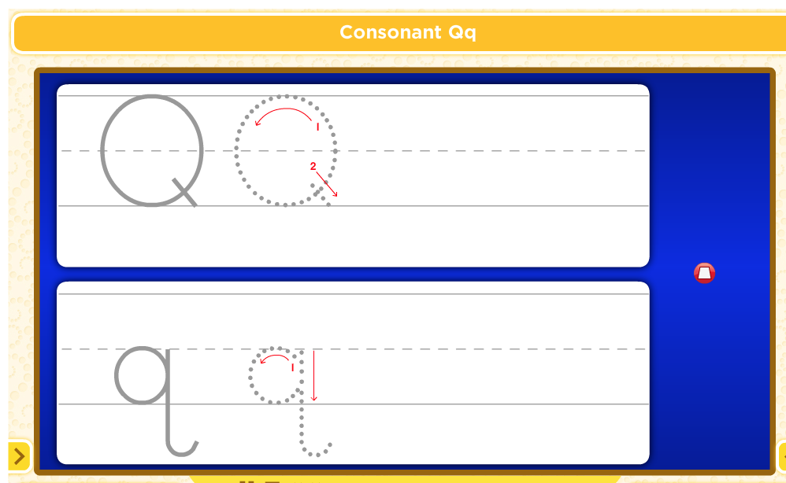
Watch as I write the letter qu. I will say /kw/ as I write the letter several times.

Slide 12
Now do it with me. Say /ks/ as I write the letter x. Write the letter x five times as you say /ks/.
Say /v/ as I write the letter v. Write the letter v five times as you say /v/.
Now say /kw/ as I write the letters qu. Write the letters qu as you say /kw/.
x x x x x
v v v v v
qu qu qu qu qu

Slide 13
Build Fluency: Sound Spellings
a
Each day you will review the sound-spellings you have learned as a warm-up.
Chorally say each sound. Repeat and vary the pace.

Slide 14
b

Slide 15
c

Slide 16
ck

Slide 17
d

Slide 18
e

Slide 19
f

Slide 20
g

Slide 21
h

Slide 22
i

Slide 23
k

Slide 24
l

Slide 25
m

Slide 26
n

Slide 27
o

Slide 28
p

Slide 29
qu

Slide 30
r

Slide 31
s

Slide 32
t

Slide 33
u

Slide 34
v

Slide 35
w

Slide 36
x

Slide 37
Blend Words with /ks/ x, /v/ v, /kw/ qu
s
Model:
Sound

Slide 38
Blend Words with /ks/ x, /v/ v, /kw/ qu
s
i
Model:
Sound
Blend

Slide 39
Blend Words with /ks/ x, /v/ v, /kw/ qu
s
i
x
Model:
Sound
Blend

Slide 40
Blend Words with /ks/ x, /v/ v, /kw/ qu
s
i
x
Model:
Word

Slide 41
Blend Words with /ks/ x, /v/ v, /kw/ qu
m
Model:
Sound

Slide 42
Blend Words with /ks/ x, /v/ v, /kw/ qu
m
i
Model:
Sound
Blend

Slide 43
Blend Words with /ks/ x, /v/ v, /kw/ qu
m
i
x
Model:
Sound
Blend

Slide 44
Blend Words with /ks/ x, /v/ v, /kw/ qu
m
i
x
Model:
Word

Slide 45
Blend Words with /ks/ x, /v/ v, /kw/ qu
v
Model:
Sound

Slide 46
Blend Words with /ks/ x, /v/ v, /kw/ qu
v
a
Model:
Sound
Blend

Slide 47
Blend Words with /ks/ x, /v/ v, /kw/ qu
v
a
n
Model:
Sound
Blend

Slide 48
Blend Words with /ks/ x, /v/ v, /kw/ qu
v
a
n
Model:
Word

Slide 49
Blend Words with /ks/ x, /v/ v, /kw/ qu
qu
Model:
Sound

Slide 50
Blend Words with /ks/ x, /v/ v, /kw/ qu
qu
i
Model:
Sound
Blend

Slide 51
Blend Words with /ks/ x, /v/ v, /kw/ qu
qu
i
t
Model:
Sound
Blend

Slide 52
Blend Words with /ks/ x, /v/ v, /kw/ qu
qu
i
t
Model:
Word

Slide 53
a

Slide 54
ax

Slide 55
ax w

Slide 56
ax wa

Slide 57
ax wax

Slide 58
ax wax m

Slide 59
ax wax mi

Slide 60
ax wax mix

Slide 61
ax wax mix M

Slide 62
ax wax mix Ma

Slide 63
ax wax mix Max

Slide 64
ax wax mix Max
qu

Slide 65
ax wax mix Max
qui

Slide 66
ax wax mix Max
quit

Slide 67
ax wax mix Max
quit qu

Slide 68
ax wax mix Max
quit qui

Slide 69
ax wax mix Max
quit quick

Slide 70
ax wax mix Max
quit quick l

Slide 71
ax wax mix Max
quit quick li

Slide 72
ax wax mix Max
quit quick lick

Slide 73
ax wax mix Max
quit quick lick s

Slide 74
ax wax mix Max
quit quick lick si

Slide 75
ax wax mix Max
quit quick lick sick

Slide 76
I

Slide 77
I am

Slide 78
I am quick!

Slide 79
I am quick!
The

Slide 80
I am quick!
The vet

Slide 81
I am quick!
The vet can

Slide 82
I am quick!
The vet can fix

Slide 83
I am quick!
The vet can fix it.

Slide 84
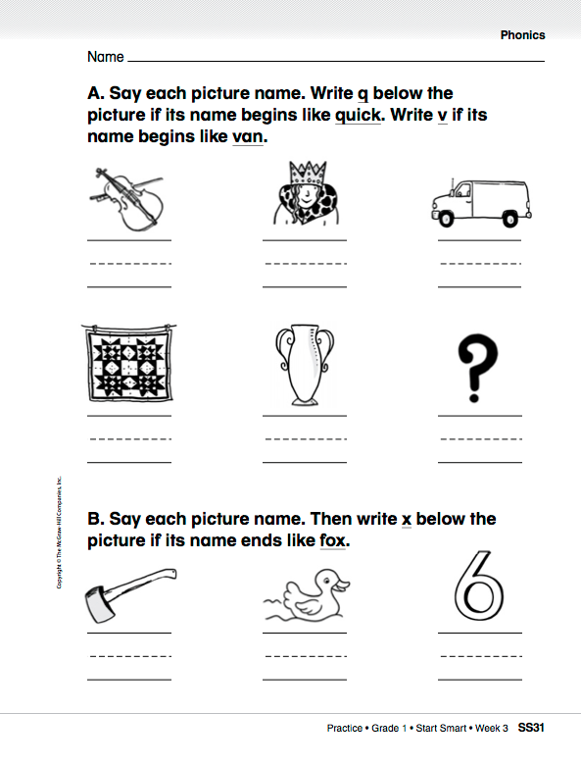

Slide 85
High-Frequency Words
see
Read:
Point to and say the word see.
This is the word see.
Say it with me: see.
I see a bird in the sky.
Read:
Point to and say the word said.
This is the word said.
Say it with me: said.
She said hello.
said
Spell:
The word see is spelled
s-e-e.
Spell it with me.
Spell:
The word said is spelled s-a-i-d.
Spell it with me.
was
Write:
Let’s write the word in the air as we say each letter: s-e-e.
Write:
Let’s write the word in the air as we say each letter: s-a-i-d.

Slide 86
Have partners make up sentences using the words.
I
you
a
like
he
has
do
can
this
to
go
is

Slide 87
Have partners make up sentences using the words.
my
here
we
look
play
are
little
the
me
where
she

Slide 88
Have partners make up sentences using the words.
with
for
and
have

Slide 89
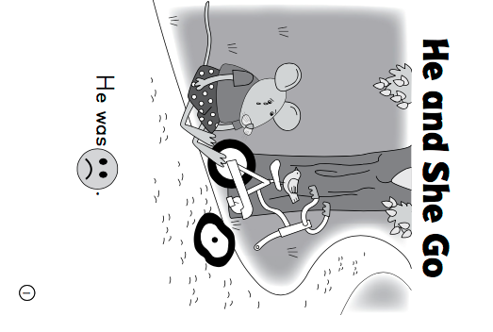
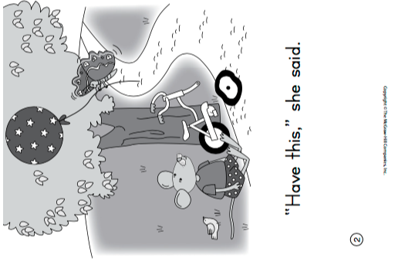

Slide 90
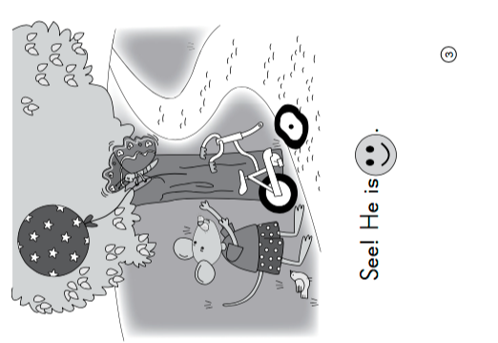
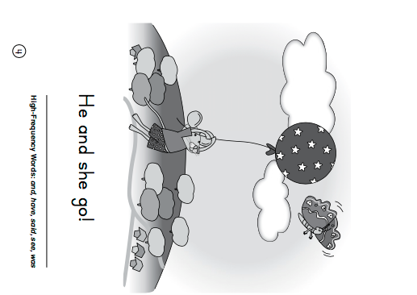

Slide 91
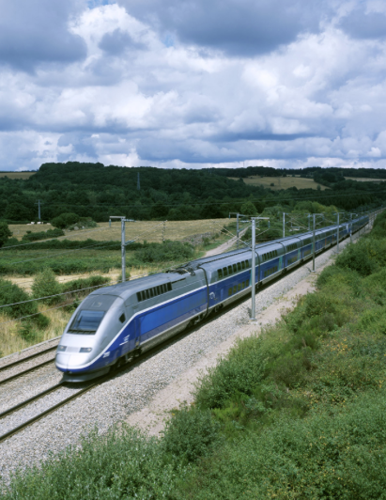
Listening Comprehension
How Do We Get Around?
Visualizing can help children understand what happens in a story. Close your eyes and picture in your mind details from the story.
The title can help us figure out what the selection might be about. I think we will read about ways that people get around, such as by bus. Let’s read to learn about some of the ways people travel.
Informational Text:
Gives facts about real people, places, animals, or events
Includes details that give important information.

Slide 92
Details give important information. Details can describe what people use to get around. Listen for important details about ways to get around.

Slide 94
Respond
How Do We Get Around?
What details did you learn about trains?
What did you learn about cars?
What are some other ways to travel?
Tell how you travel to different places.
Name your favorite way to travel.

Slide 95
Interactive Writing
Name and describe the different ways to travel in: “How Do We Get Around?”
Brainstorm
_____________
_____________
_____________
One way to get around is ____________
_____________________.
We use this way to ___
______________________
_____________________.
Example: One way to get around is a helicopter. We use this way to take people to airports or hospitals.

Slide 96
Start Smart
Day 5

Slide 97
Track the print and have children echo-read as you read each sentence again.
How many words are there in the Daily Warm-Up?
Which sentence is the longest? How many words does it have?
A hare hops quickly.
A tortoise walks slowly.
How do you get around?
This week you read “The Tortoise and the Hare” and “How Do We Get Round?”
Have partners discuss how animals or people get around.
Do you get around in those ways, too?

Slide 98
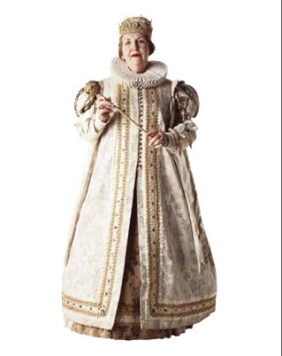
Phonological Awareness
Model:
Look at these two Photo Cards.
I will say the name of each card, then you will repeat the name:
queen green
The words queen and green rhyme because they both end in /en/.
Listen: /kw/ /en/, queen; /gr/ /en/, green. Both queen and green end in /en/.

Slide 99
Phonological Awareness
Now I will try to make other words that rhyme with queen and green.
To do so, I need to think of words that end in /en/.
Listen as I try one: /s/ /en/.
The word seen rhymes with queen and green because it also ends in / en/: queen, green, seen
?

Slide 100
Phonological Awareness
Guided Practice:
Identify the rhyme and why.
Listen to these word pairs.
If the words rhyme, say the words.
I will then ask you why they rhyme.
Think about what sounds the two words have in common at the end.
If the words don’t rhyme, remain silent.
yet/let zip/rip zip/zap
yell/bell yes/win yard/yak
zoom/boom jet/bet jog/fog
Have children generate words that rhyme with the rhyming pairs.
Now listen as I say the words again. Let’s think of other words that rhyme with each rhyming pair.

Slide 101
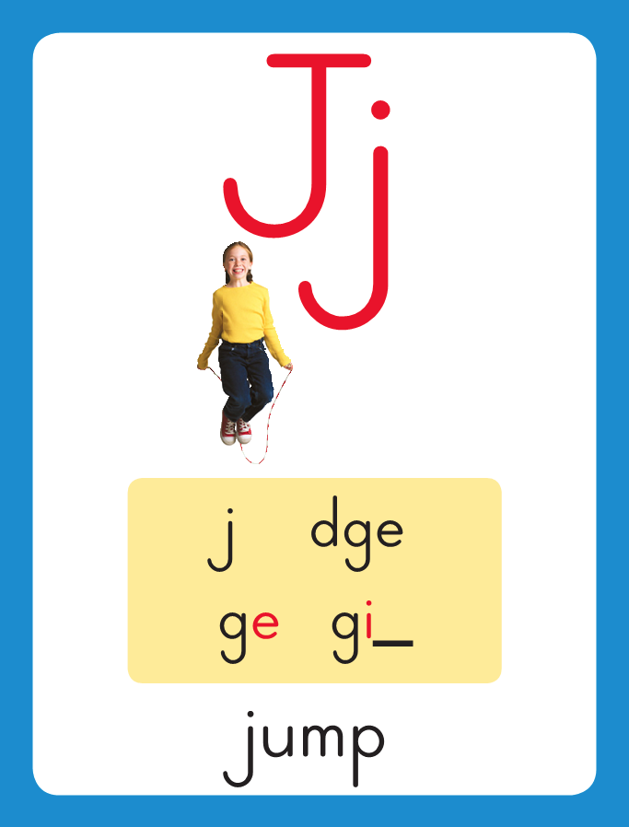
Phonics
This is the Jump sound spelling card.
The sound are /j/.
The /j/ sound is spelled with the letter j. Say it with me: /j/. This is the sound at the beginning of the word jump.
Listen: /j/ /j/ /j/, jump.

Slide 102
Watch as I write the letter j. I will say /j/ as I write the letter several times.

Slide 103
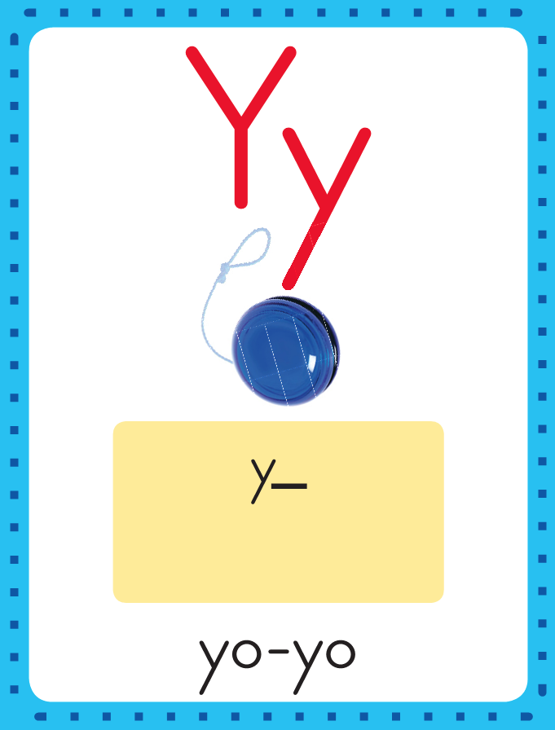
Phonics
This is the Yo-Yo sound spelling card.
The sound is /y/.
The /y/ sound is spelled with the letter y. Say it with me: /y/. This is the sound at the beginning of the word yo-yo.
Listen: /y/ /y/ /y/, yo-yo.

Slide 104
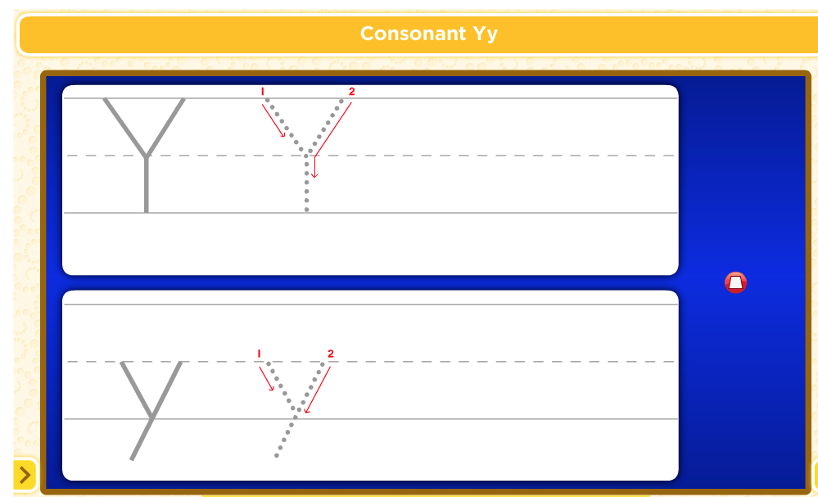
Watch as I write the letter y. I will say /y/ as I write the letter several times.

Slide 105
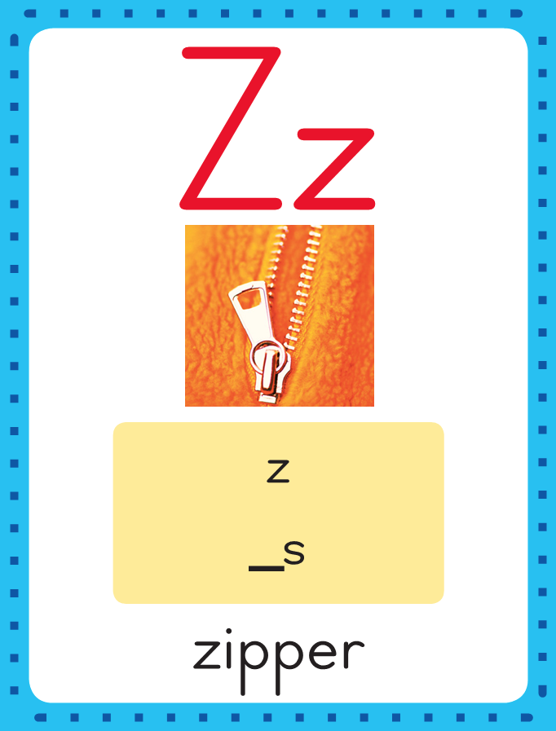
Phonics
This is the Zipper sound spelling card.
The sound is /z/.
The /z/ sound is spelled with the letter z. Say it with me: /z/. This is the sound at the beginning of the word zipper.
Listen: /z/ /z/ /z/, zipper.

Slide 106
Watch as I write the letter z. I will say /z/ as I write the letter several times.

Slide 107
Now do it with me. Say /j/ as I write the letter j. Write the letter j five times as you say /j/.
Say /y/ as I write the letter y. Write the letter y five times as you say /y/.
Now say /z/ as I write the letters z. Write the letters z as you say /z/.
j j j j j
y y y y y
z z z z z

Slide 108
Build Fluency: Sound Spellings
a
Each day you will review the sound-spellings you have learned as a warm-up.
Chorally say each sound. Repeat and vary the pace.

Slide 109
b

Slide 110
c

Slide 111
ck

Slide 112
d

Slide 113
e

Slide 114
f

Slide 115
g

Slide 116
h

Slide 117
i

Slide 118
j

Slide 119
k

Slide 120
l

Slide 121
m

Slide 122
n

Slide 123
o

Slide 124
p

Slide 125
qu

Slide 126
r

Slide 127
s

Slide 128
t

Slide 129
u

Slide 130
v

Slide 131
w

Slide 132
x

Slide 133
y

Slide 134
z

Slide 135
Blend Words with /j/ j, /y/ y, /z/ z
z
Model:
Sound

Slide 136
Blend Words with /j/ j, /y/ y, /z/ z
z
i
Model:
Sound
Blend

Slide 137
Blend Words with /j/ j, /y/ y, /z/ z
z
i
p
Model:
Sound
Blend

Slide 138
Blend Words with /j/ j, /y/ y, /z/ z
z
i
p
Model:
Word

Slide 139
Blend Words with /j/ j, /y/ y, /z/ z
z
Model:
Sound

Slide 140
Blend Words with /j/ j, /y/ y, /z/ z
z
a
Model:
Sound
Blend

Slide 141
Blend Words with /j/ j, /y/ y, /z/ z
z
a
p
Model:
Sound
Blend

Slide 142
Blend Words with /j/ j, /y/ y, /z/ z
z
a
p
Model:
Word

Slide 143
Blend Words with /j/ j, /y/ y, /z/ z
y
Model:
Sound

Slide 144
Blend Words with /j/ j, /y/ y, /z/ z
y
e
Model:
Sound
Blend

Slide 145
Blend Words with /j/ j, /y/ y, /z/ z
y
e
s
Model:
Sound
Blend

Slide 146
Blend Words with /j/ j, /y/ y, /z/ z
y
e
s
Model:
Word

Slide 147
Blend Words with /j/ j, /y/ y, /z/ z
y
Model:
Sound

Slide 148
Blend Words with /j/ j, /y/ y, /z/ z
y
e
Model:
Sound
Blend

Slide 149
Blend Words with /j/ j, /y/ y, /z/ z
y
e
t
Model:
Sound
Blend

Slide 150
Blend Words with /j/ j, /y/ y, /z/ z
y
e
t
Model:
Word

Slide 151
Blend Words with /j/ j, /y/ y, /z/ z
j
Model:
Sound

Slide 152
Blend Words with /j/ j, /y/ y, /z/ z
j
e
Model:
Sound
Blend

Slide 153
Blend Words with /j/ j, /y/ y, /z/ z
j
e
t
Model:
Sound
Blend

Slide 154
Blend Words with /j/ j, /y/ y, /z/ z
j
e
t
Model:
Word

Slide 155
Blend Words with /j/ j, /y/ y, /z/ z
j
Model:
Sound

Slide 156
Blend Words with /j/ j, /y/ y, /z/ z
j
o
Model:
Sound
Blend

Slide 157
Blend Words with /j/ j, /y/ y, /z/ z
j
o
g
Model:
Sound
Blend

Slide 158
Blend Words with /j/ j, /y/ y, /z/ z
j
o
g
Model:
Word

Slide 159
y

Slide 160
ye

Slide 161
yes

Slide 162
yes y

Slide 163
yes ye

Slide 164
yes yet

Slide 165
yes yet j

Slide 166
yes yet je

Slide 167
yes yet jet

Slide 168
yes yet jet l

Slide 169
yes yet jet le

Slide 170
yes yet jet let

Slide 171
yes yet jet let
z

Slide 172
yes yet jet let
zi

Slide 173
yes yet jet let
zip

Slide 174
yes yet jet let
zip z

Slide 175
yes yet jet let
zip za

Slide 176
yes yet jet let
zip zap

Slide 177
yes yet jet let
zip zap m

Slide 178
yes yet jet let
zip zap ma

Slide 179
yes yet jet let
zip zap map

Slide 180
yes yet jet let
zip zap map t

Slide 181
yes yet jet let
zip zap map ta

Slide 182
yes yet jet let
zip zap map tap

Slide 183
j

Slide 184
ja

Slide 185
jab

Slide 186
jab j

Slide 187
jab jo

Slide 188
jab job

Slide 189
jab job j

Slide 190
jab job ji

Slide 191
jab job jig

Slide 192
jab job jig b

Slide 193
jab job jig bi

Slide 194
jab job jig big

Slide 195
jab job jig big
y

Slide 196
jab job jig big
ya

Slide 197
jab job jig big
yak

Slide 198
jab job jig big
yak y

Slide 199
jab job jig big
yak ya

Slide 200
jab job jig big
yak yam

Slide 201
jab job jig big
yak yam j

Slide 202
jab job jig big
yak yam ja

Slide 203
jab job jig big
yak yam jam

Slide 204
jab job jig big
yak yam jam j

Slide 205
jab job jig big
yak yam jam ju

Slide 206
jab job jig big
yak yam jam jug

Slide 207
Zak

Slide 208
Zak has

Slide 209
Zak has a

Slide 210
Zak has a big

Slide 211
Zak has a big job.

Slide 212
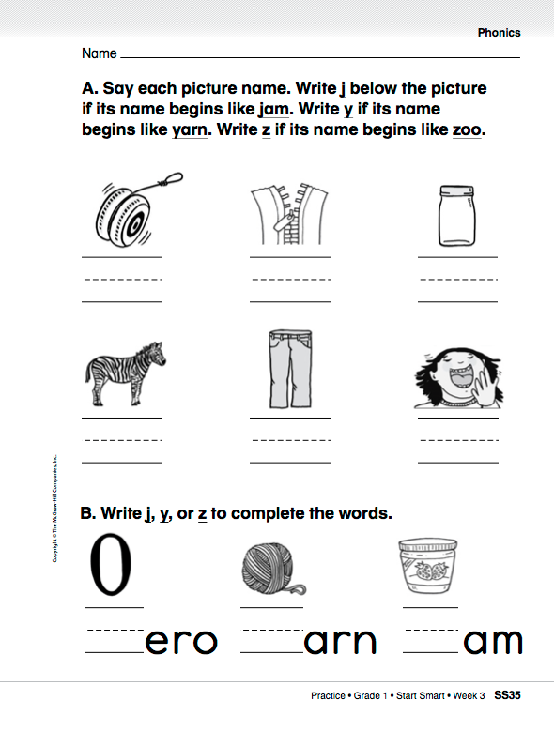

Slide 213
Have children read/spell/write each word.
are
for
said
me
and
was
she
see
Practice: Point to a word and call on a child to Read/Spell/Write it.
Challenge them to use the word in a sentence.
Have partners work together to create sentences using as many of the high-frequency words as they can.
with
have

Slide 214
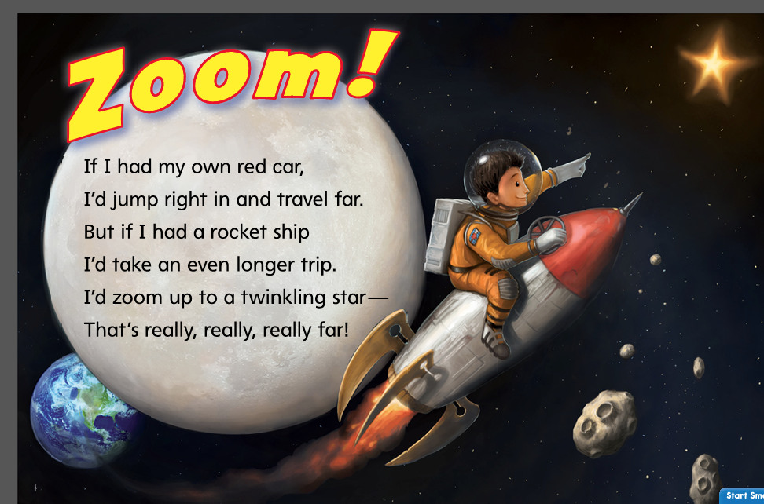
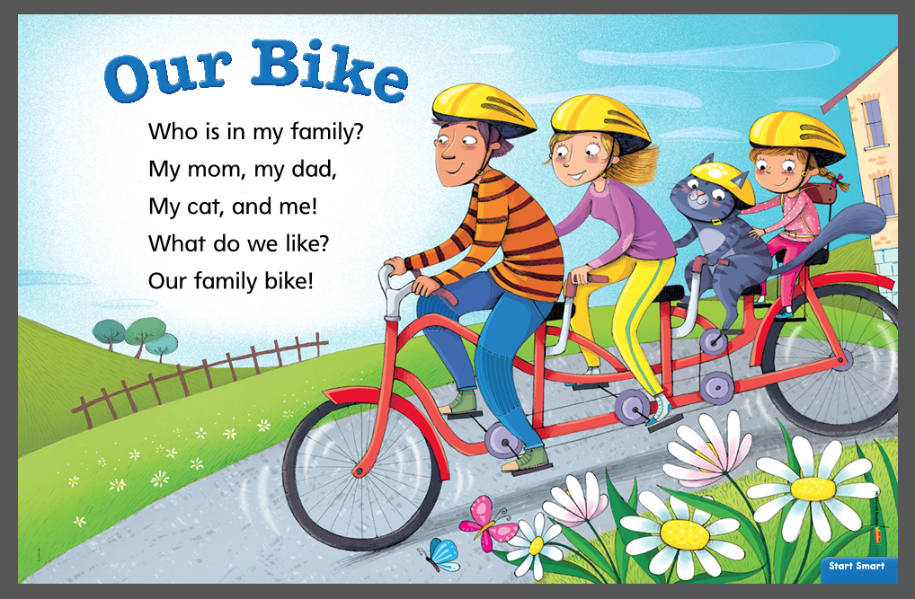
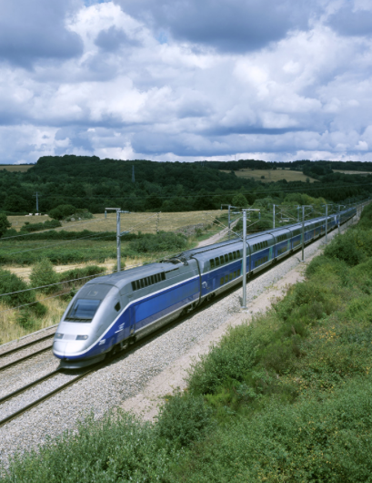
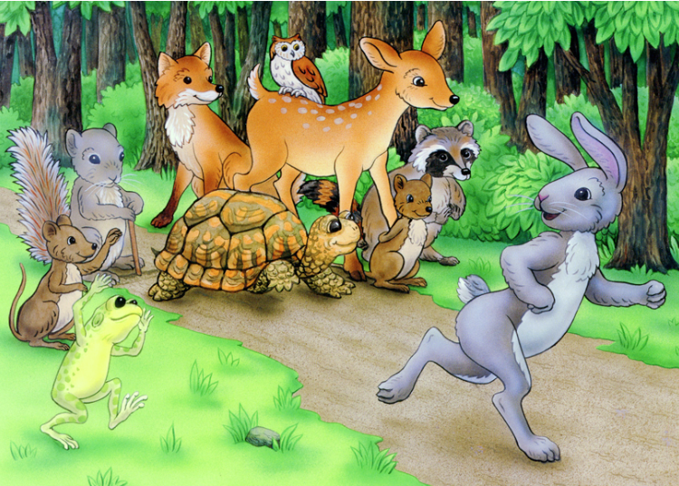
Listening Comprehension – Make Connections
All of these selections talk about how people and animals can get from one place to another.
These stories are all connected
How Do We Get Around?
The Tortoise and the Hare

Slide 215
Listening Comprehension – Make Connections
Now think about how these two selections are different.
How Do We Get Around?
The Tortoise and the Hare

Slide 216
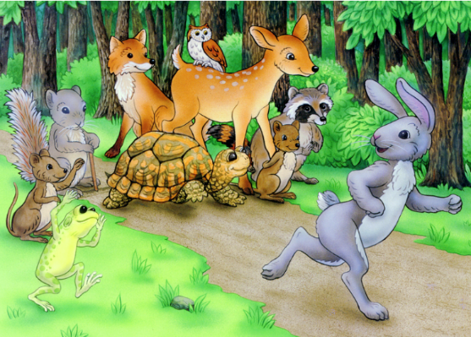
How are these two selections different?
“The Tortoise and the Hare”
“How Do We Get Around?”

Slide 217
Interactive Writing
Name and describe the different ways to travel in: “How Do We Get Around?”
“The Tortoise and the Hare” and “How Do We Get Around?” both ________________
______________________
_____________________.
“The Tortoise and the Hare” and “How Do We Get Around?” are different because ____
______________________
_____________________.
What do these two selections have in common?
How are these two selections different?

