Slide 1
Week 4 – Day 1

Slide 2
Phonemic Awareness
Phoneme Isolation
Listen as I say a word: thin.
The beginning sound in thin is /th/.
Say the sound with me: /th/.
Listen as I say a word: wash.
The ending sound in wash is /sh/.
Say the sound with me: /sh/.
Guided Practice:
Say the beginning sound you hear.
thump shoe them thick ship shell
Say the end sound you hear in these words.
fish path rang teeth cash wing

Slide 3
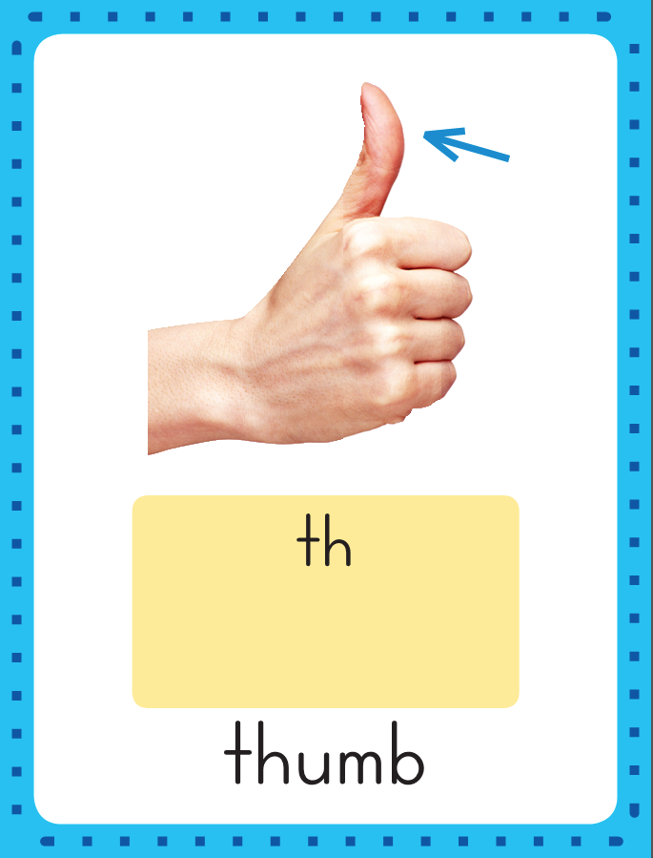
Introduce th, sh, -ng
thank
This is the Thumb Sound-Spelling Card.
The beginning sound is /th/.
The /th/ sound is spelled th.
Say it with me: /th/.
This sound is at the beginning of the word thumb.
Listen : thumb.
I’ll say /th/ as I write the letter several times.
them

Slide 4
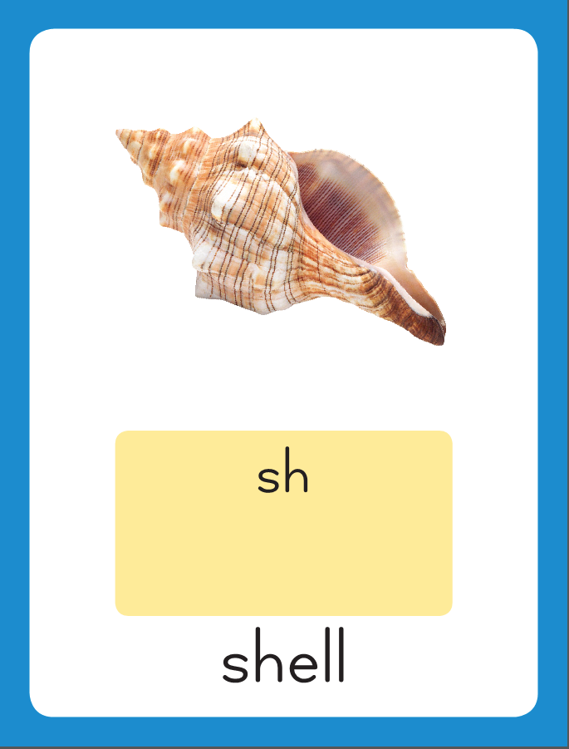
Introduce th, sh, -ng
This is the Shell Sound-Spelling Card.
The sound is /sh/.
The /sh/ sound is spelled sh.
Say it with me: /sh/.
This sound is at the beginning of the word shell.
Listen /sh/, shell.
I’ll say /sh/ as I write the letter several times.

Slide 5
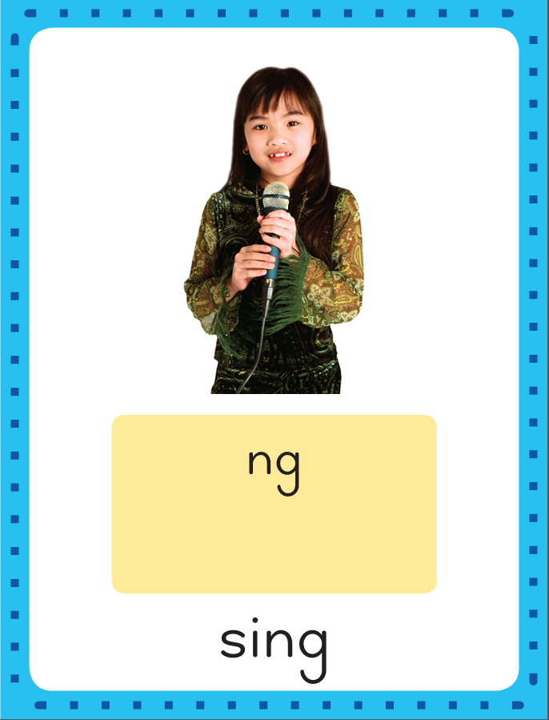
Introduce th, sh, -ng
This is the Sing Sound-Spelling Card.
The sound is /ng/.
The /ng/ sound is spelled ng.
Say it with me: /ng/.
This sound is at the eng of the word sing.
Listen /ng/, sing.
I’ll say /ng/ as I write the letter several times.

Slide 6
Introduce th, sh, -ng
Have children practice connecting the letters t and h to /th/ by writing them.
Now do it with me. Say /th/ as I write the letters th.
This time, write the letter th five times as you say the /th/ sound.

Slide 7
Introduce th, sh, -ng
Have children practice connecting the letters s and h to /sh/ by writing them.
Now do it with me. Say /sh/ as I write the letters sh.
This time, write the letter sh five times as you say the /sh/ sound.

Slide 8
Introduce th, sh, -ng
Have children practice connecting the letters n and g to /ng/ by writing them.
Now do it with me. Say /ng/ as I write the letter ng.
This time, write the letter ng five times as you say the /ng/ sound.

Slide 9
Blending Words with th, sh, -ng
th

Slide 10
Blending Words with th, sh, -ng
th
i

Slide 11
Blending Words with th, sh, -ng
th
i
n

Slide 12
Blending Words with th, sh, -ng
th
i
n

Slide 13
Blending Words with th, sh, -ng
s

Slide 14
Blending Words with th, sh, -ng
s
i

Slide 15
Blending Words with th, sh, -ng
s
i
ng

Slide 16
Blending Words with th, sh, -ng
s
i
ng

Slide 17
Blending Words with th, sh, -ng
m

Slide 18
Blending Words with th, sh, -ng
m
a

Slide 19
Blending Words with th, sh, -ng
m
a
th

Slide 20
Blending Words with th, sh, -ng
m
a
th

Slide 21
Blending Words with th, sh, -ng
w

Slide 22
Blending Words with th, sh, -ng
w
i

Slide 23
Blending Words with th, sh, -ng
w
i
sh

Slide 24
Blending Words with th, sh, -ng
w
i
sh

Slide 25
th i sh ng
a mp e th
nk sk ng sh

Slide 26
sh

Slide 27
sho

Slide 28
shop

Slide 29
shop w

Slide 30
shop wi

Slide 31
shop wish

Slide 32
shop wish th

Slide 33
shop wish the

Slide 34
shop wish then

Slide 35
shop wish then th

Slide 36
shop wish then tha

Slide 37
shop wish then that

Slide 38
shop wish then that
h

Slide 39
shop wish then that
hu

Slide 40
shop wish then that
hush

Slide 41
shop wish then that
hush cr

Slide 42
shop wish then that
hush cra

Slide 43
shop wish then that
hush crash

Slide 44
shop wish then that
hush crash s

Slide 45
shop wish then that
hush crash si

Slide 46
shop wish then that
hush crash sing

Slide 47
shop wish then that
hush crash sing s

Slide 48
shop wish then that
hush crash sing sa

Slide 49
shop wish then that
hush crash sing sang

Slide 50
shop wish then that
hush crash sing sang
b

Slide 51
shop wish then that
hush crash sing sang
ba

Slide 52
shop wish then that
hush crash sing sang
bang

Slide 53
shop wish then that
hush crash sing sang
bang l

Slide 54
shop wish then that
hush crash sing sang
bang lo

Slide 55
shop wish then that
hush crash sing sang
bang long

Slide 56
shop wish then that
hush crash sing sang
bang long th

Slide 57
shop wish then that
hush crash sing sang
bang long thi

Slide 58
shop wish then that
hush crash sing sang
bang long this

Slide 59
shop wish then that
hush crash sing sang
bang long this th

Slide 60
shop wish then that
hush crash sing sang
bang long this thu

Slide 61
shop wish then that
hush crash sing sang
bang long this thump

Slide 62
Internal Sounding Out
hip

Slide 63
Internal Sounding Out
hip ship

Slide 64
Internal Sounding Out
hip ship hot

Slide 65
Internal Sounding Out
hip ship hot shot

Slide 66
Internal Sounding Out
hip ship hot shot
mat

Slide 67
Internal Sounding Out
hip ship hot shot
mat math

Slide 68
Internal Sounding Out
hip ship hot shot
mat math desks

Slide 69
Internal Sounding Out
hip ship hot shot
mat math desks think

Slide 70
Internal Sounding Out
hip ship hot shot
mat math desks think
bring

Slide 71
Internal Sounding Out
hip ship hot shot
mat math desks think
bring grand

Slide 72
Internal Sounding Out
hip ship hot shot
mat math desks think
bring grand clang

Slide 73
Thank

Slide 74
Thank you

Slide 75
Thank you for

Slide 76
Thank you for handing

Slide 77
Thank you for handing that

Slide 78
Thank you for handing that shell

Slide 79
Thank you for handing that shell to

Slide 80
Thank you for handing that shell to me!

Slide 81
Thank you for handing that shell to me!
Beth

Slide 82
Thank you for handing that shell to me!
Beth thinks

Slide 83
Thank you for handing that shell to me!
Beth thinks she

Slide 84
Thank you for handing that shell to me!
Beth thinks she spots

Slide 85
Thank you for handing that shell to me!
Beth thinks she spots a

Slide 86
Thank you for handing that shell to me!
Beth thinks she spots a fish

Slide 87
Thank you for handing that shell to me!
Beth thinks she spots a fish in

Slide 88
Thank you for handing that shell to me!
Beth thinks she spots a fish in the

Slide 89
Thank you for handing that shell to me!
Beth thinks she spots a fish in the pond.

Slide 90
He

Slide 91
He rushed

Slide 92
He rushed to

Slide 93
He rushed to the

Slide 94
He rushed to the ship

Slide 95
He rushed to the ship to

Slide 96
He rushed to the ship to bring

Slide 97
He rushed to the ship to bring his

Slide 98
He rushed to the ship to bring his bag.

Slide 99
Spelling / Dictation
1.
2.
3.
4.
5.
fish
with
sang
ship
thing

Slide 100
High Frequency
Words

Slide 101
Read, Spell, Write
all
I see all the kids in the class.

Slide 102
Read, Spell, Write
call
I think I will call Seth.

Slide 103
Read, Spell, Write
day
I spent the day at the shop.

Slide 104
Read, Spell, Write
her
Beth lost her big bag.

Slide 105
Read, Spell, Write
want
Do you want to sing a song with me?

Slide 106
Have children read the sentences. Prompt them to identify the high-frequency words in connected text and to blend the decodable words.
I see all the kids in the class.
I think I will call Seth.
I spent the day at the shop.
Beth lost her big bag.
Do you want to sing a song with me?

Slide 107
Grammar
A common noun names a person, place, or thing and begins with a lowercase letter. Names of particular people, pets, places, and things are called proper nouns.
A proper noun begins with a capital letter.
Seth has a drum.
Miss Gum is at West School.
My dog Bing runs fast.
Proper Noun
Common Noun
Proper Noun
Proper Noun
Common Noun
Proper Noun
Which proper nouns name people, which name places, and which name pets?

Slide 108
Grammar
Work with a partner to identify the proper nouns.
We swim in Glass Pond.
Grant, Beth, and Russ snack on nuts.
Can you identify a common noun?

Slide 109
Week 4 – Day 2

Slide 110
Phonemic Awareness
Phoneme Categorization
Listen to these words: wish, bank, ship.
The words wish and ship have the the sound /i/.
The word bank does not.
It doesn’t belong.
Guided Practice:
I will say three words. Tell me which word does not belong and why:
sing, math, smash
Sing does not belong because math and smash have the sound /a/;
sing does not.
moth, path, shop
crash, rush, blush
head, mesh, long

Slide 111
Introduce th, sh, -ng
ship
This is the Shell Sound-Spelling Card.
The sound is /sh/.
The /sh/ sound is spelled sh.
Say it with me: /sh/.
This sound is at the beginning of the word shell.
Listen /sh/, shell.
I’ll say /sh/ as I write the letter several times.
trash
What are these letters?
What sound do they stand for?

Slide 112
Introduce th, sh, -ng
that
This is the Thumb Sound-Spelling Card.
The beginning sound is /th/.
The /th/ sound is spelled th.
Say it with me: /th/.
This sound is at the beginning of the word thumb.
Listen : thumb.
I’ll say /th/ as I write the letter several times.
path
What are these letters?
What sound do they stand for?

Slide 113
Introduce th, sh, -ng
This is the Sing Sound-Spelling Card.
The sound is /ng/.
The /ng/ sound is spelled ng.
Say it with me: /ng/.
This sound is at the eng of the word sing.
Listen /ng/, sing.
I’ll say /ng/ as I write the letter several times.
ring
What are these letters?
What sound do they stand for?

Slide 114
Blending Words with th, sh, -ng
r

Slide 115
Blending Words with th, sh, -ng
r
i

Slide 116
Blending Words with th, sh, -ng
r
i
ng

Slide 117
Blending Words with th, sh, -ng
r
i
ng

Slide 118
Blending Words with th, sh, -ng
f
l

Slide 119
Blending Words with th, sh, -ng
f
l
a

Slide 120
Blending Words with th, sh, -ng
f
l
a
sh

Slide 121
Blending Words with th, sh, -ng
f
l
a
sh

Slide 122
Blending Words with th, sh, -ng
th

Slide 123
Blending Words with th, sh, -ng
th
i

Slide 124
Blending Words with th, sh, -ng
th
i
ck

Slide 125
Blending Words with th, sh, -ng
th
i
ck

Slide 126
Blending Words with th, sh, -ng
sh

Slide 127
Blending Words with th, sh, -ng
sh
o

Slide 128
Blending Words with th, sh, -ng
sh
o
ck

Slide 129
Blending Words with th, sh, -ng
sh
o
ck

Slide 130
Blending Words with th, sh, -ng
c
l

Slide 131
Blending Words with th, sh, -ng
c
l
o

Slide 132
Blending Words with th, sh, -ng
c
l
o
th

Slide 133
Blending Words with th, sh, -ng
c
l
o
th

Slide 134
th

Slide 135
tha

Slide 136
that

Slide 137
that th

Slide 138
that thu

Slide 139
that thump

Slide 140
that thump m

Slide 141
that thump mo

Slide 142
that thump moth

Slide 143
that thump moth
sh

Slide 144
that thump moth
she

Slide 145
that thump moth
shed

Slide 146
that thump moth
shed tr

Slide 147
that thump moth
shed tra

Slide 148
that thump moth
shed trash

Slide 149
that thump moth
shed trash sh

Slide 150
that thump moth
shed trash she

Slide 151
that thump moth
shed trash shell

Slide 152
that thump moth
shed trash shell
wing
Internal Sounding Out

Slide 153
that thump moth
shed trash shell
wing bring
Internal Sounding Out

Slide 154
that thump moth
shed trash shell
wing bring stung
Internal Sounding Out

Slide 155
Build Words with th, sh, -ng
th
i
ng
What is the new word we made?
Let’s blend all the sounds and read the word.
Change the th to w.

Slide 156
Build Words with th, sh, -ng
w
i
ng
What is the new word we made?
Let’s blend all the sounds and read the word.
Change the w to s.

Slide 157
Build Words with th, sh, -ng
s
i
ng
What is the new word we made?
Let’s blend all the sounds and read the word.
Add l after the s.

Slide 158
Build Words with th, sh, -ng
s
l
i
ng
What is the new word we made?
Let’s blend all the sounds and read the word.
Change the l to t.

Slide 159
Build Words with th, sh, -ng
s
t
i
ng
What is the new word we made?
Let’s blend all the sounds and read the word.
Remove the t.

Slide 160
Build Words with th, sh, -ng
s
i
ng
What is the new word we made?
Let’s blend all the sounds and read the word.
Change the s to r.

Slide 161
Build Words with th, sh, -ng
r
i
ng
What is the new word we made?
Let’s blend all the sounds and read the word.
Add a b in front of the r.

Slide 162
Build Words with th, sh, -ng
b
r
i
ng
What is the new word we made?
Let’s blend all the sounds and read the word.
Change the br to w.

Slide 163
Build Words with th, sh, -ng
w
i
ng
What is the new word we made?
Let’s blend all the sounds and read the word.
Change the w to th.

Slide 164
Build Words with th, sh, -ng
th
i
ng
What is the new word we made?
Let’s blend all the sounds and read the word.
Change the ng to nk.

Slide 165
Build Words with th, sh, -ng
th
i
nk
What is the new word we made?
Let’s blend all the sounds and read the word.
Change the nk to n.

Slide 166
Build Words with th, sh, -ng
th
i
n
What is the new word we made?
Let’s blend all the sounds and read the word.
Change the i to a.

Slide 167
Build Words with th, sh, -ng
th
a
n
What is the new word we made?
Let’s blend all the sounds and read the word.

Slide 168
Structural Analysis
Say the word slowly, clapping for each syllable.
Cabin has two syllables.
When a syllable ends in a consonant and has one vowel letter, the vowel is usually short.
cabin
cab/in
Cab ends with b and has one vowel letter,
so the vowel sound in cab is /a/, the short a sound.
This is called a closed syllable.

Slide 169
Structural Analysis
Divide the syllable between the two consonants in t he middle of a word or divide before the –ing ending.
napkin
dentist
mitten
rabbit
picnic
helping
wishing
Help students divide each word into syllables, then read the words.
Help them identify the short vowel sounds and then make a list of all the closed syllables.

Slide 170
-th
-sh
-ng

Slide 171
fish
wink
fish
with
fast
with
sang
sang
shop
shop
thing
wink
thing
ship
fast
ship

Slide 172
High Frequency
Words

Slide 173
Read, Spell, Write
all
I see all the kids in the class.

Slide 174
Read, Spell, Write
call
I think I will call Seth.

Slide 175
Read, Spell, Write
day
I spent the day at the shop.

Slide 176
Read, Spell, Write
her
Beth lost her big bag.

Slide 177
Read, Spell, Write
want
Do you want to sing a song with me?

Slide 178
Grammar
The names of particular people, pets, places, and things are called proper nouns.
Proper nouns begin with a capital letter.
Bev gets Scott a snack.
Gramps lives at the top of Trent Hill.
Have children work in pairs to identify and circle each proper noun.

Slide 179
Week 4 – Day 3

Slide 180
Phonemic Awareness
Phoneme Isolation
Listen as I say the sounds in a word: /sh/ /e/ /l/.
The beginning sound in thin is /th/.
Say the sound with me: /th/.
Listen as I say a word: wash.
The ending sound in wash is /sh/.
Say the sound with me: /sh/.
Guided Practice:
Let’s do some together. I am going to say some words, sound by sound. Listen as I say a word. Blend the sounds together to say a word.
/th/ /a/ /n/ /b/ /r/ /o/ /th/ /b/ /a/ /ng/
/sh/ /a/ /k/ /m/ /a/ /sh/ /s/ /t/ /i/ /ng/
/sh/ /i/ /p/ /th/ /i/ /n/ /k/ /i/ /ng/

Slide 181
Blending Words with th, sh, -ng
s

Slide 182
Blending Words with th, sh, -ng
s
t

Slide 183
Blending Words with th, sh, -ng
s
t
i

Slide 184
Blending Words with th, sh, -ng
s
t
i
ng

Slide 185
Blending Words with th, sh, -ng
s
t
i
ng

Slide 186
Blending Words with th, sh, -ng
sh

Slide 187
Blending Words with th, sh, -ng
sh
o

Slide 188
Blending Words with th, sh, -ng
sh
o
p

Slide 189
Blending Words with th, sh, -ng
sh
o
p

Slide 190
Blending Words with th, sh, -ng
m

Slide 191
Blending Words with th, sh, -ng
m
o

Slide 192
Blending Words with th, sh, -ng
m
o
th

Slide 193
Blending Words with th, sh, -ng
m
o
th

Slide 194
Blending Words with th, sh, -ng
th

Slide 195
Blending Words with th, sh, -ng
th
i

Slide 196
Blending Words with th, sh, -ng
th
i
s

Slide 197
Blending Words with th, sh, -ng
th
i
s

Slide 198
Blending Words with th, sh, -ng
f

Slide 199
Blending Words with th, sh, -ng
f
r

Slide 200
Blending Words with th, sh, -ng
f
r
e

Slide 201
Blending Words with th, sh, -ng
f
r
e
sh

Slide 202
Blending Words with th, sh, -ng
f
r
e
sh

Slide 203
sh o th ng
i ll nk e
cl a mp st
sk th u sh

Slide 204
sh

Slide 205
shi

Slide 206
ship

Slide 207
ship sh

Slide 208
ship sho

Slide 209
ship shop

Slide 210
ship shop sh

Slide 211
ship shop she

Slide 212
ship shop shell

Slide 213
ship shop shell w

Slide 214
ship shop shell wi

Slide 215
ship shop shell wish

Slide 216
ship shop shell wish
f

Slide 217
ship shop shell wish
fi

Slide 218
ship shop shell wish
fish

Slide 219
ship shop shell wish
fish d

Slide 220
ship shop shell wish
fish di

Slide 221
ship shop shell wish
fish dish

Slide 222
ship shop shell wish
fish dish th

Slide 223
ship shop shell wish
fish dish thi

Slide 224
ship shop shell wish
fish dish this

Slide 225
ship shop shell wish
fish dish this th

Slide 226
ship shop shell wish
fish dish this tha

Slide 227
ship shop shell wish
fish dish this that

Slide 228
ship shop shell wish
fish dish this that
th

Slide 229
ship shop shell wish
fish dish this that
thi

Slide 230
ship shop shell wish
fish dish this that
thing

Slide 231
ship shop shell wish
fish dish this that
thing th

Slide 232
ship shop shell wish
fish dish this that
thing thi

Slide 233
ship shop shell wish
fish dish this that
thing think

Slide 234
ship shop shell wish
fish dish this that
thing think s

Slide 235
ship shop shell wish
fish dish this that
thing think so

Slide 236
ship shop shell wish
fish dish this that
thing think song

Slide 237
ship shop shell wish
fish dish this that
thing think song st

Slide 238
ship shop shell wish
fish dish this that
thing think song sti

Slide 239
ship shop shell wish
fish dish this that
thing think song sting

Slide 240
ship shop shell wish
fish dish this that
thing think song sting
st

Slide 241
ship shop shell wish
fish dish this that
thing think song sting
sta

Slide 242
ship shop shell wish
fish dish this that
thing think song sting
stand

Slide 243
ship shop shell wish
fish dish this that
thing think song sting
stand h

Slide 244
ship shop shell wish
fish dish this that
thing think song sting
stand hu

Slide 245
ship shop shell wish
fish dish this that
thing think song sting
stand hump

Slide 246
ship shop shell wish
fish dish this that
thing think song sting
stand hump th

Slide 247
ship shop shell wish
fish dish this that
thing think song sting
stand hump thu

Slide 248
ship shop shell wish
fish dish this that
thing think song sting
stand hump thump

Slide 249
Internal Sounding Out
singing

Slide 250
Internal Sounding Out
singing rushing

Slide 251
Internal Sounding Out
singing rushing bringing

Slide 252
Internal Sounding Out
singing rushing bringing
clanging

Slide 253
Internal Sounding Out
singing rushing bringing
clanging banging

Slide 254
Internal Sounding Out
singing rushing bringing
clanging banging
rabbit

Slide 255
Internal Sounding Out
singing rushing bringing
clanging banging
rabbit basket

Slide 256
Internal Sounding Out
singing rushing bringing
clanging banging
rabbit basket picnic

Slide 257
Internal Sounding Out
singing rushing bringing
clanging banging
rabbit basket picnic
selfish

Slide 258
Internal Sounding Out
singing rushing bringing
clanging banging
rabbit basket picnic
selfish absent

Slide 259
We

Slide 260
We thank

Slide 261
We thank Seth

Slide 262
We thank Seth for

Slide 263
We thank Seth for singing

Slide 264
We thank Seth for singing with

Slide 265
We thank Seth for singing with us.

Slide 266
We thank Seth for singing with us.
The

Slide 267
We thank Seth for singing with us.
The king

Slide 268
We thank Seth for singing with us.
The king wished

Slide 269
We thank Seth for singing with us.
The king wished for

Slide 270
We thank Seth for singing with us.
The king wished for a

Slide 271
We thank Seth for singing with us.
The king wished for a ship

Slide 272
We thank Seth for singing with us.
The king wished for a ship filled

Slide 273
We thank Seth for singing with us.
The king wished for a ship filled with

Slide 274
We thank Seth for singing with us.
The king wished for a ship filled with fish!

Slide 276
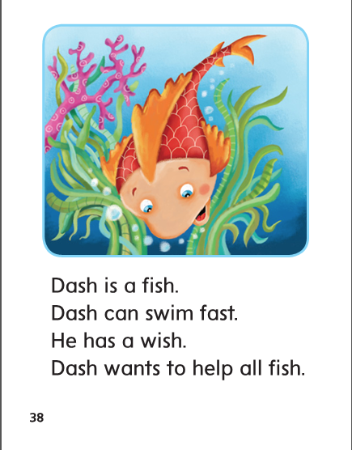

Slide 277
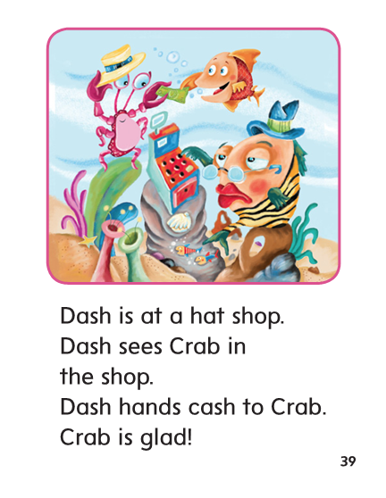

Slide 278
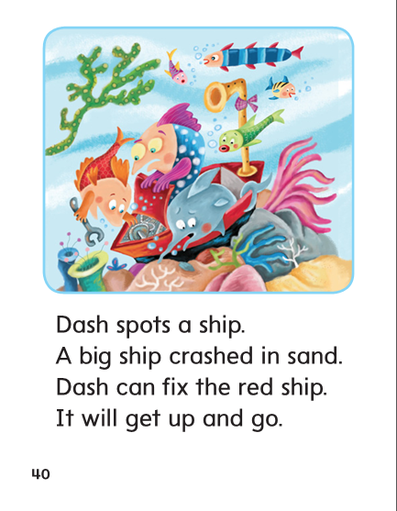

Slide 279
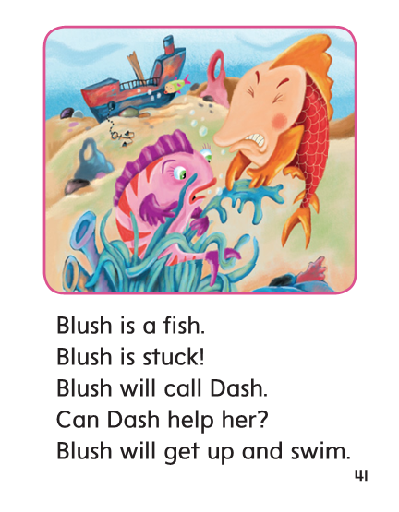

Slide 280
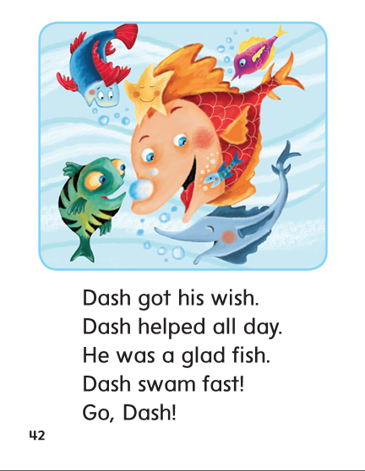

Slide 281
Structural Analysis
Say the word slowly, clapping for each syllable.
Rabbit has two syllables.
When a syllable ends in a consonant and has one vowel letter, the vowel is usually short.
rabbit
rab/bit
Rab ends with b and has one vowel letter,
so the vowel sound in rab is /a/, the short a sound.
This is called a closed syllable.
Bit ends with a t and has one vowel sound,
so the vowel sound in bit is /i/.

Slide 282
Structural Analysis
Sometimes, you may need to approximate sounds in multisyllabic words.
button
but/ton

Slide 283
Structural Analysis
Divide the syllable between the two consonants in the middle of a word or divide before the –ing ending.
thinking
pocket
finish
Help students divide each word into syllables, then read the words.
Help them identify the short vowel sound in each syllable and how they know the vowel sounds are short.

Slide 284
High Frequency
Words

Slide 285
Read, Spell, Write
all
I see all the kids in the class.

Slide 286
Read, Spell, Write
call
I think I will call Seth.

Slide 287
Read, Spell, Write
day
I spent the day at the shop.

Slide 288
Read, Spell, Write
her
Beth lost her big bag.

Slide 289
Read, Spell, Write
want
Do you want to sing a song with me?

Slide 290
Build Fluency: Word Automaticity
I want to call Beth.
I will ask her to bring a sled.
We will play all day!

Slide 291
Grammar
A proper noun names particular people, places, or things.
What are the two proper nouns in this sentence:
Could I help you, Dad? Chip asks.
What words name a particular person, place, or thing?
Have children work with partners to write new sentences about people that they know. Then have them circle the proper nouns in each sentence.

Slide 292
Week 4 – Day 4

Slide 293
Phonemic Awareness
Phoneme Categorization
Listen as I say three words: truck, hang, thump.
Truck and thump both have the /u/ sound in the middle,
but hang does not. Hang does not belong.
Guided Practice:
Listen to these words. Two words have the same middle sound. Which word does not belong?
head, hug, hunk swum, jump, think lost, shop, brush
blush, cash, stump ship, trick, rush stung, cost, rush

Slide 294
Build Words with th, sh, -ng
m
a
th
What is the new word we made?
Let’s blend all the sounds and read the word.
Change the th to sh.

Slide 295
Build Words with th, sh, -ng
m
a
sh
What is the new word we made?
Let’s blend all the sounds and read the word.
Change the m to r.

Slide 296
Build Words with th, sh, -ng
r
a
sh
What is the new word we made?
Let’s blend all the sounds and read the word.
Change the sh to ng.

Slide 297
Build Words with th, sh, -ng
r
a
ng
What is the new word we made?
Let’s blend all the sounds and read the word.
Change the a to i.

Slide 298
Build Words with th, sh, -ng
r
i
ng
What is the new word we made?
Let’s blend all the sounds and read the word.
Change the r to th.

Slide 299
Build Words with th, sh, -ng
th
i
ng
What is the new word we made?
Let’s blend all the sounds and read the word.
Change the ng to ck.

Slide 300
Build Words with th, sh, -ng
th
i
ck
What is the new word we made?
Let’s blend all the sounds and read the word.
Change the th to s.

Slide 301
Build Words with th, sh, -ng
s
i
ck
What is the new word we made?
Let’s blend all the sounds and read the word.
Change the i to a.

Slide 302
Build Words with th, sh, -ng
s
a
ck
What is the new word we made?
Let’s blend all the sounds and read the word.
Change the s to sh.

Slide 303
Build Words with th, sh, -ng
sh
a
ck
What is the new word we made?
Let’s blend all the sounds and read the word.
Change the a to o.

Slide 304
Build Words with th, sh, -ng
sh
o
ck
What is the new word we made?
Let’s blend all the sounds and read the word.
Change the ck to p.

Slide 305
Build Words with th, sh, -ng
sh
o
p
What is the new word we made?
Let’s blend all the sounds and read the word.
Change the sh to h.

Slide 306
Build Words with th, sh, -ng
h
o
p
What is the new word we made?
Let’s blend all the sounds and read the word.
Change the p to t.

Slide 307
Build Words with th, sh, -ng
h
o
t
What is the new word we made?
Let’s blend all the sounds and read the word.
Change the h to l.

Slide 308
Build Words with th, sh, -ng
l
o
t
What is the new word we made?
Let’s blend all the sounds and read the word.
Change the t to g.

Slide 309
Build Words with th, sh, -ng
l
o
ng
What is the new word we made?
Let’s blend all the sounds and read the word.

Slide 310
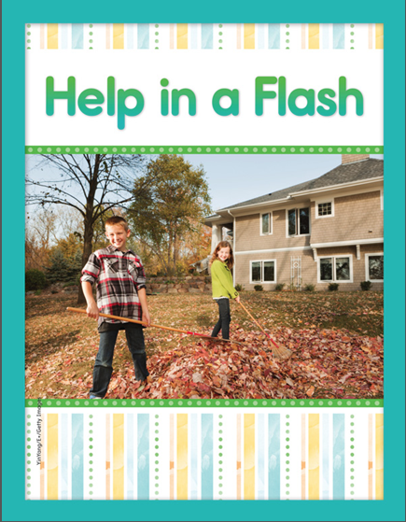

Slide 311
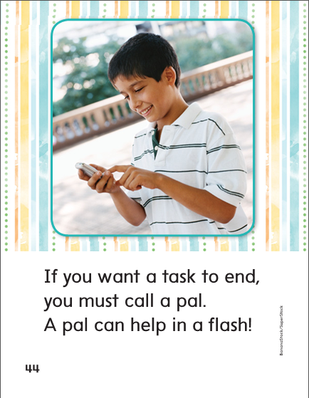

Slide 318
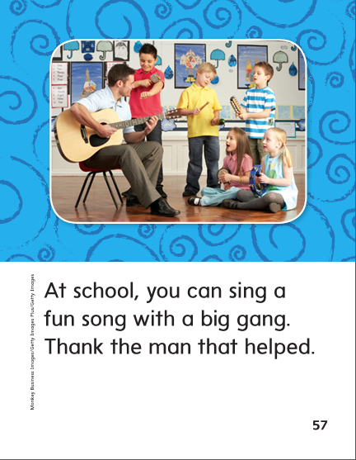

Slide 322
Structural Analysis
When a syllable has only one vowel letter and ends with a consonant,
the vowel sound is usually short.
This is called a closed syllable.
selfish
ringing
Have students come to the board and circle the closed syllables.
Ask others to explain why they are closed.
Remember you may have to approximate sounds in order to read the multisyllabic words correctly.

Slide 323
Structural Analysis
Have students work in pairs to divide the words and pronounce them.
Then have then write sentences with these words.
dentist
wishing
mitten
rabbit
thinking

Slide 324
Structural Analysis
Divide the syllable between the two consonants in the middle of a word or divide before the –ing ending.
thinking
pocket
finish
Help students divide each word into syllables, then read the words.
Help them identify the short vowel sound in each syllable and how they know the vowel sounds are short.

Slide 325
High Frequency
Words

Slide 326
Read, Spell, Write
all
I see all the kids in the class.

Slide 327
Read, Spell, Write
call
I think I will call Seth.

Slide 328
Read, Spell, Write
day
I spent the day at the shop.

Slide 329
Read, Spell, Write
her
Beth lost her big bag.

Slide 330
Read, Spell, Write
want
Do you want to sing a song with me?

Slide 331
Grammar
A proper noun names particular people, places, or things.
Proper nouns begin with a capital letter.
Proper Nouns
Common Nouns

Slide 332
dog
Stansbury Elementary
Scooby Doo
city
man
West Valley City
Mr. Broderick
president
school
President Obama

Slide 333
Week 4 – Day 5

Slide 334
Phonemic Awareness
Phoneme Blending
Listen as I say a group of sounds. Then blend the sounds to form a word.
/k/ /a/ /sh/ /th/ /i/ /nk/ /s/ /i/ /ng/
/s/ /t/ /u/ /ng/ /b/ /r/ /i/ /ng/ /s/ /m/ /a/ /sh/
Phoneme Segmentation
I am going to say a word. Tell me the sounds you hear in the word.
thin fish ship flash cling math

Slide 335
Blend and Build Words with End Blends
Read and say these words:
thank
with
shell
wish
stung

Slide 336
Blend and Build Words with End Blends
h
i
p
What is the new word we made?
Let’s blend all the sounds and read the word.
Change the h to sh.

Slide 337
Blend and Build Words with End Blends
sh
i
p
What is the new word we made?
Let’s blend all the sounds and read the word.
Change the i to o.

Slide 338
Blend and Build Words with End Blends
sh
o
p
What is the new word we made?
Let’s blend all the sounds and read the word.
Change the p to t.

Slide 339
Blend and Build Words with End Blends
sh
o
t
What is the new word we made?
Let’s blend all the sounds and read the word.
Change the sh to h.

Slide 340
Blend and Build Words with End Blends
h
o
t
What is the new word we made?
Let’s blend all the sounds and read the word.
Change the h to p.

Slide 341
Blend and Build Words with End Blends
p
o
t
What is the new word we made?
Let’s blend all the sounds and read the word.
Change the o to i.

Slide 342
Blend and Build Words with End Blends
p
i
t
What is the new word we made?
Let’s blend all the sounds and read the word.
Change the t to n.

Slide 343
Blend and Build Words with End Blends
p
i
n
What is the new word we made?
Let’s blend all the sounds and read the word.
Change the p to w.

Slide 344
Blend and Build Words with End Blends
w
i
ng
What is the new word we made?
Let’s blend all the sounds and read the word.
Change the w to d.

Slide 345
Blend and Build Words with End Blends
d
i
ng
What is the new word we made?
Let’s blend all the sounds and read the word.
Change the ng to sh.

Slide 346
Blend and Build Words with End Blends
d
i
sh
What is the new word we made?
Let’s blend all the sounds and read the word.
Change the i to a.

Slide 347
Blend and Build Words with End Blends
d
a
sh
What is the new word we made?
Let’s blend all the sounds and read the word.
Change the d to cl.

Slide 348
Blend and Build Words with End Blends
cl
a
sh
What is the new word we made?
Let’s blend all the sounds and read the word.
Change the cl to b.

Slide 349
Blend and Build Words with End Blends
b
a
th
What is the new word we made?
Let’s blend all the sounds and read the word.
Change the th to ng.

Slide 350
Blend and Build Words with End Blends
b
a
ng
What is the new word we made?
Let’s blend all the sounds and read the word.
Change the b to s.

Slide 351
Blend and Build Words with End Blends
s
a
ng
What is the new word we made?
Let’s blend all the sounds and read the word.
Change the a to o.

Slide 352
Blend and Build Words with End Blends
s
o
ng
What is the new word we made?
Let’s blend all the sounds and read the word.

Slide 353
Word Automaticity
ship

Slide 354
this

Slide 355
singing

Slide 356
rabbit

Slide 357
stand

Slide 358
shop

Slide 359
that

Slide 360
rushing

Slide 361
basket

Slide 362
hump

Slide 363
shell

Slide 364
thing

Slide 365
bringing

Slide 366
picnic

Slide 367
thump

Slide 368
wish

Slide 369
think

Slide 370
clanging

Slide 371
selfish

Slide 372
desks

Slide 373
fish

Slide 374
long

Slide 375
banging

Slide 376
absent

Slide 377
vents

Slide 378
dish

Slide 379
song

Slide 380
Structural Analysis
Have children read it and divide it into syllables.
Identify the vowel sounds and explain why the syllables are closed syllables.
pocket

Slide 381
Structural Analysis
Have children practice writing and reading more words with closed syllables.
basket
finish
helping
fishing
jumping

Slide 382
High Frequency
Words

Slide 383
Read, Spell, Write
all
I see all the kids in the class.

Slide 384
Read, Spell, Write
call
I think I will call Seth.

Slide 385
Read, Spell, Write
day
I spent the day at the shop.

Slide 386
Read, Spell, Write
her
Beth lost her big bag.

Slide 387
Read, Spell, Write
want
Do you want to sing a song with me?

Slide 388
Grammar
Have children describe proper nouns.
Have children identify the proper nouns.
Ken and Len like to eat Fizz Puffs.
How do you know which words in a sentence are proper nouns?

Slide 389
Grammar
Have children describe proper nouns.
Have children identify the proper nouns.
First Person: My name is _______________. Who are you?
Second Person: My name is _____________.
First Person: I live on ___________________. I go to ____________________.
Second Person: My pet is ______________. I like ______________________.
name of street
name of school
name of cereal
Have pairs of children each take a part and read the dialogue aloud,
filling in the proper nouns.

