Slide 1
Week 1 – Day 1

Slide 2
Phonemic Awareness – Phoneme Identity
I will say three words.
One sound will be the same in all three words.
Listen: late, make, gave.
I hear the same middle sound in late, make, and gave.
Listen: /laaat/, /maaak/, /gaaav/.
The middle sound is /a/.
Say the sound with me: /aaa/.
Guided Practice:
Listen as I say three words. Tell me the middle sound you hear in all three words.
take, vase, name gate, tape, bake fan, bag, mad
wave, game, cape bug, pup, sun safe, cape, tale
pen, net, web date, fake, vase top, log, not

Slide 3
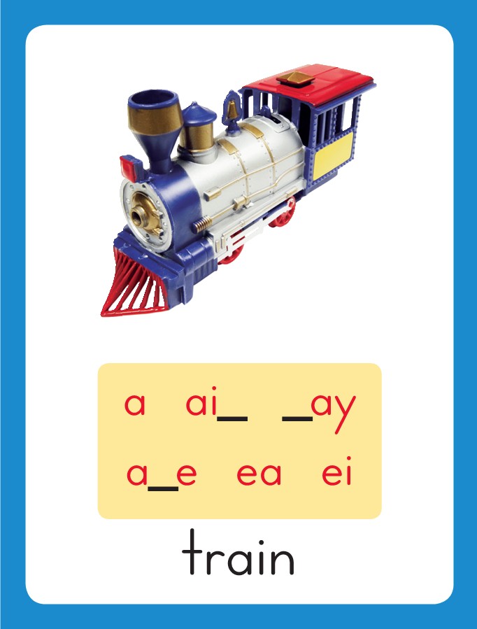
Introduce Long a: a_e
Look at this word: at.
Say it with me.
This word has the short a sound /a/.
I’ll add an e to the end.
The new word is ate.
The letters a and e act together to make the sound /a/.
Listen as I say the word: /ate/.
This is the Train
Sound-Spelling Card.
The sound is /a/.
Today we will learn a spelling for the /a/ sound.
at
ate

Slide 4
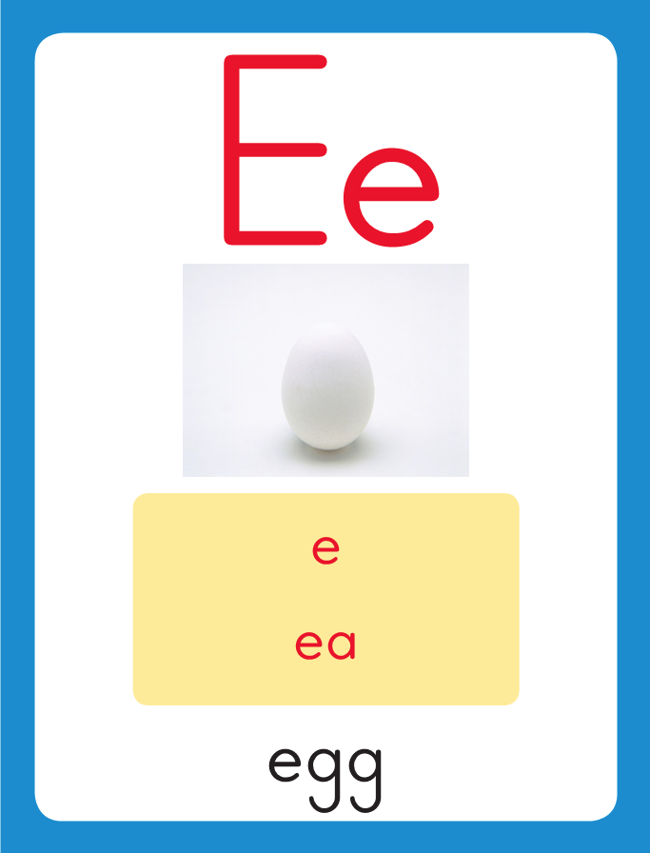
Introduce short i
Have children practice connecting the letter e to the sound /e/ by writing it.
Now do it with me. Say /e/ as I write the letter e.
This time, write the letter e five times as you say the /e/ sound.

Slide 5
Blending Words with Long a: a_e
a

Slide 6
Blending Words with Long a: a_e
a
p
e

Slide 7
Blending Words with Long a: a_e
a
p
e

Slide 8
Blending Words with Long a: a_e
m

Slide 9
Blending Words with Long a: a_e
m
a
_
e

Slide 10
Blending Words with Long a: a_e
m
a
_
e

Slide 11
Blending Words with Long a: a_e
m
a
d
e

Slide 12
Blending Words with Long a: a_e
m

Slide 13
Blending Words with Long a: a_e
m
a
_
e

Slide 14
Blending Words with Long a: a_e
m
a
_
e

Slide 15
Blending Words with Long a: a_e
m
a
k
e

Slide 16
Blending Words with Long a: a_e
b

Slide 17
Blending Words with Long a: a_e
b
a
_
e

Slide 18
Blending Words with Long a: a_e
b
a
_
e

Slide 19
Blending Words with Long a: a_e
b
a
k
e

Slide 20
Blending Words with Long a: a_e
g

Slide 21
Blending Words with Long a: a_e
g
a
_
e

Slide 22
Blending Words with Long a: a_e
g
a
_
e

Slide 23
Blending Words with Long a: a_e
g
a
m
e

Slide 24
Blending Words with Long a: a_e
s

Slide 25
Blending Words with Long a: a_e
s
a
_
e

Slide 26
Blending Words with Long a: a_e
s
a
_
e

Slide 27
Blending Words with Long a: a_e
s
a
l
e

Slide 28
Blending Words with Long a: a_e
g
r

Slide 29
Blending Words with Long a: a_e
g
r
a
_
e

Slide 30
Blending Words with Long a: a_e
g
r
a
p
e

Slide 31
Blending Words with Long a: a_e
g
r
a
p
e

Slide 32
a_e wh sh gr
sk ch a_e ph
sn a_e z a

Slide 33
l

Slide 34
la_e

Slide 35
late

Slide 36
late t

Slide 37
late ta_e

Slide 38
late take

Slide 39
late take l

Slide 40
late take la_e

Slide 41
late take lake

Slide 42
late take lake
w

Slide 43
late take lake
wa_e

Slide 44
late take lake
wade

Slide 45
late take lake
wade w

Slide 46
late take lake
wade wa_e

Slide 47
late take lake
wade wake

Slide 48
late take lake
wade wake g

Slide 49
late take lake
wade wake ga_e

Slide 50
late take lake
wade wake gaze

Slide 51
late take lake
wade wake gaze
l

Slide 52
late take lake
wade wake gaze
la_e

Slide 53
late take lake
wade wake gaze
lane

Slide 54
late take lake
wade wake gaze
lane g

Slide 55
late take lake
wade wake gaze
lane ga_e

Slide 56
late take lake
wade wake gaze
lane gate

Slide 57
late take lake
wade wake gaze
lane gate c

Slide 58
late take lake
wade wake gaze
lane gate ca_e

Slide 59
late take lake
wade wake gaze
lane gate cave

Slide 60
late take lake
wade wake gaze
lane gate cave
f

Slide 61
late take lake
wade wake gaze
lane gate cave
fa_e

Slide 62
late take lake
wade wake gaze
lane gate cave
fade

Slide 63
late take lake
wade wake gaze
lane gate cave
fade s

Slide 64
late take lake
wade wake gaze
lane gate cave
fade sa_e

Slide 65
late take lake
wade wake gaze
lane gate cave
fade save

Slide 66
late take lake
wade wake gaze
lane gate cave
fade save t

Slide 67
late take lake
wade wake gaze
lane gate cave
fade save ta_e

Slide 68
late take lake
wade wake gaze
lane gate cave
fade save tame

Slide 69
Internal Sounding Out
tap

Slide 70
Internal Sounding Out
tap tape

Slide 71
Internal Sounding Out
tap tape rat

Slide 72
Internal Sounding Out
tap tape rat rate

Slide 73
Internal Sounding Out
tap tape rat rate
snack

Slide 74
Internal Sounding Out
tap tape rat rate
snack snake

Slide 75
Internal Sounding Out
tap tape rat rate
snack snake whale

Slide 76
Internal Sounding Out
tap tape rat rate
snack snake whale
skate

Slide 77
Internal Sounding Out
tap tape rat rate
snack snake whale
skate shade

Slide 78
Internal Sounding Out
tap tape rat rate
snack snake whale
skate shade chase

Slide 79
Internal Sounding Out
tap tape rat rate
snack snake whale
skate shade chase
grape

Slide 80
Internal Sounding Out
tap tape rat rate
snack snake whale
skate shade chase
grape phase

Slide 81
Internal Sounding Out
tap tape rat rate
snack snake whale
skate shade chase
grape phase shame

Slide 82
Nate

Slide 83
Nate and

Slide 84
Nate and Kate

Slide 85
Nate and Kate like

Slide 86
Nate and Kate like to

Slide 87
Nate and Kate like to wade

Slide 88
Nate and Kate like to wade in

Slide 89
Nate and Kate like to wade in the

Slide 90
Nate and Kate like to wade in the lake.

Slide 91
Nate and Kate like to wade in the lake.
Brave

Slide 92
Nate and Kate like to wade in the lake.
Brave Dave

Slide 93
Nate and Kate like to wade in the lake.
Brave Dave gave

Slide 94
Nate and Kate like to wade in the lake.
Brave Dave gave the

Slide 95
Nate and Kate like to wade in the lake.
Brave Dave gave the whale

Slide 96
Nate and Kate like to wade in the lake.
Brave Dave gave the whale a

Slide 97
Nate and Kate like to wade in the lake.
Brave Dave gave the whale a snack.

Slide 98
Can

Slide 99
Can a

Slide 100
Can a snake

Slide 101
Can a snake bake

Slide 102
Can a snake bake you

Slide 103
Can a snake bake you a

Slide 104
Can a snake bake you a cake?

Slide 105
Spelling / Dictation
1. _________
2. _________
3. _________
4. _________
5. _________
take
came
gate
chin
graph

Slide 106
High Frequency
Words

Slide 107
Read, Spell, Write
away
My dog ran away, but he came back.

Slide 108
Read, Spell, Write
now
Can we play the game now?

Slide 109
Read, Spell, Write
some
I see some snakes in the grass.

Slide 110
Read, Spell, Write
today
I had fun at camp today.

Slide 111
Read, Spell, Write
way
Is this the way to school?

Slide 112
Read, Spell, Write
why
Why are the ducks quacking at me?

Slide 113
Have children read the sentences. Prompt them to identify the high-frequency words in connected text and to blend the decodable words.
My dog ran away, but he came back.
Can we play the game now?
3. I see some snakes in the grass.

Slide 114
Have children read the sentences. Prompt them to identify the high-frequency words in connected text and to blend the decodable words.
I had fun at camp today.
Is this the way to school?
3. Why are the ducks quacking at me?

Slide 115
Grammar
A word that shows action is called a verb.
Kate walks to school.
The whale swims fasts.
Walks and swims are verbs. Both of these words show action.
To illustrate that a verb shows action, have children act out these verbs: smile, write, stand, sit, laugh, eat, sleep.

Slide 116
Grammar
Work with a partner to identify the verbs
The wet dog shakes.
Jake kicks the ball and then runs.

Slide 117
Week 1 – Day 2

Slide 118
Phonemic Awareness – Phoneme Addition
Listen as I say this word: ape.
Now listen as I add the /k/ sound to the beginning: ape, /k/ /k/ /kape/.
When I add the /k/ sound to ape, I make a new word: cape.
ace/face age/page take/steak
Guided Practice:
I am going to say more sounds and words. Add the sound to the beginning of the word to get a new word. Tell me the word.
aim/name ache/make ace/race
aid/fade late/plate ape/shape

Slide 119
Introduce short i
ape
What are these letters?
What sound do they stand for?
gave

Slide 120
Blending Words with Long a: a_e
s

Slide 121
Blending Words with Long a: a_e
s
a
_
e

Slide 122
Blending Words with Long a: a_e
s
a
m
e

Slide 123
Blending Words with Long a: a_e
s
a
m
e

Slide 124
Blending Words with Long a: a_e
l

Slide 125
Blending Words with Long a: a_e
l
a
_
e

Slide 126
Blending Words with Long a: a_e
l
a
t
e

Slide 127
Blending Words with Long a: a_e
l
a
t
e

Slide 128
Blending Words with Long a: a_e
wh

Slide 129
Blending Words with Long a: a_e
wh
a
_
e

Slide 130
Blending Words with Long a: a_e
wh
a
l
e

Slide 131
Blending Words with Long a: a_e
wh
a
l
e

Slide 132
Blending Words with Long a: a_e
s
n

Slide 133
Blending Words with Long a: a_e
s
n
a
_
e

Slide 134
Blending Words with Long a: a_e
s
n
a
k
e

Slide 135
Blending Words with Long a: a_e
s
n
a
k
e

Slide 136
t

Slide 137
ta_e

Slide 138
tape

Slide 139
tape g

Slide 140
tape ga_e

Slide 141
tape game

Slide 142
tape game g

Slide 143
tape game ga_e

Slide 144
tape game gave

Slide 145
tape game gave
a_e

Slide 146
tape game gave
ate

Slide 147
tape game gave
ate c

Slide 148
tape game gave
ate ca_e

Slide 149
tape game gave
ate cane

Slide 150
tape game gave
ate cane t

Slide 151
tape game gave
ate cane ta_e

Slide 152
tape game gave
ate cane tale

Slide 153
tape game gave
ate cane tale
t

Slide 154
tape game gave
ate cane tale
ta_e

Slide 155
tape game gave
ate cane tale
take

Slide 156
tape game gave
ate cane tale
take f

Slide 157
tape game gave
ate cane tale
take fa_e

Slide 158
tape game gave
ate cane tale
take fame

Slide 159
tape game gave
ate cane tale
take fame d

Slide 160
tape game gave
ate cane tale
take fame da_e

Slide 161
tape game gave
ate cane tale
take fame date

Slide 162
tape game gave
ate cane tale
take fame date
sk

Slide 163
tape game gave
ate cane tale
take fame date
ska_e

Slide 164
tape game gave
ate cane tale
take fame date
skate

Slide 165
tape game gave
ate cane tale
take fame date
skate gr

Slide 166
tape game gave
ate cane tale
take fame date
skate gra_e

Slide 167
tape game gave
ate cane tale
take fame date
skate grade

Slide 168
tape game gave
ate cane tale
take fame date
skate grade ch

Slide 169
tape game gave
ate cane tale
take fame date
skate grade cha_e

Slide 170
tape game gave
ate cane tale
take fame date
skate grade chase

Slide 171
Blend Words with Long a: a_e
g
a
v
e
What is the new word we made?
Let’s blend all the sounds and read the word.
Change the g to s.

Slide 172
Blend Words with Long a: a_e
s
a
v
e
What is the new word we made?
Let’s blend all the sounds and read the word.
Change the v to l.

Slide 173
Blend Words with Long a: a_e
s
a
l
e
What is the new word we made?
Let’s blend all the sounds and read the word.
Change the s to m.

Slide 174
Blend Words with Long a: a_e
m
a
l
e
What is the new word we made?
Let’s blend all the sounds and read the word.
Change the l to k.

Slide 175
Blend Words with Long a: a_e
m
a
k
e
What is the new word we made?
Let’s blend all the sounds and read the word.
Change the m to l.

Slide 176
Blend Words with Long a: a_e
l
a
k
e
What is the new word we made?
Let’s blend all the sounds and read the word.
Change the k to n.

Slide 177
Blend Words with Long a: a_e
l
a
n
e
What is the new word we made?
Let’s blend all the sounds and read the word.
Add a p in front of the l.

Slide 178
Blend Words with Long a: a_e
p
l
a
n
e
What is the new word we made?
Let’s blend all the sounds and read the word.
Change the n to t.

Slide 179
Blend Words with Long a: a_e
p
l
a
t
e
What is the new word we made?
Let’s blend all the sounds and read the word.
Remove the p.

Slide 180
Blend Words with Long a: a_e
l
a
t
e
What is the new word we made?
Let’s blend all the sounds and read the word.
Change the l to r.

Slide 181
Blend Words with Long a: a_e
r
a
t
e
What is the new word we made?
Let’s blend all the sounds and read the word.
Change the r to g.

Slide 182
Blend Words with Long a: a_e
g
a
t
e
What is the new word we made?
Let’s blend all the sounds and read the word.
Change the t to p.

Slide 183
Blend Words with Long a: a_e
g
a
p
e
What is the new word we made?
Let’s blend all the sounds and read the word.
Change the g to gr.

Slide 184
Blend Words with Long a: a_e
g
r
a
p
e
What is the new word we made?
Let’s blend all the sounds and read the word.
Change the gr to sh.

Slide 185
Blend Words with Long a: a_e
sh
a
p
e
What is the new word we made?
Let’s blend all the sounds and read the word.
Change the p to v.

Slide 186
Blend Words with Long a: a_e
sh
a
v
e
What is the new word we made?
Let’s blend all the sounds and read the word.
Change the sh to w.

Slide 187
Blend Words with Long a: a_e
w
a
v
e
What is the new word we made?
Let’s blend all the sounds and read the word.
Change the v to d.

Slide 188
Blend Words with Long a: a_e
w
a
d
e
What is the new word we made?
Let’s blend all the sounds and read the word.
Change the w to sh.

Slide 189
Blend Words with Long a: a_e
sh
a
d
e
What is the new word we made?
Let’s blend all the sounds and read the word.

Slide 190
Structural Analysis
Read aloud the words.
Explain that isn’t is a contraction,
which is a word made by putting two words together.
Isn’t is a shorter way of saying is not.
is not
isn’t
The apostrophe (‘) stands for the letter
o in not.
The letter o was removed when the contraction was formed.

Slide 191
Structural Analysis
Read aloud the words.
Explain that aren’t is a contraction,
which is a word made by putting two words together.
Aren’t is a shorter way of saying are not.
are not
aren’t
The apostrophe (‘) stands for the letter
o in not.
The letter o was removed when the contraction was formed.

Slide 192
Structural Analysis
Read aloud the words.
Explain that can’t is a contraction,
which is a word made by putting two words together.
Can’t is a shorter way of saying can not.
can not
can’t
The apostrophe (‘) stands for the letter
o in not.
The letter o was removed when the contraction was formed.

Slide 193
Structural Analysis
Help children write the contractions for the words
And then have then use the contractions in sentences.
was not
were not
has not
have not
The letter o was removed when the contraction was formed.

Slide 194
Spelling
lake
same
date

Slide 195
make
gate
came
game
take
late
make
gate
came
game
take
late

Slide 196
High Frequency
Words

Slide 197
Read, Spell, Write
away
My dog ran away, but he came back.

Slide 198
Read, Spell, Write
now
Can we play the game now?

Slide 199
Read, Spell, Write
some
I see some snakes in the grass.

Slide 200
Read, Spell, Write
today
I had fun at camp today.

Slide 201
Read, Spell, Write
way
Is this the way to school?

Slide 202
Read, Spell, Write
why
Why are the ducks quacking at me?

Slide 203
Grammar
A word that shows action is called a verb.
Some verbs are drop, jump, and mix.
These words show something you can do.
The ape hangs on a branch.
Dale and Jane play a game.
Read the sentences aloud and have children chorally repeat.
Guide children to circle the verb in each sentence.

Slide 204
Grammar
Have children work with partners to act out these verbs:
jump wiggle
hop dance
skip smile
Have partners work together to
orally generate sentences with different verbs.

Slide 205
Week 1 – Day 3

Slide 206
Phonemic Awareness – Phoneme Substitution
I am going to say a word.
Listen: cane, /k/ /k/ /kane/.
I will change the /k/ to /l/ to make a new word.
Listen: /l/ /l/ /lane/. The new word is lane.
Guided Practice:
pale/sale date/late lake/bake
save/cave name/game case/chase
rain/mane whale/pale cape/tape

Slide 207
Phonemic Awareness – Phoneme Isolation
Place a marker for each sound you hear.
I will say one sound at a time.
Then blend the sounds to say the word.
/m/
/e/
/n/
/l/ /e/ /g/ /g/ /e/ /t/ /r/ /e/ /d/ /b/ /e/ /d/
/p/ /e/ /n/ /s/ /m/ /e/ /l/ /d/ /r/ /e/ /s/ /s/ /t/ /e/ /p/

Slide 208
Blending Words with Long a: a_e
t

Slide 209
Blending Words with Long a: a_e
t
a
_
e

Slide 210
Blending Words with Long a: a_e
t
a
k
e

Slide 211
Blending Words with Long a: a_e
t
a
k
e

Slide 212
Blending Words with Long a: a_e
f

Slide 213
Blending Words with Long a: a_e
f
a
_
e

Slide 214
Blending Words with Long a: a_e
f
a
k
e

Slide 215
Blending Words with Long a: a_e
f
a
k
e

Slide 216
Blending Words with Long a: a_e
b
l

Slide 217
Blending Words with Long a: a_e
b
l
a
_
e

Slide 218
Blending Words with Long a: a_e
b
l
a
m
e

Slide 219
Blending Words with Long a: a_e
b
l
a
m
e

Slide 220
Blending Words with Long a: a_e
c
r

Slide 221
Blending Words with Long a: a_e
c
r
a
_
e

Slide 222
Blending Words with Long a: a_e
c
r
a
t
e

Slide 223
Blending Words with Long a: a_e
c
r
a
t
e

Slide 224
Blending Words with Long a: a_e
sh

Slide 225
Blending Words with Long a: a_e
sh
a
_
e

Slide 226
Blending Words with Long a: a_e
sh
a
d
e

Slide 227
Blending Words with Long a: a_e
sh
a
d
e

Slide 228
a_e wh sh gr
sk ch a_e ph
sn a_e z a

Slide 229
w

Slide 230
wa_e

Slide 231
wake

Slide 232
wake l

Slide 233
wake la_e

Slide 234
wake late

Slide 235
wake late g

Slide 236
wake late ga_e

Slide 237
wake late gaze

Slide 238
wake late gaze
N

Slide 239
wake late gaze
Na_e

Slide 240
wake late gaze
Nate

Slide 241
wake late gaze
Nate t

Slide 242
wake late gaze
Nate ta_e

Slide 243
wake late gaze
Nate take

Slide 244
wake late gaze
Nate take t

Slide 245
wake late gaze
Nate take ta_e

Slide 246
wake late gaze
Nate take tape

Slide 247
wake late gaze
Nate take tape
a_e

Slide 248
wake late gaze
Nate take tape
ape

Slide 249
wake late gaze
Nate take tape
apes

Slide 250
wake late gaze
Nate take tape
apes l

Slide 251
wake late gaze
Nate take tape
apes la_e

Slide 252
wake late gaze
Nate take tape
apes lane

Slide 253
wake late gaze
Nate take tape
apes lane g

Slide 254
wake late gaze
Nate take tape
apes lane ga_e

Slide 255
wake late gaze
Nate take tape
apes lane game

Slide 256
wake late gaze
Nate take tape
apes lane game
g

Slide 257
wake late gaze
Nate take tape
apes lane game
ga_e

Slide 258
wake late gaze
Nate take tape
apes lane game
gate

Slide 259
wake late gaze
Nate take tape
apes lane game
gate d

Slide 260
wake late gaze
Nate take tape
apes lane game
gate da_e

Slide 261
wake late gaze
Nate take tape
apes lane game
gate date

Slide 262
wake late gaze
Nate take tape
apes lane game
gate date m

Slide 263
wake late gaze
Nate take tape
apes lane game
gate date ma_e

Slide 264
wake late gaze
Nate take tape
apes lane game
gate date make

Slide 265
Internal Sounding Out
plan

Slide 266
Internal Sounding Out
plan plane

Slide 267
Internal Sounding Out
plan plane chase

Slide 268
Internal Sounding Out
plan plane chase
van

Slide 269
Internal Sounding Out
plan plane chase
van vane

Slide 270
Internal Sounding Out
plan plane chase
van vane shape

Slide 271
Internal Sounding Out
plan plane chase
van vane shape
isn’t

Slide 272
Internal Sounding Out
plan plane chase
van vane shape
isn’t hasn’t

Slide 273
Internal Sounding Out
plan plane chase
van vane shape
isn’t hasn’t aren’t

Slide 274
Internal Sounding Out
plan plane chase
van vane shape
isn’t hasn’t aren’t
wasn’t

Slide 275
Internal Sounding Out
plan plane chase
van vane shape
isn’t hasn’t aren’t
wasn’t weren’t

Slide 276
Internal Sounding Out
can’t

Slide 277
Internal Sounding Out
can’t haven’t

Slide 278
Internal Sounding Out
can’t haven’t it’s

Slide 279
Internal Sounding Out
can’t haven’t it’s
he’s

Slide 280
Internal Sounding Out
can’t haven’t it’s
he’s she’s

Slide 281
Internal Sounding Out
can’t haven’t it’s
he’s she’s let’s

Slide 282
Internal Sounding Out
can’t haven’t it’s
he’s she’s let’s
here’s

Slide 283
Jane

Slide 284
Jane chases

Slide 285
Jane chases Tate

Slide 286
Jane chases Tate to

Slide 287
Jane chases Tate to the

Slide 288
Jane chases Tate to the lake.

Slide 289
Jane chases Tate to the lake.
Dave

Slide 290
Jane chases Tate to the lake.
Dave ate

Slide 291
Jane chases Tate to the lake.
Dave ate some

Slide 292
Jane chases Tate to the lake.
Dave ate some grapes

Slide 293
Jane chases Tate to the lake.
Dave ate some grapes for

Slide 294
Jane chases Tate to the lake.
Dave ate some grapes for lunch.

Slide 295
Structural Analysis
Read aloud the words.
Ask students what is different.
Point out that isn’t is a shortened way to say is not.
is not
isn’t
When is and not were put together to make one word, the letter o in not
was replaced with an apostrophe.
The n’t at the end shows that isn’t is a contraction.
The letter o was removed when the contraction was formed.

Slide 296
Structural Analysis
aren’t
wasn’t
weren’t
hasn’t
haven’t
can’t
Help children read these contractions.
Have them look for the words they know plus the n’t ending.
Have children tell what words the contractions stand for.

Slide 297
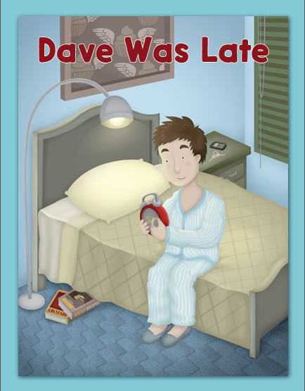

Slide 298
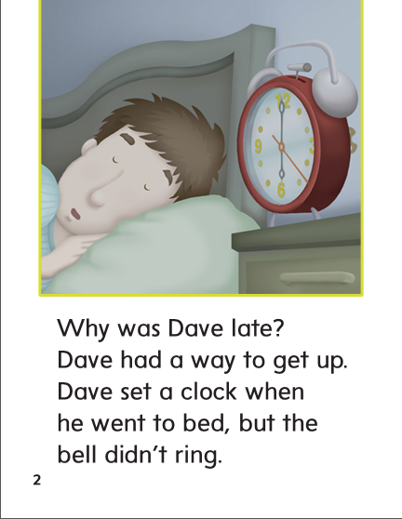

Slide 299
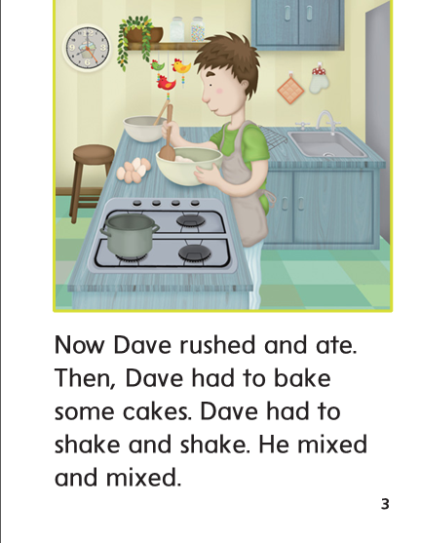

Slide 300
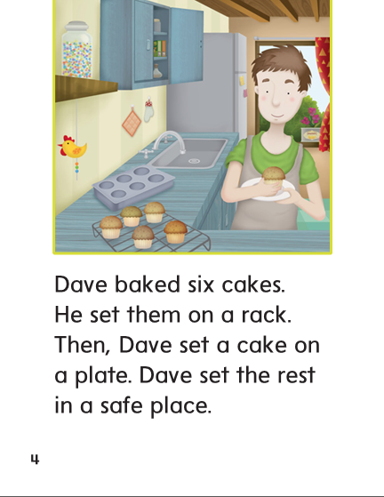

Slide 301
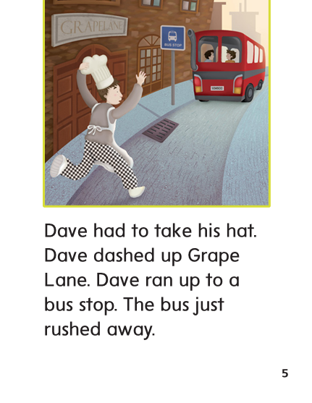

Slide 302
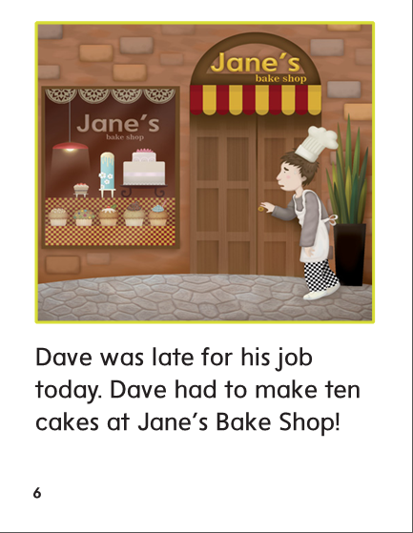

Slide 303
-ake
-ame
-ate

Slide 304
make
some
make
gate
today
gate
take
take
late
late
came
some
came
game
today
game

Slide 305
High Frequency
Words

Slide 306
Read, Spell, Write
away
My dog ran away, but he came back.

Slide 307
Read, Spell, Write
now
Can we play the game now?

Slide 308
Read, Spell, Write
some
I see some snakes in the grass.

Slide 309
Read, Spell, Write
today
I had fun at camp today.

Slide 310
Read, Spell, Write
way
Is this the way to school?

Slide 311
Read, Spell, Write
why
Why are the ducks quacking at me?

Slide 312
Build Fluency: Word Automaticity
Why are you going away now, Duck?
I have some things to do today with Frog.
I am on my way to the pond.

Slide 313
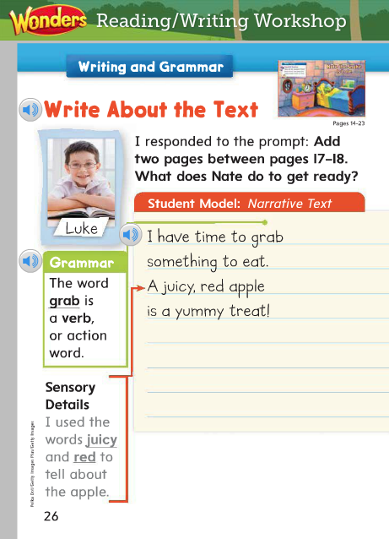
Grammar
Remember that a verb shows action. Identify the verbs in the student model.
Name the verb in this sentence:
I have time to grab something to eat.
Which word tells something you do?

Slide 314
Week 1 – Day 4

Slide 315
Phonemic Awareness
Phoneme Identity
We are going to listen for the same sound in words.
Listen carefully as I say three words: gaze, take, cape.
What sound is the same in /gaze/, /take/, /cape/?
That’s right. The middle sound is /a/.
Guided Practice:
Have children practice identifying the same phoneme in a group of words.
made, take, cave bake, name, date van, hat, pack
Wave, mane, case pup, fun, bug hot, mop, sock

Slide 316
Build Words with Long a: a_e
c
a
s
e
What is the new word we made?
Let’s blend all the sounds and read the word.
Change the s to v.

Slide 317
Build Words with Long a: a_e
c
a
v
e
What is the new word we made?
Let’s blend all the sounds and read the word.
Change the c to p.

Slide 318
Build Words with Long a: a_e
p
a
v
e
What is the new word we made?
Let’s blend all the sounds and read the word.
Change the v to l.

Slide 319
Build Words with Long a: a_e
p
a
l
e
What is the new word we made?
Let’s blend all the sounds and read the word.
Change the p to t.

Slide 320
Build Words with Long a: a_e
t
a
l
e
What is the new word we made?
Let’s blend all the sounds and read the word.
Change the l to m.

Slide 321
Build Words with Long a: a_e
t
a
m
e
What is the new word we made?
Let’s blend all the sounds and read the word.
Change the t to s.

Slide 322
Build Words with Long a: a_e
s
a
m
e
What is the new word we made?
Let’s blend all the sounds and read the word.
Change the s to sh.

Slide 323
Build Words with Long a: a_e
sh
a
m
e
What is the new word we made?
Let’s blend all the sounds and read the word.
Change the sh to l.

Slide 324
Build Words with Long a: a_e
l
a
m
e
What is the new word we made?
Let’s blend all the sounds and read the word.
Change the m to k.

Slide 325
Build Words with Long a: a_e
l
a
k
e
What is the new word we made?
Let’s blend all the sounds and read the word.
Add a f in front of l..

Slide 326
Build Words with Long a: a_e
f
l
a
k
e
What is the new word we made?
Let’s blend all the sounds and read the word.
Change the k to m.

Slide 327
Build Words with Long a: a_e
f
l
a
m
e
What is the new word we made?
Let’s blend all the sounds and read the word.
Remove the l.

Slide 328
Build Words with Long a: a_e
f
a
m
e
What is the new word we made?
Let’s blend all the sounds and read the word.
Change the m to z.

Slide 329
Build Words with Long a: a_e
f
a
z
e
What is the new word we made?
Let’s blend all the sounds and read the word.
Change the f to m.

Slide 330
Build Words with Long a: a_e
m
a
z
e
What is the new word we made?
Let’s blend all the sounds and read the word.
Change the z to d.

Slide 331
Build Words with Long a: a_e
m
a
d
e
What is the new word we made?
Let’s blend all the sounds and read the word.
Remove the e.

Slide 332
Build Words with Long a: a_e
m
a
d
What is the new word we made?
Let’s blend all the sounds and read the word.
Change the d to t.

Slide 333
Build Words with Long a: a_e
m
a
t
What is the new word we made?
Let’s blend all the sounds and read the word.
Add an e at the end.

Slide 334
Build Words with Long a: a_e
m
a
t
e
What is the new word we made?
Let’s blend all the sounds and read the word.
Change the t to l.

Slide 335
Build Words with Long a: a_e
m
a
l
e
What is the new word we made?
Let’s blend all the sounds and read the word.
Change the m to wh.

Slide 336
Build Words with Long a: a_e
wh
a
l
e
What is the new word we made?
Let’s blend all the sounds and read the word.

Slide 340
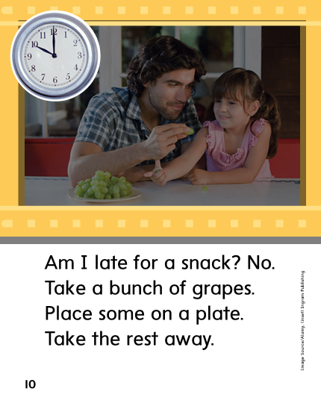

Slide 343
Structural Analysis
Read aloud the words.
Remember when two words are put together to make a contraction,
the letters left out are replaced with an apostrophe.
has not
hasn’t

Slide 344
Structural Analysis
is not
are not
was not
have not
can not
Have children work in pairs to construct contractions. Then have them write a sentence for each contraction.

Slide 345
High Frequency
Words

Slide 346
Read, Spell, Write
away
My dog ran away, but he came back.

Slide 347
Read, Spell, Write
now
Can we play the game now?

Slide 348
Read, Spell, Write
some
I see some snakes in the grass.

Slide 349
Read, Spell, Write
today
I had fun at camp today.

Slide 350
Read, Spell, Write
way
Is this the way to school?

Slide 351
Read, Spell, Write
why
Why are the ducks quacking at me?

Slide 352
Grammar
Verbs are words that tell about actions.
What are some actions that you can do?
Every sentence has at least one verb. Identify the verb or verbs.
Chan sees pancakes on a plate.
Can you help my mom rake?

Slide 353
Grammar
Have children identify which of the words are verbs.
run shake
grab vase
lunch make
catch grape

Slide 354
Week 1 – Day 5

Slide 355
Phonemic Awareness
Phoneme Blending:
Listen as I say a group of sounds. Then blend those sounds to form a word.
/m/ /a/ /n/ /b/ /a/ /k/ /l/ /a/ /k/ /f/ /l/ /a/ /k/
Phoneme Segmentation:
Now I am going to say a word. I want you to say each sound in the word.
safe game plate brave snake

Slide 356
Blend and Build Words with Long a: a_e
Read and say these words:
make
sale
shade
plate

Slide 357
Build Words with Long a: a_e
r
a
t
What is the new word we made?
Let’s blend all the sounds and read the word.
Add an e to the end of the word.

Slide 358
Build Words with Long a: a_e
r
a
t
e
What is the new word we made?
Let’s blend all the sounds and read the word.
Change the r to h.

Slide 359
Build Words with Long a: a_e
h
a
t
e
What is the new word we made?
Let’s blend all the sounds and read the word.
Remove the e.

Slide 360
Build Words with Long a: a_e
h
a
t
What is the new word we made?
Let’s blend all the sounds and read the word.
Change the h to f.

Slide 361
Build Words with Long a: a_e
f
a
t
What is the new word we made?
Let’s blend all the sounds and read the word.
Add an e to the end of the word .

Slide 362
Build Words with Long a: a_e
f
a
t
e
What is the new word we made?
Let’s blend all the sounds and read the word.
Change the t to m.

Slide 363
Build Words with Long a: a_e
f
a
m
e
What is the new word we made?
Let’s blend all the sounds and read the word.
Change the f to s.

Slide 364
Build Words with Long a: a_e
s
a
m
e
What is the new word we made?
Let’s blend all the sounds and read the word.
Change the s to sh.

Slide 365
Build Words with Long a: a_e
sh
a
m
e
What is the new word we made?
Let’s blend all the sounds and read the word.
Change the m to d.

Slide 366
Build Words with Long a: a_e
sh
a
d
e
What is the new word we made?
Let’s blend all the sounds and read the word.
Change the sh to m.

Slide 367
Build Words with Long a: a_e
m
a
d
e
What is the new word we made?
Let’s blend all the sounds and read the word.
Remove the e.

Slide 368
Build Words with Long a: a_e
m
a
d
What is the new word we made?
Let’s blend all the sounds and read the word.
Change the d to n.

Slide 369
Build Words with Long a: a_e
m
a
n
What is the new word we made?
Let’s blend all the sounds and read the word.
Add an e to the end of the word.

Slide 370
Build Words with Long a: a_e
m
a
n
e
What is the new word we made?
Let’s blend all the sounds and read the word.
Change the m to p.

Slide 371
Build Words with Long a: a_e
p
a
n
e
What is the new word we made?
Let’s blend all the sounds and read the word.
Add an l after the p.

Slide 372
Build Words with Long a: a_e
p
l
a
n
e
What is the new word we made?
Let’s blend all the sounds and read the word.
Change the n to t.

Slide 373
Build Words with Long a: a_e
p
l
a
t
e
What is the new word we made?
Let’s blend all the sounds and read the word.
Remove the p.

Slide 374
Build Words with Long a: a_e
l
a
t
e
What is the new word we made?
Let’s blend all the sounds and read the word.
Change the t to k.

Slide 375
Build Words with Long a: a_e
l
a
k
e
What is the new word we made?
Let’s blend all the sounds and read the word.
Add a f in front of the l.

Slide 376
Build Words with Long a: a_e
f
l
a
k
e
What is the new word we made?
Let’s blend all the sounds and read the word.

Slide 377
Word Automaticity
late

Slide 378
take

Slide 379
wade

Slide 380
lake

Slide 381
gaze

Slide 382
wake

Slide 383
lane

Slide 384
gate

Slide 385
cave

Slide 386
fade

Slide 387
save

Slide 388
tame

Slide 389
tap

Slide 390
tape

Slide 391
rat

Slide 392
rate

Slide 393
snack

Slide 394
snake

Slide 395
whale

Slide 396
skate

Slide 397
shade

Slide 398
chase

Slide 399
grape

Slide 400
phase

Slide 401
Structural Analysis
Have children explain how to form a contraction using the word not.
Then have them practice writing and reading contractions for these word:
is not
are not
was not
were not
has not
have not
can not

Slide 402
High Frequency
Words

Slide 403
Read, Spell, Write
away
My dog ran away, but he came back.

Slide 404
Read, Spell, Write
now
Can we play the game now?

Slide 405
Read, Spell, Write
some
I see some snakes in the grass.

Slide 406
Read, Spell, Write
today
I had fun at camp today.

Slide 407
Read, Spell, Write
way
Is this the way to school?

Slide 408
Read, Spell, Write
why
Why are the ducks quacking at me?

Slide 409
Grammar
Have children describe what verbs are and how they are used.
Have children identify the verbs:
The big dog jumps in the pond and fetches a stick.

Slide 410
Grammar
How do I know which word in a sentence is the verb?
We _____ at school today.
I don’t _____ at school.
I can’t _____ very well.
I can _____ very well!
Have children read their completed sentences to the class.
Have them choose one verb to act out.

