Slide 1
Week 1 – Day 1

Slide 2
Phonemic Awareness –
Recognize and Generate Alliteration
The same sound repeated in several words is called alliteration.
Listen as I say a sentence: Len like limes.
I hear the same sound, the /l/ sound, al the beginning of Len, likes, and limes.
I can change the name Len to another name that begins with /l/ to make a new sentence.
Listen: Lisa like limes.
Guided Practice:
I am going to say some sentences.
Tell me the sound you hear at the beginning of most words.
Then change the name to another name that begins with that sound.
Say the new sentence.
Dale dives deep. Ted told a tale. Hannah hiked up a hill.
Bob built a barn. Cate can clap. Rob ran in a race.

Slide 3
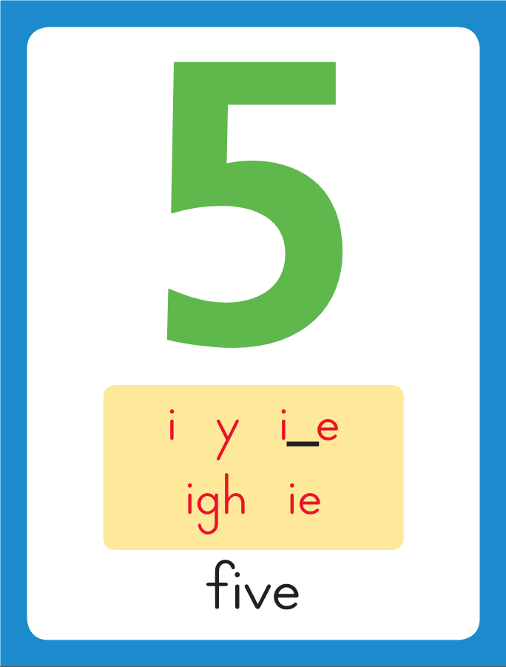
Introduce Long i: i_e
This is the Five
Sound-Spelling Card.
The sound is /i/.
Today we will learn a spelling for the /i/ sound.
Look at this word: rid.
Say it with me.
This word has the short i
sound /i/.
I’ll add an e to the end.
The new word is ride.
The letters i and e act together to make the sound /i/.
Listen as I say the word: /ride/.
bit
rid
bite
ride

Slide 4
Blending Words with Long i: i_e
l

Slide 5
Blending Words with Long i: i_e
l
i
_
e

Slide 6
Blending Words with Long i: i_e
l
i
_
e

Slide 7
Blending Words with Long i: i_e
l
i
n
e

Slide 8
Blending Words with Long i: i_e
n

Slide 9
Blending Words with Long i: i_e
n
i
_
e

Slide 10
Blending Words with Long i: i_e
n
i
_
e

Slide 11
Blending Words with Long i: i_e
n
i
n
e

Slide 12
Blending Words with Long i: i_e
w

Slide 13
Blending Words with Long i: i_e
w
i
_
e

Slide 14
Blending Words with Long i: i_e
w
i
_
e

Slide 15
Blending Words with Long i: i_e
w
i
d
e

Slide 16
Blending Words with Long i: i_e
p
r

Slide 17
Blending Words with Long i: i_e
p
r
i
_
e

Slide 18
Blending Words with Long i: i_e
p
r
i
_
e

Slide 19
Blending Words with Long i: i_e
p
r
i
z
e

Slide 20
Blending Words with Long i: i_e
wh

Slide 21
Blending Words with Long i: i_e
wh
i
_
e

Slide 22
Blending Words with Long i: i_e
wh
i
t
e

Slide 23
Blending Words with Long i: i_e
wh
i
t
e

Slide 24
i_e wh sh ing
dr a_e th sm
sk i wh a

Slide 25
p

Slide 26
pi_e

Slide 27
pine

Slide 28
pine p

Slide 29
pine pi_e

Slide 30
pine pile

Slide 31
pine pile m

Slide 32
pine pile mi_e

Slide 33
pine pile mile

Slide 34
pine pile mile l

Slide 35
pine pile mile li_e

Slide 36
pine pile mile like

Slide 37
pine pile mile like
y

Slide 38
pine pile mile like
yi_e

Slide 39
pine pile mile like
yike

Slide 40
pine pile mile like
yikes

Slide 41
pine pile mile like
yikes r

Slide 42
pine pile mile like
yikes ri_e

Slide 43
pine pile mile like
yikes ripe

Slide 44
pine pile mile like
yikes ripe v

Slide 45
pine pile mile like
yikes ripe vi_e

Slide 46
pine pile mile like
yikes ripe vine

Slide 47
pine pile mile like
yikes ripe vine sh

Slide 48
pine pile mile like
yikes ripe vine shi_e
smile while dime life

Slide 49
pine pile mile like
yikes ripe vine shine

Slide 50
pine pile mile like
yikes ripe vine shine
sm

Slide 51
pine pile mile like
yikes ripe vine shine
smi_e

Slide 52
pine pile mile like
yikes ripe vine shine
smile

Slide 53
pine pile mile like
yikes ripe vine shine
smile wh

Slide 54
pine pile mile like
yikes ripe vine shine
smile whi_e

Slide 55
pine pile mile like
yikes ripe vine shine
smile while

Slide 56
pine pile mile like
yikes ripe vine shine
smile while d

Slide 57
pine pile mile like
yikes ripe vine shine
smile while di_e

Slide 58
pine pile mile like
yikes ripe vine shine
smile while dime

Slide 59
pine pile mile like
yikes ripe vine shine
smile while dime l

Slide 60
pine pile mile like
yikes ripe vine shine
smile while dime li_e

Slide 61
pine pile mile like
yikes ripe vine shine
smile while dime life

Slide 62
Internal Sounding Out
bit

Slide 63
Internal Sounding Out
bit bite

Slide 64
Internal Sounding Out
bit bite rid

Slide 65
Internal Sounding Out
bit bite rid ride

Slide 66
Internal Sounding Out
bit bite rid ride
kit

Slide 67
Internal Sounding Out
bit bite rid ride
kit kite

Slide 68
Internal Sounding Out
bit bite rid ride
kit kite take

Slide 69
Internal Sounding Out
bit bite rid ride
kit kite take skate

Slide 70
Internal Sounding Out
bit bite rid ride
kit kite take skate
slide

Slide 71
Internal Sounding Out
bit bite rid ride
kit kite take skate
slide trash

Slide 72
Internal Sounding Out
bit bite rid ride
kit kite take skate
slide trash thing

Slide 73
Internal Sounding Out
bit bite rid ride
kit kite take skate
slide trash thing drive

Slide 74
Mike

Slide 75
Mike likes

Slide 76
Mike likes to

Slide 77
Mike likes to ride

Slide 78
Mike likes to ride his

Slide 79
Mike likes to ride his bike

Slide 80
Mike likes to ride his bike fast.

Slide 81
Mike likes to ride his bike fast.
Kate

Slide 82
Mike likes to ride his bike fast.
Kate got

Slide 83
Mike likes to ride his bike fast.
Kate got quite

Slide 84
Mike likes to ride his bike fast.
Kate got quite a

Slide 85
Mike likes to ride his bike fast.
Kate got quite a big

Slide 86
Mike likes to ride his bike fast.
Kate got quite a big prize.

Slide 87
Mike likes to ride his bike fast.
Kate got quite a big prize.
Clive

Slide 88
Mike likes to ride his bike fast.
Kate got quite a big prize.
Clive and

Slide 89
Mike likes to ride his bike fast.
Kate got quite a big prize.
Clive and Jake

Slide 90
Mike likes to ride his bike fast.
Kate got quite a big prize.
Clive and Jake will

Slide 91
Mike likes to ride his bike fast.
Kate got quite a big prize.
Clive and Jake will hike

Slide 92
Mike likes to ride his bike fast.
Kate got quite a big prize.
Clive and Jake will hike for

Slide 93
Mike likes to ride his bike fast.
Kate got quite a big prize.
Clive and Jake will hike for a

Slide 94
Mike likes to ride his bike fast.
Kate got quite a big prize.
Clive and Jake will hike for a mile.

Slide 95
Spelling / Dictation
1. _________
2. _________
3. _________
4. _________
5. _________
like
ride
bike
make
came

Slide 96
High Frequency
Words

Slide 97
Read, Spell, Write
green
My new bike is green and white

Slide 98
Read, Spell, Write
grow
The grass will grow.

Slide 99
Read, Spell, Write
pretty
This is a pretty dress.

Slide 100
Read, Spell, Write
should
When should I come to see you?

Slide 101
Read, Spell, Write
together
We can play together.

Slide 102
Read, Spell, Write
water
Do you want a drink of water?

Slide 103
Have children read the sentences. Prompt them to identify the high-frequency words in connected text and to blend the decodable words.
My new bike is green and white.
The grass will grow.
3. This is a pretty dress.

Slide 104
Have children read the sentences. Prompt them to identify the high-frequency words in connected text and to blend the decodable words.
When should I come to see you?
We can play together.
3. Do you want a drink of water?

Slide 105
Grammar
Remember that a verb is a action word.
A present tense verb tells about an action that is happening right now.
Spike hikes up the hill.
When a present-tense verb tells about one noun, it ends in –s.
Jan and Dave wipe off the plates.
When a present-tense verb tells about more than one noun, like Jan and Dave, it does not end in –s. When the naming word is I or you,
the present-tense verb does not end in –s.

Slide 106
Grammar
Have children identify the verbs in the sentences and explain why they do or not have –s at the end.
They swim in the lake.
Ike thumps the drum.
The kids wave on the bus.

Slide 107
Week 1 – Day 2

Slide 108
Phonemic Awareness –
Phoneme Deletion
Listen carefully as I say a word: smile.
The word smile has four sounds.
Say the sounds with me: /s/ /m/ /i/ /l/.
I’ll take away the first sound /s/ and
make a new word with three sounds: /m/ /i/ /l/, mile.
Continue modeling phoneme deletion with the following word sets:
bride/ride grip/ripe slime/lime spike/pike
Guided Practice:
Listen as I say a word.
The word is spine, /s/ /p/ /i/ /n/.
Then say the words without the first sound to
make the new word: /p/ /i/ /n/, pine.
spine swipe stale Fred flake
slime pride plane crate brake

Slide 109
Introduce Long i: i_e
What are these letters?
What sound do they stand for?
life
time

Slide 110
Blending Words with Long i: i_e
sh

Slide 111
Blending Words with Long i: i_e
sh
i
_
e

Slide 112
Blending Words with Long i: i_e
sh
i
_
e

Slide 113
Blending Words with Long i: i_e
sh
i
n
e

Slide 114
Blending Words with Long i: i_e
l

Slide 115
Blending Words with Long i: i_e
l
i
_
e

Slide 116
Blending Words with Long i: i_e
l
i
_
e

Slide 117
Blending Words with Long i: i_e
l
i
k
e

Slide 118
Blending Words with Long i: i_e
wh

Slide 119
Blending Words with Long i: i_e
wh
i
_
e

Slide 120
Blending Words with Long i: i_e
wh
i
_
e

Slide 121
Blending Words with Long i: i_e
wh
i
l
e

Slide 122
Blending Words with Long i: i_e
s
l

Slide 123
Blending Words with Long i: i_e
s
l
i
_
e

Slide 124
Blending Words with Long i: i_e
s
l
i
_
e

Slide 125
Blending Words with Long i: i_e
s
l
i
d
e

Slide 126
Blending Words with Long i: i_e
s
w

Slide 127
Blending Words with Long i: i_e
s
w
i
_
e

Slide 128
Blending Words with Long i: i_e
s
w
i
_
e

Slide 129
Blending Words with Long i: i_e
s
w
i
p
e

Slide 130
five nine ripe size
hike dive drive glide
pride spike lime tile

Slide 131
five nine ripe size
hike dive drive glide
pride spike lime tile

Slide 132
five nine ripe size
hike dive drive glide
pride spike lime tile

Slide 133
five nine ripe size
hike dive drive glide
pride spike lime tile

Slide 134
five nine ripe size
hike dive drive glide
pride spike lime tile

Slide 135
five nine ripe size
hike dive drive glide
pride spike lime tile

Slide 136
five nine ripe size
hike dive drive glide
pride spike lime tile

Slide 137
five nine ripe size
hike dive drive glide
pride spike lime tile

Slide 138
five nine ripe size
hike dive drive glide
pride spike lime tile

Slide 139
five nine ripe size
hike dive drive glide
pride spike lime tile

Slide 140
five nine ripe size
hike dive drive glide
pride spike lime tile

Slide 141
five nine ripe size
hike dive drive glide
pride spike lime tile

Slide 142
five nine ripe size
hike dive drive glide
pride spike lime tile

Slide 143
five nine ripe size
hike dive drive glide
pride spike lime tile

Slide 144
five nine ripe size
hike dive drive glide
pride spike lime tile

Slide 145
five nine ripe size
hike dive drive glide
pride spike lime tile

Slide 146
f

Slide 147
fi_e

Slide 148
five

Slide 149
five n

Slide 150
five ni_e

Slide 151
five nine

Slide 152
five nine r

Slide 153
five nine ri_e

Slide 154
five nine ripe

Slide 155
five nine ripe s

Slide 156
five nine ripe si_e

Slide 157
five nine ripe size

Slide 158
five nine ripe size
h

Slide 159
five nine ripe size
hi_e

Slide 160
five nine ripe size
hike

Slide 161
five nine ripe size
hike d

Slide 162
five nine ripe size
hike di_e

Slide 163
five nine ripe size
hike dive

Slide 164
five nine ripe size
hike dive dr

Slide 165
five nine ripe size
hike dive dri_e

Slide 166
five nine ripe size
hike dive drive

Slide 167
five nine ripe size
hike dive drive gl

Slide 168
five nine ripe size
hike dive drive gli_e

Slide 169
five nine ripe size
hike dive drive glide

Slide 170
five nine ripe size
hike dive drive glide
pr

Slide 171
five nine ripe size
hike dive drive glide
pri_e

Slide 172
five nine ripe size
hike dive drive glide
pride

Slide 173
five nine ripe size
hike dive drive glide
pride sp

Slide 174
five nine ripe size
hike dive drive glide
pride spi_e

Slide 175
five nine ripe size
hike dive drive glide
pride spike

Slide 176
five nine ripe size
hike dive drive glide
pride spike l

Slide 177
five nine ripe size
hike dive drive glide
pride spike li_e

Slide 178
five nine ripe size
hike dive drive glide
pride spike lime

Slide 179
five nine ripe size
hike dive drive glide
pride spike lime t

Slide 180
five nine ripe size
hike dive drive glide
pride spike lime ti_e

Slide 181
five nine ripe size
hike dive drive glide
pride spike lime tile

Slide 182
Blend Words with Long i: i_e
d
i
m
e
What is the new word we made?
Let’s blend all the sounds and read the word.
Change the m to n.

Slide 183
Blend Words with Long i: i_e
d
i
n
e
What is the new word we made?
Let’s blend all the sounds and read the word.
Change the n to v.

Slide 184
Blend Words with Long i: i_e
d
i
v
e
What is the new word we made?
Let’s blend all the sounds and read the word.
Add an r after the d.

Slide 185
Blend Words with Long i: i_e
d
r
i
v
e
What is the new word we made?
Let’s blend all the sounds and read the word.
Change the dr to f..

Slide 186
Blend Words with Long i: i_e
f
i
v
e
What is the new word we made?
Let’s blend all the sounds and read the word.
Change the v to l.

Slide 187
Blend Words with Long i: i_e
f
i
l
e
What is the new word we made?
Let’s blend all the sounds and read the word.
Change the l to n.

Slide 188
Blend Words with Long i: i_e
f
i
n
e
What is the new word we made?
Let’s blend all the sounds and read the word.
Change the f to n.

Slide 189
Blend Words with Long i: i_e
n
i
n
e
What is the new word we made?
Let’s blend all the sounds and read the word.
Change the first n to p.

Slide 190
Blend Words with Long i: i_e
p
i
n
e
What is the new word we made?
Let’s blend all the sounds and read the word.
Change the n to p.

Slide 191
Blend Words with Long i: i_e
p
i
p
e
What is the new word we made?
Let’s blend all the sounds and read the word.
Change the first p to r.

Slide 192
Blend Words with Long i: i_e
r
i
p
e
What is the new word we made?
Let’s blend all the sounds and read the word.
Change the p to d.

Slide 193
Blend Words with Long i: i_e
r
i
d
e
What is the new word we made?
Let’s blend all the sounds and read the word.
Add a b in front of r.

Slide 194
Blend Words with Long i: i_e
b
r
i
d
e
What is the new word we made?
Let’s blend all the sounds and read the word.

Slide 195
Structural Analysis
Adding –s to a noun, or naming word,
makes the noun tell about more than one.
bike
I ride my bike.
bikes
I see three more bikes.
Adding –s to bike means more than one bike.

Slide 196
Structural Analysis
The letter –s at the end of a final –e word can stand for /s/ as in bites,
/z/ as in hives, or /ez/ as in cases.
bite hive case
bites hives cases
/s/
/z/
/ez/
Use each word in a sentence.

Slide 197
Structural Analysis
Have children add –s to each word.
dime vine
cape snake
kite plate
lake
Use each word in a sentence.

Slide 198
Spelling
hike
side
fine

Slide 199
like
ride
mine
hide
spike
bike
like
ride
mine
hide
spike
bike

Slide 200
High Frequency
Words

Slide 201
Read, Spell, Write
green
My new bike is green and white

Slide 202
Read, Spell, Write
grow
The grass will grow.

Slide 203
Read, Spell, Write
pretty
This is a pretty dress.

Slide 204
Read, Spell, Write
should
When should I come to see you?

Slide 205
Read, Spell, Write
together
We can play together.

Slide 206
Read, Spell, Write
water
Do you want a drink of water?

Slide 207
Grammar
Remember that a verb is a action word.
A present tense verb tells about an action that is happening right now.
When a present-tense verb tells about one noun, it ends in –s.
When it tells about more than one noun or I or you, it does not end in –s.
Jane hides in the bush. (I)
Nate eats lunch.(Nate and Tess)
Have partners circle each verb.
Then have them create a new sentences
using each verb with the word in parentheses.

Slide 208
Week 1 – Day 3

Slide 209
Phonemic Awareness
Phoneme Segmentation
I am going to say the sounds in the word slide: /s/ /l/ /i/ /d/.
/s/
/l/
/i/
/d/
The first sound is /s/. The second sound is /l/.
The next sound is /i/. The last sound is /d/.
Place a marker in a box on the Response Board for each sound you hear. This word has four sounds: /s/ /l/ /i/ /d/.
Say the word and sounds with me: slide, /s/ /l/ /i/ /d/.

Slide 210
Phonemic Awareness – Phoneme Isolation
I’m going to say some words.
Place a marker in a box to stand for each sound.
Let’s do the first one together. The word is bride. Listen: /b/ /r/ /i/ /d/.
Place a marker in the box to stand for each sound. This word has four sounds. Say the word and sounds with me: bride, /b/ /r/ /i/ /d/.
/b/
/r/
/i/
/d/
bride mine mile smile prize
time spike like slide tribe

Slide 211
Blending Words with Long i: i_e
g
l

Slide 212
Blending Words with Long i: i_e
g
l
i
_
e

Slide 213
Blending Words with Long i: i_e
g
l
i
_
e

Slide 214
Blending Words with Long i: i_e
g
l
i
d
e

Slide 215
Blending Words with Long i: i_e
w

Slide 216
Blending Words with Long i: i_e
w
i
_
e

Slide 217
Blending Words with Long i: i_e
w
i
_
e

Slide 218
Blending Words with Long i: i_e
w
i
p
e

Slide 219
Blending Words with Long i: i_e
s

Slide 220
Blending Words with Long i: i_e
s
i
_
e

Slide 221
Blending Words with Long i: i_e
s
i
_
e

Slide 222
Blending Words with Long i: i_e
s
i
z
e

Slide 223
Blending Words with Long i: i_e
sh

Slide 224
Blending Words with Long i: i_e
sh
i
_
e

Slide 225
Blending Words with Long i: i_e
sh
i
_
e

Slide 226
Blending Words with Long i: i_e
sh
i
n
e

Slide 227
Blending Words with Long i: i_e
s
p

Slide 228
Blending Words with Long i: i_e
s
p
i
_
e

Slide 229
Blending Words with Long i: i_e
s
p
i
_
e

Slide 230
Blending Words with Long i: i_e
s
p
i
n
e

Slide 231
i_e qu sk a_e
wh i sp u
a_e sm i_e sl

Slide 232
b

Slide 233
bi_e

Slide 234
bite

Slide 235
bite d

Slide 236
bite di_e

Slide 237
bite dine

Slide 238
bite dine f

Slide 239
bite dine fi_e

Slide 240
bite dine five

Slide 241
bite dine five h

Slide 242
bite dine five hi_e

Slide 243
bite dine five hide

Slide 244
bite dine five hide
l

Slide 245
bite dine five hide
li_e

Slide 246
bite dine five hide
lime

Slide 247
bite dine five hide
lime m

Slide 248
bite dine five hide
lime mi_e

Slide 249
bite dine five hide
lime mine

Slide 250
bite dine five hide
lime mine p

Slide 251
bite dine five hide
lime mine pi_e

Slide 252
bite dine five hide
lime mine pipe

Slide 253
bite dine five hide
lime mine pipe qu

Slide 254
bite dine five hide
lime mine pipe qui_e

Slide 255
bite dine five hide
lime mine pipe quite

Slide 256
bite dine five hide
lime mine pipe quite
r

Slide 257
bite dine five hide
lime mine pipe quite
ri_e

Slide 258
bite dine five hide
lime mine pipe quite
ripe

Slide 259
bite dine five hide
lime mine pipe quite
ripe v

Slide 260
bite dine five hide
lime mine pipe quite
ripe vi_e

Slide 261
bite dine five hide
lime mine pipe quite
ripe vine

Slide 262
bite dine five hide
lime mine pipe quite
ripe vine wh

Slide 263
bite dine five hide
lime mine pipe quite
ripe vine whi_e

Slide 264
bite dine five hide
lime mine pipe quite
ripe vine white

Slide 265
bite dine five hide
lime mine pipe quite
ripe vine white wh

Slide 266
bite dine five hide
lime mine pipe quite
ripe vine white whi_e

Slide 267
bite dine five hide
lime mine pipe quite
ripe vine white while

Slide 268
Internal Sounding Out
inside

Slide 269
Internal Sounding Out
inside sunshine

Slide 270
Internal Sounding Out
inside sunshine piles

Slide 271
Internal Sounding Out
inside sunshine piles
rides

Slide 272
Internal Sounding Out
inside sunshine piles
rides bikes

Slide 273
Internal Sounding Out
inside sunshine piles
rides bikes sides

Slide 274
Internal Sounding Out
inside sunshine piles
rides bikes sides lives

Slide 275
Internal Sounding Out
inside sunshine piles
rides bikes sides lives
smiles

Slide 276
Internal Sounding Out
inside sunshine piles
rides bikes sides lives
smiles dimes

Slide 277
Internal Sounding Out
inside sunshine piles
rides bikes sides lives
smiles dimes gates

Slide 278
Internal Sounding Out
bikes

Slide 279
Internal Sounding Out
bikes skates

Slide 280
Internal Sounding Out
bikes skates spikes

Slide 281
Internal Sounding Out
bikes skates spikes
cakes

Slide 282
Internal Sounding Out
bikes skates spikes
cakes slid

Slide 283
Internal Sounding Out
bikes skates spikes
cakes slid slides

Slide 284
Internal Sounding Out
bikes skates spikes
cakes slid slides
slim

Slide 285
Internal Sounding Out
bikes skates spikes
cakes slid slides
slim slimes

Slide 286
Internal Sounding Out
bikes skates spikes
cakes slid slides
slim slimes likes

Slide 287
Mike

Slide 288
Mike likes

Slide 289
Mike likes ripe

Slide 290
Mike likes ripe red

Slide 291
Mike likes ripe red grapes.

Slide 292
Mike likes ripe red grapes.
We

Slide 293
Mike likes ripe red grapes.
We will

Slide 294
Mike likes ripe red grapes.
We will skate

Slide 295
Mike likes ripe red grapes.
We will skate and

Slide 296
Mike likes ripe red grapes.
We will skate and then

Slide 297
Mike likes ripe red grapes.
We will skate and then ride

Slide 298
Mike likes ripe red grapes.
We will skate and then ride bikes.

Slide 299
Structural Analysis
The letter –s at the end of dimes means that there is more than one dime.
It makes the word dime plural.
dime
dimes
Listen closely to hear what is different. Point out the /z/

Slide 300
Structural Analysis
Help children blend these words:
cape base
capes bases
mile crate
miles crates
Point out that the letter –s at the end of a final –e
word can stand for /s/, /z/, or /ez/.

Slide 302
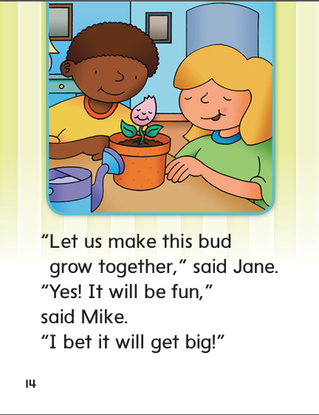

Slide 303
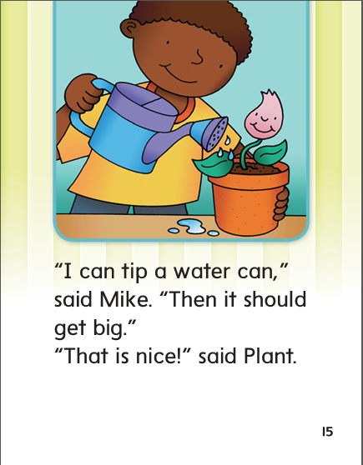

Slide 304
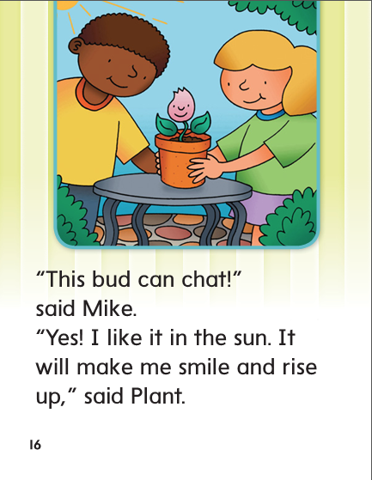

Slide 305
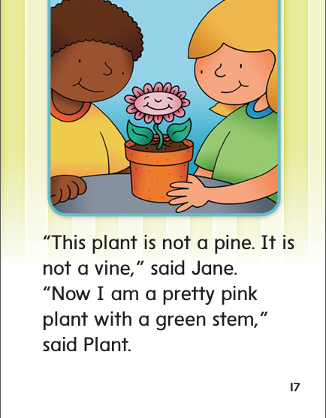

Slide 306
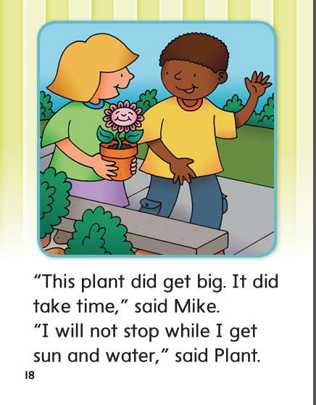

Slide 307
-ike
-ide
-ine

Slide 308
like
water
like
ride
should
ride
mine
mine
bike
bike
hide
water
hide
spike
should
spike

Slide 309
High Frequency
Words

Slide 310
Read, Spell, Write
green
My new bike is green and white

Slide 311
Read, Spell, Write
grow
The grass will grow.

Slide 312
Read, Spell, Write
pretty
This is a pretty dress.

Slide 313
Read, Spell, Write
should
When should I come to see you?

Slide 314
Read, Spell, Write
together
We can play together.

Slide 315
Read, Spell, Write
water
Do you want a drink of water?

Slide 316
Build Fluency: Word Automaticity
We should put water on the grass together.
Then green grass should grow.
The grass will be thick and pretty.

Slide 317
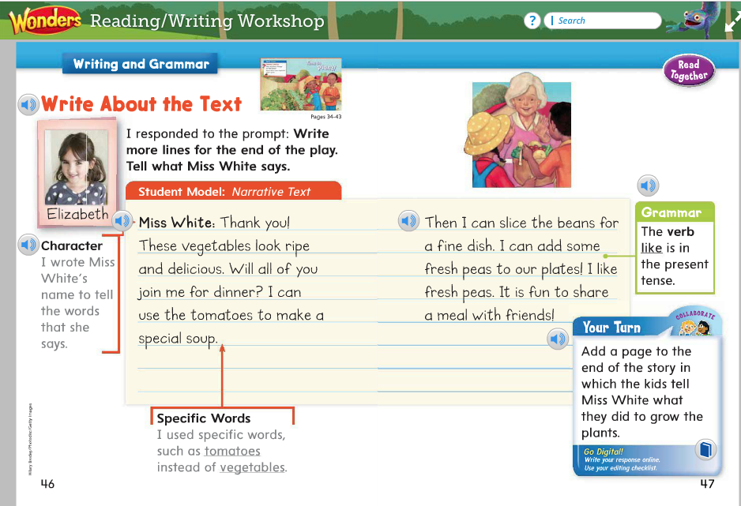
Name the verb:
I like fresh peas.
Why doesn’t like end in s?

Slide 318
Week 1 – Day 4

Slide 319
Phonemic Awareness
Phoneme Deletion
Listen carefully as I say a word: swipe.
The word swipe has four sounds: /s/ /w/ /i/ /p/.
I’ll take away the first sound and make a new word: /w/ /i/ /p/.
Guided Practice:
Have children practice deleting the initial phoneme in words.
smile slime gripe prize pride
brace blast crush swell trash

Slide 320
Build Words with Long i: i_e
t
i
l
e
What is the new word we made?
Let’s blend all the sounds and read the word.
Change the t to m.

Slide 321
Build Words with Long i: i_e
m
i
l
e
What is the new word we made?
Let’s blend all the sounds and read the word.
Change the l to n.

Slide 322
Build Words with Long i: i_e
m
i
n
e
What is the new word we made?
Let’s blend all the sounds and read the word.
Change the m to p.

Slide 323
Build Words with Long i: i_e
p
i
n
e
What is the new word we made?
Let’s blend all the sounds and read the word.
Remove the e.

Slide 324
Build Words with Long i: i_e
p
i
n
What is the new word we made?
Let’s blend all the sounds and read the word.
Change the p to f.

Slide 325
Build Words with Long i: i_e
f
i
n
What is the new word we made?
Let’s blend all the sounds and read the word.
Add the letter e after the n.

Slide 326
Build Words with Long i: i_e
f
i
n
e
What is the new word we made?
Let’s blend all the sounds and read the word.
Change the n to v.

Slide 327
Build Words with Long i: i_e
f
i
v
e
What is the new word we made?
Let’s blend all the sounds and read the word.
Change the f to l.

Slide 328
Build Words with Long i: i_e
l
i
v
e
What is the new word we made?
Let’s blend all the sounds and read the word.
Change the l to h.

Slide 329
Build Words with Long i: i_e
h
i
v
e
What is the new word we made?
Let’s blend all the sounds and read the word.
Change the v to d.

Slide 330
Build Words with Long i: i_e
h
i
d
e
What is the new word we made?
Let’s blend all the sounds and read the word.
Remove the e.

Slide 331
Build Words with Long i: i_e
h
i
d
What is the new word we made?
Let’s blend all the sounds and read the word.
Change the h to r.

Slide 332
Build Words with Long i: i_e
r
i
d
What is the new word we made?
Let’s blend all the sounds and read the word.

Slide 334
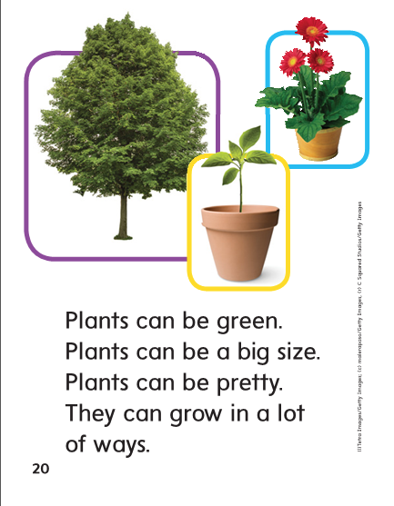

Slide 335
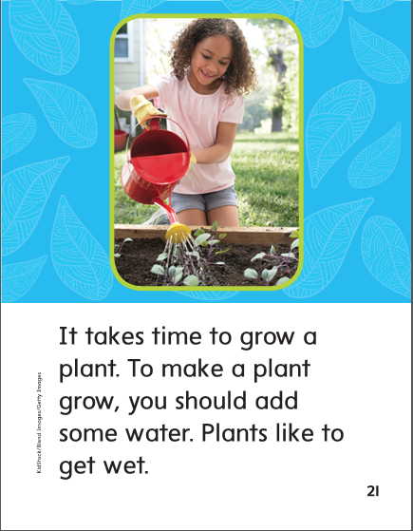

Slide 337
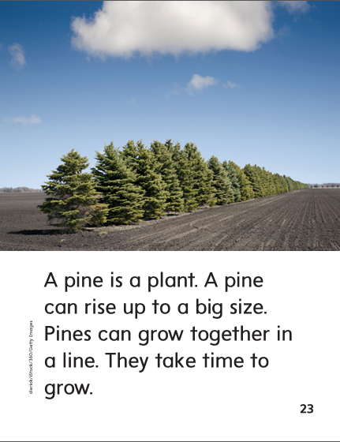

Slide 339
Structural Analysis
Remember when –s is added to a noun, or naming word, it makes the word plural. The word sides means more than one side.
side
sides

Slide 340
Structural Analysis
Have children work in pairs to construct plural nouns.
prize
ride
cake
plane
Have them write a sentence with each word.

Slide 341
High Frequency
Words

Slide 342
Read, Spell, Write
green
My new bike is green and white

Slide 343
Read, Spell, Write
grow
The grass will grow.

Slide 344
Read, Spell, Write
pretty
This is a pretty dress.

Slide 345
Read, Spell, Write
should
When should I come to see you?

Slide 346
Read, Spell, Write
together
We can play together.

Slide 347
Read, Spell, Write
water
Do you want a drink of water?

Slide 348
Grammar
Remember when a present-tense verb tells about one noun, it ends in –s. When it tells about more than one noun, or I or you, it does not end in –s.
When does the action of a present-tense verb happen?
cat snakes naps slide
Match the nouns and verbs that go together and
have them make each pair into a complete sentence.

Slide 349
Week 1 – Day 5

Slide 350
Phonemic Awareness
Phoneme Blending:
Listen as I say a group of sounds. Then blend those sounds to form a word.
/s/ /i/ /d/ /s/ /l/ /i/ /d/ /b/ /i/ /k/ /b/ /i/ /t/
/d/ /r/ /u/ /m/ /p/ /r/ /i/ /z/ /s/ /m/ /i/ /l/ /sh/ /i/ /n/
Phoneme Segmentation:
Now I am going to say a word. I want you to say each sound in the word.
mile smile ripe drive white
rise prize life kite bride

Slide 351
Blend and Build Words with Long a: a_e
Read and say these words:
like
bite
smile
shine
while

Slide 352
Build Words with Long i: i_e
s
i
d
e
What is the new word we made?
Let’s blend all the sounds and read the word.
Change the s to t.

Slide 353
Build Words with Long i: i_e
t
i
d
e
What is the new word we made?
Let’s blend all the sounds and read the word.
Change the d to l.

Slide 354
Build Words with Long i: i_e
t
i
l
e
What is the new word we made?
Let’s blend all the sounds and read the word.
Change the t to m.

Slide 355
Build Words with Long i: i_e
m
i
l
e
What is the new word we made?
Let’s blend all the sounds and read the word.
Change the m to p.

Slide 356
Build Words with Long i: i_e
p
i
l
e
What is the new word we made?
Let’s blend all the sounds and read the word.
Change the l to p.

Slide 357
Build Words with Long i: i_e
p
i
p
e
What is the new word we made?
Let’s blend all the sounds and read the word.
Remove the e.

Slide 358
Build Words with Long i: i_e
p
i
p
What is the new word we made?
Let’s blend all the sounds and read the word.
Change the p to r.

Slide 359
Build Words with Long i: i_e
r
i
p
What is the new word we made?
Let’s blend all the sounds and read the word.
Add an e to the end of the word.

Slide 360
Build Words with Long i: i_e
r
i
p
e
What is the new word we made?
Let’s blend all the sounds and read the word.
Add a g to the beginning of the word.

Slide 361
Build Words with Long i: i_e
g
r
i
p
e
What is the new word we made?
Let’s blend all the sounds and read the word.
Change the gr to w.

Slide 362
Build Words with Long i: i_e
w
i
p
e
What is the new word we made?
Let’s blend all the sounds and read the word.
Change the p to s.

Slide 363
Build Words with Long i: i_e
w
i
s
e
What is the new word we made?
Let’s blend all the sounds and read the word.
Change the w to r.

Slide 364
Build Words with Long i: i_e
r
i
s
e
What is the new word we made?
Let’s blend all the sounds and read the word.
Change the s to d.

Slide 365
Build Words with Long i: i_e
r
i
d
e
What is the new word we made?
Let’s blend all the sounds and read the word.
Remove the e.

Slide 366
Build Words with Long i: i_e
r
i
d
What is the new word we made?
Let’s blend all the sounds and read the word.
Change the r to h.

Slide 367
Build Words with Long i: i_e
h
i
d
What is the new word we made?
Let’s blend all the sounds and read the word.
Add an e to the end of the word.

Slide 368
Build Words with Long i: i_e
h
i
d
e
What is the new word we made?
Let’s blend all the sounds and read the word.
Add an e to the end of the word.

Slide 369
Word Automaticity
bite

Slide 370
pipe

Slide 371
piles

Slide 372
dimes

Slide 373
slid

Slide 374
dine

Slide 375
quite

Slide 376
rides

Slide 377
gates

Slide 378
slide

Slide 379
five

Slide 380
ripe

Slide 381
bikes

Slide 382
bites

Slide 383
slim

Slide 384
hide

Slide 385
vine

Slide 386
sides

Slide 387
skates

Slide 388
slime

Slide 389
inside

Slide 390
lime

Slide 391
smiles

Slide 392
spikes

Slide 393
white

Slide 394
mine

Slide 395
sunshine

Slide 396
lives

Slide 397
cakes

Slide 398
while

Slide 399
Structural Analysis
Remember when –s is added to a noun, or naming word, it makes the word plural. The word sides means more than one side.
side
sides

Slide 400
Grammar
Have children explain how to form a plural noun when
the word ends in a final –e spelling.
Practice adding –s to these nouns:
bike mile
file maze
wave shape

Slide 401
High Frequency
Words

Slide 402
Read, Spell, Write
green
My new bike is green and white

Slide 403
Read, Spell, Write
grow
The grass will grow.

Slide 404
Read, Spell, Write
pretty
This is a pretty dress.

Slide 405
Read, Spell, Write
should
When should I come to see you?

Slide 406
Read, Spell, Write
together
We can play together.

Slide 407
Read, Spell, Write
water
Do you want a drink of water?

Slide 408
Grammar
How do I know if the action is happening right now?
Have children provide present-tense verbs to complete the sentences.
Nate and Chuck _______ with the dog.
I _______ down the hill.
The rabbit _______ in the grass.

