Slide 1
Week 1 – Day 1

Slide 2
Phonemic Awareness –
Identify and Generate Rhyme
The same sound repeated in several words is called alliteration.
I am going to say two words.
If the two words rhyme, clap your hands.
Listen: nice, rice.
Nice and rice rhyme because they both end in the same sounds: /ice/
Listen: /n/ /ice/, nice; /r/ /ice/, rice.
What other words rhyme with nice and rice?
To figure that out, I need to think of words that end in /ice/.
I know one. The word twice: /tw/ /ice/.
The word twice ends in /ice/, so it rhymes with nice and rice.
Guided Practice:
I will say a group of words.
Tell me which two words rhyme.
Then we’ll figure out another rhyming word.
lace, late, pace cane, page, cage
fudge, judge, junk cent, lint, lent

Slide 3
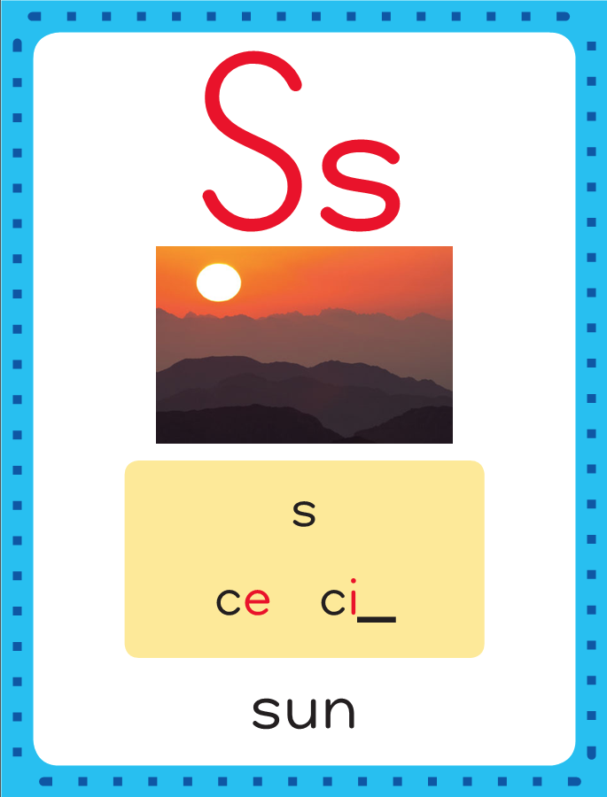
Introduce Soft c; Soft g, dge
This is the Sun
Sound-Spelling Card.
This is called soft c.
This is the word ice.
ice
cent
The /s/ sound can be spelled with c when it is followed by e or i.
The e is silent.
Say it with me: /sss/.
This is the sound at the end of ice.
Listen: /iiisss/, ice.

Slide 4
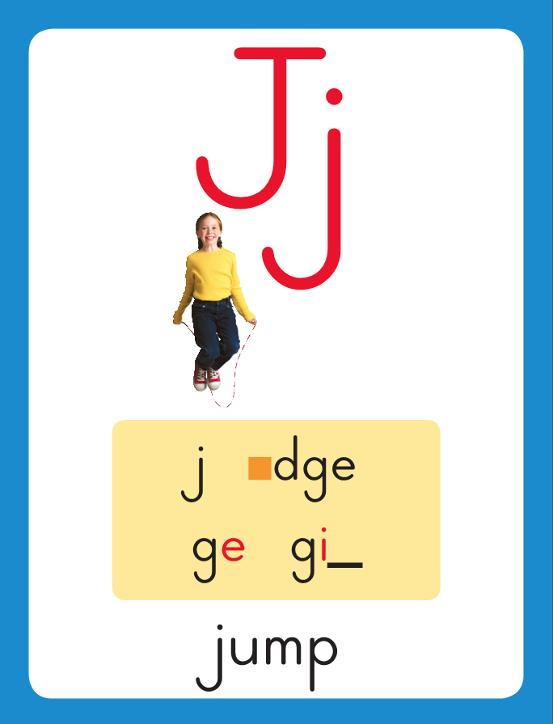
Introduce Soft c; Soft g, dge
This is the Jump
Sound-Spelling Card.
This is called soft g.
This is the word gem.
gem
gist
edge
The /j/ sound can be spelled with g and dge.
A short vowel letter sound always comes before dge.

Slide 5
Introduce Soft c; Soft g, dge
m

Slide 6
Introduce Soft c; Soft g, dge
m
i
_
e

Slide 7
Introduce Soft c; Soft g, dge
m
i
_
e

Slide 8
Introduce Soft c; Soft g, dge
m
i
c
e

Slide 9
Introduce Soft c; Soft g, dge
s
p

Slide 10
Introduce Soft c; Soft g, dge
s
p
i
_
e

Slide 11
Introduce Soft c; Soft g, dge
s
p
i
_
e

Slide 12
Introduce Soft c; Soft g, dge
s
p
i
c
e

Slide 13
Introduce Soft c; Soft g, dge
g
e

Slide 14
Introduce Soft c; Soft g, dge
g
e

Slide 15
Introduce Soft c; Soft g, dge
g
e

Slide 16
Introduce Soft c; Soft g, dge
g
e
m

Slide 17
Introduce Soft c; Soft g, dge
s
t

Slide 18
Introduce Soft c; Soft g, dge
s
t
a
_
e

Slide 19
Introduce Soft c; Soft g, dge
s
t
a
_
e

Slide 20
Introduce Soft c; Soft g, dge
s
t
a
g
e

Slide 21
Introduce Soft c; Soft g, dge
l

Slide 22
Introduce Soft c; Soft g, dge
l
o

Slide 23
Introduce Soft c; Soft g, dge
l
o

Slide 24
Introduce Soft c; Soft g, dge
l
o
dge

Slide 25
Introduce Soft c; Soft g, dge
l
o
dge

Slide 26
a_e ce dge sp
ch i_e k ge
sm sh a_e ce

Slide 27
f

Slide 28
fa_e

Slide 29
face

Slide 30
face l

Slide 31
face la_e

Slide 32
face lace

Slide 33
face lace n

Slide 34
face lace ni_e

Slide 35
face lace nice

Slide 36
face lace nice
e

Slide 37
face lace nice
edge

Slide 38
face lace nice
edge ce

Slide 39
face lace nice
edge ce

Slide 40
face lace nice
edge cent

Slide 41
face lace nice
edge cent sp

Slide 42
face lace nice
edge cent spa_e

Slide 43
face lace nice
edge cent space

Slide 44
face lace nice
edge cent space
sl

Slide 45
face lace nice
edge cent space
sli_e

Slide 46
face lace nice
edge cent space
slice

Slide 47
face lace nice
edge cent space
slice r

Slide 48
face lace nice
edge cent space
slice ra_e

Slide 49
face lace nice
edge cent space
slice race

Slide 50
face lace nice
edge cent space
slice raced

Slide 51
face lace nice
edge cent space
slice raced ge

Slide 52
face lace nice
edge cent space
slice raced ge

Slide 53
face lace nice
edge cent space
slice raced gem

Slide 54
face lace nice
edge cent space
slice raced gem
ch

Slide 55
face lace nice
edge cent space
slice raced gem
cha

Slide 56
face lace nice
edge cent space
slice raced gem
chan

Slide 57
face lace nice
edge cent space
slice raced gem
chance

Slide 58
face lace nice
edge cent space
slice raced gem
chance pl

Slide 59
face lace nice
edge cent space
slice raced gem
chance pla_e

Slide 60
face lace nice
edge cent space
slice raced gem
chance place

Slide 61
face lace nice
edge cent space
slice raced gem
chance place c

Slide 62
face lace nice
edge cent space
slice raced gem
chance place ca_e

Slide 63
face lace nice
edge cent space
slice raced gem
chance place cage

Slide 64
Internal Sounding Out
age

Slide 65
Internal Sounding Out
age wage

Slide 66
Internal Sounding Out
age wage ice

Slide 67
Internal Sounding Out
age wage ice
rice

Slide 68
Internal Sounding Out
age wage ice
rice sell

Slide 69
Internal Sounding Out
age wage ice
rice sell cell

Slide 70
Internal Sounding Out
age wage ice
rice sell cell
bike

Slide 71
Internal Sounding Out
age wage ice
rice sell cell
bike smile

Slide 72
Internal Sounding Out
age wage ice
rice sell cell
bike smile kite

Slide 73
Internal Sounding Out
age wage ice
rice sell cell
bike smile kite
make

Slide 74
Internal Sounding Out
age wage ice
rice sell cell
bike smile kite
make shake

Slide 75
Internal Sounding Out
age wage ice
rice sell cell
bike smile kite
make shake can’t

Slide 76
Can

Slide 77
Can mice

Slide 78
Can mice dance?

Slide 79
Can mice dance?
Lance

Slide 80
Can mice dance?
Lance swam

Slide 81
Can mice dance?
Lance swam to

Slide 82
Can mice dance?
Lance swam to the

Slide 83
Can mice dance?
Lance swam to the bridge.

Slide 84
Can mice dance?
Lance swam to the bridge.
The

Slide 85
Can mice dance?
Lance swam to the bridge.
The nice

Slide 86
Can mice dance?
Lance swam to the bridge.
The nice judge

Slide 87
Can mice dance?
Lance swam to the bridge.
The nice judge is

Slide 88
Can mice dance?
Lance swam to the bridge.
The nice judge is on

Slide 89
Can mice dance?
Lance swam to the bridge.
The nice judge is on stage

Slide 90
Can mice dance?
Lance swam to the bridge.
The nice judge is on stage with

Slide 91
Can mice dance?
Lance swam to the bridge.
The nice judge is on stage with a

Slide 92
Can mice dance?
Lance swam to the bridge.
The nice judge is on stage with a prize.

Slide 93
Spelling / Dictation
1. _________
2. _________
3. _________
4. _________
5. _________
rice
page
wedge
like
nice

Slide 94
High Frequency
Words

Slide 95
Read, Spell, Write
any
Do you have any time to play?

Slide 96
Read, Spell, Write
from
The cake came from the shop.

Slide 97
Read, Spell, Write
happy
The dog is happy when I pet his face.

Slide 98
Read, Spell, Write
once
Once I ran a mile.

Slide 99
Read, Spell, Write
so
It is hot, so I will play inside.

Slide 100
Read, Spell, Write
upon
Once upon a time, a king had a magic stone.

Slide 101
Have children read the sentences. Prompt them to identify the high-frequency words in connected text and to blend the decodable words.
Do you have any time to play?
The cake came from the shop.
3. The dog is happy when I pet his face.

Slide 102
Have children read the sentences. Prompt them to identify the high-frequency words in connected text and to blend the decodable words.
Once I ran a mile.
It is hot, so I will play inside.
3. Once upon a time, a king had a magic stone.

Slide 103
Grammar
Remember that a verb is a action word.
A past tense verb tells about an action that has already happened.
Yesterday Jen danced
on a stage.
Danced is a verb. Many past-tense verbs end in –ed.
Mike will fix the fence on Monday.
Adding the verb will before the action word shows that something will happen in the future.

Slide 104
Grammar
Have children identify the verbs in the sentences.
Have children work with a partner to change each verb to past-tense by adding –ed, and to future-tense by adding will.
I pick up the slice of bread. (picked; will pick)
I munch on the sandwich.
(munched; will munch)

Slide 105
Week 1 – Day 2

Slide 106
Phonemic Awareness –
Phoneme Segmentation
I am going to say the sounds in the word rice.
Listen: /r/ /i/ /s/.
The first sound is /r/. The second sound is /i/. The last sound is /s/.
I’ll place a marker in a box for each sound I hear.
The word has three sounds: /r/ /i/ /s/.
Say the word and its sounds with me: ricer, /r/ /i/ /s/.
/r/
/i/
/s/

Slide 107
Phonemic Awareness –
Phoneme Segmentation
I am going to say the sounds in the word rice.
Place a marker in a box to stand for each sound.
gem face dance cage bridge fudge
lodge lace cinch slice age dodge

Slide 108
Introduce Soft c; Soft g, dge
cent
ice
What are these letter?
What sound do they stand for?

Slide 109
Introduce Soft c; Soft g, dge
page
What are these letter?
What sound do they stand for?
fugde

Slide 110
Blending Words with Soft c, g, dge
r

Slide 111
Blending Words with Soft c, g, dge
r
i
_
e

Slide 112
Blending Words with Soft c, g, dge
r
i
_
e

Slide 113
Blending Words with Soft c, g, dge
r
i
c
e

Slide 114
Blending Words with Soft c, g, dge
s
l

Slide 115
Blending Words with Soft c, g, dge
s
l
i
_
e

Slide 116
Blending Words with Soft c, g, dge
s
l
i
_
e

Slide 117
Blending Words with Soft c, g, dge
s
l
i
c
e

Slide 118
Blending Words with Soft c, g, dge
a
_
e

Slide 119
Blending Words with Soft c, g, dge
a
g
e

Slide 120
Blending Words with Soft c, g, dge
w

Slide 121
Blending Words with Soft c, g, dge
w
e

Slide 122
Blending Words with Soft c, g, dge
w
e

Slide 123
Blending Words with Soft c, g, dge
w
e
dge

Slide 124
Blending Words with Soft c, g, dge
w
e
dge

Slide 125
Blending Words with Soft c, g, dge
h

Slide 126
Blending Words with Soft c, g, dge
h
i

Slide 127
Blending Words with Soft c, g, dge
h
i

Slide 128
Blending Words with Soft c, g, dge
h
i
n

Slide 129
Blending Words with Soft c, g, dge
h
i
n
ge

Slide 130
Blending Words with Soft c, g, dge
h
i
n
ge

Slide 131
ce

Slide 132
ce

Slide 133
cent

Slide 134
cent a_e

Slide 135
cent ace

Slide 136
cent ace n

Slide 137
cent ace ni_e

Slide 138
cent ace nice

Slide 139
cent ace nice
sp

Slide 140
cent ace nice
spa_e

Slide 141
cent ace nice
space

Slide 142
cent ace nice
space ge

Slide 143
cent ace nice
space ge

Slide 144
cent ace nice
space gel

Slide 145
cent ace nice
space gel p

Slide 146
cent ace nice
space gel pa_e

Slide 147
cent ace nice
space gel page

Slide 148
cent ace nice
space gel page
st

Slide 149
cent ace nice
space gel page
sta_e

Slide 150
cent ace nice
space gel page
stage

Slide 151
cent ace nice
space gel page
stage br

Slide 152
cent ace nice
space gel page
stage bri

Slide 153
cent ace nice
space gel page
stage bridge

Slide 154
cent ace nice
space gel page
stage bridge
d

Slide 155
cent ace nice
space gel page
stage bridge
do

Slide 156
cent ace nice
space gel page
stage bridge
dodge

Slide 157
cent ace nice
space gel page
stage bridge
dodge sm

Slide 158
cent ace nice
space gel page
stage bridge
dodge smu

Slide 159
cent ace nice
space gel page
stage bridge
dodge smudge

Slide 160
Blending Words with Soft c, g, dge
f
a
c
e
What is the new word we made?
Let’s blend all the sounds and read the word.
Change the f to sp.

Slide 161
Blending Words with Soft c, g, dge
sp
a
c
e
What is the new word we made?
Let’s blend all the sounds and read the word.
Change the sp to tr.

Slide 162
Blending Words with Soft c, g, dge
tr
a
c
e
What is the new word we made?
Let’s blend all the sounds and read the word.
Remove the t.

Slide 163
Blending Words with Soft c, g, dge
r
a
c
e
What is the new word we made?
Let’s blend all the sounds and read the word.
Change the a to i.

Slide 164
Blending Words with Soft c, g, dge
r
i
c
e
What is the new word we made?
Let’s blend all the sounds and read the word.
Change the r to n.

Slide 165
Blending Words with Soft c, g, dge
n
i
c
e
What is the new word we made?
Let’s blend all the sounds and read the word.
Change the n to m.

Slide 166
Blending Words with Soft c, g, dge
m
i
c
e
What is the new word we made?
Let’s blend all the sounds and read the word.
Change the m to l.

Slide 167
Blending Words with Soft c, g, dge
l
i
c
e
What is the new word we made?
Let’s blend all the sounds and read the word.
Change the i to a.

Slide 168
Blending Words with Soft c, g, dge
l
a
c
e
What is the new word we made?
Let’s blend all the sounds and read the word.
Change the l to p.

Slide 169
Blending Words with Soft c, g, dge
p
a
c
e
What is the new word we made?
Let’s blend all the sounds and read the word.
Change the p to f.

Slide 170
Blending Words with Soft c, g, dge
f
a
c
e
What is the new word we made?
Let’s blend all the sounds and read the word.
Change the f to r.

Slide 171
Blending Words with Soft c, g, dge
r
a
c
e
What is the new word we made?
Let’s blend all the sounds and read the word.
Change the c to g.

Slide 172
Blending Words with Soft c, g, dge
r
a
g
e
What is the new word we made?
Let’s blend all the sounds and read the word.
Change the r to p.

Slide 173
Blending Words with Soft c, g, dge
p
a
g
e
What is the new word we made?
Let’s blend all the sounds and read the word.
Change the p to w.

Slide 174
Blending Words with Soft c, g, dge
w
a
g
e
What is the new word we made?
Let’s blend all the sounds and read the word.
Change the w to c.

Slide 175
Blending Words with Soft c, g, dge
c
a
g
e
What is the new word we made?
Let’s blend all the sounds and read the word.
Change the c to s.

Slide 176
Blending Words with Soft c, g, dge
s
a
g
e
What is the new word we made?
Let’s blend all the sounds and read the word.
Change the s to st.

Slide 177
Blending Words with Soft c, g, dge
st
a
g
e
What is the new word we made?
Let’s blend all the sounds and read the word.

Slide 178
Structural Analysis
Inflectional Endings –ed, -ing
When a word ends in final e, you drop the e before adding –ed or –ing.
Remember that when –ed is added to a verb, or action word, it tells about something that has already happened; when –ing is added to a verb, it tells about something that is happening now.
race
raced
racing

Slide 179
Structural Analysis
Inflectional Endings –ed, -ing
Say race and raced again and listen for the /t/ sound at the end of raced.
The letters ed can also stand for the /d/ sound as in cringed.
race
raced
cringe
cringed
/t/
/d/

Slide 180
Structural Analysis
Inflectional Endings –ed, -ing
By adding the letters –ing at the end of a word adds a syllable, or word part.
Use each word in a sentence.
race
racing

Slide 181
Structural Analysis
Inflectional Endings –ed, -ing
Have children add –ed and –ing to each word
and then use each word in a sentence.
place
slice
rage
plunge

Slide 182
Spelling
mice
cage
hedge

Slide 183
rice
age
wedge
ledge
nice
page
rice
age
wedge
ledge
nice
page

Slide 184
High Frequency
Words

Slide 185
Read, Spell, Write
any
Do you have any time to play?

Slide 186
Read, Spell, Write
from
The cake came from the shop.

Slide 187
Read, Spell, Write
happy
The dog is happy when I pet his face.

Slide 188
Read, Spell, Write
once
Once I ran a mile.

Slide 189
Read, Spell, Write
so
It is hot, so I will play inside.

Slide 190
Read, Spell, Write
upon
Once upon a time, a king had a magic stone.

Slide 191
Grammar
A past tense verb tells about an action that has already happened.
Many past-tense verbs end in –ed.
A future-tense verb tells about an action that is going to happen.
Adding will before a verb makes it future tense.
Guide children to circle the verb or verbs in each sentence and identify which is past tense and which is future tense.
Vance sliced the fudge cake.
We will play together on Sunday.
Once children have changes the sentences to past tense, have them change the sentences to future tense by adding will.

Slide 192
Week 1 – Day 3

Slide 193
Phonemic Awareness
Phoneme Blending
I am going to put one marker in each box as I say each sound.
Then I will blend the sounds to form a word.
Place a marker for each sound as you say /m/ /i/ /s/.
This word has three sounds: /m/ /i/ /s/.
Listen as I blend these sounds to form a word:
/mmmiiisss/. Mice. The word is mice.
/m/
/i/
/s/

Slide 194
Phonemic Awareness
Phoneme Blending
Using your own boards, place a marker for each sound you hear. I will say one sound at a time. Then blend the sounds to say the word.
/s/ /e/ /l/ /e/ /j/ /f/ /a/ /s/
/n/ /i/ /s/ /s/ /t/ /a/ /j/ /s/ /l/ /u/ /j/
/t/ /i/ /j/ /p/ /r/ /a/ /n/ /s/ /p/ /l/ /u/ /n/ /j/

Slide 195
Blending Words with Soft c, g, dge
p

Slide 196
Blending Words with Soft c, g, dge
p
a
_
e

Slide 197
Blending Words with Soft c, g, dge
p
a
_
e

Slide 198
Blending Words with Soft c, g, dge
p
a
g
e

Slide 199
Blending Words with Soft c, g, dge
c

Slide 200
Blending Words with Soft c, g, dge
c
a
_
e

Slide 201
Blending Words with Soft c, g, dge
c
a
_
e

Slide 202
Blending Words with Soft c, g, dge
c
a
g
e

Slide 203
Blending Words with Soft c, g, dge
b

Slide 204
Blending Words with Soft c, g, dge
b
a

Slide 205
Blending Words with Soft c, g, dge
b
a

Slide 206
Blending Words with Soft c, g, dge
b
a
dge

Slide 207
Blending Words with Soft c, g, dge
b
a
dge

Slide 208
Blending Words with Soft c, g, dge
s
p

Slide 209
Blending Words with Soft c, g, dge
s
p

Slide 210
Blending Words with Soft c, g, dge
s
p
i
_
e

Slide 211
Blending Words with Soft c, g, dge
s
p
i
_
e

Slide 212
Blending Words with Soft c, g, dge
s
p
i
c
e

Slide 213
Blending Words with Soft c, g, dge
g
r

Slide 214
Blending Words with Soft c, g, dge
g
r

Slide 215
Blending Words with Soft c, g, dge
g
r
a
_
e

Slide 216
Blending Words with Soft c, g, dge
g
r
a
_
e

Slide 217
Blending Words with Soft c, g, dge
g
r
a
c
e

Slide 218
dge a_e ce i_e
ing ge sm pl
i_e dge ce a_e

Slide 219
e

Slide 220
edge

Slide 221
edge f

Slide 222
edge fu

Slide 223
edge fudge

Slide 224
edge fudge f

Slide 225
edge fudge fa_e

Slide 226
edge fudge face

Slide 227
edge fudge face
n

Slide 228
edge fudge face
ni_e

Slide 229
edge fudge face
nice

Slide 230
edge fudge face
nice br

Slide 231
edge fudge face
nice bra_e

Slide 232
edge fudge face
nice brace

Slide 233
edge fudge face
nice brace i_e

Slide 234
edge fudge face
nice brace ice

Slide 235
edge fudge face
nice brace ice
ce

Slide 236
edge fudge face
nice brace ice
ce

Slide 237
edge fudge face
nice brace ice
cent

Slide 238
edge fudge face
nice brace ice
cent r

Slide 239
edge fudge face
nice brace ice
cent ra_e

Slide 240
edge fudge face
nice brace ice
cent rage

Slide 241
edge fudge face
nice brace ice
cent rage b

Slide 242
edge fudge face
nice brace ice
cent rage bu

Slide 243
edge fudge face
nice brace ice
cent rage budge

Slide 244
edge fudge face
nice brace ice
cent rage budge
f

Slide 245
edge fudge face
nice brace ice
cent rage budge
fe

Slide 246
edge fudge face
nice brace ice
cent rage budge
fen

Slide 247
edge fudge face
nice brace ice
cent rage budge
fence

Slide 248
edge fudge face
nice brace ice
cent rage budge
fence pl

Slide 249
edge fudge face
nice brace ice
cent rage budge
fence pla_e

Slide 250
edge fudge face
nice brace ice
cent rage budge
fence place

Slide 251
edge fudge face
nice brace ice
cent rage budge
fence place r

Slide 252
edge fudge face
nice brace ice
cent rage budge
fence place ra_e

Slide 253
edge fudge face
nice brace ice
cent rage budge
fence place race

Slide 254
edge

Slide 255
piled placed

Slide 256
piled placed making

Slide 257
piled placed making
riding

Slide 258
piled placed making
riding slicing

Slide 259
piled placed making
riding slicing smiled

Slide 260
piled placed making
riding slicing smiled
baked

Slide 261
piled placed making
riding slicing smiled
baked tracing

Slide 262
piled placed making
riding slicing smiled
baked tracing liked

Slide 263
piled placed making
riding slicing smiled
baked tracing liked
space

Slide 264
piled placed making
riding slicing smiled
baked tracing liked
space spice

Slide 265
piled placed making
riding slicing smiled
baked tracing liked
space spice cages

Slide 266
Lance

Slide 267
Lance raced

Slide 268
Lance raced past

Slide 269
Lance raced past the

Slide 270
Lance raced past the fence.

Slide 271
Lance raced past the fence.
Madge

Slide 272
Lance raced past the fence.
Madge danced

Slide 273
Lance raced past the fence.
Madge danced on

Slide 274
Lance raced past the fence.
Madge danced on the

Slide 275
Lance raced past the fence.
Madge danced on the stage.

Slide 276
Structural Analysis
Inflectional Endings –ed, -ing
Say each of these words.
Ask children what to listen closely to hear what is different.
Remember that –ed means the action took place in the past;
-ing means the action is taking place now.
Since the word pledge ends in final –e,
e was dropped before adding –ed or –ing.
pledge
pledged
pledging

Slide 277
Structural Analysis
Inflectional Endings –ed, -ing
Help children blend the words.
Point out that –ed at the end of a word can stand for /t/ as in raced or /d/ as in cringed. Also point out that adding –ing at the end of a word adds a syllable.
race
raced
racing

Slide 278
Structural Analysis
Inflectional Endings –ed, -ing
Help children blend the words.
Point out that –ed at the end of a word can stand for /t/ as in raced or /d/ as in cringed. Also point out that adding –ing at the end of a word adds a syllable.
cringe
cringed
cringing

Slide 279
Structural Analysis
Inflectional Endings –ed, -ing
Help children blend the words.
Point out that –ed at the end of a word can stand for /t/ as in raced or /d/ as in cringed. Also point out that adding –ing at the end of a word adds a syllable.
judge
judged
judging

Slide 281
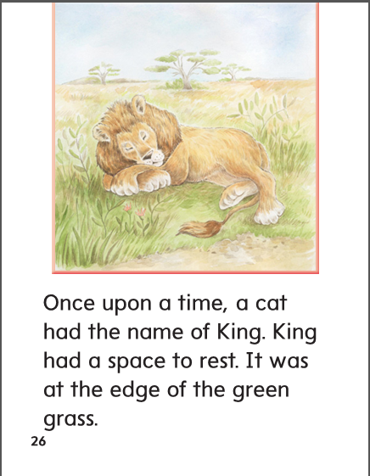

Slide 282
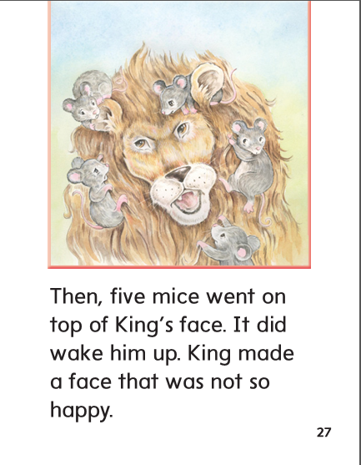

Slide 283
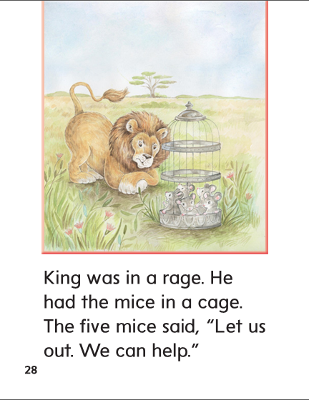

Slide 284
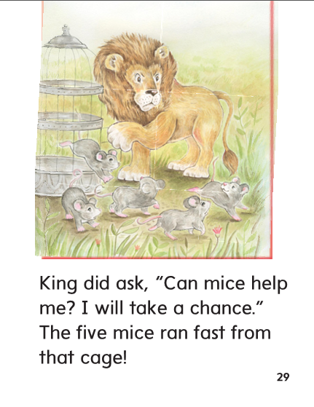

Slide 285
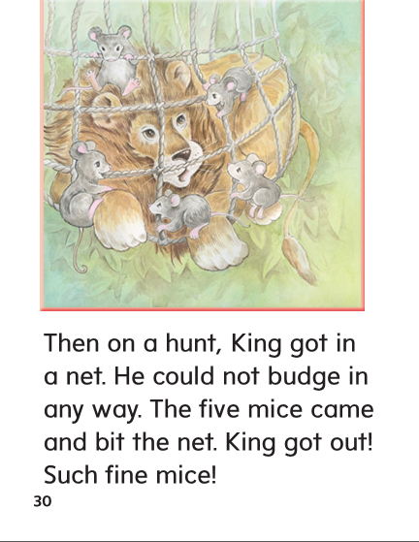

Slide 286
-ice
-age
-edge

Slide 287
rice
from
rice
wedge
once
wedge
page
page
nice
nice
ledge
from
ledge
age
once
age

Slide 288
High Frequency
Words

Slide 289
Read, Spell, Write
any
Do you have any time to play?

Slide 290
Read, Spell, Write
from
The cake came from the shop.

Slide 291
Read, Spell, Write
happy
The dog is happy when I pet his face.

Slide 292
Read, Spell, Write
once
Once I ran a mile.

Slide 293
Read, Spell, Write
so
It is hot, so I will play inside.

Slide 294
Read, Spell, Write
upon
Once upon a time, a king had a magic stone.

Slide 295
Build Fluency: Word Automaticity
Can you see any ducks from the bridge?
I am happy, so I smile a lot.
Once upon a time five mice ran a race.

Slide 296
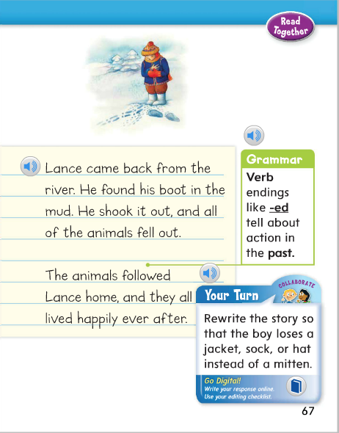
Name the verbs in this sentence:
The animals followed Lance home, and they all lived happily ever after.
How do you know his happened in the past?

Slide 297
Week 1 – Day 4

Slide 298
Phonemic Awareness
Phoneme Segmentation
Listen carefully as I say a word: glance.
What are the sounds in the word?
Yes, /g/ /l/ /a/ /n/ /s/.
There are five sounds.
Let’s say them again: /g/ /l/ /a/ /n/ /s/, glance
Guided Practice:
Tell me which sounds you hear in the word and then say the word.
ice cell stage fence pledge
race chance face slice gel
dodge page

Slide 299
Blending Words with Soft c, g, dge
p
a
c
e
What is the new word we made?
Let’s blend all the sounds and read the word.
Change the c to g.

Slide 300
Blending Words with Soft c, g, dge
p
a
g
e
What is the new word we made?
Let’s blend all the sounds and read the word.
Change the p to w.

Slide 301
Blending Words with Soft c, g, dge
w
a
g
e
What is the new word we made?
Let’s blend all the sounds and read the word.
Change the w to c.

Slide 302
Blending Words with Soft c, g, dge
c
a
g
e
What is the new word we made?
Let’s blend all the sounds and read the word.
Change the c to r.

Slide 303
Blending Words with Soft c, g, dge
r
a
g
e
What is the new word we made?
Let’s blend all the sounds and read the word.
Change the g to c.

Slide 304
Blending Words with Soft c, g, dge
r
a
c
e
What is the new word we made?
Let’s blend all the sounds and read the word.
Change the a to i.

Slide 305
Blending Words with Soft c, g, dge
r
i
c
e
What is the new word we made?
Let’s blend all the sounds and read the word.
Change the r to l.

Slide 306
Blending Words with Soft c, g, dge
l
i
c
e
What is the new word we made?
Let’s blend all the sounds and read the word.
Add s in front of l.

Slide 307
Blending Words with Soft c, g, dge
s
l
i
c
e
What is the new word we made?
Let’s blend all the sounds and read the word.
Change the l to p.

Slide 308
Blending Words with Soft c, g, dge
s
p
i
c
e
What is the new word we made?
Let’s blend all the sounds and read the word.
Change the i to a.

Slide 309
Blending Words with Soft c, g, dge
s
p
a
c
e
What is the new word we made?
Let’s blend all the sounds and read the word.
Change the sp to r.

Slide 310
Blending Words with Soft c, g, dge
r
a
c
e
What is the new word we made?
Let’s blend all the sounds and read the word.
Change the a to i.

Slide 311
Blending Words with Soft c, g, dge
r
i
c
e
What is the new word we made?
Let’s blend all the sounds and read the word.
Change the ce to dge.

Slide 312
Blending Words with Soft c, g, dge
r
i
dge
What is the new word we made?
Let’s blend all the sounds and read the word.
Change the ce to dge.

Slide 313
Blending Words with Soft c, g, dge
r
i
dge
What is the new word we made?
Let’s blend all the sounds and read the word.
Add a b in front of the r.

Slide 314
Blending Words with Soft c, g, dge
b
r
i
dge
What is the new word we made?
Let’s blend all the sounds and read the word.

Slide 315
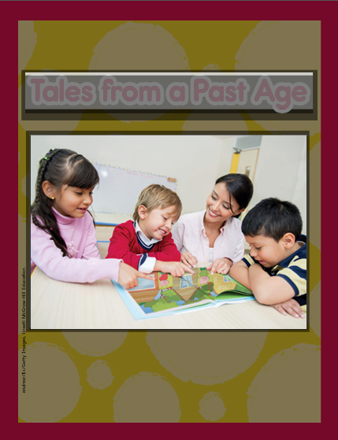

Slide 321
Structural Analysis
Inflectional Endings –ed, -ing
Say each of these words.
Remember that –ed means the action took place in the past;
-ing means the action is taking place now.
Since the word pledge ends in final –e,
e was dropped before adding –ed or –ing.
dance
danced
dancing

Slide 322
Structural Analysis
Inflectional Endings –ed, -ing
Have children work in pairs to construct words that tell about actions in the past and actions happening now by adding –ed and –ing.
Then have the write sentences with each word.
trace
change
dodge

Slide 323
High Frequency
Words

Slide 324
Read, Spell, Write
any
Do you have any time to play?

Slide 325
Read, Spell, Write
from
The cake came from the shop.

Slide 326
Read, Spell, Write
happy
The dog is happy when I pet his face.

Slide 327
Read, Spell, Write
once
Once I ran a mile.

Slide 328
Read, Spell, Write
so
It is hot, so I will play inside.

Slide 329
Read, Spell, Write
upon
Once upon a time, a king had a magic stone.

Slide 330
Grammar
A past tense verb tells about an action that has already happened.
A future-tense verb tells about an action that is going to happen.
Ask, What can you do to most verbs to show that an action happened in the past?
What can you do to a verb to show that an action will happen in the future?
Yesterday Bob raced Lance around the track.
I will brush my dog on Monday.
I rested on a nice cot.
Guide children to identify the verb or verbs as you say aloud the following sentences. Have children identify which verbs show past and future tense.

Slide 331
Week 1 – Day 5

Slide 332
Phonemic Awareness
Phoneme Blending:
Listen as I say a group of sounds. Then blend those sounds to form a word.
/i/ /s/ /s/ /l/ /i/ /s/ /w/ /e/ /j/ /t/ /r/ /a/ /s/
/ch/ /a/ /n/ /s/ /p/ /l/ /u/ /n/ /j/ /m/ /i/ /s/
Phoneme Segmentation:
Now I am going to say a word. I want you to say each sound in the word.
hinge dice wage smudge fence

Slide 333
Blend and Build Words with Soft c, g, dge
Read and say these words:
mice
place
cent
gem
Stage
lodge

Slide 334
Blending Words with Soft c, g, dge
r
i
c
e
What is the new word we made?
Let’s blend all the sounds and read the word.
Change the r to n.

Slide 335
Blending Words with Soft c, g, dge
n
i
c
e
What is the new word we made?
Let’s blend all the sounds and read the word.
Change the n to m.

Slide 336
Blending Words with Soft c, g, dge
m
i
c
e
What is the new word we made?
Let’s blend all the sounds and read the word.
Change the m to l.

Slide 337
Blending Words with Soft c, g, dge
l
i
c
e
What is the new word we made?
Let’s blend all the sounds and read the word.
Change the m to l.

Slide 338
Blending Words with Soft c, g, dge
l
i
c
e
What is the new word we made?
Let’s blend all the sounds and read the word.
Change the i to a.

Slide 339
Blending Words with Soft c, g, dge
l
a
c
e
What is the new word we made?
Let’s blend all the sounds and read the word.
Add a p in front of the l.

Slide 340
Blending Words with Soft c, g, dge
p
l
a
c
e
What is the new word we made?
Let’s blend all the sounds and read the word.
Remove the l.

Slide 341
Blending Words with Soft c, g, dge
p
a
c
e
What is the new word we made?
Let’s blend all the sounds and read the word.
Change the p to r.

Slide 342
Blending Words with Soft c, g, dge
r
a
c
e
What is the new word we made?
Let’s blend all the sounds and read the word.
Add a g in front of the r.

Slide 343
Blending Words with Soft c, g, dge
g
r
a
c
e
What is the new word we made?
Let’s blend all the sounds and read the word.
Change the g to t.

Slide 344
Blending Words with Soft c, g, dge
t
r
a
c
e
What is the new word we made?
Let’s blend all the sounds and read the word.
Remove the t.

Slide 345
Blending Words with Soft c, g, dge
r
a
c
e
What is the new word we made?
Let’s blend all the sounds and read the word.
Change the c to g.

Slide 346
Blending Words with Soft c, g, dge
r
a
g
e
What is the new word we made?
Let’s blend all the sounds and read the word.
Change the r to c.

Slide 347
Blending Words with Soft c, g, dge
c
a
g
e
What is the new word we made?
Let’s blend all the sounds and read the word.
Remove the c.

Slide 348
Blending Words with Soft c, g, dge
a
g
e
What is the new word we made?
Let’s blend all the sounds and read the word.
Change the a to e.

Slide 349
Blending Words with Soft c, g, dge
e
dge
What is the new word we made?
Let’s blend all the sounds and read the word.
Add a w in front of the e.

Slide 350
Blending Words with Soft c, g, dge
w
e
dge
What is the new word we made?
Let’s blend all the sounds and read the word.
Change the w to l.

Slide 351
Blending Words with Soft c, g, dge
l
e
dge
What is the new word we made?
Let’s blend all the sounds and read the word.
Change the e to o.

Slide 352
Blending Words with Soft c, g, dge
l
o
dge
What is the new word we made?
Let’s blend all the sounds and read the word.
Change the l to d.

Slide 353
Blending Words with Soft c, g, dge
d
o
dge
What is the new word we made?
Let’s blend all the sounds and read the word.
Change the l to d.

Slide 354
Word Automaticity
edge

Slide 355
cent

Slide 356
raced

Slide 357
slicing

Slide 358
space

Slide 359
fudge

Slide 360
rage

Slide 361
piled

Slide 362
smiled

Slide 363
spice

Slide 364
face

Slide 365
budge

Slide 366
placed

Slide 367
baked

Slide 368
dice

Slide 369
fence

Slide 370
nice

Slide 371
making

Slide 372
tracing

Slide 373
cages

Slide 374
brace

Slide 375
place

Slide 376
riding

Slide 377
liked

Slide 378
states

Slide 379
ice

Slide 380
Structural Analysis
Inflectional Endings –ed, -ing
Have children explain how to add the –ed and –ing endings to words that end in final –e. Then have children practice adding –ed and –ing to these words:
place make
brace slice
race dodge
take judge

Slide 381
High Frequency
Words

Slide 382
Read, Spell, Write
any
Do you have any time to play?

Slide 383
Read, Spell, Write
from
The cake came from the shop.

Slide 384
Read, Spell, Write
happy
The dog is happy when I pet his face.

Slide 385
Read, Spell, Write
once
Once I ran a mile.

Slide 386
Read, Spell, Write
so
It is hot, so I will play inside.

Slide 387
Read, Spell, Write
upon
Once upon a time, a king had a magic stone.

Slide 388
Grammar
Have children describe what past tense verbs are and how they are used.
What is one way I would know if the action in a sentence happened in the past?
The sun shined on the class picnic.
Have children provide past-tense verbs to complete the following sentences.
We _____ at school on Friday.
Chad _____ down the hill.

Slide 389
Grammar
Have children describe what future-tense verbs are and how they are used.
What can you do to a verb to show that an action will happen in the future?
Tonight, I ___________________.
The frog ___________ in the water.
Have children complete them with future-tense verbs.

