Slide 1
Week 1 – Day 1

Slide 2
Phonemic Awareness –
Phoneme Segmentation
Listen carefully as I say a word: rose.
How many sounds are in the word rose?
I will place a marker in a box for each sound I hear: /r/ /o/ /z/.
I will place three markers because I hear three sounds in the word rose.
/r/
/o/
/z/

Slide 3
Phonemic Awareness –
Phoneme Segmentation
Listen carefully as I say some words.
Place one marker in a box for each sound you hear.
Then tell me how many sounds are in each word.
note hope stove smoke
use cute huge these

Slide 4
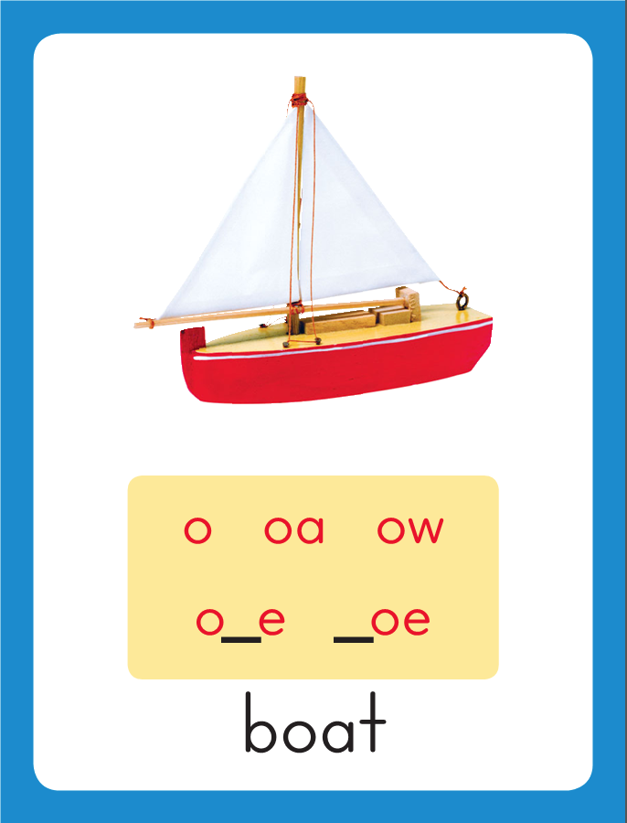
Introduce /o/ o_e, /u/ u_e, /e/ e_e
This is the Boat
Sound-Spelling Card.
The sound is /o/.
Look at this word: hop.
Say it with me.
This word has the /o/ sound. I’ll add an e to the end. The letters o and e act together to make the long o sound: /o/.
Listen: /hop/, hope.
I’ll say /o/ as I write the letters o_e several times.
hop
hope

Slide 5
Have children practice connecting the letters o_e to the sound /o/ by writing hope.
Now do it with me. Say /o/ as I write hope.
This time, write the word five times as you say the /o/ sound.
hope hope hope
hope hope

Slide 6
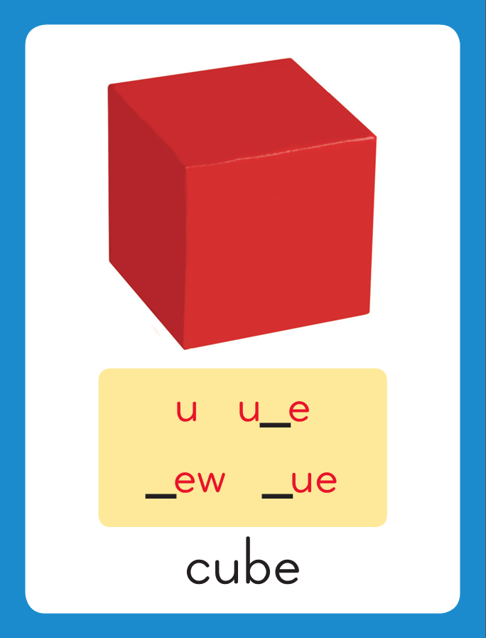
Introduce /o/ o_e, /u/ u_e, /e/ e_e
This is the Cube
Sound-Spelling Card.
The sound is /u/.
Look at this word: cub.
Say it with me.
This word has the /u/ sound. I’ll add an e to the end. The letters u and e act together to make the long u sound: /u/.
Listen: /cub/, cube.
I’ll say /u/ as I write the letters u_e several times.
cub
cube

Slide 7
Have children practice connecting the letters u_e to the sound /u/ by writing cube.
Now do it with me. Say /u/ as I write cube.
This time, write the word five times as you say the /u/ sound.
cube cube cube
cube cube

Slide 8
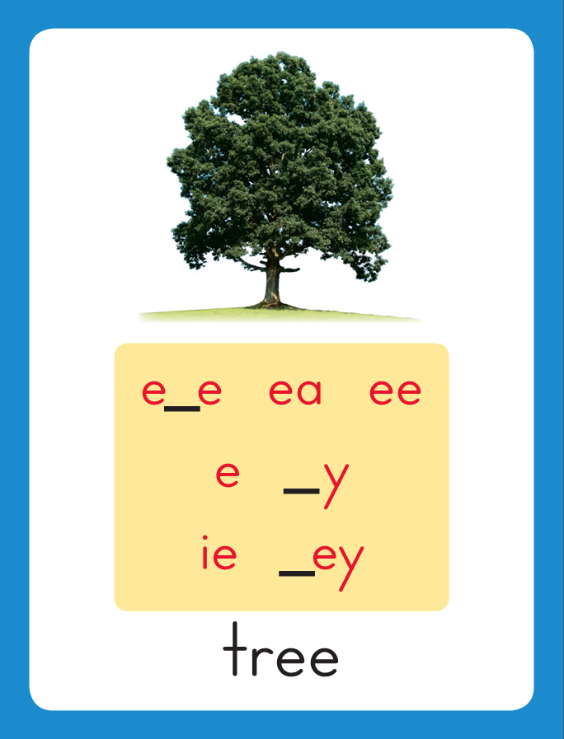
Introduce /o/ o_e, /u/ u_e, /e/ e_e
This is the Tree
Sound-Spelling Card.
The sound is /e/.
Look at this word: pet.
Say it with me.
This word has the /e/ sound. I’ll add an e to the end. The letters e and e act together to make the long e sound: /e/.
Listen: /pet/, Pete.
I’ll say /e/ as I write the letters e_e several times.
pet
Pete

Slide 9
Have children practice connecting the letters e_e to the sound /e/ by writing Pete.
Now do it with me. Say /e/ as I write Pete.
This time, write the word five times as you say the /e/ sound.
Pete Pete Pete
Pete Pete

Slide 10
Blend with /o/ o_e, /u/ u_e, /e/ e_e
n

Slide 11
Blend with /o/ o_e, /u/ u_e, /e/ e_e
n
o
_
e

Slide 12
Blend with /o/ o_e, /u/ u_e, /e/ e_e
n
o
_
e

Slide 13
Blend with /o/ o_e, /u/ u_e, /e/ e_e
n
o
t
e

Slide 14
Blend with /o/ o_e, /u/ u_e, /e/ e_e
h

Slide 15
Blend with /o/ o_e, /u/ u_e, /e/ e_e
h
o
_
e

Slide 16
Blend with /o/ o_e, /u/ u_e, /e/ e_e
h
o
_
e

Slide 17
Blend with /o/ o_e, /u/ u_e, /e/ e_e
h
o
s
e

Slide 18
Blend with /o/ o_e, /u/ u_e, /e/ e_e
m

Slide 19
Blend with /o/ o_e, /u/ u_e, /e/ e_e
m
u
_
e

Slide 20
Blend with /o/ o_e, /u/ u_e, /e/ e_e
m
u
_
e

Slide 21
Blend with /o/ o_e, /u/ u_e, /e/ e_e
m
u
l
e

Slide 22
Blend with /o/ o_e, /u/ u_e, /e/ e_e
f

Slide 23
Blend with /o/ o_e, /u/ u_e, /e/ e_e
f
u
_
e

Slide 24
Blend with /o/ o_e, /u/ u_e, /e/ e_e
f
u
_
e

Slide 25
Blend with /o/ o_e, /u/ u_e, /e/ e_e
f
u
m
e

Slide 26
Blend with /o/ o_e, /u/ u_e, /e/ e_e
e
_
e

Slide 27
Blend with /o/ o_e, /u/ u_e, /e/ e_e
e
v
e

Slide 28
o_e ge st u_e
ing e_e th gl
cl v o_e sm

Slide 29
h

Slide 30
ho_e

Slide 31
home

Slide 32
home b

Slide 33
home bo_e

Slide 34
home bone

Slide 35
home bone h

Slide 36
home bone hu_e

Slide 37
home bone huge

Slide 38
home bone huge
c

Slide 39
home bone huge
cu_e

Slide 40
home bone huge
cute

Slide 41
home bone huge
cute P

Slide 42
home bone huge
cute Pe_e

Slide 43
home bone huge
cute Pete

Slide 44
home bone huge
cute Pete E_e

Slide 45
home bone huge
cute Pete Eve

Slide 46
home bone huge
cute Pete Eve
u_e

Slide 47
home bone huge
cute Pete Eve
use

Slide 48
home bone huge
cute Pete Eve
use n

Slide 49
home bone huge
cute Pete Eve
use no_e

Slide 50
home bone huge
cute Pete Eve
use nose

Slide 51
home bone huge
cute Pete Eve
use nose st

Slide 52
home bone huge
cute Pete Eve
use nose sto_e

Slide 53
home bone huge
cute Pete Eve
use nose stove

Slide 54
home bone huge
cute Pete Eve
use nose stove
c

Slide 55
home bone huge
cute Pete Eve
use nose stove
cu_e

Slide 56
home bone huge
cute Pete Eve
use nose stove
cube

Slide 57
home bone huge
cute Pete Eve
use nose stove
cube th

Slide 58
home bone huge
cute Pete Eve
use nose stove
cube tho_e

Slide 59
home bone huge
cute Pete Eve
use nose stove
cube those

Slide 60
home bone huge
cute Pete Eve
use nose stove
cube those th

Slide 61
home bone huge
cute Pete Eve
use nose stove
cube those the_e

Slide 62
home bone huge
cute Pete Eve
use nose stove
cube those these

Slide 63
Internal Sounding Out
globe

Slide 64
Internal Sounding Out
globe mute

Slide 65
Internal Sounding Out
globe mute close

Slide 66
Internal Sounding Out
globe mute close
hole

Slide 67
Internal Sounding Out
globe mute close
hole vote

Slide 68
Internal Sounding Out
globe mute close
hole vote smoke

Slide 69
Internal Sounding Out
globe mute close
hole vote smoke
used

Slide 70
Internal Sounding Out
globe mute close
hole vote smoke
used hoping

Slide 71
Internal Sounding Out
globe mute close
hole vote smoke
used hoping joked

Slide 72
Internal Sounding Out
globe mute close
hole vote smoke
used hoping joked
poles

Slide 73
Internal Sounding Out
globe mute close
hole vote smoke
used hoping joked
poles fumes

Slide 74
Internal Sounding Out
globe mute close
hole vote smoke
used hoping joked
poles fumes cones

Slide 75
The

Slide 76
The rope

Slide 77
The rope broke

Slide 78
The rope broke on

Slide 79
The rope broke on the

Slide 80
The rope broke on the flag

Slide 81
The rope broke on the flag pole.

Slide 82
The rope broke on the flag pole.
Steve

Slide 83
The rope broke on the flag pole.
Steve woke

Slide 84
The rope broke on the flag pole.
Steve woke up

Slide 85
The rope broke on the flag pole.
Steve woke up when

Slide 86
The rope broke on the flag pole.
Steve woke up when he

Slide 87
The rope broke on the flag pole.
Steve woke up when he smelled

Slide 88
The rope broke on the flag pole.
Steve woke up when he smelled smoke.

Slide 89
The

Slide 90
The cute

Slide 91
The cute white

Slide 92
The cute white rat

Slide 93
The cute white rat dove

Slide 94
The cute white rat dove down

Slide 95
The cute white rat dove down the

Slide 96
The cute white rat dove down the hole.

Slide 97
Spelling / Dictation
1. _________
2. _________
3. _________
4. _________
5. _________
hope
cute
nose
cube
note

Slide 98
High Frequency
Words

Slide 99
Read, Spell, Write
ago
The lake froze five days ago.

Slide 100
Read, Spell, Write
boy
Pete is a nice boy.

Slide 101
Read, Spell, Write
girl
A new girl is in the class.

Slide 102
Read, Spell, Write
how
How will you get home?

Slide 103
Read, Spell, Write
old
The bridge is old.

Slide 104
Read, Spell, Write
people
People like those games.

Slide 105
Have children read the sentences. Prompt them to identify the high-frequency words in connected text and to blend the decodable words.
The lake froze five days ago.
Pete is a nice boy.
3. A new girl is in the class.

Slide 106
Have children read the sentences. Prompt them to identify the high-frequency words in connected text and to blend the decodable words.
How will you get home?
The bridge is old.
3. People like those games.

Slide 107
Grammar
Remember that a verb is a action word.
A past tense verb tells about an action that has already happened.
Yesterday Jen danced
on a stage.
Danced is a verb. Many past-tense verbs end in –ed.
Mike will fix the fence on Monday.
Adding the verb will before the action word shows that something will happen in the future.

Slide 108
Grammar
Is and Are
Is and are are present-tense verbs.
Remember when we talk about the present,
we are talking about what is going on right now.
June is joking.
Rose and Lance are riding bikes.
The verb is is used when telling about one noun in one sentence.
The verb are is used when telling about more than one noun in one sentence.

Slide 109
Grammar
Is and Are
Have children identify which verb, is or are,
should be used to complete the sentences.
The sun _____ shining.
Three dogs _____ playing.
They _____ racing to the end.

Slide 110
Week 1 – Day 2

Slide 111
Phonemic Awareness –
Phoneme Isolation
Listen carefully as I say a word: rope, /r/ /o/ /p/.
What sound do you hear in the middle of rope?
That’s right. The word rope has the /ooo/ sound in the middle.
I’m going to say some more words.
Say the sound you hear in the middle of each word.
rose these note yoke rice
mule face huge vote cute

Slide 112
Introduce /o/ o_e, /u/ u_e, /e/ e_e
cute
mule
What are these letters?
What sound do they stand for?

Slide 113
Introduce /o/ o_e, /u/ u_e, /e/ e_e
rose
cone
What are these letters?
What sound do they stand for?

Slide 114
Introduce /o/ o_e, /u/ u_e, /e/ e_e
Eve
these
What are these letters?
What sound do they stand for?

Slide 115
Blend with /o/ o_e, /u/ u_e, /e/ e_e
m

Slide 116
Blend with /o/ o_e, /u/ u_e, /e/ e_e
m
u
_
e

Slide 117
Blend with /o/ o_e, /u/ u_e, /e/ e_e
m
u
_
e

Slide 118
Blend with /o/ o_e, /u/ u_e, /e/ e_e
m
u
t
e

Slide 119
Blend with /o/ o_e, /u/ u_e, /e/ e_e
h

Slide 120
Blend with /o/ o_e, /u/ u_e, /e/ e_e
h
u
_
e

Slide 121
Blend with /o/ o_e, /u/ u_e, /e/ e_e
h
u
_
e

Slide 122
Blend with /o/ o_e, /u/ u_e, /e/ e_e
h
u
g
e

Slide 123
Blend with /o/ o_e, /u/ u_e, /e/ e_e
d

Slide 124
Blend with /o/ o_e, /u/ u_e, /e/ e_e
d
o
_
e

Slide 125
Blend with /o/ o_e, /u/ u_e, /e/ e_e
d
o
_
e

Slide 126
Blend with /o/ o_e, /u/ u_e, /e/ e_e
d
o
m
e

Slide 127
Blend with /o/ o_e, /u/ u_e, /e/ e_e
r

Slide 128
Blend with /o/ o_e, /u/ u_e, /e/ e_e
r
o
_
e

Slide 129
Blend with /o/ o_e, /u/ u_e, /e/ e_e
r
o
_
e

Slide 130
Blend with /o/ o_e, /u/ u_e, /e/ e_e
r
o
p
e

Slide 131
Blend with /o/ o_e, /u/ u_e, /e/ e_e
th

Slide 132
Blend with /o/ o_e, /u/ u_e, /e/ e_e
th
e
_
e

Slide 133
Blend with /o/ o_e, /u/ u_e, /e/ e_e
th
e
_
e

Slide 134
Blend with /o/ o_e, /u/ u_e, /e/ e_e
th
e
s
e

Slide 135
b

Slide 136
bo_e

Slide 137
bone

Slide 138
bone h

Slide 139
bone ho_e

Slide 140
bone home

Slide 141
bone home r

Slide 142
bone home ro_e

Slide 143
bone home rose

Slide 144
bone home rose
cl

Slide 145
bone home rose
clo_e

Slide 146
bone home rose
close

Slide 147
bone home rose
close c

Slide 148
bone home rose
close cu_e

Slide 149
bone home rose
close cube

Slide 150
bone home rose
close cube fu_e

Slide 151
bone home rose
close cube fume

Slide 152
bone home rose
close cube fume
u_e

Slide 153
bone home rose
close cube fume
use th

Slide 154
bone home rose
close cube fume
use the_e

Slide 155
bone home rose
close cube fume
use these

Slide 156
bone home rose
close cube fume
use these St

Slide 157
bone home rose
close cube fume
use these Ste_e

Slide 158
bone home rose
close cube fume
use these Steve

Slide 159
Build with /o/ o_e, /u/ u_e, /e/ e_e
m
u
l
e
What is the new word we made?
Let’s blend all the sounds and read the word.
Change the u to o.

Slide 160
Build with /o/ o_e, /u/ u_e, /e/ e_e
m
o
l
e
What is the new word we made?
Let’s blend all the sounds and read the word.
Change the m to s.

Slide 161
Build with /o/ o_e, /u/ u_e, /e/ e_e
s
o
l
e
What is the new word we made?
Let’s blend all the sounds and read the word.
Change the s to h.

Slide 162
Build with /o/ o_e, /u/ u_e, /e/ e_e
h
o
l
e
What is the new word we made?
Let’s blend all the sounds and read the word.
Change the l to p.

Slide 163
Build with /o/ o_e, /u/ u_e, /e/ e_e
h
o
p
e
What is the new word we made?
Let’s blend all the sounds and read the word.
Change the h to m.

Slide 164
Build with /o/ o_e, /u/ u_e, /e/ e_e
m
o
p
e
What is the new word we made?
Let’s blend all the sounds and read the word.
Change the p to l.

Slide 165
Build with /o/ o_e, /u/ u_e, /e/ e_e
m
o
l
e
What is the new word we made?
Let’s blend all the sounds and read the word.
Change the m to p.

Slide 166
Build with /o/ o_e, /u/ u_e, /e/ e_e
p
o
l
e
What is the new word we made?
Let’s blend all the sounds and read the word.
Change the l to s.

Slide 167
Build with /o/ o_e, /u/ u_e, /e/ e_e
p
o
s
e
What is the new word we made?
Let’s blend all the sounds and read the word.
Change the p to n.

Slide 168
Build with /o/ o_e, /u/ u_e, /e/ e_e
n
o
s
e
What is the new word we made?
Let’s blend all the sounds and read the word.
Change the n to r.

Slide 169
Build with /o/ o_e, /u/ u_e, /e/ e_e
r
o
s
e
What is the new word we made?
Let’s blend all the sounds and read the word.
Change the r to ch.

Slide 170
Build with /o/ o_e, /u/ u_e, /e/ e_e
ch
o
s
e
What is the new word we made?
Let’s blend all the sounds and read the word.
Change the ch to th.

Slide 171
Build with /o/ o_e, /u/ u_e, /e/ e_e
th
o
s
e
What is the new word we made?
Let’s blend all the sounds and read the word.
Change the o to e.

Slide 172
Build with /o/ o_e, /u/ u_e, /e/ e_e
th
e
s
e
What is the new word we made?
Let’s blend all the sounds and read the word.
Change the o to e.

Slide 173
Structural Analysis
CVCe Syllables
Say the word awake and ask children how many syllables you hear.
Draw a line between the syllables.
Underline the a and e in wake and remind children
that the letters a_e work together to make the long a sound.
When they see the letter a with a silent e, they should remember that the letters make only one vowel sound, so they are apart of the same syllable.
awake
a/wake

Slide 174
Structural Analysis
CVCe Syllables
Say the word awake and ask children how many syllables you hear.
Draw a line between the syllables.
Underline the a and e in wake and remind children
that the letters a_e work together to make the long a sound.
When they see the letter a with a silent e, they should remember that the letters make only one vowel sound, so they are apart of the same syllable.
explode
ex/plode

Slide 175
Structural Analysis
Have children read each word and draw a line to divide it into syllables. Then use each word in a sentence.
bathrobe
inside
cupcake
awoke
compete

Slide 176
Spelling
home
fume

Slide 177
hope
cube
note
cute
nose
rope
hope
cube
note
cute
nose
rope

Slide 178
High Frequency
Words

Slide 179
Read, Spell, Write
ago
The lake froze five days ago.

Slide 180
Read, Spell, Write
boy
Pete is a nice boy.

Slide 181
Read, Spell, Write
girl
A new girl is in the class.

Slide 182
Read, Spell, Write
how
How will you get home?

Slide 183
Read, Spell, Write
old
The bridge is old.

Slide 184
Read, Spell, Write
people
People like those games.

Slide 185
Grammar
Is and Are
Is and are are present-tense verbs.
Remember when we talk about the present,
we are talking about what is going on right now.
My name is Steve.
People are standing on the bridge.
The girl is placing plants in the pots.
Have children work in pairs to identify each verb.
The verb is is used when telling about one noun in one sentence.
The verb are is used when telling about more than one noun in one sentence.

Slide 186
Week 1 – Day 3

Slide 187
Phonemic Awareness
Phoneme Segmentation
I am going to say a word. Then I will say it sound by sound.
I want you to listen carefully.
The word is cube. Listen as I stretch the sounds: /kuuub/.
Now I will say the sounds in the word cube one at a time.
I will place one counter on the Response Board as I say each sound.
Repeat with words robe and cheese.
/k/
/u/
/b/

Slide 188
Phonemic Awareness
Phoneme Segmentation
Now it’s your turn. I will say a word.
Place a counter in each box for each sound you hear.
/k/
/u/
/b/
hose joke cute Eve
use pole smoke fume
spoke these huge globe

Slide 189
Build with /o/ o_e, /u/ u_e, /e/ e_e
w

Slide 190
Build with /o/ o_e, /u/ u_e, /e/ e_e
w
o
_
e

Slide 191
Build with /o/ o_e, /u/ u_e, /e/ e_e
w
o
_
e

Slide 192
Build with /o/ o_e, /u/ u_e, /e/ e_e
w
o
k
e

Slide 193
Build with /o/ o_e, /u/ u_e, /e/ e_e
c

Slide 194
Build with /o/ o_e, /u/ u_e, /e/ e_e
c
u
_
e

Slide 195
Build with /o/ o_e, /u/ u_e, /e/ e_e
c
u
_
e

Slide 196
Build with /o/ o_e, /u/ u_e, /e/ e_e
c
u
b
e

Slide 197
Build with /o/ o_e, /u/ u_e, /e/ e_e
g
l

Slide 198
Build with /o/ o_e, /u/ u_e, /e/ e_e
g
l
o
_
e

Slide 199
Build with /o/ o_e, /u/ u_e, /e/ e_e
g
l
o
_
e

Slide 200
Build with /o/ o_e, /u/ u_e, /e/ e_e
g
l
o
b
e

Slide 201
Build with /o/ o_e, /u/ u_e, /e/ e_e
s
m

Slide 202
Build with /o/ o_e, /u/ u_e, /e/ e_e
s
m
o
_
e

Slide 203
Build with /o/ o_e, /u/ u_e, /e/ e_e
s
m
o
_
e

Slide 204
Build with /o/ o_e, /u/ u_e, /e/ e_e
s
m
o
k
e

Slide 205
Build with /o/ o_e, /u/ u_e, /e/ e_e
S
t

Slide 206
Build with /o/ o_e, /u/ u_e, /e/ e_e
S
t
e
_
e

Slide 207
Build with /o/ o_e, /u/ u_e, /e/ e_e
S
t
e
_
e

Slide 208
Build with /o/ o_e, /u/ u_e, /e/ e_e
S
t
e
v
e

Slide 209
th e_e wh o_e
u_e st a ch
i pl e i_e

Slide 210
th

Slide 211
the_e

Slide 212
these

Slide 213
these h

Slide 214
these ho_e

Slide 215
these home

Slide 216
these homes

Slide 217
these homes u_e

Slide 218
these homes use

Slide 219
these homes used

Slide 220
these homes used
b

Slide 221
these homes used
bo_e

Slide 222
these homes used
bone

Slide 223
these homes used
bone st

Slide 224
these homes used
bone sto_e

Slide 225
these homes used
bone stone

Slide 226
these homes used
bone stone wh

Slide 227
these homes used
bone stone who_e

Slide 228
these homes used
bone stone whole

Slide 229
these homes used
bone stone whole
c

Slide 230
these homes used
bone stone whole
cu

Slide 231
these homes used
bone stone whole
cut

Slide 232
these homes used
bone stone whole
cut c

Slide 233
these homes used
bone stone whole
cut cu_e

Slide 234
these homes used
bone stone whole
cut cute

Slide 235
these homes used
bone stone whole
cut cute r

Slide 236
these homes used
bone stone whole
cut cute ro

Slide 237
these homes used
bone stone whole
cut cute rod

Slide 238
these homes used
bone stone whole
cut cute rod r

Slide 239
these homes used
bone stone whole
cut cute rod ro_e

Slide 240
these homes used
bone stone whole
cut cute rod rode

Slide 241
these homes used
bone stone whole
cut cute rod rode
ch

Slide 242
these homes used
bone stone whole
cut cute rod rode
cho_e

Slide 243
these homes used
bone stone whole
cut cute rod rode
chose

Slide 244
these homes used
bone stone whole
cut cute rod rode
chose ch

Slide 245
these homes used
bone stone whole
cut cute rod rode
chose cho_e

Slide 246
these homes used
bone stone whole
cut cute rod rode
chose choke

Slide 247
awake
Internal Sounding Out

Slide 248
awake pancake
Internal Sounding Out

Slide 249
awake pancake
explode
Internal Sounding Out

Slide 250
awake pancake
explode inside
Internal Sounding Out

Slide 251
awake pancake
explode inside
complete
Internal Sounding Out

Slide 252
awake pancake
explode inside
complete bedtime
Internal Sounding Out

Slide 253
Steve

Slide 254
Steve smells

Slide 255
Steve smells a

Slide 256
Steve smells a rose

Slide 257
Steve smells a rose with

Slide 258
Steve smells a rose with his

Slide 259
Steve smells a rose with his nose.

Slide 260
Steve smells a rose with his nose.
This

Slide 261
Steve smells a rose with his nose.
This cute

Slide 262
Steve smells a rose with his nose.
This cute home

Slide 263
Steve smells a rose with his nose.
This cute home can

Slide 264
Steve smells a rose with his nose.
This cute home can use

Slide 265
Steve smells a rose with his nose.
This cute home can use a

Slide 266
Steve smells a rose with his nose.
This cute home can use a new

Slide 267
Steve smells a rose with his nose.
This cute home can use a new stove.

Slide 268
Structural Analysis
CVCe Syllables
Listen carefully to hear the vowel sounds.
Point out the /a/ sound in pan and the /a/ sound in cake.
Have children tell how many syllables they hear in pancake.
pancake
pan/cake
The letters a_e act as a team to stand for the /a/ sound.
This is a vowel-consonant-e syllable.
When decoding two-syllable words, children may have to approximate sounds.

Slide 269
Structural Analysis
Have children tell how many syllables they hear in each word and divide the word into syllables. Point out that each syllable has one vowel sound even though it may have more than one vowel letter when two vowels act as a team.
classmate
bedtime
complete
invite
sunrise
onstage
nickname

Slide 274
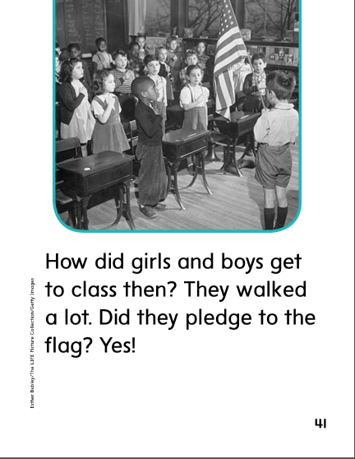

Slide 276
o_e
e_e

Slide 277
hope
rope
hope
cute
people
cute
nose
nose
cube
cube
note
rope
note
ago
people
ago

Slide 278
High Frequency
Words

Slide 279
Read, Spell, Write
ago
The lake froze five days ago.

Slide 280
Read, Spell, Write
boy
Pete is a nice boy.

Slide 281
Read, Spell, Write
girl
A new girl is in the class.

Slide 282
Read, Spell, Write
how
How will you get home?

Slide 283
Read, Spell, Write
old
The bridge is old.

Slide 284
Read, Spell, Write
people
People like those games.

Slide 285
Build Fluency: Word Automaticity
How old is that boy?
I met a girl named Eve five days ago.
Lots of people went on the hike.

Slide 286
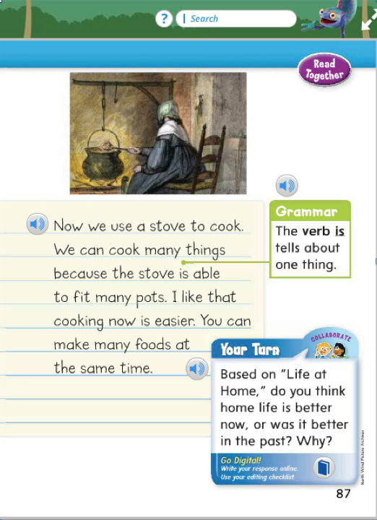
Name the verb in this sentence:
The stove is able to fit many pots.
Which word in the beginning of the sentence names a person, place, or thing?
Look for another sentence that contains the verb is or are.

Slide 287
Week 1 – Day 4

Slide 288
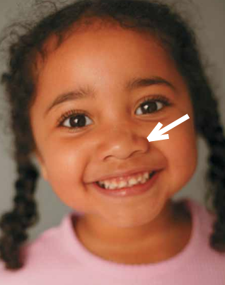
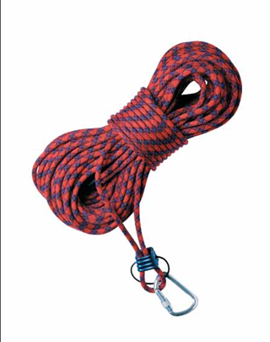
Phonemic Awareness
Phoneme Isolation
Listen as I say the name of each photo: nose, rope.
I hear the /o/ sound in the middle of nose and rope.
Listen as I stretch this middle sound: /noooz/, /rooop/.
The middle sound is /o/.

Slide 289
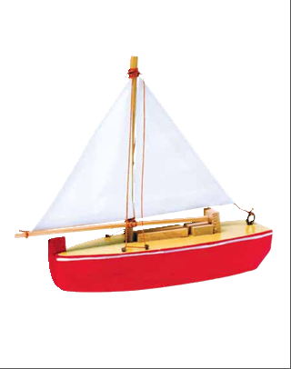
Phonemic Awareness
Phoneme Isolation
Tell me the middle sound you hear in each word.

Slide 290
Phonemic Awareness
Phoneme Isolation
Tell me the middle sound you hear in each word.

Slide 291
Phonemic Awareness
Phoneme Isolation
Tell me the middle sound you hear in each word.

Slide 292
Phonemic Awareness
Phoneme Isolation
Tell me the middle sound you hear in each word.

Slide 293
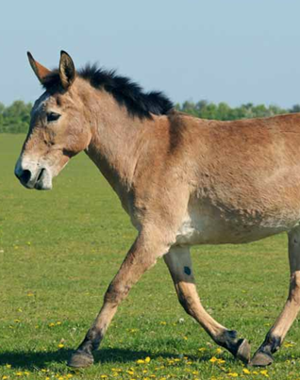
Phonemic Awareness
Phoneme Isolation
Tell me the middle sound you hear in each word.

Slide 294
Phonemic Awareness
Phoneme Isolation
Tell me the middle sound you hear in each word.

Slide 295
Phonemic Awareness
Phoneme Isolation
Tell me the middle sound you hear in each word.

Slide 296
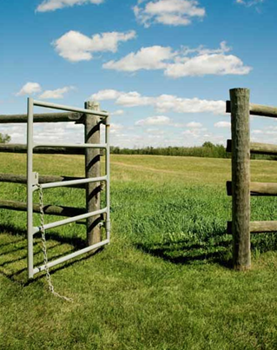
Phonemic Awareness
Phoneme Isolation
Tell me the middle sound you hear in each word.

Slide 297
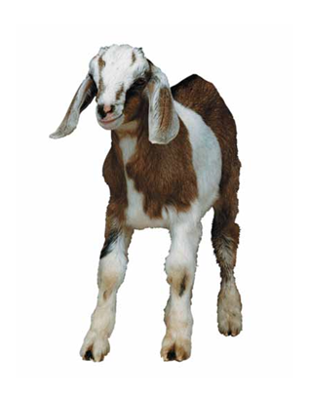
Phonemic Awareness
Phoneme Isolation
Tell me the middle sound you hear in each word.

Slide 298
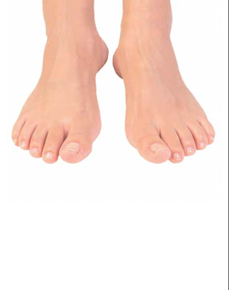
Phonemic Awareness
Phoneme Isolation
Tell me the middle sound you hear in each word.

Slide 299
Phonemic Awareness
Phoneme Isolation
Tell me the middle sound you hear in each word.

Slide 300
Phonemic Awareness
Phoneme Isolation
Tell me the middle sound you hear in each word.

Slide 301
Build with /o/ o_e, /u/ u_e, /e/ e_e
th
e
s
e
What is the new word we made?
Let’s blend all the sounds and read the word.
Change the e to o.

Slide 302
Build with /o/ o_e, /u/ u_e, /e/ e_e
th
o
s
e
What is the new word we made?
Let’s blend all the sounds and read the word.
Change the th to ch.

Slide 303
Build with /o/ o_e, /u/ u_e, /e/ e_e
ch
o
s
e
What is the new word we made?
Let’s blend all the sounds and read the word.
Change the s to k.

Slide 304
Build with /o/ o_e, /u/ u_e, /e/ e_e
ch
o
k
e
What is the new word we made?
Let’s blend all the sounds and read the word.
Change the ch to br.

Slide 305
Build with /o/ o_e, /u/ u_e, /e/ e_e
br
o
k
e
What is the new word we made?
Let’s blend all the sounds and read the word.
Change the br to p.

Slide 306
Build with /o/ o_e, /u/ u_e, /e/ e_e
p
o
k
e
What is the new word we made?
Let’s blend all the sounds and read the word.
Change the k to l.

Slide 307
Build with /o/ o_e, /u/ u_e, /e/ e_e
p
o
l
e
What is the new word we made?
Let’s blend all the sounds and read the word.
Change the p to r.

Slide 308
Build with /o/ o_e, /u/ u_e, /e/ e_e
r
o
l
e
What is the new word we made?
Let’s blend all the sounds and read the word.
Change the r to h.

Slide 309
Build with /o/ o_e, /u/ u_e, /e/ e_e
h
o
l
e
What is the new word we made?
Let’s blend all the sounds and read the word.
Change the h to m.

Slide 310
Build with /o/ o_e, /u/ u_e, /e/ e_e
m
o
l
e
What is the new word we made?
Let’s blend all the sounds and read the word.
Change the o to u.

Slide 311
Build with /o/ o_e, /u/ u_e, /e/ e_e
m
u
l
e
What is the new word we made?
Let’s blend all the sounds and read the word.
Change the l to t.

Slide 312
Build with /o/ o_e, /u/ u_e, /e/ e_e
m
u
t
e
What is the new word we made?
Let’s blend all the sounds and read the word.
Change the m to c.

Slide 313
Build with /o/ o_e, /u/ u_e, /e/ e_e
c
u
t
e
What is the new word we made?
Let’s blend all the sounds and read the word.
Change the t to b.

Slide 314
Build with /o/ o_e, /u/ u_e, /e/ e_e
c
u
b
e
What is the new word we made?
Let’s blend all the sounds and read the word.

Slide 316
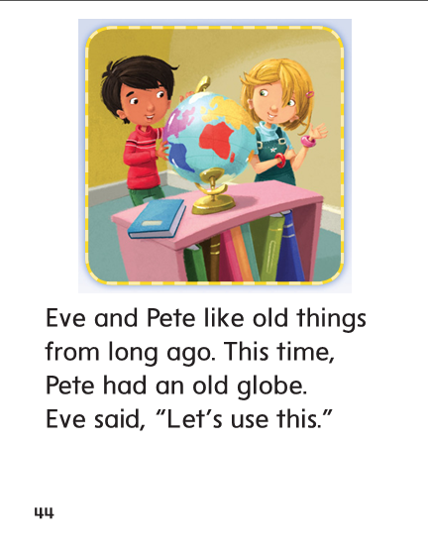

Slide 318
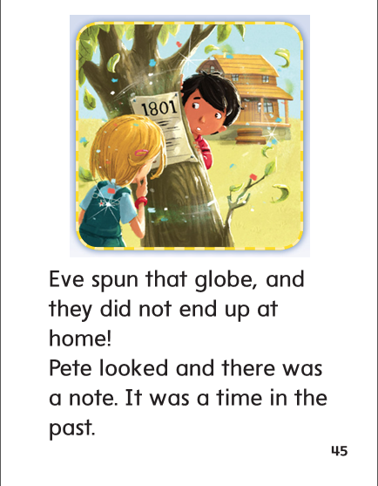

Slide 319
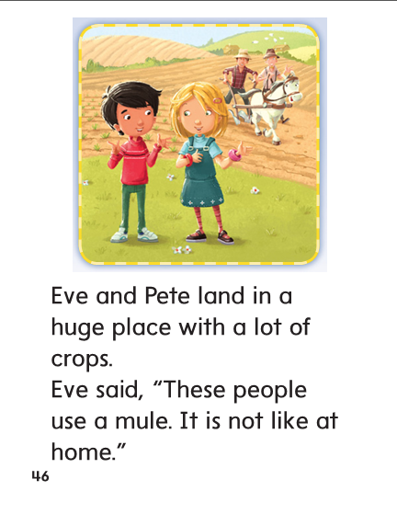

Slide 320
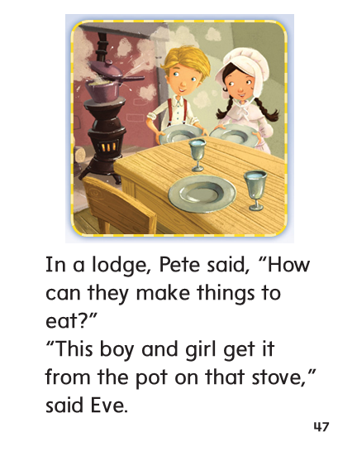

Slide 321
Structural Analysis
CVCe Syllables
Read words with children.
Remind children that words are made up of smaller parts called syllables,
And that one vowel sound is heard in each syllable.
When children see a vowel-consonant-silent e spelling,
They should know that this is one syllable and these letters should be kept together.
update
sunshine
awoke

Slide 322
Structural Analysis
Have children work in pairs to divide each word into syllables,
Read the words, and t hen write sentences with each word.
excite
escape
reptile
hopeful

Slide 323
High Frequency
Words

Slide 324
Read, Spell, Write
ago
The lake froze five days ago.

Slide 325
Read, Spell, Write
boy
Pete is a nice boy.

Slide 326
Read, Spell, Write
girl
A new girl is in the class.

Slide 327
Read, Spell, Write
how
How will you get home?

Slide 328
Read, Spell, Write
old
The bridge is old.

Slide 329
Read, Spell, Write
people
People like those games.

Slide 330
Grammar
Is and Are
The verb is is used when telling about one noun in one sentence.
The verb are is used when telling about more than one noun in one sentence.
Grace _____singing a song.
The birds _____ in a cage.
The girls ______sliding on ice.
Have children complete the sentences with is or are.

Slide 331
Week 1 – Day 5

Slide 332
Phonemic Awareness
Phoneme Segmentation:
I am going to say a word. I want you to say each sound in the word.
bone robe muse phone huge smoke
Phoneme Blending:
Now I am going to say a group of sounds. Then blend those sounds to form a word.
/r/ /o/ /z/ /u/ /z/ /b/ /r/ /o/ /k/
/f/ /u/ /m/ /n/ /o/ /t/

Slide 333
Blend and Build Words with Soft c, g, dge
Read and say these words:
rose
home
use
cute
Steve

Slide 334
Blending Words with Soft c, g, dge
h
o
m
e
What is the new word we made?
Let’s blend all the sounds and read the word.
Change the h to d.

Slide 335
Blending Words with Soft c, g, dge
d
o
v
e
What is the new word we made?
Let’s blend all the sounds and read the word.
Change the m to v.

Slide 336
Blending Words with Soft c, g, dge
d
o
v
e
What is the new word we made?
Let’s blend all the sounds and read the word.
Change the d to w.

Slide 337
Blending Words with Soft c, g, dge
w
o
v
e
What is the new word we made?
Let’s blend all the sounds and read the word.
Change the v to k.

Slide 338
Blending Words with Soft c, g, dge
w
o
k
e
What is the new word we made?
Let’s blend all the sounds and read the word.
Change the w to j.

Slide 339
Blending Words with Soft c, g, dge
j
o
k
e
What is the new word we made?
Let’s blend all the sounds and read the word.
Change the j to p.

Slide 340
Blending Words with Soft c, g, dge
p
o
k
e
What is the new word we made?
Let’s blend all the sounds and read the word.
Change the k to l.

Slide 341
Blending Words with Soft c, g, dge
p
o
l
e
What is the new word we made?
Let’s blend all the sounds and read the word.
Change the p to m.

Slide 342
Blending Words with Soft c, g, dge
m
o
l
e
What is the new word we made?
Let’s blend all the sounds and read the word.
Change the o to u.

Slide 343
Blending Words with Soft c, g, dge
m
u
l
e
What is the new word we made?
Let’s blend all the sounds and read the word.
Change the l to t.

Slide 344
Blending Words with Soft c, g, dge
m
u
t
e
What is the new word we made?
Let’s blend all the sounds and read the word.
Change the m to c.

Slide 345
Blending Words with Soft c, g, dge
c
u
t
e
What is the new word we made?
Let’s blend all the sounds and read the word.
Change the t to b.

Slide 346
Blending Words with Soft c, g, dge
c
u
b
e
What is the new word we made?
Let’s blend all the sounds and read the word.

Slide 347
Word Automaticity
these

Slide 348
homes

Slide 349
used

Slide 350
bone

Slide 351
stone

Slide 352
whole

Slide 353
rose

Slide 354
spoke

Slide 355
mule

Slide 356
Pete

Slide 357
phone

Slide 358
clothes

Slide 359
cut

Slide 360
cute

Slide 361
rod

Slide 362
rode

Slide 363
chose

Slide 364
choke

Slide 365
awake

Slide 366
pancake

Slide 367
explode

Slide 368
inside

Slide 369
complete

Slide 370
bedtime

Slide 371
Structural Analysis
CVCe Syllables
Have children tell what a syllable is and then tell how many
syllables they hear in the word advice.
advice
Have children explain why there are three vowel letters but only two syllables.
Then have children practice writing CVCe multisyllabic words such as unlike, complete, milkshake, and expose.

Slide 372
High Frequency
Words

Slide 373
Read, Spell, Write
ago
The lake froze five days ago.

Slide 374
Read, Spell, Write
boy
Pete is a nice boy.

Slide 375
Read, Spell, Write
girl
A new girl is in the class.

Slide 376
Read, Spell, Write
how
How will you get home?

Slide 377
Read, Spell, Write
old
The bridge is old.

Slide 378
Read, Spell, Write
people
People like those games.

Slide 379
Grammar
Is and Are
Ask children how to use is and are.
Identify whether the verbs refer to one or more than one:
Two mice are eating rice.
A mole is in the hole.
Challenge:
Change the noun in the first sentences to describe one mouse. Have them identify how the verb will change.
Why do we use the verb are in the first sentence?
Why do we use the verb is in the second sentence?

