Slide 1
Week 1 – Day 1

Slide 2
Phonemic Awareness –
Phoneme Segmentation
Listen carefully as I say a word: good.
How many sounds are in the word good?
I will place a marker in a box for each sound I hear: /g/ /u/ /d/.
I will place three markers because I hear three sounds in the word good.
/g/
/u/
/d/

Slide 3
Phonemic Awareness –
Phoneme Segmentation
Listen carefully as I say some words.
Place one marker in a box for each sound you hear.
Then tell me how many sounds are in each word.
foot wood push cooks
put wool brook stood

Slide 4
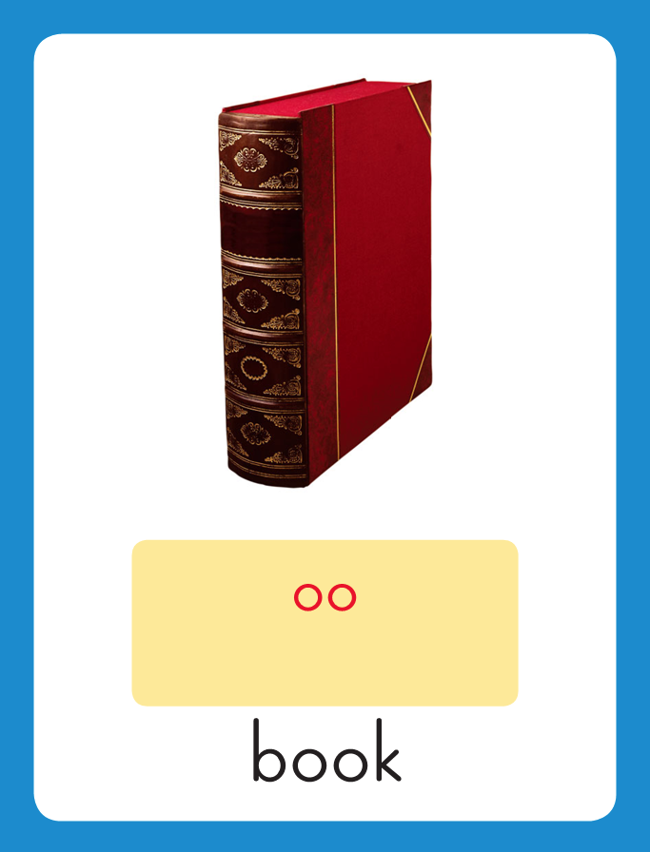
Introduce /u/ oo, u
This is the Book
Sound-Spelling Card.
The sound is /u/.
The /u/ sound can be spelled with the letters oo.
Say it with me: /u/.
This is the sound in the middle of the word book.
Listen: /b/ /u/ /k/, book.
I’ll say /u/ as I write the letters oo several times.
Repeat for /u/ spelled u as in put.

Slide 5
Have children practice connecting the letters oo to the sound /u/ by writing them.
Now do it with me. Say /u/ as I write the letters oo.
This time, write the letters five times as you say the /u/ sound.
Repeat for /u/ spelled u as in put.
oo oo oo oo oo
u u u u u

Slide 6
Blend with /u/ oo, u
f

Slide 7
Blend with /u/ oo, u
f
oo

Slide 8
Blend with /u/ oo, u
f
oo

Slide 9
Blend with /u/ oo, u
f
oo
t

Slide 10
Blend with /u/ oo, u
h

Slide 11
Blend with /u/ oo, u
h
oo

Slide 12
Blend with /u/ oo, u
h
oo

Slide 13
Blend with /u/ oo, u
h
oo
k

Slide 14
Blend with /u/ oo, u
g

Slide 15
Blend with /u/ oo, u
g
oo

Slide 16
Blend with /u/ oo, u
g
oo

Slide 17
Blend with /u/ oo, u
g
oo
d

Slide 18
Blend with /u/ oo, u
p

Slide 19
Blend with /u/ oo, u
p
u

Slide 20
Blend with /u/ oo, u
p
u

Slide 21
Blend with /u/ oo, u
p
u
ll

Slide 22
oo cr sh i_e
ge o_e w u
i_e ce oo u_e
ll a_e st k

Slide 23
l

Slide 24
loo

Slide 25
look

Slide 26
look g

Slide 27
look goo

Slide 28
look good

Slide 29
look good f

Slide 30
look good fu

Slide 31
look good full

Slide 32
look good full
w

Slide 33
look good full
woo

Slide 34
look good full
wool

Slide 35
look good full
wool b

Slide 36
look good full
wool boo

Slide 37
look good full
wool book

Slide 38
look good full
wool book w

Slide 39
look good full
wool book woo

Slide 40
look good full
wool book wood

Slide 41
look good full
wool book wood
h

Slide 42
look good full
wool book wood
hoo

Slide 43
look good full
wool book wood
hood

Slide 44
look good full
wool book wood
hood cr

Slide 45
look good full
wool book wood
hood croo

Slide 46
look good full
wool book wood
hood crook

Slide 47
look good full
wool book wood
hood crook sh

Slide 48
look good full
wool book wood
hood crook shoo

Slide 49
look good full
wool book wood
hood crook shook

Slide 50
look good full
wool book wood
hood crook shook
st

Slide 51
look good full
wool book wood
hood crook shook
stoo

Slide 52
look good full
wool book wood
hood crook shook
stood

Slide 53
look good full
wool book wood
hood crook shook
stood p

Slide 54
look good full
wool book wood
hood crook shook
stood pu

Slide 55
look good full
wool book wood
hood crook shook
stood push

Slide 56
look good full
wool book wood
hood crook shook
stood push p

Slide 57
look good full
wool book wood
hood crook shook
stood push pu

Slide 58
look good full
wool book wood
hood crook shook
stood push pull

Slide 59
Internal Sounding Out
top

Slide 60
Internal Sounding Out
top took

Slide 61
Internal Sounding Out
top took pot

Slide 62
Internal Sounding Out
top took pot
put

Slide 63
Internal Sounding Out
top took pot
put cake

Slide 64
Internal Sounding Out
top took pot
put cake cook

Slide 65
Internal Sounding Out
top took pot
put cake cook
home

Slide 66
Internal Sounding Out
top took pot
put cake cook
home cage

Slide 67
Internal Sounding Out
top took pot
put cake cook
home cage cute

Slide 68
Internal Sounding Out
top took pot
put cake cook
home cage cute
race

Slide 69
Internal Sounding Out
top took pot
put cake cook
home cage cute
race nice

Slide 70
Internal Sounding Out
top took pot
put cake cook
home cage cute
race nice baked

Slide 71
Who

Slide 72
Who took

Slide 73
Who took my

Slide 74
Who took my book?

Slide 75
Who took my book?
Put

Slide 76
Who took my book?
Put the

Slide 77
Who took my book?
Put the wood

Slide 78
Who took my book?
Put the wood in

Slide 79
Who took my book?
Put the wood in the

Slide 80
Who took my book?
Put the wood in the box.

Slide 81
Who took my book?
Put the wood in the box.
He

Slide 82
Who took my book?
Put the wood in the box.
He pushed

Slide 83
Who took my book?
Put the wood in the box.
He pushed it

Slide 84
Who took my book?
Put the wood in the box.
He pushed it with

Slide 85
Who took my book?
Put the wood in the box.
He pushed it with his

Slide 86
Who took my book?
Put the wood in the box.
He pushed it with his foot.

Slide 87
Spelling / Dictation
1. _________
2. _________
3. _________
4. _________
5. _________
book
hood
look
wood
took

Slide 88
High Frequency
Words

Slide 89
Read, Spell, Write
after
We can play after school.

Slide 90
Read, Spell, Write
buy
What did you buy?

Slide 91
Read, Spell, Write
done
When will the food be done?

Slide 92
Read, Spell, Write
every
Every kid got a book.

Slide 93
Read, Spell, Write
soon
We can go home soon.

Slide 94
Read, Spell, Write
work
This is so much work.

Slide 95
Have children read the sentences. Prompt them to identify the high-frequency words in connected text and to blend the decodable words.
We can play after school.
What did you buy?
3. When will the food be done?

Slide 96
Have children read the sentences. Prompt them to identify the high-frequency words in connected text and to blend the decodable words.
Every kid got a book.
We can go home soon.
3. This is so much work!

Slide 97
Grammar
Contractions with Not
A contraction is a form of two words put together to form one word.
Some contractions are formed by putting a word together with the word not.
An apostrophe takes the place of the letter o in not.
is not = isn’t
did not = didn’t
are not = aren’t
does not = doesn’t
can not = can’t
do not = don’t

Slide 98
Grammar
Contractions with Not
Read each sentence aloud.
Have children identify the contractions in each sentence.
Those aren’t my wool socks.
I can’t zip my bookbag.
Mom didn’t buy the book.

Slide 99
Week 1 – Day 2

Slide 100
Phonemic Awareness –
Phoneme Blending
Listen as I say the sounds in a wod: /l/ /u/ /k/.
Now I will blend the sounds together and say the word: /llluuuk/, look.
Let’s say the word together: look.
Guided Practice
I’m going to say some more words, sound by sound.
Listen as I say a word.
Blend the sounds together to say the word.
/k/ /u/ /k/ /w/ /u/ /d/ /p/ /u/ /l/
/s/ /t/ /u/ /d/ /p/ /u/ /sh/ /p/ /u/ /t/
/f/ /u/ /l/ /sh/ /u/ /k/ /k/ /r/ /u/ /k/

Slide 101
Blend with /u/ oo, u
cook
push
u
What are these letters?
What sound do they stand for?

Slide 102
Blend with /u/ oo, u
t

Slide 103
Blend with /u/ oo, u
t
oo

Slide 104
Blend with /u/ oo, u
t
oo

Slide 105
Blend with /u/ oo, u
t
oo
k

Slide 106
Blend with /u/ oo, u
g

Slide 107
Blend with /u/ oo, u
g
oo

Slide 108
Blend with /u/ oo, u
g
oo

Slide 109
Blend with /u/ oo, u
g
oo
d

Slide 110
Blend with /u/ oo, u
f

Slide 111
Blend with /u/ oo, u
f
oo

Slide 112
Blend with /u/ oo, u
f
oo

Slide 113
Blend with /u/ oo, u
f
oo
t

Slide 114
Blend with /u/ oo, u
p

Slide 115
Blend with /u/ oo, u
p
u

Slide 116
Blend with /u/ oo, u
p
u

Slide 117
Blend with /u/ oo, u
p
u
t

Slide 118
b

Slide 119
boo

Slide 120
book

Slide 121
book p

Slide 122
book pu

Slide 123
book push

Slide 124
book push h

Slide 125
book push hoo

Slide 126
book push hook

Slide 127
book push hook
st

Slide 128
book push hook
stoo

Slide 129
book push hook
stood

Slide 130
book push hook
stood c

Slide 131
book push hook
stood coo

Slide 132
book push hook
stood cook

Slide 133
book push hook
stood cook w

Slide 134
book push hook
stood cook woo

Slide 135
book push hook
stood cook wood

Slide 136
book push hook
stood cook wood
sh

Slide 137
book push hook
stood cook wood
shoo

Slide 138
book push hook
stood cook wood
shook

Slide 139
book push hook
stood cook wood
shook p

Slide 140
book push hook
stood cook wood
shook pu

Slide 141
book push hook
stood cook wood
shook pull

Slide 142
book push hook
stood cook wood
shook pull f

Slide 143
book push hook
stood cook wood
shook pull foo

Slide 144
book push hook
stood cook wood
shook pull foot

Slide 145
Build with /u/ oo, u
l
oo
k
What is the new word we made?
Let’s blend all the sounds and read the word.
Change the l to b.

Slide 146
Build with /u/ oo, u
b
oo
k
What is the new word we made?
Let’s blend all the sounds and read the word.
Change the b to c.

Slide 147
Build with /u/ oo, u
c
oo
k
What is the new word we made?
Let’s blend all the sounds and read the word.
Change the c to h.

Slide 148
Build with /u/ oo, u
h
oo
k
What is the new word we made?
Let’s blend all the sounds and read the word.
Change the k to d.

Slide 149
Build with /u/ oo, u
h
oo
d
What is the new word we made?
Let’s blend all the sounds and read the word.
Change the oo to a.

Slide 150
Build with /u/ oo, u
h
a
d
What is the new word we made?
Let’s blend all the sounds and read the word.
Change the d to t.

Slide 151
Build with /u/ oo, u
h
a
t
What is the new word we made?
Let’s blend all the sounds and read the word.
Change the h to f.

Slide 152
Build with /u/ oo, u
f
a
t
What is the new word we made?
Let’s blend all the sounds and read the word.
Change the a to oo.

Slide 153
Build with /u/ oo, u
f
oo
t
What is the new word we made?
Let’s blend all the sounds and read the word.
Change the oo to i.

Slide 154
Build with /u/ oo, u
f
i
t
What is the new word we made?
Let’s blend all the sounds and read the word.
Change the f to p.

Slide 155
Build with /u/ oo, u
p
i
t
What is the new word we made?
Let’s blend all the sounds and read the word.
Change the i to u.

Slide 156
Build with /u/ oo, u
p
u
t
What is the new word we made?
Let’s blend all the sounds and read the word.
Change the t to sh.

Slide 157
Build with /u/ oo, u
p
u
sh
What is the new word we made?
Let’s blend all the sounds and read the word.
Change the sh to ll.

Slide 158
Build with /u/ oo, u
p
u
ll
What is the new word we made?
Let’s blend all the sounds and read the word.

Slide 159
Structural Analysis
Inflectional Endings –ed, -ing
Read each of the words.
Note the double g in tagged and tagging.
When a word has a short vowel and ends in a consonant, you double the consonant before adding –ed or –ing.
tag
tagged
tagging
Listen for the /d/ sound at the end of tagged.
When adding the letters –ing at the end of a word adds a syllable

Slide 160
Structural Analysis
Inflectional Endings –ed, -ing
Have children add –ed and –ing to each word and
then use each word in a sentence.
fit
tap
clap
jog
Remember when a word has a short vowel and ends in a consonant, you double the consonant before adding –ed or –ing.

Slide 161
Spelling
hook
good

Slide 162
book
wood
cook
hood
look
took
book
wood
cook
hood
look
took

Slide 163
High Frequency
Words

Slide 164
Read, Spell, Write
after
We can play after school.

Slide 165
Read, Spell, Write
buy
What did you buy?

Slide 166
Read, Spell, Write
done
When will the food be done?

Slide 167
Read, Spell, Write
every
Every kid got a book.

Slide 168
Read, Spell, Write
soon
We can go home soon.

Slide 169
Read, Spell, Write
work
This is so much work.

Slide 170
Grammar
Contractions with Not
Remember a contraction is a way to put two words together
to make a new, shorter word.
Have children identify the contraction, tell what two words make it, and tell what letter the apostrophe replaces.
Mom doesn’t eat rice.
They aren’t going home together.
Have partners write sentences that tells a school rule using a contraction.

Slide 171
Week 1 – Day 3

Slide 172
Phonemic Awareness
Phoneme Deletion
Listen as I say a word: plate.
The word plate has four sounds.
Say the sounds with me: /p/ /l/ /a/ /t/.
I’ll take away the first sound /p/
and make a new word with three sounds: /l/ /a/ /t/.
Continue modeling phoneme deletion with the following word sets:
brace/race flake/lake swipe/wipe slime/lime
Guided Practice:
Listen as I say a word.
The word is bride, /b/ /r/ /i/ /d/.
Bride without the /b/ is /r/ /i/ /d/, ride.
sat ill plane brake smile
clap grace wedge flick block

Slide 173
Blend with /u/ oo, u
s
t

Slide 174
Blend with /u/ oo, u
s
t
oo

Slide 175
Blend with /u/ oo, u
s
t
oo

Slide 176
Blend with /u/ oo, u
s
t
oo
d

Slide 177
Blend with /u/ oo, u
p

Slide 178
Blend with /u/ oo, u
p
u

Slide 179
Blend with /u/ oo, u
p
u

Slide 180
Blend with /u/ oo, u
p
u
sh

Slide 181
Blend with /u/ oo, u
sh

Slide 182
Blend with /u/ oo, u
sh
oo

Slide 183
Blend with /u/ oo, u
sh
oo

Slide 184
Blend with /u/ oo, u
sh
oo
k

Slide 185
Blend with /u/ oo, u
c
r

Slide 186
Blend with /u/ oo, u
c
r
oo

Slide 187
Blend with /u/ oo, u
c
r
oo

Slide 188
Blend with /u/ oo, u
c
r
oo
ck

Slide 189
Blend with /u/ oo, u
w

Slide 190
Blend with /u/ oo, u
w
oo

Slide 191
Blend with /u/ oo, u
w
oo

Slide 192
Blend with /u/ oo, u
w
oo
l

Slide 193
oo ing sh o_e
a_e w u cl
ll oo ch st

Slide 194
g

Slide 195
goo

Slide 196
good

Slide 197
good p

Slide 198
good pu

Slide 199
good put

Slide 200
good put f

Slide 201
good put fu

Slide 202
good put full

Slide 203
good put full
l

Slide 204
good put full
loo

Slide 205
good put full
look

Slide 206
good put full
look w

Slide 207
good put full
look woo

Slide 208
good put full
look wood

Slide 209
good put full
look wood p

Slide 210
good put full
look wood pu

Slide 211
good put full
look wood push

Slide 212
good put full
look wood push
c

Slide 213
good put full
look wood push
coo

Slide 214
good put full
look wood push
cook

Slide 215
good put full
look wood push
cook h

Slide 216
good put full
look wood push
cook hoo

Slide 217
good put full
look wood push
cook hood

Slide 218
good put full
look wood push
cook hood cr

Slide 219
good put full
look wood push
cook hood croo

Slide 220
good put full
look wood push
cook hood crook

Slide 221
good put full
look wood push
cook hood crook
f

Slide 222
good put full
look wood push
cook hood crook
foo

Slide 223
good put full
look wood push
cook hood crook
foot

Slide 224
good put full
look wood push
cook hood crook
foot b

Slide 225
good put full
look wood push
cook hood crook
foot boo

Slide 226
good put full
look wood push
cook hood crook
foot book

Slide 227
good put full
look wood push
cook hood crook
foot book b

Slide 228
good put full
look wood push
cook hood crook
foot book ba_e

Slide 229
good put full
look wood push
cook hood crook
foot book bake

Slide 230
Internal Sounding Out
stopped

Slide 231
Internal Sounding Out
stopped stopping

Slide 232
Internal Sounding Out
stopped stopping
clapped

Slide 233
Internal Sounding Out
stopped stopping
clapped clapping

Slide 234
Internal Sounding Out
stopped stopping
clapped clapping
shopped

Slide 235
Internal Sounding Out
stopped stopping
clapped clapping
shopped shopping

Slide 236
Internal Sounding Out
stopped stopping
clapped clapping
shopped shopping
chatted

Slide 237
Internal Sounding Out
stopped stopping
clapped clapping
shopped shopping
chatted chatting

Slide 238
This

Slide 239
This bag

Slide 240
This bag is

Slide 241
This bag is full

Slide 242
This bag is full of

Slide 243
This bag is full of wool.

Slide 244
This bag is full of wool.
He

Slide 245
This bag is full of wool.
He shook

Slide 246
This bag is full of wool.
He shook his

Slide 247
This bag is full of wool.
He shook his foot

Slide 248
This bag is full of wool.
He shook his foot and

Slide 249
This bag is full of wool.
He shook his foot and waved

Slide 250
This bag is full of wool.
He shook his foot and waved his

Slide 251
This bag is full of wool.
He shook his foot and waved his hand.

Slide 252
Structural Analysis
Inflectional Endings –ed, -ing
Read each of the words.
Note the double g in tagged and tagging.
When a word has a short vowel and ends in a consonant, you double the consonant before adding –ed or –ing.
stop
stopped
stopping
Listen for the /d/ sound at the end of tagged.
When adding the letters –ing at the end of a word adds a syllable

Slide 253
Structural Analysis
Inflectional Endings –ed, -ing
Read each of the words.
Note the double g in tagged and tagging.
When a word has a short vowel and ends in a consonant, you double the consonant before adding –ed or –ing.
tip
tipped
tipping
Listen for the /t/ sound at the end of tipped.
When adding the letters –ing at the end of a word adds a syllable

Slide 254
Structural Analysis
Inflectional Endings –ed, -ing
Read each of the words.
Note the double g in tagged and tagging.
When a word has a short vowel and ends in a consonant, you double the consonant before adding –ed or –ing.
brag
bragged
bragging
Listen for the /d/ sound at the end of bragged.
When adding the letters –ing at the end of a word adds a syllable

Slide 256
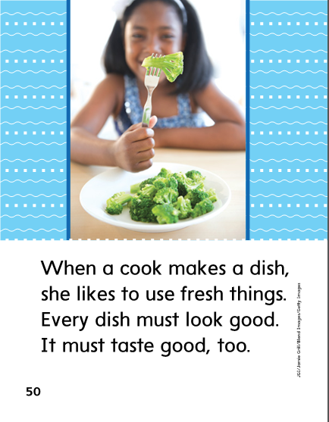

Slide 257
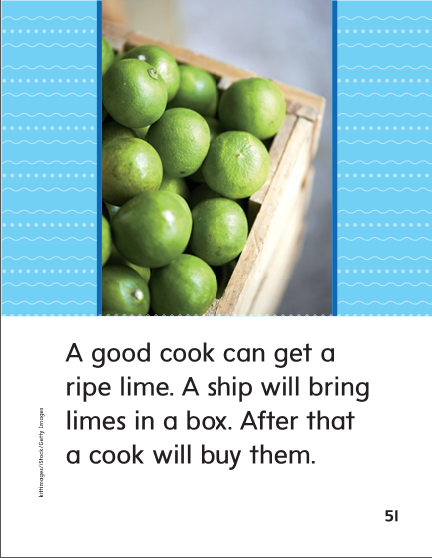

Slide 258
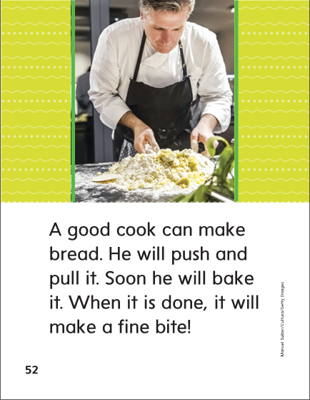

Slide 260
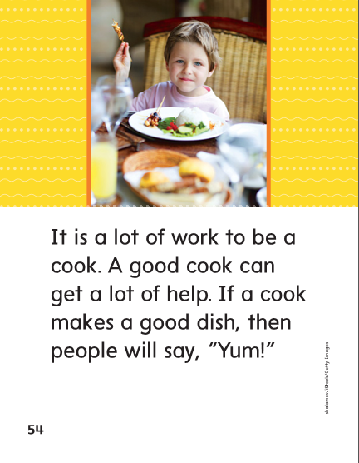

Slide 261
-ook
-ood

Slide 262
book
took
book
hood
done
hood
look
look
wood
wood
cook
took
cook
buy
done
buy

Slide 263
High Frequency
Words

Slide 264
Read, Spell, Write
after
We can play after school.

Slide 265
Read, Spell, Write
buy
What did you buy?

Slide 266
Read, Spell, Write
done
When will the food be done?

Slide 267
Read, Spell, Write
every
Every kid got a book.

Slide 268
Read, Spell, Write
soon
We can go home soon.

Slide 269
Read, Spell, Write
work
This is so much work.

Slide 270
Build Fluency: Word Automaticity
He will be done soon.
I will work after I have a snack.
Do you buy lunch every day?

Slide 271
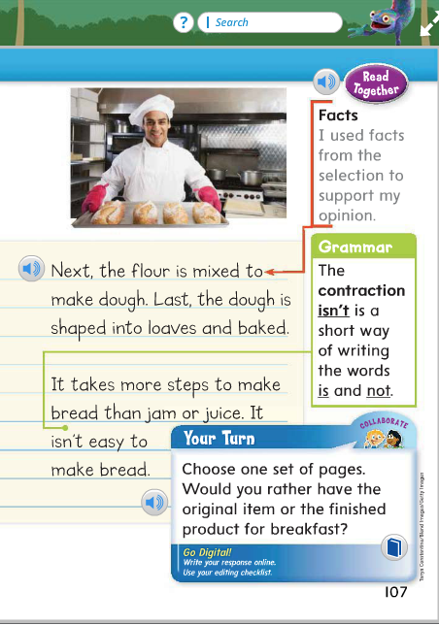
Remember a contraction is a shorter way of writing two words. For contractions with not, an apostrophe takes the place of the missing letter o.
Identify the contraction on page 107.
What two words make the contraction?
I didn’t know there were so many
steps to make bread.
Identify the contraction in this sentence.

Slide 272
Grammar
Contractions with Not
Correct the errors.
isnt
arent
cant
didnt
doesnt

Slide 273
Week 1 – Day 4

Slide 274
Phonemic Awareness
Phoneme Segmentation
Listen as I say a word: foot.
What sounds are in the work foot?
Yes, /f/ /u/ /t/.
There are three sounds.
Say them with me: /f/ /u/ /t/, foot.
Guided Practice:
I am going to say some words.
Tell me which sounds you hear in the word and then say the word.
book pulls crook stood put shook

Slide 275
Build Words with /u/ oo, u
f
u
ll
What is the new word we made?
Let’s blend all the sounds and read the word.
Change the f to p.

Slide 276
Build Words with /u/ oo, u
p
u
ll
What is the new word we made?
Let’s blend all the sounds and read the word.
Change the ll to sh.

Slide 277
Build Words with /u/ oo, u
p
u
sh
What is the new word we made?
Let’s blend all the sounds and read the word.
Change the sh to t.

Slide 278
Build Words with /u/ oo, u
p
u
t
What is the new word we made?
Let’s blend all the sounds and read the word.
Change the u to a.

Slide 279
Build Words with /u/ oo, u
p
a
t
What is the new word we made?
Let’s blend all the sounds and read the word.
Change the p to s.

Slide 280
Build Words with /u/ oo, u
s
a
t
What is the new word we made?
Let’s blend all the sounds and read the word.
Change the a to e.

Slide 281
Build Words with /u/ oo, u
s
e
t
What is the new word we made?
Let’s blend all the sounds and read the word.
Change the s to w.

Slide 282
Build Words with /u/ oo, u
w
e
t
What is the new word we made?
Let’s blend all the sounds and read the word.
Change the t to d.

Slide 283
Build Words with /u/ oo, u
w
e
d
What is the new word we made?
Let’s blend all the sounds and read the word.
Change the e to oo.

Slide 284
Build Words with /u/ oo, u
w
oo
d
What is the new word we made?
Let’s blend all the sounds and read the word.
Change the w to g.

Slide 285
Build Words with /u/ oo, u
g
oo
d
What is the new word we made?
Let’s blend all the sounds and read the word.
Change the g to h.

Slide 286
Build Words with /u/ oo, u
h
oo
d
What is the new word we made?
Let’s blend all the sounds and read the word.
Change the d to k.

Slide 287
Build Words with /u/ oo, u
h
oo
k
What is the new word we made?
Let’s blend all the sounds and read the word.
Change the h to b.

Slide 288
Build Words with /u/ oo, u
b
oo
k
What is the new word we made?
Let’s blend all the sounds and read the word.
Change the b to l.

Slide 289
Build Words with /u/ oo, u
l
oo
k
What is the new word we made?
Let’s blend all the sounds and read the word.

Slide 290
Structural Analysis
Inflectional Endings –ed, -ing
Read each of the words.
Remember that sometimes when you add –ed or –ing to a word, the final consonant is doubled before adding the ending.
flip
flipped
flipping

Slide 291
Structural Analysis
Inflectional Endings –ed, -ing
Read each of the words.
Remember that sometimes when you add –ed or –ing to a word, the final consonant is doubled before adding the ending.
grab
drip
shop
Have students work in pairs to construct words by adding –ed and –ing.
Then have them write a sentence with each word.

Slide 292
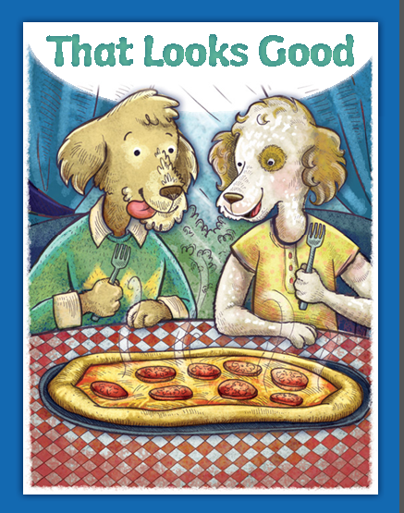

Slide 293
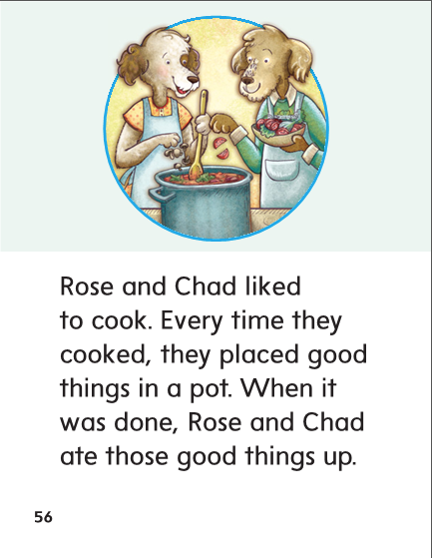

Slide 294
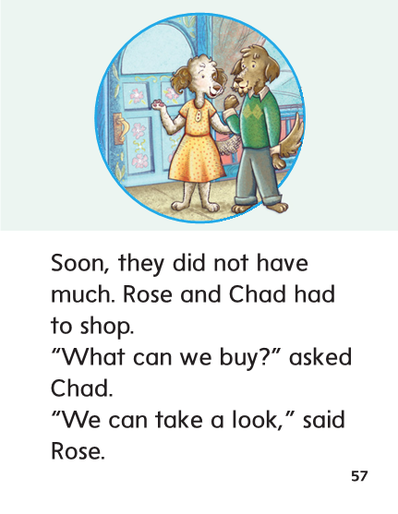

Slide 295
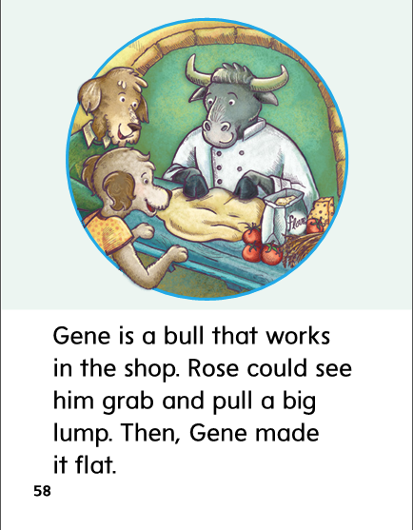

Slide 296
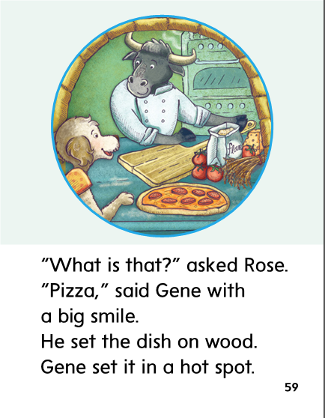

Slide 297
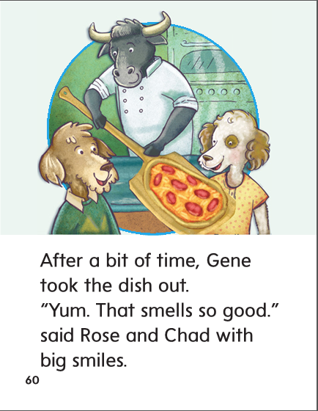

Slide 298
High Frequency
Words

Slide 299
Read, Spell, Write
after
We can play after school.

Slide 300
Read, Spell, Write
buy
What did you buy?

Slide 301
Read, Spell, Write
done
When will the food be done?

Slide 302
Read, Spell, Write
every
Every kid got a book.

Slide 303
Read, Spell, Write
soon
We can go home soon.

Slide 304
Read, Spell, Write
work
This is so much work.

Slide 305
Grammar
Contractions with Not
Have the children write the verb and the word not for each contraction.
The boy isn’t in the race.
Pete and Jen aren’t jumping rope.
People can’t walk on the wet bridge.
They don’t want to play the game.

Slide 306
Grammar
Contractions with Not
Have children correct each sentence.
The map doesnt have our state on it.
I dont like prunes.
That isnt my notebook.

Slide 307
Week 1 – Day 5

Slide 308
Phonemic Awareness
Phoneme Blending:
Listen as I say a group of sounds. Then blend those sounds to form a word.
/p/ /u/ /sh/ /s/ /t/ /u/ /d/ /b/ /u/ /k/ /g/ /u/ /d/
Phoneme Segmentation:
I am going to say a word. I want you to say each sound in the word.
foot good book pull put stood

Slide 309
Blend and Build Words with Soft c, g, dge
Read and say these words:
push
put
foot
look

Slide 310
Blend and Build Words with /u/ oo, u
g
oo
d
What is the new word we made?
Let’s blend all the sounds and read the word.
Change the g to w.

Slide 311
Blend and Build Words with /u/ oo, u
w
oo
d
What is the new word we made?
Let’s blend all the sounds and read the word.
Change the w to h.

Slide 312
Blend and Build Words with /u/ oo, u
h
oo
d
What is the new word we made?
Let’s blend all the sounds and read the word.
Change the d to k.

Slide 313
Blend and Build Words with /u/ oo, u
h
oo
k
What is the new word we made?
Let’s blend all the sounds and read the word.
Change the h to b.

Slide 314
Blend and Build Words with /u/ oo, u
b
oo
k
What is the new word we made?
Let’s blend all the sounds and read the word.
Change the b to c.

Slide 315
Blend and Build Words with /u/ oo, u
c
oo
k
What is the new word we made?
Let’s blend all the sounds and read the word.
Change the c to l.

Slide 316
Blend and Build Words with /u/ oo, u
l
oo
k
What is the new word we made?
Let’s blend all the sounds and read the word.
Change the l to t.

Slide 317
Blend and Build Words with /u/ oo, u
t
oo
k
What is the new word we made?
Let’s blend all the sounds and read the word.
Change the t to sh.

Slide 318
Blend and Build Words with /u/ oo, u
sh
oo
k
What is the new word we made?
Let’s blend all the sounds and read the word.
Change the sh to cr.

Slide 319
Blend and Build Words with /u/ oo, u
cr
oo
k
What is the new word we made?
Let’s blend all the sounds and read the word.
Change the cr to br.

Slide 320
Blend and Build Words with /u/ oo, u
br
oo
k
What is the new word we made?
Let’s blend all the sounds and read the word.

Slide 321
Word Automaticity
good

Slide 322
push

Slide 323
book

Slide 324
stopped

Slide 325
shopped

Slide 326
put

Slide 327
cook

Slide 328
bake

Slide 329
stopping

Slide 330
shopping

Slide 331
full

Slide 332
hood

Slide 333
pole

Slide 334
clapped

Slide 335
chatted

Slide 336
look

Slide 337
crook

Slide 338
pull

Slide 339
clapping

Slide 340
chatting

Slide 341
wood

Slide 342
foot

Slide 343
push

Slide 344
Structural Analysis
Inflectional Endings –ed, -ing
Have children explain how to add endings –ed and –ing to words that end with a short vowel followed by one consonant.
Practice writing words with –ed and –ing
___________
___________
___________
___________
___________
___________
___________
chatted
stopped
hopped
drumming
petting
wagged
trimmed
getting

Slide 345
High Frequency
Words

Slide 346
Read, Spell, Write
after
We can play after school.

Slide 347
Read, Spell, Write
buy
What did you buy?

Slide 348
Read, Spell, Write
done
When will the food be done?

Slide 349
Read, Spell, Write
every
Every kid got a book.

Slide 350
Read, Spell, Write
soon
We can go home soon.

Slide 351
Read, Spell, Write
work
This is so much work.

Slide 352
Grammar
Contractions with Not
How are contractions with not are formed.
Identify the following contractions.
It isn’t time to get up.
I can’t walk up the big hill.
Don’t nap while we take a test.
I didn’t get to see your new bike.

Slide 353
Grammar
Contractions with Not
What is a contraction?
What letter takes the place of the letter o in a contraction with not?
Change the contractions in each sentence to the two words each one stands for.
It isn’t time to get up.
I can’t walk up the big hill.
Don’t nap while we take a test.
I didn’t get to see your new bike.

Slide 354
Grammar
Contractions with Not
Have children fix the contraction in each sentence.
The cat di’dnt eat its snack.
They areno’t going to ride the bus.
My dig doesn’t like to take a bath.

