Slide 1
Week 1 – Day 1

Slide 2
Phonological Awareness
Identify and Generate Awareness
Listen carefully as I say two words: same, fame.
Same and fame rhyme because they both end with the same sounds.
Same and fame end with /am/.
What is another word that ends with same and fame?
I will think of other words that end with /am/.
Shame rhymes with same and fame because shame ends with /am/.
Guided Practice:
I will say three words.
Tell me which two words rhyme.
Then say another word that rhymes with them.
pail, wag, game aim, like, same
way, wag, stay book, took, room
hose, home, those gain, ran, rain

Slide 3
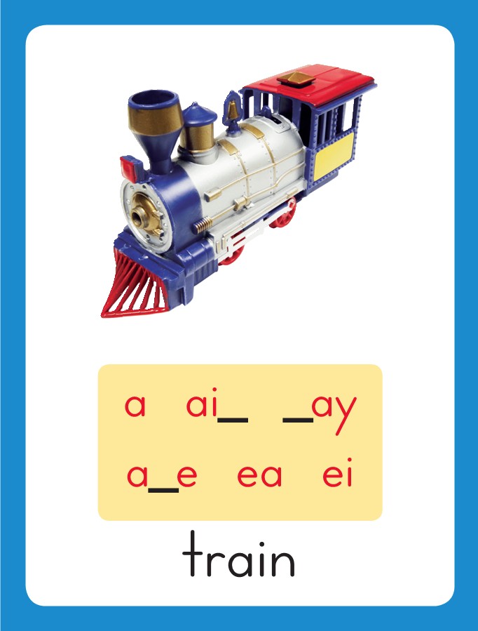
Introduce Long a: a, ai, ay
April
This is the Train
Sound-Spelling Card.
The sound is /a/.
This is the sound in the middle of the word train.
Listen: /traaan/.
The /a/ sound can be spelled with the letters
a as in April,
ai as in train,
or ay as in say.
Say the sound with me: /aaa/.
I’ll say /a/ as I write the letters
a, ai, and ay several times.
train
say

Slide 4
Have children practice connecting the letters a, ai, and ay to the sound /a/ by writing these spellings.
Now do it with me. Say /a/ as I write the letters a, ai, and ay.
This time, write the letters a, ai, and ay five times each as you say the /a/ sound.
a a a a a
ai ai ai ai ai
ay ay ay ay ay

Slide 5
Blending Words with Long a: a, ai, ay
s

Slide 6
Blending Words with Long a: a, ai, ay
s
ai

Slide 7
Blending Words with Long a: a, ai, ay
s
ai

Slide 8
Blending Words with Long a: a, ai, ay
s
ai
l

Slide 9
Blending Words with Long a: a, ai, ay
ai

Slide 10
Blending Words with Long a: a, ai, ay
ai
m

Slide 11
Blending Words with Long a: a, ai, ay
ai
m

Slide 12
Blending Words with Long a: a, ai, ay
h

Slide 13
Blending Words with Long a: a, ai, ay
h
ay

Slide 14
Blending Words with Long a: a, ai, ay
h
ay

Slide 15
Blending Words with Long a: a, ai, ay
g

Slide 16
Blending Words with Long a: a, ai, ay
g
r

Slide 17
Blending Words with Long a: a, ai, ay
g
r

Slide 18
Blending Words with Long a: a, ai, ay
g
r
ay

Slide 19
Blending Words with Long a: a, ai, ay
g
r
ay

Slide 20
Blending Words with Long a: a, ai, ay
b

Slide 21
Blending Words with Long a: a, ai, ay
b
a

Slide 22
Blending Words with Long a: a, ai, ay
b
a

Slide 23
Blending Words with Long a: a, ai, ay
b
a
c

Slide 24
Blending Words with Long a: a, ai, ay
b
a
c
o

Slide 25
Blending Words with Long a: a, ai, ay
b
a
c
o

Slide 26
Blending Words with Long a: a, ai, ay
b
a
c
o
n

Slide 27
Blending Words with Long a: a, ai, ay
b
a
c
o
n

Slide 28
ay sw dge ai
ce i_e tr u_e
k o_e b a_e

Slide 29
s

Slide 30
say

Slide 31
say d

Slide 32
say day

Slide 33
say day w

Slide 34
say day way

Slide 35
say day way
w

Slide 36
say day way
wai

Slide 37
say day way
wait

Slide 38
say day way
wait t

Slide 39
say day way
wait tai

Slide 40
say day way
wait tail

Slide 41
say day way
wait tail m

Slide 42
say day way
wait tail mai

Slide 43
say day way
wait tail mail

Slide 44
say day way
wait tail mail
p

Slide 45
say day way
wait tail mail
pai

Slide 46
say day way
wait tail mail
pain

Slide 47
say day way
wait tail mail
pain p

Slide 48
say day way
wait tail mail
pain pai

Slide 49
say day way
wait tail mail
pain paint

Slide 50
say day way
wait tail mail
pain paint br

Slide 51
say day way
wait tail mail
pain paint brai

Slide 52
say day way
wait tail mail
pain paint brain

Slide 53
say day way
wait tail mail
pain paint brain
sw

Slide 54
say day way
wait tail mail
pain paint brain
sway

Slide 55
say day way
wait tail mail
pain paint brain
swayed

Slide 56
say day way
wait tail mail
pain paint brain
swayed e

Slide 57
say day way
wait tail mail
pain paint brain
swayed ex

Slide 58
say day way
wait tail mail
pain paint brain
swayed expl

Slide 59
say day way
wait tail mail
pain paint brain
swayed explai

Slide 60
say day way
wait tail mail
pain paint brain
swayed explain

Slide 61
say day way
wait tail mail
pain paint brain
swayed explained

Slide 62
Internal Sounding Out
bat

Slide 63
Internal Sounding Out
bat bait

Slide 64
Internal Sounding Out
bat bait man

Slide 65
Internal Sounding Out
bat bait man
main

Slide 66
Internal Sounding Out
bat bait man
main tray

Slide 67
Internal Sounding Out
bat bait man
main tray train

Slide 68
Internal Sounding Out
bat bait man
main tray train
book

Slide 69
Internal Sounding Out
bat bait man
main tray train
book cute

Slide 70
Internal Sounding Out
bat bait man
main tray train
book cute home

Slide 71
Internal Sounding Out
bat bait man
main tray train
book cute home
race

Slide 72
Internal Sounding Out
bat bait man
main tray train
book cute home
race badge

Slide 73
Gail

Slide 74
Gail and

Slide 75
Gail and April

Slide 76
Gail and April like

Slide 77
Gail and April like to

Slide 78
Gail and April like to sail.

Slide 79
Gail and April like to sail.
Ray

Slide 80
Gail and April like to sail.
Ray waited

Slide 81
Gail and April like to sail.
Ray waited all

Slide 82
Gail and April like to sail.
Ray waited all day

Slide 83
Gail and April like to sail.
Ray waited all day to

Slide 84
Gail and April like to sail.
Ray waited all day to play.

Slide 85
Gail and April like to sail.
Ray waited all day to play.
I

Slide 86
Gail and April like to sail.
Ray waited all day to play.
I can

Slide 87
Gail and April like to sail.
Ray waited all day to play.
I can make

Slide 88
Gail and April like to sail.
Ray waited all day to play.
I can make a

Slide 89
Gail and April like to sail.
Ray waited all day to play.
I can make a gray

Slide 90
Gail and April like to sail.
Ray waited all day to play.
I can make a gray snail

Slide 91
Gail and April like to sail.
Ray waited all day to play.
I can make a gray snail from

Slide 92
Gail and April like to sail.
Ray waited all day to play.
I can make a gray snail from clay.

Slide 93
Spelling / Dictation
1. _________
2. _________
3. _________
4. _________
5. _________
mail
play
rain
way
chain

Slide 94
High Frequency
Words

Slide 95
Read, Spell, Write
about
I read a story about a monkey with a long tail.

Slide 96
Read, Spell, Write
animal
A mule is a animal.

Slide 97
Read, Spell, Write
carry
We use a pail to carry the shells.

Slide 98
Read, Spell, Write
eight
Eight chicks hatched from eight eggs.

Slide 99
Read, Spell, Write
give
Will mom give us a ride to school?

Slide 100
Read, Spell, Write
our
We wait for our bus at the bus stop.

Slide 101
Have children read the sentences. Prompt them to identify the high-frequency words in connected text and to blend the decodable words.
I read a story about a monkey with a long tail.
A mule is an animal.
3. We use a pail to carry the shells.

Slide 102
Have children read the sentences. Prompt them to identify the high-frequency words in connected text and to blend the decodable words.
Eight chicks hatched from eight eggs.
Will mom give us a ride to school?
3. We wait for our bus at the bus stop.

Slide 103
Grammar
Was and Were
Was and Were are past-tense verbs.
Past-tense verbs tell about an action that has happened already.
Gail was pushing Eve in the swing.
The girls were playing together.
Was is used when telling about one noun and were is used when telling about more than one.

Slide 104
Grammar
Was and Were
Identify whether was or were should be used to complete the sentence.
A mole _____digging a tunnel.
Eight kids ______ painting.
A snail ______ on the plant.

Slide 105
Week 1 – Day 2

Slide 106
Phonemic Awareness – Phoneme Categorization
Listen as I say three words: rain, pail, mat.
Two of the words, rain and pail, have the /a/ sound.
Mat does not. Mat does not belong.
Guided Practice:
I will say three words. Tell me which word does not belong and why.
hay, fly, gray pain, cat, raise bean, day, street
nose, trail, bait paid, mat, fan hope, rail, gain

Slide 107
Blending Words with Long a: a, ai, ay
agent
What are these letters?
What sound do they stand for?
sail
day

Slide 108
Blending Words with Long a: a, ai, ay
p

Slide 109
Blending Words with Long a: a, ai, ay
p
ai

Slide 110
Blending Words with Long a: a, ai, ay
p
ai

Slide 111
Blending Words with Long a: a, ai, ay
p
ai
l

Slide 112
Blending Words with Long a: a, ai, ay
p

Slide 113
Blending Words with Long a: a, ai, ay
p
ai

Slide 114
Blending Words with Long a: a, ai, ay
p
ai

Slide 115
Blending Words with Long a: a, ai, ay
p
ai
n

Slide 116
Blending Words with Long a: a, ai, ay
p
ai
n
t

Slide 117
Blending Words with Long a: a, ai, ay
t

Slide 118
Blending Words with Long a: a, ai, ay
t
r

Slide 119
Blending Words with Long a: a, ai, ay
t
r

Slide 120
Blending Words with Long a: a, ai, ay
t
r
ay

Slide 121
Blending Words with Long a: a, ai, ay
t
r
ay

Slide 122
Blending Words with Long a: a, ai, ay
A

Slide 123
Blending Words with Long a: a, ai, ay
A
p

Slide 124
Blending Words with Long a: a, ai, ay
A
p
r

Slide 125
Blending Words with Long a: a, ai, ay
A
p
r
i

Slide 126
Blending Words with Long a: a, ai, ay
A
p
r
i
l

Slide 127
Blending Words with Long a: a, ai, ay
A
p
r
i
l

Slide 128
ai

Slide 129
aim

Slide 130
aim n

Slide 131
aim nai

Slide 132
aim nail

Slide 133
aim nail p

Slide 134
aim nail pay

Slide 135
aim nail pay
w

Slide 136
aim nail pay
wai

Slide 137
aim nail pay
wait

Slide 138
aim nail pay
wait sw

Slide 139
aim nail pay
wait sway

Slide 140
aim nail pay
wait sway h

Slide 141
aim nail pay
wait sway hay

Slide 142
aim nail pay
wait sway hay
t

Slide 143
aim nail pay
wait sway hay
tai

Slide 144
aim nail pay
wait sway hay
tail

Slide 145
aim nail pay
wait sway hay
tail cl

Slide 146
aim nail pay
wait sway hay
tail clay

Slide 147
aim nail pay
wait sway hay
tail clay w

Slide 148
aim nail pay
wait sway hay
tail clay wai

Slide 149
aim nail pay
wait sway hay
tail clay waist

Slide 150
aim nail pay
wait sway hay
tail clay waist
sn

Slide 151
aim nail pay
wait sway hay
tail clay waist
snai

Slide 152
aim nail pay
wait sway hay
tail clay waist
snail

Slide 153
aim nail pay
wait sway hay
tail clay waist
snail a

Slide 154
aim nail pay
wait sway hay
tail clay waist
snail apr

Slide 155
aim nail pay
wait sway hay
tail clay waist
snail apro

Slide 156
aim nail pay
wait sway hay
tail clay waist
snail apron

Slide 157
Blend Words with Long a: a, ai, ay
m
ai
l
What is the new word we made?
Let’s blend all the sounds and read the word.
Change the m to w.

Slide 158
Blend Words with Long a: a, ai, ay
w
ai
l
What is the new word we made?
Let’s blend all the sounds and read the word.
Change the l to t.

Slide 159
Blend Words with Long a: a, ai, ay
w
ai
t
What is the new word we made?
Let’s blend all the sounds and read the word.
Change the w to b.

Slide 160
Blend Words with Long a: a, ai, ay
b
ai
t
What is the new word we made?
Let’s blend all the sounds and read the word.
Change the b to g.

Slide 161
Blend Words with Long a: a, ai, ay
g
ai
t
What is the new word we made?
Let’s blend all the sounds and read the word.
Change the t to n.

Slide 162
Blend Words with Long a: a, ai, ay
g
ai
n
What is the new word we made?
Let’s blend all the sounds and read the word.
Change the g to r.

Slide 163
Blend Words with Long a: a, ai, ay
r
ai
n
What is the new word we made?
Let’s blend all the sounds and read the word.
Add a d in front of r.

Slide 164
Blend Words with Long a: a, ai, ay
d
r
ai
n
What is the new word we made?
Let’s blend all the sounds and read the word.
Change the d to b.

Slide 165
Blend Words with Long a: a, ai, ay
b
r
ai
n
What is the new word we made?
Let’s blend all the sounds and read the word.
Change the n to d.

Slide 166
Blend Words with Long a: a, ai, ay
b
r
ai
d
What is the new word we made?
Let’s blend all the sounds and read the word.
Remove the b.

Slide 167
Blend Words with Long a: a, ai, ay
r
ai
d
What is the new word we made?
Let’s blend all the sounds and read the word.
Remove the d.

Slide 168
Blend Words with Long a: a, ai, ay
r
ay
What is the new word we made?
Let’s blend all the sounds and read the word.
Change the r to b.

Slide 169
Blend Words with Long a: a, ai, ay
b
ay
What is the new word we made?
Let’s blend all the sounds and read the word.
Change the b to s.

Slide 170
Blend Words with Long a: a, ai, ay
s
ay
What is the new word we made?
Let’s blend all the sounds and read the word.
Change the s to sw.

Slide 171
Blend Words with Long a: a, ai, ay
sw
ay
What is the new word we made?
Let’s blend all the sounds and read the word.
Change the sw to st.

Slide 172
Blend Words with Long a: a, ai, ay
st
ay
What is the new word we made?
Let’s blend all the sounds and read the word.\

Slide 173
Structural Analysis
We can put words in alphabetical order based on the first letter.
day
may
say
These words are in alphabetical order because d comes before m in the alphabet and m comes before s.

Slide 174
Structural Analysis
Sometimes words begin with the same first letter.
sail
sock
When words begin with the same letter, you have to look at the second letter to put words in ABC order. These words are in ABC order
Because a comes before o in the alphabet.

Slide 175
Structural Analysis
All three words begin with the same letter.
Name the second letter in each word.
sway
sail
stay
Which letter comes first in the alphabet?
Alphabetize the words.
w, a, t

Slide 176
Structural Analysis
All three words begin with the same letter.
Name the second letter in each word.
play
pan
press
Which letter comes first in the alphabet?
Alphabetize the words.
l, a, r

Slide 177
Structural Analysis
All three words begin with the same letter.
Name the second letter in each word.
blade
brain
bake
Which letter comes first in the alphabet?
Alphabetize the words.
l, r, a

Slide 178
Spelling
sail
say

Slide 179
mail
play
rain
way
chain
day
mail
play
rain
way
chain
day

Slide 180
High Frequency
Words

Slide 181
Read, Spell, Write
about
I read a story about a monkey with a long tail.

Slide 182
Read, Spell, Write
animal
A mule is a animal.

Slide 183
Read, Spell, Write
carry
We use a pail to carry the shells.

Slide 184
Read, Spell, Write
eight
Eight chicks hatched from eight eggs.

Slide 185
Read, Spell, Write
give
Will mom give us a ride to school?

Slide 186
Read, Spell, Write
our
We wait for our bus at the bus stop.

Slide 187
Grammar
Was and Were
Was and Were are past-tense verbs.
Past-tense verbs tell about an action that has happened already.
Have children identify each verb.
The pants were too little for Mary.
I was just going to call you.
Was is used when telling about one noun and were is used when telling about more than one.

Slide 188
Week 1 – Day 3

Slide 189
Phonemic Awareness – Phoneme Blending
I am going to say a word one sound at a time.
Listen carefully to these three sounds: /w/ /a/ /t/.
Now I will blend the three sounds to say a word:
/waaat/, wait. The word is wait.
Guided Practice: I will say one sound at a time. Then blend the sounds to say a word.
/h/ /a/ /r/ /a/ /n/ /m/ /a/ /l/
/p/ /l/ /a/ /s/ /n/ /a/ /l/ /p/ /a/ /n/ /t/

Slide 190
Blending Words with Long a: a, ai, ay
r

Slide 191
Blending Words with Long a: a, ai, ay
r
ai

Slide 192
Blending Words with Long a: a, ai, ay
r
ai

Slide 193
Blending Words with Long a: a, ai, ay
r
ai
l

Slide 194
Blending Words with Long a: a, ai, ay
t

Slide 195
Blending Words with Long a: a, ai, ay
t
r

Slide 196
Blending Words with Long a: a, ai, ay
t
r
ay

Slide 197
Blending Words with Long a: a, ai, ay
t
r
ay

Slide 198
Blending Words with Long a: a, ai, ay
ch

Slide 199
Blending Words with Long a: a, ai, ay
ch
ai

Slide 200
Blending Words with Long a: a, ai, ay
ch
ai

Slide 201
Blending Words with Long a: a, ai, ay
ch
ai
n

Slide 202
Blending Words with Long a: a, ai, ay
s

Slide 203
Blending Words with Long a: a, ai, ay
s
t

Slide 204
Blending Words with Long a: a, ai, ay
s
t
ay

Slide 205
Blending Words with Long a: a, ai, ay
s
t
ay

Slide 206
Blending Words with Long a: a, ai, ay
a

Slide 207
Blending Words with Long a: a, ai, ay
a
p

Slide 208
Blending Words with Long a: a, ai, ay
a
p
r

Slide 209
Blending Words with Long a: a, ai, ay
a
p
r
o

Slide 210
Blending Words with Long a: a, ai, ay
a
p
r
o
n

Slide 211
Blending Words with Long a: a, ai, ay
a
p
r
o
n

Slide 212
ai dge o_e ce
ch ay sw u_e
a_e br i_e st

Slide 213
w

Slide 214
wai

Slide 215
wait

Slide 216
wait w

Slide 217
wait way

Slide 218
wait way d

Slide 219
wait way day

Slide 220
wait way day
m

Slide 221
wait way day
may

Slide 222
wait way day
may gr

Slide 223
wait way day
may gray

Slide 224
wait way day
may gray sw

Slide 225
wait way day
may gray sway

Slide 226
wait way day
may gray sway
t

Slide 227
wait way day
may gray sway
tai

Slide 228
wait way day
may gray sway
tail

Slide 229
wait way day
may gray sway
tail pl

Slide 230
wait way day
may gray sway
tail plai

Slide 231
wait way day
may gray sway
tail plain

Slide 232
wait way day
may gray sway
tail plain tr

Slide 233
wait way day
may gray sway
tail plain tray

Slide 234
wait way day
may gray sway
tail plain tray
tr

Slide 235
wait way day
may gray sway
tail plain tray
trai

Slide 236
wait way day
may gray sway
tail plain tray
train

Slide 237
wait way day
may gray sway
tail plain tray
train ch

Slide 238
wait way day
may gray sway
tail plain tray
train chai

Slide 239
wait way day
may gray sway
tail plain tray
train chain

Slide 240
wait way day
may gray sway
tail plain tray
train chain dr

Slide 241
wait way day
may gray sway
tail plain tray
train chain drai

Slide 242
wait way day
may gray sway
tail plain tray
train chain drain

Slide 243
Internal Sounding Out
claim

Slide 244
Internal Sounding Out
claim clay

Slide 245
Internal Sounding Out
claim clay stain

Slide 246
Internal Sounding Out
claim clay stain
plays

Slide 247
Internal Sounding Out
claim clay stain
plays waited

Slide 248
Internal Sounding Out
claim clay stain
plays waited explain

Slide 249
Internal Sounding Out
claim clay stain
plays waited explain
ran

Slide 250
Internal Sounding Out
claim clay stain
plays waited explain
ran rain

Slide 251
Internal Sounding Out
claim clay stain
plays waited explain
ran rain mad

Slide 252
Internal Sounding Out
claim clay stain
plays waited explain
ran rain mad maid

Slide 253
Internal Sounding Out
claim clay stain
plays waited explain
ran rain mad maid
pant

Slide 254
Internal Sounding Out
claim clay stain
plays waited explain
ran rain mad maid
pant paint

Slide 255
Internal Sounding Out
claim clay stain
plays waited explain
ran rain mad maid
pant paint cent

Slide 256
Internal Sounding Out
claim clay stain
plays waited explain
ran rain mad maid
pant paint cent face

Slide 257
Internal Sounding Out
claim clay stain
plays waited explain
ran rain mad maid
pant paint cent face
bride

Slide 258
Internal Sounding Out
claim clay stain
plays waited explain
ran rain mad maid
pant paint cent face
bride bridge

Slide 259
Internal Sounding Out
claim clay stain
plays waited explain
ran rain mad maid
pant paint cent face
bride bridge stone

Slide 260
The

Slide 261
The train

Slide 262
The train will

Slide 263
The train will not

Slide 264
The train will not stay

Slide 265
The train will not stay here

Slide 266
The train will not stay here all

Slide 267
The train will not stay here all day.

Slide 268
The train will not stay here all day.
Ray

Slide 269
The train will not stay here all day.
Ray paid

Slide 270
The train will not stay here all day.
Ray paid for

Slide 271
The train will not stay here all day.
Ray paid for the

Slide 272
The train will not stay here all day.
Ray paid for the grain

Slide 273
The train will not stay here all day.
Ray paid for the grain and

Slide 274
The train will not stay here all day.
Ray paid for the grain and the

Slide 275
The train will not stay here all day.
Ray paid for the grain and the hay.

Slide 276
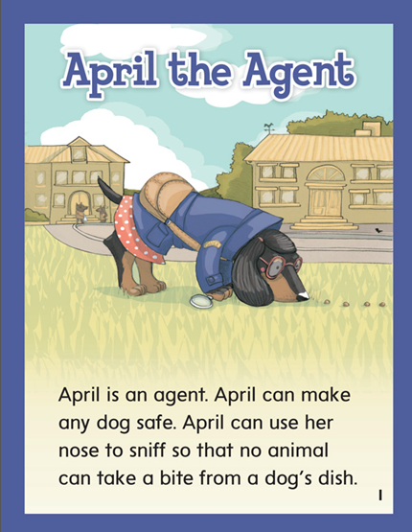

Slide 277
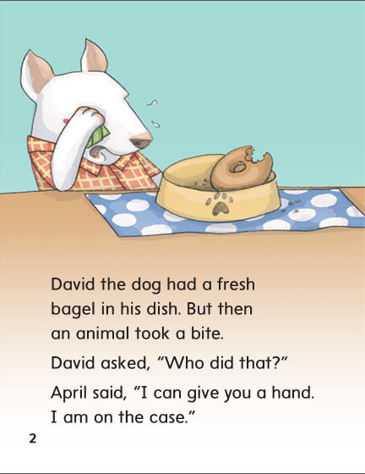

Slide 278
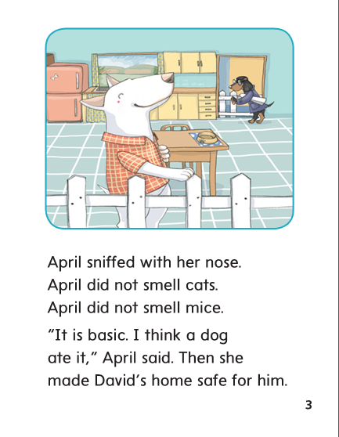

Slide 279
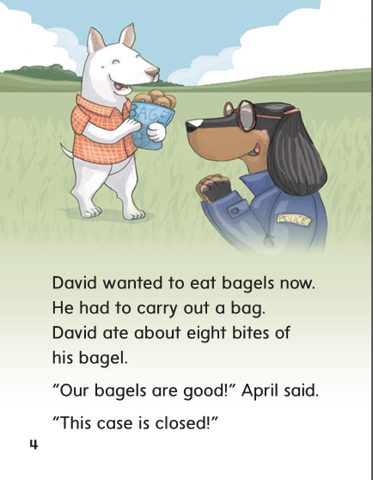

Slide 280
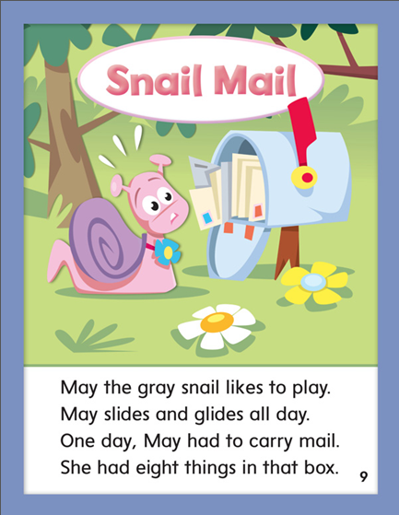

Slide 281
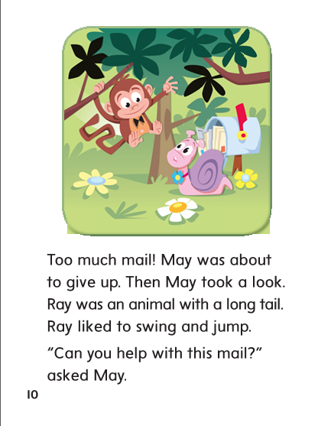

Slide 282
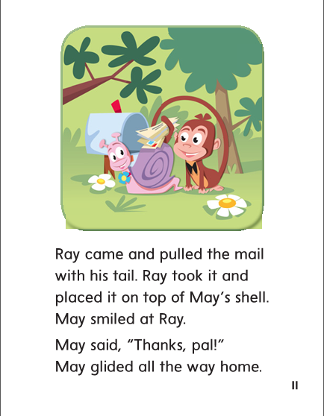

Slide 283
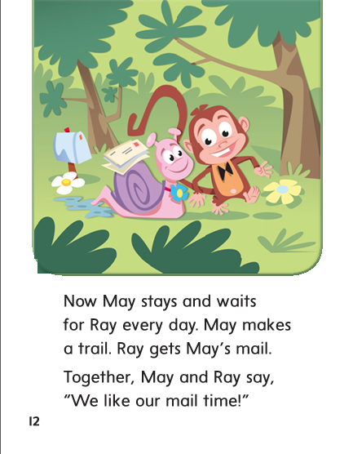

Slide 284
Structural Analysis
Read the words. Tell children you will put them in alphabetical order.
bus
train
bike

Slide 285
Structural Analysis
First, I will circle each first letter.
bus
train
bike
B comes before t in the alphabet so bus and bike come before train.
Bus and bike both start with b so you have to look at the second letter.

Slide 286
Structural Analysis
bus
bike
train
Bike comes before bus in ABC order because i comes before u.

Slide 287
Structural Analysis
First, I will circle each first letter.
bike
bus
train
Bike comes before bus in ABC order because i comes before u.

Slide 288
Structural Analysis
Have partners use the first and second letters to put the words in ABC order.
cook
aim
at

Slide 289
Structural Analysis
Have partners use the first and second letters to put the words in ABC order.
rode
day
run

Slide 290
Structural Analysis
Have partners use the first and second letters to put the words in ABC order.
mile
maid
mule

Slide 291
-ai
-ay

Slide 292
mail
our
mail
way
carry
way
chain
chain
day
day
rain
our
rain
play
carry
play

Slide 293
High Frequency
Words

Slide 294
Read, Spell, Write
about
I read a story about a monkey with a long tail.

Slide 295
Read, Spell, Write
animal
A mule is a animal.

Slide 296
Read, Spell, Write
carry
We use a pail to carry the shells.

Slide 297
Read, Spell, Write
eight
Eight chicks hatched from eight eggs.

Slide 298
Read, Spell, Write
give
Will mom give us a ride to school?

Slide 299
Read, Spell, Write
our
We wait for our bus at the bus stop.

Slide 300
Build Fluency: Word Automaticity
A hen is an animal.
We have eight hens.
We carry the eggs home and give them to our mom.
We tell our mom about the hens.

Slide 301
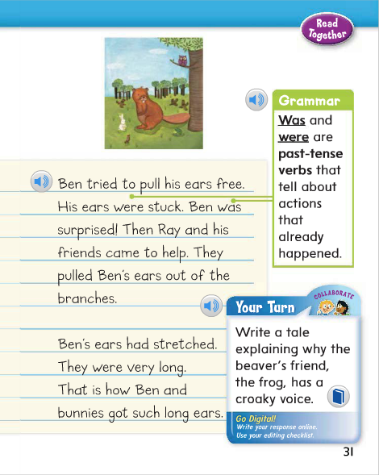
Identify the verb in this sentence:
His ears were stuck.
Ears is the noun.
The verb were is used because the noun names more than one.
Identify the verb in this sentence:
Ben was surprised!
Which word is the noun?
Ben is the noun.
The verb was is used because the noun, Ben, names just one.

Slide 302
Week 1 – Day 4

Slide 303
Phonological Awareness
Identify and Generate Rhyme
Listen as I say two words: sail, mail.
Sail and mail rhyme because they both end with the same /al/ sound.
What is another word that rhymes with sail and mail?
I will think of other words that end with /al/.
Tail rhymes with sail and mail because tail ends with /al/.
Guided Practice:
I will say three words.
Tell me which two words rhyme.
Then say another word that rhymes with them.
brain, book, main
watch, wait, gate
may, tray, why

Slide 304
Build Words with Long a: a, ai, ay
p
ai
l
What is the new word we made?
Let’s blend all the sounds and read the word.
Change the p to t.

Slide 305
Build Words with Long a: a, ai, ay
t
ai
l
What is the new word we made?
Let’s blend all the sounds and read the word.
Change the t to tr.

Slide 306
Build Words with Long a: a, ai, ay
tr
ai
l
What is the new word we made?
Let’s blend all the sounds and read the word.
Change the l to n.

Slide 307
Build Words with Long a: a, ai, ay
tr
ai
n
What is the new word we made?
Let’s blend all the sounds and read the word.
Change the tr to r.

Slide 308
Build Words with Long a: a, ai, ay
r
ai
n
What is the new word we made?
Let’s blend all the sounds and read the word.
Change the ai to a.

Slide 309
Build Words with Long a: a, ai, ay
r
a
n
What is the new word we made?
Let’s blend all the sounds and read the word.
Change the r to m.

Slide 310
Build Words with Long a: a, ai, ay
m
a
n
What is the new word we made?
Let’s blend all the sounds and read the word.
Change the a to ai.

Slide 311
Build Words with Long a: a, ai, ay
m
ai
n
What is the new word we made?
Let’s blend all the sounds and read the word.
Change the m to p.

Slide 312
Build Words with Long a: a, ai, ay
p
ai
n
What is the new word we made?
Let’s blend all the sounds and read the word.
Change the ai to a.

Slide 313
Build Words with Long a: a, ai, ay
p
a
n
What is the new word we made?
Let’s blend all the sounds and read the word.
Change the n to d.

Slide 314
Build Words with Long a: a, ai, ay
p
a
d
What is the new word we made?
Let’s blend all the sounds and read the word.
Change the a to ai.

Slide 315
Build Words with Long a: a, ai, ay
p
ai
d
What is the new word we made?
Let’s blend all the sounds and read the word.
Remove the d.

Slide 316
Build Words with Long a: a, ai, ay
p
ay
What is the new word we made?
Let’s blend all the sounds and read the word.
Change the p to r.

Slide 317
Build Words with Long a: a, ai, ay
r
ay
What is the new word we made?
Let’s blend all the sounds and read the word.
Change the r to s.

Slide 318
Build Words with Long a: a, ai, ay
s
ay
What is the new word we made?
Let’s blend all the sounds and read the word.
Change the s to sw.

Slide 319
Build Words with Long a: a, ai, ay
sw
ay
What is the new word we made?
Let’s blend all the sounds and read the word.
Change the sw to st.

Slide 320
Build Words with Long a: a, ai, ay
st
ay
What is the new word we made?
Let’s blend all the sounds and read the word.

Slide 329
Structural Analysis
Remember when you alphabetize words, you look at the first letters.
If the letters are the same, then you look at the second letter.
day
say
stay
Are these words in alphabetical order?

Slide 330
Structural Analysis
Remember when you alphabetize words, you look at the first letters.
If the letters are the same, then you look at the second letter.
tray
fail
took
Have children work in pairs to alphabetize the words.

Slide 331
Structural Analysis
Remember when you alphabetize words, you look at the first letters.
If the letters are the same, then you look at the second letter.
cube
chain
bone
Have children work in pairs to alphabetize the words.

Slide 332
Structural Analysis
Remember when you alphabetize words, you look at the first letters.
If the letters are the same, then you look at the second letter.
mole
mail
mix
Have children work in pairs to alphabetize the words.

Slide 333
High Frequency
Words

Slide 334
Read, Spell, Write
about
I read a story about a monkey with a long tail.

Slide 335
Read, Spell, Write
animal
A mule is a animal.

Slide 336
Read, Spell, Write
carry
We use a pail to carry the shells.

Slide 337
Read, Spell, Write
eight
Eight chicks hatched from eight eggs.

Slide 338
Read, Spell, Write
give
Will mom give us a ride to school?

Slide 339
Read, Spell, Write
our
We wait for our bus at the bus stop.

Slide 340
Grammar
Was and Were
Remember that the past-tense verb was tells about one noun and
were tells about more than one noun.
The hose ______ on the grass.
We ______ last in the line.
The boys _______ cooking lunch.
Have children complete the sentences with was or were.

Slide 341
Week 1 – Day 5

Slide 342
Phonemic Awareness
Phoneme Blending:
Listen as I say a group of sounds. Then blend those sounds to form a word.
/ch/ /a/ /n/ /w/ /a/ /t/ /s/ /t/ /a/ /t/ /r/ /a/ /l/
Phoneme Segmentation:
Now I am going to say a word. I want you to say each sound in the word.
say gray tail rain train

Slide 343
Blend and Build Words with Long a: a_e
Read and say these words:
play
paint
stay
rain
April

Slide 344
Build Words with Long a: a, ai, ay
r
ai
n
What is the new word we made?
Let’s blend all the sounds and read the word.
Change the r to br.

Slide 345
Build Words with Long a: a, ai, ay
br
ai
n
What is the new word we made?
Let’s blend all the sounds and read the word.
Change the first d to p.

Slide 346
Build Words with Long a: a, ai, ay
br
ai
d
What is the new word we made?
Let’s blend all the sounds and read the word.
Change the br to r.

Slide 347
Build Words with Long a: a, ai, ay
r
ai
d
What is the new word we made?
Let’s blend all the sounds and read the word.
Change the ai to i

Slide 348
Build Words with Long a: a, ai, ay
r
i
d
What is the new word we made?
Let’s blend all the sounds and read the word.
Change the r to d.

Slide 349
Build Words with Long a: a, ai, ay
d
i
d
What is the new word we made?
Let’s blend all the sounds and read the word.
Change the i to a.

Slide 350
Build Words with Long a: a, ai, ay
d
a
d
What is the new word we made?
Let’s blend all the sounds and read the word.
Change the i to a.

Slide 351
Build Words with Long a: a, ai, ay
p
a
d
What is the new word we made?
Let’s blend all the sounds and read the word.
Change the a to ai.

Slide 352
Build Words with Long a: a, ai, ay
p
ai
d
What is the new word we made?
Let’s blend all the sounds and read the word.
Change the d to l.

Slide 353
Build Words with Long a: a, ai, ay
p
ai
l
What is the new word we made?
Let’s blend all the sounds and read the word.
Change the p to n.

Slide 354
Build Words with Long a: a, ai, ay
n
ai
l
What is the new word we made?
Let’s blend all the sounds and read the word.
Change the n to sn.

Slide 355
Build Words with Long a: a, ai, ay
sn
ai
l
What is the new word we made?
Let’s blend all the sounds and read the word.
Change the sn to s.

Slide 356
Build Words with Long a: a, ai, ay
s
ai
l
What is the new word we made?
Let’s blend all the sounds and read the word.
Change the s to m.

Slide 357
Build Words with Long a: a, ai, ay
m
ai
l
What is the new word we made?
Let’s blend all the sounds and read the word.
Change the l to d.

Slide 358
Build Words with Long a: a, ai, ay
m
ai
d
What is the new word we made?
Let’s blend all the sounds and read the word.

Slide 359
Word Automaticity
wait

Slide 360
tail

Slide 361
claim

Slide 362
ran

Slide 363
cent

Slide 364
way

Slide 365
plain

Slide 366
clay

Slide 367
rain

Slide 368
face

Slide 369
day

Slide 370
tray

Slide 371
stain

Slide 372
mad

Slide 373
bride

Slide 374
may

Slide 375
train

Slide 376
plays

Slide 377
maid

Slide 378
bridge

Slide 379
gray

Slide 380
chain

Slide 381
waited

Slide 382
pant

Slide 383
cube

Slide 384
sway

Slide 385
drain

Slide 386
explain

Slide 387
paint

Slide 388
stone

Slide 389
Structural Analysis
Have children explain how to put words that begin
with the same letter in ABC order.
Then have children practice writing these word sets in ABC order
sail
pail
shell

Slide 390
Structural Analysis
Have children explain how to put words that begin
with the same letter in ABC order.
Then have children practice writing these word sets in ABC order
rain
hay
hot

Slide 391
Structural Analysis
Have children explain how to put words that begin
with the same letter in ABC order.
Then have children practice writing these word sets in ABC order
waist
head
hand

Slide 392
High Frequency
Words

Slide 393
Read, Spell, Write
about
I read a story about a monkey with a long tail.

Slide 394
Read, Spell, Write
animal
A mule is a animal.

Slide 395
Read, Spell, Write
carry
We use a pail to carry the shells.

Slide 396
Read, Spell, Write
eight
Eight chicks hatched from eight eggs.

Slide 397
Read, Spell, Write
give
Will mom give us a ride to school?

Slide 398
Read, Spell, Write
our
We wait for our bus at the bus stop.

Slide 399
Grammar
Was and Were
Ask children how to use was and were.
Have children identify whether the nouns describe one or more than one.
Two cooks were using a pail.
The lunch tray was on Clay’s desk.
Why is were used in the first sentence?
Why is was used in the second sentence?

