Slide 1
Week 1 – Day 1

Slide 2
Phonological Awareness
Phoneme Identity
Listen carefully as I say three words: keep, please, field.
What sound is the same in keep, please, and field?
They all have the /e/ sound in the middle.
Guided Practice:
I will say three words.
Listen carefully and tell me the sound that you hear that is the same in all three words.
sheet, freeze, peach catch, hitch, watch hope, stove, toad
claim, take, strain green, meat, seal speed, road, made

Slide 3
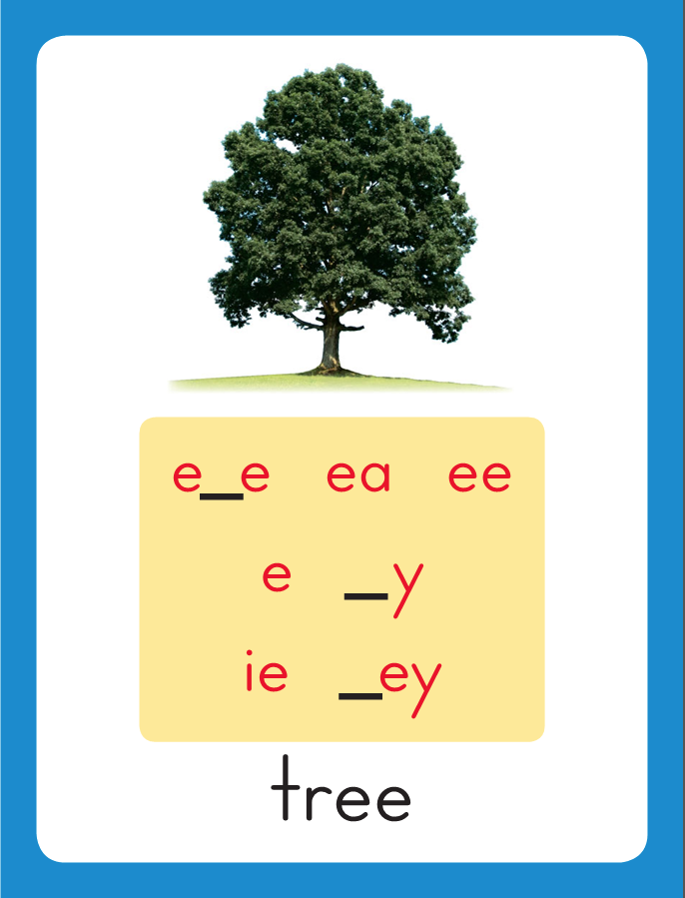
Introduce Long e: e, ee, ea, ie
This is the Tree
Sound-Spelling Card.
The sound is /e/.
This is the sound at the end of the word tree.
Listen: /treee/, tree.
The /e/ sound can be spelled with the letters
e as in she,
ee as in tree,
ea as in meat,
and ie as in field.
Say the sound with me: /eee/.
I’ll say /e/ as I write the letters
e, ee, ea and ie several times.
tree
meat
field

Slide 4
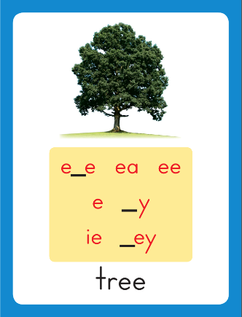
Have children practice connecting the letters e, ee, ea and ie to the sound /e/ by writing these spellings.
Now do it with me. Say /e/ as I write the letters e, ee, ea or ie.
This time, write the letters e, ee, ea and ie five times each as you say the /e/ sound.
e e e e e
ee ee ee ee ee
ea ea ea ea ea
ie ie ie ie ie

Slide 5
Blending Words with Long e: e, ee, ea, ie
f

Slide 6
Blending Words with Long e: e, ee, ea, ie
f
r

Slide 7
Blending Words with Long e: e, ee, ea, ie
f
r
ee

Slide 8
Blending Words with Long e: e, ee, ea, ie
f
r
ee

Slide 9
Blending Words with Long e: e, ee, ea, ie
f
r
ee
ze

Slide 10
Blending Words with Long e: e, ee, ea, ie
f
r
ee
ze

Slide 11
Blending Words with Long e: e, ee, ea, ie
sh

Slide 12
Blending Words with Long e: e, ee, ea, ie
sh
e

Slide 13
Blending Words with Long e: e, ee, ea, ie
sh
e

Slide 14
Blending Words with Long e: e, ee, ea, ie
f

Slide 15
Blending Words with Long e: e, ee, ea, ie
f
ee

Slide 16
Blending Words with Long e: e, ee, ea, ie
f
ee

Slide 17
Blending Words with Long e: e, ee, ea, ie
f
ee
l

Slide 18
Blending Words with Long e: e, ee, ea, ie
f
ee
l

Slide 19
Blending Words with Long e: e, ee, ea, ie
r

Slide 20
Blending Words with Long e: e, ee, ea, ie
r
ea

Slide 21
Blending Words with Long e: e, ee, ea, ie
r
ea

Slide 22
Blending Words with Long e: e, ee, ea, ie
r
ea
d

Slide 23
Blending Words with Long e: e, ee, ea, ie
r
ea
d

Slide 24
Blending Words with Long e: e, ee, ea, ie
sh

Slide 25
Blending Words with Long e: e, ee, ea, ie
sh
ie

Slide 26
Blending Words with Long e: e, ee, ea, ie
sh
ie

Slide 27
Blending Words with Long e: e, ee, ea, ie
sh
ie
l

Slide 28
Blending Words with Long e: e, ee, ea, ie
sh
ie
l
d

Slide 29
Blending Words with Long e: e, ee, ea, ie
sh
ie
l
d

Slide 30
e ch ea ze
sp ee sn a_e
ie dge o_e sh
br oo pl ay

Slide 31
m

Slide 32
me

Slide 33
me b

Slide 34
me be

Slide 35
me be ea

Slide 36
me be eat

Slide 37
me be eat
ea

Slide 38
me be eat
each

Slide 39
me be eat
each n

Slide 40
me be eat
each nea

Slide 41
me be eat
each neat

Slide 42
me be eat
each neat s

Slide 43
me be eat
each neat see

Slide 44
me be eat
each neat see
k

Slide 45
me be eat
each neat see
kee

Slide 46
me be eat
each neat see
keep

Slide 47
me be eat
each neat see
keep d

Slide 48
me be eat
each neat see
keep dee

Slide 49
me be eat
each neat see
keep deep

Slide 50
me be eat
each neat see
keep deep sp

Slide 51
me be eat
each neat see
keep deep spea

Slide 52
me be eat
each neat see
keep deep speak

Slide 53
me be eat
each neat see
keep deep speak
ch

Slide 54
me be eat
each neat see
keep deep speak
chie

Slide 55
me be eat
each neat see
keep deep speak
chief

Slide 56
me be eat
each neat see
keep deep speak
chief f

Slide 57
me be eat
each neat see
keep deep speak
chief fie

Slide 58
me be eat
each neat see
keep deep speak
chief field

Slide 59
me be eat
each neat see
keep deep speak
chief field sn

Slide 60
me be eat
each neat see
keep deep speak
chief field snee

Slide 61
me be eat
each neat see
keep deep speak
chief field sneeze

Slide 62
Internal Sounding Out
bet

Slide 63
Internal Sounding Out
bet beat

Slide 64
Internal Sounding Out
bet beat fed

Slide 65
Internal Sounding Out
bet beat fed
feed

Slide 66
Internal Sounding Out
bet beat fed
feed hat

Slide 67
Internal Sounding Out
bet beat fed
feed hat heat

Slide 68
Internal Sounding Out
bet beat fed
feed hat heat
train

Slide 69
Internal Sounding Out
bet beat fed
feed hat heat
train play

Slide 70
Internal Sounding Out
bet beat fed
feed hat heat
train play took

Slide 71
Internal Sounding Out
bet beat fed
feed hat heat
train play took
bridge

Slide 72
Internal Sounding Out
bet beat fed
feed hat heat
train play took
bridge shape

Slide 73
Internal Sounding Out
bet beat fed
feed hat heat
train play took
bridge shape stone

Slide 74
Dean

Slide 75
Dean reads

Slide 76
Dean reads each

Slide 77
Dean reads each day

Slide 78
Dean reads each day of

Slide 79
Dean reads each day of the

Slide 80
Dean reads each day of the week.

Slide 81
Dean reads each day of the week.
We

Slide 82
Dean reads each day of the week.
We will

Slide 83
Dean reads each day of the week.
We will eat

Slide 84
Dean reads each day of the week.
We will eat a

Slide 85
Dean reads each day of the week.
We will eat a big

Slide 86
Dean reads each day of the week.
We will eat a big feast

Slide 87
Dean reads each day of the week.
We will eat a big feast on

Slide 88
Dean reads each day of the week.
We will eat a big feast on Sunday.

Slide 89
Dean reads each day of the week.
We will eat a big feast on Sunday.
Please

Slide 90
Dean reads each day of the week.
We will eat a big feast on Sunday.
Please leave

Slide 91
Dean reads each day of the week.
We will eat a big feast on Sunday.
Please leave the

Slide 92
Dean reads each day of the week.
We will eat a big feast on Sunday.
Please leave the clean

Slide 93
Dean reads each day of the week.
We will eat a big feast on Sunday.
Please leave the clean
sheets

Slide 94
Dean reads each day of the week.
We will eat a big feast on Sunday.
Please leave the clean
sheets on

Slide 95
Dean reads each day of the week.
We will eat a big feast on Sunday.
Please leave the clean
sheets on the

Slide 96
Dean reads each day of the week.
We will eat a big feast on Sunday.
Please leave the clean
sheets on the bed.

Slide 97
Spelling / Dictation
1. _________
2. _________
3. _________
4. _________
5. _________
me
feed
beak
play
rain

Slide 98
High Frequency
Words

Slide 99
Read, Spell, Write
because
I like the dress because it is blue.

Slide 100
Read, Spell, Write
blue
I like the dress because it is blue.

Slide 101
Read, Spell, Write
into
We jumped into the other lake.

Slide 102
Read, Spell, Write
or
I will take a large piece or a small piece.

Slide 103
Read, Spell, Write
other
We jumped into the other lake.

Slide 104
Read, Spell, Write
small
I will take a large piece or a small piece.

Slide 105
Have children read the sentences. Prompt them to identify the high-frequency words in connected text and to blend the decodable words.
I like the dress because it is blue.
We jumped into the other lake.
I will take a large piece or a small piece.

Slide 106
Grammar
Has and Have
Have is a verb that means “to own something.”
We use the word have when we talk about ourselves or a group of people, or when we use the word you.
I have pet fish.
They have pet fish.
You have pet fish.
Discuss why have is used in each sentence.

Slide 107
Grammar
Has and Have
We use the word has instead of have when we talk about one thing or one person other than ourselves.
Tim has pet fish.
She has pet fish.
Discuss why has is used in each sentence.

Slide 108
Grammar
Has and Have
Read the sentences aloud. Have children work with a partner to identify the correct verb to complete each sentence.
Gail _____ three cats.
Dean and Kay ______ a cat.
We _____ one dog.
The dog ______ a leash.

Slide 109
Week 1 – Day 2

Slide 110
Phonemic Awareness – Phoneme Segmentation
I am going to say the sounds in the word keep.
Listen: /k/ /e/ /p/. I’ll place a marker in a box on the Response Board/Sound-Spelling Workboard for each sound I hear.
The first sound is /k/. The second sound is /e/. The last sound is /p/.
This word has three sounds: /k/ /e/ /p/.
/k/
/e/
/p/

Slide 111
Phonemic Awareness – Phoneme Segmentation
Let’s do some together. I’ll say a word.
Place a marker in a box to stand for each sound.
Let’s do the first one together.
Let’s do some together. I’ll say a word. Place a marker in a box to stand for each sound.
she teeth wheel heat chief
steal brief eat leave freeze

Slide 112
Introduce Long e: e, ee, ea, ie
we
deep
What are these letters?
What sound do they stand for?
speak
chief

Slide 113
Blending Words with Long e: e, ee, ea, ie
n

Slide 114
Blending Words with Long e: e, ee, ea, ie
n
ee

Slide 115
Blending Words with Long e: e, ee, ea, ie
n
ee

Slide 116
Blending Words with Long e: e, ee, ea, ie
n
ee
d

Slide 117
Blending Words with Long e: e, ee, ea, ie
n
ee
d

Slide 118
Blending Words with Long e: e, ee, ea, ie
ea

Slide 119
Blending Words with Long e: e, ee, ea, ie
ea
t

Slide 120
Blending Words with Long e: e, ee, ea, ie
ea
t

Slide 121
Blending Words with Long e: e, ee, ea, ie
s

Slide 122
Blending Words with Long e: e, ee, ea, ie
s
l

Slide 123
Blending Words with Long e: e, ee, ea, ie
s
l
ee

Slide 124
Blending Words with Long e: e, ee, ea, ie
s
l
ee

Slide 125
Blending Words with Long e: e, ee, ea, ie
s
l
ee
p

Slide 126
Blending Words with Long e: e, ee, ea, ie
s
l
ee
p

Slide 127
Blending Words with Long e: e, ee, ea, ie
h

Slide 128
Blending Words with Long e: e, ee, ea, ie
h
e

Slide 129
Blending Words with Long e: e, ee, ea, ie
h
e

Slide 130
Blending Words with Long e: e, ee, ea, ie
n

Slide 131
Blending Words with Long e: e, ee, ea, ie
n
ie

Slide 132
Blending Words with Long e: e, ee, ea, ie
n
ie

Slide 133
Blending Words with Long e: e, ee, ea, ie
n
ie
ce

Slide 134
Blending Words with Long e: e, ee, ea, ie
n
ie
ce

Slide 135
fl

Slide 136
flee

Slide 137
flee sh

Slide 138
flee she

Slide 139
flee she sw

Slide 140
flee she swee

Slide 141
flee she sweep

Slide 142
flee she sweep
cl

Slide 143
flee she sweep
clea

Slide 144
flee she sweep
clean

Slide 145
flee she sweep
clean sp

Slide 146
flee she sweep
clean spea

Slide 147
flee she sweep
clean speak

Slide 148
flee she sweep
clean speak th

Slide 149
flee she sweep
clean speak thie

Slide 150
flee she sweep
clean speak thief

Slide 151
flee she sweep
clean speak thief
l

Slide 152
flee she sweep
clean speak thief
lea

Slide 153
flee she sweep
clean speak thief
leave

Slide 154
flee she sweep
clean speak thief
leave fr

Slide 155
flee she sweep
clean speak thief
leave free

Slide 156
flee she sweep
clean speak thief
leave free b

Slide 157
flee she sweep
clean speak thief
leave free bea

Slide 158
flee she sweep
clean speak thief
leave free beach

Slide 159
flee she sweep
clean speak thief
leave free beach
gr

Slide 160
flee she sweep
clean speak thief
leave free beach
gree

Slide 161
flee she sweep
clean speak thief
leave free beach
green

Slide 162
flee she sweep
clean speak thief
leave free beach
green r

Slide 163
flee she sweep
clean speak thief
leave free beach
green rea

Slide 164
flee she sweep
clean speak thief
leave free beach
green read

Slide 165
flee she sweep
clean speak thief
leave free beach
green read pl

Slide 166
flee she sweep
clean speak thief
leave free beach
green read plea

Slide 167
flee she sweep
clean speak thief
leave free beach
green read please

Slide 168
Blend Words with Long e: e, ee, ea, ie
b
ea
n
What is the new word we made?
Let’s blend all the sounds and read the word.
Change the n to t.

Slide 169
Blend Words with Long e: e, ee, ea, ie
b
ea
t
What is the new word we made?
Let’s blend all the sounds and read the word.
Change the b to s.

Slide 170
Blend Words with Long e: e, ee, ea, ie
s
ea
t
What is the new word we made?
Let’s blend all the sounds and read the word.
Change the s to ch.

Slide 171
Blend Words with Long e: e, ee, ea, ie
ch
ea
t
What is the new word we made?
Let’s blend all the sounds and read the word.
Change the t to p.

Slide 172
Blend Words with Long e: e, ee, ea, ie
ch
ea
p
What is the new word we made?
Let’s blend all the sounds and read the word.
Change the ch to h.

Slide 173
Blend Words with Long e: e, ee, ea, ie
h
ea
p
What is the new word we made?
Let’s blend all the sounds and read the word.
Change the h to r.

Slide 174
Blend Words with Long e: e, ee, ea, ie
r
ea
p
What is the new word we made?
Let’s blend all the sounds and read the word.
Change the p to l.

Slide 175
Blend Words with Long e: e, ee, ea, ie
r
ea
l
What is the new word we made?
Let’s blend all the sounds and read the word.
Change the r to d.

Slide 176
Blend Words with Long e: e, ee, ea, ie
d
ea
l
What is the new word we made?
Let’s blend all the sounds and read the word.
Change the d to s.

Slide 177
Blend Words with Long e: e, ee, ea, ie
s
ea
l
What is the new word we made?
Let’s blend all the sounds and read the word.
Remove the l.

Slide 178
Blend Words with Long e: e, ee, ea, ie
s
ea
What is the new word we made?
Let’s blend all the sounds and read the word.
Change the ea to ee.

Slide 179
Blend Words with Long e: e, ee, ea, ie
s
ee
What is the new word we made?
Let’s blend all the sounds and read the word.
Add a p to the end of the word.

Slide 180
Blend Words with Long e: e, ee, ea, ie
s
ee
p
What is the new word we made?
Let’s blend all the sounds and read the word.
Change the s to sh.

Slide 181
Blend Words with Long e: e, ee, ea, ie
sh
ee
p
What is the new word we made?
Let’s blend all the sounds and read the word.
Change the sh to d.

Slide 182
Blend Words with Long e: e, ee, ea, ie
d
ee
p
What is the new word we made?
Let’s blend all the sounds and read the word.
Change the d to ch and change the p to f.

Slide 183
Blend Words with Long e: e, ee, ea, ie
ch
ie
f
What is the new word we made?
Let’s blend all the sounds and read the word.
Change the d to ch and change the p to f.

Slide 184
Blend Words with Long e: e, ee, ea, ie
ch
ie
f
What is the new word we made?
Let’s blend all the sounds and read the word.
Change the ch to th.

Slide 185
Blend Words with Long e: e, ee, ea, ie
th
ie
f
What is the new word we made?
Let’s blend all the sounds and read the word.
Change the th to gr.

Slide 186
Blend Words with Long e: e, ee, ea, ie
gr
ie
f
What is the new word we made?
Let’s blend all the sounds and read the word.

Slide 187
Structural Analysis
Prefixes re-, un-, pre-
A prefix is a word part that is added to the beginning of a word.
A prefix changes the meaning of the word.
heat
reheat
re- means
“again”
Mom will heat my soup.
I will reheat the soup tonight when I get hungry.
Adding re- to the word heat changes the meaning of heat to “heat again.”
It also adds a syllable to the word.

Slide 188
Structural Analysis
Prefixes re-, un-, pre-
A prefix is a word part that is added to the beginning of a word.
A prefix changes the meaning of the word.
clean
unclean
un- means
“not” or
“the opposite of”
I promise to clean my room.
My mom was upset at my sister’s unclean room.
Adding un- to the word clean changes the meaning of clean to “not clean.”
It also adds a syllable to the word.

Slide 189
Structural Analysis
Prefixes re-, un-, pre-
A prefix is a word part that is added to the beginning of a word.
A prefix changes the meaning of the word.
read
preread
pre- means
“before”
I want to read the story again.
Reading the title of the story is a good preread strategy.
Adding pre- to the word read changes the meaning of read to “before reading.”
It also adds a syllable to the word.

Slide 190
Structural Analysis
Prefixes re-, un-, pre-
Have children add re- to each word and then use each word in a sentence.
read
play

Slide 191
Structural Analysis
Prefixes re-, un-, pre-
Have children add un- to each word and then use each word in a sentence.
paid
real

Slide 192
Structural Analysis
Prefixes re-, un-, pre-
Have children add pre- to each word and then use each word in a sentence.
teach
cook

Slide 193
Spelling
we
leaf
need

Slide 194
me
beak
keep
feed
we
seat
me
beak
keep
feed
we
seat

Slide 195
High Frequency
Words

Slide 196
Read, Spell, Write
because
I like the dress because it is blue.

Slide 197
Read, Spell, Write
blue
I like the dress because it is blue.

Slide 198
Read, Spell, Write
into
We jumped into the other lake.

Slide 199
Read, Spell, Write
or
I will take a large piece or a small piece.

Slide 200
Read, Spell, Write
other
We jumped into the other lake.

Slide 201
Read, Spell, Write
small
I will take a large piece or a small piece.

Slide 202
Grammar
Has and Have
We use the word have to tell about more than one person, place or thing that has or owns something. We also use have when we say I or you. We use has to tell about one person, place, or thing that owns something.
Dogs do not have hands.
The boy has a green pail.
Guide children to circle has or have in each sentence.
Have children write a sentence to tell what pets they or their friends have. Remember to use have or has correctly.

Slide 203
Week 1 – Day 3

Slide 204
Phonemic Awareness
Identify and Generate Rhyme
I am going to say two words. Listen: meal, peel.
Meal and peel rhyme because they both end in the same sounds: /el/.
Listen: /m/ /el/, meal; /p/ /el/, peel.
What other words rhyme with meal and peel?
Feel, /f/ /el/. The word feel ends in /el/, so it rhymes with meal and peel.
Guided Practice: I will say a group of words. Tell me which two words in the group rhyme. Then name other words that rhyme with those words.
meet, rate, seat bead, weed, beg play, team, hay
say, see, bee shirt, shield, dirt book, beak, crook

Slide 205
Blending Words with Long e: e, ee, ea, ie
d

Slide 206
Blending Words with Long e: e, ee, ea, ie
d
ee

Slide 207
Blending Words with Long e: e, ee, ea, ie
d
ee

Slide 208
Blending Words with Long e: e, ee, ea, ie
d
ee
p

Slide 209
Blending Words with Long e: e, ee, ea, ie
d
ee
p

Slide 210
Blending Words with Long e: e, ee, ea, ie
m

Slide 211
Blending Words with Long e: e, ee, ea, ie
m
e

Slide 212
Blending Words with Long e: e, ee, ea, ie
m
e

Slide 213
Blending Words with Long e: e, ee, ea, ie
b

Slide 214
Blending Words with Long e: e, ee, ea, ie
b
ee

Slide 215
Blending Words with Long e: e, ee, ea, ie
b
ee

Slide 216
Blending Words with Long e: e, ee, ea, ie
l

Slide 217
Blending Words with Long e: e, ee, ea, ie
l
ea

Slide 218
Blending Words with Long e: e, ee, ea, ie
l
ea

Slide 219
Blending Words with Long e: e, ee, ea, ie
l
ea
f

Slide 220
Blending Words with Long e: e, ee, ea, ie
l
ea
f

Slide 221
Blending Words with Long e: e, ee, ea, ie
w

Slide 222
Blending Words with Long e: e, ee, ea, ie
w
ea

Slide 223
Blending Words with Long e: e, ee, ea, ie
w
ea

Slide 224
Blending Words with Long e: e, ee, ea, ie
w
ea
ve

Slide 225
Blending Words with Long e: e, ee, ea, ie
w
ea
ve

Slide 226
Blending Words with Long e: e, ee, ea, ie
n

Slide 227
Blending Words with Long e: e, ee, ea, ie
n
ie

Slide 228
Blending Words with Long e: e, ee, ea, ie
n
ie

Slide 229
Blending Words with Long e: e, ee, ea, ie
n
ie
ce

Slide 230
Blending Words with Long e: e, ee, ea, ie
n
ie
ce

Slide 231
ea sh re ing
ch ee ze un
ie tr pre wh
ay oo ai o_e

Slide 232
t

Slide 233
tea

Slide 234
team

Slide 235
team s

Slide 236
team see

Slide 237
team see s

Slide 238
team see see

Slide 239
team see seed

Slide 240
team see seed
ea

Slide 241
team see seed
eat

Slide 242
team see seed
eat s

Slide 243
team see seed
eat sea

Slide 244
team see seed
eat seat

Slide 245
team see seed
eat seat sl

Slide 246
team see seed
eat seat slee

Slide 247
team see seed
eat seat sleep

Slide 248
team see seed
eat seat sleep
t

Slide 249
team see seed
eat seat sleep
tea

Slide 250
team see seed
eat seat sleep
teach

Slide 251
team see seed
eat seat sleep
teach sh

Slide 252
team see seed
eat seat sleep
teach shie

Slide 253
team see seed
eat seat sleep
teach shield

Slide 254
team see seed
eat seat sleep
teach shield tr

Slide 255
team see seed
eat seat sleep
teach shield tree

Slide 256
team see seed
eat seat sleep
teach shield tree
ch

Slide 257
team see seed
eat seat sleep
teach shield tree
chee

Slide 258
team see seed
eat seat sleep
teach shield tree
cheese

Slide 259
team see seed
eat seat sleep
teach shield tree
cheese s

Slide 260
team see seed
eat seat sleep
teach shield tree
cheese sea

Slide 261
team see seed
eat seat sleep
teach shield tree
cheese sea wh

Slide 262
team see seed
eat seat sleep
teach shield tree
cheese sea whee

Slide 263
team see seed
eat seat sleep
teach shield tree
cheese sea wheel

Slide 264
Internal Sounding Out
reread

Slide 265
Internal Sounding Out
reread preheat

Slide 266
Internal Sounding Out
reread preheat unreal

Slide 267
Internal Sounding Out
reread preheat unreal
unzipped

Slide 268
Internal Sounding Out
reread preheat unreal
unzipped refreeze

Slide 269
Internal Sounding Out
reread preheat unreal
unzipped refreeze
repay

Slide 270
Internal Sounding Out
reread preheat unreal
unzipped refreeze
repay unhook

Slide 271
Internal Sounding Out
reread preheat unreal
unzipped refreeze
repay unhook prepaid

Slide 272
Internal Sounding Out
reread preheat unreal
unzipped refreeze
repay unhook prepaid
shopping

Slide 273
Internal Sounding Out
reread preheat unreal
unzipped refreeze
repay unhook prepaid
shopping bathrobe

Slide 274
Dean

Slide 275
Dean needs

Slide 276
Dean needs to

Slide 277
Dean needs to plant

Slide 278
Dean needs to plant those

Slide 279
Dean needs to plant those seeds.

Slide 280
Dean needs to plant those seeds.
Jean,

Slide 281
Dean needs to plant those seeds.
Jean, please

Slide 282
Dean needs to plant those seeds.
Jean, please preheat

Slide 283
Dean needs to plant those seeds.
Jean, please preheat the

Slide 284
Dean needs to plant those seeds.
Jean, please preheat the meat

Slide 285
Dean needs to plant those seeds.
Jean, please preheat the meat for

Slide 286
Dean needs to plant those seeds.
Jean, please preheat the meat for lunch.

Slide 287
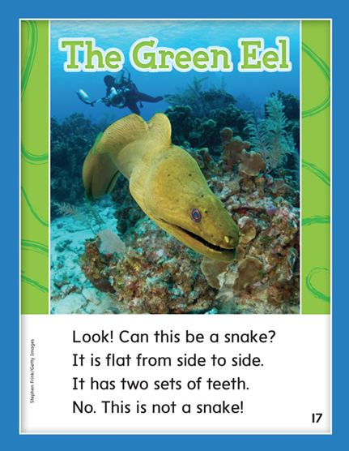

Slide 289
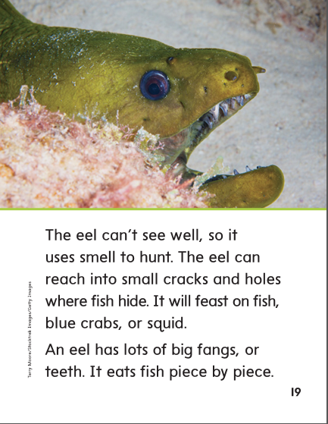

Slide 290
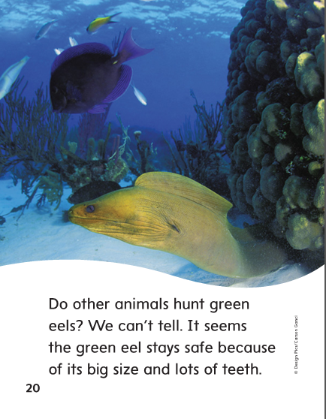

Slide 291
Structural Analysis
Prefixes re-, un-, pre-
A prefix is a word part that is added to the beginning of a word.
A prefix changes the meaning of the word.
sweep
resweep
re- means
“again”
Resweep means “to sweep again.”
I had to resweep the driveway after the wind blew leaves everywhere.

Slide 292
Structural Analysis
Prefixes re-, un-, pre-
A prefix is a word part that is added to the beginning of a word.
A prefix changes the meaning of the word.
read
preread
pre- means
“before”
Preread means “what you do before you read.”
We will preread the table of contents.

Slide 293
Structural Analysis
Prefixes re-, un-, pre-
A prefix is a word part that is added to the beginning of a word.
A prefix changes the meaning of the word.
clean
unclean
un- means
“not” or
“the opposite of”
Unclean means “not clean.”
The classroom was very unclean after the party.

Slide 294
Structural Analysis
Prefixes re-, un-, pre-
Help children blend the following words.
Point out that an extra syllable is added when the word has a prefix.
Ask children to define the prefix words and use them in a sentence.
weave unweave
freeze
refreeze
read
preread

Slide 295
-e
-ea
-ee

Slide 296
me
other
me
keep
because
keep
beak
beak
we
we
feed
other
feed
seat
because
seat

Slide 297
High Frequency
Words

Slide 298
Read, Spell, Write
because
I like the dress because it is blue.

Slide 299
Read, Spell, Write
blue
I like the dress because it is blue.

Slide 300
Read, Spell, Write
into
We jumped into the other lake.

Slide 301
Read, Spell, Write
or
I will take a large piece or a small piece.

Slide 302
Read, Spell, Write
other
We jumped into the other lake.

Slide 303
Read, Spell, Write
small
I will take a large piece or a small piece.

Slide 304
Build Fluency: Word Automaticity
I see a small blue egg in the nest.
Dean likes the other dog because it is small.
Will she come into our class or go home?

Slide 305
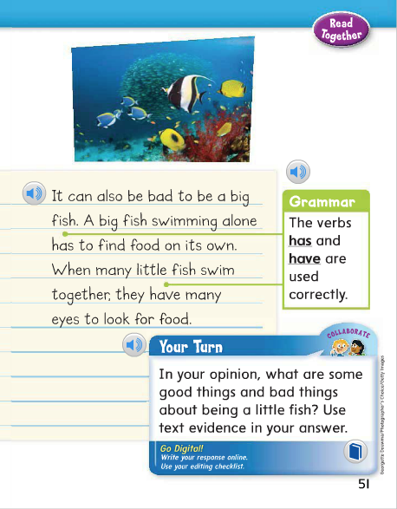
Has tells about one person or thing.
Have tells about more than one person or thing.
Why did Andrew use has in the first sentence?
Why did Andrew use have in the second sentence?

Slide 306
Week 1 – Day 4

Slide 307
Phonemic Awareness
Phoneme Identity
Listen carefully as I say three words: queen, peel, seat.
What is the same?
I hear the /e/ sound in the middle of queen, peel, and seat.
All three words have the same vowel sound, /e/.
Guided Practice:
Have children practice identifying the same phoneme in a group of words.
bee, he, she raid, plain, case shape, sheet, show
creek, shake, fork geese, girl, get leave, deep, breeze

Slide 308
Build Words with Long e: e, ee, ea, ie
b
ee
What is the new word we made?
Let’s blend all the sounds and read the word.
Change the b to m.

Slide 309
Build Words with Long e: e, ee, ea, ie
m
e
What is the new word we made?
Let’s blend all the sounds and read the word.
Change the m to s.

Slide 310
Build Words with Long e: e, ee, ea, ie
s
ee
What is the new word we made?
Let’s blend all the sounds and read the word.
Change the ee to ea.

Slide 311
Build Words with Long e: e, ee, ea, ie
s
ea
What is the new word we made?
Let’s blend all the sounds and read the word.
Change the s to n and add a t at the end of the word.

Slide 312
Build Words with Long e: e, ee, ea, ie
n
ea
t
What is the new word we made?
Let’s blend all the sounds and read the word.
Change the n to h.

Slide 313
Build Words with Long e: e, ee, ea, ie
h
ea
t
What is the new word we made?
Let’s blend all the sounds and read the word.
Change the t to l.

Slide 314
Build Words with Long e: e, ee, ea, ie
h
ea
l
What is the new word we made?
Let’s blend all the sounds and read the word.
Change the ea to ee.

Slide 315
Build Words with Long e: e, ee, ea, ie
h
ee
l
What is the new word we made?
Let’s blend all the sounds and read the word.
Change the h to f.

Slide 316
Build Words with Long e: e, ee, ea, ie
f
ee
l
What is the new word we made?
Let’s blend all the sounds and read the word.
Add a d to the end of the word.

Slide 317
Build Words with Long e: e, ee, ea, ie
f
ie
l
d
What is the new word we made?
Let’s blend all the sounds and read the word.
Change the f to sh.

Slide 318
Build Words with Long e: e, ee, ea, ie
sh
ie
l
d
What is the new word we made?
Let’s blend all the sounds and read the word.

Slide 319
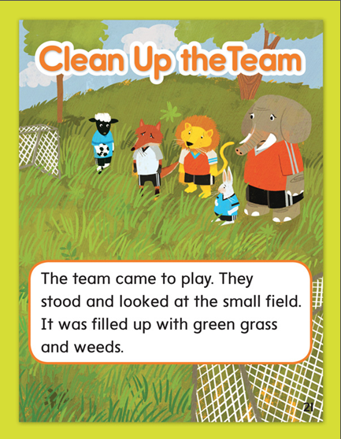

Slide 320
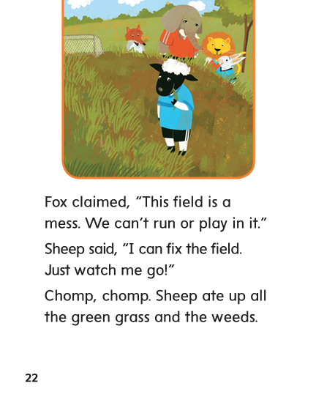

Slide 321
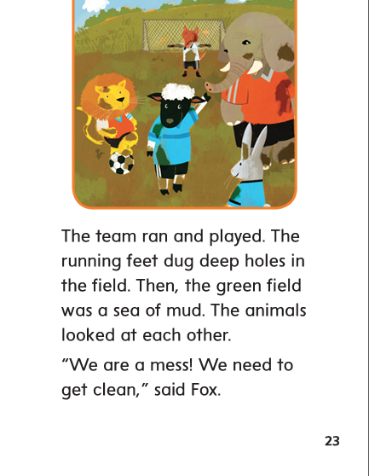

Slide 322
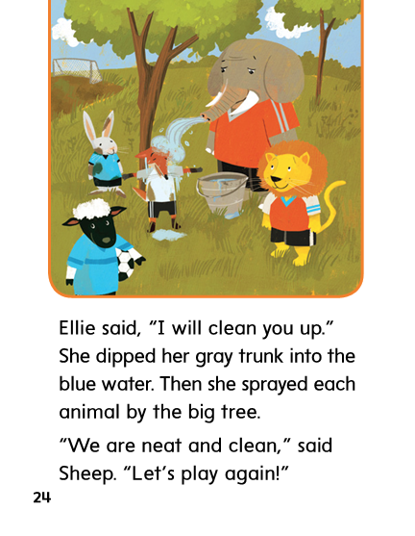

Slide 323
Structural Analysis
Prefixes re-, un-, pre-
A prefix is a word part that is added to the beginning of a word.
A prefix changes the meaning of the word.
freeze
unfreeze
un- means
“not” or
“the opposite of.”
Unfreeze means “not freeze, or thaw.”
Mom will unfreeze the meat for tonight’s dinner.

Slide 324
Structural Analysis
Prefixes re-, un-, pre-
A prefix is a word part that is added to the beginning of a word.
A prefix changes the meaning of the word.
pay
repay
re- means
“again”
Repay means “to pay again.”
My dad has to repay the library fine because they have no record
that he has already paid it.

Slide 325
Structural Analysis
Prefixes re-, un-, pre-
A prefix is a word part that is added to the beginning of a word.
A prefix changes the meaning of the word.
school
preschool
pre- means
“before”
Preschool means “the school you attend before kindergarten.”
My little brother will attend preschool this year
and kindergarten next year.

Slide 326
Structural Analysis
Prefixes re-, un-, pre-
Have children work in pairs to construct words that have the prefixes re-, un-, and pre-; then have them write a sentence with each word.
seed heat
shield
peel

Slide 327
High Frequency
Words

Slide 328
Read, Spell, Write
because
I like the dress because it is blue.

Slide 329
Read, Spell, Write
blue
I like the dress because it is blue.

Slide 330
Read, Spell, Write
into
We jumped into the other lake.

Slide 331
Read, Spell, Write
or
I will take a large piece or a small piece.

Slide 332
Read, Spell, Write
other
We jumped into the other lake.

Slide 333
Read, Spell, Write
small
I will take a large piece or a small piece.

Slide 334
Grammar
Has and Have
We use the word have to tell about more than one person, place or thing that has or owns something. We also use have when we say I or you. We use has to tell about one person, place, or thing that owns something.
Have children use a sentence to tell what he or she has.

Slide 335
Grammar
Has and Have
We use the word have to tell about more than one person, place or thing that has or owns something. We also use have when we say I or you. We use has to tell about one person, place, or thing that owns something.
Have children use a sentence to tell what they have.

Slide 336
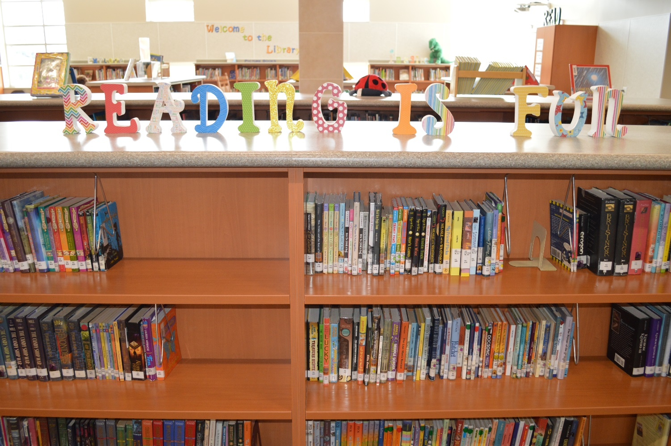
Grammar
Has and Have
Have children write a sentence for each picture,
telling something the place, person or people have or has.

Slide 337
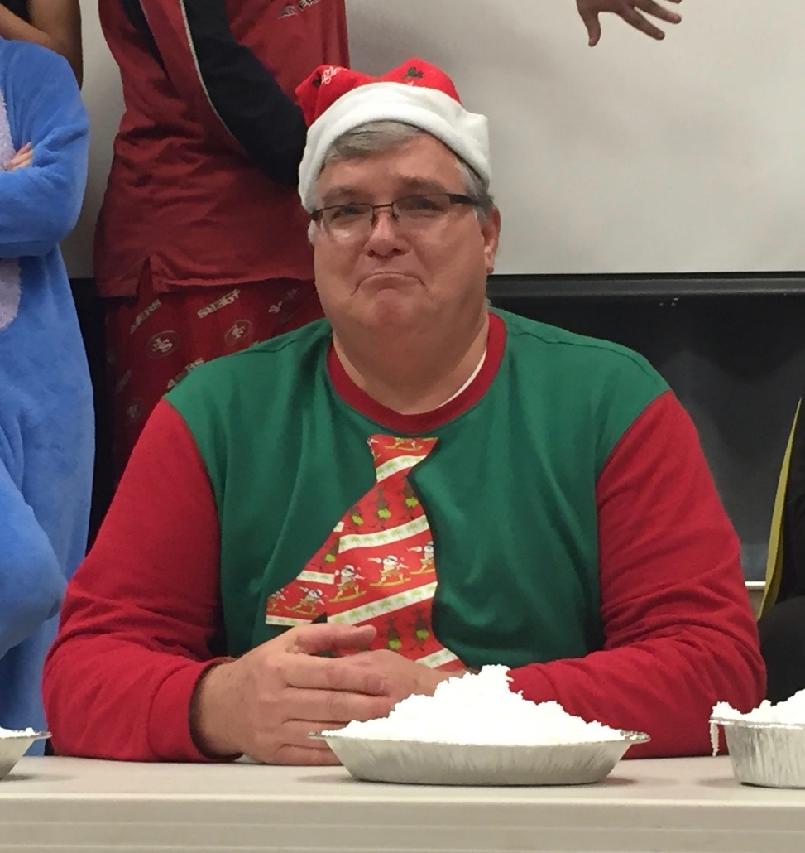
Grammar
Has and Have
Have children write a sentence for each picture,
telling something the place, person or people have or has.

Slide 338
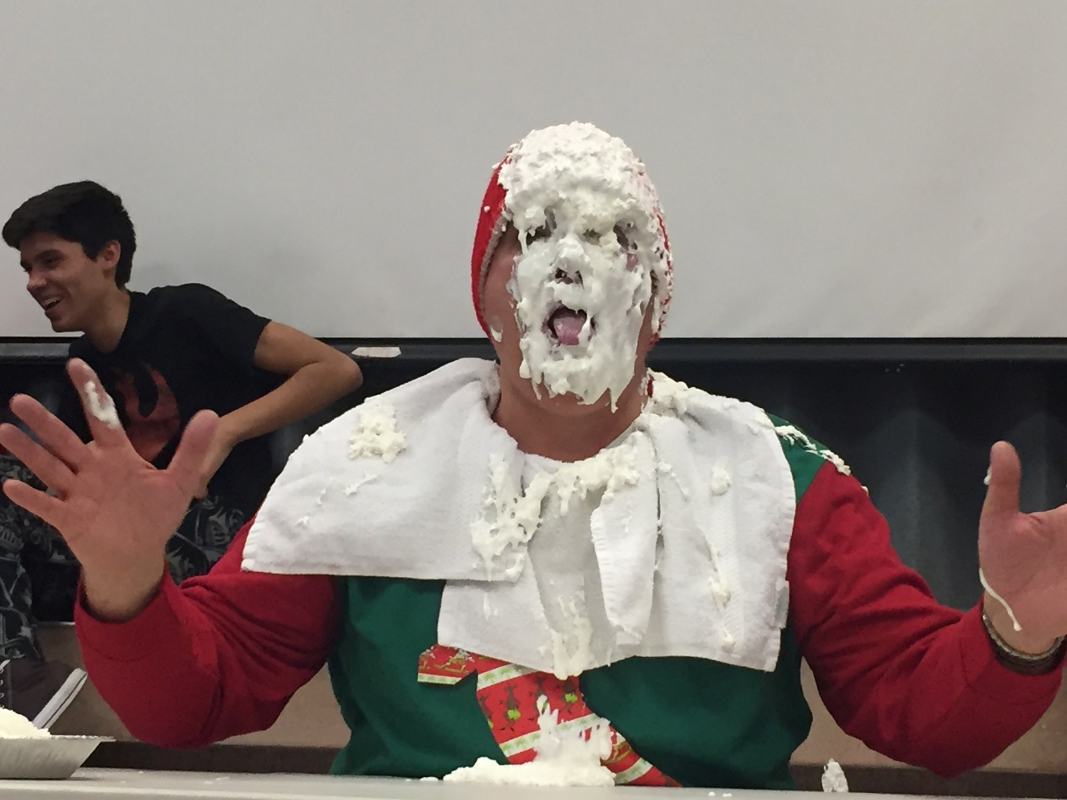
Grammar
Has and Have
Have children write a sentence for each picture,
telling something the place, person or people have or has.

Slide 339
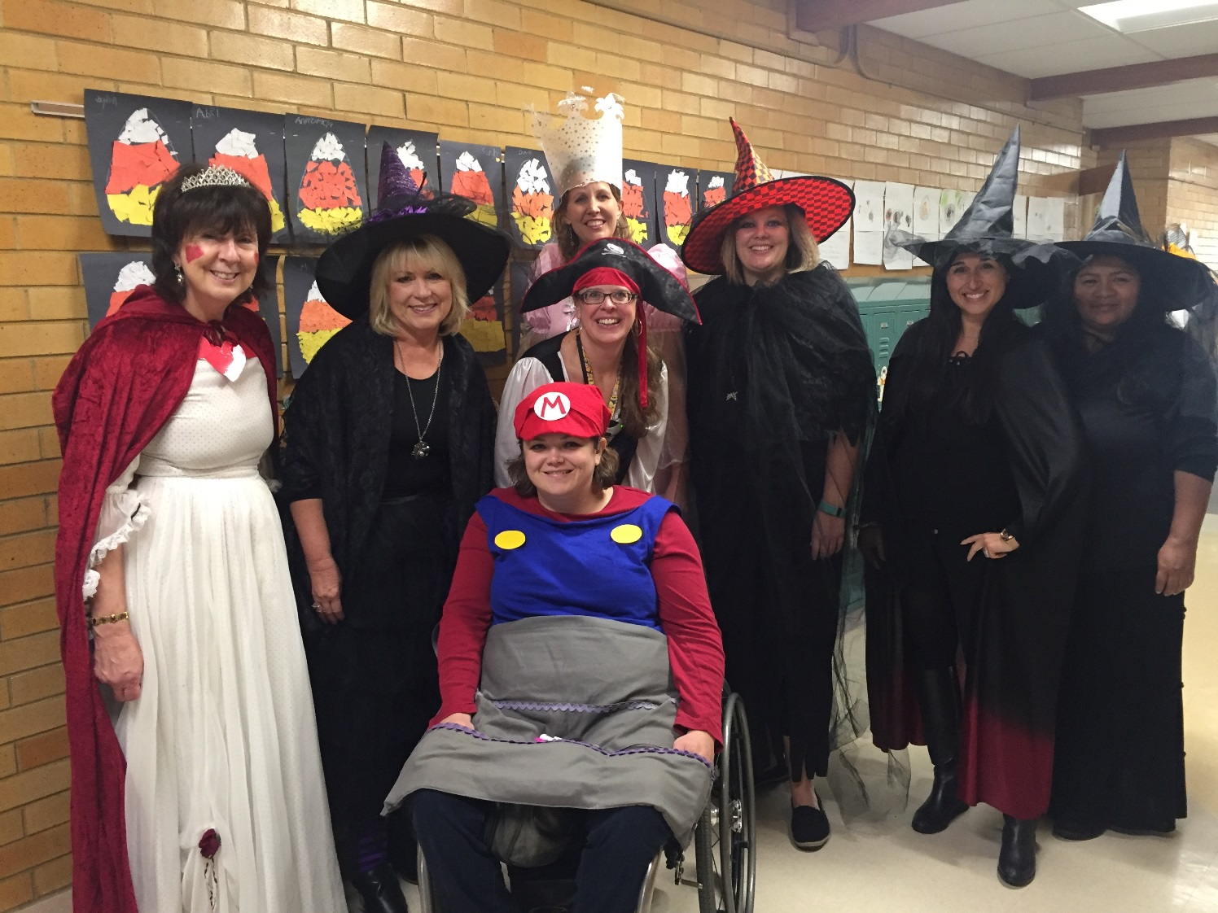
Grammar
Has and Have
Have children write a sentence for each picture,
telling something the place, person or people have or has.

Slide 340
Week 1 – Day 5

Slide 341
Phonemic Awareness
Phoneme Blending:
Listen as I say a group of sounds. Then blend those sounds to form a word.
/s/ /e/ /m/ /e/ /t/ /t/ /r/ /e/ /s/ /p/ /e/ /ch/
Phoneme Segmentation:
Now I am going to say a word. I want you to say each sound in the word.
she feed feast green steam

Slide 342
Blend and Build Words with Long a: a_e
Read and say these words:
she
week
seat
least
field
chief

Slide 343
Build Words with Long a: a, ai, ay
ea
t
What is the new word we made?
Let’s blend all the sounds and read the word.
Add a m to the front of the word.

Slide 344
Build Words with Long a: a, ai, ay
m
ea
t
What is the new word we made?
Let’s blend all the sounds and read the word.
Change the m to s.

Slide 345
Build Words with Long a: a, ai, ay
s
ea
t
What is the new word we made?
Let’s blend all the sounds and read the word.
Remove the t.

Slide 346
Build Words with Long a: a, ai, ay
s
ea
What is the new word we made?
Let’s blend all the sounds and read the word.
Change the s to tr.

Slide 347
Build Words with Long a: a, ai, ay
tr
ee
What is the new word we made?
Let’s blend all the sounds and read the word.
Change the tr to fr.

Slide 348
Build Words with Long a: a, ai, ay
fr
ee
What is the new word we made?
Let’s blend all the sounds and read the word.
Add a d to the end of the word..

Slide 349
Build Words with Long a: a, ai, ay
fr
ee
d
What is the new word we made?
Let’s blend all the sounds and read the word.
Change the fr to f.

Slide 350
Build Words with Long a: a, ai, ay
f
ee
d
What is the new word we made?
Let’s blend all the sounds and read the word.
Change the d to l.

Slide 351
Build Words with Long a: a, ai, ay
f
ee
l
What is the new word we made?
Let’s blend all the sounds and read the word.
Add a d to the end of the word.

Slide 352
Build Words with Long a: a, ai, ay
f
ie
l
d
What is the new word we made?
Let’s blend all the sounds and read the word.
Change the f to sh.

Slide 353
Build Words with Long a: a, ai, ay
sh
ie
l
d
What is the new word we made?
Let’s blend all the sounds and read the word.
Change the f to sh.

Slide 354
Word Automaticity
team

Slide 355
teach

Slide 356
reread

Slide 357
refreeze

Slide 358
paint

Slide 359
see

Slide 360
shield

Slide 361
preheat

Slide 362
preread

Slide 363
shopping

Slide 364
seed

Slide 365
tree

Slide 366
unzipped

Slide 367
repaid

Slide 368
notebook

Slide 369
eat

Slide 370
cheese

Slide 371
prepay

Slide 372
unhook

Slide 373
bathrobe

Slide 374
seat

Slide 375
sea

Slide 376
sleep

Slide 377
wheel

Slide 378
unreal

Slide 379
preteach

Slide 380
huge

Slide 381
Structural Analysis
Prefixes re-, un-, pre-
Have children tell the meaning of the prefixes re-, un-, and pre- and how adding them to a word changes the word’s meaning.
re-
un-
pre -

Slide 382
High Frequency
Words

Slide 383
Read, Spell, Write
because
I like the dress because it is blue.

Slide 384
Read, Spell, Write
blue
I like the dress because it is blue.

Slide 385
Read, Spell, Write
into
We jumped into the other lake.

Slide 386
Read, Spell, Write
or
I will take a large piece or a small piece.

Slide 387
Read, Spell, Write
other
We jumped into the other lake.

Slide 388
Read, Spell, Write
small
I will take a large piece or a small piece.

Slide 389
Grammar
Has and Have
Have children tell when to use the verbs has and have.
Have children tell which verb correctly completes each sentence.
Dee and Steve _________ a hen.
The bird _________ an egg in its nest.

