Slide 1
Week 1 – Day 1

Slide 2
Phonemic Awareness
Phoneme Categorization
Listen as I say three words: bone, cake, hope.
Which word doesn’t belong?
Bone and hope have the /o/ sound in the middle, but cake does not.
The word cake does not belong.
Guided Practice:
Listen to these words. Two words have one sound that is the same. One does not. Which word does not belong?
goat, team, road bowl, roast, feed top, home, got
Stove, phone, cute coat, soap, rake comb, safe, rain

Slide 3
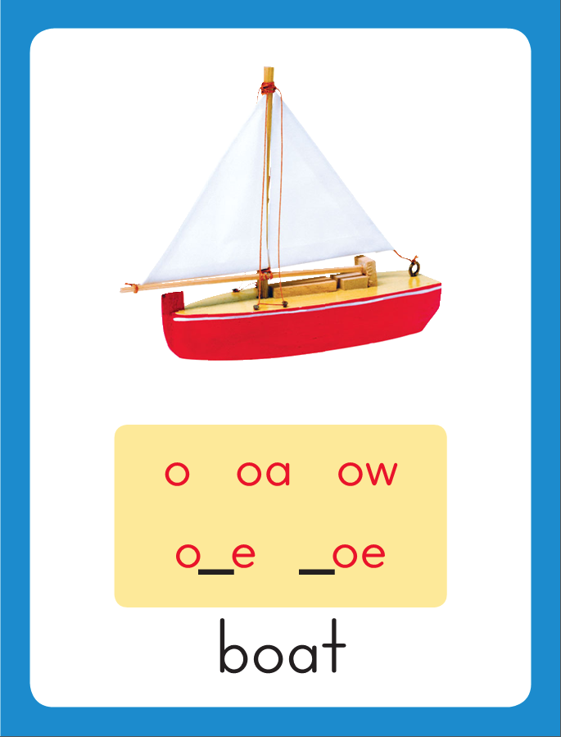
Introduce Long o: o, oa, ow, oe
go
This is the Boat
Sound-Spelling Card.
The sound is /o/.
This is the sound in the middle of the word boat.
Listen: /booot/, boat.
The /o/ sound can be spelled with the letters
o as in go,
oa as in soap,
ow as in snow,
and oe as in toe.
Say the sound with me: /ooo/.
I’ll say /o/ as I write the letters
o, oa, ow and oe several times.
soap
snow
toe

Slide 4
Have children practice connecting the letters o, oa, ow and oe to the sound /o/ by writing these spellings.
Now do it with me. Say /o/ as I write the letters o, oa, ow or oe.
This time, write the letters o, oa, ow and oe five times each as you say the /o/ sound.
o o o o o
oa oa oa oa
ow ow ow ow
oe oe oe oe

Slide 5
Blending Words with Long o: o, oa, ow, oe
g

Slide 6
Blending Words with Long o: o, oa, ow, oe
g
oa

Slide 7
Blending Words with Long o: o, oa, ow, oe
g
oa

Slide 8
Blending Words with Long o: o, oa, ow, oe
g
oa
t

Slide 9
Blending Words with Long o: o, oa, ow, oe
g
oa
t

Slide 10
Blending Words with Long o: o, oa, ow, oe
l

Slide 11
Blending Words with Long o: o, oa, ow, oe
l
oa

Slide 12
Blending Words with Long o: o, oa, ow, oe
l
oa

Slide 13
Blending Words with Long o: o, oa, ow, oe
l
oa
d

Slide 14
Blending Words with Long o: o, oa, ow, oe
l
oa
d

Slide 15
Blending Words with Long o: o, oa, ow, oe
r

Slide 16
Blending Words with Long o: o, oa, ow, oe
r
ow

Slide 17
Blending Words with Long o: o, oa, ow, oe
r
ow

Slide 18
Blending Words with Long o: o, oa, ow, oe
t

Slide 19
Blending Words with Long o: o, oa, ow, oe
t
oe

Slide 20
Blending Words with Long o: o, oa, ow, oe
t
oe

Slide 21
Blending Words with Long o: o, oa, ow, oe
m

Slide 22
Blending Words with Long o: o, oa, ow, oe
m
o

Slide 23
Blending Words with Long o: o, oa, ow, oe
m
o

Slide 24
Blending Words with Long o: o, oa, ow, oe
m
o
st

Slide 25
Blending Words with Long o: o, oa, ow, oe
m
o
st

Slide 26
o gr th ow
ld oa fl ing
oe sn un re

Slide 27
n

Slide 28
no

Slide 29
no g

Slide 30
no go

Slide 31
no go s

Slide 32
no go so

Slide 33
no go so
gr

Slide 34
no go so
grow

Slide 35
no go so
grow b

Slide 36
no go so
grow bo

Slide 37
no go so
grow both

Slide 38
no go so
grow both c

Slide 39
no go so
grow both co

Slide 40
no go so
grow both cold

Slide 41
no go so
grow both cold
b

Slide 42
no go so
grow both cold
bo

Slide 43
no go so
grow both cold
bold

Slide 44
no go so
grow both cold
bold l

Slide 45
no go so
grow both cold
bold loa

Slide 46
no go so
grow both cold
bold load

Slide 47
no go so
grow both cold
bold load g

Slide 48
no go so
grow both cold
bold load goe

Slide 49
no go so
grow both cold
bold load goes

Slide 50
no go so
grow both cold
bold load goes
c

Slide 51
no go so
grow both cold
bold load goes
coa

Slide 52
no go so
grow both cold
bold load goes
coat

Slide 53
no go so
grow both cold
bold load goes
coat sn

Slide 54
no go so
grow both cold
bold load goes
coat snow

Slide 55
no go so
grow both cold
bold load goes
coat snow m

Slide 56
no go so
grow both cold
bold load goes
coat snow mo

Slide 57
no go so
grow both cold
bold load goes
coat snow most

Slide 58
Internal Sounding Out
toad

Slide 59
Internal Sounding Out
toad told

Slide 60
Internal Sounding Out
toad told bat

Slide 61
Internal Sounding Out
toad told bat
boat

Slide 62
Internal Sounding Out
toad told bat
boat flow

Slide 63
Internal Sounding Out
toad told bat
boat flow flown

Slide 64
Internal Sounding Out
toad told bat
boat flow flown
going

Slide 65
Internal Sounding Out
toad told bat
boat flow flown
going unload

Slide 66
Internal Sounding Out
toad told bat
boat flow flown
going unload regrow

Slide 67
Internal Sounding Out
toad told bat
boat flow flown
going unload regrow
don’t

Slide 68
Internal Sounding Out
toad told bat
boat flow flown
going unload regrow
don’t hippo

Slide 69
Internal Sounding Out
toad told bat
boat flow flown
going unload regrow
don’t hippo oatmeal

Slide 70
Can

Slide 71
Can I

Slide 72
Can I go

Slide 73
Can I go to

Slide 74
Can I go to the

Slide 75
Can I go to the show?

Slide 76
Can I go to the show?
Both

Slide 77
Can I go to the show?
Both Mo

Slide 78
Can I go to the show?
Both Mo and

Slide 79
Can I go to the show?
Both Mo and Joe

Slide 80
Can I go to the show?
Both Mo and Joe like

Slide 81
Can I go to the show?
Both Mo and Joe like to

Slide 82
Can I go to the show?
Both Mo and Joe like to row

Slide 83
Can I go to the show?
Both Mo and Joe like to row the

Slide 84
Can I go to the show?
Both Mo and Joe like to row the boat.

Slide 85
Can I go to the show?
Both Mo and Joe like to row the boat.
Joan

Slide 86
Can I go to the show?
Both Mo and Joe like to row the boat.
Joan made

Slide 87
Can I go to the show?
Both Mo and Joe like to row the boat.
Joan made a

Slide 88
Can I go to the show?
Both Mo and Joe like to row the boat.
Joan made a roast

Slide 89
Can I go to the show?
Both Mo and Joe like to row the boat.
Joan made a roast and

Slide 90
Can I go to the show?
Both Mo and Joe like to row the boat.
Joan made a roast and a

Slide 91
Can I go to the show?
Both Mo and Joe like to row the boat.
Joan made a roast and a fresh

Slide 92
Can I go to the show?
Both Mo and Joe like to row the boat.
Joan made a roast and a fresh loaf

Slide 93
Can I go to the show?
Both Mo and Joe like to row the boat.
Joan made a roast and a fresh loaf of

Slide 94
Can I go to the show?
Both Mo and Joe like to row the boat.
Joan made a roast and a fresh loaf of bread.

Slide 95
Spelling / Dictation
1. _________
2. _________
3. _________
4. _________
5. _________
low
boat
toe
no
oat

Slide 96
High Frequency
Words

Slide 97
Read, Spell, Write
find
Did you find some food?

Slide 98
Read, Spell, Write
food
There is still some food in on the table.

Slide 99
Read, Spell, Write
more
Do you need more time?

Slide 100
Read, Spell, Write
over
We can start the game over.

Slide 101
Read, Spell, Write
start
When can we start the test?

Slide 102
Read, Spell, Write
warm
That hat can keep you warm.

Slide 103
Have children read the sentences. Prompt them to identify the high-frequency words in connected text and to blend the decodable words.
Did you find some food?
Do you need more time?
We can start the game over.
This hat can keep you warm.

Slide 104
Grammar
Go and Do
Go and do are action verbs. They are present-tense verbs and tell about what is happening now. When using go and do to tell something that already happened, the words change forms.
The past tense of go is went.
The past tense of do is did.
Today I go to school.
Gran went home last week.
Now we do our spelling test.
Last Monday I did the dishes.
Point out why the form of go and do is used in each sentence.

Slide 105
Grammar
Go and Do
Read the sentences aloud.
Have children identify whether go, went, do, or did should
be used to complete the sentences.
Last week I ______ shopping with Joan.
She ______ the math problem.
Today Dad and I ______ the painting job.
They _______ to the library every day.

Slide 106
Week 1 – Day 2

Slide 107
Phonemic Awareness
Phoneme Blending
I am going to ay a word sound by sound.
Then I will blend the sounds to form the word.
The sounds are /b/ /o/ /t/.
Listen as I blend the sounds: /booot/. The word is boat.
Guided Practice:
Let’s do some more. I will say one sound at a time. Then we will blend the sounds to make a word.
/n/ /o/ /k/ /o/ /t/ /t/ /o/
/f/ /l/ /o/ /t/ /s/ /o/ /k/ /h/ /o/ /l/ /d/

Slide 108
Introduce Long o: o, oa, ow, oe
no
road
What are these letters?
What sound do they stand for?
snow
goes

Slide 109
Blending Words with Long o: o, oa, ow, oe
c

Slide 110
Blending Words with Long o: o, oa, ow, oe
c
o

Slide 111
Blending Words with Long o: o, oa, ow, oe
c
o

Slide 112
Blending Words with Long o: o, oa, ow, oe
c
o
ld

Slide 113
Blending Words with Long o: o, oa, ow, oe
c
o
ld

Slide 114
Blending Words with Long o: o, oa, ow, oe
b

Slide 115
Blending Words with Long o: o, oa, ow, oe
b
o

Slide 116
Blending Words with Long o: o, oa, ow, oe
b
o

Slide 117
Blending Words with Long o: o, oa, ow, oe
b
o
th

Slide 118
Blending Words with Long o: o, oa, ow, oe
b
o
th

Slide 119
Blending Words with Long o: o, oa, ow, oe
g

Slide 120
Blending Words with Long o: o, oa, ow, oe
g
oa

Slide 121
Blending Words with Long o: o, oa, ow, oe
g
oa

Slide 122
Blending Words with Long o: o, oa, ow, oe
g
oa
t

Slide 123
Blending Words with Long o: o, oa, ow, oe
g
oa
t

Slide 124
Blending Words with Long o: o, oa, ow, oe
gr

Slide 125
Blending Words with Long o: o, oa, ow, oe
gr
ow

Slide 126
Blending Words with Long o: o, oa, ow, oe
gr
ow

Slide 127
Blending Words with Long o: o, oa, ow, oe
J

Slide 128
Blending Words with Long o: o, oa, ow, oe
J
oe

Slide 129
Blending Words with Long o: o, oa, ow, oe
J
oe

Slide 130
g

Slide 131
go

Slide 132
gold

Slide 133
gold c

Slide 134
gold coa

Slide 135
gold coast

Slide 136
gold coast m

Slide 137
gold coast mow

Slide 138
gold coast mow
t

Slide 139
gold coast mow
to

Slide 140
gold coast mow
told

Slide 141
gold coast mow
told sh

Slide 142
gold coast mow
told show

Slide 143
gold coast mow
told show s

Slide 144
gold coast mow
told show so

Slide 145
gold coast mow
told show so
thr

Slide 146
gold coast mow
told show so
throa

Slide 147
gold coast mow
told show so
throat

Slide 148
gold coast mow
told show so
throat pr

Slide 149
gold coast mow
told show so
throat pro

Slide 150
gold coast mow
told show so
throat pro r

Slide 151
gold coast mow
told show so
throat pro roa

Slide 152
gold coast mow
told show so
throat pro roast

Slide 153
gold coast mow
told show so
throat pro roast
sl

Slide 154
gold coast mow
told show so
throat pro roast
slow

Slide 155
gold coast mow
told show so
throat pro roast
slow t

Slide 156
gold coast mow
told show so
throat pro roast
slow toe

Slide 157
gold coast mow
told show so
throat pro roast
slow toes

Slide 158
Blend with Long o: o, oa, ow, oe
f
oa
m
What is the new word we made?
Let’s blend all the sounds and read the word.
Change the m to l.

Slide 159
Blend with Long o: o, oa, ow, oe
f
oa
l
What is the new word we made?
Let’s blend all the sounds and read the word.
Change the f to c.

Slide 160
Blend with Long o: o, oa, ow, oe
c
oa
l
What is the new word we made?
Let’s blend all the sounds and read the word.
Change the l to t.

Slide 161
Blend with Long o: o, oa, ow, oe
c
oa
t
What is the new word we made?
Let’s blend all the sounds and read the word.
Change the c to b.

Slide 162
Blend with Long o: o, oa, ow, oe
b
oa
t
What is the new word we made?
Let’s blend all the sounds and read the word.
Change the t to st.

Slide 163
Blend with Long o: o, oa, ow, oe
b
oa
st
What is the new word we made?
Let’s blend all the sounds and read the word.
Change the b to r.

Slide 164
Blend with Long o: o, oa, ow, oe
r
oa
st
What is the new word we made?
Let’s blend all the sounds and read the word.
Change the st to d.

Slide 165
Blend with Long o: o, oa, ow, oe
r
oa
d
What is the new word we made?
Let’s blend all the sounds and read the word.
Change the r to l.

Slide 166
Blend with Long o: o, oa, ow, oe
l
oa
d
What is the new word we made?
Let’s blend all the sounds and read the word.
Change the d to n.

Slide 167
Blend with Long o: o, oa, ow, oe
l
oa
n
What is the new word we made?
Let’s blend all the sounds and read the word.
Change the l to gr.

Slide 168
Blend with Long o: o, oa, ow, oe
gr
oa
n
What is the new word we made?
Let’s blend all the sounds and read the word.
Remove the n.

Slide 169
Blend with Long o: o, oa, ow, oe
gr
ow
What is the new word we made?
Let’s blend all the sounds and read the word.
Change the gr to sh.

Slide 170
Blend with Long o: o, oa, ow, oe
sh
ow
What is the new word we made?
Let’s blend all the sounds and read the word.
Change the sh to sl.

Slide 171
Blend with Long o: o, oa, ow, oe
sl
ow
What is the new word we made?
Let’s blend all the sounds and read the word.
Change the sl to gl.

Slide 172
Blend with Long o: o, oa, ow, oe
gl
ow
What is the new word we made?
Let’s blend all the sounds and read the word.
Change the gl to g.

Slide 173
Blend with Long o: o, oa, ow, oe
g
o
What is the new word we made?
Let’s blend all the sounds and read the word.
Change the g to t.

Slide 174
Blend with Long o: o, oa, ow, oe
t
oe
What is the new word we made?
Let’s blend all the sounds and read the word.

Slide 175
Structural Analysis
Open Syllables
Read aloud the word taken. Say the word, clapping for each syllable.
taken
ta/ken
When sounding out the second syllable ken, they will have to approximate, using the sound /e/ to get close to the /u/ sound.
When a syllable ends in a vowel, the vowel sound is usually long.
This is called an open syllable.
For example, the vowel sound in the syllable ta is /a/.

Slide 176
Structural Analysis
Open Syllables
Help children divide each word into syllables, then read the words.
Identify the open syllable and explain why they are open.
robot
silent
donate
frozen
okay
locate

Slide 177
Structural Analysis
Open Syllables
Help children divide each word into syllables, then read the words.
Identify the open syllable and explain why they are open.
ro/bot
si/lent
do/nate
fro/zen
o/kay
lo/cate

Slide 178
Spelling
snow
coat
go
doe

Slide 179
low
boat
no
oat
row
toe
over
over
low
boat
no
oat
row
toe

Slide 180
High Frequency
Words

Slide 181
Read, Spell, Write
find
Did you find some food?

Slide 182
Read, Spell, Write
food
There is still some food in on the table.

Slide 183
Read, Spell, Write
more
Do you need more time?

Slide 184
Read, Spell, Write
over
We can start the game over.

Slide 185
Read, Spell, Write
start
When can we start the test?

Slide 186
Read, Spell, Write
warm
That hat can keep you warm.

Slide 187
Grammar
Go and Do
Go and do tell about actions that take place now.
Went and did tell what happened before.
Read the sentences. Guide children to circle the verbs.
They go to school on the bus.
I went home when it snowed.
You do your report.
I did the reading test.

Slide 188
Week 1 – Day 3

Slide 189
Phonemic Awareness
Contrast Sounds
Listen as I say two words: most, must.
I can hear that these words have one sound that is different.
Most has the /o/ sound and must has the /u/ sound.
I will say the word most again because I can hear the /o/ sound in most.
Guided Practice: Say the word that has the /o/ sound. Let’s do the first one together.
bold, build coat, cute mean, moan hop, hope
blue, blow crow, crew bait, boat sock, soak

Slide 190
Blend with Long o: o, oa, ow, oe
b

Slide 191
Blend with Long o: o, oa, ow, oe
b
l

Slide 192
Blend with Long o: o, oa, ow, oe
b
l
ow

Slide 193
Blend with Long o: o, oa, ow, oe
b
l
ow

Slide 194
Blend with Long o: o, oa, ow, oe
c

Slide 195
Blend with Long o: o, oa, ow, oe
c
o

Slide 196
Blend with Long o: o, oa, ow, oe
c
o

Slide 197
Blend with Long o: o, oa, ow, oe
c
o
l

Slide 198
Blend with Long o: o, oa, ow, oe
c
o
l
d

Slide 199
Blend with Long o: o, oa, ow, oe
c
o
l
d

Slide 200
Blend with Long o: o, oa, ow, oe
t

Slide 201
Blend with Long o: o, oa, ow, oe
t
oa

Slide 202
Blend with Long o: o, oa, ow, oe
t
oa

Slide 203
Blend with Long o: o, oa, ow, oe
t
oa
s

Slide 204
Blend with Long o: o, oa, ow, oe
t
oa
s
t

Slide 205
Blend with Long o: o, oa, ow, oe
t
oa
s
t

Slide 206
Blend with Long o: o, oa, ow, oe
f

Slide 207
Blend with Long o: o, oa, ow, oe
f
l

Slide 208
Blend with Long o: o, oa, ow, oe
f
l
ow

Slide 209
Blend with Long o: o, oa, ow, oe
f
l
ow

Slide 210
Blend with Long o: o, oa, ow, oe
g

Slide 211
Blend with Long o: o, oa, ow, oe
g
oe

Slide 212
Blend with Long o: o, oa, ow, oe
g
oe

Slide 213
Blend with Long o: o, oa, ow, oe
g
oe
s

Slide 214
Blend with Long o: o, oa, ow, oe
g
oe
s

Slide 215
ow gr ing o
st oe ch ld
oa be ay hip
zen lo tel bot

Slide 216
gr

Slide 217
grow

Slide 218
grow n

Slide 219
grow no

Slide 220
grow no s

Slide 221
grow no so

Slide 222
grow no so
g

Slide 223
grow no so
go

Slide 224
grow no so
going

Slide 225
grow no so
going m

Slide 226
grow no so
going mo

Slide 227
grow no so
going most

Slide 228
grow no so
going most s

Slide 229
grow no so
going most so

Slide 230
grow no so
going most sold

Slide 231
grow no so
going most sold
bl

Slide 232
grow no so
going most sold
blow

Slide 233
grow no so
going most sold
blow sn

Slide 234
grow no so
going most sold
blow snow

Slide 235
grow no so
going most sold
blow snow t

Slide 236
grow no so
going most sold
blow snow toe

Slide 237
grow no so
going most sold
blow snow toes

Slide 238
grow no so
going most sold
blow snow toes
s

Slide 239
grow no so
going most sold
blow snow toes
soa

Slide 240
grow no so
going most sold
blow snow toes
soap

Slide 241
grow no so
going most sold
blow snow toes
soap c

Slide 242
grow no so
going most sold
blow snow toes
soap coa

Slide 243
grow no so
going most sold
blow snow toes
soap coach

Slide 244
grow no so
going most sold
blow snow toes
soap coach t

Slide 245
grow no so
going most sold
blow snow toes
soap coach to

Slide 246
grow no so
going most sold
blow snow toes
soap coach told

Slide 247
Internal Sounding Out
man

Slide 248
Internal Sounding Out
man moan

Slide 249
Internal Sounding Out
man moan cot

Slide 250
Internal Sounding Out
man moan cot
coat

Slide 251
Internal Sounding Out
man moan cot
coat held

Slide 252
Internal Sounding Out
man moan cot
coat held hold

Slide 253
Internal Sounding Out
man moan cot
coat held hold
hippo

Slide 254
Internal Sounding Out
man moan cot
coat held hold
hippo below

Slide 255
Internal Sounding Out
man moan cot
coat held hold
hippo below photo

Slide 256
Internal Sounding Out
man moan cot
coat held hold
hippo below photo
frozen

Slide 257
Internal Sounding Out
man moan cot
coat held hold
hippo below photo
frozen hello

Slide 258
Internal Sounding Out
man moan cot
coat held hold
hippo below photo
frozen hello locate

Slide 259
Internal Sounding Out
man

Slide 260
Internal Sounding Out
man moan

Slide 261
Internal Sounding Out
man moan cot

Slide 262
Internal Sounding Out
man moan cot
hotel

Slide 263
Internal Sounding Out
man moan cot
hotel motel

Slide 264
Internal Sounding Out
man moan cot
hotel motel secret

Slide 269
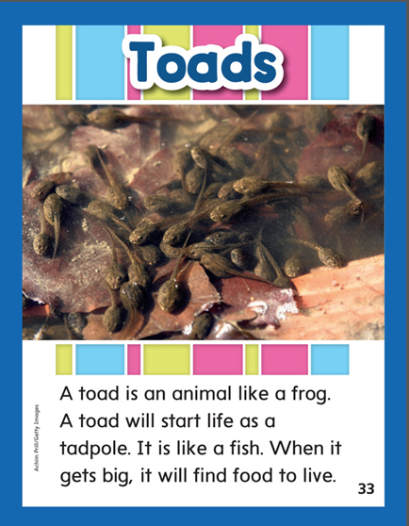

Slide 270
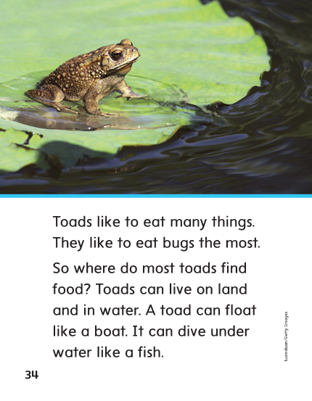

Slide 271
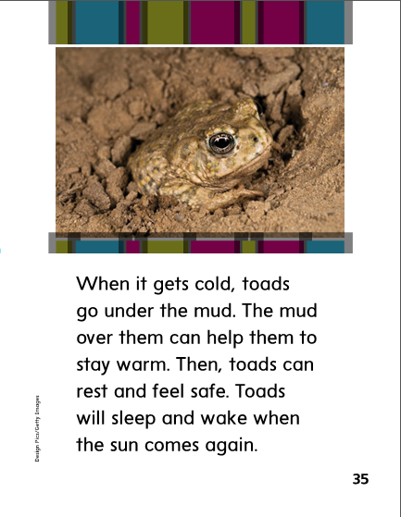

Slide 272
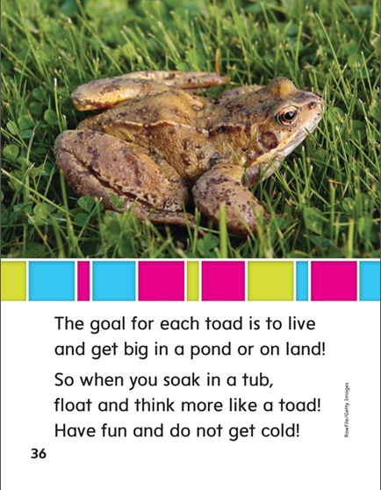

Slide 273
Structural Analysis
Open Syllables
Read aloud the word photo.
Say the word, clapping for each syllable.
Draw a line between the syllables: pho/to.
When a syllable ends in a vowel, the vowel sound is usually long.
This is called an open syllable.
The vowel sound in pho is /o/, the long o sound.
The vowel sound in to is also /o/.
photo
pho/to

Slide 274
Structural Analysis
Open Syllables
Help children divide each word into syllables, then read the words.
Identify the open syllable and explain why they are open.
frozen
begin
silent
basic
Help children divide the words into syllables.
Read the words.
Identify the vowel sound in each syllable.
Which syllables are open syllables?

Slide 275
o
oa
ow
oe

Slide 276
low
over
low
boat
Joe
boat
no
no
row
row
oat
over
oat
toe
Joe
toe

Slide 277
High Frequency
Words

Slide 278
Read, Spell, Write
find
Did you find some food?

Slide 279
Read, Spell, Write
food
There is still some food in on the table.

Slide 280
Read, Spell, Write
more
Do you need more time?

Slide 281
Read, Spell, Write
over
We can start the game over.

Slide 282
Read, Spell, Write
start
When can we start the test?

Slide 283
Read, Spell, Write
warm
That hat can keep you warm.

Slide 284
Build Fluency: Word Automaticity
Did you find more food?
We can start over.
Is it warm today.

Slide 285
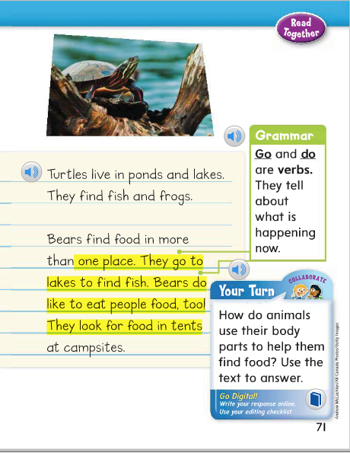
What is the verb in this sentence:
Sea gulls go after fish and insects, too.
Find sentences in David’s report that contain go and do.
Circle the verbs and then write new sentences using, go, do, did, and went.

Slide 286
Week 1 – Day 4

Slide 287
Phonemic Awareness
Phoneme Categorization
Listen to theses words: goals, name, soap.
Which word does not belong?
Name does not belong because name does not have the /o/ vowel sound like goal and soap.
Guided Practice:
Now you try it. Listen for the word that has a different vowel sound. Which word does not belong?
no, cold, peach home, find, grow clock, goal, stop
Rake, goat, made bowl, toe, cube both, booth, tube

Slide 288
Build Words with Long o: o, oa, ow, oe
t
oa
d
What is the new word we made?
Let’s blend all the sounds and read the word.
Change the t to r.

Slide 289
Build Words with Long o: o, oa, ow, oe
r
oa
d
What is the new word we made?
Let’s blend all the sounds and read the word.
Change the d to st.

Slide 290
Build Words with Long o: o, oa, ow, oe
r
oa
st
What is the new word we made?
Let’s blend all the sounds and read the word.
Change the r to t.

Slide 291
Build Words with Long o: o, oa, ow, oe
t
oa
st
What is the new word we made?
Let’s blend all the sounds and read the word.
Change the t to b.

Slide 292
Build Words with Long o: o, oa, ow, oe
b
oa
st
What is the new word we made?
Let’s blend all the sounds and read the word.
Change the st to t.

Slide 293
Build Words with Long o: o, oa, ow, oe
b
oa
t
What is the new word we made?
Let’s blend all the sounds and read the word.
Change the oa to a.

Slide 294
Build Words with Long o: o, oa, ow, oe
b
a
t
What is the new word we made?
Let’s blend all the sounds and read the word.
Change the b to c.

Slide 295
Build Words with Long o: o, oa, ow, oe
c
a
t
What is the new word we made?
Let’s blend all the sounds and read the word.
Change the a to o.

Slide 296
Build Words with Long o: o, oa, ow, oe
c
o
t
What is the new word we made?
Let’s blend all the sounds and read the word.
Change the o to oa.

Slide 297
Build Words with Long o: o, oa, ow, oe
c
oa
t
What is the new word we made?
Let’s blend all the sounds and read the word.
Change the t to l.

Slide 298
Build Words with Long o: o, oa, ow, oe
c
oa
l
What is the new word we made?
Let’s blend all the sounds and read the word.
Change the c to g.

Slide 299
Build Words with Long o: o, oa, ow, oe
g
oa
l
What is the new word we made?
Let’s blend all the sounds and read the word.
Remove the l.

Slide 300
Build Words with Long o: o, oa, ow, oe
g
o
What is the new word we made?
Let’s blend all the sounds and read the word.
Change the g to b.

Slide 301
Build Words with Long o: o, oa, ow, oe
b
ow
What is the new word we made?
Let’s blend all the sounds and read the word.
Change the b to l.

Slide 302
Build Words with Long o: o, oa, ow, oe
l
ow
What is the new word we made?
Let’s blend all the sounds and read the word.
Change the l to fl.

Slide 303
Build Words with Long o: o, oa, ow, oe
fl
ow
What is the new word we made?
Let’s blend all the sounds and read the word.
Change the fl to sl.

Slide 304
Build Words with Long o: o, oa, ow, oe
sl
ow
What is the new word we made?
Let’s blend all the sounds and read the word.
Change the sl to gl.

Slide 305
Build Words with Long o: o, oa, ow, oe
gl
ow
What is the new word we made?
Let’s blend all the sounds and read the word.
Change the gl to gr.

Slide 306
Build Words with Long o: o, oa, ow, oe
gr
ow
What is the new word we made?
Let’s blend all the sounds and read the word.
Add a n to the end of the word.

Slide 307
Build Words with Long o: o, oa, ow, oe
gr
ow
n
What is the new word we made?
Let’s blend all the sounds and read the word.

Slide 308
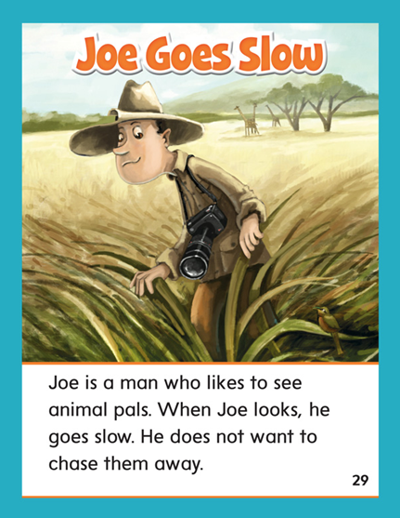

Slide 309
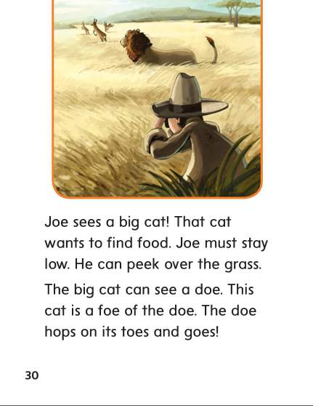

Slide 310
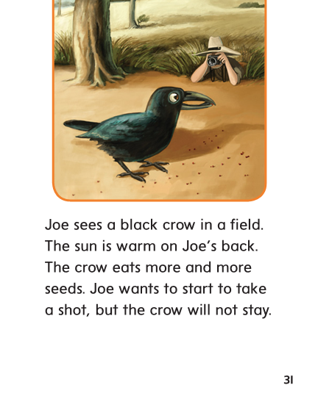

Slide 311
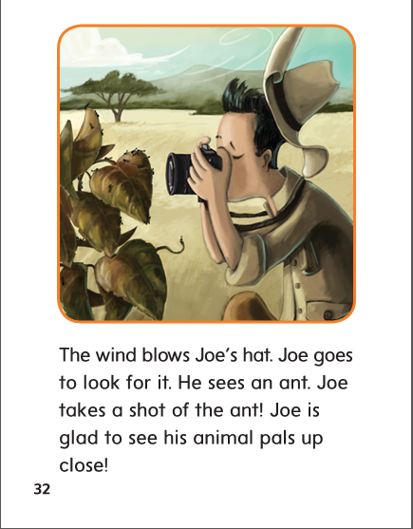

Slide 312
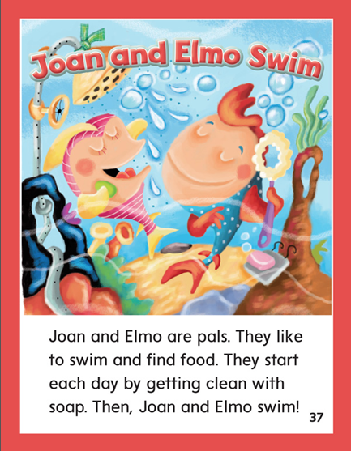

Slide 313
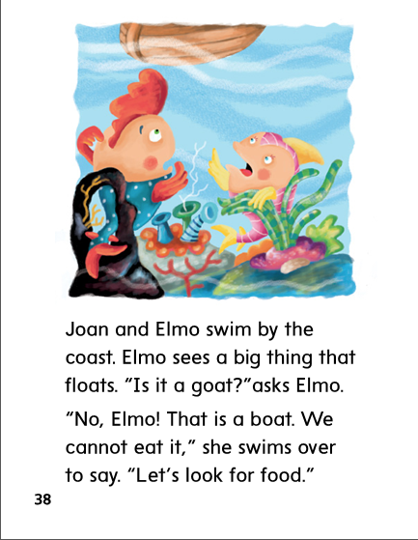

Slide 314
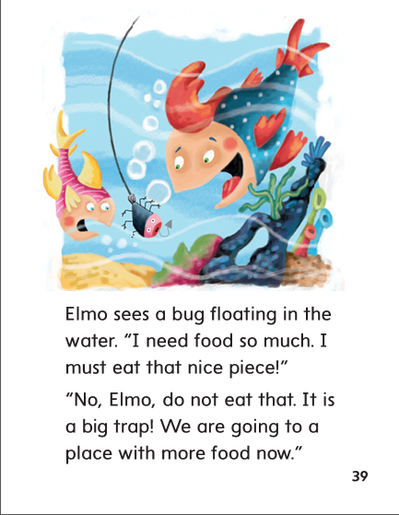

Slide 315
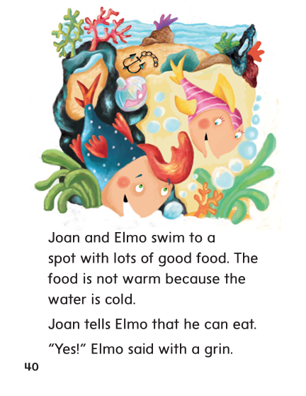

Slide 316
Structural Analysis
Open Syllables
Review how to read the words using what children know
about open and closed syllables.
When the syllable ends with a vowel, the vowel sound is usually long.
When the syllable ends with a consonant, the vowel sound is usually short.
mo/ment
be/gin

Slide 317
Structural Analysis
Open Syllables
Help children divide each word into syllables and pronounce them
robot
secret
frozen
open

Slide 318
Structural Analysis
Open Syllables
Help children divide each word into syllables and pronounce them
ro/bot
se/cret
fro/zen
o/pen

Slide 319
High Frequency
Words

Slide 320
Read, Spell, Write
find
Did you find some food?

Slide 321
Read, Spell, Write
food
There is still some food in on the table.

Slide 322
Read, Spell, Write
more
Do you need more time?

Slide 323
Read, Spell, Write
over
We can start the game over.

Slide 324
Read, Spell, Write
start
When can we start the test?

Slide 325
Read, Spell, Write
warm
That hat can keep you warm.

Slide 326
Grammar
Go and Do
The past-tense form of go is went.
The past-tense form of do is did.
Have children complete the sentences with do, did, go, or went.
Last week we ______ bowling.
Trace, Ling, and Fay _____ to school together.
We _____ many paintings.
Our group _____the poster yesterday.

Slide 327
Week 1 – Day 5

Slide 328
Phonemic Awareness
Phoneme Blending:
Listen as I say a group of sounds. Then blend those sounds to form a word.
/f/ /o/ /n/ /s/ /o/ /l/ /d/ /j/ /o/ /k/
/g/ /r/ /o/ /k/ /o/ /t/
Phoneme Substitution:
Have children practice substituting the /o/ sound in words to form new words.
Listen to the sound in the word cloak: /k/ /l/ /o/ /k/
Now listen as I change the /o/ sound to /o/: /k/ /l/ /o/ /k/
The word is clock.
Have the children practice with:
own/on soak/sock bolt/belt foam/fame

Slide 329
Blend and Build Words with Long o: o, oa, ow, oe
Read and say these words:
most
coat
show
toe

Slide 330
Blend and Build Words with Long o: o, oa, ow, oe
l
ow
What is the new word we made?
Let’s blend all the sounds and read the word.
Change the l to sl.

Slide 331
Blend and Build Words with Long o: o, oa, ow, oe
sl
ow
What is the new word we made?
Let’s blend all the sounds and read the word.
Change the sl to gl.

Slide 332
Blend and Build Words with Long o: o, oa, ow, oe
gl
ow
What is the new word we made?
Let’s blend all the sounds and read the word.
Change the gl to gr.

Slide 333
Blend and Build Words with Long o: o, oa, ow, oe
gr
ow
What is the new word we made?
Let’s blend all the sounds and read the word.
Change the gr to cr.

Slide 334
Blend and Build Words with Long o: o, oa, ow, oe
cr
ow
What is the new word we made?
Let’s blend all the sounds and read the word.
Change the cr to r.

Slide 335
Blend and Build Words with Long o: o, oa, ow, oe
r
ow
What is the new word we made?
Let’s blend all the sounds and read the word.
Change the r to n.

Slide 336
Blend and Build Words with Long o: o, oa, ow, oe
n
o
What is the new word we made?
Let’s blend all the sounds and read the word.
Change the n to s.

Slide 337
Blend and Build Words with Long o: o, oa, ow, oe
n
o
What is the new word we made?
Let’s blend all the sounds and read the word.
Change the n to g.

Slide 338
Blend and Build Words with Long o: o, oa, ow, oe
g
o
What is the new word we made?
Let’s blend all the sounds and read the word.
Add a s to the end of the word.

Slide 339
Blend and Build Words with Long o: o, oa, ow, oe
g
oe
s
What is the new word we made?
Let’s blend all the sounds and read the word.
Change the g to t.

Slide 340
Blend and Build Words with Long o: o, oa, ow, oe
t
oe
s
What is the new word we made?
Let’s blend all the sounds and read the word.
Change the t to r.

Slide 341
Blend and Build Words with Long o: o, oa, ow, oe
r
ow
s
What is the new word we made?
Let’s blend all the sounds and read the word.
Change the s to d.

Slide 342
Blend and Build Words with Long o: o, oa, ow, oe
r
oa
d
What is the new word we made?
Let’s blend all the sounds and read the word.
Change the d to m.

Slide 343
Blend and Build Words with Long o: o, oa, ow, oe
r
oa
st
What is the new word we made?
Let’s blend all the sounds and read the word.

Slide 344
Word Automaticity
grow

Slide 345
no

Slide 346
so

Slide 347
going

Slide 348
most

Slide 349
sold

Slide 350
blow

Slide 351
snow

Slide 352
toes

Slide 353
soap

Slide 354
coach

Slide 355
told

Slide 356
man

Slide 357
moan

Slide 358
cot

Slide 359
coat

Slide 360
held

Slide 361
hold

Slide 362
hippos

Slide 363
below

Slide 364
photo

Slide 365
frozen

Slide 366
hello

Slide 367
locate

Slide 368
okay

Slide 369
rainbow

Slide 370
robot

Slide 371
hotel

Slide 372
motel

Slide 373
secret

Slide 374
Structural Analysis
Open Syllables
Have children practice writing and reading words with open syllables.
1.________
2.________
3.________
4. ________
below
locate
going
okay

Slide 375
High Frequency
Words

Slide 376
Read, Spell, Write
find
Did you find some food?

Slide 377
Read, Spell, Write
food
There is still some food in on the table.

Slide 378
Read, Spell, Write
more
Do you need more time?

Slide 379
Read, Spell, Write
over
We can start the game over.

Slide 380
Read, Spell, Write
start
When can we start the test?

Slide 381
Read, Spell, Write
warm
That hat can keep you warm.

Slide 382
Grammar
Go and Do
Ask children when to use go and when to use went.
Have them explain when to use do and when to use did.
Have students identify the verbs.
They go to the bus stop.
We went to see a beehive last weekend.
You do your project now.
I did my report last night.
Why are the verbs go and do used in the first and third sentences?
Why are the verbs went and did used in the second and fourth sentences?

