Slide 1
Week 1 – Day 1

Slide 2
Phonemic Awareness
Phoneme Categorization
Listen as I say three words: side, night, rope.
Side and night have the long i sound /i/ in the middle.
Rope does not have the /i/ sound.
Which word doesn’t belong?
Rope does not belong.
Guided Practice:
Listen to sounds in these words. Which word does not belong?
child, heap, might both, right, cried night, green, sleep
paint, cake, flies boat, pie, road bide, lip, slight

Slide 3
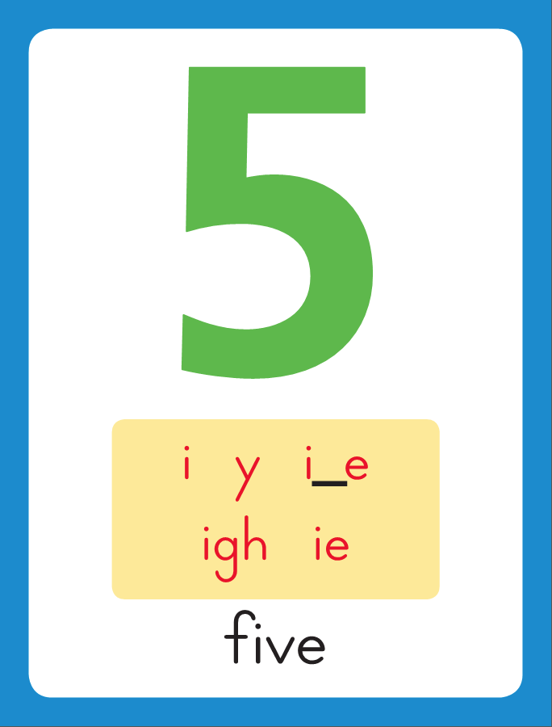
Introduce Long i: i, y, igh, ie
find
This is the Five
Sound-Spelling Card.
The sound is /i/.
This is the sound in the middle of the word five.
Listen: /fffiiivvv/, five.
The long i sound can be spelled with the letters
i as in find,
y as in my,
igh as in night,
and ie as in pie.
Say the sound with me: /iii/.
I’ll say /i/ as I write the letters
i, y, igh and ie several times.
my
night
pie

Slide 4
Have children practice connecting the letters i, y, igh and ie to the sound /i/ by writing these spellings.
Now do it with me. Say /i/ as I write the letters i, y, igh or ie.
This time, write the letters i, y, igh and ie five times each as you say the /i/ sound.
i i i i i
y y y y y
igh igh igh igh
ie ie ie ie ie

Slide 5
Blending Words with Long i: i, y, igh, ie
s

Slide 6
Blending Words with Long i: i, y, igh, ie
s
igh

Slide 7
Blending Words with Long i: i, y, igh, ie
s
igh

Slide 8
Blending Words with Long i: i, y, igh, ie
s
igh
t

Slide 9
Blending Words with Long i: i, y, igh, ie
s
igh
t

Slide 10
Blending Words with Long i: i, y, igh, ie
f

Slide 11
Blending Words with Long i: i, y, igh, ie
f
i

Slide 12
Blending Words with Long i: i, y, igh, ie
f
i

Slide 13
Blending Words with Long i: i, y, igh, ie
f
i
nd

Slide 14
Blending Words with Long i: i, y, igh, ie
f
i
nd

Slide 15
Blending Words with Long i: i, y, igh, ie
m

Slide 16
Blending Words with Long i: i, y, igh, ie
m
y

Slide 17
Blending Words with Long i: i, y, igh, ie
m
y

Slide 18
Blending Words with Long i: i, y, igh, ie
l

Slide 19
Blending Words with Long i: i, y, igh, ie
l
ie

Slide 20
Blending Words with Long i: i, y, igh, ie
l
ie

Slide 21
igh fl sk i
ch ea nd ow
ee st ay y
gr ai sn oe

Slide 22
r

Slide 23
righ

Slide 24
right

Slide 25
right h

Slide 26
right hi

Slide 27
right hi fl

Slide 28
right hi fly

Slide 29
right hi fly f

Slide 30
right hi fly fi

Slide 31
right hi fly find

Slide 32
right hi fly find
sk

Slide 33
right hi fly find
sky

Slide 34
right hi fly find
sky h

Slide 35
right hi fly find
sky high

Slide 36
right hi fly find
sky high b

Slide 37
right hi fly find
sky high by

Slide 38
right hi fly find
sky high by I

Slide 39
right hi fly find
sky high by I
t

Slide 40
right hi fly find
sky high by I
tie

Slide 41
right hi fly find
sky high by I
tie cr

Slide 42
right hi fly find
sky high by I
tie cry

Slide 43
right hi fly find
sky high by I
tie cry s

Slide 44
right hi fly find
sky high by I
tie cry sigh

Slide 45
right hi fly find
sky high by I
tie cry sigh n

Slide 46
right hi fly find
sky high by I
tie cry sigh nigh

Slide 47
right hi fly find
sky high by I
tie cry sigh night

Slide 48
Internal Sounding Out
lit

Slide 49
Internal Sounding Out
lit light

Slide 50
Internal Sounding Out
lit light kid

Slide 51
Internal Sounding Out
lit light kid kind

Slide 52
Internal Sounding Out
lit light kid kind
tie

Slide 53
Internal Sounding Out
lit light kid kind
tie toe

Slide 54
Internal Sounding Out
lit light kid kind
tie toe snow

Slide 55
Internal Sounding Out
lit light kid kind
tie toe snow toast

Slide 56
Internal Sounding Out
lit light kid kind
tie toe snow toast
teach

Slide 57
Internal Sounding Out
lit light kid kind
tie toe snow toast
teach green

Slide 58
Internal Sounding Out
lit light kid kind
tie toe snow toast
teach green paint

Slide 59
Why

Slide 60
Why did

Slide 61
Why did the

Slide 62
Why did the child

Slide 63
Why did the child cry?

Slide 64
Why did the child cry?
The

Slide 65
Why did the child cry?
The plane

Slide 66
Why did the child cry?
The plane can

Slide 67
Why did the child cry?
The plane can fly

Slide 68
Why did the child cry?
The plane can fly high

Slide 69
Why did the child cry?
The plane can fly high in

Slide 70
Why did the child cry?
The plane can fly high in the

Slide 71
Why did the child cry?
The plane can fly high in the sky.

Slide 72
The

Slide 73
The bright

Slide 74
The bright light

Slide 75
The bright light came

Slide 76
The bright light came on

Slide 77
The bright light came on at

Slide 78
The bright light came on at night.

Slide 79
Spelling / Dictation
1. _________
2. _________
3. _________
4. _________
5. _________
find
night
by
pie
right

Slide 80
High Frequency
Words

Slide 81
Read, Spell, Write
caught
He caught a big fish.

Slide 82
Read, Spell, Write
flew
The plane flew high in the sky.

Slide 83
Read, Spell, Write
know
Do you know my name?

Slide 84
Read, Spell, Write
laugh
The joke made me laugh.

Slide 85
Read, Spell, Write
listen
Listen to this song.

Slide 86
Read, Spell, Write
cold
We were cold at night.

Slide 87
Have children read the sentences. Prompt them to identify the high-frequency words in connected text and to blend the decodable words.
He caught a big fish.
The plane flew high in the sky.
Do you know my name?
The joke made me laugh.
Listen to this song.
We were cold at night.

Slide 88
Grammar
See and Saw
See and saw are two forms of the same verb.
To see means “to look at.”
We use the present-tense verb see to tell what you are looking at now.
We also use see to tell what several people are looking at.
When we talk about one other person who us looking at something, we add an s to see and use sees.
I see a big bug!
Joe sees a big bug!
Joe and Mack see a big bug!
Discuss why see or sees is used in each sentence.

Slide 89
Grammar
See and Saw
We use the word saw instead of see when we talk about looking at something in the past.
Tim saw a big bug last week.
I saw a big bug yesterday.
Discuss why saw is used in each sentence.

Slide 90
Grammar
See and Saw
Have children work with a partner to identify the correct verb form to complete each sentence.
I _____ a bug now.
Yesterday, we _____ a bug.
They _____ an anthill last week.
The dog _____ a grasshopper now.

Slide 91
Week 1 – Day 2

Slide 92
Phonemic Awareness
Phoneme Identity
Listen carefully as I say three words: fly, pie, kite.
All of these words have one sound that is the same.
The sound /i/ is the same in all three words.
I can hear /i/ in fly, pie, and kite.
Guided Practice:
Listen carefully as I say three words. Tell me the sound you hear that is the same in all three words.
bike, tie, fry sold, mow, toe find, shy, night
stop, lock, not seed, teen, be cry, why, right

Slide 93
Introduce Long i: i, y, igh, ie
wild
try
What are these letters?
What sound do they stand for?
right
tie

Slide 94
Blending Words with Long i: i, y, igh, ie
p

Slide 95
Blending Words with Long i: i, y, igh, ie
p
ie

Slide 96
Blending Words with Long i: i, y, igh, ie
p
ie

Slide 97
Blending Words with Long i: i, y, igh, ie
k

Slide 98
Blending Words with Long i: i, y, igh, ie
k
i

Slide 99
Blending Words with Long i: i, y, igh, ie
k
i

Slide 100
Blending Words with Long i: i, y, igh, ie
k
i
nd

Slide 101
Blending Words with Long i: i, y, igh, ie
k
i
nd

Slide 102
Blending Words with Long i: i, y, igh, ie
b

Slide 103
Blending Words with Long i: i, y, igh, ie
b
y

Slide 104
Blending Words with Long i: i, y, igh, ie
b
y

Slide 105
Blending Words with Long i: i, y, igh, ie
t

Slide 106
Blending Words with Long i: i, y, igh, ie
t
igh

Slide 107
Blending Words with Long i: i, y, igh, ie
t
igh

Slide 108
Blending Words with Long i: i, y, igh, ie
t
igh
t

Slide 109
Blending Words with Long i: i, y, igh, ie
t
igh
t

Slide 110
h

Slide 111
hi

Slide 112
hi f

Slide 113
hi fi

Slide 114
hi find

Slide 115
hi find m

Slide 116
hi find mi

Slide 117
hi find mind

Slide 118
hi find mind
h

Slide 119
hi find mind
high

Slide 120
hi find mind
high l

Slide 121
hi find mind
high ligh

Slide 122
hi find mind
high light

Slide 123
hi find mind
high light wh

Slide 124
hi find mind
high light why

Slide 125
hi find mind
high light why
m

Slide 126
hi find mind
high light why
migh

Slide 127
hi find mind
high light why
might

Slide 128
hi find mind
high light why
might br

Slide 129
hi find mind
high light why
might brigh

Slide 130
hi find mind
high light why
might bright

Slide 131
hi find mind
high light why
might bright t

Slide 132
hi find mind
high light why
might bright tie

Slide 133
hi find mind
high light why
might bright tie
cr

Slide 134
hi find mind
high light why
might bright tie
crie

Slide 135
hi find mind
high light why
might bright tie
cried

Slide 136
hi find mind
high light why
might bright tie
cried l

Slide 137
hi find mind
high light why
might bright tie
cried lie

Slide 138
hi find mind
high light why
might bright tie
cried lie dr

Slide 139
hi find mind
high light why
might bright tie
cried lie drie

Slide 140
hi find mind
high light why
might bright tie
cried lie dried

Slide 141
Build with Long i: i, y, igh, ie
b
i
nd
What is the new word we made?
Let’s blend all the sounds and read the word.
Change the b to f.

Slide 142
Build with Long i: i, y, igh, ie
f
i
nd
What is the new word we made?
Let’s blend all the sounds and read the word.
Change the f to w.

Slide 143
Build with Long i: i, y, igh, ie
w
i
nd
What is the new word we made?
Let’s blend all the sounds and read the word.
Change the w to k.

Slide 144
Build with Long i: i, y, igh, ie
k
i
nd
What is the new word we made?
Let’s blend all the sounds and read the word.
Change the k to gr.

Slide 145
Build with Long i: i, y, igh, ie
gr
i
nd
What is the new word we made?
Let’s blend all the sounds and read the word.
Change the gr to bl.

Slide 146
Build with Long i: i, y, igh, ie
bl
i
nd
What is the new word we made?
Let’s blend all the sounds and read the word.
Change the bl to m.

Slide 147
Build with Long i: i, y, igh, ie
m
i
nd
What is the new word we made?
Let’s blend all the sounds and read the word.
Change the nd to t.

Slide 148
Build with Long i: i, y, igh, ie
m
igh
t
What is the new word we made?
Let’s blend all the sounds and read the word.
Change the m to s.

Slide 149
Build with Long i: i, y, igh, ie
s
igh
t
What is the new word we made?
Let’s blend all the sounds and read the word.
Change the s to f.

Slide 150
Build with Long i: i, y, igh, ie
f
igh
t
What is the new word we made?
Let’s blend all the sounds and read the word.
Change the f to fr.

Slide 151
Build with Long i: i, y, igh, ie
fr
igh
t
What is the new word we made?
Let’s blend all the sounds and read the word.
Change the fr to fl.

Slide 152
Build with Long i: i, y, igh, ie
fl
igh
t
What is the new word we made?
Let’s blend all the sounds and read the word.
Change the fl to sl.

Slide 153
Build with Long i: i, y, igh, ie
sl
igh
t
What is the new word we made?
Let’s blend all the sounds and read the word.
Change the sl to s.

Slide 154
Build with Long i: i, y, igh, ie
s
igh
t
What is the new word we made?
Let’s blend all the sounds and read the word.
Remove the t.

Slide 155
Build with Long i: i, y, igh, ie
s
igh
What is the new word we made?
Let’s blend all the sounds and read the word.
Change the s to sh.

Slide 156
Build with Long i: i, y, igh, ie
sh
y
What is the new word we made?
Let’s blend all the sounds and read the word.
Change the sh to sk.

Slide 157
Build with Long i: i, y, igh, ie
sk
y
What is the new word we made?
Let’s blend all the sounds and read the word.
Change the sh to sk.

Slide 158
Structural Analysis
Inflectional Endings
When a word ends in y,
you change the y to i before adding the –es or –ed endings.
cry
cries
cried

Slide 159
Structural Analysis
Inflectional Endings
You do not change the y when you add –ing.
cry
crying

Slide 160
Structural Analysis
Inflectional Endings
Have children add –es, -ed, and –ing to each word and then use each word in a sentence.
fry
try
dry
spy

Slide 161
Spelling
mind
my
light
tie

Slide 162
find
night
by
right
kind
pie
find
night
by
right
kind
pie

Slide 163
High Frequency
Words

Slide 164
Read, Spell, Write
caught
He caught a big fish.

Slide 165
Read, Spell, Write
flew
The plane flew high in the sky.

Slide 166
Read, Spell, Write
know
Do you know my name?

Slide 167
Read, Spell, Write
laugh
The joke made me laugh.

Slide 168
Read, Spell, Write
listen
Listen to this song.

Slide 169
Read, Spell, Write
cold
We were cold at night.

Slide 170
Grammar
See and Saw
We use the words see and saw to tell about the present,
or what is happening now.
We use saw when talking about seeing something in the past.
I see fish now!
Jack sees the dogs.
I saw bees yesterday.
Guide children to identify the verb in each sentence.
If the sentence is past tense, have children say it correctly in present tense. If it is present tense, have then change it to past tense.

Slide 171
Week 1 – Day 3

Slide 172
Phonemic Awareness
Phoneme Segmentation
Listen as I say a word: light.
How many sounds are there in light and what are they?
There are three sounds in light: /i/ /i/ /t/.
Guided Practice:
I am going to say more words. Tell me how many sounds you hear and what they are.
sky light flight pie tried
fry right blind find sigh

Slide 173
Blending Words with Long i: i, y, igh, ie
tr

Slide 174
Blending Words with Long i: i, y, igh, ie
tr
y

Slide 175
Blending Words with Long i: i, y, igh, ie
tr
y

Slide 176
Blending Words with Long i: i, y, igh, ie
ch

Slide 177
Blending Words with Long i: i, y, igh, ie
ch
i

Slide 178
Blending Words with Long i: i, y, igh, ie
ch
i

Slide 179
Blending Words with Long i: i, y, igh, ie
ch
i
ld

Slide 180
Blending Words with Long i: i, y, igh, ie
ch
i
ld

Slide 181
Blending Words with Long i: i, y, igh, ie
n

Slide 182
Blending Words with Long i: i, y, igh, ie
n
igh

Slide 183
Blending Words with Long i: i, y, igh, ie
n
igh
t

Slide 184
Blending Words with Long i: i, y, igh, ie
n
igh
t

Slide 185
Blending Words with Long i: i, y, igh, ie
dr

Slide 186
Blending Words with Long i: i, y, igh, ie
dr
ie

Slide 187
Blending Words with Long i: i, y, igh, ie
dr
ie

Slide 188
Blending Words with Long i: i, y, igh, ie
dr
ie
d

Slide 189
Blending Words with Long i: i, y, igh, ie
dr
ie
d

Slide 190
fl

Slide 191
fly

Slide 192
fly r

Slide 193
fly righ

Slide 194
fly right

Slide 195
fly right l

Slide 196
fly right ligh

Slide 197
fly right light

Slide 198
fly right light
sk

Slide 199
fly right light
sky

Slide 200
fly right light
sky h

Slide 201
fly right light
sky hi

Slide 202
fly right light
sky hi t

Slide 203
fly right light
sky hi tie

Slide 204
fly right light
sky hi tied

Slide 205
fly right light
sky hi tied
f

Slide 206
fly right light
sky hi tied
fi

Slide 207
fly right light
sky hi tied
find

Slide 208
fly right light
sky hi tied
find b

Slide 209
fly right light
sky hi tied
find by

Slide 210
fly right light
sky hi tied
find by h

Slide 211
fly right light
sky hi tied
find by high

Slide 212
fly right light
sky hi tied
find by high
br

Slide 213
fly right light
sky hi tied
find by high
brigh

Slide 214
fly right light
sky hi tied
find by high
bright

Slide 215
fly right light
sky hi tied
find by high
bright p

Slide 216
fly right light
sky hi tied
find by high
bright pie

Slide 217
fly right light
sky hi tied
find by high
bright pie w

Slide 218
fly right light
sky hi tied
find by high
bright pie wi

Slide 219
fly right light
sky hi tied
find by high
bright pie wild

Slide 220
Internal Sounding Out
tree

Slide 221
Internal Sounding Out
tree try

Slide 222
Internal Sounding Out
tree try she

Slide 223
Internal Sounding Out
tree try she
shy

Slide 224
Internal Sounding Out
tree try she
shy say

Slide 225
Internal Sounding Out
tree try she
shy say sigh

Slide 226
Internal Sounding Out
tree try she
shy say sigh
flies

Slide 227
Internal Sounding Out
tree try she
shy say sigh
flies cried

Slide 228
Internal Sounding Out
tree try she
shy say sigh
flies cried sighed

Slide 229
Internal Sounding Out
tree try she
shy say sigh
flies cried sighed
fried

Slide 230
Internal Sounding Out
tree try she
shy say sigh
flies cried sighed
fried spied

Slide 231
Internal Sounding Out
tree try she
shy say sigh
flies cried sighed
fried spied tried

Slide 232
Internal Sounding Out
skies

Slide 233
Internal Sounding Out
skies flying

Slide 234
Internal Sounding Out
skies flying crying

Slide 235
Internal Sounding Out
skies flying crying
dries

Slide 236
Internal Sounding Out
skies flying crying
dries frying

Slide 237
Internal Sounding Out
skies flying crying
dries frying tries

Slide 238
Dwight

Slide 239
Dwight tried

Slide 240
Dwight tried to

Slide 241
Dwight tried to fry

Slide 242
Dwight tried to fry five

Slide 243
Dwight tried to fry five eggs.

Slide 244
Dwight tried to fry five eggs.
Why

Slide 245
Dwight tried to fry five eggs.
Why did

Slide 246
Dwight tried to fry five eggs.
Why did the

Slide 247
Dwight tried to fry five eggs.
Why did the shy

Slide 248
Dwight tried to fry five eggs.
Why did the shy child

Slide 249
Dwight tried to fry five eggs.
Why did the shy child
cry?

Slide 250
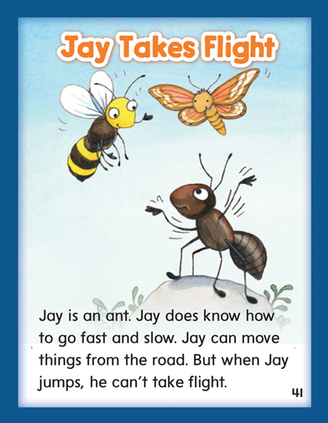

Slide 251
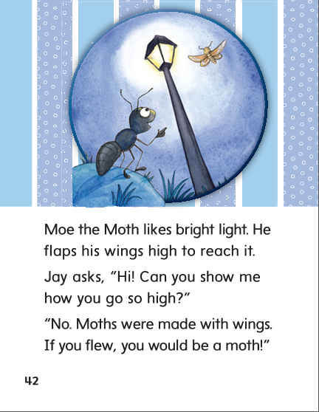

Slide 252
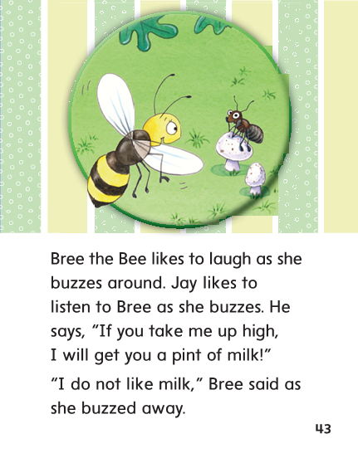

Slide 253
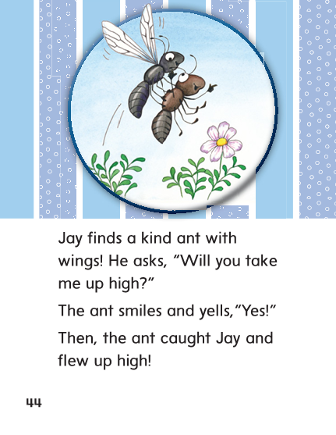

Slide 254
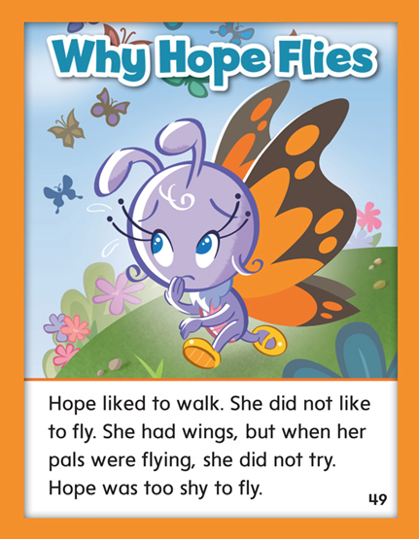

Slide 255
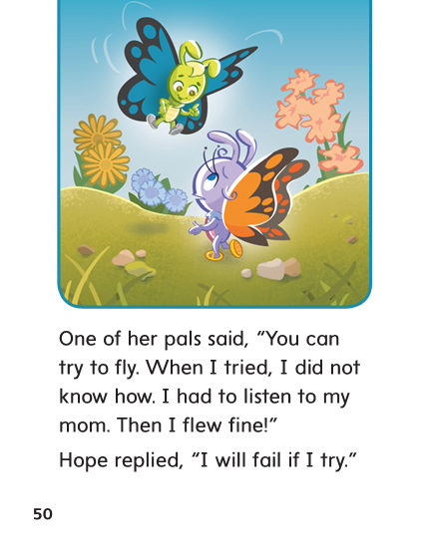

Slide 257
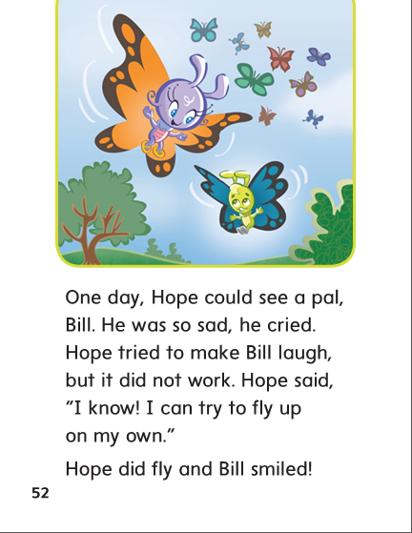

Slide 258
Structural Analysis
Inflectional Endings
When a word ends in y,
you change the y to i before adding the –es or –ed endings.
You do not change the y when adding –ing.
try
tries
tried
trying

Slide 259
Structural Analysis
Inflectional Endings
When a word ends in y,
you change the y to i before adding the –es or –ed endings.
You do not change the y when adding –ing.
fly
flies
flying
cry
cries
cried
crying
dry
dries
dried
drying

Slide 260
i
y
igh
ie

Slide 261
find
caught
find
right
listen
right
pie
pie
by
by
right
caught
right
kind
listen
kind

Slide 262
High Frequency
Words

Slide 263
Read, Spell, Write
caught
He caught a big fish.

Slide 264
Read, Spell, Write
flew
The plane flew high in the sky.

Slide 265
Read, Spell, Write
know
Do you know my name?

Slide 266
Read, Spell, Write
laugh
The joke made me laugh.

Slide 267
Read, Spell, Write
listen
Listen to this song.

Slide 268
Read, Spell, Write
cold
We were cold at night.

Slide 269
Build Fluency: Word Automaticity
Did you know I caught a fish?
Listen to him laugh!
We were glad when we flew in the plane.

Slide 270
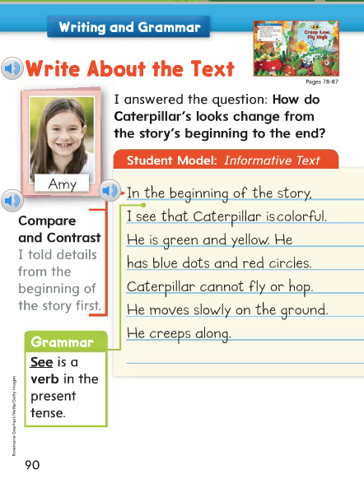
Remember that see and sees tell about the present (something you are looking at right now).
Saw tells about the past.
Why did Amy use see?

Slide 271
Week 1 – Day 4

Slide 272
Phonemic Awareness
Phoneme Identity
Listen carefully as I say three words: night, cried, fly.
What is the same in night, cried, and fly?
The sound that is the same is /i/.
Night, cried and fly all have the long I sound, /i/.
Guided Practice:
I will say three words:
Listen and tell me the sound that you hear that is the same in all three words.
high, shy, ride me, bee, sea cone, joke, show
right, find, bike made, save, pay spy, light, tried

Slide 273
Build with Long i: i, y, igh, ie
n
igh
t
What is the new word we made?
Let’s blend all the sounds and read the word.
Change the n to t.

Slide 274
Build with Long i: i, y, igh, ie
t
igh
t
What is the new word we made?
Let’s blend all the sounds and read the word.
Change the first t to l.

Slide 275
Build with Long i: i, y, igh, ie
l
igh
t
What is the new word we made?
Let’s blend all the sounds and read the word.
Change the l to m.

Slide 276
Build with Long i: i, y, igh, ie
m
igh
t
What is the new word we made?
Let’s blend all the sounds and read the word.
Change the m to r.

Slide 277
Build with Long i: i, y, igh, ie
r
igh
t
What is the new word we made?
Let’s blend all the sounds and read the word.
Change the r to br.

Slide 278
Build with Long i: i, y, igh, ie
br
igh
t
What is the new word we made?
Let’s blend all the sounds and read the word.
Change the br to f.

Slide 279
Build with Long i: i, y, igh, ie
f
igh
t
What is the new word we made?
Let’s blend all the sounds and read the word.
Change the f to fr.

Slide 280
Build with Long i: i, y, igh, ie
fr
igh
t
What is the new word we made?
Let’s blend all the sounds and read the word.
Change the fr to fl.

Slide 281
Build with Long i: i, y, igh, ie
fl
igh
t
What is the new word we made?
Let’s blend all the sounds and read the word.
Change the fl to sl.

Slide 282
Build with Long i: i, y, igh, ie
sl
igh
t
What is the new word we made?
Let’s blend all the sounds and read the word.
Change the sl to s.

Slide 283
Build with Long i: i, y, igh, ie
s
igh
t
What is the new word we made?
Let’s blend all the sounds and read the word.

Slide 284
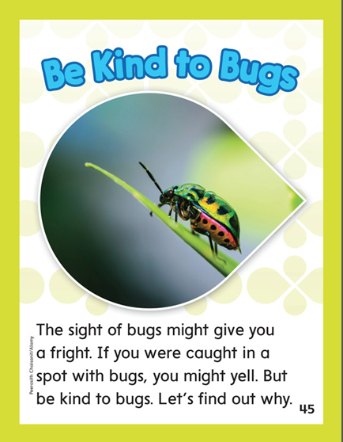

Slide 285
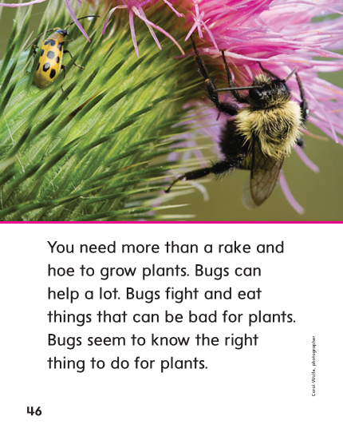

Slide 287
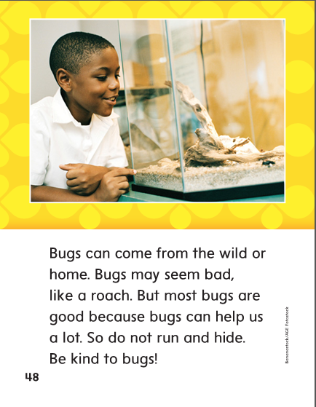

Slide 288
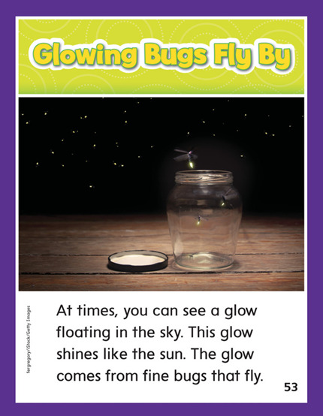

Slide 290
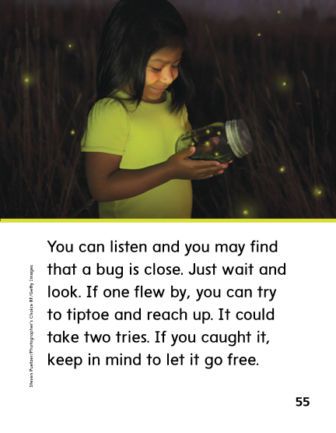

Slide 292
Structural Analysis
Inflectional Endings
When a word ends in y,
you change the y to i before adding the –es or –ed endings.
You do not change the y when adding –ing.
spy
spies
spied
spying

Slide 293
Structural Analysis
Inflectional Endings
Have children work in pairs to construct action words ending with –es, -ed, and –ing.
Then have them write sentences with each word.
cry
dry
fry

Slide 294
High Frequency
Words

Slide 295
Read, Spell, Write
caught
He caught a big fish.

Slide 296
Read, Spell, Write
flew
The plane flew high in the sky.

Slide 297
Read, Spell, Write
know
Do you know my name?

Slide 298
Read, Spell, Write
laugh
The joke made me laugh.

Slide 299
Read, Spell, Write
listen
Listen to this song.

Slide 300
Read, Spell, Write
cold
We were cold at night.

Slide 301
Grammar
See and Saw
Review with children when to use see, sees, and saw.
Your friend was looking at the moon last night.
How could you explain using see, sees, or saw instead of was looking?

Slide 302
Grammar
See and Saw
Children choose three pronouns and complete the sentences three ways, each time with their assigned tense.
_______ _______ a huge moth.
I, we, they, you, he, and she
Have partners read aloud their completed sentences.

Slide 303
Week 1 – Day 5

Slide 304
Phonemic Awareness
Phoneme Segmentation:
I am going to say a word. I want you to say each sound in the word.
shy fly tight pie cry
Phoneme Substitution:
I am going to say a word. I want you to change a sound and say the new word.
light/late bite/bait pay/pie free/fry float/flight

Slide 305
Blend and Build Words with Long i: i, y, igh, ie
Read and say these words:
find
sky
right
tie

Slide 306
Blend and Build Words with Long i: i, y, igh, ie
h
i
What is the new word we made?
Let’s blend all the sounds and read the word.
Add the letter t to the end of the word.

Slide 307
Blend and Build Words with Long i: i, y, igh, ie
h
i
t
What is the new word we made?
Let’s blend all the sounds and read the word.
Change the h to b.

Slide 308
Blend and Build Words with Long i: i, y, igh, ie
b
i
t
What is the new word we made?
Let’s blend all the sounds and read the word.
Remove the t.

Slide 309
Blend and Build Words with Long i: i, y, igh, ie
b
y
What is the new word we made?
Let’s blend all the sounds and read the word.
Change the b to cr.

Slide 310
Blend and Build Words with Long i: i, y, igh, ie
cr
y
What is the new word we made?
Let’s blend all the sounds and read the word.
Change the cr to dr.

Slide 311
Blend and Build Words with Long i: i, y, igh, ie
dr
y
What is the new word we made?
Let’s blend all the sounds and read the word.
Change the dr to fr.

Slide 312
Blend and Build Words with Long i: i, y, igh, ie
fr
y
What is the new word we made?
Let’s blend all the sounds and read the word.
Change the fr to tr.

Slide 313
Blend and Build Words with Long i: i, y, igh, ie
tr
y
What is the new word we made?
Let’s blend all the sounds and read the word.
Add a d to the end of the word.

Slide 314
Blend and Build Words with Long i: i, y, igh, ie
tr
ie
d
What is the new word we made?
Let’s blend all the sounds and read the word.
Change the tr to cr.

Slide 315
Blend and Build Words with Long i: i, y, igh, ie
cr
ie
d
What is the new word we made?
Let’s blend all the sounds and read the word.
Change the cr to dr.

Slide 316
Blend and Build Words with Long i: i, y, igh, ie
dr
ie
d
What is the new word we made?
Let’s blend all the sounds and read the word.
Change the dr to fr.

Slide 317
Blend and Build Words with Long i: i, y, igh, ie
fr
ie
d
What is the new word we made?
Let’s blend all the sounds and read the word.
Change the d to t.

Slide 318
Blend and Build Words with Long i: i, y, igh, ie
fr
igh
t
What is the new word we made?
Let’s blend all the sounds and read the word.
Change the fr to r.

Slide 319
Blend and Build Words with Long i: i, y, igh, ie
r
igh
t
What is the new word we made?
Let’s blend all the sounds and read the word.

Slide 320
Word Automaticity
fly

Slide 321
find

Slide 322
tree

Slide 323
flies

Slide 324
skies

Slide 325
right

Slide 326
by

Slide 327
try

Slide 328
cried

Slide 329
flying

Slide 330
light

Slide 331
high

Slide 332
she

Slide 333
sighed

Slide 334
crying

Slide 335
sky

Slide 336
bright

Slide 337
shy

Slide 338
fried

Slide 339
dries

Slide 340
hi

Slide 341
pie

Slide 342
say

Slide 343
spied

Slide 344
frying

Slide 345
tied

Slide 346
wild

Slide 347
sigh

Slide 348
tried

Slide 349
tries

Slide 350
Structural Analysis
Inflectional Endings
Have children explain how to add endings –es, -rd, and –ing to words that end in y.
cry
dry
Have children practice changing the endings of words,
such as cry and dry.

Slide 351
High Frequency
Words

Slide 352
Read, Spell, Write
caught
He caught a big fish.

Slide 353
Read, Spell, Write
flew
The plane flew high in the sky.

Slide 354
Read, Spell, Write
know
Do you know my name?

Slide 355
Read, Spell, Write
laugh
The joke made me laugh.

Slide 356
Read, Spell, Write
listen
Listen to this song.

Slide 357
Read, Spell, Write
cold
We were cold at night.

Slide 358
Grammar
See and Saw
Ask children to tell when to use the verbs see, sees, and saw.
They _____ ants on a log. (past)
We _____ ants at the picnic. (present)
Mack _____ a snail. (present)

Slide 359
Grammar
See and Saw
Ask: I want to tell about something I am looking at right now.
Do I use see, sees, or saw?
I ______ a _______.
Have partners write a sentence with see, sees, or saw.

