Slide 1
Week 1 – Day 1

Slide 2
Phonemic Awareness
Phoneme Categorization
Listen to the ending sounds in these words: baby, fly, happy.
The words baby and happy end with /e/.
The word fly does not end with /e/. It does not belong.
Guided Practice:
Say the words. Have children identify the word that does not belong. Guide practice with the first example.
key, lucky, truth stamp, bond, jump
bench, moth, lunch page, bridge, log

Slide 3
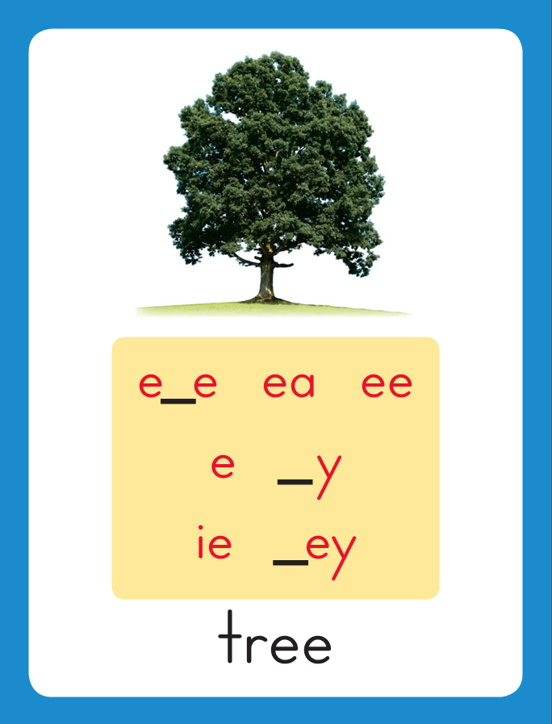
Introduce Long e: y, ey
funny
key
What are these letters?
What sound do they stand for?

Slide 4
Have children practice connecting the letters y and ey to the sound /e/ by writing them.
Now do it with me. Say /e/ as I write the letters y and ey
y y y y y
ey ey ey ey ey

Slide 5
Blending Words with Long e: y and ey
s
i
l
l
y

Slide 6
Blending Words with Long e: y and ey
s
i
l

Slide 7
Blending Words with Long e: y and ey
s
i
l
l
y

Slide 8
Blending Words with Long e: y and ey
s
i
l
l
y

Slide 9
Blending Words with Long e: y and ey
v
a
l

Slide 10
Blending Words with Long e: y and ey
v
a
l
l
ey

Slide 11
Blending Words with Long e: y and ey
v
a
l
l
ey

Slide 12
y ba hap ty
pup ey cit fus
gy bag ny igh
ow sk ie oa

Slide 13
stud

Slide 14
study

Slide 15
study real

Slide 16
study really

Slide 17
study really ba

Slide 18
study really baby

Slide 19
study really baby
hap

Slide 20
study really baby
happy

Slide 21
study really baby
happy kit

Slide 22
study really baby
happy kitty

Slide 23
study really baby
happy kitty pup

Slide 24
study really baby
happy kitty puppy

Slide 25
study really baby
happy kitty puppy
Mick

Slide 26
study really baby
happy kitty puppy
Mickey

Slide 27
study really baby
happy kitty puppy
Mickey cit

Slide 28
study really baby
happy kitty puppy
Mickey city

Slide 29
study really baby
happy kitty puppy
Mickey city fus

Slide 30
study really baby
happy kitty puppy
Mickey city fussy

Slide 31
Internal Sounding Out
baggy

Slide 32
Internal Sounding Out
baggy buggy

Slide 33
Internal Sounding Out
baggy buggy puppy

Slide 34
Internal Sounding Out
baggy buggy puppy
peppy

Slide 35
Internal Sounding Out
baggy buggy puppy
peppy penny

Slide 36
Internal Sounding Out
baggy buggy puppy
peppy penny sky

Slide 37
Internal Sounding Out
baggy buggy puppy
peppy penny sky
night

Slide 38
Internal Sounding Out
baggy buggy puppy
peppy penny sky
night bowl

Slide 39
Internal Sounding Out
baggy buggy puppy
peppy penny sky
night bowl tie

Slide 40
Internal Sounding Out
baggy buggy puppy
peppy penny sky
night bowl tie boat

Slide 41
The

Slide 42
The baby

Slide 43
The baby is

Slide 44
The baby is very

Slide 45
The baby is very fussy.

Slide 46
The baby is very fussy.
Betty

Slide 47
The baby is very fussy.
Betty went

Slide 48
The baby is very fussy.
Betty went to

Slide 49
The baby is very fussy.
Betty went to the

Slide 50
The baby is very fussy.
Betty went to the muddy

Slide 51
The baby is very fussy.
Betty went to the muddy pond.

Slide 52
The baby is very fussy.
Betty went to the muddy pond.
Tommy

Slide 53
The baby is very fussy.
Betty went to the muddy pond.
Tommy lost

Slide 54
The baby is very fussy.
Betty went to the muddy pond.
Tommy lost his

Slide 55
The baby is very fussy.
Betty went to the muddy pond.
Tommy lost his key

Slide 56
The baby is very fussy.
Betty went to the muddy pond.
Tommy lost his key in

Slide 57
The baby is very fussy.
Betty went to the muddy pond.
Tommy lost his key in the

Slide 58
The baby is very fussy.
Betty went to the muddy pond.
Tommy lost his key in the muddy

Slide 59
The baby is very fussy.
Betty went to the muddy pond.
Tommy lost his key in the muddy pond.

Slide 60
Spelling / Dictation
1. _________
2. _________
3. _________
4. _________
5. _________
key
bumpy
puppy
sandy
funny

Slide 61
High Frequency
Words

Slide 62
Read, Spell, Write
found
We found our lost dog.

Slide 63
Read, Spell, Write
hard
It is not hard to write your name.

Slide 64
Read, Spell, Write
near
The women lives near the school.

Slide 65
Read, Spell, Write
women
She is a very nice women.

Slide 66
Read, Spell, Write
would
Would you like to play with us?

Slide 67
Read, Spell, Write
write
It is not hard to write your name.

Slide 68
Have children read the sentences. Prompt them to identify the high-frequency words in connected text and to blend the decodable words.
We found our lost dog.
It is not hard to write your name.
That women lives near the school.
Would you like to play with us?

Slide 69
Grammar
Adverbs that tell when
Words such as first, then, next, soon, later today, tomorrow, yesterday, early, and always tell when an action takes place.
Penny got a puppy today. First, she gave him a bath. Penny will take him for a walk later.
Ask: When did Penny get a puppy? The adverb today tells when.
When did she give him a bath? When will she take him for a walk?

Slide 70
Grammar
Adverbs that tell when
Words such as first, then, next, soon, later today, tomorrow, yesterday, early, and always tell when an action takes place.
My hamster Izzy wakes me early.
Izzy always kicks shavings out of her cage.
Have children work with a partner to identify the adverbs that tell when.

Slide 71
Week 1 – Day 2

Slide 72
Phonemic Awareness
Phoneme Deletion
Listen carefully how to delete final sounds to form a new word: dirty.
Now listen as I say the word and take away the last sound: dirty, dirt.
When I took away the /e/ sound at the end of dirty, I made a new word: dirt.
Guided Practice:
Have children delete the /e/ sound to form new words. Do the first two examples with them.
sleepy frosty puffy fizzy
jumpy curly eighty grouchy

Slide 73
Introduce Long e: y, ey
This is the Tree
Sound-Spelling Card.
The sound is /e/.
This is the sound at the end of the word tree.
Listen: /treee/, tree.
Today we will learn more spellings for the /e/ sound.
Look at the word: happy.
Say it with me. This word has the long e sound /e/ spelled with the letter y.
The long e sound can also be spelled with the letters ey as in key.
happy
key

Slide 74
Blending Words with Long e: y, ey
d
a
d

Slide 75
Blending Words with Long e: y, ey
d
a
d
d
y

Slide 76
Blending Words with Long e: y, ey
d
a
d
d
y

Slide 77
Blending Words with Long e: y, ey
j
e
l

Slide 78
Blending Words with Long e: y, ey
j
e
l
l
y

Slide 79
Blending Words with Long e: y, ey
j
e
l
l
y

Slide 80
Blending Words with Long e: y, ey
h
o
b

Slide 81
Blending Words with Long e: y, ey
h
o
b
b
y

Slide 82
Blending Words with Long e: y, ey
h
o
b
b
y

Slide 83
Blending Words with Long e: y, ey
h
o
ck

Slide 84
Blending Words with Long e: y, ey
h
o
ck
ey

Slide 85
Blending Words with Long e: y, ey
h
o
ck
ey

Slide 86
bud

Slide 87
buddy

Slide 88
buddy luck

Slide 89
buddy lucky

Slide 90
buddy lucky win

Slide 91
buddy lucky windy

Slide 92
buddy lucky windy
tum

Slide 93
buddy lucky windy
tummy

Slide 94
buddy lucky windy
tummy hap

Slide 95
buddy lucky windy
tummy happy

Slide 96
buddy lucky windy
tummy happy key

Slide 97
buddy lucky windy
tummy happy key
skin

Slide 98
buddy lucky windy
tummy happy key
skinny

Slide 99
buddy lucky windy
tummy happy key
skinny mes

Slide 100
buddy lucky windy
tummy happy key
skinny messy

Slide 101
buddy lucky windy
tummy happy key
skinny messy al

Slide 102
buddy lucky windy
tummy happy key
skinny messy alley

Slide 103
Build with Long e: y, ey
y
u
ck
y
What is the new word we made?
Let’s blend all the sounds and read the word.
Change the first y to d.

Slide 104
Build with Long e: y, ey
d
u
ck
y
What is the new word we made?
Let’s blend all the sounds and read the word.
Change the d to l.

Slide 105
Build with Long e: y, ey
l
u
ck
y
What is the new word we made?
Let’s blend all the sounds and read the word.
Remove the y.

Slide 106
Build with Long e: y, ey
l
u
ck
What is the new word we made?
Let’s blend all the sounds and read the word.
Change the u to i.

Slide 107
Build with Long e: y, ey
l
i
ck
What is the new word we made?
Let’s blend all the sounds and read the word.
Change the l to st.

Slide 108
Build with Long e: y, ey
st
i
ck
What is the new word we made?
Let’s blend all the sounds and read the word.
Add a y to the end of the word.

Slide 109
Build with Long e: y, ey
st
i
ck
y
What is the new word we made?
Let’s blend all the sounds and read the word.
Remove the st.

Slide 110
Build with Long e: y, ey
i
ck
y
What is the new word we made?
Let’s blend all the sounds and read the word.
Add a p in front of the word.

Slide 111
Build with Long e: y, ey
p
i
ck
y
What is the new word we made?
Let’s blend all the sounds and read the word.
Remove the y.

Slide 112
Build with Long e: y, ey
p
i
ck
What is the new word we made?
Let’s blend all the sounds and read the word.
Change the p to R.

Slide 113
Build with Long e: y, ey
R
i
ck
What is the new word we made?
Let’s blend all the sounds and read the word.
Change the i to o.

Slide 114
Build with Long e: y, ey
r
o
ck
What is the new word we made?
Let’s blend all the sounds and read the word.
Add a y to the end of the word.

Slide 115
Build with Long e: y, ey
r
o
ck
y
What is the new word we made?
Let’s blend all the sounds and read the word.
Add a y to the end of the word.

Slide 116
Structural Analysis
Compound Words
Bathtub is a compound word.
A compound word is a longer word made up of two smaller words.
The word bathtub is made up of the words bath and tub.
bath
tub
bathtub
A bathtub is a tub in which you can take a bath.
Looking for smaller words in a longer word can sometimes help them pronounce and figure out the meaning of the longer word.

Slide 117
Structural Analysis
Compound Words
Have children name the two smaller words in each compound word and say what the compound words mean.
Then have them use the compound word in a sentence.
sunset
anthill
seashell
teapot
snowflake

Slide 118
High Frequency
Words

Slide 119
Read, Spell, Write
found
We found our lost dog.

Slide 120
Read, Spell, Write
hard
It is not hard to write your name.

Slide 121
Read, Spell, Write
near
The women lives near the school.

Slide 122
Read, Spell, Write
women
She is a very nice women.

Slide 123
Read, Spell, Write
would
Would you like to play with us?

Slide 124
Read, Spell, Write
write
It is not hard to write your name.

Slide 125
Grammar
Adverbs that tell when
Adverbs can tell when an action takes place.
Here is a list of example adverbs: first, then, next, soon, later, today, tomorrow, yesterday, early, always.
Yesterday, snowflakes fell from the sky.
I woke early and looked outside.
Soon I will make a snowman!
Have children circle the adverb in each sentence.

Slide 126
Grammar
Adverbs that tell when
Have children work in pairs to identify each adverb that tells when.
First, Mickey walked to the top of the hill.
Then, he sat on the sled and went down.

Slide 127
Week 1 – Day 3

Slide 128
Phonemic Awareness
Phoneme Blending
Listen as I say the sounds in a word: /s/ /i/ /t/ /e/.
Now I will blend the sounds together and say the word: /sssiiiteee/.
Let’s say the word together: city.
Guided Practice:
I am going to say more words, sound by sound. Blend the sounds together to say the word. Do the first one with the children.
/m/ /e/ /s/ /e/ /f/ /u/ /n/ /e/
/d/ /u/ /s/ /t/ /e/ /f/ /i/ /sh/ /e/

Slide 129
Blending Words with Long e: y and ey
sk
i
n

Slide 130
Blending Words with Long e: y and ey
sk
i
n
n
y

Slide 131
Blending Words with Long e: y and ey
sk
i
n
n
y

Slide 132
Blending Words with Long e: y and ey
h
a
p

Slide 133
Blending Words with Long e: y and ey
h
a
p
p
y

Slide 134
Blending Words with Long e: y and ey
h
a
p
p
y

Slide 135
Blending Words with Long e: y and ey
l
u
ck

Slide 136
Blending Words with Long e: y and ey
l
u
ck
y

Slide 137
Blending Words with Long e: y and ey
l
u
ck
y

Slide 138
Blending Words with Long e: y and ey
h
o
ck

Slide 139
Blending Words with Long e: y and ey
h
o
ck
ey

Slide 140
Blending Words with Long e: y and ey
h
o
ck
ey

Slide 141
ba ny ea by
ey cit pup key
igh ay o_e ill
pot oo vol py

Slide 142
ba

Slide 143
baby

Slide 144
baby fun

Slide 145
baby funny

Slide 146
baby funny real

Slide 147
baby funny really

Slide 148
baby funny really
pen

Slide 149
baby funny really
penny

Slide 150
baby funny really
penny kit

Slide 151
baby funny really
penny kitty

Slide 152
baby funny really
penny kitty cit

Slide 153
baby funny really
penny kitty city

Slide 154
baby funny really
penny kitty city
k

Slide 155
baby funny really
penny kitty city
key

Slide 156
baby funny really
penny kitty city
key pup

Slide 157
baby funny really
penny kitty city
key puppy

Slide 158
baby funny really
penny kitty city
key puppy hon

Slide 159
baby funny really
penny kitty city
key puppy honey

Slide 160
baby funny really
penny kitty city
key puppy honey
mes

Slide 161
baby funny really
penny kitty city
key puppy honey
messy

Slide 162
baby funny really
penny kitty city
key puppy honey
messy val

Slide 163
baby funny really
penny kitty city
key puppy honey
messy valley

Slide 164
baby funny really
penny kitty city
key puppy honey
messy valley vol

Slide 165
baby funny really
penny kitty city
key puppy honey
messy valley volley

Slide 166
Internal Sounding Out
misty

Slide 167
Internal Sounding Out
misty musty

Slide 168
Internal Sounding Out
misty musty monkey

Slide 169
Internal Sounding Out
misty musty monkey
bathtub

Slide 170
Internal Sounding Out
misty musty monkey
bathtub seashell

Slide 171
Internal Sounding Out
misty musty monkey
bathtub seashell
football

Slide 172
Internal Sounding Out
misty musty monkey
bathtub seashell
football teapot

Slide 173
Internal Sounding Out
misty musty monkey
bathtub seashell
football teapot
daylight

Slide 174
Internal Sounding Out
misty musty monkey
bathtub seashell
football teapot
daylight notebook

Slide 175
The

Slide 176
The tiny

Slide 177
The tiny puppy

Slide 178
The tiny puppy is

Slide 179
The tiny puppy is happy.

Slide 180
The tiny puppy is happy.
Can

Slide 181
The tiny puppy is happy.
Can you

Slide 182
The tiny puppy is happy.
Can you see

Slide 183
The tiny puppy is happy.
Can you see the

Slide 184
The tiny puppy is happy.
Can you see the valley

Slide 185
The tiny puppy is happy.
Can you see the valley when

Slide 186
The tiny puppy is happy.
Can you see the valley when it

Slide 187
The tiny puppy is happy.
Can you see the valley when it is

Slide 188
The tiny puppy is happy.
Can you see the valley when it is foggy?

Slide 189
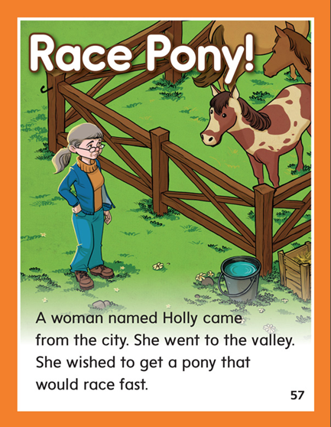

Slide 190
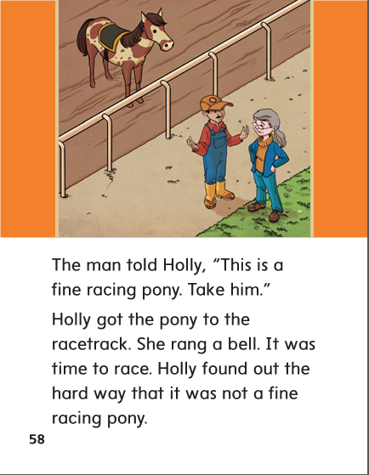

Slide 191
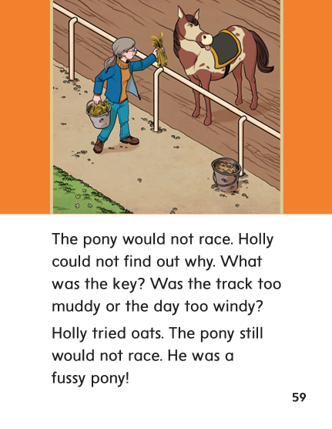

Slide 192
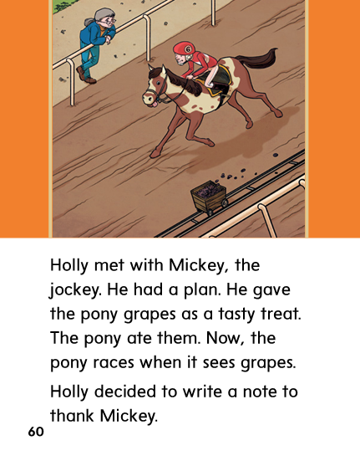

Slide 193
Structural Analysis
Compound Words
A compound word is a longer word made up of two smaller words.
Sandbox is a compound word made up of the words sand and box.
The two smaller words often help us figure out the meaning of the compound word.
sandbox
sand box
A sandbox is a box filled with sand.
Looking for smaller words in a longer word can sometimes help them pronounce and figure out the meaning of the longer word.

Slide 194
Structural Analysis
Compound Words
Have children name the two smaller words in each compound word. Help children blend the words. Point out that compound words have more than one syllable.
cookbook
pancake
sunshine
sailboat
snowman

Slide 195
y
ey

Slide 196
key
puppy
key
penny
honey
penny
bumpy
bumpy
monkey
monkey
sandy
puppy
sandy
funny
honey
funny

Slide 197
High Frequency
Words

Slide 198
Read, Spell, Write
found
We found our lost dog.

Slide 199
Read, Spell, Write
hard
It is not hard to write your name.

Slide 200
Read, Spell, Write
near
The women lives near the school.

Slide 201
Read, Spell, Write
women
She is a very nice women.

Slide 202
Read, Spell, Write
would
Would you like to play with us?

Slide 203
Read, Spell, Write
write
It is not hard to write your name.

Slide 204
Build Fluency: Word Automaticity
I found a pen near my desk.
It is hard to write with this pen.
Would you help that women?

Slide 205
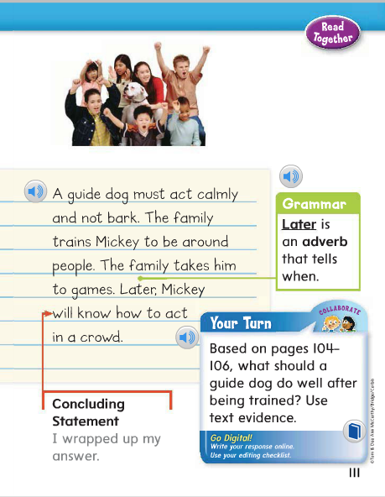
Adverbs can tell when an action takes place.
Identify the adverb in this student model.
What word in this sentence tells when?
Circle the adverb.

Slide 206
Week 1 – Day 4

Slide 207
Phonemic Awareness
Phoneme Categorization
Listen as I say three words: windy, growing, hobby.
Windy and hobby have the long e sound at the end.
Growing does not. Growing does not belong.
Guided Practice:
Listen to these words. Two words have the same ending sound. One has a different sound.
Which word does not belong?
body, icy, hand key, sing, penny
rocky, sunny, believe reply, heavy, pony

Slide 208
Build with Long e: y, ey
b
a
gg
y
What is the new word we made?
Let’s blend all the sounds and read the word.
Change the a to u.

Slide 209
Build with Long e: y, ey
b
u
gg
y
What is the new word we made?
Let’s blend all the sounds and read the word.
Change the gg to dd.

Slide 210
Build with Long e: y, ey
b
u
dd
y
What is the new word we made?
Let’s blend all the sounds and read the word.
Change the dd to nn.

Slide 211
Build with Long e: y, ey
b
u
nn
y
What is the new word we made?
Let’s blend all the sounds and read the word.
Change the b to s.

Slide 212
Build with Long e: y, ey
s
u
nn
y
What is the new word we made?
Let’s blend all the sounds and read the word.
Change the s to f.

Slide 213
Build with Long e: y, ey
f
u
nn
y
What is the new word we made?
Let’s blend all the sounds and read the word.
Change the nn to ss.

Slide 214
Build with Long e: y, ey
f
u
ss
y
What is the new word we made?
Let’s blend all the sounds and read the word.
Change the ss to zz.

Slide 215
Build with Long e: y, ey
f
u
zz
y
What is the new word we made?
Let’s blend all the sounds and read the word.
Remove the y.

Slide 216
Build with Long e: y, ey
f
u
zz
What is the new word we made?
Let’s blend all the sounds and read the word.
Change the u to i.

Slide 217
Build with Long e: y, ey
f
i
zz
What is the new word we made?
Let’s blend all the sounds and read the word.
Change the zz to sh.

Slide 218
Build with Long e: y, ey
f
i
sh
What is the new word we made?
Let’s blend all the sounds and read the word.
Add y to the end of the word.

Slide 219
Build with Long e: y, ey
f
i
sh
y
What is the new word we made?
Let’s blend all the sounds and read the word.

Slide 222
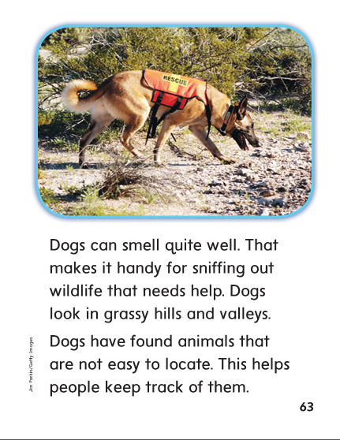

Slide 224
Structural Analysis
Compound Words
A compound word is a longer word made up of two smaller words.
Footprint is made up of the words foot and print.
You can often use the smaller words to figure out the meaning.
footprint
foot print
A footprint is a print made on the ground with a foot.

Slide 225
Structural Analysis
Compound Words
Have children work in pairs to identify the two smaller words in each compound word and determine the word’s meaning.
homemade
sunshine
meatloaf
pigpen
bathrobe

Slide 226
High Frequency
Words

Slide 227
Read, Spell, Write
found
We found our lost dog.

Slide 228
Read, Spell, Write
hard
It is not hard to write your name.

Slide 229
Read, Spell, Write
near
The women lives near the school.

Slide 230
Read, Spell, Write
women
She is a very nice women.

Slide 231
Read, Spell, Write
would
Would you like to play with us?

Slide 232
Read, Spell, Write
write
It is not hard to write your name.

Slide 233
Grammar
Adverbs that tell when
Some adverbs tell when an action takes place.
Ask: What are some words that tell when?
First, I get out the cookbook.
Then, I get out the eggs and a bowl.
Soon we will have pancakes!
Identify the words that tell when.

Slide 234
Week 1 – Day 5

Slide 235
Phonemic Awareness
Phoneme Deletion:
Listen as I say a word. Take away the last sound to make a new word.
baggy dolly foggy bossy icy hilly
Phoneme Addition:
Listen as I say a word. Then add the /e/ sound to the end to form a new word.
bell wind dad mess sleep fun

Slide 236
Blend and Build Words with Long i: i, y, igh, ie
Read and say these words:
key
hockey
happy
funny

Slide 237
Blend and Build Words with Long e: y, ey
j
e
ll
y
What is the new word we made?
Let’s blend all the sounds and read the word.
Change the j to b.

Slide 238
Blend and Build Words with Long e: y, ey
b
e
ll
y
What is the new word we made?
Let’s blend all the sounds and read the word.
Remove the y.

Slide 239
Blend and Build Words with Long e: y, ey
b
e
ll
What is the new word we made?
Let’s blend all the sounds and read the word.
Change the e to i.

Slide 240
Blend and Build Words with Long e: y, ey
b
i
ll
What is the new word we made?
Let’s blend all the sounds and read the word.
Change the b to ch.

Slide 241
Blend and Build Words with Long e: y, ey
ch
i
ll
What is the new word we made?
Let’s blend all the sounds and read the word.
Add an y to the end of a word..

Slide 242
Blend and Build Words with Long e: y, ey
ch
i
ll
y
What is the new word we made?
Let’s blend all the sounds and read the word.
Change the ch to a h.

Slide 243
Blend and Build Words with Long e: y, ey
h
i
ll
y
What is the new word we made?
Let’s blend all the sounds and read the word.
Change the i to o.

Slide 244
Blend and Build Words with Long e: y, ey
h
o
ll
y
What is the new word we made?
Let’s blend all the sounds and read the word.
Change the h to d.

Slide 245
Blend and Build Words with Long e: y, ey
d
o
ll
y
What is the new word we made?
Let’s blend all the sounds and read the word.
Remove the y.

Slide 246
Blend and Build Words with Long e: y, ey
d
o
ll
What is the new word we made?
Let’s blend all the sounds and read the word.
Change the o to u..

Slide 247
Blend and Build Words with Long e: y, ey
d
u
ll
What is the new word we made?
Let’s blend all the sounds and read the word.
Change the ll to mp.

Slide 248
Blend and Build Words with Long e: y, ey
d
u
mp
What is the new word we made?
Let’s blend all the sounds and read the word.
Change the d to b..

Slide 249
Blend and Build Words with Long e: y, ey
b
u
mp
What is the new word we made?
Let’s blend all the sounds and read the word.
Add a y to the end of the word..

Slide 250
Blend and Build Words with Long e: y, ey
b
u
mp
y
What is the new word we made?
Let’s blend all the sounds and read the word.
Change the b to gr.

Slide 251
Blend and Build Words with Long e: y, ey
gr
u
mp
y
What is the new word we made?
Let’s blend all the sounds and read the word.
Change the b to gr.

Slide 252
Word Automaticity
baby

Slide 253
city

Slide 254
valley

Slide 255
bathtub

Slide 256
teapot

Slide 257
funny

Slide 258
key

Slide 259
volley

Slide 260
seashell

Slide 261
daylight

Slide 262
really

Slide 263
puppy

Slide 264
misty

Slide 265
penny

Slide 266
honey

Slide 267
musty

Slide 268
sunrise

Slide 269
notebook

Slide 270
kitty

Slide 271
messy

Slide 272
monkey

Slide 273
football

Slide 274
anthill

Slide 275
Structural Analysis
Compound Words
Have children practice writing and reading compound words:
bedtime
snowman
backpack
cupcake
hilltop
raincoat

Slide 276
High Frequency
Words

Slide 277
Read, Spell, Write
found
We found our lost dog.

Slide 278
Read, Spell, Write
hard
It is not hard to write your name.

Slide 279
Read, Spell, Write
near
The women lives near the school.

Slide 280
Read, Spell, Write
women
She is a very nice women.

Slide 281
Read, Spell, Write
would
Would you like to play with us?

Slide 282
Read, Spell, Write
write
It is not hard to write your name.

Slide 283
Grammar
Adverbs that tell when
Describe adverbs that tell when.
Identify the adverbs in the following sentences:
I have to give my dog a bath today. First, I get out the hose, soap, and a brush. Next, I get my dad. He always holds the dog while I wash.
What question can each adverb answer?

