Slide 1
Week 1 – Day 1

Slide 2
Phonological Awareness
Contrast Vowel Sounds
Listen carefully as I say two words. Listen: barn, bone.
I hear different middle sounds in the words.
Only one has the /ar/ sounds: /b/ /ar/ /n/.
Bone does not have the /ar/ sounds.
Repeat with shack/shark and bark/bake.
Guided Practice:
I will say two words.
Which word has the /ar/ sounds? Say the word.
arm, aim pat, part jay, jar march, make
art, ate head, hard harp, hope dark, dirt

Slide 3
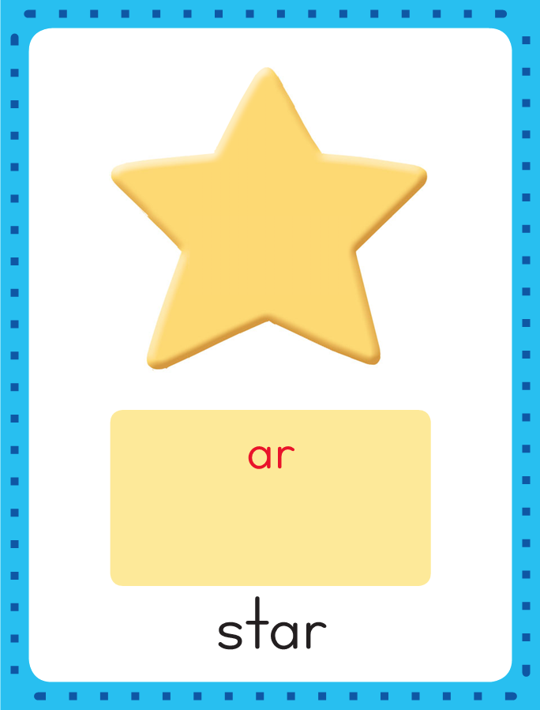
Introduce /ar/: ar
This is the Star
Sound-Spelling Card.
The sounds at the end of the wortd star are /ar/.
Listen: /star/.
When the vowel a is followed by an r the sound changes.
Together a and r stand for /ar/.
Say the sounds with me: /ar/.
I’ll say /ar/ as I write the letters a and r several times.

Slide 4
Have children practice connecting the letters ar to the sounds
/ar/ by writing them.
Now do it with me. Say /ar/ as I write the letters ar.
This time, write the letters ar five times as you say the /ar/ sounds.
ar ar ar ar ar

Slide 5
Blend Words with /ar/: ar
f

Slide 6
Blend Words with /ar/: ar
f
ar

Slide 7
Blend Words with /ar/: ar
f
ar

Slide 8
Blend Words with /ar/: ar
f
ar
m

Slide 9
Blend Words with /ar/: ar
f
ar
m

Slide 10
Blend Words with /ar/: ar
ar

Slide 11
Blend Words with /ar/: ar
ar
m

Slide 12
Blend Words with /ar/: ar
ar
m

Slide 13
Blend Words with /ar/: ar
y

Slide 14
Blend Words with /ar/: ar
y
ar

Slide 15
Blend Words with /ar/: ar
y
ar

Slide 16
Blend Words with /ar/: ar
y
ar
d

Slide 17
Blend Words with /ar/: ar
y
ar
d

Slide 18
Blend Words with /ar/: ar
l

Slide 19
Blend Words with /ar/: ar
l
ar

Slide 20
Blend Words with /ar/: ar
l
ar

Slide 21
Blend Words with /ar/: ar
l
ar
ge

Slide 22
Blend Words with /ar/: ar
l
ar
ge

Slide 23
Blend Words with /ar/: ar
st

Slide 24
Blend Words with /ar/: ar
st
ar

Slide 25
Blend Words with /ar/: ar
st
ar

Slide 26
Blend Words with /ar/: ar
st
ar
t

Slide 27
Blend Words with /ar/: ar
st
ar
t

Slide 28
ar ge igh ch
ck ey sh ar
tch sm ar oa

Slide 29
ar

Slide 30
art

Slide 31
art d

Slide 32
art dar

Slide 33
art dark

Slide 34
art dark b

Slide 35
art dark bar

Slide 36
art dark barn

Slide 37
art dark barn
c

Slide 38
art dark barn
car

Slide 39
art dark barn
car h

Slide 40
art dark barn
car har

Slide 41
art dark barn
car hard

Slide 42
art dark barn
car hard y

Slide 43
art dark barn
car hard yar

Slide 44
art dark barn
car hard yarn

Slide 45
art dark barn
car hard yarn
h

Slide 46
art dark barn
car hard yarn
har

Slide 47
art dark barn
car hard yarn
harm

Slide 48
art dark barn
car hard yarn
harm sh

Slide 49
art dark barn
car hard yarn
harm shar

Slide 50
art dark barn
car hard yarn
harm sharp

Slide 51
art dark barn
car hard yarn
harm sharp sc

Slide 52
art dark barn
car hard yarn
harm sharp scar

Slide 53
art dark barn
car hard yarn
harm sharp scarf

Slide 54
art dark barn
car hard yarn
harm sharp scarf
p

Slide 55
art dark barn
car hard yarn
harm sharp scarf
par

Slide 56
art dark barn
car hard yarn
harm sharp scarf
part

Slide 57
art dark barn
car hard yarn
harm sharp scarf
part ch

Slide 58
art dark barn
car hard yarn
harm sharp scarf
part char

Slide 59
art dark barn
car hard yarn
harm sharp scarf
part chart

Slide 60
art dark barn
car hard yarn
harm sharp scarf
part chart ch

Slide 61
art dark barn
car hard yarn
harm sharp scarf
part chart char

Slide 62
art dark barn
car hard yarn
harm sharp scarf
part chart charge

Slide 63
Internal Sounding Out
had

Slide 64
Internal Sounding Out
had hard

Slide 65
Internal Sounding Out
had hard match

Slide 66
Internal Sounding Out
had hard match
march

Slide 67
Internal Sounding Out
had hard match
march smart

Slide 68
Internal Sounding Out
had hard match
march smart apart

Slide 69
Internal Sounding Out
had hard match
march smart apart
child

Slide 70
Internal Sounding Out
had hard match
march smart apart
child party

Slide 71
Internal Sounding Out
had hard match
march smart apart
child party coat

Slide 72
Internal Sounding Out
had hard match
march smart apart
child party coat
fried

Slide 73
Internal Sounding Out
had hard match
march smart apart
child party coat
fried hockey

Slide 74
Internal Sounding Out
had hard match
march smart apart
child party coat
fried hockey night

Slide 75
A

Slide 76
A dog

Slide 77
A dog started

Slide 78
A dog started to

Slide 79
A dog started to bark

Slide 80
A dog started to bark in

Slide 81
A dog started to bark in the

Slide 82
A dog started to bark in the dark

Slide 83
A dog started to bark in the dark yard.

Slide 84
A dog started to bark in the dark yard.
Can

Slide 85
A dog started to bark in the dark yard.
Can a

Slide 86
A dog started to bark in the dark yard.
Can a shark

Slide 87
A dog started to bark in the dark yard.
Can a shark live

Slide 88
A dog started to bark in the dark yard.
Can a shark live in

Slide 89
A dog started to bark in the dark yard.
Can a shark live in a

Slide 90
A dog started to bark in the dark yard.
Can a shark live in a barn

Slide 91
A dog started to bark in the dark yard.
Can a shark live in a barn on

Slide 92
A dog started to bark in the dark yard.
Can a shark live in a barn on a

Slide 93
A dog started to bark in the dark yard.
Can a shark live in a barn on a farm?

Slide 94
A dog started to bark in the dark yard.
Can a shark live in a barn on a farm?
Clark

Slide 95
A dog started to bark in the dark yard.
Can a shark live in a barn on a farm?
Clark will

Slide 96
A dog started to bark in the dark yard.
Can a shark live in a barn on a farm?
Clark will park

Slide 97
A dog started to bark in the dark yard.
Can a shark live in a barn on a farm?
Clark will park his

Slide 98
A dog started to bark in the dark yard.
Can a shark live in a barn on a farm?
Clark will park his car

Slide 99
A dog started to bark in the dark yard.
Can a shark live in a barn on a farm?
Clark will park his car in

Slide 100
A dog started to bark in the dark yard.
Can a shark live in a barn on a farm?
Clark will park his car in the

Slide 101
A dog started to bark in the dark yard.
Can a shark live in a barn on a farm?
Clark will park his car in the backyard.

Slide 102
Spelling / Dictation
1. _________
2. _________
3. _________
4. _________
5. _________
cart
harm
barn
arm
yarn

Slide 103
High Frequency
Words

Slide 104
Read, Spell, Write
four
I see four fish in the fish tank.

Slide 105
Read, Spell, Write
large
I saw a large dog in the park.

Slide 106
Read, Spell, Write
none
Ted has one left, but Mark has none.

Slide 107
Read, Spell, Write
only
The card only costs five cents.

Slide 108
Read, Spell, Write
put
Where did you put my book?

Slide 109
Read, Spell, Write
round
A penny is round.

Slide 110
Have children read the sentences. Prompt them to identify the high-frequency words in connected text and to blend the decodable words.
I see four fish in the fish tank.
I saw a large dog in the park.
Ted has one left, but Mark had none.

Slide 111
Have children read the sentences. Prompt them to identify the high-frequency words in connected text and to blend the decodable words.
The card only costs five cents.
Where did you put my book?
A penny is round.

Slide 112
Grammar
Join sentences with and, but, or
Two complete sentences can be joined together with a joining word.
The words and, but, and or are used to put two sentences together.
You march to the top of the hill.
You look for the barn.
You march to the top of the hill and you look for the barn.
Circle the joining word and explain to children the difference in meaning of and, but, and or.

Slide 113
Grammar
Join sentences with and, but, or
Two complete sentences can be joined together with a joining word.
The words and, but, and or are used to put two sentences together.
Walk by the lake.
Do not go in the water.
Walk by the lake but do not go in the water.
Circle the joining word and explain to children the difference in meaning of and, but, and or.

Slide 114
Grammar
Join sentences with and, but, or
Two complete sentences can be joined together with a joining word.
The words and, but, and or are used to put two sentences together.
Marge might win the prize.
Charlie might win the prize.
Marge might win the prize or Charlie might win the prize.
Circle the joining word and explain to children the difference in meaning of and, but, and or.

Slide 115
Grammar
Join sentences with and, but, or
Read the sentences below and have children identify
the word to join the two sentences.
Who is he and where is he from?
You can take the high path or you can take the low path?
We were going to take a car trip but we ran out of gas.

Slide 116
Week 1 – Day 2

Slide 117
Phonemic Awareness
Phoneme Categorization
Listen as I say three words: yarn, coat, bark.
Two of the words have the same sounds in the middle.
One does not. Yarn and bark have the /ar/ sounds.
Coat does not. Coat does not belong.
Guided Practice:
I will say three words. Tell me which word does not belong and why.
sharp, hard, beach pain, mark, late charge, main, cart
scarf, back, hand store, guard, charm stork, bird, first

Slide 118
Review /ar/: ar
star
What are the letters?
What sound do they stand for?
park

Slide 119
Blend Words with /ar/: ar
m

Slide 120
Blend Words with /ar/: ar
m
ar

Slide 121
Blend Words with /ar/: ar
m
ar

Slide 122
Blend Words with /ar/: ar
m
ar
k

Slide 123
Blend Words with /ar/: ar
m
ar
k

Slide 124
Blend Words with /ar/: ar
d

Slide 125
Blend Words with /ar/: ar
d
ar

Slide 126
Blend Words with /ar/: ar
d
ar

Slide 127
Blend Words with /ar/: ar
d
ar
k

Slide 128
Blend Words with /ar/: ar
d
ar
k

Slide 129
Blend Words with /ar/: ar
st

Slide 130
Blend Words with /ar/: ar
st
ar

Slide 131
Blend Words with /ar/: ar
st
ar

Slide 132
Blend Words with /ar/: ar
st
ar
t

Slide 133
Blend Words with /ar/: ar
st
ar
t

Slide 134
Blend Words with /ar/: ar
l

Slide 135
Blend Words with /ar/: ar
l
ar

Slide 136
Blend Words with /ar/: ar
l
ar

Slide 137
Blend Words with /ar/: ar
l
ar
ge

Slide 138
Blend Words with /ar/: ar
l
ar
ge

Slide 139
f

Slide 140
far

Slide 141
far ar

Slide 142
far arm

Slide 143
far arm h

Slide 144
far arm har

Slide 145
far arm hard

Slide 146
far arm hard
b

Slide 147
far arm hard
bar

Slide 148
far arm hard
bark

Slide 149
far arm hard
bark ch

Slide 150
far arm hard
bark char

Slide 151
far arm hard
bark chart

Slide 152
far arm hard
bark chart sh

Slide 153
far arm hard
bark chart shar

Slide 154
far arm hard
bark chart sharp

Slide 155
far arm hard
bark chart sharp
ch

Slide 156
far arm hard
bark chart sharp
char

Slide 157
far arm hard
bark chart sharp
charge

Slide 158
far arm hard
bark chart sharp
charge m

Slide 159
far arm hard
bark chart sharp
charge mar

Slide 160
far arm hard
bark chart sharp
charge march

Slide 161
far arm hard
bark chart sharp
charge march sc

Slide 162
far arm hard
bark chart sharp
charge march scar

Slide 163
far arm hard
bark chart sharp
charge march scar
barn

Slide 164
far arm hard
bark chart sharp
charge march scar
barnyard

Slide 165
far arm hard
bark chart sharp
charge march scar
barnyard re

Slide 166
far arm hard
bark chart sharp
charge march scar
barnyard restart

Slide 167
Build Words with /ar/ ar
c
ar
d
What is the new word we made?
Let’s blend all the sounds and read the word.
Change the c to h.

Slide 168
Build Words with /ar/ ar
h
ar
d
What is the new word we made?
Let’s blend all the sounds and read the word.
Change the d to p.

Slide 169
Build Words with /ar/ ar
h
ar
p
What is the new word we made?
Let’s blend all the sounds and read the word.
Change the h to sh.

Slide 170
Build Words with /ar/ ar
sh
ar
p
What is the new word we made?
Let’s blend all the sounds and read the word.
Change the p to k.

Slide 171
Build Words with /ar/ ar
sh
ar
k
What is the new word we made?
Let’s blend all the sounds and read the word.
Change the sh to p.

Slide 172
Build Words with /ar/ ar
p
ar
k
What is the new word we made?
Let’s blend all the sounds and read the word.
Change the k to t.

Slide 173
Build Words with /ar/ ar
p
ar
t
What is the new word we made?
Let’s blend all the sounds and read the word.
Change the p to c.

Slide 174
Build Words with /ar/ ar
c
ar
t
What is the new word we made?
Let’s blend all the sounds and read the word.
Change the c to ch.

Slide 175
Build Words with /ar/ ar
ch
ar
t
What is the new word we made?
Let’s blend all the sounds and read the word.
Change the t to m.

Slide 176
Build Words with /ar/ ar
ch
ar
m
What is the new word we made?
Let’s blend all the sounds and read the word.
Change the ch to h.

Slide 177
Build Words with /ar/ ar
h
ar
m
What is the new word we made?
Let’s blend all the sounds and read the word.
Change the h to f.

Slide 178
Build Words with /ar/ ar
f
ar
m
What is the new word we made?
Let’s blend all the sounds and read the word.
Remove the m.

Slide 179
Build Words with /ar/ ar
f
ar
What is the new word we made?
Let’s blend all the sounds and read the word.
Remove the m.

Slide 180
Build Words with /ar/ ar
f
ar
What is the new word we made?
Let’s blend all the sounds and read the word.
Change the f to b.

Slide 181
Build Words with /ar/ ar
b
ar
What is the new word we made?
Let’s blend all the sounds and read the word.
Change the b to c.

Slide 182
Build Words with /ar/ ar
c
ar
What is the new word we made?
Let’s blend all the sounds and read the word.
Change the c to sc.

Slide 183
Build Words with /ar/ ar
sc
ar
f
What is the new word we made?
Let’s blend all the sounds and read the word.

Slide 184
Structural Analysis
Irregular Plurals
We add –s or –es to many words
to make them mean “more than one.”
shark
sharks
marsh
marshes

Slide 185
Structural Analysis
Irregular Plurals
Some words change in other ways
to make them mean “more than one.”
Men means “more than one man.”
men
man
One man sat down.
Two men stood up.
Explain that the vowel sound and spelling changed.

Slide 186
Structural Analysis
Irregular Plurals
Some words change in other ways
to make them mean “more than one.”
Sheep means “more than one sheep.”
sheep
sheep
One sheep has black wool.
Five sheep have white wool.

Slide 187
Structural Analysis
Irregular Plurals
Match each word to its plural.
child
people
woman
deer
person
children
deer
feet
foot
women

Slide 188
Spelling
part
darn
charm

Slide 189
cart
barn
arm
yarn
harm
art
cart
barn
arm
yarn
harm
art

Slide 190
High Frequency
Words

Slide 191
Read, Spell, Write
four
I see four fish in the fish tank.

Slide 192
Read, Spell, Write
large
I saw a large dog in the park.

Slide 193
Read, Spell, Write
none
Ted has one left, but Mark has none.

Slide 194
Read, Spell, Write
only
The card only costs five cents.

Slide 195
Read, Spell, Write
put
Where did you put my book?

Slide 196
Read, Spell, Write
round
A penny is round.

Slide 197
Grammar
Join sentences with so and because
Two complete sentences can be joined together.
A cause and effect can be joined into one sentence,
Chen is cold.
He does not have his coat.
Chen is cold because
he does not have his coat.
Circle the words that join the sentences together.
Explain the difference between so and because.

Slide 198
Grammar
Join sentences with so and because
Two complete sentences can be joined together.
A cause and effect can be joined into one sentence,
Barb lives far away.
She rides the bus to school.
Barb lives far away so
she rides the bus to school.
Circle the words that join the sentences together.
Explain the difference between so and because.

Slide 199
Week 1 – Day 3

Slide 200
Phonemic Awareness
Phoneme Blending
I am going to say a word sound by sound.
Listen carefully to these sounds: /f/ /ar/.
Now listen as I blend the sounds: /fffar/, far.
The word is far.
I am going to say another word sound by sound.
Listen carefully to these sounds: /f/ /ar/ /m/.
Now listen as I blend the sounds: /fffarm/, farm.
The word is farm.
Guided Practice:
I will say a word sound by sound. Then we will blend the sounds to say a word.
/ar/ /t/ /k/ /ar/ /sh/ /ar/ /p/ /y/ /ar/ /d/
/s/ /t/ /ar/ /d/ /ar/ /t/ /l/ /ar/ /j/ /s/ /m/ /ar/ /t/

Slide 201
Blend Words with /ar/ ar
h

Slide 202
Blend Words with /ar/ ar
h
ar

Slide 203
Blend Words with /ar/ ar
h
ar

Slide 204
Blend Words with /ar/ ar
h
ar
m

Slide 205
Blend Words with /ar/ ar
h
ar
m

Slide 206
Blend Words with /ar/ ar
sc

Slide 207
Blend Words with /ar/ ar
sc
ar

Slide 208
Blend Words with /ar/ ar
sc
ar

Slide 209
Blend Words with /ar/ ar
ch

Slide 210
Blend Words with /ar/ ar
ch
ar

Slide 211
Blend Words with /ar/ ar
ch
ar

Slide 212
Blend Words with /ar/ ar
ch
ar
ge

Slide 213
Blend Words with /ar/ ar
ch
ar
ge

Slide 214
Blend Words with /ar/ ar
st

Slide 215
Blend Words with /ar/ ar
st
ar

Slide 216
Blend Words with /ar/ ar
st
ar

Slide 217
Blend Words with /ar/ ar
st
ar
t

Slide 218
Blend Words with /ar/ ar
st
ar
t

Slide 219
Blend Words with /ar/ ar
sh

Slide 220
Blend Words with /ar/ ar
sh
ar

Slide 221
Blend Words with /ar/ ar
sh
ar

Slide 222
Blend Words with /ar/ ar
sh
ar
k

Slide 223
Blend Words with /ar/ ar
sh
ar
k

Slide 224
ar ge sh ee
sm ch ar th
ce i_e sp ar

Slide 225
l

Slide 226
lar

Slide 227
large

Slide 228
large f

Slide 229
large far

Slide 230
large farm

Slide 231
large farm b

Slide 232
large farm bar

Slide 233
large farm barn

Slide 234
large farm barn
sh

Slide 235
large farm barn
shar

Slide 236
large farm barn
sharp

Slide 237
large farm barn
sharp sm

Slide 238
large farm barn
sharp smar

Slide 239
large farm barn
sharp smart

Slide 240
large farm barn
sharp smart m

Slide 241
large farm barn
sharp smart mar

Slide 242
large farm barn
sharp smart marsh

Slide 243
large farm barn
sharp smart marsh
m

Slide 244
large farm barn
sharp smart marsh
mar

Slide 245
large farm barn
sharp smart marsh
mark

Slide 246
large farm barn
sharp smart marsh
mark d

Slide 247
large farm barn
sharp smart marsh
mark dar

Slide 248
large farm barn
sharp smart marsh
mark dark

Slide 249
large farm barn
sharp smart marsh
mark dark sp

Slide 250
large farm barn
sharp smart marsh
mark dark spar

Slide 251
large farm barn
sharp smart marsh
mark dark spark

Slide 252
large farm barn
sharp smart marsh
mark dark spark
ch

Slide 253
large farm barn
sharp smart marsh
mark dark spark
char

Slide 254
large farm barn
sharp smart marsh
mark dark spark
charge

Slide 255
large farm barn
sharp smart marsh
mark dark spark
charge m

Slide 256
large farm barn
sharp smart marsh
mark dark spark
charge ma

Slide 257
large farm barn
sharp smart marsh
mark dark spark
charge man

Slide 258
large farm barn
sharp smart marsh
mark dark spark
charge man m

Slide 259
large farm barn
sharp smart marsh
mark dark spark
charge man me

Slide 260
large farm barn
sharp smart marsh
mark dark spark
charge man men

Slide 261
Internal Sounding Out
foot

Slide 262
Internal Sounding Out
foot feet

Slide 263
Internal Sounding Out
foot feet sheep

Slide 264
Internal Sounding Out
foot feet sheep
child

Slide 265
Internal Sounding Out
foot feet sheep
child child

Slide 266
Internal Sounding Out
foot feet sheep
child children

Slide 267
Internal Sounding Out
foot feet sheep
child children tooth
teeth

Slide 268
Internal Sounding Out
foot feet sheep
child children tooth
teeth mice

Slide 269
Internal Sounding Out
foot feet sheep
child children tooth
teeth mice barn

Slide 270
Internal Sounding Out
foot feet sheep
child children tooth
teeth mice barnyard

Slide 271
Internal Sounding Out
foot feet sheep
child children tooth
teeth mice barnyard
post

Slide 272
Internal Sounding Out
foot feet sheep
child children tooth
teeth mice barnyard
postcard

Slide 273
Internal Sounding Out
foot feet sheep
child children tooth
teeth mice barnyard
postcard book

Slide 274
Internal Sounding Out
foot feet sheep
child children tooth
teeth mice barnyard
postcard bookmark

Slide 275
Mars

Slide 276
Mars is

Slide 277
Mars is a

Slide 278
Mars is a planet

Slide 279
Mars is a planet far

Slide 280
Mars is a planet far away.

Slide 281
Mars is a planet far away.
Mark

Slide 282
Mars is a planet far away.
Mark put

Slide 283
Mars is a planet far away.
Mark put large

Slide 284
Mars is a planet far away.
Mark put large jars

Slide 285
Mars is a planet far away.
Mark put large jars in

Slide 286
Mars is a planet far away.
Mark put large jars in his

Slide 287
Mars is a planet far away.
Mark put large jars in his cart

Slide 288
Mars is a planet far away.
Mark put large jars in his cart at

Slide 289
Mars is a planet far away.
Mark put large jars in his cart at the

Slide 290
Mars is a planet far away.
Mark put large jars in his cart at the market.

Slide 291
Structural Analysis
Irregular Plurals
Some words change in other ways
to make them mean “more than one.”
Child means one child and children means “more than one child.”
child
children
One child runs to the swings.
Many children go down the slide.

Slide 292
Structural Analysis
Irregular Plurals
As you point to and read each word, ask children to repeat the word and say its plural form. Write the plural forms beside the singular forms. Then have children use the words in sentences to show their meaning.
singular
plural
man
ox
foot
person
fish

Slide 293
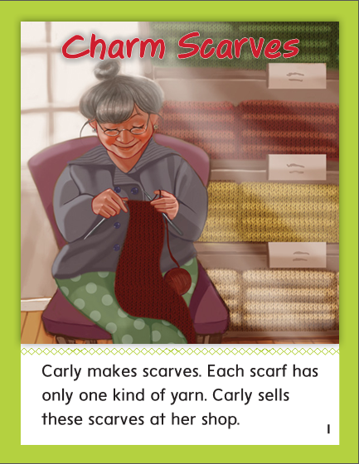

Slide 294
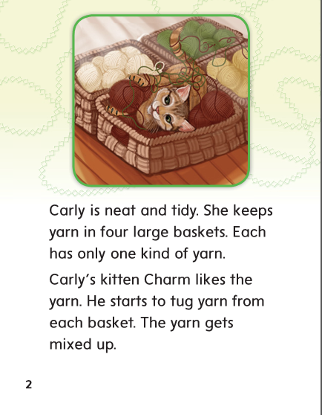

Slide 296
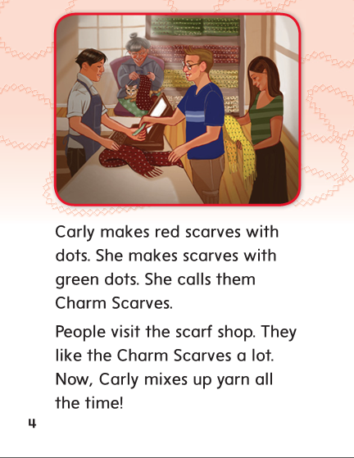

Slide 297
art
arn
arm

Slide 298
cart
farm
cart
yarn
charm
yarn
harm
harm
barn
barn
art
farm
art
arm
charm
arm

Slide 299
High Frequency
Words

Slide 300
Read, Spell, Write
four
I see four fish in the fish tank.

Slide 301
Read, Spell, Write
large
I saw a large dog in the park.

Slide 302
Read, Spell, Write
none
Ted has one left, but Mark has none.

Slide 303
Read, Spell, Write
only
The card only costs five cents.

Slide 304
Read, Spell, Write
put
Where did you put my book?

Slide 305
Read, Spell, Write
round
A penny is round.

Slide 306
Build Fluency: Word Automaticity
Mom put four round cookies into the jar.
Once I ate two, only two were left.
Dad ate two. Now there are non left.

Slide 307
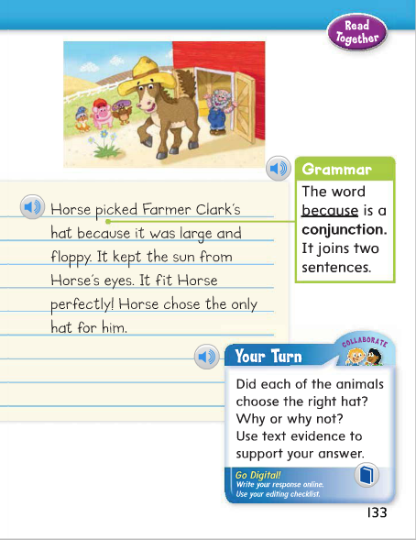
Grammar
Join sentences with and, but, or
Remember that and, but, or, so, and because are words that are used to join sentences together.
Identify the conjunction in the model sentence.
Tell me the joining word in this sentence.
Join two other sentences in this paragraph using a conjunction.

Slide 308
Week 1 – Day 4

Slide 309
Phonemic Awareness
Phoneme Categorization
Listen as I say three words: barn, wait, marsh.
Barn and marsh have the /ar/ sounds.
Wait does not. Wait does not belong.
Guided Practice:
I will say three words:
Tell me which word does not belong and why.
part, harm, chase match, harp, cat horn, mark, force
night, like, dare cart, feel, charm boat, sharp, charge

Slide 310
Build Words with /ar/ ar
t
ar
What is the new word we made?
Let’s blend all the sounds and read the word.
Change the t to f.

Slide 311
Build Words with /ar/ ar
f
ar
What is the new word we made?
Let’s blend all the sounds and read the word.
Add the letter m to the end of the word.

Slide 312
Build Words with /ar/ ar
f
ar
m
What is the new word we made?
Let’s blend all the sounds and read the word.
Change the f to ch.

Slide 313
Build Words with /ar/ ar
ch
ar
m
What is the new word we made?
Let’s blend all the sounds and read the word.
Change the m to t.

Slide 314
Build Words with /ar/ ar
ch
ar
t
What is the new word we made?
Let’s blend all the sounds and read the word.
Change the ch to c.

Slide 315
Build Words with /ar/ ar
c
ar
t
What is the new word we made?
Let’s blend all the sounds and read the word.
Remove the t.

Slide 316
Build Words with /ar/ ar
c
ar
What is the new word we made?
Let’s blend all the sounds and read the word.
Change the c to b.

Slide 317
Build Words with /ar/ ar
b
ar
What is the new word we made?
Let’s blend all the sounds and read the word.
Add the letter k to the end of the word.

Slide 318
Build Words with /ar/ ar
b
ar
k
What is the new word we made?
Let’s blend all the sounds and read the word.
Change the k to n.

Slide 319
Build Words with /ar/ ar
b
ar
n
What is the new word we made?
Let’s blend all the sounds and read the word.
Change the b to y.

Slide 320
Build Words with /ar/ ar
y
ar
n
What is the new word we made?
Let’s blend all the sounds and read the word.
Change the n to d.

Slide 321
Build Words with /ar/ ar
y
ar
d
What is the new word we made?
Let’s blend all the sounds and read the word.
Change the y to h.

Slide 322
Build Words with /ar/ ar
h
ar
d
What is the new word we made?
Let’s blend all the sounds and read the word.
Change the d to p.

Slide 323
Build Words with /ar/ ar
h
ar
p
What is the new word we made?
Let’s blend all the sounds and read the word.
Change the h to sh.

Slide 324
Build Words with /ar/ ar
sh
ar
p
What is the new word we made?
Let’s blend all the sounds and read the word.
Change the p to k.

Slide 325
Build Words with /ar/ ar
sh
ar
k
What is the new word we made?
Let’s blend all the sounds and read the word.

Slide 326
Structural Analysis
Irregular Plurals
Some words do not add –s or –es to make them
mean “more than one.”
woman
women
One woman left the store.
Several women kept shopping.
Explain that the vowel sound and spelling changed.

Slide 327
Structural Analysis
Irregular Plurals
Sort the words into singular and plural.
singular
plural
foot, man, child, sheep, children, feet, men,

Slide 332
High Frequency
Words

Slide 333
Read, Spell, Write
four
I see four fish in the fish tank.

Slide 334
Read, Spell, Write
large
I saw a large dog in the park.

Slide 335
Read, Spell, Write
none
Ted has one left, but Mark has none.

Slide 336
Read, Spell, Write
only
The card only costs five cents.

Slide 337
Read, Spell, Write
put
Where did you put my book?

Slide 338
Read, Spell, Write
round
A penny is round.

Slide 339
Grammar
Join sentences with so and because
So and because are used to join two sentences
when there is a cause and effect.
We were late for the bus so we had to run.
Carly gave back the jar of jam because it was too tart.
Guide children to identify the joining words
as you say these sentences.

Slide 340
Grammar
Join sentences with so and because
Have the children complete the sentences with so and because.
I can’t come over and play ______
I have to help my dad.
The joke was funny _____ I laughed.
My dog got very muddy __________
I had to wash her.

Slide 341
Week 1 – Day 5

Slide 342
Phonemic Awareness
Phoneme Blending:
Listen as I say a group of sounds. Then blend those sounds to form a word.
/h/ /ar/ /d/ /ch/ /ar/ /t/ /s/ /t/ /ar/ /t/
/s/ /p/ /ar/ /k/ /m/ /ar/ /ch/
Phoneme Segmentation:
Now I am going to say a word. I want you to say each sound in the word. You can say the /ar/ sounds together.
car yard bark charm marsh scarf

Slide 343
Blend and Build Words with Long i: i, y, igh, ie
Read and say these words:
card
march
dark
smart

Slide 344
Blend and Build Words with /ar/ ar
m
ar
t
What is the new word we made?
Let’s blend all the sounds and read the word.
Change the m to c.

Slide 345
Blend and Build Words with /ar/ ar
c
ar
t
What is the new word we made?
Let’s blend all the sounds and read the word.
Change the c to ch.

Slide 346
Blend and Build Words with /ar/ ar
ch
ar
t
What is the new word we made?
Let’s blend all the sounds and read the word.
Remove the ch.

Slide 347
Blend and Build Words with /ar/ ar
ar
t
What is the new word we made?
Let’s blend all the sounds and read the word.
Change the t to m.

Slide 348
Blend and Build Words with /ar/ ar
ar
m
What is the new word we made?
Let’s blend all the sounds and read the word.
Add the letter h to the beginning of the word..

Slide 349
Blend and Build Words with /ar/ ar
h
ar
m
What is the new word we made?
Let’s blend all the sounds and read the word.
Change the h to ch.

Slide 350
Blend and Build Words with /ar/ ar
ch
ar
m
What is the new word we made?
Let’s blend all the sounds and read the word.
Change the ch to f.

Slide 351
Blend and Build Words with /ar/ ar
f
ar
m
What is the new word we made?
Let’s blend all the sounds and read the word.
Remove the m.

Slide 352
Blend and Build Words with /ar/ ar
f
ar
What is the new word we made?
Let’s blend all the sounds and read the word.
Change the f to t.

Slide 353
Blend and Build Words with /ar/ ar
t
ar
What is the new word we made?
Let’s blend all the sounds and read the word.
Change the t to st.

Slide 354
Blend and Build Words with /ar/ ar
st
ar
What is the new word we made?
Let’s blend all the sounds and read the word.
Change the st to sc.

Slide 355
Blend and Build Words with /ar/ ar
sc
ar
What is the new word we made?
Let’s blend all the sounds and read the word.
Change the sc to c.

Slide 356
Blend and Build Words with /ar/ ar
c
ar
What is the new word we made?
Let’s blend all the sounds and read the word.
Change the c to b.

Slide 357
Blend and Build Words with /ar/ ar
b
ar
What is the new word we made?
Let’s blend all the sounds and read the word.
Add the letter k to the end of the word.

Slide 358
Blend and Build Words with /ar/ ar
b
ar
k
What is the new word we made?
Let’s blend all the sounds and read the word.
Add the letter k to the end of the word.

Slide 359
Blend and Build Words with /ar/ ar
b
ar
k
What is the new word we made?
Let’s blend all the sounds and read the word.
Change the b to p.

Slide 360
Blend and Build Words with /ar/ ar
p
ar
k
What is the new word we made?
Let’s blend all the sounds and read the word.
Change the p to sp.

Slide 361
Blend and Build Words with /ar/ ar
sp
ar
k
What is the new word we made?
Let’s blend all the sounds and read the word.
Change the sp to sh.

Slide 362
Blend and Build Words with /ar/ ar
sh
ar
k
What is the new word we made?
Let’s blend all the sounds and read the word.
Change the k to p.

Slide 363
Blend and Build Words with /ar/ ar
sh
ar
p
What is the new word we made?
Let’s blend all the sounds and read the word.

Slide 364
Word Automaticity
large

Slide 365
marsh

Slide 366
man

Slide 367
child

Slide 368
barnyard

Slide 369
farm

Slide 370
mark

Slide 371
men

Slide 372
children

Slide 373
postcard

Slide 374
barn

Slide 375
dark

Slide 376
foot

Slide 377
tooth

Slide 378
bookmark

Slide 379
sharp

Slide 380
spark

Slide 381
feet

Slide 382
teeth

Slide 383
smart

Slide 384
charge

Slide 385
sheep

Slide 386
mice

Slide 387
charcoal

Slide 388
Structural Analysis
Irregular Plurals
Have children explain ways to make words mean “more than one.”
Have children write the plurals for these words:
singular
plural
man
child
foot
woman

Slide 389
High Frequency
Words

Slide 390
Read, Spell, Write
four
I see four fish in the fish tank.

Slide 391
Read, Spell, Write
large
I saw a large dog in the park.

Slide 392
Read, Spell, Write
none
Ted has one left, but Mark has none.

Slide 393
Read, Spell, Write
only
The card only costs five cents.

Slide 394
Read, Spell, Write
put
Where did you put my book?

Slide 395
Read, Spell, Write
round
A penny is round.

Slide 396
Grammar
Joining Sentences
Two sentences can be joined using and, but, or, so, or because.
Identify the joining words in the following sentences:
My dog barked because he was happy to see me.
Miss Carlin parked her car and walked into the shop.
Do you like oatmeal or do you like toast?
Dad wanted to make meatloaf but he didn’t have any meat.
Art likes to make kids laugh so he acts silly.

