Slide 1
Week 2 – Day 1

Slide 2
Phonological Awareness
Identify and generate Rhyme
I am going to say two words. Listen: shirt, hurt.
Shirt and hurt rhyme because they both end in the same sounds: /urt/.
Listen: /sh/ /urt/, shirt; /h/ /urt/, hurt.
What other words rhyme with shirt and hurt?
To figure that out, I need to think of words that end in /urt/.
I know one: dirt, /d/ /urt/.
The word dirt ends in /urt/, so It rhymes with shirt and hurt.
Guided Practice:
I will say a group of words. Tell me which two words in the group rhyme.
Then think o other words that rhyme with the rhyming pair.
turn, torn, earn make, far, scar heard, chirp, third
rain, plane, pay roar, cart, core goal, oat, goat

Slide 3
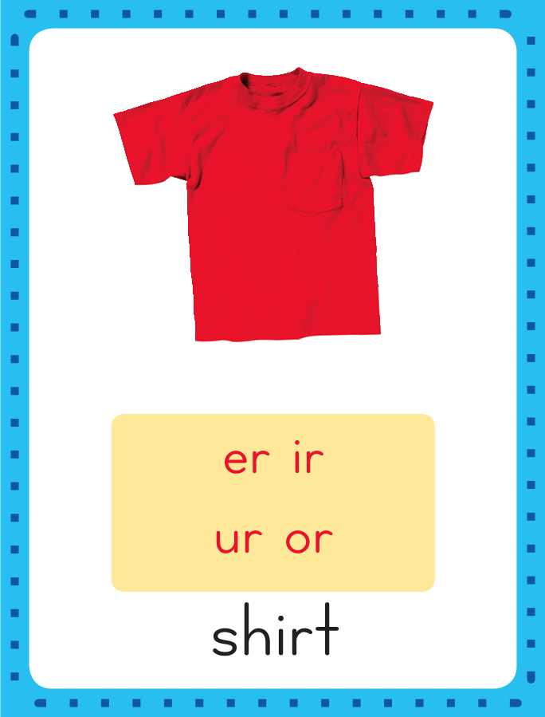
Introduce /ur/: er, ir, ur, or
her
This is the Shirt
Sound-Spelling Card.
The sounds in the middle of shirt are /ur/.
Listen: /shirt/,shirt.
The /ur/ sounds can be spelled with the letters ir as in shirt, er as in her, ur as in fur, and or as in worm. Say the sounds with me: /ur/.
shirt
fur
worm

Slide 4
Have children practice connecting the letters er, ir, ur, and or to the sounds /ur/ by writing them.
Now do it with me. Say /ar/ as I write the letters ar.
This time, write the letters ar five times as you say the /ar/ sounds.
er er er er er
ir ir ir ir ir
ur ur ur ur ur
or or or or or

Slide 5
Blend Words with /ur/: er, ir, ur, or
g

Slide 6
Blend Words with /ur/: er, ir, ur, or
g
ir

Slide 7
Blend Words with /ur/: er, ir, ur, or
g
ir

Slide 8
Blend Words with /ur/: er, ir, ur, or
g
ir
l

Slide 9
Blend Words with /ur/: er, ir, ur, or
g
ir
l

Slide 10
Blend Words with /ur/: er, ir, ur, or
ge

Slide 11
Blend Words with /ur/: er, ir, ur, or
g
er

Slide 12
Blend Words with /ur/: er, ir, ur, or
g
er

Slide 13
Blend Words with /ur/: er, ir, ur, or
g
er
m

Slide 14
Blend Words with /ur/: er, ir, ur, or
g
er
m

Slide 15
Blend Words with /ur/: er, ir, ur, or
c

Slide 16
Blend Words with /ur/: er, ir, ur, or
c
ur

Slide 17
Blend Words with /ur/: er, ir, ur, or
c
ur

Slide 18
Blend Words with /ur/: er, ir, ur, or
c
ur
b

Slide 19
Blend Words with /ur/: er, ir, ur, or
c
ur
b

Slide 20
Blend Words with /ur/: er, ir, ur, or
w

Slide 21
Blend Words with /ur/: er, ir, ur, or
w
or

Slide 22
Blend Words with /ur/: er, ir, ur, or
w
or

Slide 23
Blend Words with /ur/: er, ir, ur, or
w
or
ld

Slide 24
Blend Words with /ur/: er, ir, ur, or
w
or
ld

Slide 25
er st or ck
cl ir j ur
ar sh re igh
ge i_e sk er

Slide 26
h

Slide 27
her

Slide 28
her b

Slide 29
her bir

Slide 30
her bird

Slide 31
her bird c

Slide 32
her bird cur

Slide 33
her bird curl

Slide 34
her bird curl
f

Slide 35
her bird curl
fir

Slide 36
her bird curl
first

Slide 37
her bird curl
first w

Slide 38
her bird curl
first wor

Slide 39
her bird curl
first worm

Slide 40
her bird curl
first worm d

Slide 41
her bird curl
first worm dir

Slide 42
her bird curl
first worm dirt

Slide 43
her bird curl
first worm dirt
w

Slide 44
her bird curl
first worm dirt
wor

Slide 45
her bird curl
first worm dirt
word

Slide 46
her bird curl
first worm dirt
word v

Slide 47
her bird curl
first worm dirt
word ver

Slide 48
her bird curl
first worm dirt
word verb

Slide 49
her bird curl
first worm dirt
word verb t

Slide 50
her bird curl
first worm dirt
word verb tur

Slide 51
her bird curl
first worm dirt
word verb turn

Slide 52
her bird curl
first worm dirt
word verb turn
j

Slide 53
her bird curl
first worm dirt
word verb turn
jer

Slide 54
her bird curl
first worm dirt
word verb turn
jerk

Slide 55
her bird curl
first worm dirt
word verb turn
jerk n

Slide 56
her bird curl
first worm dirt
word verb turn
jerk nur

Slide 57
her bird curl
first worm dirt
word verb turn
jerk nurse

Slide 58
her bird curl
first worm dirt
word verb turn
jerk nurse c

Slide 59
her bird curl
first worm dirt
word verb turn
jerk nurse cur

Slide 60
her bird curl
first worm dirt
word verb turn
jerk nurse curve

Slide 61
Internal Sounding Out
bun

Slide 62
Internal Sounding Out
bun burn

Slide 63
Internal Sounding Out
bun burn clock

Slide 64
Internal Sounding Out
bun burn clock
clerk

Slide 65
Internal Sounding Out
bun burn clock
clerk shirt

Slide 66
Internal Sounding Out
bun burn clock
clerk shirt skirt

Slide 67
Internal Sounding Out
bun burn clock
clerk shirt skirt
large

Slide 68
Internal Sounding Out
bun burn clock
clerk shirt skirt
large lucky

Slide 69
Internal Sounding Out
bun burn clock
clerk shirt skirt
large lucky flight

Slide 70
Internal Sounding Out
bun burn clock
clerk shirt skirt
large lucky flight
bet

Slide 71
Internal Sounding Out
bun burn clock
clerk shirt skirt
large lucky flight
better

Slide 72
Internal Sounding Out
bun burn clock
clerk shirt skirt
large lucky flight
better re

Slide 73
Internal Sounding Out
bun burn clock
clerk shirt skirt
large lucky flight
better return

Slide 74
Internal Sounding Out
bun burn clock
clerk shirt skirt
large lucky flight
better return sur

Slide 75
Internal Sounding Out
bun burn clock
clerk shirt skirt
large lucky flight
better return surprise

Slide 76
The

Slide 77
The girls

Slide 78
The girls at

Slide 79
The girls at work

Slide 80
The girls at work were

Slide 81
The girls at work were
thirsty.

Slide 82
The girls at work were
thirsty.
A

Slide 83
The girls at work were
thirsty.
A big

Slide 84
The girls at work were
thirsty.
A big bird

Slide 85
The girls at work were
thirsty.
A big bird lurks

Slide 86
The girls at work were
thirsty.
A big bird lurks on

Slide 87
The girls at work were
thirsty.
A big bird lurks on top

Slide 88
The girls at work were
thirsty.
A big bird lurks on top of

Slide 89
The girls at work were
thirsty.
A big bird lurks on top of the

Slide 90
The girls at work were
thirsty.
A big bird lurks on top of the church.

Slide 91
Fern

Slide 92
Fern will

Slide 93
Fern will hurry

Slide 94
Fern will hurry back

Slide 95
Fern will hurry back to

Slide 96
Fern will hurry back to change

Slide 97
Fern will hurry back to change her

Slide 98
Fern will hurry back to change her skirt.

Slide 99
Spelling / Dictation
1. _________
2. _________
3. _________
4. _________
5. _________
her
work
dirt
fern
fur

Slide 100
High Frequency
Words

Slide 101
Read, Spell, Write
another
The cat will climb another tree.

Slide 102
Read, Spell, Write
climb
The cat will climb another tree.

Slide 103
Read, Spell, Write
full
The glass is not full.

Slide 104
Read, Spell, Write
great
The park is great, so let’s walk through it.

Slide 105
Read, Spell, Write
poor
The poor dog needs more eater.

Slide 106
Read, Spell, Write
through
The park is great, so let’s walk through it.

Slide 107
Have children read the sentences. Prompt them to identify the high-frequency words in connected text and to blend the decodable words.
The cat will climb another tree.
The glass is not full!
The poor dog needs more water.
This park is great, so let’s walk through it.

Slide 108
Grammar
Adjectives
An adjective is a word that describes a noun. Explain that adjectives tell number, color, size, or shape. They also tell how things look, sound, feel, smell, or taste.
A big crow floated in the sky.
I feel the hot sun on my face.
Big and hot are adjectives.
Big describes size and hot tells how something feels.

Slide 109
Grammar
Adjectives
Have partners work together to identify the adjectives.
Did you see the girl in the red skirt?
I see six birds on the tree.
I ate a sweet peach at lunch.

Slide 110
Week 2 – Day 2

Slide 111
Phonemic Awareness
Phoneme Substitution
Listen carefully as I say a word: bird, /bird/.
I will change the /b/ sound to /h/, and make a new word.
The new word is herd, /hurd/.
Guided Practice:
Let’s do some together. The word is turn. Say it with me: /turnnn/.
We will change the first sound /t/ to /b/.
Let’s say the new word together: burn.
Now listen as I say some words. I want to change the first sound in each word to the sound I give you to make a new word.
dirt, /h/ dried, /f/ jumpy, /b/
burst, /th/ term, /w/ my, /sh/
cart, /h/ nurse, /p/ rail, /m/

Slide 112
Introduce /ur/: er, ir, ur, or
term
firm
What are the letters?
What sound do they stand for?
surf
work

Slide 113
Blend Words with /ur/: er, ir, ur, or
th

Slide 114
Blend Words with /ur/: er, ir, ur, or
th
ir

Slide 115
Blend Words with /ur/: er, ir, ur, or
th
ir

Slide 116
Blend Words with /ur/: er, ir, ur, or
th
ir
st

Slide 117
Blend Words with /ur/: er, ir, ur, or
th
ir
st

Slide 118
Blend Words with /ur/: er, ir, ur, or
ch

Slide 119
Blend Words with /ur/: er, ir, ur, or
ch
ir

Slide 120
Blend Words with /ur/: er, ir, ur, or
ch
ir

Slide 121
Blend Words with /ur/: er, ir, ur, or
ch
ir
p

Slide 122
Blend Words with /ur/: er, ir, ur, or
ch
ir
p

Slide 123
Blend Words with /ur/: er, ir, ur, or
f

Slide 124
Blend Words with /ur/: er, ir, ur, or
f
er

Slide 125
Blend Words with /ur/: er, ir, ur, or
f
er

Slide 126
Blend Words with /ur/: er, ir, ur, or
f
er
n

Slide 127
Blend Words with /ur/: er, ir, ur, or
f
er
n

Slide 128
Blend Words with /ur/: er, ir, ur, or
b

Slide 129
Blend Words with /ur/: er, ir, ur, or
b
ur

Slide 130
Blend Words with /ur/: er, ir, ur, or
b
ur

Slide 131
Blend Words with /ur/: er, ir, ur, or
b
ur
n

Slide 132
Blend Words with /ur/: er, ir, ur, or
b
ur
n

Slide 133
Blend Words with /ur/: er, ir, ur, or
w

Slide 134
Blend Words with /ur/: er, ir, ur, or
w
or

Slide 135
Blend Words with /ur/: er, ir, ur, or
w
or

Slide 136
Blend Words with /ur/: er, ir, ur, or
w
or
m

Slide 137
Blend Words with /ur/: er, ir, ur, or
w
or
m

Slide 138
s

Slide 139
sir

Slide 140
sir w

Slide 141
sir wor

Slide 142
sir worse

Slide 143
sir worse sk

Slide 144
sir worse skir

Slide 145
sir worse skirt

Slide 146
sir worse skirt
h

Slide 147
sir worse skirt
hur

Slide 148
sir worse skirt
hurl

Slide 149
sir worse skirt
hurl b

Slide 150
sir worse skirt
hurl bir

Slide 151
sir worse skirt
hurl birth

Slide 152
sir worse skirt
hurl birth g

Slide 153
sir worse skirt
hurl birth gir

Slide 154
sir worse skirt
hurl birth girl

Slide 155
sir worse skirt
hurl birth girl
w

Slide 156
sir worse skirt
hurl birth girl
wor

Slide 157
sir worse skirt
hurl birth girl
word

Slide 158
sir worse skirt
hurl birth girl
word t

Slide 159
sir worse skirt
hurl birth girl
word tur

Slide 160
sir worse skirt
hurl birth girl
word turn

Slide 161
sir worse skirt
hurl birth girl
word turn ch

Slide 162
sir worse skirt
hurl birth girl
word turn chur

Slide 163
sir worse skirt
hurl birth girl
word turn church

Slide 164
Build Words with /ur/ er, ir, ur, or
g
er
m
What is the new word we made?
Let’s blend all the sounds and read the word.
Change the g to t.

Slide 165
Build Words with /ur/ er, ir, ur, or
t
er
m
What is the new word we made?
Let’s blend all the sounds and read the word.
Change the t to p.

Slide 166
Build Words with /ur/ er, ir, ur, or
p
er
m
What is the new word we made?
Let’s blend all the sounds and read the word.
Change the m to k.

Slide 167
Build Words with /ur/ er, ir, ur, or
p
er
k
What is the new word we made?
Let’s blend all the sounds and read the word.
Change the p to j.

Slide 168
Build Words with /ur/ er, ir, ur, or
j
er
k
What is the new word we made?
Let’s blend all the sounds and read the word.
Change the j to cl.

Slide 169
Build Words with /ur/ er, ir, ur, or
cl
er
k
What is the new word we made?
Let’s blend all the sounds and read the word.
Change the cl to c and the k to l.

Slide 170
Build Words with /ur/ er, ir, ur, or
c
ur
l
What is the new word we made?
Let’s blend all the sounds and read the word.
Change the c to h.

Slide 171
Build Words with /ur/ er, ir, ur, or
h
ur
l
What is the new word we made?
Let’s blend all the sounds and read the word.
Change the l to t.

Slide 172
Build Words with /ur/ er, ir, ur, or
h
ur
t
What is the new word we made?
Let’s blend all the sounds and read the word.
Change the h to sh.

Slide 173
Build Words with /ur/ er, ir, ur, or
sh
ir
t
What is the new word we made?
Let’s blend all the sounds and read the word.
Change the sh to sk.

Slide 174
Build Words with /ur/ er, ir, ur, or
sk
ir
t
What is the new word we made?
Let’s blend all the sounds and read the word.
Change the ir to i.

Slide 175
Build Words with /ur/ er, ir, ur, or
sk
i
t
What is the new word we made?
Let’s blend all the sounds and read the word.
Change the sk to s.

Slide 176
Build Words with /ur/ er, ir, ur, or
s
i
t
What is the new word we made?
Let’s blend all the sounds and read the word.
Change the s to b.

Slide 177
Build Words with /ur/ er, ir, ur, or
b
i
t
What is the new word we made?
Let’s blend all the sounds and read the word.
Change the t to d.

Slide 178
Build Words with /ur/ er, ir, ur, or
b
i
d
What is the new word we made?
Let’s blend all the sounds and read the word.
Change the i to ir.

Slide 179
Build Words with /ur/ er, ir, ur, or
b
ir
d
What is the new word we made?
Let’s blend all the sounds and read the word.
Change the b to th.

Slide 180
Build Words with /ur/ er, ir, ur, or
th
ir
d
What is the new word we made?
Let’s blend all the sounds and read the word.
Change the th to w.

Slide 181
Build Words with /ur/ er, ir, ur, or
w
or
d
What is the new word we made?
Let’s blend all the sounds and read the word.
Change the th to w.

Slide 182
Structural Analysis
Inflectual Ending -er
The ending –er can be added to some words to make new words.
Adding –er to a verb, or action word, changes the verb to a moun, or naming word.
teach
teacher
A teacher is a person who teaches.
Have students use both words in a sentence.

Slide 183
Structural Analysis
Inflectual Ending -er
work
learner
farm
fight
read
Have chiidren add –er to each word and explain what the new word means. Then have them use each word in a sentence.

Slide 184
Spelling
verb
girl
turn
worm

Slide 185
her
bird
fur
work
fern
dirt
her
bird
fur
work
fern
dirt

Slide 186
High Frequency
Words

Slide 187
Read, Spell, Write
another
The cat will climb another tree.

Slide 188
Read, Spell, Write
climb
The cat will climb another tree.

Slide 189
Read, Spell, Write
full
The glass is not full.

Slide 190
Read, Spell, Write
great
The park is great, so let’s walk through it.

Slide 191
Read, Spell, Write
poor
The poor dog needs more eater.

Slide 192
Read, Spell, Write
through
The park is great, so let’s walk through it.

Slide 193
Grammar
Adjectives
An adjective tells number, color, size, shape, and how things look, sound, feel, smell or taste. Words like red, big, round, soft, and sour are adjectives. These words describe things.
I took off my wet socks and put them in the tan basket.
Can you climb to the top of the high cliff?
Guide children to circle the adjectives in each sentence.

Slide 194
Grammar
Adjectives
Have children work in pairs to identify and circle each adjective.
Curtis got three stars on his math homework.
Can you put the blue sheets on the bed?

Slide 195
Week 2 – Day 3

Slide 196
Phonological Awareness
Phoneme Blending
Listen as I say the sounds in a word: /g/ /ur/ /l/.
Now, I will blend the sounds together and say the word: /gurlll/, girl.
Let’s say the word together: girl.
Guided Practice:
I am going to say some words, sound by sound. Blend the sounds together to say the word.
/w/ /ur//d/ /b/ /ur/ /d/ /t/ /ur/ /n/ /n/ /ur/ /s/ /f/ /ur//m/
/w/ /ur/ /m/ /b/ /ur/ /n/ /th/ /ur/ /d/ /p/ /ur/ /s/ /s//w//ur//v/

Slide 197
Blend Words with /ur/ er, ir, ur, or
h

Slide 198
Blend Words with /ur/ er, ir, ur, or
h
ur

Slide 199
Blend Words with /ur/ er, ir, ur, or
h
ur

Slide 200
Blend Words with /ur/ er, ir, ur, or
h
ur
t

Slide 201
Blend Words with /ur/ er, ir, ur, or
h
ur
t

Slide 202
Blend Words with /ur/ er, ir, ur, or
f

Slide 203
Blend Words with /ur/ er, ir, ur, or
f
er

Slide 204
Blend Words with /ur/ er, ir, ur, or
f
er

Slide 205
Blend Words with /ur/ er, ir, ur, or
f
er
n

Slide 206
Blend Words with /ur/ er, ir, ur, or
f
er
n

Slide 207
Blend Words with /ur/ er, ir, ur, or
sh

Slide 208
Blend Words with /ur/ er, ir, ur, or
sh
ir

Slide 209
Blend Words with /ur/ er, ir, ur, or
sh
ir

Slide 210
Blend Words with /ur/ er, ir, ur, or
sh
ir
t

Slide 211
Blend Words with /ur/ er, ir, ur, or
sh
ir
t

Slide 212
Blend Words with /ur/ er, ir, ur, or
w

Slide 213
Blend Words with /ur/ er, ir, ur, or
w
or

Slide 214
Blend Words with /ur/ er, ir, ur, or
w
or

Slide 215
Blend Words with /ur/ er, ir, ur, or
w
or
th

Slide 216
Blend Words with /ur/ er, ir, ur, or
w
or
th

Slide 217
Blend Words with /ur/ er, ir, ur, or
b

Slide 218
Blend Words with /ur/ er, ir, ur, or
b
ur

Slide 219
Blend Words with /ur/ er, ir, ur, or
b
ur

Slide 220
Blend Words with /ur/ er, ir, ur, or
b
ur
st

Slide 221
Blend Words with /ur/ er, ir, ur, or
b
ur
st

Slide 222
ur sh er ge
st ir ch or
ay th ea ar
ley val ly sil

Slide 223
s

Slide 224
sur

Slide 225
surf

Slide 226
surf h

Slide 227
surf her

Slide 228
surf her f

Slide 229
surf her fir

Slide 230
surf her first

Slide 231
surf her first
w

Slide 232
surf her first
wor

Slide 233
surf her first
work

Slide 234
surf her first
work n

Slide 235
surf her first
work ne

Slide 236
surf her first
work nev

Slide 237
surf her first
work never

Slide 238
surf her first
work never g

Slide 239
surf her first
work never gir

Slide 240
surf her first
work never girl

Slide 241
surf her first
work never girl
n

Slide 242
surf her first
work never girl
nur

Slide 243
surf her first
work never girl
nurse

Slide 244
surf her first
work never girl
nurse v

Slide 245
surf her first
work never girl
nurse ver

Slide 246
surf her first
work never girl
nurse verb

Slide 247
surf her first
work never girl
nurse verb h

Slide 248
surf her first
work never girl
nurse verb her

Slide 249
surf her first
work never girl
nurse verb hers

Slide 250
surf her first
work never girl
nurse verb herse

Slide 251
surf her first
work never girl
nurse verb herself

Slide 252
surf her first
work never girl
nurse verb herself
t

Slide 253
surf her first
work never girl
nurse verb herself
tur

Slide 254
surf her first
work never girl
nurse verb herself
turn

Slide 255
surf her first
work never girl
nurse verb herself
turned

Slide 256
surf her first
work never girl
nurse verb herself
turned w

Slide 257
surf her first
work never girl
nurse verb herself
turned wor

Slide 258
surf her first
work never girl
nurse verb herself
turned work

Slide 259
surf her first
work never girl
nurse verb herself
turned worker

Slide 260
surf her first
work never girl
nurse verb herself
turned worker s

Slide 261
surf her first
work never girl
nurse verb herself
turned worker sur

Slide 262
surf her first
work never girl
nurse verb herself
turned worker surf

Slide 263
surf her first
work never girl
nurse verb herself
turned worker surfer

Slide 264
Internal Sounding Out
teach

Slide 265
Internal Sounding Out
teacher

Slide 266
Internal Sounding Out
teacher start

Slide 267
Internal Sounding Out
teacher starter

Slide 268
Internal Sounding Out
teacher starter fight

Slide 269
Internal Sounding Out
teacher starter fighter

Slide 270
Internal Sounding Out
teacher starter fighter
paint

Slide 271
Internal Sounding Out
teacher starter fighter
painter

Slide 272
Internal Sounding Out
teacher starter fighter
painter help

Slide 273
Internal Sounding Out
teacher starter fighter
painter helper

Slide 274
Internal Sounding Out
teacher starter fighter
painter helper farm

Slide 275
Internal Sounding Out
teacher starter fighter
painter helper farmer

Slide 276
Internal Sounding Out
teacher starter fighter
painter helper farmer
rent

Slide 277
Internal Sounding Out
teacher starter fighter
painter helper farmer
renter

Slide 278
Internal Sounding Out
teacher starter fighter
painter helper farmer
renter play

Slide 279
Internal Sounding Out
teacher starter fighter
painter helper farmer
renter player

Slide 280
Internal Sounding Out
teacher starter fighter
painter helper farmer
renter player sharp

Slide 281
Internal Sounding Out
teacher starter fighter
painter helper farmer
renter player sharp
barge

Slide 282
Internal Sounding Out
teacher starter fighter
painter helper farmer
renter player sharp
barge bird

Slide 283
Internal Sounding Out
teacher starter fighter
painter helper farmer
renter player sharp
barge birdbath

Slide 284
Internal Sounding Out
teacher starter fighter
painter helper farmer
renter player sharp
barge birdbath val

Slide 285
Internal Sounding Out
teacher starter fighter
painter helper farmer
renter player sharp
barge birdbath valley

Slide 286
The

Slide 287
The bird

Slide 288
The bird is

Slide 289
The bird is in

Slide 290
The bird is in a

Slide 291
The bird is in a hurry

Slide 292
The bird is in a hurry to

Slide 293
The bird is in a hurry to catch

Slide 294
The bird is in a hurry to catch the

Slide 295
The bird is in a hurry to catch the worm.

Slide 296
The bird is in a hurry to catch the worm.
Those

Slide 297
The bird is in a hurry to catch the worm.
Those workers

Slide 298
The bird is in a hurry to catch the worm.
Those workers never

Slide 299
The bird is in a hurry to catch the worm.
Those workers never have

Slide 300
The bird is in a hurry to catch the worm.
Those workers never have to

Slide 301
The bird is in a hurry to catch the worm.
Those workers never have to work

Slide 302
The bird is in a hurry to catch the worm.
Those workers never have to work on

Slide 303
The bird is in a hurry to catch the worm.
Those workers never have to work on Thursday.

Slide 304
Structural Analysis
Inflectional Ending -er
Listen closely to hear what is different.
Point out the –er at the end of worker.
work
worker
The letters –er at the end of a word make the word mean “someone who does something.”
A worker is a person who works.

Slide 305
Structural Analysis
Inflectional Ending -er
Listen closely to hear what is different.
Point out the –er at the end of worker.
learn
learner
The letters –er at the end of a word make the word mean “someone who does something.”
A learner is a person who learns.

Slide 306
Structural Analysis
Inflectional Ending -er
Help children blend the words.
Then have them use both words in each pair in one sentence,.
jump jumper
surf surfer
paint painter
help helper
farm farmer

Slide 307
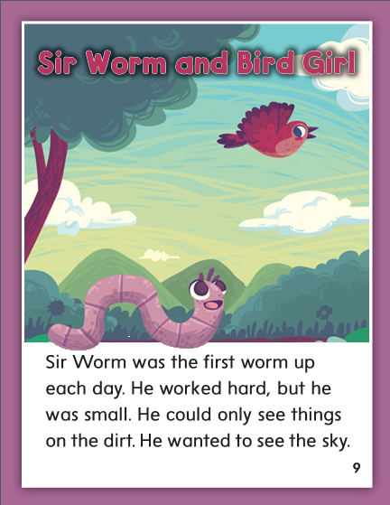

Slide 308
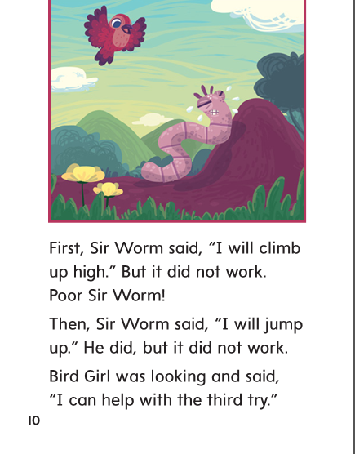

Slide 309
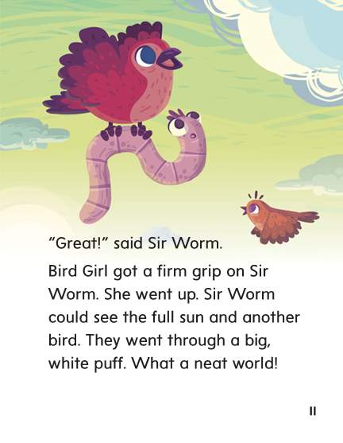

Slide 310
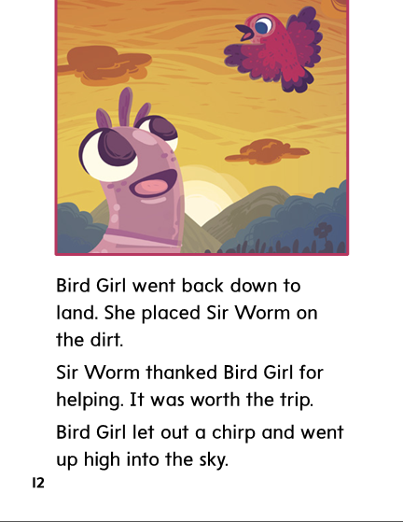

Slide 311
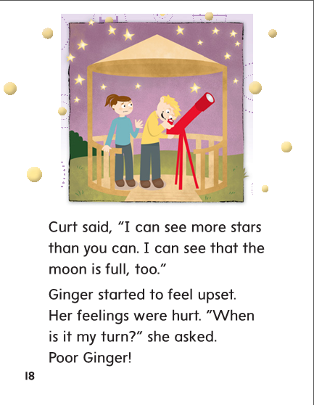

Slide 312
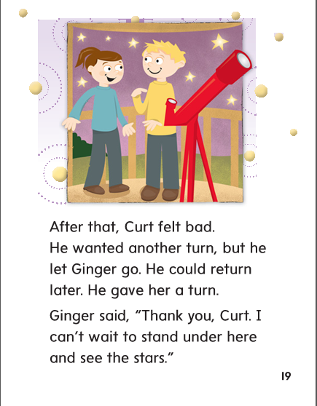

Slide 313
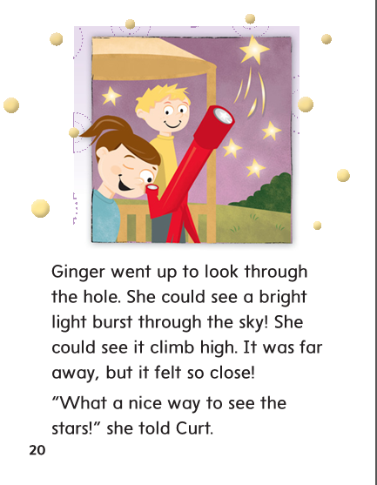

Slide 314
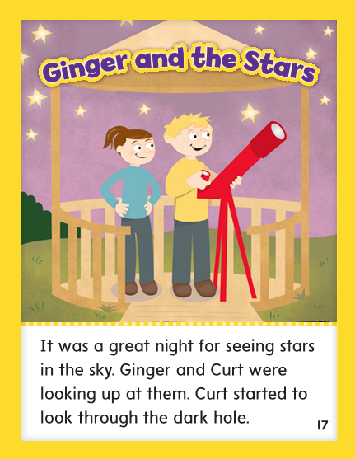

Slide 315
er
ir
ur
or

Slide 316
her
bird
fur
fern
dirt
work
her
bird
fur
fern
dirt
work

Slide 317
High Frequency
Words

Slide 318
Read, Spell, Write
another
The cat will climb another tree.

Slide 319
Read, Spell, Write
climb
The cat will climb another tree.

Slide 320
Read, Spell, Write
full
The glass is not full.

Slide 321
Read, Spell, Write
great
The park is great, so let’s walk through it.

Slide 322
Read, Spell, Write
poor
The poor dog needs more eater.

Slide 323
Read, Spell, Write
through
The park is great, so let’s walk through it.

Slide 324
Build Fluency: Word Automaticity
Can we go through the park another time?
The poor puppy cannot climb out of the box.
That was a great meal, but I am too full now!

Slide 325
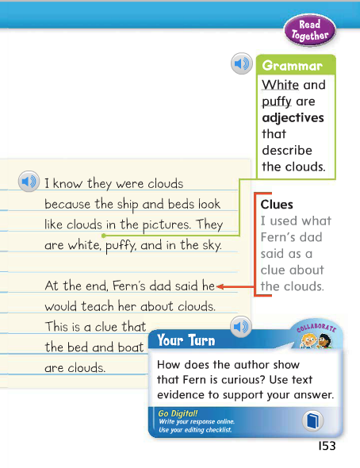
Remember that adjectives describe size, shape, number, and color, and how things look, sound, feel, smell, and taste.
Identify the adjectives in the model sentence.
Which words in this sentence are adjectives?
What noun do they describe?

Slide 326
Week 2 – Day 4

Slide 327
Phonological Awareness
Phoneme Deletion
Listen carefully as I say a word: turn.
The word turn has these sounds: /t/ /ur/ /n/.
I’ll take away the first sound /t/ to make a new word: /ur/ /n/.
The new word is earn.
Guided Practice:
Listen carefully as I say a word. I want you to delete, or take away, the first sound in the word to make a new word.
twirl part train spark fright farm

Slide 328
Blend Words with /ur/ er, ir, ur, or
t
ur
n
What is the new word we made?
Let’s blend all the sounds and read the word.
Change the t to b.

Slide 329
Blend Words with /ur/ er, ir, ur, or
b
ur
n
What is the new word we made?
Let’s blend all the sounds and read the word.
Change the n to st.

Slide 330
Blend Words with /ur/ er, ir, ur, or
b
ur
st
What is the new word we made?
Let’s blend all the sounds and read the word.
Change the ur to u.

Slide 331
Blend Words with /ur/ er, ir, ur, or
b
u
st
What is the new word we made?
Let’s blend all the sounds and read the word.
Change the st to d.

Slide 332
Blend Words with /ur/ er, ir, ur, or
b
u
d
What is the new word we made?
Let’s blend all the sounds and read the word.
Change the u to i.

Slide 333
Blend Words with /ur/ er, ir, ur, or
b
i
d
What is the new word we made?
Let’s blend all the sounds and read the word.
Change the i to ir.

Slide 334
Blend Words with /ur/ er, ir, ur, or
b
ir
d
What is the new word we made?
Let’s blend all the sounds and read the word.
Change the b to th.

Slide 335
Blend Words with /ur/ er, ir, ur, or
th
ir
d
What is the new word we made?
Let’s blend all the sounds and read the word.
Change the d to st.

Slide 336
Blend Words with /ur/ er, ir, ur, or
th
ir
st
What is the new word we made?
Let’s blend all the sounds and read the word.
Change the th to f.

Slide 337
Blend Words with /ur/ er, ir, ur, or
f
ir
st
What is the new word we made?
Let’s blend all the sounds and read the word.
Change the st to n.

Slide 338
Blend Words with /ur/ er, ir, ur, or
f
er
n
What is the new word we made?
Let’s blend all the sounds and read the word.
Change the f to h and the n to d.

Slide 339
Blend Words with /ur/ er, ir, ur, or
h
er
d
What is the new word we made?
Let’s blend all the sounds and read the word.
Change the h to v and the d to b.

Slide 340
Blend Words with /ur/ er, ir, ur, or
v
er
b
What is the new word we made?
Let’s blend all the sounds and read the word.

Slide 341
Structural Analysis
Inflectional Ending -er
Remember that the –er ending means “some who.”
A herder is someone who herds animals.
herd
herder

Slide 342
Structural Analysis
Inflectional Ending -er
Have children work in pairs to construct words with the –er ending.
Then have them write a sentence with each word.
teach
play
lead
read

Slide 348
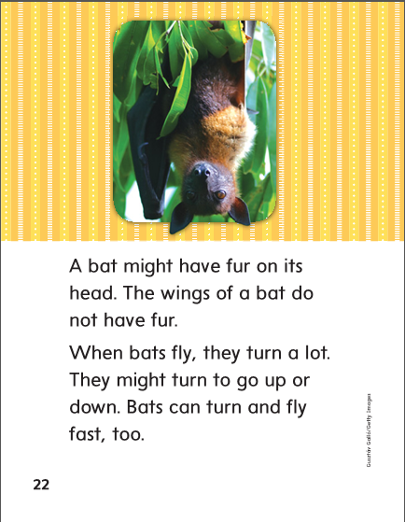

Slide 349
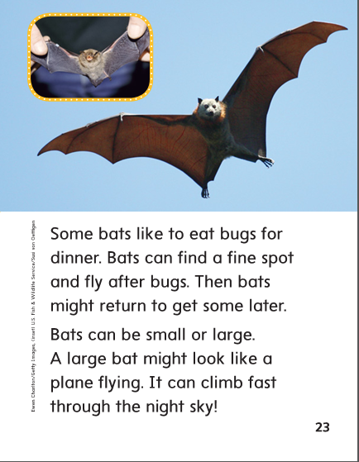

Slide 350
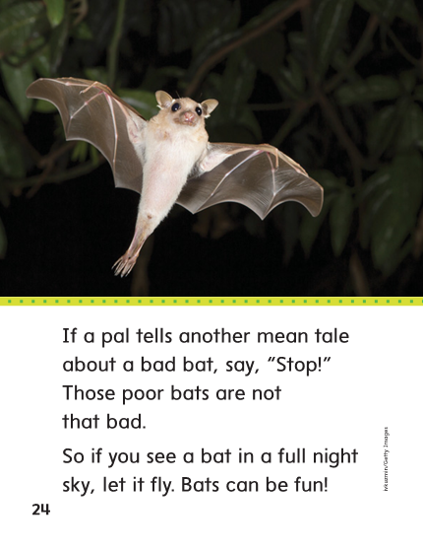

Slide 351
High Frequency
Words

Slide 352
Read, Spell, Write
another
The cat will climb another tree.

Slide 353
Read, Spell, Write
climb
The cat will climb another tree.

Slide 354
Read, Spell, Write
full
The glass is not full.

Slide 355
Read, Spell, Write
great
The park is great, so let’s walk through it.

Slide 356
Read, Spell, Write
poor
The poor dog needs more eater.

Slide 357
Read, Spell, Write
through
The park is great, so let’s walk through it.

Slide 358
Grammar
Adjectives
An adjective describes size, shape, number, and color. Adjectives also tell how things look, sound, feel, smell, and taste.
The chirping bird sits in the little nest.
Miss Cox teaches in the yellow classroom.
Guide children to identify the adjectives in each sentence.

Slide 359
Grammar
Adjectives
Have children identify each adjective and the noun it describes.
The funny kitten chases yarn.
The big bowl is filled with plums.

Slide 360
Week 2 – Day 5

Slide 361
Phonemic Awareness
Phoneme Blending:
Listen as I say a group of sounds. Then blend those sounds to form a word.
/f/ /ur/ /n/ /b/ /ur/ /d/ /th/ /ur/ /d/
/s/ /w/ /ur/ /v/ /p/ /ur/ /s/
Phoneme Substitution:
Listen for the /ur/ sounds in the words I say. Replace the /ur/ sounds with the sound or sounds I say to make a new word.
fur, /ar/ burn, /ar/ herd, /e/
term, /a/ shirt, /or/ stir, /a/

Slide 362
Blend and Build Words with Long i: i, y, igh, ie
Read and say these words:
her
girl
burn
word

Slide 363
Blend and Build Words with /ur/ er, ir, ur, or
w
or
m
What is the new word we made?
Let’s blend all the sounds and read the word.

Slide 364
Blend and Build Words with /ur/ er, ir, ur, or
w
or
d
What is the new word we made?
Let’s blend all the sounds and read the word.
Change the d to th.

Slide 365
Blend and Build Words with /ur/ er, ir, ur, or
w
or
th
What is the new word we made?
Let’s blend all the sounds and read the word.
Change the th to se.

Slide 366
Blend and Build Words with /ur/ er, ir, ur, or
w
or
se
What is the new word we made?
Let’s blend all the sounds and read the word.
Change the se to st.

Slide 367
Blend and Build Words with /ur/ er, ir, ur, or
w
or
st
What is the new word we made?
Let’s blend all the sounds and read the word.
Change the se to st.

Slide 368
Blend and Build Words with /ur/ er, ir, ur, or
Let’s start over with another word
d
ir
t
What is the new word we made?
Let’s blend all the sounds and read the word.
Change the d to sh.

Slide 369
Blend and Build Words with /ur/ er, ir, ur, or
Let’s start over with another word
sh
ir
t
What is the new word we made?
Let’s blend all the sounds and read the word.
Change the sh to sk.

Slide 370
Blend and Build Words with /ur/ er, ir, ur, or
Let’s start over with another word
sk
ir
t
What is the new word we made?
Let’s blend all the sounds and read the word.
Change the sk to f and the t to st.

Slide 371
Blend and Build Words with /ur/ er, ir, ur, or
Let’s start over with another word
f
ir
st
What is the new word we made?
Let’s blend all the sounds and read the word.
Change the st to m.

Slide 372
Blend and Build Words with /ur/ er, ir, ur, or
Let’s start over with another word
f
ir
m
What is the new word we made?
Let’s blend all the sounds and read the word.
Change the f to t.

Slide 373
Blend and Build Words with /ur/ er, ir, ur, or
Let’s start over with another word
t
er
m
What is the new word we made?
Let’s blend all the sounds and read the word.
Change the t to h and the m to d.

Slide 374
Blend and Build Words with /ur/ er, ir, ur, or
Let’s start over with another word
h
er
d
What is the new word we made?
Let’s blend all the sounds and read the word.
Change the t to h and the m to d.

Slide 375
Word Automaticity
surf

Slide 376
girl

Slide 377
worker

Slide 378
painter

Slide 379
sharp

Slide 380
her

Slide 381
nurse

Slide 382
surfer

Slide 383
helper

Slide 384
barge

Slide 385
first

Slide 386
verb

Slide 387
teacher

Slide 388
farmer

Slide 389
birdbath

Slide 390
work

Slide 391
herself

Slide 392
starter

Slide 393
renter

Slide 394
silly

Slide 395
never

Slide 396
turned

Slide 397
fighter

Slide 398
player

Slide 399
valley

Slide 400
Structural Analysis
Inflectional Ending -er
Have the children explain how the inflectional ending –er changes the meaning of a word.
worker
teacher
farmer
Have children practice writing and saying words with –er.

Slide 401
High Frequency
Words

Slide 402
Read, Spell, Write
another
The cat will climb another tree.

Slide 403
Read, Spell, Write
climb
The cat will climb another tree.

Slide 404
Read, Spell, Write
full
The glass is not full.

Slide 405
Read, Spell, Write
great
The park is great, so let’s walk through it.

Slide 406
Read, Spell, Write
poor
The poor dog needs more eater.

Slide 407
Read, Spell, Write
through
The park is great, so let’s walk through it.

Slide 408
Grammar
Adjectives
An adjective describes size, shape, number, and color. Adjectives also tell how things look, sound, feel, smell, and taste.
Lin saw two worms in the big garden.
The bright sun shone on the hot car.
Would you like the pink car?
I do not like that sweet drink.
Guide children to identify the adjectives in each sentence.

