Slide 1
Week 3 – Day 1

Slide 2
Phonological Awareness
Phoneme Categorization
Listen as I say three words: more, treat, shore.
The words more and shore have the same ending sounds, /or/.
Listen: /m/ /or/, /sh/ /or/.
The word treat does not end in /or/.
It does not belong.
Guided Practice:
Say the words. Have children identify the word that does not end with the same sounds.
cart, stack, heart paid, trade, lend poor, rake, store
mold, coat, boat dust, list, trust fair, bear, burn

Slide 3
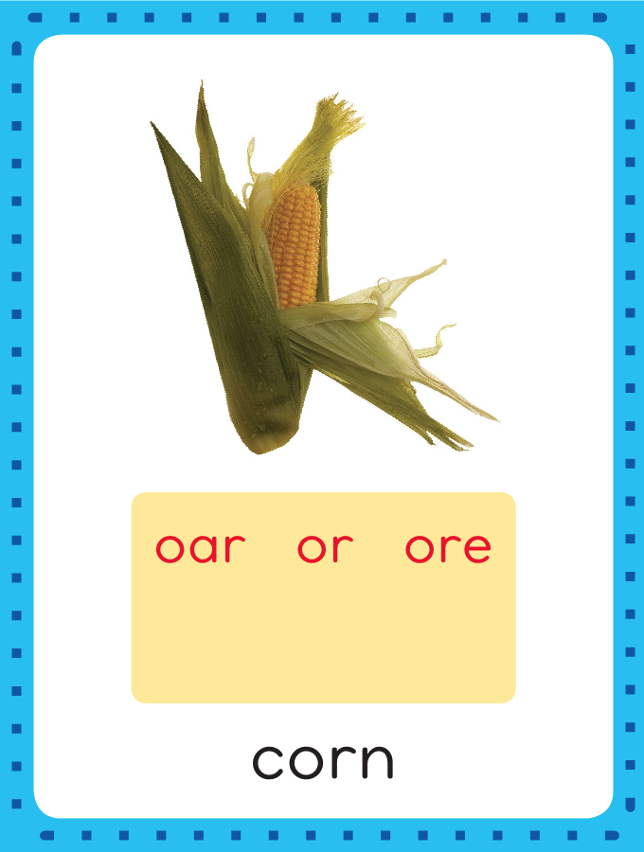
Introduce /or/: or, ore, oar
corn
This is the Corn
Sound-Spelling Card.
The sounds are /or/.
Say the sounds with me: /or/.
These sounds are in the middle of the word corn.
The /or/ sounds can be spelled with the letters or as in corn, ore as in more, and oar as in roar.
I’ll say /or/ as I write the different spellings for the sounds several times.
more
roar

Slide 4
Have children practice connecting the letters or, ore, and oar to the sounds /or/ by writing them.
Now do it with me. Say /or/ as I write the letters or, ore, and oar.
or or or or or
ore ore ore ore oar oar oar oar

Slide 5
Blend Words with /or/: or, ore, oar
s

Slide 6
Blend Words with /or/: or, ore, oar
s
or

Slide 7
Blend Words with /or/: or, ore, oar
s
or

Slide 8
Blend Words with /or/: or, ore, oar
s
or
t

Slide 9
Blend Words with /or/: or, ore, oar
s
or
t

Slide 10
Blend Words with /or/: or, ore, oar
n

Slide 11
Blend Words with /or/: or, ore, oar
n
or

Slide 12
Blend Words with /or/: or, ore, oar
n
or

Slide 13
Blend Words with /or/: or, ore, oar
n
or
th

Slide 14
Blend Words with /or/: or, ore, oar
n
or
th

Slide 15
Blend Words with /or/: or, ore, oar
sh

Slide 16
Blend Words with /or/: or, ore, oar
sh
ore

Slide 17
Blend Words with /or/: or, ore, oar
sh
ore

Slide 18
Blend Words with /or/: or, ore, oar
s

Slide 19
Blend Words with /or/: or, ore, oar
s
ore

Slide 20
Blend Words with /or/: or, ore, oar
s
ore

Slide 21
or sh oar ch
th ir ar st
ore ist er k

Slide 22
or

Slide 23
or f

Slide 24
or for

Slide 25
or for b

Slide 26
or for bor

Slide 27
or for born

Slide 28
or for born m

Slide 29
or for born more

Slide 30
or for born more
st

Slide 31
or for born more
store

Slide 32
or for born more
store sh

Slide 33
or for born more
store shor

Slide 34
or for born more
store short

Slide 35
or for born more
store short t

Slide 36
or for born more
store short tor

Slide 37
or for born more
store short torn

Slide 38
or for born more
store short torn
t

Slide 39
or for born more
store short torn
tor

Slide 40
or for born more
store short torn
torch

Slide 41
or for born more
store short torn
torch r

Slide 42
or for born more
store short torn
torch roar

Slide 43
or for born more
store short torn
torch roar w

Slide 44
or for born more
store short torn
torch roar wor

Slide 45
or for born more
store short torn
torch roar worn

Slide 46
or for born more
store short torn
torch roar worn
f

Slide 47
or for born more
store short torn
torch roar worn
for

Slide 48
or for born more
store short torn
torch roar worn
form

Slide 49
or for born more
store short torn
torch roar worn
form b

Slide 50
or for born more
store short torn
torch roar worn
form boar

Slide 51
or for born more
store short torn
torch roar worn
form board

Slide 52
or for born more
store short torn
torch roar worn
form board f

Slide 53
or for born more
store short torn
torch roar worn
form board far

Slide 54
or for born more
store short torn
torch roar worn
form board farm

Slide 55
Internal Sounding Out
tar

Slide 56
Internal Sounding Out
tar tore

Slide 57
Internal Sounding Out
tar tore pork

Slide 58
Internal Sounding Out
tar tore pork
park

Slide 59
Internal Sounding Out
tar tore pork
park verb

Slide 60
Internal Sounding Out
tar tore pork
park verb third

Slide 61
Internal Sounding Out
tar tore pork
park verb third
turn

Slide 62
Internal Sounding Out
tar tore pork
park verb third
turn dark

Slide 63
Internal Sounding Out
tar tore pork
park verb third
turn dark teach

Slide 64
Internal Sounding Out
tar tore pork
park verb third
turn dark teacher

Slide 65
Internal Sounding Out
tar tore pork
park verb third
turn dark teacher
art

Slide 66
Internal Sounding Out
tar tore pork
park verb third
turn dark teacher
artist

Slide 67
Internal Sounding Out
tar tore pork
park verb third
turn dark teacher
artist storm

Slide 68
Internal Sounding Out
tar tore pork
park verb third
turn dark teacher
artist storm sports

Slide 69
The

Slide 70
The boat’s

Slide 71
The boat’s oar

Slide 72
The boat’s oar was

Slide 73
The boat’s oar was lost

Slide 74
The boat’s oar was lost in

Slide 75
The boat’s oar was lost in the

Slide 76
The boat’s oar was lost in the storm.

Slide 77
The boat’s oar was lost in the storm.
Norm

Slide 78
The boat’s oar was lost in the storm.
Norm likes

Slide 79
The boat’s oar was lost in the storm.
Norm likes to

Slide 80
The boat’s oar was lost in the storm.
Norm likes to play

Slide 81
The boat’s oar was lost in the storm.
Norm likes to play sports.

Slide 82
The boat’s oar was lost in the storm.
Norm likes to play sports.
Can

Slide 83
The boat’s oar was lost in the storm.
Norm likes to play sports.
Can you

Slide 84
The boat’s oar was lost in the storm.
Norm likes to play sports.
Can you eat

Slide 85
The boat’s oar was lost in the storm.
Norm likes to play sports.
Can you eat corn

Slide 86
The boat’s oar was lost in the storm.
Norm likes to play sports.
Can you eat corn with

Slide 87
The boat’s oar was lost in the storm.
Norm likes to play sports.
Can you eat corn with a

Slide 88
The boat’s oar was lost in the storm.
Norm likes to play sports.
Can you eat corn with a fork?

Slide 89
Spelling / Dictation
1. _________
2. _________
3. _________
4. _________
5. _________
born
soar
more
corn
roar

Slide 90
High Frequency
Words

Slide 91
Read, Spell, Write
began
It began to snow last night.

Slide 92
Read, Spell, Write
better
I hope you feel better.

Slide 93
Read, Spell, Write
guess
Can you guess how old he is?

Slide 94
Read, Spell, Write
learn
She will learn to ride a bike.

Slide 95
Read, Spell, Write
right
This is the right way to hold a fork.

Slide 96
Read, Spell, Write
sure
He is sure he will be on time.

Slide 97
Have children read the sentences. Prompt them to identify the high-frequency words in connected text and to blend the decodable words.
It began to snow last night.
I hope you feel better.
Can you guess how old he is?
She will learn to ride a bike.
This is the right way to hold a fork.
He is sure he will be on time.

Slide 98
Grammar
Adjectives that Compare
We add –er to most adjectives to compare two people, places, or things. We add –est to most adjectives to compare three or more people, places, or things.
Curt is a fast runner.
Sheena is a faster runner than Curt.
Jen is the fastest runner of all!
Faster and fastest are adjectives that compare.
Faster is comparing two people.
Fastest is comparing three people.

Slide 99
Grammar
Adjectives that Compare
We add –er to most adjectives to compare two people, places, or things. We add –est to most adjectives to compare three or more people, places, or things.
The first row of corn is long.
The next row of corn is longer.
The last row of corn is the longest.
Have children identify the adjectives that compare.

Slide 100
Week 3 – Day 2

Slide 101
Phonological Awareness
Phoneme Substitution
Listen to the sounds in the word stem: /s/ /t/ /e/ /m/.
Stem has the /e/ sound in the middle.
Listen as I change the /e/ sound to /or/: /s/ /t/ /or/ /m/.
The word is storm.
Guided Practice:
I’ll say a word. Change one sound to /or/ to make a new word.
pet/pork tin/torn can/corn hen/horn
card/cord park/pork bare/bore care/core

Slide 102
Introduce /or/: or, ore, oar
torn
wore
What are the letters?
What sound do they stand for?
board

Slide 103
Blend Words with /or/: or, ore, oar
c

Slide 104
Blend Words with /or/: or, ore, oar
c
ore

Slide 105
Blend Words with /or/: or, ore, oar
c
ore

Slide 106
Blend Words with /or/: or, ore, oar
p

Slide 107
Blend Words with /or/: or, ore, oar
p
or

Slide 108
Blend Words with /or/: or, ore, oar
p
or

Slide 109
Blend Words with /or/: or, ore, oar
p
or
ch

Slide 110
Blend Words with /or/: or, ore, oar
p
or
ch

Slide 111
Blend Words with /or/: or, ore, oar
sh

Slide 112
Blend Words with /or/: or, ore, oar
sh
ore

Slide 113
Blend Words with /or/: or, ore, oar
sh
ore

Slide 114
Blend Words with /or/: or, ore, oar
b
oar

Slide 115
Blend Words with /or/: or, ore, oar
b
oar

Slide 116
Blend Words with /or/: or, ore, oar
b
oar
d

Slide 117
Blend Words with /or/: or, ore, oar
b
oar
d

Slide 118
oar

Slide 119
oar f

Slide 120
oar for

Slide 121
oar fork

Slide 122
oar fork f

Slide 123
oar fork for

Slide 124
oar fork form

Slide 125
oar fork form
w

Slide 126
oar fork form
wore

Slide 127
oar fork form
wore b

Slide 128
oar fork form
wore bor

Slide 129
oar fork form
wore born

Slide 130
oar fork form
wore born sh

Slide 131
oar fork form
wore born shor

Slide 132
oar fork form
wore born short

Slide 133
oar fork form
wore born short
m

Slide 134
oar fork form
wore born short
more

Slide 135
oar fork form
wore born short
more s

Slide 136
oar fork form
wore born short
more sor

Slide 137
oar fork form
wore born short
more sort

Slide 138
oar fork form
wore born short
more sort n

Slide 139
oar fork form
wore born short
more sort nor

Slide 140
oar fork form
wore born short
more sort north

Slide 141
oar fork form
wore born short
more sort north
sc

Slide 142
oar fork form
wore born short
more sort north
score

Slide 143
oar fork form
wore born short
more sort north
score t

Slide 144
oar fork form
wore born short
more sort north
score tor

Slide 145
oar fork form
wore born short
more sort north
score torch

Slide 146
oar fork form
wore born short
more sort north
score torch s

Slide 147
oar fork form
wore born short
more sort north
score torch soar

Slide 148
Build Words with /or/ or, ore, oar
f
or
k
What is the new word we made?
Let’s blend all the sounds and read the word.
Change the f to c.

Slide 149
Build Words with /or/ or, ore, oar
c
or
k
What is the new word we made?
Let’s blend all the sounds and read the word.
Change the c to st.

Slide 150
Build Words with /or/ or, ore, oar
st
or
k
What is the new word we made?
Let’s blend all the sounds and read the word.
Remove the k.

Slide 151
Build Words with /or/ or, ore, oar
st
ore
What is the new word we made?
Let’s blend all the sounds and read the word.
Change the st to sh.

Slide 152
Build Words with /or/ or, ore, oar
sh
ore
What is the new word we made?
Let’s blend all the sounds and read the word.
Change the sh to sn.

Slide 153
Build Words with /or/ or, ore, oar
sn
ore
What is the new word we made?
Let’s blend all the sounds and read the word.
Change the sn to ch.

Slide 154
Build Words with /or/ or, ore, oar
ch
ore
What is the new word we made?
Let’s blend all the sounds and read the word.
Change the ch to c.

Slide 155
Build Words with /or/ or, ore, oar
c
ore
What is the new word we made?
Let’s blend all the sounds and read the word.
Change the c to m.

Slide 156
Build Words with /or/ or, ore, oar
m
ore
What is the new word we made?
Let’s blend all the sounds and read the word.
Change the m to b.

Slide 157
Build Words with /or/ or, ore, oar
b
ore
What is the new word we made?
Let’s blend all the sounds and read the word.
Change the b to s.

Slide 158
Build Words with /or/ or, ore, oar
s
ore
What is the new word we made?
Let’s blend all the sounds and read the word.
Change the s to r.

Slide 159
Build Words with /or/ or, ore, oar
r
oar
What is the new word we made?
Let’s blend all the sounds and read the word.

Slide 160
Structural Analysis
Abbreviations
Read aloud the sentences.
Point out that the sentences sound the same when you read them aloud, but the first word in each sentence looks different.
Mr. is an abbreviation. An abbreviation is a short way of writing a word.
Most abbreviations have a period at the end.
Mister Ford is my teacher.
Mr. Ford is my teacher.

Slide 161
Structural Analysis
Abbreviations
Read aloud the sentences.
Point out that the sentences sound the same when you read them aloud, but the first word in each sentence looks different.
Mr. is an abbreviation. An abbreviation is a short way of writing a word.
Most abbreviations have a period at the end.
Doctor / Dr.
Missus / Mrs.
Street / St.
Avenue / Ave
Road / Rd.

Slide 162
Structural Analysis
Abbreviations
Have children read the abbreviations and then
use each abbreviation in a sentence.
Mr.
Mrs.
Dr.
St.
Ave.

Slide 163
Spelling
torn
chore
bore

Slide 164
born
soar
corn
core
more
roar
born
soar
corn
core
more
roar

Slide 165
High Frequency
Words

Slide 166
Read, Spell, Write
began
It began to snow last night.

Slide 167
Read, Spell, Write
better
I hope you feel better.

Slide 168
Read, Spell, Write
guess
Can you guess how old he is?

Slide 169
Read, Spell, Write
learn
She will learn to ride a bike.

Slide 170
Read, Spell, Write
right
This is the right way to hold a fork.

Slide 171
Read, Spell, Write
sure
He is sure he will be on time.

Slide 172
Grammar
Adjectives that Compare
We add –er to most adjectives to compare two people, places, or things. We add –est to most adjectives to compare three or more people, places, or things.
The bird is high in the sky.
The jet is higher than the bird.
The spaceship is the highest of all.
Which compares two things?
Which compares more than two things?

Slide 173
Grammar
Adjectives that Compare
We add –er to most adjectives to compare two people, places, or things. We add –est to most adjectives to compare three or more people, places, or things.
Fall is colder than summer.
Winter is the coldest of all.
Identify the adjectives and tell if they are comparing two things
or three or more things.

Slide 174
Week 3 – Day 3

Slide 175
Phonological Awareness
Phoneme Blending
I’m going to put one marker in each box as I say each sound.
Then I will blend the sounds to form a word.
/s/
/or/
/t/
Listen as I blend these sounds: /sssort/, sort.
The word is sort.

Slide 176
Phonological Awareness
Phoneme Blending
I will say one sound at a time.
Then we will blend the sounds to say a word.
/f/ /or/ /m/ /or/ /p/ /or/ /ch/ /r/ /or/
/sh/ /or/ /t/ /s/ /n/ /or/ /n/ /or/ /th/ /s/ /p/ /or/ /t/

Slide 177
Blend Words with /or/: or, ore, oar
sp

Slide 178
Blend Words with /or/: or, ore, oar
sp
or

Slide 179
Blend Words with /or/: or, ore, oar
sp
or

Slide 180
Blend Words with /or/: or, ore, oar
sp
or
t

Slide 181
Blend Words with /or/: or, ore, oar
sp
or
t

Slide 182
Blend Words with /or/: or, ore, oar
sc

Slide 183
Blend Words with /or/: or, ore, oar
sc
ore

Slide 184
Blend Words with /or/: or, ore, oar
sc
ore

Slide 185
Blend Words with /or/: or, ore, oar
st

Slide 186
Blend Words with /or/: or, ore, oar
st
or

Slide 187
Blend Words with /or/: or, ore, oar
st
or
k

Slide 188
Blend Words with /or/: or, ore, oar
st
or
k

Slide 189
Blend Words with /or/: or, ore, oar
r

Slide 190
Blend Words with /or/: or, ore, oar
r
oar

Slide 191
Blend Words with /or/: or, ore, oar
r
oar

Slide 192
or ch ir sh
sn ore th ar
be ow ty oar

Slide 193
st

Slide 194
stor

Slide 195
storm

Slide 196
storm b

Slide 197
storm bor

Slide 198
storm born

Slide 199
storm born f

Slide 200
storm born for

Slide 201
storm born for
m

Slide 202
storm born for
more

Slide 203
storm born for
more s

Slide 204
storm born for
more sore

Slide 205
storm born for
more sore p

Slide 206
storm born for
more sore por

Slide 207
storm born for
more sore porch

Slide 208
storm born for
more sore porch
n

Slide 209
storm born for
more sore porch
nor

Slide 210
storm born for
more sore porch
north

Slide 211
storm born for
more sore porch
north s

Slide 212
storm born for
more sore porch
north soar

Slide 213
storm born for
more sore porch
north soar ch

Slide 214
storm born for
more sore porch
north soar chore

Slide 215
storm born for
more sore porch
north soar chores

Slide 216
storm born for
more sore porch
north soar chores
sh

Slide 217
storm born for
more sore porch
north soar chores
shor

Slide 218
storm born for
more sore porch
north soar chores
short

Slide 219
storm born for
more sore porch
north soar chores
short for

Slide 220
storm born for
more sore porch
north soar chores
short forty

Slide 221
storm born for
more sore porch
north soar chores
short forty be

Slide 222
storm born for
more sore porch
north soar chores
short forty before

Slide 223
Internal Sounding Out
sup

Slide 224
Internal Sounding Out
support

Slide 225
Internal Sounding Out
support snow

Slide 226
Internal Sounding Out
support snowstorm

Slide 227
Internal Sounding Out
support snowstorm
Mr.

Slide 228
Internal Sounding Out
support snowstorm
Mr. Mrs.

Slide 229
Internal Sounding Out
support snowstorm
Mr. Mrs. St.

Slide 230
Internal Sounding Out
support snowstorm
Mr. Mrs. St. Dr.

Slide 231
Internal Sounding Out
support snowstorm
Mr. Mrs. St. Dr. Ave.

Slide 232
Internal Sounding Out
support snowstorm
Mr. Mrs. St. Dr. Ave.
form

Slide 233
Internal Sounding Out
support snowstorm
Mr. Mrs. St. Dr. Ave.
form firm

Slide 234
Internal Sounding Out
support snowstorm
Mr. Mrs. St. Dr. Ave.
form firm farm

Slide 235
Internal Sounding Out
support snowstorm
Mr. Mrs. St. Dr. Ave.
form firm farm
board

Slide 236
Internal Sounding Out
support snowstorm
Mr. Mrs. St. Dr. Ave.
form firm farm
board bird

Slide 237
Internal Sounding Out
support snowstorm
Mr. Mrs. St. Dr. Ave.
form firm farm
board bird barn

Slide 238
Does

Slide 239
Does a

Slide 240
Does a big

Slide 241
Does a big cat

Slide 242
Does a big cat roar

Slide 243
Does a big cat roar or

Slide 244
Does a big cat roar or snore?

Slide 245
Does a big cat roar or snore?
Mr.

Slide 246
Does a big cat roar or snore?
Mr. Thorn

Slide 247
Does a big cat roar or snore?
Mr. Thorn will

Slide 248
Does a big cat roar or snore?
Mr. Thorn will report

Slide 249
Does a big cat roar or snore?
Mr. Thorn will report the

Slide 250
Does a big cat roar or snore?
Mr. Thorn will report the game’s

Slide 251
Does a big cat roar or snore?
Mr. Thorn will report the game’s score

Slide 252
Does a big cat roar or snore?
Mr. Thorn will report the game’s score for

Slide 253
Does a big cat roar or snore?
Mr. Thorn will report the game’s score for us.

Slide 254
Structural Analysis
Abbreviations
Read aloud these words.
Sun. is an abbreviation for Sunday.
Remember a an abbreviation is a short way of writing a word.
Most abbreviations end with a period.
Sunday, Sun.

Slide 255
Structural Analysis
Abbreviations
Monday, Mon.
Tuesday, Tues.
Wednesday, Wed.
Thursday, Thurs.
Friday, Fri.

Slide 256
Structural Analysis
Abbreviations
January, Jan.
February, Feb.
March, Mar.
April, Apr.
August, Aug.

Slide 257
Structural Analysis
Abbreviations
September, Sept.
October, Oct.
November, Nov.
December, Dec.

Slide 258
Structural Analysis
Abbreviations
Mon.
Wed.
Dec.
Jan.
Sept.
Where have you seen thee abbreviations written?
What do they stand for?
Use each one in a sentence.

Slide 261
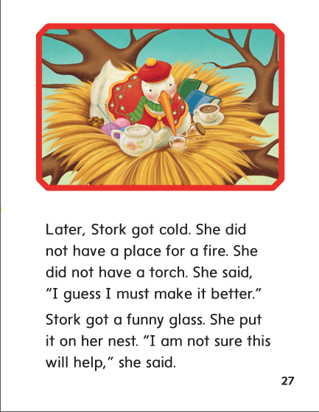

Slide 264
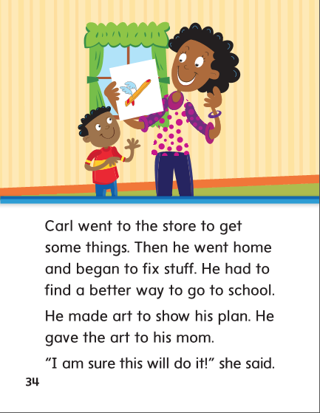

Slide 266
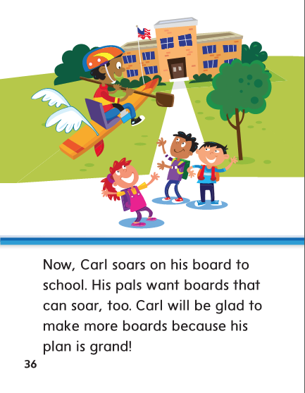

Slide 267
-or
-ore
-oar

Slide 268
born
roar
corn
soar
core
more
born
roar
corn
soar
core
more

Slide 269
High Frequency
Words

Slide 270
Read, Spell, Write
began
It began to snow last night.

Slide 271
Read, Spell, Write
better
I hope you feel better.

Slide 272
Read, Spell, Write
guess
Can you guess how old he is?

Slide 273
Read, Spell, Write
learn
She will learn to ride a bike.

Slide 274
Read, Spell, Write
right
This is the right way to hold a fork.

Slide 275
Read, Spell, Write
sure
He is sure he will be on time.

Slide 276
Build Fluency: Word Automaticity
He felt better when the show began.
We can learn the right way to do it.
Are you sure, or did you guess?

Slide 277
Usually when we add –er to most adjectives to compare two nouns. Add –est to compare more than two.
Identify the adjective in the model sentence.

Slide 278
Grammar
Adjectives that Compare
Guide children to find adjectives that compare in the following sentences. Have children work with partners to identify what is being compared in each case.
The greatest robot ever made will do my chores.
Jake’s robot is taller than my robot.

Slide 279
Week 3 – Day 4

Slide 280
Phonological Awareness
Phoneme Addition
Listen as I say as word.
Then I will add a sound to make a new word.
The word is or.
What word will I make if I add /f/ to the beginning of or?
If I add /f/ to the beginning of or, I make the word /fffor/, for.
Guided Practice:
I will say a word, then I’ll say a sound to add to the beginning of the word. Say the new word.
oar/roar ore/more right/bright port/sport park/spark

Slide 281
Build Words with /or/ or, ore, oar
b
oar
What is the new word we made?
Let’s blend all the sounds and read the word.
Change the b to r.

Slide 282
Build Words with /or/ or, ore, oar
r
oar
What is the new word we made?
Let’s blend all the sounds and read the word.
Change the r to s.

Slide 283
Build Words with /or/ or, ore, oar
s
oar
What is the new word we made?
Let’s blend all the sounds and read the word.
Remove the s.

Slide 284
Build Words with /or/ or, ore, oar
oar
What is the new word we made?
Let’s blend all the sounds and read the word.
Add a f in front of the word.

Slide 285
Build Words with /or/ or, ore, oar
f
or
What is the new word we made?
Let’s blend all the sounds and read the word.
Add a k to the end of the word.

Slide 286
Build Words with /or/ or, ore, oar
f
or
k
What is the new word we made?
Let’s blend all the sounds and read the word.
Change the k to t.

Slide 287
Build Words with /or/ or, ore, oar
f
or
t
What is the new word we made?
Let’s blend all the sounds and read the word.
Change the f to sh.

Slide 288
Build Words with /or/ or, ore, oar
sh
or
t
What is the new word we made?
Let’s blend all the sounds and read the word.
Remove the t.

Slide 289
Build Words with /or/ or, ore, oar
sh
ore
What is the new word we made?
Let’s blend all the sounds and read the word.
Change the sh to sn.

Slide 290
Build Words with /or/ or, ore, oar
sn
ore
What is the new word we made?
Let’s blend all the sounds and read the word.
Change the sn to sc.

Slide 291
Build Words with /or/ or, ore, oar
sc
ore
What is the new word we made?
Let’s blend all the sounds and read the word.
Change the sc to st.

Slide 292
Build Words with /or/ or, ore, oar
st
ore
What is the new word we made?
Let’s blend all the sounds and read the word.

Slide 293
Build Words with /or/ or, ore, oar
ore
or
These two words sound alike but are spelled differently
and have different meanings.

Slide 294
Structural Analysis
Abbreviations
Read aloud these words.
Remember a an abbreviation is a short way of writing a word.
Most abbreviations end with a period.
Mrs.
Tues.
Aug.
Rd.

Slide 295
Structural Analysis
Abbreviations
Have children word in pairs to match abbreviations to full names.
Then write sentences with abbreviations.
Doctor St.
December Dr.
Wednesday Dec.
Street Wed.

Slide 298
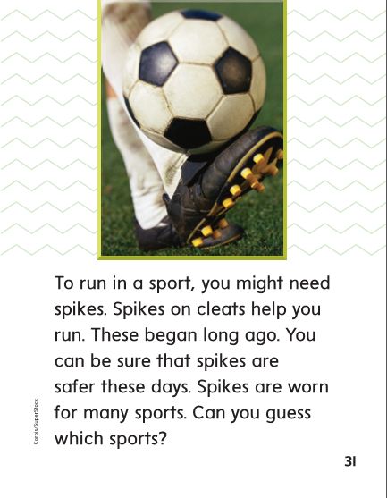

Slide 299
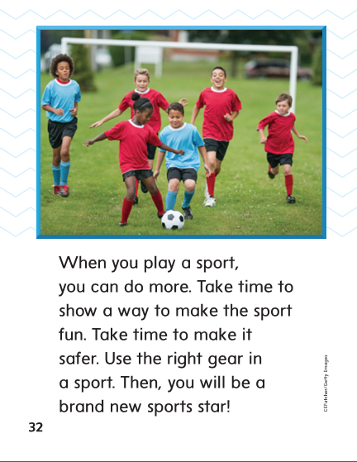

Slide 301
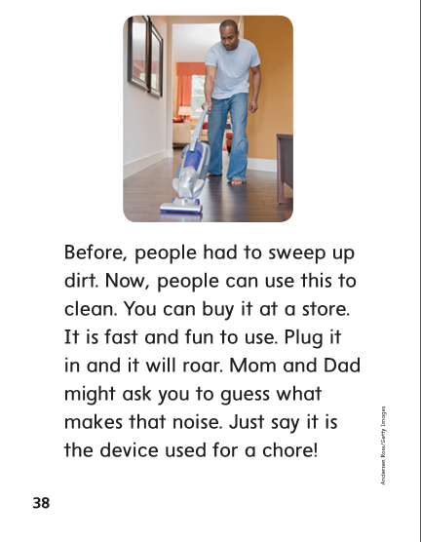

Slide 302
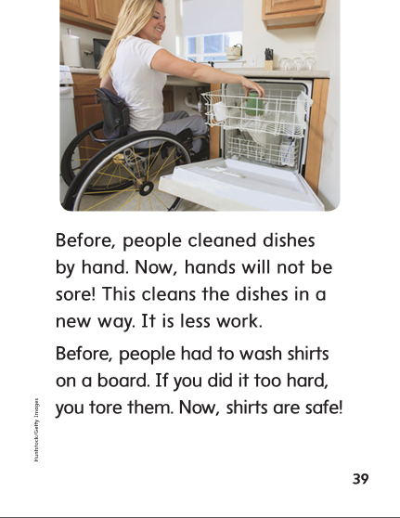

Slide 304
High Frequency
Words

Slide 305
Read, Spell, Write
began
It began to snow last night.

Slide 306
Read, Spell, Write
better
I hope you feel better.

Slide 307
Read, Spell, Write
guess
Can you guess how old he is?

Slide 308
Read, Spell, Write
learn
She will learn to ride a bike.

Slide 309
Read, Spell, Write
right
This is the right way to hold a fork.

Slide 310
Read, Spell, Write
sure
He is sure he will be on time.

Slide 311
Grammar
Adjectives that Compare
Most adjectives that compare two nouns end in –er and most adjectives that compare three or more nouns end in –est.
The big couch is (soft) _________ than the little couch.
Of the three kids, Cord is the (short) ___________.
The truck is (long) __________ than the car.
The sky is (dark) ___________ at night than it is in the morning.
Have children change each adjective to one that compares.

Slide 312
Week 3 – Day 5

Slide 313
Phonemic Awareness
Phoneme Blending:
Listen as I say a group of sounds. Then blend those sounds to form a word.
/m/ /or/ /sh/ /or/ /s/ /n/ /or/ /p/ /or/ /ch/
Phoneme Segmentation:
Now I am going to say a word. I want you to say each sound in the word.
for roar sort born sport chore

Slide 314
Blend and Build Words with /or/ or, ore, oar
Read and say these words:
for
store
soar

Slide 315
Blend and Build Words with /or/ or, ore, oar
m
ore
What is the new word we made?
Let’s blend all the sounds and read the word.
Change the m to sc.

Slide 316
Blend and Build Words with /or/ or, ore, oar
sc
ore
What is the new word we made?
Let’s blend all the sounds and read the word.
Change the sc to sh.

Slide 317
Blend and Build Words with /or/ or, ore, oar
sh
ore
What is the new word we made?
Let’s blend all the sounds and read the word.
Change the sh to st.

Slide 318
Blend and Build Words with /or/ or, ore, oar
st
ore
What is the new word we made?
Let’s blend all the sounds and read the word.
Change the st to t and add an n to the end of the word.

Slide 319
Blend and Build Words with /or/ or, ore, oar
t
or
n
What is the new word we made?
Let’s blend all the sounds and read the word.
Change the t to h.

Slide 320
Blend and Build Words with /or/ or, ore, oar
h
or
n
What is the new word we made?
Let’s blend all the sounds and read the word.
Change the h to sw.

Slide 321
Blend and Build Words with /or/ or, ore, oar
sw
or
n
What is the new word we made?
Let’s blend all the sounds and read the word.
Change the sw to b.

Slide 322
Blend and Build Words with /or/ or, ore, oar
b
or
n
What is the new word we made?
Let’s blend all the sounds and read the word.
Change the n to r.

Slide 323
Blend and Build Words with /or/ or, ore, oar
b
oar
What is the new word we made?
Let’s blend all the sounds and read the word.
Remove the n.

Slide 324
Word Automaticity
storm

Slide 325
porch

Slide 326
forty

Slide 327
Mr.

Slide 328
form

Slide 329
born

Slide 330
north

Slide 331
support

Slide 332
Mrs.

Slide 333
firm

Slide 334
for

Slide 335
soar

Slide 336
snowstorm

Slide 337
St.

Slide 338
board

Slide 339
more

Slide 340
chores

Slide 341
Dr.

Slide 342
bird

Slide 343
sore

Slide 344
short

Slide 345
before

Slide 346
Ave.

Slide 347
barn

Slide 348
Structural Analysis
Abbreviations
Have children explain abbreviations.
Have them write as many abbreviations as they can.
Have partners think of new sentences using each abbreviation.

Slide 349
Structural Analysis
Abbreviations
Mr. Sat.
Mrs. Thurs.
Dr. Feb.
St. Dec.
Rd. Apr.

Slide 350
High Frequency
Words

Slide 351
Read, Spell, Write
began
It began to snow last night.

Slide 352
Read, Spell, Write
better
I hope you feel better.

Slide 353
Read, Spell, Write
guess
Can you guess how old he is?

Slide 354
Read, Spell, Write
learn
She will learn to ride a bike.

Slide 355
Read, Spell, Write
right
This is the right way to hold a fork.

Slide 356
Read, Spell, Write
sure
He is sure he will be on time.

Slide 357
Grammar
Adjectives that Compare
Have children describe when adjectives with –er
and adjectives with –est are used.
Have children identify the adjectives that compare.
I am the tallest kid on the baseball team.
The blue car is smaller than the gray one.
This was the wettest day in June.

Slide 358
Grammar
Adjectives that Compare
Display the incorrect sentences.
Have children correct them.
The dog is loudest than the TV show.
Plums are sweet than green beans.
Miss Beck is old than Miss York.
Coach North is the older of the three.

