Slide 1
Week 4 – Day 1

Slide 2
Phonological Awareness
Phoneme Substitution
I am going to say a word: lid, /l/ /i/ /d/.
Now I will change the vowel sound to make a new word.
I will change the /i/ sound to /ou/.
The word is /l/ /ou/ /d/, loud.
Guided Practice:
I will say a word. Then I want you to change the vowel sound to /ou/. What’s the new word?
hay/how coach/couch den/down skit/scout
gain/gown pride/proud send/sound math/mouth

Slide 3
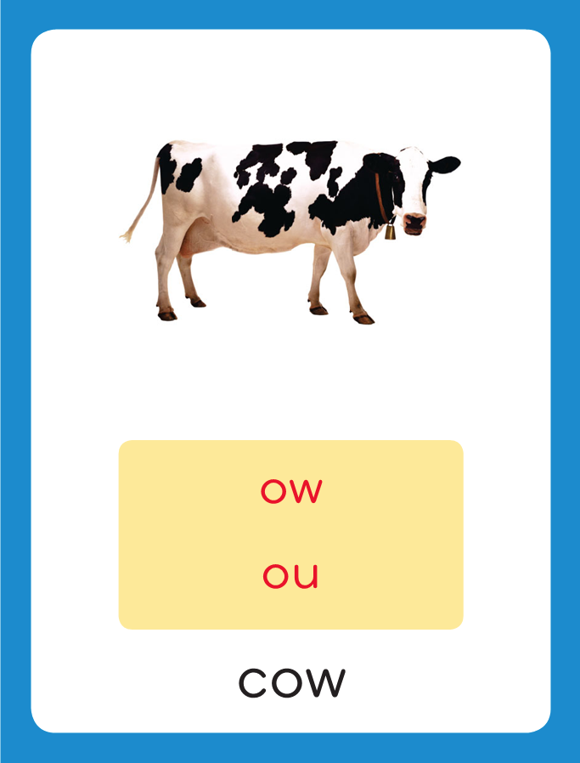
Introduce Diphthongs ou, ow
This is the Cow
Sound-Spelling Card.
The sounds are /ou/.
This is the sound at the end of the word cow.
Listen: /k/ /ou/, cow.
The /ou/ sound can be spelled with the letters ow as in cow or ou as in out. Say the sound with me: /ou/. I’ll say /ou/ as I write the letters ou and ow several times.
cow
out

Slide 4
Have children practice connecting the letters ow and ou to the sound /ou/ by writing them.
Now do it with me. Say /ou/ as I write the letters ow and ou.
ou ou ou ou ou
ow ow ow ow ow

Slide 5
Blend with Diphthongs ou, ow
s

Slide 6
Blend with Diphthongs ou, ow
s
ou

Slide 7
Blend with Diphthongs ou, ow
s
ou
nd

Slide 8
Blend with Diphthongs ou, ow
n

Slide 9
Blend with Diphthongs ou, ow
n
ow

Slide 10
Blend with Diphthongs ou, ow
n
ow

Slide 11
Blend with Diphthongs ou, ow
cl

Slide 12
Blend with Diphthongs ou, ow
cl
ow

Slide 13
Blend with Diphthongs ou, ow
cl
ow
n

Slide 14
Blend with Diphthongs ou, ow
f

Slide 15
Blend with Diphthongs ou, ow
f
ou

Slide 16
Blend with Diphthongs ou, ow
f
ou

Slide 17
Blend with Diphthongs ou, ow
f
ou
l

Slide 18
Blend with Diphthongs ou, ow
f
ou
l

Slide 19
ow ce th ore
cr ou or sh
ur ow st ir
nd er ge ou

Slide 20
h

Slide 21
how

Slide 22
how d

Slide 23
how dow

Slide 24
how down

Slide 25
how down ou

Slide 26
how down out

Slide 27
how down out
f

Slide 28
how down out
fou

Slide 29
how down out
found

Slide 30
how down out
found h

Slide 31
how down out
found hou

Slide 32
how down out
found house

Slide 33
how down out
found house c

Slide 34
how down out
found house cou

Slide 35
how down out
found house count

Slide 36
how down out
found house count
cr

Slide 37
how down out
found house count
crow

Slide 38
how down out
found house count
crown

Slide 39
how down out
found house count
crown fr

Slide 40
how down out
found house count
crown frow

Slide 41
how down out
found house count
crown frown

Slide 42
how down out
found house count
crown frown w

Slide 43
how down out
found house count
crown frown wow

Slide 44
how down out
found house count
crown frown wow
s

Slide 45
how down out
found house count
crown frown wow
sou

Slide 46
how down out
found house count
crown frown wow
south

Slide 47
how down out
found house count
crown frown wow
south m

Slide 48
how down out
found house count
crown frown wow
south mou

Slide 49
how down out
found house count
crown frown wow
south mouse

Slide 50
how down out
found house count
crown frown wow
south mouse b

Slide 51
how down out
found house count
crown frown wow
south mouse bou

Slide 52
how down out
found house count
crown frown wow
south mouse boun

Slide 53
how down out
found house count
crown frown wow
south mouse bounce

Slide 54
Internal Sounding Out
shut

Slide 55
Internal Sounding Out
shut shout

Slide 56
Internal Sounding Out
shut shout pot

Slide 57
Internal Sounding Out
shut shout pot
pout

Slide 58
Internal Sounding Out
shut shout pot
pout find

Slide 59
Internal Sounding Out
shut shout pot
pout find found

Slide 60
Internal Sounding Out
shut shout pot
pout find found
fork

Slide 61
Internal Sounding Out
shut shout pot
pout find found
fork store

Slide 62
Internal Sounding Out
shut shout pot
pout find found
fork store girl

Slide 63
Internal Sounding Out
shut shout pot
pout find found
fork store girl
burn

Slide 64
Internal Sounding Out
shut shout pot
pout find found
fork store girl
burn part

Slide 65
Internal Sounding Out
shut shout pot
pout find found
fork store girl
burn part germs

Slide 66
How

Slide 67
How loud

Slide 68
How loud is

Slide 69
How loud is the

Slide 70
How loud is the sound

Slide 71
How loud is the sound of

Slide 72
How loud is the sound of the

Slide 73
How loud is the sound of the crowd?

Slide 74
How loud is the sound of the crowd?
Did

Slide 75
How loud is the sound of the crowd?
Did the

Slide 76
How loud is the sound of the crowd?
Did the clown

Slide 77
How loud is the sound of the crowd?
Did the clown frown

Slide 78
How loud is the sound of the crowd?
Did the clown frown when

Slide 79
How loud is the sound of the crowd?
Did the clown frown when he

Slide 80
How loud is the sound of the crowd?
Did the clown frown when he fell

Slide 81
How loud is the sound of the crowd?
Did the clown frown when he fell down?

Slide 82
How loud is the sound of the crowd?
Did the clown frown when he fell down?
Now

Slide 83
How loud is the sound of the crowd?
Did the clown frown when he fell down?
Now we

Slide 84
How loud is the sound of the crowd?
Did the clown frown when he fell down?
Now we found

Slide 85
How loud is the sound of the crowd?
Did the clown frown when he fell down?
Now we found a

Slide 86
How loud is the sound of the crowd?
Did the clown frown when he fell down?
Now we found a mouse

Slide 87
How loud is the sound of the crowd?
Did the clown frown when he fell down?
Now we found a mouse in

Slide 88
How loud is the sound of the crowd?
Did the clown frown when he fell down?
Now we found a mouse in the

Slide 89
How loud is the sound of the crowd?
Did the clown frown when he fell down?
Now we found a mouse in the house!

Slide 90
Spelling / Dictation
1. _________
2. _________
3. _________
4. _________
5. _________
cow
mouse
town
mouth
how

Slide 91
High Frequency
Words

Slide 92
Read, Spell, Write
color
The color I like best is red.

Slide 93
Read, Spell, Write
early
She woke up early.

Slide 94
Read, Spell, Write
instead
What do you want to do instead?

Slide 95
Read, Spell, Write
nothing
There is nothing to do while we wait.

Slide 96
Read, Spell, Write
oh
Oh, I did not see you.

Slide 97
Read, Spell, Write
thought
He thought we should eat lunch now.

Slide 98
Have children read the sentences. Prompt them to identify the high-frequency words in connected text and to blend the decodable words.
The color I like best is red.
She woke up early.
What do you want to do instead?
There is nothing to do while we wait.
Oh, I did not see you.
He thought we should eat lunch now.

Slide 99
Grammar
Using A and An
The words a and an are special adjectives called articles.
A hound sniffs the ground.
An ape grabbed my cap!
We use a before a word that begins with a consonant sound.
We use an before a word that begins with a vowel sound.

Slide 100
Grammar
Using A and An
Have children identify the articles.
A clown did funny tricks.
My pencil is only an inch long.
I see an oak tree.
Our class keeps a pet mouse in a cage.
We use a before a word that begins with a consonant sound.
We use an before a word that begins with a vowel sound.

Slide 101
Week 4 – Day 2

Slide 102
Phonological Awareness
Phoneme Isolation
Listen carefully as I say a word: out.
What sound do you hear at the beginning of the word? /ou/
The word out has the /ou/ sound at the beginning.
Listen carefully as I say a word: gown.
What sound do you hear in the middle of the word? /ou/
The word gown has the /ou/ sound in the middle.
Listen carefully as I say a word: cow.
What sound do you hear at the end of the word? /ou/
The word out has the /ou/ sound at the end.
Guided Practice:
Listen carefully as I say a word. Tell me the sound you hear at the beginning, in the middle, or at the end of the word.
(beginning) ouch aim eat out
(middle) crowd meat south late
(end) now how hi go

Slide 103
Review Diphthongs ou, ow
sound
What are the letters?
What sound do they stand for?
now

Slide 104
Blend with Diphthongs ou, ow
p

Slide 105
Blend with Diphthongs ou, ow
p
ou

Slide 106
Blend with Diphthongs ou, ow
p
ou

Slide 107
Blend with Diphthongs ou, ow
p
ou
nd

Slide 108
Blend with Diphthongs ou, ow
p
ou
nd

Slide 109
Blend with Diphthongs ou, ow
h

Slide 110
Blend with Diphthongs ou, ow
h
ow

Slide 111
Blend with Diphthongs ou, ow
h
ow

Slide 112
Blend with Diphthongs ou, ow
h
ow
l

Slide 113
Blend with Diphthongs ou, ow
h
ow
l

Slide 114
Blend with Diphthongs ou, ow
g

Slide 115
Blend with Diphthongs ou, ow
g
ow

Slide 116
Blend with Diphthongs ou, ow
g
ow

Slide 117
Blend with Diphthongs ou, ow
g
ow
n

Slide 118
Blend with Diphthongs ou, ow
g
ow
n

Slide 119
Blend with Diphthongs ou, ow
c

Slide 120
Blend with Diphthongs ou, ow
c
ou

Slide 121
Blend with Diphthongs ou, ow
c
ou

Slide 122
Blend with Diphthongs ou, ow
c
ou
nt

Slide 123
Blend with Diphthongs ou, ow
c
ou
nt

Slide 124
c

Slide 125
cow

Slide 126
cow h

Slide 127
cow how

Slide 128
cow how ou

Slide 129
cow how out

Slide 130
cow how out
ow

Slide 131
cow how out
owl

Slide 132
cow how out
owl sh

Slide 133
cow how out
owl shou

Slide 134
cow how out
owl shout

Slide 135
cow how out
owl shout gr

Slide 136
cow how out
owl shout grou

Slide 137
cow how out
owl shout ground

Slide 138
cow how out
owl shout ground
bl

Slide 139
cow how out
owl shout ground
blou

Slide 140
cow how out
owl shout ground
blouse

Slide 141
cow how out
owl shout ground
blouse d

Slide 142
cow how out
owl shout ground
blouse dow

Slide 143
cow how out
owl shout ground
blouse down

Slide 144
cow how out
owl shout ground
blouse down br

Slide 145
cow how out
owl shout ground
blouse down brow

Slide 146
cow how out
owl shout ground
blouse down brown

Slide 147
cow how out
owl shout ground
blouse down brown
m

Slide 148
cow how out
owl shout ground
blouse down brown
mou

Slide 149
cow how out
owl shout ground
blouse down brown
mouth

Slide 150
cow how out
owl shout ground
blouse down brown
mouth sc

Slide 151
cow how out
owl shout ground
blouse down brown
mouth scou

Slide 152
cow how out
owl shout ground
blouse down brown
mouth scout

Slide 153
cow how out
owl shout ground
blouse down brown
mouth scout cr

Slide 154
cow how out
owl shout ground
blouse down brown
mouth scout crow

Slide 155
cow how out
owl shout ground
blouse down brown
mouth scout crowd

Slide 156
Build with Dipthongs ou, ow
c
ou
ch
What is the new word we made?
Let’s blend all the sounds and read the word.
Change the c to sl.

Slide 157
Build with Dipthongs ou, ow
sl
ou
ch
What is the new word we made?
Let’s blend all the sounds and read the word.
Change the sl to p.

Slide 158
Build with Dipthongs ou, ow
p
ou
ch
What is the new word we made?
Let’s blend all the sounds and read the word.
Change the ch to nd.

Slide 159
Build with Dipthongs ou, ow
p
ou
nd
What is the new word we made?
Let’s blend all the sounds and read the word.
Change the p to r.

Slide 160
Build with Dipthongs ou, ow
r
ou
nd
What is the new word we made?
Let’s blend all the sounds and read the word.
Change the r to s.

Slide 161
Build with Dipthongs ou, ow
s
ou
nd
What is the new word we made?
Let’s blend all the sounds and read the word.
Change the s to gr.

Slide 162
Build with Dipthongs ou, ow
gr
ou
nd
What is the new word we made?
Let’s blend all the sounds and read the word.
Change the gr to m.

Slide 163
Build with Dipthongs ou, ow
m
ou
nd
What is the new word we made?
Let’s blend all the sounds and read the word.
Change the nd to th.

Slide 164
Build with Dipthongs ou, ow
m
ou
th
What is the new word we made?
Let’s blend all the sounds and read the word.
Change the th to nt.

Slide 165
Build with Dipthongs ou, ow
m
ou
nt
What is the new word we made?
Let’s blend all the sounds and read the word.
Change the m to c.

Slide 166
Build with Dipthongs ou, ow
c
ou
ch
What is the new word we made?
Let’s blend all the sounds and read the word.
Remove the ch.

Slide 167
Build with Dipthongs ou, ow
c
ow
What is the new word we made?
Let’s blend all the sounds and read the word.
Change the c to n.

Slide 168
Build with Dipthongs ou, ow
n
ow
What is the new word we made?
Let’s blend all the sounds and read the word.
Change the n to h.

Slide 169
Build with Dipthongs ou, ow
h
ow
What is the new word we made?
Let’s blend all the sounds and read the word.
Change the h to w.

Slide 170
Build with Dipthongs ou, ow
w
ow
What is the new word we made?
Let’s blend all the sounds and read the word.
Change the w to pl.

Slide 171
Build with Dipthongs ou, ow
pl
ow
What is the new word we made?
Let’s blend all the sounds and read the word.
Change the pl to br.

Slide 172
Build with Dipthongs ou, ow
br
ow
What is the new word we made?
Let’s blend all the sounds and read the word.
Add an n to the end of the word.

Slide 173
Build with Dipthongs ou, ow
br
ow
n
What is the new word we made?
Let’s blend all the sounds and read the word.
Change the br to cr.

Slide 174
Build with Dipthongs ou, ow
cr
ow
n
What is the new word we made?
Let’s blend all the sounds and read the word.
Change the cr to d.

Slide 175
Build with Dipthongs ou, ow
d
ow
n
What is the new word we made?
Let’s blend all the sounds and read the word.

Slide 176
Structural Analysis
Inflectional Endings –er, -est
We add –er and –est to adjectives, or describing words, to compare things.
For example, His music is loud.
Her music is louder,
My music is the loudest of all.
We add –est to compare three or more things.
Notice that –er and –est adds a syllable to the syllable.
loud
louder
loudest

Slide 177
Structural Analysis
Inflectional Endings –er, -est
cute
cuter
cutest
dry
drier
driest
big
bigger
biggest
Remember to drop the final e before adding –er and –est.
Remember to change the y to i before adding
–er and –est.
Remember to double the final consonant before adding
–er and –est.

Slide 178
Structural Analysis
Inflectional Endings –er, -est
proud
sharp
kind
high
nice
funny
sad
Have children add
-er and –est to each word and then use each in a sentence.

Slide 179
Spelling
ou
ow

Slide 180
cow
town
mouse
how
out
mouth
cow
town
mouse
how
out
mouth

Slide 181
High Frequency
Words

Slide 182
Read, Spell, Write
color
The color I like best is red.

Slide 183
Read, Spell, Write
early
She woke up early.

Slide 184
Read, Spell, Write
instead
What do you want to do instead?

Slide 185
Read, Spell, Write
nothing
There is nothing to do while we wait.

Slide 186
Read, Spell, Write
oh
Oh, I did not see you.

Slide 187
Read, Spell, Write
thought
He thought we should eat lunch now.

Slide 188
Grammar
Using This and That
The words this and that are also special adjectives.
This is used when talking about a thing or person that is close by.
That is used when talking about a thing or person that is far away.
This tea is too hot to drink.
That owl flew into the park.
What is close by and what is far away?

Slide 189
Grammar
Using This and That
Have children identify the special adjectives,
That ballpark is too far to walk to.
“This crown is mine,” said the queen.

Slide 190
Week 4 – Day 3

Slide 191
Phonological Awareness
Phoneme Blending
I’m going to put one marker in each box as I say each sound.
Then I will blend the sounds to form a word.
/l/
/ou/
/d/
Listen as I blend these sounds: /llloud/, loud.
The word is loud.

Slide 192
Phonological Awareness
Phoneme Blending
I will say one sound at a time.
Then we will blend the sounds to say a word.
/ou/ /t/ /s/ /ou/ /th/ /m/ /ou/ /s/ /h/ /ou/
/d/ /ou/ /n/ /b/ /r/ /ou//n/ /k/ /l/ /ou/ /d/ /ou/ /l/

Slide 193
Blend with Dipthongs ou, ow
gr

Slide 194
Blend with Dipthongs ou, ow
gr
ow

Slide 195
Blend with Dipthongs ou, ow
gr
ow
l

Slide 196
Blend with Dipthongs ou, ow
gr
ow
l

Slide 197
Blend with Dipthongs ou, ow
sh

Slide 198
Blend with Dipthongs ou, ow
sh
ou

Slide 199
Blend with Dipthongs ou, ow
sh
ou

Slide 200
Blend with Dipthongs ou, ow
sh
ou
t

Slide 201
Blend with Dipthongs ou, ow
sh
ou
t

Slide 202
Blend with Dipthongs ou, ow
bl

Slide 203
Blend with Dipthongs ou, ow
bl
ou

Slide 204
Blend with Dipthongs ou, ow
bl
ou

Slide 205
Blend with Dipthongs ou, ow
bl
ou
se

Slide 206
Blend with Dipthongs ou, ow
bl
ou
se

Slide 207
Blend with Dipthongs ou, ow
f

Slide 208
Blend with Dipthongs ou, ow
f
ow

Slide 209
Blend with Dipthongs ou, ow
f
ow

Slide 210
Blend with Dipthongs ou, ow
f
ow
l

Slide 211
Blend with Dipthongs ou, ow
f
ow
l

Slide 212
ow er sh est
se ou fr nd
ay pl ow er
ou cr est gr

Slide 213
d

Slide 214
dow

Slide 215
down

Slide 216
down ou

Slide 217
down out

Slide 218
down out h

Slide 219
down out how

Slide 220
down out how
f

Slide 221
down out how
fou

Slide 222
down out how
found

Slide 223
down out how
found h

Slide 224
down out how
found hou

Slide 225
down out how
found house

Slide 226
down out how
found house cr

Slide 227
down out how
found house crow

Slide 228
down out how
found house crown

Slide 229
down out how
found house crown
w

Slide 230
down out how
found house crown
wow

Slide 231
down out how
found house crown
wow s

Slide 232
down out how
found house crown
wow sou

Slide 233
down out how
found house crown
wow sound

Slide 234
down out how
found house crown
wow sound fr

Slide 235
down out how
found house crown
wow sound frow

Slide 236
down out how
found house crown
wow sound frown

Slide 237
Internal Sounding Out
loud

Slide 238
Internal Sounding Out
louder

Slide 239
Internal Sounding Out
louder loud

Slide 240
Internal Sounding Out
louder loudest

Slide 241
Internal Sounding Out
louder loudest
round

Slide 242
Internal Sounding Out
louder loudest
rounder

Slide 243
Internal Sounding Out
louder loudest
rounder round

Slide 244
Internal Sounding Out
louder loudest
rounder roundest

Slide 245
Internal Sounding Out
louder loudest
rounder roundest
proud

Slide 246
Internal Sounding Out
louder loudest
rounder roundest
prouder

Slide 247
Internal Sounding Out
louder loudest
rounder roundest
prouder proud

Slide 248
Internal Sounding Out
louder loudest
rounder roundest
prouder proudest

Slide 249
Internal Sounding Out
louder loudest
rounder roundest
prouder proudest
short

Slide 250
Internal Sounding Out
louder loudest
rounder roundest
prouder proudest
shorter

Slide 251
Internal Sounding Out
louder loudest
rounder roundest
prouder proudest
shorter short

Slide 252
Internal Sounding Out
louder loudest
rounder roundest
prouder proudest
shorter shortest

Slide 253
Internal Sounding Out
play

Slide 254
Internal Sounding Out
playground

Slide 255
Internal Sounding Out
playground
dog

Slide 256
Internal Sounding Out
playground
doghouse

Slide 257
Internal Sounding Out
playground
doghouse
pow

Slide 258
Internal Sounding Out
playground
doghouse
power

Slide 259
Internal Sounding Out
playground
doghouse
power
tow

Slide 260
Internal Sounding Out
playground
doghouse
power
towel

Slide 261
Just

Slide 262
Just now

Slide 263
Just now the

Slide 264
Just now the crowd

Slide 265
Just now the crowd got

Slide 266
Just now the crowd got very

Slide 267
Just now the crowd got very loud.

Slide 268
Just now the crowd got very loud.
We

Slide 269
Just now the crowd got very loud.
We found

Slide 270
Just now the crowd got very loud.
We found our

Slide 271
Just now the crowd got very loud.
We found our lost

Slide 272
Just now the crowd got very loud.
We found our lost cow

Slide 273
Just now the crowd got very loud.
We found our lost cow in

Slide 274
Just now the crowd got very loud.
We found our lost cow in the

Slide 275
Just now the crowd got very loud.
We found our lost cow in the next

Slide 276
Just now the crowd got very loud.
We found our lost cow in the next town!

Slide 277
Structural Analysis
Inflectional Endings –er, -est
Remember the ending –er of an adjective, or describing word, is used to compare two things; -est is used to compare three or more things.
proud
prouder
proudest

Slide 278
Structural Analysis
Inflectional Endings –er, -est
wide
wider
widest
shy
shier
shiest
hot
hotter
hottest
Remember to drop the final e before adding –er and –est.
Remember to change the y to i before adding
–er and –est.
Remember to double the final consonant before adding
–er and –est.

Slide 279
Help children blend the words. Point out the extra syllable.
Structural Analysis
Inflectional Endings –er, -est
sharp
sharper
sharpest
slow
slower
slowest
safe
safer
safest
mad
madder
maddest

Slide 281
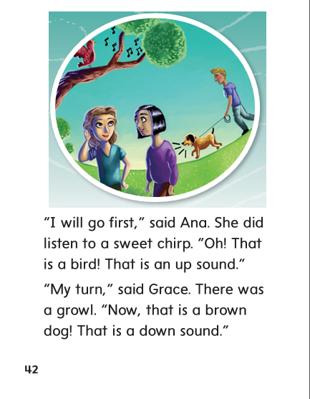

Slide 282
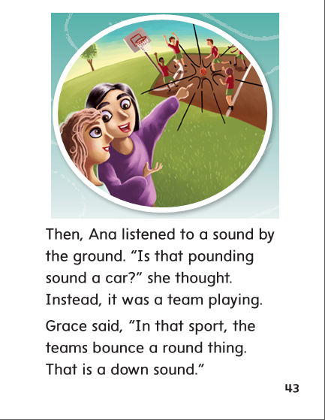

Slide 283
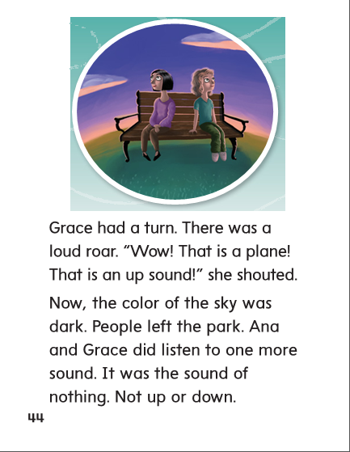

Slide 284
High Frequency
Words

Slide 285
Read, Spell, Write
color
The color I like best is red.

Slide 286
Read, Spell, Write
early
She woke up early.

Slide 287
Read, Spell, Write
instead
What do you want to do instead?

Slide 288
Read, Spell, Write
nothing
There is nothing to do while we wait.

Slide 289
Read, Spell, Write
oh
Oh, I did not see you.

Slide 290
Read, Spell, Write
thought
He thought we should eat lunch now.

Slide 291
Build Fluency: Word Automaticity
Pick a color instead of red.
We did nothing early in the day.
Oh, I thought that game was fun!

Slide 292
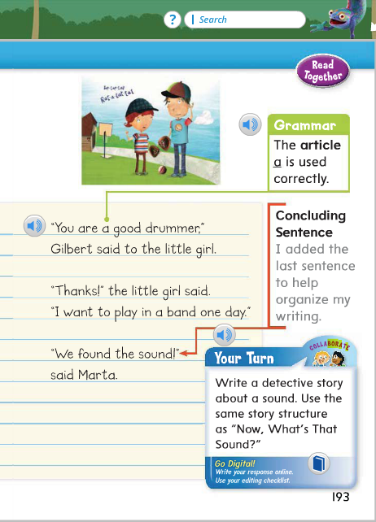
Remember that a is used before words that start with a consonant sound and an is used before words that start with a vowel sound.
This is used for a noun that is close by and that is used for a noun that is far away.
Name the article in this sentence:
You are a good drummer.
Name the adjective in this sentence:
I hear that sound again.

Slide 293
Week 4 – Day 4

Slide 294
Phonological Awareness
Phoneme Isolation
Listen carefully as I say a word: owl.
I hear the /ou/ sound at the beginning of owl.
Say the sound with me: /ou/.
Now say the word with me: /ou/ /l/, owl.
Listen carefully as I say another word: mouth.
I hear the /ou/ sound in the middle of mouth.
Say the sound with me: /ou/.
Now say the word with me: /m/ /ou/ /th/, mouth.
Guided Practice:
I am going to say some more words. Tell me if you hear the /ou/ sound in the beginning or in the middle of each word.
mouse out brown shout ouch ground owl

Slide 295
Build Words with Dipthongs ou, ow
d
ow
n
What is the new word we made?
Let’s blend all the sounds and read the word.
Change the d to t.

Slide 296
Build Words with Dipthongs ou, ow
t
ow
n
What is the new word we made?
Let’s blend all the sounds and read the word.
Change the t to fr.

Slide 297
Build Words with Dipthongs ou, ow
fr
ow
n
What is the new word we made?
Let’s blend all the sounds and read the word.
Change the fr to cl.

Slide 298
Build Words with Dipthongs ou, ow
cl
ow
n
What is the new word we made?
Let’s blend all the sounds and read the word.
Change the cl to cr.

Slide 299
Build Words with Dipthongs ou, ow
cr
ow
n
What is the new word we made?
Let’s blend all the sounds and read the word.
Change the n to d.

Slide 300
Build Words with Dipthongs ou, ow
cr
ow
d
What is the new word we made?
Let’s blend all the sounds and read the word.
Change the cr to pl and remove the d.

Slide 301
Build Words with Dipthongs ou, ow
pl
ow
What is the new word we made?
Let’s blend all the sounds and read the word.
Change the pl to br.

Slide 302
Build Words with Dipthongs ou, ow
br
ow
What is the new word we made?
Let’s blend all the sounds and read the word.
Change the br to n.

Slide 303
Build Words with Dipthongs ou, ow
n
ow
What is the new word we made?
Let’s blend all the sounds and read the word.
Change the n to h.

Slide 304
Build Words with Dipthongs ou, ow
h
ow
What is the new word we made?
Let’s blend all the sounds and read the word.
Add se to the end of the word.

Slide 305
Build Words with Dipthongs ou, ow
h
ou
se
What is the new word we made?
Let’s blend all the sounds and read the word.
Change h to bl.

Slide 306
Build Words with Dipthongs ou, ow
bl
ou
se
What is the new word we made?
Let’s blend all the sounds and read the word.
Change bl to sp.

Slide 307
Build Words with Dipthongs ou, ow
bl
ou
se
What is the new word we made?
Let’s blend all the sounds and read the word.
Change bl to sp.

Slide 308
Build Words with Dipthongs ou, ow
m
ou
se
What is the new word we made?
Let’s blend all the sounds and read the word.
Change se to th.

Slide 309
Build Words with Dipthongs ou, ow
m
ou
th
What is the new word we made?
Let’s blend all the sounds and read the word.
Change th to nd.

Slide 310
Build Words with Dipthongs ou, ow
m
ou
nd
What is the new word we made?
Let’s blend all the sounds and read the word.
Change m to f.

Slide 311
Build Words with Dipthongs ou, ow
f
ou
nd
What is the new word we made?
Let’s blend all the sounds and read the word.
Change f to s.

Slide 312
Build Words with Dipthongs ou, ow
s
ou
nd
What is the new word we made?
Let’s blend all the sounds and read the word.

Slide 313
Structural Analysis
Inflectional Endings –er, -est
Remember that –er and –est are added to compare things.
tall
taller
tallest

Slide 314
Structural Analysis
Inflectional Endings –er, -est
clean
soft
slow
late
dry
Have children work in pairs to construct comparing words
ending with –er or –est.
Then have them write sentences with each word.
-er ending is used to compare two things; -est ending is used to compare more than two things.

Slide 315
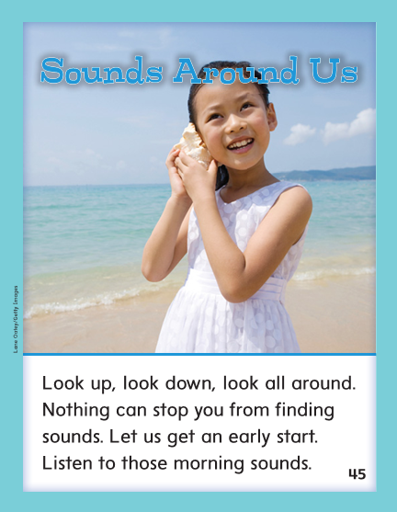

Slide 316
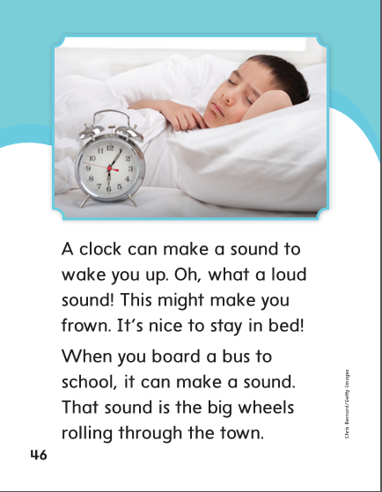

Slide 317
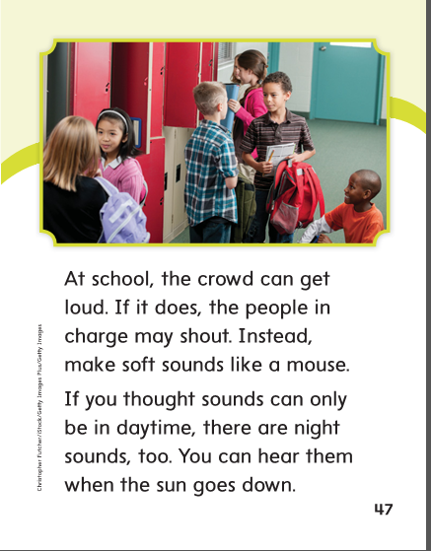

Slide 319
High Frequency
Words

Slide 320
Read, Spell, Write
color
The color I like best is red.

Slide 321
Read, Spell, Write
early
She woke up early.

Slide 322
Read, Spell, Write
instead
What do you want to do instead?

Slide 323
Read, Spell, Write
nothing
There is nothing to do while we wait.

Slide 324
Read, Spell, Write
oh
Oh, I did not see you.

Slide 325
Read, Spell, Write
thought
He thought we should eat lunch now.

Slide 326
Grammar
Using A, An, This, That
A is used before words that start with a consonant sound.
An is used before words that start with a vowel sound.
I live in ___ old house.
I take ___ book with me to read.
This is used for a noun that is close.
That is used for a noun that is far away.
The truck is close. It plows _______ side of the road first.
Why is _______ blouse on the ground by the doghouse?

Slide 327
Week 4 – Day 5

Slide 328
Phonemic Awareness
Phoneme Blending:
Listen as I say a group of sounds. Then blend those sounds to form a word.
/ou/ /t/ /s/ /ou/ /th/ /t/ /ou/ /n/ /f/ /ou/ /n/ /d/
Phoneme Substitution:
I will say a word. I want you to change the vowel sound and say the new word.
lid/loud shut/shout ten/town find/found

Slide 329
Blend and Build Words with /ou/ ou, ow
Read and say these words:
shout
south
wow

Slide 330
Blend and Build Words with /ou/ ou, ow
l
ou
d
What is the new word we made?
Let’s blend all the sounds and read the word.
Change the l to cl.

Slide 331
Blend and Build Words with /ou/ ou, ow
cl
ou
d
What is the new word we made?
Let’s blend all the sounds and read the word.
Change the d to t.

Slide 332
Blend and Build Words with /ou/ ou, ow
cl
ou
t
What is the new word we made?
Let’s blend all the sounds and read the word.
Change the cl to p.

Slide 333
Blend and Build Words with /ou/ ou, ow
p
ou
t
What is the new word we made?
Let’s blend all the sounds and read the word.
Change the p to sh.

Slide 334
Blend and Build Words with /ou/ ou, ow
sh
ou
t
What is the new word we made?
Let’s blend all the sounds and read the word.
Remove the sh.

Slide 335
Blend and Build Words with /ou/ ou, ow
ou
t
What is the new word we made?
Let’s blend all the sounds and read the word.
Change the t to ch.

Slide 336
Blend and Build Words with /ou/ ou, ow
ou
ch
What is the new word we made?
Let’s blend all the sounds and read the word.
Add the letter c to the front of the word.

Slide 337
Blend and Build Words with /ou/ ou, ow
c
ou
ch
What is the new word we made?
Let’s blend all the sounds and read the word.
Change the c to p.

Slide 338
Blend and Build Words with /ou/ ou, ow
p
ou
ch
What is the new word we made?
Let’s blend all the sounds and read the word.
Change the p to sl.

Slide 339
Blend and Build Words with /ou/ ou, ow
sl
ou
ch
What is the new word we made?
Let’s blend all the sounds and read the word.
Change the sl to cr.

Slide 340
Blend and Build Words with /ou/ ou, ow
cr
ou
ch
What is the new word we made?
Let’s blend all the sounds and read the word.
Change the ch to n.

Slide 341
Blend and Build Words with /ou/ ou, ow
cr
ow
n
What is the new word we made?
Let’s blend all the sounds and read the word.
Change the cr to cl.

Slide 342
Blend and Build Words with /ou/ ou, ow
cl
ow
n
What is the new word we made?
Let’s blend all the sounds and read the word.
Change the cl to d.

Slide 343
Blend and Build Words with /ou/ ou, ow
d
ow
n
What is the new word we made?
Let’s blend all the sounds and read the word.
Change the d to g.

Slide 344
Blend and Build Words with /ou/ ou, ow
g
ow
n
What is the new word we made?
Let’s blend all the sounds and read the word.
Change the g to fr.

Slide 345
Blend and Build Words with /ou/ ou, ow
fr
ow
n
What is the new word we made?
Let’s blend all the sounds and read the word.

Slide 346
Word Automaticity
down

Slide 347
out

Slide 348
how

Slide 349
found

Slide 350
house

Slide 351
crown

Slide 352
wow

Slide 353
out

Slide 354
frown

Slide 355
sound

Slide 356
louder

Slide 357
loudest

Slide 358
rounder

Slide 359
roundest

Slide 360
prouder

Slide 361
proudest

Slide 362
shorter

Slide 363
shortest

Slide 364
playground

Slide 365
doghouse

Slide 366
power

Slide 367
towel

Slide 368
Structural Analysis
Inflectional Endings –er, -est
Have children explain when the –er and the –est endings are used.
Have then practice reading words with –er and –est.
fast
faster
fastest
dark
darker
darkest
safe
safer
safest

Slide 369
High Frequency
Words

Slide 370
Read, Spell, Write
color
The color I like best is red.

Slide 371
Read, Spell, Write
early
She woke up early.

Slide 372
Read, Spell, Write
instead
What do you want to do instead?

Slide 373
Read, Spell, Write
nothing
There is nothing to do while we wait.

Slide 374
Read, Spell, Write
oh
Oh, I did not see you.

Slide 375
Read, Spell, Write
thought
He thought we should eat lunch now.

Slide 376
Grammar
Using A, An, This, That
Have children describe when the adjectives a, an, this, and that are used.
Have children identify the adjectives:
This mix needs a cup of water.
Could you hand me that cup?
What does this tell you about where the mix is?
What does that tell you about where the cup is?
Why did the writer use a instead of an?

