Slide 1
Week 5 – Day 1

Slide 2
Phonological Awareness
Phoneme Blending
Listen as I say three sounds: /b/ /oi/ /l/.
Now I will blend the sounds together and say the word: /boilll/.
Let’s say the word together: boil.
Guided Practice:
I am going to say some words, sound by sound. Blend the sounds together to say the word.
/j/ /oi/ /v/ /oi/ /s/ /oi/ /l/
/k/ /oi/ /n/ /p/ /oi/ /n/ /t/ /n/ /oi/ /z/

Slide 3
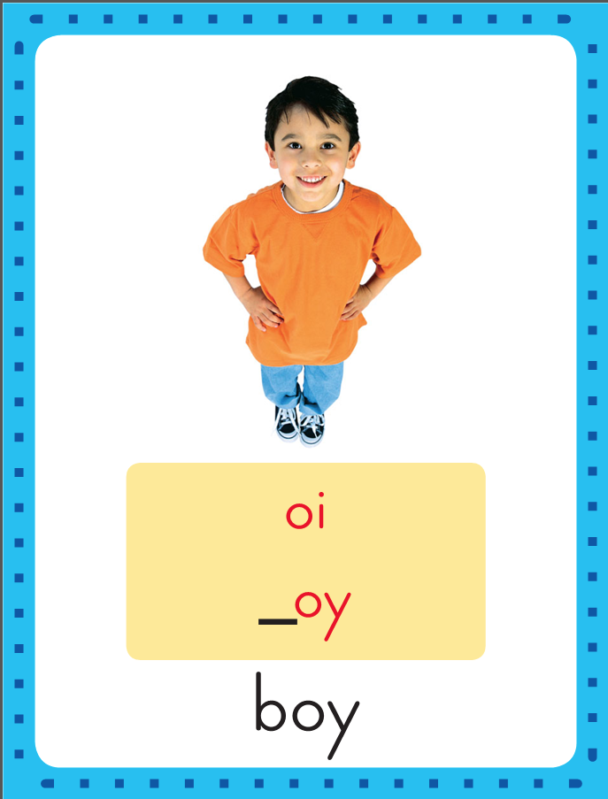
Introduce Diphthongs oi, oy
This is the Boy
Sound-Spelling Card.
The sound is /oi/.
This is the sound is at the end of the word boy. Listen: /b/ /oi/, boy. The /oi/ sound can be spelled with the letters oy as in boy or oi as in coin. Say the sound with me: /oi/.
I’ll say /oi/ as I write the letters oi and oy several times.
coin
boy

Slide 4
Have children practice connecting the letters oi and oy to the sound /oi/ by writing them.
Now do it with me. Say /oi/ as I write the letters oi and oy.
oi oi oi oi oi
oy oy oy oy oy

Slide 5
Introduce Diphthongs oi, oy
s

Slide 6
Introduce Diphthongs oi, oy
s
oi

Slide 7
Introduce Diphthongs oi, oy
s
oi

Slide 8
Introduce Diphthongs oi, oy
s
oi
l

Slide 9
Introduce Diphthongs oi, oy
s
oi
l

Slide 10
Introduce Diphthongs oi, oy
j

Slide 11
Introduce Diphthongs oi, oy
j
oi

Slide 12
Introduce Diphthongs oi, oy
j
oi

Slide 13
Introduce Diphthongs oi, oy
j
oi
n

Slide 14
Introduce Diphthongs oi, oy
j
oi
n

Slide 15
Introduce Diphthongs oi, oy
b

Slide 16
Introduce Diphthongs oi, oy
b
oy

Slide 17
Introduce Diphthongs oi, oy
b
oy

Slide 18
Introduce Diphthongs oi, oy
t

Slide 19
Introduce Diphthongs oi, oy
t
oy

Slide 20
Introduce Diphthongs oi, oy
t
oy

Slide 21
oy nt st ow
br oi ar nd
ir ful ore ce
ing oy ou oi

Slide 22
j

Slide 23
joy

Slide 24
joy j

Slide 25
joy joi

Slide 26
joy join

Slide 27
joy join oi

Slide 28
joy join oil

Slide 29
joy join oil
b

Slide 30
joy join oil
boi

Slide 31
joy join oil
boil

Slide 32
joy join oil
boil p

Slide 33
joy join oil
boil poi

Slide 34
joy join oil
boil point

Slide 35
joy join oil
boil point m

Slide 36
joy join oil
boil point moi

Slide 37
joy join oil
boil point moist

Slide 38
joy join oil
boil point moist
j

Slide 39
joy join oil
boil point moist
joi

Slide 40
joy join oil
boil point moist
joins

Slide 41
joy join oil
boil point moist
joins j

Slide 42
joy join oil
boil point moist
joins joi

Slide 43
joy join oil
boil point moist
joins joint

Slide 44
joy join oil
boil point moist
joins joints

Slide 45
joy join oil
boil point moist
joins joints j

Slide 46
joy join oil
boil point moist
joins joints joy

Slide 47
joy join oil
boil point moist
joins joints joyful

Slide 48
joy join oil
boil point moist
joins joints joyful
c

Slide 49
joy join oil
boil point moist
joins joints joyful
coi

Slide 50
joy join oil
boil point moist
joins joints joyful
coin

Slide 51
joy join oil
boil point moist
joins joints joyful
coin t

Slide 52
joy join oil
boil point moist
joins joints joyful
coin toy

Slide 53
joy join oil
boil point moist
joins joints joyful
coin toy h

Slide 54
joy join oil
boil point moist
joins joints joyful
coin toy hoi

Slide 55
joy join oil
boil point moist
joins joints joyful
coin toy hoist

Slide 56
Internal Sounding Out
boil

Slide 57
Internal Sounding Out
boil broil

Slide 58
Internal Sounding Out
boil broil soil

Slide 59
Internal Sounding Out
boil broil soil
spoil

Slide 60
Internal Sounding Out
boil broil soil
spoil oink

Slide 61
Internal Sounding Out
boil broil soil
spoil oink ink

Slide 62
Internal Sounding Out
boil broil soil
spoil oink ink
loud

Slide 63
Internal Sounding Out
boil broil soil
spoil oink ink
loud found

Slide 64
Internal Sounding Out
boil broil soil
spoil oink ink
loud found store

Slide 65
Internal Sounding Out
boil broil soil
spoil oink ink
loud found store
cow

Slide 66
Internal Sounding Out
boil broil soil
spoil oink ink
loud found store
cow bird

Slide 67
Internal Sounding Out
boil broil soil
spoil oink ink
loud found store
cow bird park

Slide 68
Roy

Slide 69
Roy found

Slide 70
Roy found a

Slide 71
Roy found a coin

Slide 72
Roy found a coin in

Slide 73
Roy found a coin in the

Slide 74
Roy found a coin in the soil.

Slide 75
Roy found a coin in the soil.
The

Slide 76
Roy found a coin in the soil.
The boy

Slide 77
Roy found a coin in the soil.
The boy lost

Slide 78
Roy found a coin in the soil.
The boy lost his

Slide 79
Roy found a coin in the soil.
The boy lost his voice

Slide 80
Roy found a coin in the soil.
The boy lost his voice
from

Slide 81
Roy found a coin in the soil.
The boy lost his voice
from shouting.

Slide 82
Roy found a coin in the soil.
The boy lost his voice
from shouting.
That

Slide 83
Roy found a coin in the soil.
The boy lost his voice
from shouting.
That toy

Slide 84
Roy found a coin in the soil.
The boy lost his voice
from shouting.
That toy makes

Slide 85
Roy found a coin in the soil.
The boy lost his voice
from shouting.
That toy makes so

Slide 86
Roy found a coin in the soil.
The boy lost his voice
from shouting.
That toy makes so much

Slide 87
Roy found a coin in the soil.
The boy lost his voice
from shouting.
That toy makes so much noise!

Slide 88
Spelling / Dictation
1. _________
2. _________
3. _________
4. _________
5. _________
spoil
boy
coin
toy
join

Slide 89
High Frequency
Words

Slide 90
Read, Spell, Write
above
How does rain fall from the sky above?

Slide 91
Read, Spell, Write
build
He knew how to build a town out of blocks.

Slide 92
Read, Spell, Write
fall
How does rain fall from the sky above?

Slide 93
Read, Spell, Write
knew
He knew how to build a town out of blocks.

Slide 94
Read, Spell, Write
money
How much money does it cost?

Slide 95
Read, Spell, Write
toward
The dog ran toward the yard.

Slide 96
Read, Spell, Write
color
The color I like best is red.

Slide 97
Have children read the sentences. Prompt them to identify the high-frequency words in connected text and to blend the decodable words.
How does rain fall from the sky above?
He knew how to build a town out of blocks.
How much money does it cost?
The dog ran toward the yard.

Slide 98
Grammar
Prepositions and Prepositional Phrases
A preposition connects a noun or pronoun to another part of a sentence. A prepositional phrase begins with a preposition and ends with a noun or pronoun.
The brown mole is in the ground.
The word in connects the words the brown mole and the phrase that tells where the mole is – the ground.

Slide 99
Grammar
Prepositions and Prepositional Phrases
Work with a partner to identify the preposition in each sentence.
The storm is heading toward our town.
The dark clouds are above our heads.
We should go in the house.
We want to be dry during the storm.
I see the sun beyond the clouds.

Slide 100
Week 5 – Day 2

Slide 101
Phonological Awareness
Phoneme Segmentation
Listen carefully as I say a word: coin.
How many sounds are in the word coin?
I will place a marker in a box for each sound I hear: /k/ /oi/ /n/.
I will place three markers because I hear three sounds in the word coin.
/k/
/oi/
/n/

Slide 102
Phonological Awareness
Phoneme Segmentation
Listen carefully as I say some words.
Place one marker in a box for each sound you hear.
Then tell me how many sounds are in each word
oil join spoil joy
noise point voice broil

Slide 103
Introduce Diphthongs oi, oy
boil
What are the letters?
What sound do they stand for?
toy

Slide 104
Blend Words with Diphthongs oi, oy
j

Slide 105
Blend Words with Diphthongs oi, oy
j
oi

Slide 106
Blend Words with Diphthongs oi, oy
j
oi

Slide 107
Blend Words with Diphthongs oi, oy
j
oi
n

Slide 108
Blend Words with Diphthongs oi, oy
j
oi
n

Slide 109
Blend Words with Diphthongs oi, oy
v

Slide 110
Blend Words with Diphthongs oi, oy
v
oi

Slide 111
Blend Words with Diphthongs oi, oy
v
oi

Slide 112
Blend Words with Diphthongs oi, oy
v
oi
ce

Slide 113
Blend Words with Diphthongs oi, oy
v
oi
ce

Slide 114
Blend Words with Diphthongs oi, oy
p

Slide 115
Blend Words with Diphthongs oi, oy
p
oi

Slide 116
Blend Words with Diphthongs oi, oy
p
oi

Slide 117
Blend Words with Diphthongs oi, oy
p
oi
nt

Slide 118
Blend Words with Diphthongs oi, oy
p
oi
nt

Slide 119
Blend Words with Diphthongs oi, oy
b

Slide 120
Blend Words with Diphthongs oi, oy
b
oy

Slide 121
Blend Words with Diphthongs oi, oy
b
oy

Slide 122
b

Slide 123
boi

Slide 124
boil

Slide 125
boil f

Slide 126
boil foi

Slide 127
boil foil

Slide 128
boil foil oi

Slide 129
boil foil oink

Slide 130
boil foil oink
j

Slide 131
boil foil oink
joy

Slide 132
boil foil oink
joy t

Slide 133
boil foil oink
joy toy

Slide 134
boil foil oink
joy toy oi

Slide 135
boil foil oink
joy toy oil

Slide 136
boil foil oink
joy toy oil
s

Slide 137
boil foil oink
joy toy oil
soy

Slide 138
boil foil oink
joy toy oil
soy sp

Slide 139
boil foil oink
joy toy oil
soy spoi

Slide 140
boil foil oink
joy toy oil
soy spoil

Slide 141
boil foil oink
joy toy oil
soy spoil br

Slide 142
boil foil oink
joy toy oil
soy spoil broi

Slide 143
boil foil oink
joy toy oil
soy spoil broil

Slide 144
boil foil oink
joy toy oil
soy spoil broil
m

Slide 145
boil foil oink
joy toy oil
soy spoil broil
moi

Slide 146
boil foil oink
joy toy oil
soy spoil broil
moist

Slide 147
boil foil oink
joy toy oil
soy spoil broil
moist e

Slide 148
boil foil oink
joy toy oil
soy spoil broil
moist en

Slide 149
boil foil oink
joy toy oil
soy spoil broil
moist enj

Slide 150
boil foil oink
joy toy oil
soy spoil broil
moist enjoy

Slide 151
boil foil oink
joy toy oil
soy spoil broil
moist enjoy c

Slide 152
boil foil oink
joy toy oil
soy spoil broil
moist enjoy cow

Slide 153
boil foil oink
joy toy oil
soy spoil broil
moist enjoy cowb

Slide 154
boil foil oink
joy toy oil
soy spoil broil
moist enjoy cowboy

Slide 155
Build with Dipthongs oi, oy
f
oi
l
What is the new word we made?
Let’s blend all the sounds and read the word.
Change the f to s.

Slide 156
Build with Dipthongs oi, oy
s
oi
l
What is the new word we made?
Let’s blend all the sounds and read the word.
Change the s to sp.

Slide 157
Build with Dipthongs oi, oy
sp
oi
l
What is the new word we made?
Let’s blend all the sounds and read the word.
Remove the sp.

Slide 158
Build with Dipthongs oi, oy
oi
l
What is the new word we made?
Let’s blend all the sounds and read the word.
Add a b to the front of a word..

Slide 159
Build with Dipthongs oi, oy
b
oi
l
What is the new word we made?
Let’s blend all the sounds and read the word.
Remove the l.

Slide 160
Build with Dipthongs oi, oy
b
oy
What is the new word we made?
Let’s blend all the sounds and read the word.
Change the b to t.

Slide 161
Build with Dipthongs oi, oy
t
oy
What is the new word we made?
Let’s blend all the sounds and read the word.
Change the t to R.

Slide 162
Build with Dipthongs oi, oy
R
oy
What is the new word we made?
Let’s blend all the sounds and read the word.
Change the t to R.

Slide 163
Structural Analysis
Final Stable Syllables
Read aloud the following words.
Say each word, clapping for each syllable.
table
simple

Slide 164
Structural Analysis
Final Stable Syllables
Draw a line between the syllables.
When we see le at the end of a word and there is a consonant before the letters, they make the sound /ul/.
The consonant plus le are all in the same final syllable.
This is called a final stable syllable.
ta/ble
sim/ple
Help children pronounce the syllables ble and ple.

Slide 165
Structural Analysis
Final Stable Syllables
Help children divide each word into syllables, and blend the syllables to read the words. The have children use each word in a sentence.
candle
apple
title
puddle
marble

Slide 166
Structural Analysis
Final Stable Syllables
Help children divide each word into syllables, and blend the syllables to read the words. The have children use each word in a sentence.
can/dle
ap/ple
ti/tle
pud/dle
mar/ble

Slide 167
Spelling
Roy
soil

Slide 168
spoil
boy
coin
joy
join
toy
spoil
boy
coin
joy
join
toy

Slide 169
High Frequency
Words

Slide 170
Read, Spell, Write
above
How does rain fall from the sky above?

Slide 171
Read, Spell, Write
build
He knew how to build a town out of blocks.

Slide 172
Read, Spell, Write
fall
How does rain fall from the sky above?

Slide 173
Read, Spell, Write
knew
He knew how to build a town out of blocks.

Slide 174
Read, Spell, Write
money
How much money does it cost?

Slide 175
Read, Spell, Write
toward
The dog ran toward the yard.

Slide 176
Grammar
Prepositions and Prepositional Phrases
A preposition connects one part of a sentence to another.
A prepositional phrase is a group of words that begins with a preposition and ends with a noun or pronoun.
The light is above the porch.
The preposition above connects the words the light is and the porch.

Slide 177
Grammar
Prepositions and Prepositional Phrases
Complete each sentence below with one of these prepositions:
for, in, on.
Snow is ________ the ground.
I put your mittens _______ in your coat pocket.
There is a prize ________ building the best snowman.

Slide 178
Week 5 – Day 3

Slide 179
Phonological Awareness
Phoneme Categorization
Listen carefully as I say three words: shirt, first, park.
Which one of these words does not belong?
Shirt and first both have the /ur/ sounds in the middle.
Park does not. It does not belong.
Guided Practice:
Now I’ll say a group of words. Listen carefully, then tell me which word does not belong and why.
verb, torn, her barn, farm, shirt germ, third, star
sport, corn, stir arm, hurt, card born, first, term

Slide 180
Blend words with Dipthongs oi, oy
br

Slide 181
Blend words with Dipthongs oi, oy
br
oi

Slide 182
Blend words with Dipthongs oi, oy
br
oi

Slide 183
Blend words with Dipthongs oi, oy
br
oi
l

Slide 184
Blend words with Dipthongs oi, oy
br
oi
l

Slide 185
Blend words with Dipthongs oi, oy
j

Slide 186
Blend words with Dipthongs oi, oy
j
oy

Slide 187
Blend words with Dipthongs oi, oy
j
oy

Slide 188
Blend words with Dipthongs oi, oy
ch

Slide 189
Blend words with Dipthongs oi, oy
ch
oi

Slide 190
Blend words with Dipthongs oi, oy
ch
oi

Slide 191
Blend words with Dipthongs oi, oy
ch
oi
ce

Slide 192
Blend words with Dipthongs oi, oy
ch
oi
ce

Slide 193
Blend words with Dipthongs oi, oy
c

Slide 194
Blend words with Dipthongs oi, oy
c
ow

Slide 195
Blend words with Dipthongs oi, oy
c
ow

Slide 196
Blend words with Dipthongs oi, oy
c
ow
b

Slide 197
Blend words with Dipthongs oi, oy
c
ow
b
oy

Slide 198
Blend words with Dipthongs oi, oy
c
ow
b
oy

Slide 199
Blend words with Dipthongs oi, oy
c
ow
b
oy

Slide 200
oi nt oy st
ful ou zle ur
dle ar gen kle
ti rat zle oi

Slide 201
b

Slide 202
boi

Slide 203
boil

Slide 204
boils

Slide 205
boils j

Slide 206
boils joi

Slide 207
boils join

Slide 208
boils join p

Slide 209
boils join poi

Slide 210
boils join point

Slide 211
boils join point
h

Slide 212
boils join point
hoi

Slide 213
boils join point
hoist

Slide 214
boils join point
hoist m

Slide 215
boils join point
hoist moi

Slide 216
boils join point
hoist moist

Slide 217
boils join point
hoist moist j

Slide 218
boils join point
hoist moist joy

Slide 219
boils join point
hoist moist joy
j

Slide 220
boils join point
hoist moist joy
joi

Slide 221
boils join point
hoist moist joy
joint

Slide 222
boils join point
hoist moist joy
joints

Slide 223
boils join point
hoist moist joy
joints oi

Slide 224
boils join point
hoist moist joy
joints oil

Slide 225
boils join point
hoist moist joy
joints oil e

Slide 226
boils join point
hoist moist joy
joints oil en

Slide 227
boils join point
hoist moist joy
joints oil enj

Slide 228
boils join point
hoist moist joy
joints oil enjoy

Slide 229
boils join point
hoist moist joy
joints oil enjoys

Slide 230
boils join point
hoist moist joy
joints oil enjoys
h

Slide 231
boils join point
hoist moist joy
joints oil enjoys
hoi

Slide 232
boils join point
hoist moist joy
joints oil enjoys
hoist

Slide 233
boils join point
hoist moist joy
joints oil enjoys
hoisted

Slide 234
boils join point
hoist moist joy
joints oil enjoys
hoisted j

Slide 235
boils join point
hoist moist joy
joints oil enjoys
hoisted joy

Slide 236
boils join point
hoist moist joy
joints oil enjoys
hoisted joyful

Slide 237
boils join point
hoist moist joy
joints oil enjoys
hoisted joyful s

Slide 238
boils join point
hoist moist joy
joints oil enjoys
hoisted joyful soy

Slide 239
boy
Internal Sounding Out

Slide 240
boy boil
Internal Sounding Out

Slide 241
boy boil broil
Internal Sounding Out

Slide 242
boy boil broil
mouse
Internal Sounding Out

Slide 243
boy boil broil
mouse moist
Internal Sounding Out

Slide 244
boy boil broil
mouse moist most
Internal Sounding Out

Slide 245
boy boil broil
mouse moist most
ap
Internal Sounding Out

Slide 246
boy boil broil
mouse moist most
apple
Internal Sounding Out

Slide 247
boy boil broil
mouse moist most
apple can
Internal Sounding Out

Slide 248
boy boil broil
mouse moist most
apple candle
Internal Sounding Out

Slide 249
boy boil broil
mouse moist most
apple candle ta
Internal Sounding Out

Slide 250
boy boil broil
mouse moist most
apple candle table
Internal Sounding Out

Slide 251
boy boil broil
mouse moist most
apple candle table
puz
Internal Sounding Out

Slide 252
boy boil broil
mouse moist most
apple candle table
puzzle
Internal Sounding Out

Slide 253
boy boil broil
mouse moist most
apple candle table
puzzle bun
Internal Sounding Out

Slide 254
boy boil broil
mouse moist most
apple candle table
puzzle bundle
Internal Sounding Out

Slide 255
boy boil broil
mouse moist most
apple candle table
puzzle bundle pur
Internal Sounding Out

Slide 256
boy boil broil
mouse moist most
apple candle table
puzzle bundle purple
Internal Sounding Out

Slide 257
boy boil broil
mouse moist most
apple candle table
puzzle bundle purple
rat
Internal Sounding Out

Slide 258
boy boil broil
mouse moist most
apple candle table
puzzle bundle purple
rattle
Internal Sounding Out

Slide 259
boy boil broil
mouse moist most
apple candle table
puzzle bundle purple
rattle ti
Internal Sounding Out

Slide 260
boy boil broil
mouse moist most
apple candle table
puzzle bundle purple
rattle title
Internal Sounding Out

Slide 261
boy boil broil
mouse moist most
apple candle table
puzzle bundle purple
rattle title gen
Internal Sounding Out

Slide 262
boy boil broil
mouse moist most
apple candle table
puzzle bundle purple
rattle title gentle
Internal Sounding Out

Slide 263
Roy

Slide 264
Roy spoke

Slide 265
Roy spoke in

Slide 266
Roy spoke in a

Slide 267
Roy spoke in a loud

Slide 268
Roy spoke in a loud voice.

Slide 269
Roy spoke in a loud voice.
This

Slide 270
Roy spoke in a loud voice.
This boy

Slide 271
Roy spoke in a loud voice.
This boy enjoys

Slide 272
Roy spoke in a loud voice.
This boy enjoys noisy

Slide 273
Roy spoke in a loud voice.
This boy enjoys noisy toys.

Slide 274
Structural Analysis
Final Stable Syllables
Read aloud this word,
clapping for each syllable.
middle

Slide 275
Structural Analysis
Final Stable Syllables
Draw a line between the syllables.
When you see the consonant plus le spelling at the end of a word, the consonant plus le stay in the same syllable.
The letters le make the sound /el/.
This called a final stable syllable.
mid/dle

Slide 276
Structural Analysis
Final Stable Syllables
Help children divide each word into syllables, identify the final stable syllable, and then read the word.
little
uncle
eagle
fable
jungle

Slide 277
Structural Analysis
Final Stable Syllables
Help children divide each word into syllables, identify the final stable syllable, and then read the word.
lit/tle
un/cle
ea/gle
fa/ble
jun/gle

Slide 278
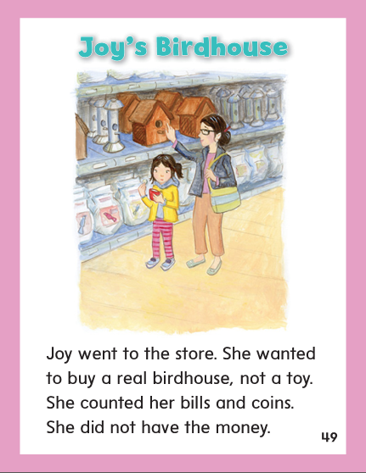

Slide 279
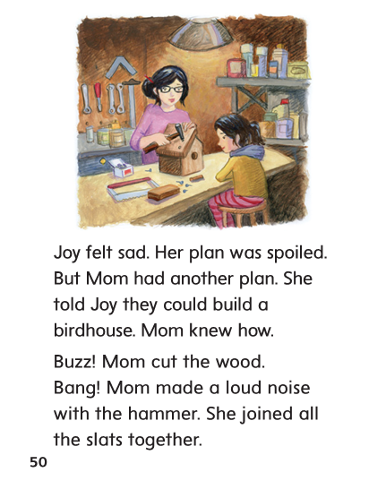

Slide 280
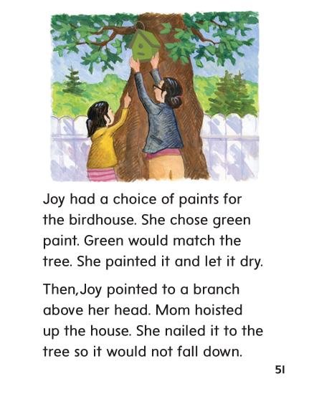

Slide 281
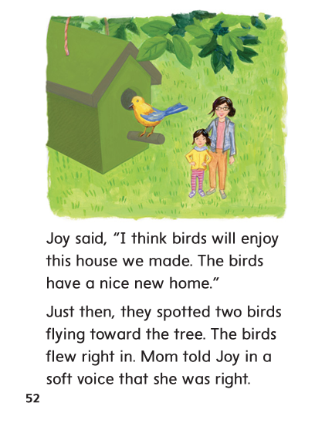

Slide 282
Spelling
/oi/
/oy/
other

Slide 283
spoil
boy
coin
joy
join
toy
town
mouse
build
spoil
boy
coin
joy
join
toy
town
mouse
build

Slide 284
High Frequency
Words

Slide 285
Read, Spell, Write
above
How does rain fall from the sky above?

Slide 286
Read, Spell, Write
build
He knew how to build a town out of blocks.

Slide 287
Read, Spell, Write
fall
How does rain fall from the sky above?

Slide 288
Read, Spell, Write
knew
He knew how to build a town out of blocks.

Slide 289
Read, Spell, Write
money
How much money does it cost?

Slide 290
Read, Spell, Write
toward
The dog ran toward the yard.

Slide 291
Build Fluency: Word Automaticity
She knew she needed more money.
They can build a bridge above water.
He ran toward the girl when he saw her fall.

Slide 292
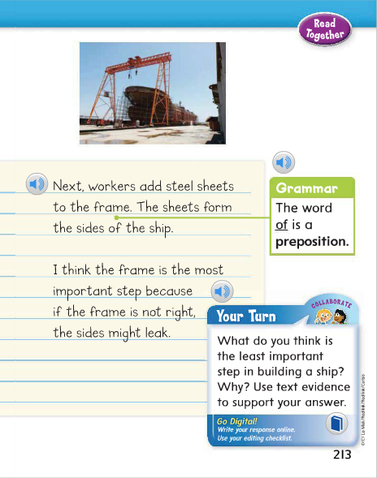
A preposition connects a noun or a pronoun to other words in a sentence.
Identify the prepositions in the model sentence.
What is the preposition in this sentence?

Slide 293
Week 5 – Day 4

Slide 294
Phonological Awareness
Phoneme Blending
Listen to these sounds: /f/ /oi/ /l/.
Now listen as I blend the sounds: /fffoilll/.
What’s the word? Foil.
Guided Practice:
Listen carefully as I say some more sounds. Blend the sounds to make words.
/t/ /oi/ /b/ /oi/ /s/ /oi/ /l/ /b/ /r/ /oi/ /l/
/v/ /oi/ /s/ /ch/ /oi/ /s/ /m/ /oi/ /s/ /t/ /s/ /p/ /oi//l/

Slide 295
Build Words with Dipthongs oi, oy
c
oi
n
What is the new word we made?
Let’s blend all the sounds and read the word.
Change the c to j.

Slide 296
Build Words with Dipthongs oi, oy
j
oi
n
What is the new word we made?
Let’s blend all the sounds and read the word.
Remove the n.

Slide 297
Build Words with Dipthongs oi, oy
j
oy
What is the new word we made?
Let’s blend all the sounds and read the word.
Change the j to t.

Slide 298
Build Words with Dipthongs oi, oy
t
oy
What is the new word we made?
Let’s blend all the sounds and read the word.
Change the t to b.

Slide 299
Build Words with Dipthongs oi, oy
b
oy
What is the new word we made?
Let’s blend all the sounds and read the word.
Add a l to the end of the word.

Slide 300
Build Words with Dipthongs oi, oy
b
oi
l
What is the new word we made?
Let’s blend all the sounds and read the word.
Change the b to sp.

Slide 301
Build Words with Dipthongs oi, oy
sp
oi
l
What is the new word we made?
Let’s blend all the sounds and read the word.
Change the sp to s.

Slide 302
Build Words with Dipthongs oi, oy
s
oi
l
What is the new word we made?
Let’s blend all the sounds and read the word.
Change the s to f.

Slide 303
Build Words with Dipthongs oi, oy
f
oi
l
What is the new word we made?
Let’s blend all the sounds and read the word.
Remove the f.

Slide 304
Build Words with Dipthongs oi, oy
oi
l
What is the new word we made?
Let’s blend all the sounds and read the word.
Remove the f.

Slide 305
Structural Analysis
Final Stable Syllables
Remember when you see le at the end of a word and there is a consonant before the letters, they make the sound /ul/. The consonant plus le are all in the same final syllable.
rid/dle
cra/dle

Slide 306
Structural Analysis
Final Stable Syllables
Have children work in pairs to divide the words into syllables and pronounce them using what they know about open, closed, and final stable syllables.
apple
battle
eagle
title

Slide 311
High Frequency
Words

Slide 312
Read, Spell, Write
above
How does rain fall from the sky above?

Slide 313
Read, Spell, Write
build
He knew how to build a town out of blocks.

Slide 314
Read, Spell, Write
fall
How does rain fall from the sky above?

Slide 315
Read, Spell, Write
knew
He knew how to build a town out of blocks.

Slide 316
Read, Spell, Write
money
How much money does it cost?

Slide 317
Read, Spell, Write
toward
The dog ran toward the yard.

Slide 318
Grammar
Prepositions and Prepositional Phrases
A preposition connects nouns to other words in a sentence.
Ask: What are some prepositions?
(above, beyond, during, for, in, of, on, toward)
A bridge goes above water.
A long bridge is in Florida.
Have children identify the prepositions.

Slide 319
Week 5 – Day 5

Slide 320
Phonemic Awareness
Phoneme Segmentation:
Listen as I say word. Then say each sound in the word. Tell me how many sounds you hear:
boy join moist spoil choice
Phoneme Blending:
Listen as I say a group of sounds. Then blend the sounds to form a word.
/k/ /oi/ /n/ /b/ /oi/ /l/ /j/ /oi/
/s/ /oi/ /l/ /s/ /p/ /oi/ /l/

Slide 321
Blend and Build Words with Dipthongs oi, oy
Read and say these words:
boy
noise
enjoy
choice

Slide 322
Blend and Build Words with Dipthongs oi, oy
sp
oi
l
What is the new word we made?
Let’s blend all the sounds and read the word.
Change the sp to s.

Slide 323
Blend and Build Words with Dipthongs oi, oy
s
oi
l
What is the new word we made?
Let’s blend all the sounds and read the word.
Change the s to f.

Slide 324
Blend and Build Words with Dipthongs oi, oy
f
oi
l
What is the new word we made?
Let’s blend all the sounds and read the word.
Change the f to b.

Slide 325
Blend and Build Words with Dipthongs oi, oy
b
oi
l
What is the new word we made?
Let’s blend all the sounds and read the word.
Remove the l.

Slide 326
Blend and Build Words with Dipthongs oi, oy
b
oy
What is the new word we made?
Let’s blend all the sounds and read the word.
Change the b to j.

Slide 327
Blend and Build Words with Dipthongs oi, oy
j
oy
What is the new word we made?
Let’s blend all the sounds and read the word.
Add a n to the end of the word.

Slide 328
Blend and Build Words with Dipthongs oi, oy
j
oi
n
What is the new word we made?
Let’s blend all the sounds and read the word.
Change the j to p and change the n to nt.

Slide 329
Blend and Build Words with Dipthongs oi, oy
p
oi
nt
What is the new word we made?
Let’s blend all the sounds and read the word.
Change the j to p and change the n to nt.

Slide 330
Word Automaticity
boils

Slide 331
joints

Slide 332
boy

Slide 333
apple

Slide 334
purple

Slide 335
join

Slide 336
oil

Slide 337
boil

Slide 338
candle

Slide 339
rattle

Slide 340
point

Slide 341
enjoys

Slide 342
broil

Slide 343
table

Slide 344
title

Slide 345
hoist

Slide 346
moist

Slide 347
joy

Slide 348
hoisted

Slide 349
joyful

Slide 350
soy

Slide 351
mouse

Slide 352
puzzle

Slide 353
gentle

Slide 354
moist

Slide 355
bundle

Slide 356
sparkle

Slide 357
most

Slide 358
Structural Analysis
Final Stable Syllables
Have children explain what a final stable syllable is.
Have them read the following words:
puddle
table
apple
bottle
candle

Slide 359
High Frequency
Words

Slide 360
Read, Spell, Write
above
How does rain fall from the sky above?

Slide 361
Read, Spell, Write
build
He knew how to build a town out of blocks.

Slide 362
Read, Spell, Write
fall
How does rain fall from the sky above?

Slide 363
Read, Spell, Write
knew
He knew how to build a town out of blocks.

Slide 364
Read, Spell, Write
money
How much money does it cost?

Slide 365
Read, Spell, Write
toward
The dog ran toward the yard.

Slide 366
Grammar
Prepositions and Prepositional Phrases
Have children describe how prepositions are used in sentences.
Write the following sentences and have children identify the prepositions.
My dad is building a shelf for my room. He will hang it above my bed. He worked during the night. He surprised me in the morning. I held it for him when he hung it. Then we put stuffed animals on the shelf.
Ask: How do I know which word in a sentence is a preposition?

