Slide 1
Week 1 – Day 1

Slide 2
Phonological Awareness
Phoneme Identity
Listen as I say three words: fruit, noon, chew.
These words have one sound that is the same.
I hear /u/ in fruit, noon, and chew.
Guided Practice:
Listen as I say three words. Which sound is the same?
moose, hoop, juice house, cow, town glued, zoom, mood
flew, too, shoo stork, corn, board boot, goose, drew

Slide 3
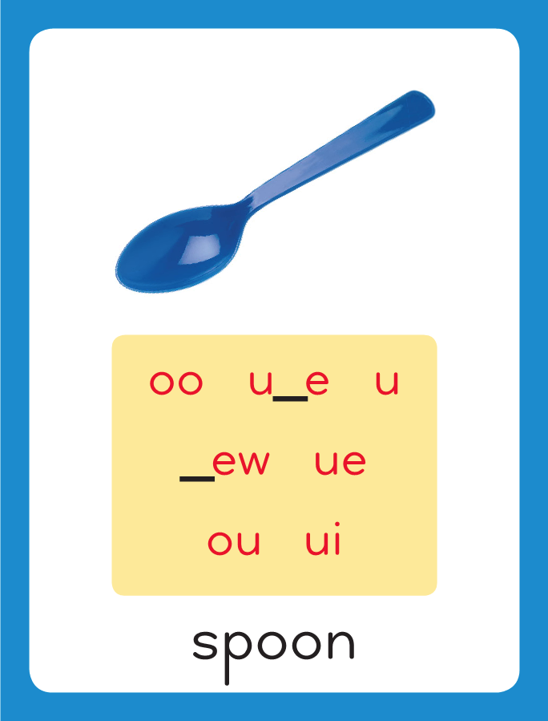
Introduce Variant Vowel /u/
spoon
truth
This is the Spoon
Sound-Spelling Card.
The sound is /u/.
This is the sound in the middle of the word spoon.
Listen: /spuuun/.
The /u/ sound can be spelled: oo, u, u_e, ew, ue, ui, and ou.
Say it with me: /u/.
I’ll say /u/ as I write the different spellings.
rule
chew
glue
fruit
you

Slide 4
Have children practice connecting the letters oo, u, u_e, ew, ue, ui, and ou to the sound /u/ by writing them.
Now do it with me. Say /u/ as I write the letters oo, u, u_e, ew, ue, ui, and ou.
This time, write the different spelling five times as you say /u/.
oo oo oo oo oo
u u u u u
u_e u_e u_e u_e u_e
ew ew ew ew ew
ue ue ue ue ue
ui ui ui ui ui
ou ou ou ou ou

Slide 5
Blend with Variant Vowel /u/
s

Slide 6
Blend with Variant Vowel /u/
s
oo

Slide 7
Blend with Variant Vowel /u/
s
oo

Slide 8
Blend with Variant Vowel /u/
s
oo
n

Slide 9
Blend with Variant Vowel /u/
s
oo
n

Slide 10
Blend with Variant Vowel /u/
tr

Slide 11
Blend with Variant Vowel /u/
tr
u

Slide 12
Blend with Variant Vowel /u/
tr
u

Slide 13
Blend with Variant Vowel /u/
tr
u
th

Slide 14
Blend with Variant Vowel /u/
tr
u
th

Slide 15
Blend with Variant Vowel /u/
fl

Slide 16
Blend with Variant Vowel /u/
fl
u_e

Slide 17
Blend with Variant Vowel /u/
fl
u_e

Slide 18
Blend with Variant Vowel /u/
fl
u
te

Slide 19
Blend with Variant Vowel /u/
fl
u
te

Slide 20
Blend with Variant Vowel /u/
n

Slide 21
Blend with Variant Vowel /u/
n
ew

Slide 22
Blend with Variant Vowel /u/
n
ew

Slide 23
Blend with Variant Vowel /u/
tr

Slide 24
Blend with Variant Vowel /u/
tr
ue

Slide 25
Blend with Variant Vowel /u/
tr
ue

Slide 26
Blend with Variant Vowel /u/
s

Slide 27
Blend with Variant Vowel /u/
s
ui

Slide 28
Blend with Variant Vowel /u/
s
ui

Slide 29
Blend with Variant Vowel /u/
s
ui
t

Slide 30
Blend with Variant Vowel /u/
s
ui
t

Slide 31
Blend with Variant Vowel /u/
y

Slide 32
Blend with Variant Vowel /u/
y
ou

Slide 33
Blend with Variant Vowel /u/
y
ou

Slide 34
ou er u_e or
dr ew ce oo
u st ui ur
oi ou ay oy

Slide 35
s

Slide 36
sou

Slide 37
soup

Slide 38
soup r

Slide 39
soup roo

Slide 40
soup room

Slide 41
soup room s

Slide 42
soup room soo

Slide 43
soup room soon

Slide 44
soup room soon
t

Slide 45
soup room soon
too

Slide 46
soup room soon
tool

Slide 47
soup room soon
tools

Slide 48
soup room soon
tools s

Slide 49
soup room soon
tools su

Slide 50
soup room soon
tools sup

Slide 51
soup room soon
tools super

Slide 52
soup room soon
tools super c

Slide 53
soup room soon
tools super coo

Slide 54
soup room soon
tools super cool

Slide 55
soup room soon
tools super cool
r

Slide 56
soup room soon
tools super cool
ru_e

Slide 57
soup room soon
tools super cool
rude

Slide 58
soup room soon
tools super cool
rude dr

Slide 59
soup room soon
tools super cool
rude drew

Slide 60
soup room soon
tools super cool
rude drew n

Slide 61
soup room soon
tools super cool
rude drew new

Slide 62
soup room soon
tools super cool
rude drew new
bl

Slide 63
soup room soon
tools super cool
rude drew new
blue

Slide 64
soup room soon
tools super cool
rude drew new
blue j

Slide 65
soup room soon
tools super cool
rude drew new
blue jui

Slide 66
soup room soon
tools super cool
rude drew new
blue juice

Slide 67
soup room soon
tools super cool
rude drew new
blue juice y

Slide 68
soup room soon
tools super cool
rude drew new
blue juice you

Slide 69
Internal Sounding Out
look

Slide 70
Internal Sounding Out
look loop

Slide 71
Internal Sounding Out
look loop rode

Slide 72
Internal Sounding Out
look loop rode
rude

Slide 73
Internal Sounding Out
look loop rode
rude stay

Slide 74
Internal Sounding Out
look loop rode
rude stay stew

Slide 75
Internal Sounding Out
look loop rode
rude stay stew
coin

Slide 76
Internal Sounding Out
look loop rode
rude stay stew
coin mouse

Slide 77
Internal Sounding Out
look loop rode
rude stay stew
coin mouse town

Slide 78
Internal Sounding Out
look loop rode
rude stay stew
coin mouse town
corn

Slide 79
Internal Sounding Out
look loop rode
rude stay stew
coin mouse town
corn hurt

Slide 80
Internal Sounding Out
look loop rode
rude stay stew
coin mouse town
corn hurt boys

Slide 81
Duke

Slide 82
Duke wore

Slide 83
Duke wore a

Slide 84
Duke wore a blue

Slide 85
Duke wore a blue suit

Slide 86
Duke wore a blue suit and

Slide 87
Duke wore a blue suit and brown

Slide 88
Duke wore a blue suit and brown boots.

Slide 89
Duke wore a blue suit and brown boots.
Lucy

Slide 90
Duke wore a blue suit and brown boots.
Lucy jumped

Slide 91
Duke wore a blue suit and brown boots.
Lucy jumped into

Slide 92
Duke wore a blue suit and brown boots.
Lucy jumped into her

Slide 93
Duke wore a blue suit and brown boots.
Lucy jumped into her new

Slide 94
Duke wore a blue suit and brown boots.
Lucy jumped into her new pool.

Slide 95
Duke wore a blue suit and brown boots.
Lucy jumped into her new pool.
A

Slide 96
Duke wore a blue suit and brown boots.
Lucy jumped into her new pool.
A moose

Slide 97
Duke wore a blue suit and brown boots.
Lucy jumped into her new pool.
A moose from

Slide 98
Duke wore a blue suit and brown boots.
Lucy jumped into her new pool.
A moose from the

Slide 99
Duke wore a blue suit and brown boots.
Lucy jumped into her new pool.
A moose from the zoo

Slide 100
Duke wore a blue suit and brown boots.
Lucy jumped into her new pool.
A moose from the zoo was

Slide 101
Duke wore a blue suit and brown boots.
Lucy jumped into her new pool.
A moose from the zoo was on

Slide 102
Duke wore a blue suit and brown boots.
Lucy jumped into her new pool.
A moose from the zoo was on the

Slide 103
Duke wore a blue suit and brown boots.
Lucy jumped into her new pool.
A moose from the zoo was on the loose!

Slide 104
Spelling / Dictation
1. _________
2. _________
3. _________
4. _________
5. _________
moon
tune
flew
blue
fruit

Slide 105
High Frequency
Words

Slide 106
Read, Spell, Write
answer
I will answer the phone.

Slide 107
Read, Spell, Write
brought
Sam brought his flute home from school.

Slide 108
Read, Spell, Write
busy
We had a busy day at school today.

Slide 109
Read, Spell, Write
door
Who opened the door?

Slide 110
Read, Spell, Write
enough
Do we have enough time to play this game?

Slide 111
Read, Spell, Write
eyes
My eyes are brown.

Slide 112
Have children read the sentences. Prompt them to identify the high-frequency words in connected text and to blend the decodable words.
I will answer the phone.
Sam brought his flute home from school.
We had a busy day at school today.

Slide 113
Have children read the sentences. Prompt them to identify the high-frequency words in connected text and to blend the decodable words.
Who opened the door?
Do we have enough time to play this game?
My eyes are brown.

Slide 114
Grammar
Pronouns
A noun is a person, place, thing, or idea.
Pronouns are words that take the place of nouns.
My name is _________. I am your teacher. Your name is __________. You are one student in this class. John is a boy. He is in our class. Myra is a girl. She is in our class.
You and I are in this room. We are in this room. The kids are sitting in the corner. They are sitting in the corner.
Circle the pronouns and explain that a pronoun can stand for a certain person, or group of people.

Slide 115
Grammar
Pronouns
A noun is a person, place, thing, or idea.
Pronouns are words that take the place of nouns.
We got fruit at the farm stand. They will make fruit pie. You can help, too. She cuts up a plum. He makes the crust. I know it will taste good!
Have children identify the pronouns.

Slide 116
Week 1 – Day 2

Slide 117
Phonemic Awareness
Phoneme Segmentation
Listen as I say a word: moose.
How many sounds do you hear in moose?
Listen: /m/ /oo/ /s/.
I hear three sounds in moose.
Guided Practice:
Have children segment the words and say the number of sounds.
school flew broom group
tooth prune grew bruise

Slide 118
Introduce Variant Vowel /u/
spoon
truth
tube
grew
true
What are the letters?
What sound do they stand for?
juice
group

Slide 119
Blend with Variant Vowel /u/
bl

Slide 120
Blend with Variant Vowel /u/
bl
ue

Slide 121
Blend with Variant Vowel /u/
bl
ue

Slide 122
Blend with Variant Vowel /u/
r

Slide 123
Blend with Variant Vowel /u/
r
oo

Slide 124
Blend with Variant Vowel /u/
r
oo

Slide 125
Blend with Variant Vowel /u/
r
oo
t

Slide 126
Blend with Variant Vowel /u/
r
oo
t

Slide 127
Blend with Variant Vowel /u/
fr

Slide 128
Blend with Variant Vowel /u/
fr
ui

Slide 129
Blend with Variant Vowel /u/
fr
ui

Slide 130
Blend with Variant Vowel /u/
fr
ui
t

Slide 131
Blend with Variant Vowel /u/
fr
ui
t

Slide 132
Blend with Variant Vowel /u/
n

Slide 133
Blend with Variant Vowel /u/
n
ew

Slide 134
Blend with Variant Vowel /u/
n
ew

Slide 135
Blend with Variant Vowel /u/
n
ew
s

Slide 136
Blend with Variant Vowel /u/
n
ew
s

Slide 137
s

Slide 138
sou

Slide 139
soup

Slide 140
soup fl

Slide 141
soup flew

Slide 142
soup flew r

Slide 143
soup flew roo

Slide 144
soup flew roof

Slide 145
soup flew roof
t

Slide 146
soup flew roof
tu_e

Slide 147
soup flew roof
tune

Slide 148
soup flew roof
tune h

Slide 149
soup flew roof
tune hoo

Slide 150
soup flew roof
tune hoop

Slide 151
soup flew roof
tune hoop dr

Slide 152
soup flew roof
tune hoop drew

Slide 153
soup flew roof
tune hoop drew
sc

Slide 154
soup flew roof
tune hoop drew
scoo

Slide 155
soup flew roof
tune hoop drew
scoop

Slide 156
soup flew roof
tune hoop drew
scoop n

Slide 157
soup flew roof
tune hoop drew
scoop noo

Slide 158
soup flew roof
tune hoop drew
scoop noon

Slide 159
soup flew roof
tune hoop drew
scoop noon s

Slide 160
soup flew roof
tune hoop drew
scoop noon sui

Slide 161
soup flew roof
tune hoop drew
scoop noon suit

Slide 162
soup flew roof
tune hoop drew
scoop noon suit
tr

Slide 163
soup flew roof
tune hoop drew
scoop noon suit
true

Slide 164
soup flew roof
tune hoop drew
scoop noon suit
true pr

Slide 165
soup flew roof
tune hoop drew
scoop noon suit
true pru_e

Slide 166
soup flew roof
tune hoop drew
scoop noon suit
true prune

Slide 167
soup flew roof
tune hoop drew
scoop noon suit
true prune gr

Slide 168
soup flew roof
tune hoop drew
scoop noon suit
true prune grew

Slide 169
Build with Variant Vowel /u/
m
oo
n
What is the new word we made?
Let’s blend all the sounds and read the word.
Change the n to d.

Slide 170
Build with Variant Vowel /u/
m
oo
d
What is the new word we made?
Let’s blend all the sounds and read the word.
Change the m to f.

Slide 171
Build with Variant Vowel /u/
f
oo
d
What is the new word we made?
Let’s blend all the sounds and read the word.
Change the d to l.

Slide 172
Build with Variant Vowel /u/
f
oo
l
What is the new word we made?
Let’s blend all the sounds and read the word.
Change the f to t.

Slide 173
Build with Variant Vowel /u/
t
oo
l
What is the new word we made?
Let’s blend all the sounds and read the word.
Remove the l.

Slide 174
Build with Variant Vowel /u/
t
oo
What is the new word we made?
Let’s blend all the sounds and read the word.
Change the t to z.

Slide 175
Build with Variant Vowel /u/
z
oo
What is the new word we made?
Let’s blend all the sounds and read the word.
Add the letter m to the end of the word.

Slide 176
Build with Variant Vowel /u/
z
oo
m
What is the new word we made?
Let’s blend all the sounds and read the word.
Change the z to r.

Slide 177
Build with Variant Vowel /u/
r
oo
m
What is the new word we made?
Let’s blend all the sounds and read the word.
Change the m to t.

Slide 178
Build with Variant Vowel /u/
r
oo
t
What is the new word we made?
Let’s blend all the sounds and read the word.
Change the r to fr.

Slide 179
Build with Variant Vowel /u/
fr
ui
t
What is the new word we made?
Let’s blend all the sounds and read the word.
Change the fr to s.

Slide 180
Build with Variant Vowel /u/
s
ui
t
What is the new word we made?
Let’s blend all the sounds and read the word.
Remove the t.

Slide 181
Build with Variant Vowel /u/
s
ue
What is the new word we made?
Let’s blend all the sounds and read the word.
Change the s to d.

Slide 182
Build with Variant Vowel /u/
d
ue
What is the new word we made?
Let’s blend all the sounds and read the word.
Change the d to dr.

Slide 183
Build with Variant Vowel /u/
dr
ew
What is the new word we made?
Let’s blend all the sounds and read the word.
Change the dr to gr.

Slide 184
Build with Variant Vowel /u/
gr
ew
What is the new word we made?
Let’s blend all the sounds and read the word.
Add the letter p to the end of the word.

Slide 185
Build with Variant Vowel /u/
gr
ou
p
What is the new word we made?
Let’s blend all the sounds and read the word.

Slide 186
Structural Analysis
Suffixes –ful and -less
Some word parts added to the end of words are called suffixes.
help
helpful
helpless
-ful means “full” or “full of”
Helpful means
“full of help”
-less means “without”
Helpless means
“without help”

Slide 187
Structural Analysis
Suffixes –ful and -less
Help children identify the root word and suffix, blend the word, tell what it means, and use it in a sentence.
fearful
joyful
toothless
useless

Slide 188
Spelling
food
rule
grew
glue
suit
group

Slide 189
moon
tune
flew
blue
fruit
soup
moon
tune
flew
blue
fruit
soup

Slide 190
High Frequency
Words

Slide 191
Read, Spell, Write
answer
I will answer the phone.

Slide 192
Read, Spell, Write
brought
Sam brought his flute home from school.

Slide 193
Read, Spell, Write
busy
We had a busy day at school today.

Slide 194
Read, Spell, Write
door
Who opened the door?

Slide 195
Read, Spell, Write
enough
Do we have enough time to play this game?

Slide 196
Read, Spell, Write
eyes
My eyes are brown.

Slide 197
Grammar
Pronouns
The pronouns I, he, she, and it stand for one noun; we and they stand for more than one; and you can stand for one or more.
Bruce and Ruth were born on the same day. (They, She). Bruce wants to have a party. (I, He) Ruth wants to go skating. (They, She) Luke and I think they should have a skating party. (It, We)
Have children choose which pronoun could replace
the underlined subject of each sentence.

Slide 198
Week 1 – Day 3

Slide 199
Phonemic Awareness
Identify and Generate Rhyme
Listen carefully as I say three words: pool, stool, bill.
Pool and stool rhyme because they both end with the same sounds: /ul/.
What is another word that rhymes with pool and stool?
Rule ends with /ul/ too, so rule rhymes with pool and stool.
Guided Practice:
Have children practice identifying and generating rhyming words,
soon, could, noon loose, tube, goose
boy, too, you school, coop, group

Slide 200
Blend with Variant Vowel /u/
s

Slide 201
Blend with Variant Vowel /u/
s
ui

Slide 202
Blend with Variant Vowel /u/
s
ui

Slide 203
Blend with Variant Vowel /u/
s
ui
t

Slide 204
Blend with Variant Vowel /u/
s
ui
t

Slide 205
Blend with Variant Vowel /u/
fl

Slide 206
Blend with Variant Vowel /u/
fl
u_e

Slide 207
Blend with Variant Vowel /u/
fl
u_e

Slide 208
Blend with Variant Vowel /u/
fl
u
te

Slide 209
Blend with Variant Vowel /u/
fl
u
te

Slide 210
Blend with Variant Vowel /u/
sp

Slide 211
Blend with Variant Vowel /u/
sp
oo

Slide 212
Blend with Variant Vowel /u/
sp
oo

Slide 213
Blend with Variant Vowel /u/
sp
oo
n

Slide 214
Blend with Variant Vowel /u/
sp
oo
n

Slide 215
Blend with Variant Vowel /u/
st

Slide 216
Blend with Variant Vowel /u/
st
ew

Slide 217
Blend with Variant Vowel /u/
st
ew

Slide 218
Blend with Variant Vowel /u/
tr

Slide 219
Blend with Variant Vowel /u/
tr
u

Slide 220
Blend with Variant Vowel /u/
tr
u

Slide 221
Blend with Variant Vowel /u/
tr
u
th

Slide 222
Blend with Variant Vowel /u/
tr
u
th

Slide 223
oo sn ou th
gr u_e ce ue
ew bl ui y
ful ai less ar

Slide 224
f

Slide 225
foo

Slide 226
food

Slide 227
food t

Slide 228
food too

Slide 229
food too n

Slide 230
food too new

Slide 231
food too new
m

Slide 232
food too new
moo

Slide 233
food too new
moo sn

Slide 234
food too new
moo snoo

Slide 235
food too new
moo snoop

Slide 236
food too new
moo snoop r

Slide 237
food too new
moo snoop roo

Slide 238
food too new
moo snoop room

Slide 239
food too new
moo snoop room
r

Slide 240
food too new
moo snoop room
ru_e

Slide 241
food too new
moo snoop room
rule

Slide 242
food too new
moo snoop room
rule gr

Slide 243
food too new
moo snoop room
rule grew

Slide 244
food too new
moo snoop room
rule grew gr

Slide 245
food too new
moo snoop room
rule grew grou

Slide 246
food too new
moo snoop room
rule grew group

Slide 247
food too new
moo snoop room
rule grew group
y

Slide 248
food too new
moo snoop room
rule grew group
you

Slide 249
food too new
moo snoop room
rule grew group
youth

Slide 250
food too new
moo snoop room
rule grew group
youth j

Slide 251
food too new
moo snoop room
rule grew group
youth jui

Slide 252
food too new
moo snoop room
rule grew group
youth juice

Slide 253
food too new
moo snoop room
rule grew group
youth juice z

Slide 254
food too new
moo snoop room
rule grew group
youth juice zoo

Slide 255
food too new
moo snoop room
rule grew group
youth juice zoom

Slide 256
blue
Internal Sounding Out

Slide 257
blue tool
Internal Sounding Out

Slide 258
blue tool truth
Internal Sounding Out

Slide 259
blue tool truth
pain
Internal Sounding Out

Slide 260
blue tool truth
painful
Internal Sounding Out

Slide 261
blue tool truth
painful end
Internal Sounding Out

Slide 262
blue tool truth
painful endless
Internal Sounding Out

Slide 263
blue tool truth
painful endless use
Internal Sounding Out

Slide 264
blue tool truth
painful endless useful
Internal Sounding Out

Slide 265
blue tool truth
painful endless useful
clue
Internal Sounding Out

Slide 266
blue tool truth
painful endless useful
clueless
Internal Sounding Out

Slide 267
blue tool truth
painful endless useful
clueless hope
Internal Sounding Out

Slide 268
blue tool truth
painful endless useful
clueless hopeful
Internal Sounding Out

Slide 269
blue tool truth
painful endless useful
clueless hopeful
help
Internal Sounding Out

Slide 270
blue tool truth
painful endless useful
clueless hopeful
helpless
Internal Sounding Out

Slide 271
blue tool truth
painful endless useful
clueless hopeful
helpless harm
Internal Sounding Out

Slide 272
blue tool truth
painful endless useful
clueless hopeful
helpless harmful
Internal Sounding Out

Slide 273
blue tool truth
painful endless useful
clueless hopeful
helpless harmful
spoon
Internal Sounding Out

Slide 274
blue tool truth
painful endless useful
clueless hopeful
helpless harmful
spoonful
Internal Sounding Out

Slide 275
blue tool truth
painful endless useful
clueless hopeful
helpless harmful
spoonful cloud
Internal Sounding Out

Slide 276
blue tool truth
painful endless useful
clueless hopeful
helpless harmful
spoonful cloudless
Internal Sounding Out

Slide 277
Luke

Slide 278
Luke and

Slide 279
Luke and June

Slide 280
Luke and June found

Slide 281
Luke and June found glue

Slide 282
Luke and June found glue at

Slide 283
Luke and June found glue at school.

Slide 284
Luke and June found glue at school.
Ruby

Slide 285
Luke and June found glue at school.
Ruby used

Slide 286
Luke and June found glue at school.
Ruby used a

Slide 287
Luke and June found glue at school.
Ruby used a spoon

Slide 288
Luke and June found glue at school.
Ruby used a spoon to

Slide 289
Luke and June found glue at school.
Ruby used a spoon to stir

Slide 290
Luke and June found glue at school.
Ruby used a spoon to stir the

Slide 291
Luke and June found glue at school.
Ruby used a spoon to stir the stew.

Slide 292
Structural Analysis
Suffixes –ful and -less
Remember the suffix –ful means “full’ or ‘full of”
so spoonful means “a spoon that is full.”
spoon
spoonful

Slide 293
Structural Analysis
Suffixes –ful and -less
Remember the suffix –less means “without”
so cloudless means “without clouds.”
cloud
cloudless

Slide 294
Structural Analysis
Suffixes –ful and -less
Read the words with children. Ask children to add –ful, blend the new word, tell what it means, and use it in a sentence. Repeat with –less.
pain
hope
use
harm

Slide 295
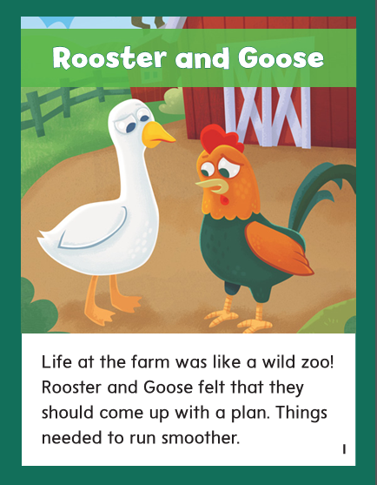

Slide 296
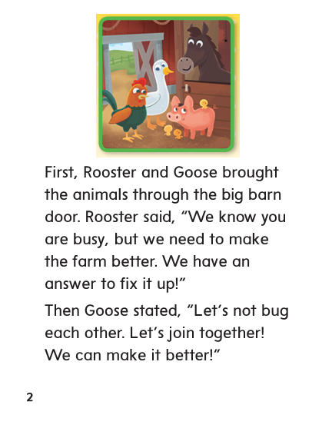

Slide 297
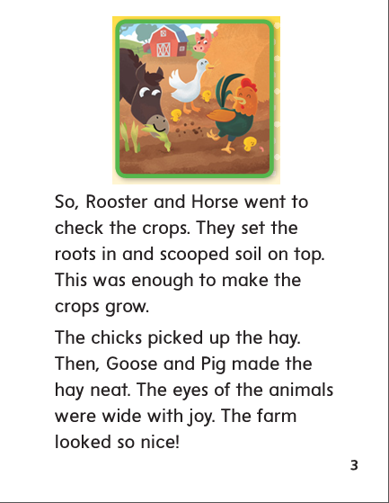

Slide 298
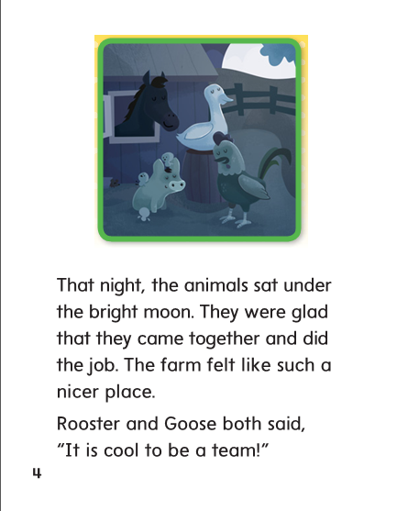

Slide 299
oo
u_e
ew
ue
ui
ou

Slide 300
moon
moon
moon
tune
tune
tune
flew
flew
flew
blue
blue
blew
fruit
fruit
fruit
soup
soup
soup

Slide 301
High Frequency
Words

Slide 302
Read, Spell, Write
answer
I will answer the phone.

Slide 303
Read, Spell, Write
brought
Sam brought his flute home from school.

Slide 304
Read, Spell, Write
busy
We had a busy day at school today.

Slide 305
Read, Spell, Write
door
Who opened the door?

Slide 306
Read, Spell, Write
enough
Do we have enough time to play this game?

Slide 307
Read, Spell, Write
eyes
My eyes are brown.

Slide 308
Build Fluency: Word Automaticity
The bell rings. I open my eyes. “Who is there?” I ask.
“We are,” Gram and Gramps answer.
I open the door.
“Are you and Dad busy?” they ask. “We brought lunch. We have enough food for all of us.”

Slide 309
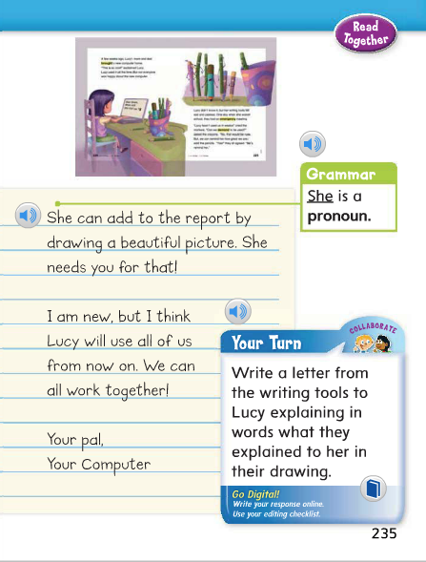
Remember that pronouns take the place of nouns.
Identify the pronouns in the model sentence.
Which pronoun is in this sentence?

Slide 310
Week 1 – Day 4

Slide 311
Phonological Awareness
Syllable Deletion
Listen carefully as I say a word: harmless.
I will delete the last syllable, or part, of the word: less.
What word do I have if I take less away from harmless?
Harmless without less is harm.
Guided Practice:
Have children practice syllable deletion.
cheerful without ful helpless without less cowboy without cow
roomy without y undo without un sandwich without wich

Slide 312
Build Words Variant Vowel /u/
r
oo
f
What is the new word we made?
Let’s blend all the sounds and read the word.
Change the f to t.

Slide 313
Build Words Variant Vowel /u/
r
oo
t
What is the new word we made?
Let’s blend all the sounds and read the word.
Change the r to b.

Slide 314
Build Words Variant Vowel /u/
b
oo
t
What is the new word we made?
Let’s blend all the sounds and read the word.
Change the b to h.

Slide 315
Build Words Variant Vowel /u/
h
oo
t
What is the new word we made?
Let’s blend all the sounds and read the word.
Change the h to sh.

Slide 316
Build Words Variant Vowel /u/
sh
oo
t
What is the new word we made?
Let’s blend all the sounds and read the word.
Remove the t.

Slide 317
Build Words Variant Vowel /u/
sh
oo
What is the new word we made?
Let’s blend all the sounds and read the word.
Change the sh to m.

Slide 318
Build Words Variant Vowel /u/
m
oo
What is the new word we made?
Let’s blend all the sounds and read the word.
Change the m to b.

Slide 319
Build Words Variant Vowel /u/
b
oo
What is the new word we made?
Let’s blend all the sounds and read the word.
Change the b to bl.

Slide 320
Build Words Variant Vowel /u/
bl
ue
What is the new word we made?
Let’s blend all the sounds and read the word.
Change the bl to gr.

Slide 321
Build Words Variant Vowel /u/
gr
ew
What is the new word we made?
Let’s blend all the sounds and read the word.
Change the gr to dr.

Slide 322
Build Words Variant Vowel /u/
dr
ew
What is the new word we made?
Let’s blend all the sounds and read the word.
Change the dr to d.

Slide 323
Build Words Variant Vowel /u/
d
ew
What is the new word we made?
Let’s blend all the sounds and read the word.
Add the letter n to the end of the word.

Slide 324
Build Words Variant Vowel /u/
d
u
ne
What is the new word we made?
Let’s blend all the sounds and read the word.
Change the d to t.

Slide 325
Build Words Variant Vowel /u/
t
u
ne
What is the new word we made?
Let’s blend all the sounds and read the word.
Change the d to t.

Slide 326
Structural Analysis
Suffixes –ful and -less
Remember that –ful means “full” or “full of”
and –less means “without”
useful
useless
Have children blend the words and use them in sentences.

Slide 327
Structural Analysis
Suffixes –ful and -less
Have partners sort them by suffix. Identify the root word and suffix in each word, blend the word, tell its meaning, and use it in a sentence.
hopeless
graceful
playful
harmless
thankful
clueless

Slide 329
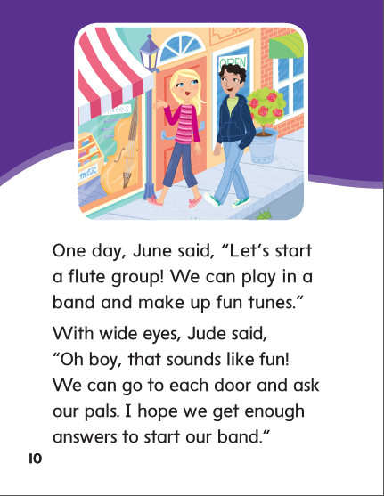

Slide 330
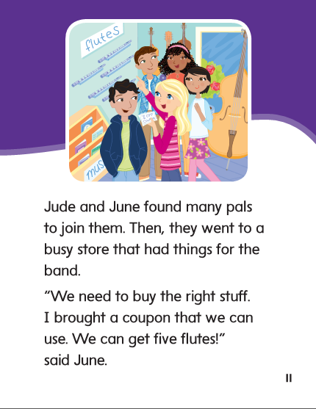

Slide 331
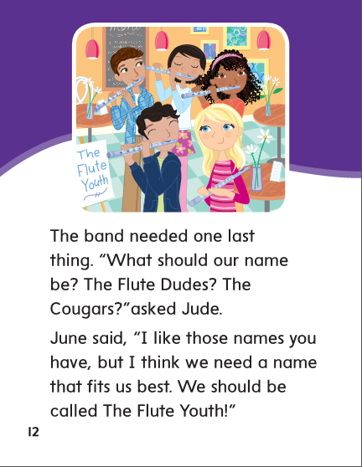

Slide 332
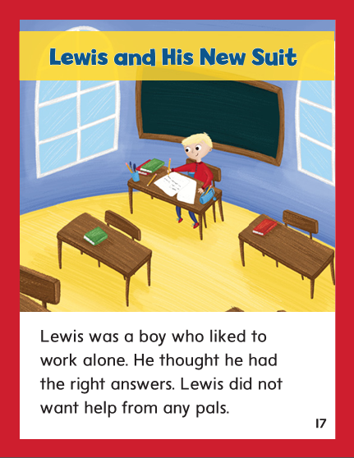

Slide 333
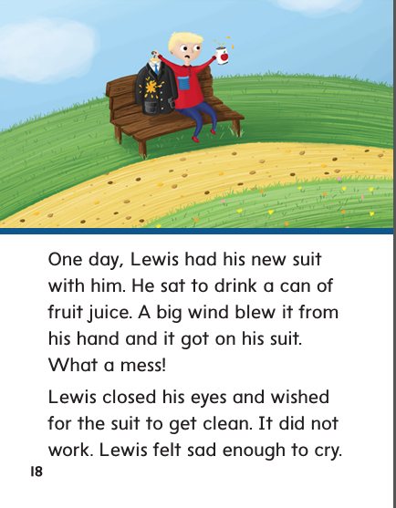

Slide 334
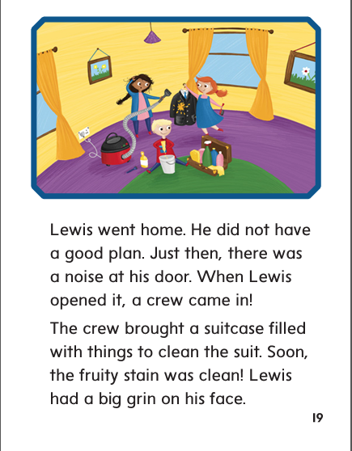

Slide 335
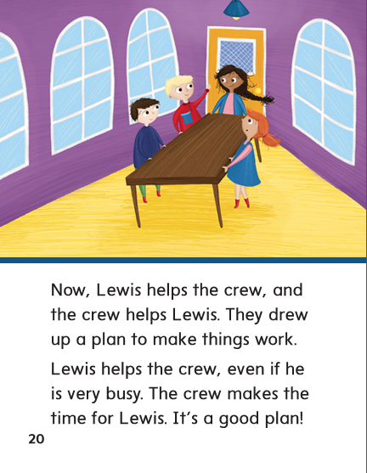

Slide 336
High Frequency
Words

Slide 337
Read, Spell, Write
answer
I will answer the phone.

Slide 338
Read, Spell, Write
brought
Sam brought his flute home from school.

Slide 339
Read, Spell, Write
busy
We had a busy day at school today.

Slide 340
Read, Spell, Write
door
Who opened the door?

Slide 341
Read, Spell, Write
enough
Do we have enough time to play this game?

Slide 342
Read, Spell, Write
eyes
My eyes are brown.

Slide 343
Grammar
Pronouns
The pronouns I, he, she, and it stand for one noun; we and they stand for more than one; and you can stand for one or more.
The tube is fun to play in the marching band.
(It, He)
Mom answered the door. (They, She)
The kids are shooting hoops at the park. (He, They)
Bruce is making soup. (He, It)
Miss Dowd and I live next door to each other. (She, We)
Circle the pronouns and explain that a pronoun can stand for a certain person, or group of people.

Slide 344
Week 1 – Day 5

Slide 345
Phonemic Awareness
Phoneme Segmentation:
I am going to say a word. I want you to say each sound in the word.
zoo soup chew fruit moon blue spoon
Phoneme Substitution:
Now I am going to say a word. Then I’ll tell you a sound to change to make a new word.
Let’s do one together:
suit/boot
Continue with:
fool/pool room/root tooth/tool

Slide 346
Blend and Build Words with Long i: i, y, igh, ie
Read and say these words:
soon
news
rule
truth
blue
you
fruit

Slide 347
Blend and Build with Variant Vowel /u/
cl
ue
What is the new word we made?
Let’s blend all the sounds and read the word.
Change the cl to gl.

Slide 348
Blend and Build with Variant Vowel /u/
gl
ue
What is the new word we made?
Let’s blend all the sounds and read the word.
Change the gl to bl.

Slide 349
Blend and Build with Variant Vowel /u/
bl
ue
What is the new word we made?
Let’s blend all the sounds and read the word.
Change the bl to s.

Slide 350
Blend and Build with Variant Vowel /u/
s
ue
What is the new word we made?
Let’s blend all the sounds and read the word.
Add the letter t to the end of the word..

Slide 351
Blend and Build with Variant Vowel /u/
s
ui
t
What is the new word we made?
Let’s blend all the sounds and read the word.
Change the t to p.

Slide 352
Blend and Build with Variant Vowel /u/
s
ou
p
What is the new word we made?
Let’s blend all the sounds and read the word.
Change the p to n.

Slide 353
Blend and Build with Variant Vowel /u/
s
oo
n
What is the new word we made?
Let’s blend all the sounds and read the word.
Change the s to m.

Slide 354
Blend and Build with Variant Vowel /u/
m
oo
n
What is the new word we made?
Let’s blend all the sounds and read the word.
Change the n to d.

Slide 355
Blend and Build with Variant Vowel /u/
m
oo
d
What is the new word we made?
Let’s blend all the sounds and read the word.
Change the m to f.

Slide 356
Blend and Build with Variant Vowel /u/
f
oo
d
What is the new word we made?
Let’s blend all the sounds and read the word.
Change the d to l.

Slide 357
Blend and Build with Variant Vowel /u/
f
oo
l
What is the new word we made?
Let’s blend all the sounds and read the word.
Change the f to c.

Slide 358
Blend and Build with Variant Vowel /u/
c
oo
l
What is the new word we made?
Let’s blend all the sounds and read the word.
Change the c to p.

Slide 359
Blend and Build with Variant Vowel /u/
p
oo
l
What is the new word we made?
Let’s blend all the sounds and read the word.
Change the p to sp.

Slide 360
Blend and Build with Variant Vowel /u/
sp
oo
l
What is the new word we made?
Let’s blend all the sounds and read the word.
Change the l to n.

Slide 361
Blend and Build with Variant Vowel /u/
sp
oo
n
What is the new word we made?
Let’s blend all the sounds and read the word.
Change the l to n.

Slide 362
Word Automaticity
food

Slide 363
room

Slide 364
juice

Slide 365
painful

Slide 366
helpless

Slide 367
too

Slide 368
rule

Slide 369
zoom

Slide 370
endless

Slide 371
harmful

Slide 372
new

Slide 373
grew

Slide 374
blue

Slide 375
hopeful

Slide 376
useless

Slide 377
moo

Slide 378
group

Slide 379
tool

Slide 380
useful

Slide 381
spoonful

Slide 382
snoop

Slide 383
youth

Slide 384
truth

Slide 385
clueless

Slide 386
cloudless

Slide 387
Structural Analysis
Suffixes –ful and -less
Have children explain what –ful and –less mean.
Then have them read words such as:
useful
helpful
painless
clueless

Slide 388
High Frequency
Words

Slide 389
Read, Spell, Write
answer
I will answer the phone.

Slide 390
Read, Spell, Write
brought
Sam brought his flute home from school.

Slide 391
Read, Spell, Write
busy
We had a busy day at school today.

Slide 392
Read, Spell, Write
door
Who opened the door?

Slide 393
Read, Spell, Write
enough
Do we have enough time to play this game?

Slide 394
Read, Spell, Write
eyes
My eyes are brown.

Slide 395
Grammar
Pronouns
Have children describe when the pronouns
I, you, he, she, it, we, and they are used.
Have children identify the pronouns:
Jan and I are going to the zoo. It is a fun place. We like the snake house. Would you like to go too?
What pronoun takes the place of Jan and I? What takes the place of zoo?
How many nouns does I stand for?

Slide 396
Grammar
Pronouns
Have children work in pairs to write sentences using:
he
she
it
they

