Slide 1
Week 2 – Day 1

Slide 2
Phonemic Awareness
Phoneme Categorization
Listen as I say three words: jaw, draw, glue.
Jaw and draw have the /o/ sound.
Glue does not have the /o/ sound.
Glue does not belong.
Listen as I say three more words: lawn, match, cause.
Lawn and cause have the /o/ sound.
Match does not have the /o/ sound.
Match does not belong.
Guided Practice:
I will say three words. Tell me which word does not belong and why.
dawn, hole, pause wait, saw, game mouth, yawn, couch
fruit, hall, moon sauce, cause, join row, law, claw

Slide 3
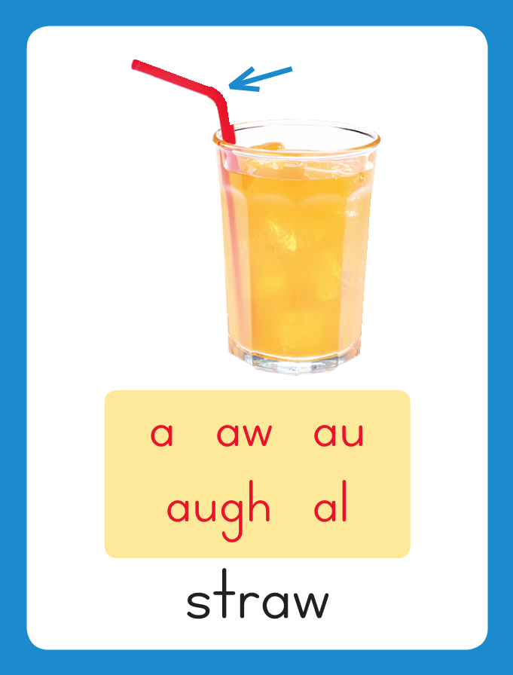
Introduce Variant Vowel /o/
ball
saw
This is the Straw
Sound-Spelling Card.
The sound is /o/.
This is the sound at the end of the word straw.
Listen: /ssstrrrooo/.
The /o/ sound can be spelled with the letters
a, aw, au, augh, and al
Say the sound with me: /o/.
I’ll say /o/ as I write the letters a, aw, au, augh, and al several times.
haul
caught
walk

Slide 4
Have children practice connecting the letters a, aw, au, augh, and al to the sound /o/ by writing them.
Now do it with me. Say /o/ as I write the letters a, aw, au, augh, and al.
This time, write each spelling five times as you say the /o/ sound.
a a a a a
aw aw aw aw aw
au au au au au
al al al al al
augh augh augh

Slide 5
Blend with Variant Vowel /o/
s

Slide 6
Blend with Variant Vowel /o/
s
aw

Slide 7
Blend with Variant Vowel /o/
s
aw

Slide 8
Blend with Variant Vowel /o/
sm

Slide 9
Blend with Variant Vowel /o/
sm
al

Slide 10
Blend with Variant Vowel /o/
sm
al

Slide 11
Blend with Variant Vowel /o/
sm
al
l

Slide 12
Blend with Variant Vowel /o/
sm
al
l

Slide 13
Blend with Variant Vowel /o/
h

Slide 14
Blend with Variant Vowel /o/
h
au

Slide 15
Blend with Variant Vowel /o/
h
au

Slide 16
Blend with Variant Vowel /o/
h
au
l

Slide 17
Blend with Variant Vowel /o/
h
au
l

Slide 18
Blend with Variant Vowel /o/
t

Slide 19
Blend with Variant Vowel /o/
t
augh

Slide 20
Blend with Variant Vowel /o/
t
augh

Slide 21
Blend with Variant Vowel /o/
t
augh
t

Slide 22
Blend with Variant Vowel /o/
t
augh
t

Slide 23
Blend with Variant Vowel /o/
w

Slide 24
Blend with Variant Vowel /o/
w
al

Slide 25
Blend with Variant Vowel /o/
w
al

Slide 26
Blend with Variant Vowel /o/
w
al
k

Slide 27
Blend with Variant Vowel /o/
w
al
k

Slide 28
al cl aw lt
cr augh sp au
ar ce oy ful
se oo gr ew

Slide 29
f

Slide 30
fal

Slide 31
fall

Slide 32
fall p

Slide 33
fall paw

Slide 34
fall paw f

Slide 35
fall paw fau

Slide 36
fall paw fault

Slide 37
fall paw fault
t

Slide 38
fall paw fault
tal

Slide 39
fall paw fault
talk

Slide 40
fall paw fault
talk cl

Slide 41
fall paw fault
talk claw

Slide 42
fall paw fault
talk claw c

Slide 43
fall paw fault
talk claw caugh

Slide 44
fall paw fault
talk claw caught

Slide 45
fall paw fault
talk claw caught
m

Slide 46
fall paw fault
talk claw caught
mal

Slide 47
fall paw fault
talk claw caught
mall

Slide 48
fall paw fault
talk claw caught
mall l

Slide 49
fall paw fault
talk claw caught
mall law

Slide 50
fall paw fault
talk claw caught
mall lawn

Slide 51
fall paw fault
talk claw caught
mall lawn c

Slide 52
fall paw fault
talk claw caught
mall lawn cau

Slide 53
fall paw fault
talk claw caught
mall lawn cause

Slide 54
fall paw fault
talk claw caught
mall lawn cause
cr

Slide 55
fall paw fault
talk claw caught
mall lawn cause
craw

Slide 56
fall paw fault
talk claw caught
mall lawn cause
crawl

Slide 57
fall paw fault
talk claw caught
mall lawn cause
crawl b

Slide 58
fall paw fault
talk claw caught
mall lawn cause
crawl bal

Slide 59
fall paw fault
talk claw caught
mall lawn cause
crawl bald

Slide 60
fall paw fault
talk claw caught
mall lawn cause
crawl bald s

Slide 61
fall paw fault
talk claw caught
mall lawn cause
crawl bald sau

Slide 62
fall paw fault
talk claw caught
mall lawn cause
crawl bald sauce

Slide 63
Internal Sounding Out
call

Slide 64
Internal Sounding Out
call cool

Slide 65
Internal Sounding Out
call cool yarn

Slide 66
Internal Sounding Out
call cool yarn
yawn

Slide 67
Internal Sounding Out
call cool yarn
yawn false

Slide 68
Internal Sounding Out
call cool yarn
yawn false face

Slide 69
Internal Sounding Out
call cool yarn
yawn false face
shout

Slide 70
Internal Sounding Out
call cool yarn
yawn false face
shout point

Slide 71
Internal Sounding Out
call cool yarn
yawn false face
shout point toys

Slide 72
Internal Sounding Out
call cool yarn
yawn false face
shout point toys
grew

Slide 73
Internal Sounding Out
call cool yarn
yawn false face
shout point toys
grew spoon

Slide 74
Internal Sounding Out
call cool yarn
yawn false face
shout point toys
grew spoon awful

Slide 75
Paul

Slide 76
Paul saw

Slide 77
Paul saw a

Slide 78
Paul saw a hawk

Slide 79
Paul saw a hawk in

Slide 80
Paul saw a hawk in the

Slide 81
Paul saw a hawk in the big

Slide 82
Paul saw a hawk in the big tree.

Slide 83
Paul saw a hawk in the big tree.
He

Slide 84
Paul saw a hawk in the big tree.
He taught

Slide 85
Paul saw a hawk in the big tree.
He taught his

Slide 86
Paul saw a hawk in the big tree.
He taught his daughter

Slide 87
Paul saw a hawk in the big tree.
He taught his daughter to

Slide 88
Paul saw a hawk in the big tree.
He taught his daughter to draw.

Slide 89
Paul saw a hawk in the big tree.
He taught his daughter to draw.
My

Slide 90
Paul saw a hawk in the big tree.
He taught his daughter to draw.
My dog

Slide 91
Paul saw a hawk in the big tree.
He taught his daughter to draw.
My dog almost

Slide 92
Paul saw a hawk in the big tree.
He taught his daughter to draw.
My dog almost caught

Slide 93
Paul saw a hawk in the big tree.
He taught his daughter to draw.
My dog almost caught the

Slide 94
Paul saw a hawk in the big tree.
He taught his daughter to draw.
My dog almost caught the ball

Slide 95
Paul saw a hawk in the big tree.
He taught his daughter to draw.
My dog almost caught the ball in

Slide 96
Paul saw a hawk in the big tree.
He taught his daughter to draw.
My dog almost caught the ball in her

Slide 97
Paul saw a hawk in the big tree.
He taught his daughter to draw.
My dog almost caught the ball in her paws.

Slide 98
Spelling / Dictation
1. _________
2. _________
3. _________
4. _________
5. _________

Slide 99
High Frequency
Words

Slide 100
Read, Spell, Write
brother
This is a picture of Tom’s brother Tim.

Slide 101
Read, Spell, Write
father
Jake’s father and mother coach
his baseball team.

Slide 102
Read, Spell, Write
friend
My friend and I love to play baseball.

Slide 103
Read, Spell, Write
love
My friend and I love to play baseball.

Slide 104
Read, Spell, Write
mother
Jake’s father and mother coach
his baseball team.

Slide 105
Read, Spell, Write
picture
This is a picture of Tom’s brother Tim.

Slide 106
Have children read the sentences. Prompt them to identify the high-frequency words in connected text and to blend the decodable words.
This is a picture of Tom’s brother Tim.
Jake’s father and mother coach his baseball team.
My friend and I love to play baseball.

Slide 107
Grammar
Possessive Pronouns
Pronouns are words that take the place of nouns.
A possessive pronoun shows who or what has or owns something.
Some possessive pronouns are used before nouns.
My house is white.
His coat is too small.
The dog sleeps in its bed.
They put their spelling tests in the basket.
Your mother just called.
Julie lost her tooth.
Gran stayed at our house.
My, your, his, her, its, our, and their are possessive pronouns.

Slide 108
Grammar
Possessive Pronouns
Identify the possessive pronouns.
The school has its own pool.
Miss Dawson helped me with my math.
Susie likes her new skirt.
Jack left his flute on the lawn.

Slide 109
Week 2 – Day 2

Slide 110
Phonemic Awareness
Phoneme Reversal
Listen as I blend these sounds: /n/ /e/ /t/, /nnneeet/, net.
Now I will say the sounds backward and blend them to make a new word.
Listen: /t/ /e/ /n/, /teeennn/, ten.
Listen as I blend these sounds: /t/ /e/ /l/, /ttteeel/, tell.
Now I will say the sounds backward and blend them to make a new word.
Listen: /l/ /e/ /t/, /llleeet/, let.
Guided Practice:
Now I am going to say more sounds. Blend the sounds to say a word. Then say the sounds backward and blend them to make another word.
/p/ /o/ /t/ /b/ /a/ /k/ /ch/ /i/ /p/ /z/ /u/ /t/ /o/ /t/

Slide 111
Introduce Variant Vowel /o/
wall
paw
cause
What are the letters?
What sound do they stand for?
caught
talk

Slide 112
Blend with Variant Vowel /o/
dr

Slide 113
Blend with Variant Vowel /o/
dr
aw

Slide 114
Blend with Variant Vowel /o/
dr
aw

Slide 115
Blend with Variant Vowel /o/
w

Slide 116
Blend with Variant Vowel /o/
w
al

Slide 117
Blend with Variant Vowel /o/
w
al

Slide 118
Blend with Variant Vowel /o/
w
al
k

Slide 119
Blend with Variant Vowel /o/
w
al
k

Slide 120
Blend with Variant Vowel /o/
w

Slide 121
Blend with Variant Vowel /o/
w
a

Slide 122
Blend with Variant Vowel /o/
w
a

Slide 123
Blend with Variant Vowel /o/
w
a
sh

Slide 124
Blend with Variant Vowel /o/
w
a
sh

Slide 125
Blend with Variant Vowel /o/
j

Slide 126
Blend with Variant Vowel /o/
j
aw

Slide 127
Blend with Variant Vowel /o/
j
aw

Slide 128
Blend with Variant Vowel /o/
c

Slide 129
Blend with Variant Vowel /o/
c
augh

Slide 130
Blend with Variant Vowel /o/
c
augh

Slide 131
Blend with Variant Vowel /o/
c
augh
t

Slide 132
Blend with Variant Vowel /o/
c
augh
t

Slide 133
Blend with Variant Vowel /o/
h

Slide 134
Blend with Variant Vowel /o/
h
au

Slide 135
Blend with Variant Vowel /o/
h
au

Slide 136
Blend with Variant Vowel /o/
h
au
l

Slide 137
Blend with Variant Vowel /o/
h
au
l

Slide 138
ch

Slide 139
chal

Slide 140
chalk

Slide 141
chalk cr

Slide 142
chalk craw

Slide 143
chalk crawl

Slide 144
chalk crawl h

Slide 145
chalk crawl haw

Slide 146
chalk crawl hawk

Slide 147
chalk crawl hawk
s

Slide 148
chalk crawl hawk
sau

Slide 149
chalk crawl hawk
sauce

Slide 150
chalk crawl hawk
sauce w

Slide 151
chalk crawl hawk
sauce wa

Slide 152
chalk crawl hawk
sauce wall

Slide 153
chalk crawl hawk
sauce wall t

Slide 154
chalk crawl hawk
sauce wall taugh

Slide 155
chalk crawl hawk
sauce wall taught

Slide 156
chalk crawl hawk
sauce wall taught
sm

Slide 157
chalk crawl hawk
sauce wall taught
sma

Slide 158
chalk crawl hawk
sauce wall taught
small

Slide 159
chalk crawl hawk
sauce wall taught
small t

Slide 160
chalk crawl hawk
sauce wall taught
small tal

Slide 161
chalk crawl hawk
sauce wall taught
small talk

Slide 162
chalk crawl hawk
sauce wall taught
small talk s

Slide 163
chalk crawl hawk
sauce wall taught
small talk sa

Slide 164
chalk crawl hawk
sauce wall taught
small talk salt

Slide 165
chalk crawl hawk
sauce wall taught
small talk salt y

Slide 166
chalk crawl hawk
sauce wall taught
small talk salt yaw

Slide 167
chalk crawl hawk
sauce wall taught
small talk salt yawn

Slide 168
Build with Variant Vowel /o/
s
aw
What is the new word we made?
Let’s blend all the sounds and read the word.
Change the s to l.

Slide 169
Build with Variant Vowel /o/
l
aw
What is the new word we made?
Let’s blend all the sounds and read the word.
Add an n to the end of the word.

Slide 170
Build with Variant Vowel /o/
l
aw
n
What is the new word we made?
Let’s blend all the sounds and read the word.
Change the l to d.

Slide 171
Build with Variant Vowel /o/
d
aw
n
What is the new word we made?
Let’s blend all the sounds and read the word.
Change the d to dr.

Slide 172
Build with Variant Vowel /o/
dr
aw
n
What is the new word we made?
Let’s blend all the sounds and read the word.
Remove the n.

Slide 173
Build with Variant Vowel /o/
dr
aw
What is the new word we made?
Let’s blend all the sounds and read the word.
Change the dr to r.

Slide 174
Build with Variant Vowel /o/
r
aw
What is the new word we made?
Let’s blend all the sounds and read the word.
Change the r to j.

Slide 175
Build with Variant Vowel /o/
j
aw
What is the new word we made?
Let’s blend all the sounds and read the word.
Change the j to p.

Slide 176
Build with Variant Vowel /o/
p
aw
What is the new word we made?
Let’s blend all the sounds and read the word.
Add se to the end of the word.

Slide 177
Build with Variant Vowel /o/
p
au
se
What is the new word we made?
Let’s blend all the sounds and read the word.
Change the p to c.

Slide 178
Build with Variant Vowel /o/
c
au
se
What is the new word we made?
Let’s blend all the sounds and read the word.
Change the c to cl.

Slide 179
Build with Variant Vowel /o/
cl
au
se
What is the new word we made?
Let’s blend all the sounds and read the word.
Remove the se.

Slide 180
Build with Variant Vowel /o/
cl
aw
What is the new word we made?
Let’s blend all the sounds and read the word.
Change to cl to c and add an l to the end of the word..

Slide 181
Build with Variant Vowel /o/
c
a
ll
What is the new word we made?
Let’s blend all the sounds and read the word.
Change to cl to c and add an l to the end of the word.

Slide 182
Build with Variant Vowel /o/
c
a
ll
What is the new word we made?
Let’s blend all the sounds and read the word.
Change the c to w.

Slide 183
Build with Variant Vowel /o/
w
al
k
What is the new word we made?
Let’s blend all the sounds and read the word.
Change the w to t.

Slide 184
Build with Variant Vowel /o/
t
al
k
What is the new word we made?
Let’s blend all the sounds and read the word.
Change the w to t.

Slide 185
Structural Analysis
Vowel Team Syllables
The letters ow stand for the vowel team sound /ou/.
When you see the letters for a vowel spelling in a word, the letters act as a team and must stay together in the same syllable.
down
downtown
down/town

Slide 186
Structural Analysis
Vowel Team Syllables
The vowel team stays together in the same syllable.
rain
draw
boat
rainbow
drawing
boathouse
Work with children to divide the words into syllables,
then blend the syllables to read the words.

Slide 187
Structural Analysis
Vowel Team Syllables
Work with children to find the vowel teams.
joyful
repeat
Hauling
railroad
Have children identify each syllable,
then blend the syllables to read the words.

Slide 188
Spelling
sauce
jaw

Slide 189
haul
cause
saw
claw
dawn
paw
haul
cause
saw
claw
dawn
paw

Slide 190
High Frequency
Words

Slide 191
Read, Spell, Write
brother
This is a picture of Tom’s brother Tim.

Slide 192
Read, Spell, Write
father
Jake’s father and mother coach
his baseball team.

Slide 193
Read, Spell, Write
friend
My friend and I love to play baseball.

Slide 194
Read, Spell, Write
love
My friend and I love to play baseball.

Slide 195
Read, Spell, Write
mother
Jake’s father and mother coach
his baseball team.

Slide 196
Read, Spell, Write
picture
This is a picture of Tom’s brother Tim.

Slide 197
Grammar
Possessive Pronouns
Some possessive pronouns are used before nouns.
Some possessive pronouns can stand alone.
Is this book yours? It is mine. It is his.
The bat is theirs. Only the baseballs are ours.
This shirt is just like hers.
Mine, yours, his, hers, ours, and theirs are possessive pronouns.

Slide 198
Grammar
Possessive Pronouns
Have partners identify the possessive pronouns that stand alone.
That soup tastes better than mine.
This school is smaller than theirs.

Slide 199
Week 2 – Day 3

Slide 200
Phonemic Awareness
Phoneme Blending
I will say three sounds. I will put one marker in each box as I say each sound. Put a marker in a box as you say each sound: /d/ /aw/ /n/.
Now blend the sounds to form a word: /d/ /aw/ /n/, dooonnn/, dawn.
/d/
/aw/
/n/

Slide 201
Phonemic Awareness
Phoneme Blending
Let’s do some together. I will say one sound at a time. Place a marker for each sound you hear. Then we will blend the sounds to say a word.
/d/
/aw/
/n/
/j/ /aw/ /b/ /aw/ /l/ /w/ /aw/ /k/ /h/ /aw/ /l/
/k/ /l/ /aw/ /k/ /aw/ /z/ /k/ /r/ /aw/ /l/ /f/ /aw/ /l/ /t/

Slide 202
Blend with Variant Vowel /aw/
h

Slide 203
Blend with Variant Vowel /aw/
h
aw

Slide 204
Blend with Variant Vowel /aw/
h
aw

Slide 205
Blend with Variant Vowel /aw/
h
aw
k

Slide 206
Blend with Variant Vowel /aw/
h
aw
k

Slide 207
Blend with Variant Vowel /aw/
s

Slide 208
Blend with Variant Vowel /aw/
s
al

Slide 209
Blend with Variant Vowel /aw/
s
al

Slide 210
Blend with Variant Vowel /aw/
s
al
t

Slide 211
Blend with Variant Vowel /aw/
s
al
t

Slide 212
Blend with Variant Vowel /aw/
l

Slide 213
Blend with Variant Vowel /aw/
l
au

Slide 214
Blend with Variant Vowel /aw/
l
au

Slide 215
Blend with Variant Vowel /aw/
l
au
n

Slide 216
Blend with Variant Vowel /aw/
l
au
n
ch

Slide 217
Blend with Variant Vowel /aw/
l
au
n
ch

Slide 218
Blend with Variant Vowel /aw/
ch

Slide 219
Blend with Variant Vowel /aw/
ch
al

Slide 220
Blend with Variant Vowel /aw/
ch
al

Slide 221
Blend with Variant Vowel /aw/
ch
al
k

Slide 222
Blend with Variant Vowel /aw/
ch
al
k

Slide 223
al ce aw nt
sh ful y augh
ay to less oo
u_e un oi ue

Slide 224
c

Slide 225
cal

Slide 226
call

Slide 227
call s

Slide 228
call sau

Slide 229
call sauce

Slide 230
call sauce t

Slide 231
call sauce tal

Slide 232
call sauce talk

Slide 233
call sauce talk
b

Slide 234
call sauce talk
bal

Slide 235
call sauce talk
ball

Slide 236
call sauce talk
ball b

Slide 237
call sauce talk
ball ba

Slide 238
call sauce talk
ball bald

Slide 239
call sauce talk
ball bald c

Slide 240
call sauce talk
ball bald caugh

Slide 241
call sauce talk
ball bald caught

Slide 242
call sauce talk
ball bald caught
a

Slide 243
call sauce talk
ball bald caught
al

Slide 244
call sauce talk
ball bald caught
als

Slide 245
call sauce talk
ball bald caught
also

Slide 246
call sauce talk
ball bald caught
also h

Slide 247
call sauce talk
ball bald caught
also hau

Slide 248
call sauce talk
ball bald caught
also haunt

Slide 249
call sauce talk
ball bald caught
also haunt dr

Slide 250
call sauce talk
ball bald caught
also haunt draw

Slide 251
call sauce talk
ball bald caught
also haunt drawing

Slide 252
call sauce talk
ball bald caught
also haunt drawing
aw

Slide 253
call sauce talk
ball bald caught
also haunt drawing
awful

Slide 254
call sauce talk
ball bald caught
also haunt drawing
awful b

Slide 255
call sauce talk
ball bald caught
also haunt drawing
awful be

Slide 256
call sauce talk
ball bald caught
also haunt drawing
awful bec

Slide 257
call sauce talk
ball bald caught
also haunt drawing
awful becau

Slide 258
call sauce talk
ball bald caught
also haunt drawing
awful because

Slide 259
Internal Sounding Out
oatmeal

Slide 260
Internal Sounding Out
oatmeal daughter

Slide 261
Internal Sounding Out
oatmeal daughter
August

Slide 262
Internal Sounding Out
oatmeal daughter
August auto

Slide 263
Internal Sounding Out
oatmeal daughter
August auto always

Slide 264
Internal Sounding Out
oatmeal daughter
August auto always
hallway

Slide 265
Internal Sounding Out
oatmeal daughter
August auto always
hallway sleepless

Slide 266
Internal Sounding Out
oatmeal daughter
August auto always
hallway sleepless
join

Slide 267
Internal Sounding Out
oatmeal daughter
August auto always
hallway sleepless
join June

Slide 268
Internal Sounding Out
oatmeal daughter
August auto always
hallway sleepless
join June untrue

Slide 269
Did

Slide 270
Did you

Slide 271
Did you draw

Slide 272
Did you draw a

Slide 273
Did you draw a hawk,

Slide 274
Did you draw a hawk, a

Slide 275
Did you draw a hawk, a fawn,

Slide 276
Did you draw a hawk, a fawn, or

Slide 277
Did you draw a hawk, a fawn, or a

Slide 278
Did you draw a hawk, a fawn, or a walrus?

Slide 279
Did you draw a hawk, a fawn, or a walrus?
Mrs.

Slide 280
Did you draw a hawk, a fawn, or a walrus?
Mrs. Paul’s

Slide 281
Did you draw a hawk, a fawn, or a walrus?
Mrs. Paul’s daughter

Slide 282
Did you draw a hawk, a fawn, or a walrus?
Mrs. Paul’s daughter crawled

Slide 283
Did you draw a hawk, a fawn, or a walrus?
Mrs. Paul’s daughter crawled on

Slide 284
Did you draw a hawk, a fawn, or a walrus?
Mrs. Paul’s daughter crawled on the

Slide 285
Did you draw a hawk, a fawn, or a walrus?
Mrs. Paul’s daughter crawled on the lawn.

Slide 286
Structural Analysis
Vowel Team Syllables
When the letters au come together in a word, they act as a vowel team and must stay in the same syllable. Blend the first syllable with children:
/lllooonnn/. The blend the second syllable: /drrreee/. Finally blend the two syllables to read laundry.
laundry

Slide 287
Structural Analysis
Vowel Team Syllables
When the letters ai come together in a word, they act as a vowel team and must stay in the same syllable. Blend the first syllable with children:
/ex/. The blend the second syllable: /plllaaan/. Finally blend the two syllables to read explain.
explain

Slide 288
Structural Analysis
Vowel Team Syllables
awful
soaking

Slide 289
Structural Analysis
Vowel Team Syllables
launching
faucet
jigsaw
lawyer
raccoon
oatmeal
Have children identify the letters for the vowel spelling in each vowel team syllable.
Help blend each syllable and then blend the syllables to read the words.

Slide 290
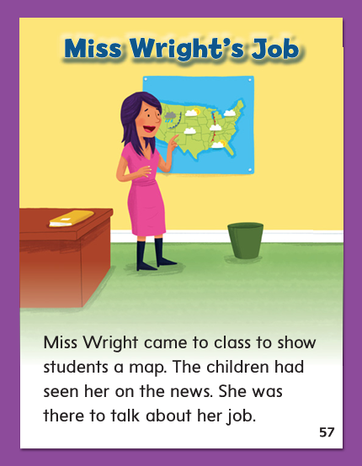

Slide 291
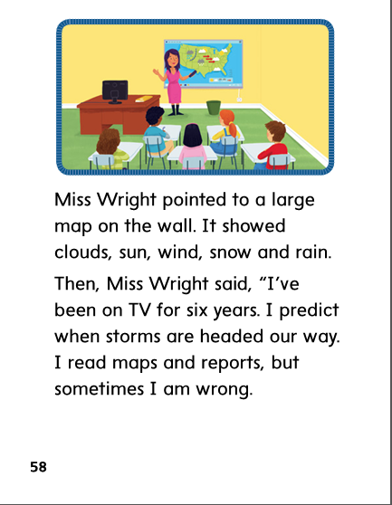

Slide 292
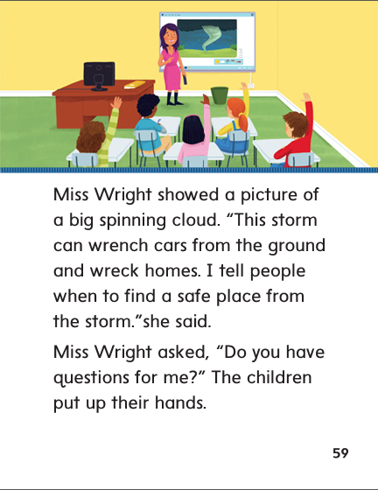

Slide 293
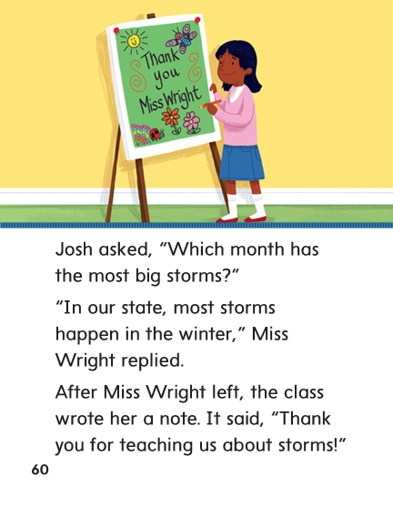

Slide 295
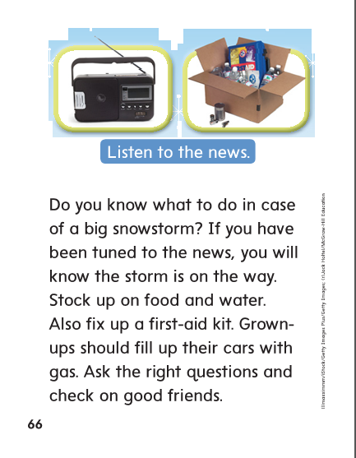

Slide 298
aw
au

Slide 299
haul
haul
haul
cause
cause
cause
saw
saw
saw
claw
claw
claw
paw
paw
paw
sauce
sauce
sauce

Slide 300
High Frequency
Words

Slide 301
Read, Spell, Write
brother
This is a picture of Tom’s brother Tim.

Slide 302
Read, Spell, Write
father
Jake’s father and mother coach
his baseball team.

Slide 303
Read, Spell, Write
friend
My friend and I love to play baseball.

Slide 304
Read, Spell, Write
love
My friend and I love to play baseball.

Slide 305
Read, Spell, Write
mother
Jake’s father and mother coach
his baseball team.

Slide 306
Read, Spell, Write
picture
This is a picture of Tom’s brother Tim.

Slide 307
Build Fluency: Word Automaticity
My brother is my best friend.
My brother and I love our mother and father.
We have a picture of all four of us together.

Slide 308
Possessive pronouns show who or what has or owns something.
Which possessive pronoun is in the following sentence?

Slide 309
Week 2 – Day 4

Slide 310
Phonemic Awareness
Phoneme Categorization
Listen as I say three words: pause, yawn, tool.
Two of the words have the /aw/ sound. One does not.
Pause and yawn have the /aw/ sound.
Tool does not have the /aw/ sound. Tool does not belong.
Guided Practice:
I will say three words. Tell me which word does not belong and why.
clown, jaws, sauce draw, lawn, boy hope, coat, dawn
flute, call, soon mall, chalk, rope day, raw, pain

Slide 311
Build Words Variant Vowel /aw/
l
aw
n
What is the new word we made?
Let’s blend all the sounds and read the word.
Remove the n.

Slide 312
Build Words Variant Vowel /aw/
l
aw
What is the new word we made?
Let’s blend all the sounds and read the word.
Add an s to the end of the word..

Slide 313
Build Words Variant Vowel /aw/
l
aw
s
What is the new word we made?
Let’s blend all the sounds and read the word.
Change the l to p.

Slide 314
Build Words Variant Vowel /aw/
p
aw
s
What is the new word we made?
Let’s blend all the sounds and read the word.
Change the word to a homonym of paws.

Slide 315
Build Words Variant Vowel /aw/
p
au
se
What is the new word we made?
Let’s blend all the sounds and read the word.
Change the p to c.

Slide 316
Build Words Variant Vowel /aw/
c
au
se
What is the new word we made?
Let’s blend all the sounds and read the word.
Add an ll between the au and se.

Slide 317
Build Words Variant Vowel /aw/
c
a
ll
s
What is the new word we made?
Let’s blend all the sounds and read the word.
Remove the s.

Slide 318
Build Words Variant Vowel /aw/
c
a
ll
What is the new word we made?
Let’s blend all the sounds and read the word.
Change the c to m.

Slide 319
Build Words Variant Vowel /aw/
m
a
ll
What is the new word we made?
Let’s blend all the sounds and read the word.
Change the m to sm.

Slide 320
Build Words Variant Vowel /aw/
sm
a
ll
What is the new word we made?
Let’s blend all the sounds and read the word.
Change the sm to st.

Slide 321
Build Words Variant Vowel /aw/
st
a
ll
What is the new word we made?
Let’s blend all the sounds and read the word.
Change the st to t.

Slide 322
Build Words Variant Vowel /aw/
t
a
ll
What is the new word we made?
Let’s blend all the sounds and read the word.
Change the t to f.

Slide 323
Build Words Variant Vowel /aw/
f
a
ll
What is the new word we made?
Let’s blend all the sounds and read the word.
Change the ll to n.

Slide 324
Build Words Variant Vowel /aw/
f
aw
n
What is the new word we made?
Let’s blend all the sounds and read the word.
Change the f to d.

Slide 325
Build Words Variant Vowel /aw/
d
aw
n
What is the new word we made?
Let’s blend all the sounds and read the word.
Change the f to d.

Slide 326
Structural Analysis
Vowel Team Syllables
When you see the letters for a vowel spelling in a word, those letters act as a team and must therefore stay together in the same syllable.
crawling

Slide 327
Structural Analysis
Vowel Team Syllables
Have partners blend and read the words.
Then have them use the words in sentences.
because
daughter
railroad
tallest
zooming
hallway

Slide 328
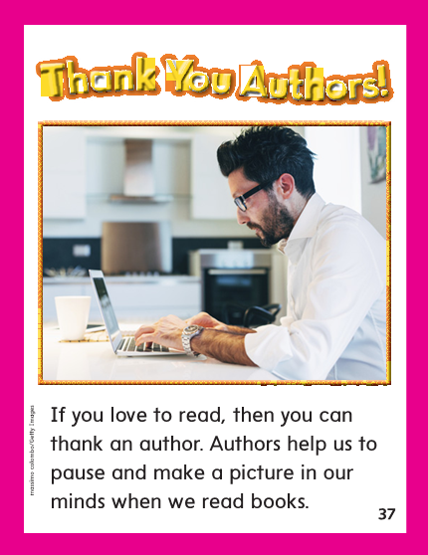

Slide 331
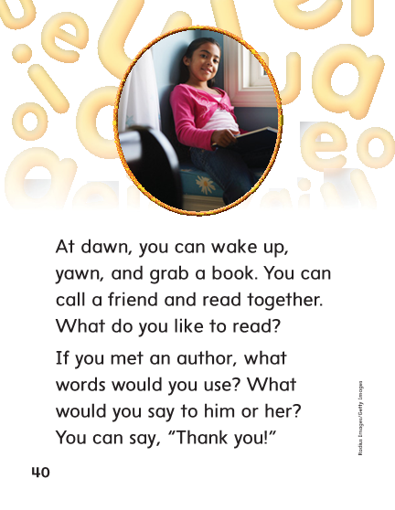

Slide 332
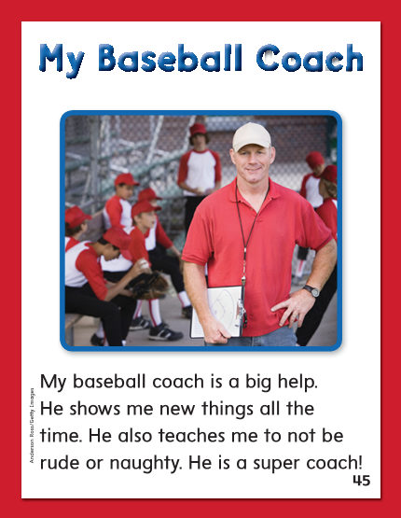

Slide 333
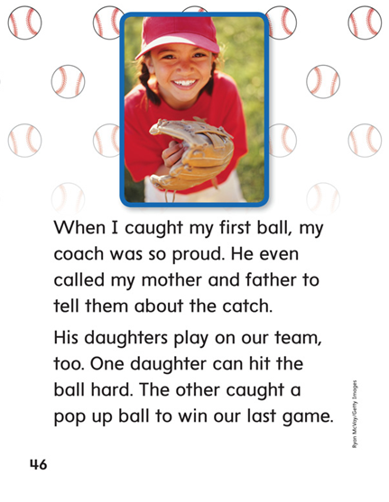

Slide 334
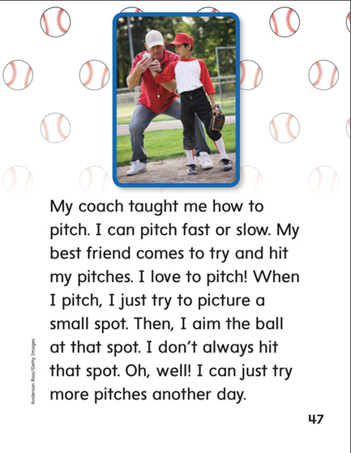

Slide 337
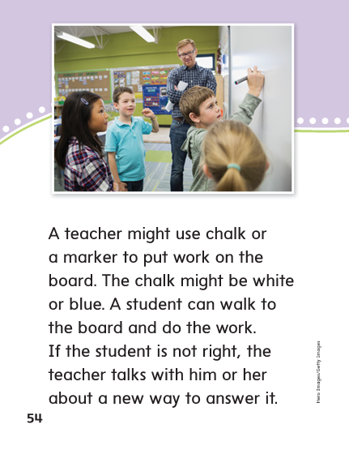

Slide 338
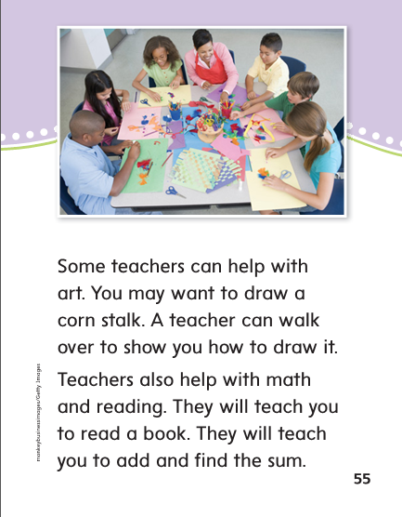

Slide 339
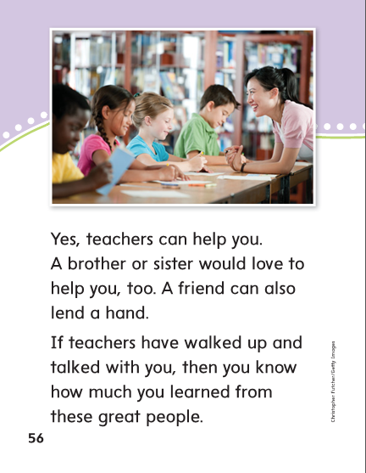

Slide 340
High Frequency
Words

Slide 341
Read, Spell, Write
brother
This is a picture of Tom’s brother Tim.

Slide 342
Read, Spell, Write
father
Jake’s father and mother coach
his baseball team.

Slide 343
Read, Spell, Write
friend
My friend and I love to play baseball.

Slide 344
Read, Spell, Write
love
My friend and I love to play baseball.

Slide 345
Read, Spell, Write
mother
Jake’s father and mother coach
his baseball team.

Slide 346
Read, Spell, Write
picture
This is a picture of Tom’s brother Tim.

Slide 347
Grammar
Possessive Pronouns
Possessive Pronouns show who or what has or owns something.
Have pairs of children use each word in a sentence.
my its yours
your our his
his their hers
her mine ours

Slide 348
Week 2 – Day 5

Slide 349
Phonemic Awareness
Phoneme Segmentation:
I am going to say a word. I want you to say each sound in the word.
paw fault small clause taught
Phoneme Substitution:
I am going to say a word. Then I’ll tell you to change a sound to make a new word.
Continue with:
fawn/ yawn raw/jaw ball/mall

Slide 350
Blend and Build Words with Long i: i, y, igh, ie
Read and say these words:
hawk
walk
launch
small
daughter

Slide 351
Blend and Build with /aw/
y
aw
n
What is the new word we made?
Let’s blend all the sounds and read the word.
Change the y to d.

Slide 352
Blend and Build with /aw/
d
aw
n
What is the new word we made?
Let’s blend all the sounds and read the word.
Change the d to dr.

Slide 353
Blend and Build with /aw/
dr
aw
n
What is the new word we made?
Let’s blend all the sounds and read the word.
Remove the n.

Slide 354
Blend and Build with /aw/
dr
aw
What is the new word we made?
Let’s blend all the sounds and read the word.
Change the dr to r.

Slide 355
Blend and Build with /aw/
r
aw
What is the new word we made?
Let’s blend all the sounds and read the word.
Change the r to s.

Slide 356
Blend and Build with /aw/
s
aw
What is the new word we made?
Let’s blend all the sounds and read the word.
Add ce to the end of the word..

Slide 357
Blend and Build with /aw/
s
au
ce
What is the new word we made?
Let’s blend all the sounds and read the word.
Change the ce to lt.

Slide 358
Blend and Build with /aw/
s
a
lt
What is the new word we made?
Let’s blend all the sounds and read the word.
Change the s to h.

Slide 359
Blend and Build with /aw/
h
a
lt
What is the new word we made?
Let’s blend all the sounds and read the word.
Change the lt to ll.

Slide 360
Blend and Build with /aw/
h
a
ll
What is the new word we made?
Let’s blend all the sounds and read the word.
Change the h to w.

Slide 361
Blend and Build with /aw/
w
a
ll
What is the new word we made?
Let’s blend all the sounds and read the word.
Change the w to m.

Slide 362
Blend and Build with /aw/
m
a
ll
What is the new word we made?
Let’s blend all the sounds and read the word.
Change the w to m.

Slide 363
Word Automaticity
call

Slide 364
sauce

Slide 365
talk

Slide 366
yawn

Slide 367
haul

Slide 368
ball

Slide 369
bald

Slide 370
caught

Slide 371
also

Slide 372
haunt

Slide 373
drawing

Slide 374
awful

Slide 375
because

Slide 376
oatmeal

Slide 377
daughter

Slide 378
August

Slide 379
auto

Slide 380
always

Slide 381
hallway

Slide 382
sleepless

Slide 383
join

Slide 384
June

Slide 385
shoot

Slide 386
shout

Slide 387
untrue

Slide 388
Structural Analysis
Vowel Team Syllables
Have children explain why a vowel team stays in the same syllable in a longer, multisyllabic word. Then have children practice reading two syllable words with vowel team syllables.
awful
laundry
because
drawing
August

Slide 389
High Frequency
Words

Slide 390
Read, Spell, Write
brother
This is a picture of Tom’s brother Tim.

Slide 391
Read, Spell, Write
father
Jake’s father and mother coach
his baseball team.

Slide 392
Read, Spell, Write
friend
My friend and I love to play baseball.

Slide 393
Read, Spell, Write
love
My friend and I love to play baseball.

Slide 394
Read, Spell, Write
mother
Jake’s father and mother coach
his baseball team.

Slide 395
Read, Spell, Write
picture
This is a picture of Tom’s brother Tim.

Slide 396
Grammar
Possessive Pronouns
Have children describe when possessive pronouns are used.
Have children identify the possessive pronouns in the following sentences:
I went fishing with my mom and dad. Mom put her fish in a bucket. I caught a fish that is bigger than hers. Dad caught a fish that is bigger than mine. His is bigger than both of ours!

Slide 397
Grammar
Possessive Pronouns
What do pronouns take the place of?
What do possessive pronouns show?
Have children work in pairs to write sentences using:
your its our their mine

