Slide 1
Week 3 – Day 1

Slide 2
Phonemic Awareness
Phoneme Categorization
Listen carefully as I say three words: wrap, rough, sing.
Which word does not belong?
That’s right, sing does not begin with the /r/ sound like the words wrap and rough do.
Sing does not belong.
Guided Practice:
Listen to the following words. Tell me which word does not belong and why.
sick, wall, knit strap, draw, flip cause, bought, slide
Grape, broil, grill now, ripe, sign thing, flush, these

Slide 3
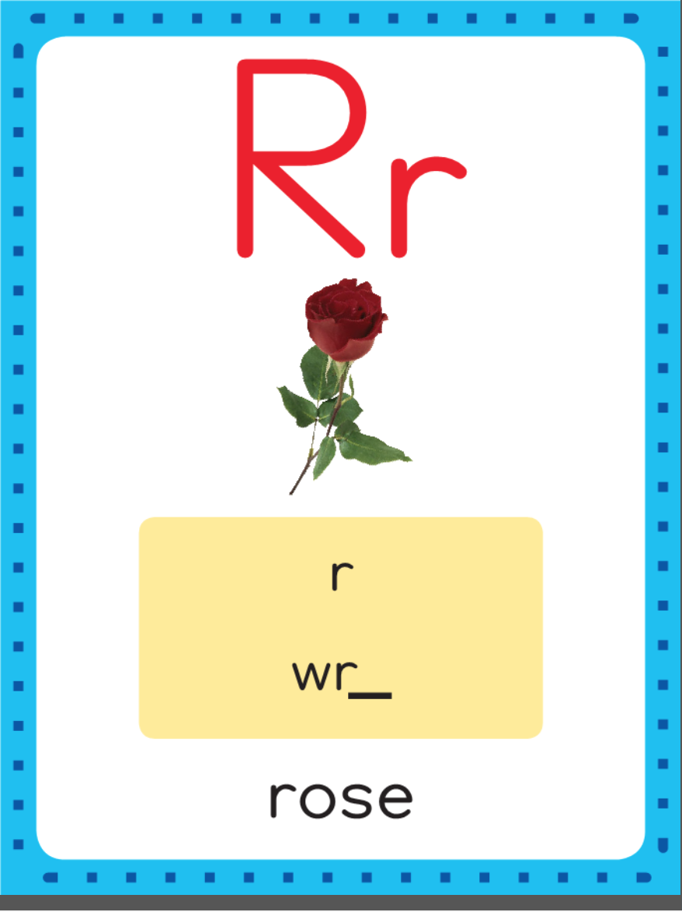
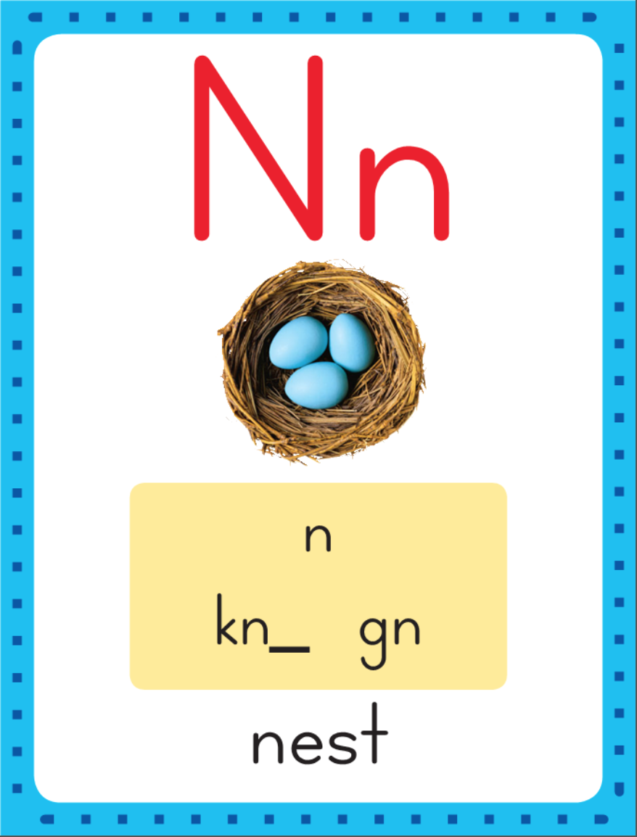
When the consonants wr, kn, or gn appear together at the beginning of a word or syllable, the first letter is silent.
write
knit gnat

Slide 4
Have children practice connecting the letters wr to the sound /r/ and the letters kn and gn to the sound letters wr.
Write the letters wr five tmes as you say the /r/ sound. Repeat for kn and gn.
wr wr wr wr
kn kn kn kn kn
gn gn gn gn gn

Slide 5
Blend Words with Silent Letters wr, kn, gn
kn

Slide 6
Blend Words with Silent Letters wr, kn, gn
kn
ee

Slide 7
Blend Words with Silent Letters wr, kn, gn
kn
ee

Slide 8
Blend Words with Silent Letters wr, kn, gn
kn

Slide 9
Blend Words with Silent Letters wr, kn, gn
kn
o

Slide 10
Blend Words with Silent Letters wr, kn, gn
kn
o

Slide 11
Blend Words with Silent Letters wr, kn, gn
kn
o
b

Slide 12
Blend Words with Silent Letters wr, kn, gn
kn
o
b

Slide 13
Blend Words with Silent Letters wr, kn, gn
wr

Slide 14
Blend Words with Silent Letters wr, kn, gn
wr
e

Slide 15
Blend Words with Silent Letters wr, kn, gn
wr
e

Slide 16
Blend Words with Silent Letters wr, kn, gn
wr
e
ck

Slide 17
Blend Words with Silent Letters wr, kn, gn
wr
e
ck

Slide 18
Blend Words with Silent Letters wr, kn, gn
gn

Slide 19
Blend Words with Silent Letters wr, kn, gn
gn
o_e

Slide 20
Blend Words with Silent Letters wr, kn, gn
gn
o_e

Slide 21
Blend Words with Silent Letters wr, kn, gn
gn
o
me

Slide 22
Blend Words with Silent Letters wr, kn, gn
gn
o
me

Slide 23
wr i_e kn ee
o_e ng aw wr
gn ot ing ew
augh er ear ui

Slide 24
wr

Slide 25
wri_e

Slide 26
write

Slide 27
write kn

Slide 28
write knee

Slide 29
write kneel

Slide 30
write kneel wr

Slide 31
write kneel wro_e

Slide 32
write kneel wrote

Slide 33
write kneel wrote
kn

Slide 34
write kneel wrote
kni_e

Slide 35
write kneel wrote
knife

Slide 36
write kneel wrote
knife kn

Slide 37
write kneel wrote
knife kni

Slide 38
write kneel wrote
knife knit

Slide 39
write kneel wrote
knife knit wr

Slide 40
write kneel wrote
knife knit wro

Slide 41
write kneel wrote
knife knit wrong

Slide 42
write kneel wrote
knife knit wrong
gn

Slide 43
write kneel wrote
knife knit wrong
gnaw

Slide 44
write kneel wrote
knife knit wrong
gnaw wr

Slide 45
write kneel wrote
knife knit wrong
gnaw wra

Slide 46
write kneel wrote
knife knit wrong
gnaw wrap

Slide 47
write kneel wrote
knife knit wrong
gnaw wrap gn

Slide 48
write kneel wrote
knife knit wrong
gnaw wrap gna

Slide 49
write kneel wrote
knife knit wrong
gnaw wrap gnat

Slide 50
write kneel wrote
knife knit wrong
gnaw wrap gnat
wr

Slide 51
write kneel wrote
knife knit wrong
gnaw wrap gnat
wri

Slide 52
write kneel wrote
knife knit wrong
gnaw wrap gnat
wrist

Slide 53
write kneel wrote
knife knit wrong
gnaw wrap gnat
wrist kn

Slide 54
write kneel wrote
knife knit wrong
gnaw wrap gnat
wrist kno

Slide 55
write kneel wrote
knife knit wrong
gnaw wrap gnat
wrist knot

Slide 56
write kneel wrote
knife knit wrong
gnaw wrap gnat
wrist knot wr

Slide 57
write kneel wrote
knife knit wrong
gnaw wrap gnat
wrist knot wre

Slide 58
write kneel wrote
knife knit wrong
gnaw wrap gnat
wrist knot wren

Slide 59
Internal Sounding Out
ring

Slide 60
Internal Sounding Out
ring wring

Slide 61
Internal Sounding Out
ring wring no

Slide 62
Internal Sounding Out
ring wring no
gnome

Slide 63
Internal Sounding Out
ring wring no
gnome new

Slide 64
Internal Sounding Out
ring wring no
gnome new knew

Slide 65
Internal Sounding Out
ring wring no
gnome new knew
taught

Slide 66
Internal Sounding Out
ring wring no
gnome new knew
taught smaller

Slide 67
Internal Sounding Out
ring wring no
gnome new knew
taught smaller grew

Slide 68
Internal Sounding Out
ring wring no
gnome new knew
taught smaller grew
fearful

Slide 69
Internal Sounding Out
ring wring no
gnome new knew
taught smaller grew
fearful blue

Slide 70
Internal Sounding Out
ring wring no
gnome new knew
taught smaller grew
fearful blue suit

Slide 71
He

Slide 72
He cut

Slide 73
He cut the

Slide 74
He cut the knot

Slide 75
He cut the knot with

Slide 76
He cut the knot with a

Slide 77
He cut the knot with a knife.

Slide 78
He cut the knot with a knife.
I

Slide 79
He cut the knot with a knife.
I knew

Slide 80
He cut the knot with a knife.
I knew a

Slide 81
He cut the knot with a knife.
I knew a mouse

Slide 82
He cut the knot with a knife.
I knew a mouse gnawed

Slide 83
He cut the knot with a knife.
I knew a mouse gnawed on

Slide 84
He cut the knot with a knife.
I knew a mouse gnawed on the

Slide 85
He cut the knot with a knife.
I knew a mouse gnawed on the cheese.

Slide 86
He cut the knot with a knife.
I knew a mouse gnawed on the cheese.
Wrap

Slide 87
He cut the knot with a knife.
I knew a mouse gnawed on the cheese.
Wrap the

Slide 88
He cut the knot with a knife.
I knew a mouse gnawed on the cheese.
Wrap the cloth

Slide 89
He cut the knot with a knife.
I knew a mouse gnawed on the cheese.
Wrap the cloth on

Slide 90
He cut the knot with a knife.
I knew a mouse gnawed on the cheese.
Wrap the cloth on your

Slide 91
He cut the knot with a knife.
I knew a mouse gnawed on the cheese.
Wrap the cloth on your wrist.

Slide 92
Spelling / Dictation
1. _________
2. _________
3. _________
4. _________
5. _________

Slide 93
High Frequency
Words

Slide 94
Read, Spell, Write
been
The children have been here all day.

Slide 95
Read, Spell, Write
children
The children have been here all day.

Slide 96
Read, Spell, Write
month
This is the first month in the year.

Slide 97
Read, Spell, Write
question
Their group has a question it would like to ask.

Slide 98
Read, Spell, Write
their
Their group has a question it would like to ask.

Slide 99
Read, Spell, Write
year
This is the first month of the year.

Slide 100
Have children read the sentences. Prompt them to identify the high-frequency words in connected text and to blend the decodable words.
The children have been here all day.
This is the first month in the year.
Their group has a question it would like to ask.

Slide 101
Grammar
Special Pronouns
Some pronouns do not refer to a specific person, place, thing, or number. Anyone means “any person” and everyone means “all people.”
Does anyone know what time it is?
Everyone thought the joke was funny.
Anything means “no special thing,” everything means “all things,” and nothing means “no thing.”

Slide 102
Grammar
Special Pronouns
Anything means “no special thing,” everything means “all things,” and nothing means “no thing.”
You can have anything you want for lunch.
There is nothing in the mailbox.

Slide 103
Grammar
Special Pronouns
Have children identify the pronouns.
Does anyone know what is in the box? Everyone thinks the box is filled with peanuts. “I do not think there is anything to eat in that box,” said Nate. The children looked in. Nothing was in the box?

Slide 104
Week 3 – Day 2

Slide 105
Phonemic Awareness
Phoneme Segmentation
I am going to say the sounds in the word knob. Listen: /n/ /o/ /b/.
The first sound is /n/. The second sound is /o/. The last sound is /b/. I’ll put a marker in a box for each sound I hear.
This word has three sounds: /n/ /o/ /b/. Say the word with me: knob.
/n/
/o/
/b/

Slide 106
Phonemic Awareness
Phoneme Blending
I’m going to say some more words. Place a marker in a box to stand for each sound. Then tell me the sounds.
wrote flaw knock booth choice
house wreck snore know threw

Slide 107
What are these letters?
What sounds do they stand for?
write
knot gnat

Slide 108
Blend with Silent Letters wr, kn, gn
gn

Slide 109
Blend with Silent Letters wr, kn, gn
gn
a

Slide 110
Blend with Silent Letters wr, kn, gn
gn
a

Slide 111
Blend with Silent Letters wr, kn, gn
gn
a
t

Slide 112
Blend with Silent Letters wr, kn, gn
gn
a
t

Slide 113
Blend with Silent Letters wr, kn, gn
kn

Slide 114
Blend with Silent Letters wr, kn, gn
kn
ee

Slide 115
Blend with Silent Letters wr, kn, gn
kn
ee

Slide 116
Blend with Silent Letters wr, kn, gn
wr

Slide 117
Blend with Silent Letters wr, kn, gn
wr
i_e

Slide 118
Blend with Silent Letters wr, kn, gn
wr
i_e

Slide 119
Blend with Silent Letters wr, kn, gn
wr
i
te

Slide 120
Blend with Silent Letters wr, kn, gn
wr
i
te

Slide 121
kn

Slide 122
know

Slide 123
know wr

Slide 124
know wro

Slide 125
know wrong

Slide 126
know wrong gn

Slide 127
know wrong gno_e

Slide 128
know wrong gnome

Slide 129
know wrong gnome
kn

Slide 130
know wrong gnome
kno

Slide 131
know wrong gnome
knob

Slide 132
know wrong gnome
knob wr

Slide 133
know wrong gnome
knob wri

Slide 134
know wrong gnome
knob wrist

Slide 135
know wrong gnome
knob wrist kn

Slide 136
know wrong gnome
knob wrist kno

Slide 137
know wrong gnome
knob wrist knock

Slide 138
know wrong gnome
knob wrist knock
wr

Slide 139
know wrong gnome
knob wrist knock
wra

Slide 140
know wrong gnome
knob wrist knock
wrap

Slide 141
know wrong gnome
knob wrist knock
wrap wr

Slide 142
know wrong gnome
knob wrist knock
wrap wre

Slide 143
know wrong gnome
knob wrist knock
wrap wreck

Slide 144
know wrong gnome
knob wrist knock
wrap wreck kn

Slide 145
know wrong gnome
knob wrist knock
wrap wreck knigh

Slide 146
know wrong gnome
knob wrist knock
wrap wreck knight

Slide 147
Build with Silent Letters wr, kn, gn
kn
a
ck
What is the new word we made?
Let’s blend all the sounds and read the word.
Change the a to o.

Slide 148
Build with Silent Letters wr, kn, gn
kn
o
ck
What is the new word we made?
Let’s blend all the sounds and read the word.
Change the ck to b.

Slide 149
Build with Silent Letters wr, kn, gn
kn
o
b
What is the new word we made?
Let’s blend all the sounds and read the word.
Remove the b.

Slide 150
Build with Silent Letters wr, kn, gn
kn
ow
What is the new word we made?
Let’s blend all the sounds and read the word.
Add a n to the end of the word..

Slide 151
Build with Silent Letters wr, kn, gn
kn
ow
n
What is the new word we made?
Let’s blend all the sounds and read the word.
Change the n to t.

Slide 152
Build with Silent Letters wr, kn, gn
kn
o
t
What is the new word we made?
Let’s blend all the sounds and read the word.
Change the o to i.

Slide 153
Build with Silent Letters wr, kn, gn
kn
i
t
What is the new word we made?
Let’s blend all the sounds and read the word.
Change the i to i_e and add an f in the blank.

Slide 154
Build with Silent Letters wr, kn, gn
kn
i
fe
What is the new word we made?
Let’s blend all the sounds and read the word.
Remove the fe and change the I to ee.

Slide 155
Build with Silent Letters wr, kn, gn
kn
ee
What is the new word we made?
Let’s blend all the sounds and read the word.
Add an l to the end of the word.

Slide 156
Build with Silent Letters wr, kn, gn
kn
ee
l
What is the new word we made?
Let’s blend all the sounds and read the word.
Add an l to the end of the word.

Slide 157
Structural Analysis
Compound Words
Birdhouse is a compound word.
A compound word is a longer word made up of
two smaller words they may know.
The word birdhouse is made up of the words bird and house.
bird
house
birdhouse
Looking for smaller words in longer words can sometimes help them pronounce and figure out the meaning of the longer word.
A birdhouse is a house for a bird to live in.

Slide 158
Structural Analysis
Compound Words
Have children name the two smaller words in each compound word and then use each compound word in a sentence.,
bookbag
daydream
wristwatch
homework
baseball

Slide 159
wr
kn
gn

Slide 160
gnat
write
knife
wrong
know
gnu
gnat
write
knife
wrong
know
gnu

Slide 161
High Frequency
Words

Slide 162
Read, Spell, Write
been
The children have been here all day.

Slide 163
Read, Spell, Write
children
The children have been here all day.

Slide 164
Read, Spell, Write
month
This is the first month in the year.

Slide 165
Read, Spell, Write
question
Their group has a question it would like to ask.

Slide 166
Read, Spell, Write
their
Their group has a question it would like to ask.

Slide 167
Read, Spell, Write
year
This is the first month of the year.

Slide 168
Grammar
Special Pronouns
There are pronouns that do not refer to a specific person, place, thing, or number. Nobody means “no person,” somebody means “no special person,” and anybody means “any person.” Anybody means the same as anyone.
I knocked on the door, but nobody came.
Somebody got my backpack by mistake.
I didn’t know anybody at my new school.

Slide 169
Grammar
Special Pronouns
Have children identify the special pronouns and
explain what they mean in the sentences.
Paul said, “Nobody wants to play ball. I wish I could find somebody who wants to play. Luke, do you know anybody who wants to play?”

Slide 170
Week 3 – Day 3

Slide 171
Phonemic Awareness
Phoneme Substitution
I’m going to say a word and its sounds: gnat, /n/ /a/ /t/.
Change the /a/ to /i/. The new word is /n/ /i/ /t/, knit.
Guided Practice:
Have children practice substituting phonemes with these examples. For each word, change the sound and say the new word.
write/wrote wreck/rack gnaw/knew
wring/rung knight/note quite/quote

Slide 172
Blend with Silent Letters wr, kn, gn
wr

Slide 173
Blend with Silent Letters wr, kn, gn
wr
a

Slide 174
Blend with Silent Letters wr, kn, gn
wr
a

Slide 175
Blend with Silent Letters wr, kn, gn
wr
a
p

Slide 176
Blend with Silent Letters wr, kn, gn
wr
a
p

Slide 177
Blend with Silent Letters wr, kn, gn
gn

Slide 178
Blend with Silent Letters wr, kn, gn
gn
u

Slide 179
Blend with Silent Letters wr, kn, gn
gn
u

Slide 180
Blend with Silent Letters wr, kn, gn
kn

Slide 181
Blend with Silent Letters wr, kn, gn
kn
ow

Slide 182
Blend with Silent Letters wr, kn, gn
kn
ow

Slide 183
Blend with Silent Letters wr, kn, gn
kn
ow
n

Slide 184
Blend with Silent Letters wr, kn, gn
kn
ow
n

Slide 185
wr i_e ck ng
igh st aw kn
ee ay dr ou
augh st ui sh

Slide 186
wr

Slide 187
wri_e

Slide 188
write

Slide 189
writes

Slide 190
writes kn

Slide 191
writes knee

Slide 192
writes knee kn

Slide 193
writes knee kno

Slide 194
writes knee knock

Slide 195
writes knee knock
wr

Slide 196
writes knee knock
wro

Slide 197
writes knee knock
wrong

Slide 198
writes knee knock
wrong wr

Slide 199
writes knee knock
wrong wro_e

Slide 200
writes knee knock
wrong wrote

Slide 201
writes knee knock
wrong wrote gn

Slide 202
writes knee knock
wrong wrote gna

Slide 203
writes knee knock
wrong wrote gnat

Slide 204
writes knee knock
wrong wrote gnat
kn

Slide 205
writes knee knock
wrong wrote gnat
knigh

Slide 206
writes knee knock
wrong wrote gnat
knight

Slide 207
writes knee knock
wrong wrote gnat
knight wr

Slide 208
writes knee knock
wrong wrote gnat
knight wri

Slide 209
writes knee knock
wrong wrote gnat
knight wrist

Slide 210
writes knee knock
wrong wrote gnat
knight wrist wr

Slide 211
writes knee knock
wrong wrote gnat
knight wrist wra

Slide 212
writes knee knock
wrong wrote gnat
knight wrist wrap

Slide 213
writes knee knock
wrong wrote gnat
knight wrist wrap
gn

Slide 214
writes knee knock
wrong wrote gnat
knight wrist wrap
gnaw

Slide 215
writes knee knock
wrong wrote gnat
knight wrist wrap
gnaw wr

Slide 216
writes knee knock
wrong wrote gnat
knight wrist wrap
gnaw wre

Slide 217
writes knee knock
wrong wrote gnat
knight wrist wrap
gnaw wreck

Slide 218
writes knee knock
wrong wrote gnat
knight wrist wrap
gnaw wreck gn

Slide 219
writes knee knock
wrong wrote gnat
knight wrist wrap
gnaw wreck gnu

Slide 220
Internal sounding out
kneepad

Slide 221
Internal sounding out
kneepad snowball

Slide 222
Internal sounding out
kneepad snowball
wristwatch

Slide 223
Internal sounding out
kneepad snowball
wristwatch moonlight

Slide 224
Internal sounding out
kneepad snowball
wristwatch moonlight
baseball

Slide 225
Internal sounding out
kneepad snowball
wristwatch moonlight
baseball daydream

Slide 226
Internal sounding out
kneepad snowball
wristwatch moonlight
baseball daydream
homework

Slide 227
Internal sounding out
kneepad snowball
wristwatch moonlight
baseball daydream
homework doghouse

Slide 228
Internal sounding out
caught

Slide 229
Internal sounding out
caught strawberry

Slide 230
Internal sounding out
caught strawberry
suitcase

Slide 231
Internal sounding out
caught strawberry
suitcase toothbrush

Slide 232
I

Slide 233
I wrote

Slide 234
I wrote the

Slide 235
I wrote the wrong

Slide 236
I wrote the wrong date

Slide 237
I wrote the wrong date on

Slide 238
I wrote the wrong date on my

Slide 239
I wrote the wrong date on my test.

Slide 240
I wrote the wrong date on my test.
Do

Slide 241
I wrote the wrong date on my test.
Do you

Slide 242
I wrote the wrong date on my test.
Do you know

Slide 243
I wrote the wrong date on my test.
Do you know how

Slide 244
I wrote the wrong date on my test.
Do you know how to

Slide 245
I wrote the wrong date on my test.
Do you know how to knit

Slide 246
I wrote the wrong date on my test.
Do you know how to knit a

Slide 247
I wrote the wrong date on my test.
Do you know how to knit a scarf?

Slide 248
Structural Analysis
Compound Words
Compound words are made up of two smaller words.
Lunchtime is a compound word made up of the words lunch and time.
The two smaller words often help us figure out the meaning of the compound word.
lunchtime

Slide 249
Structural Analysis
Compound Words
Have children name the two smaller words in each compound.
Help children blend the words.
classroom
snowstorm
kneepad
sunlight
rainfall

Slide 250
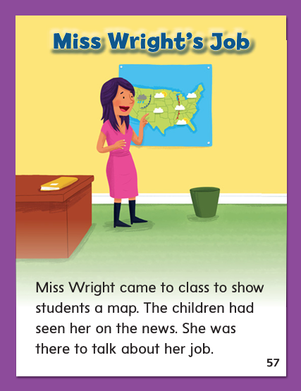

Slide 251
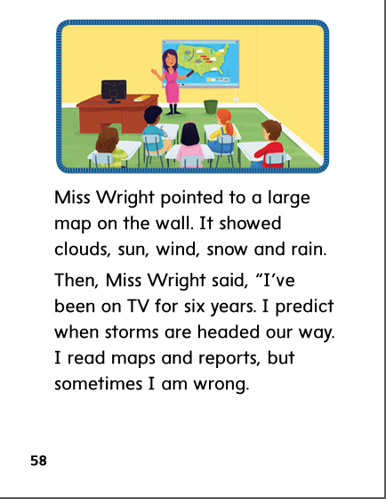

Slide 252
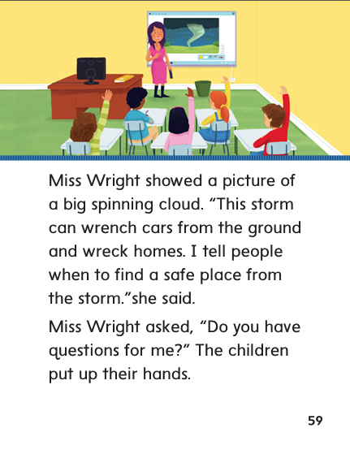

Slide 253
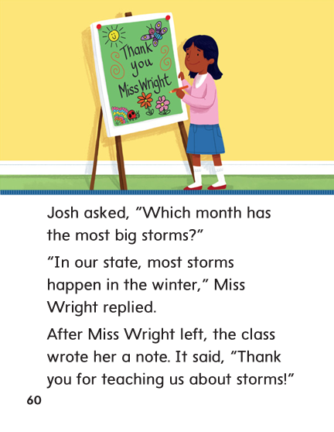

Slide 258
High Frequency
Words

Slide 259
Read, Spell, Write
been
The children have been here all day.

Slide 260
Read, Spell, Write
children
The children have been here all day.

Slide 261
Read, Spell, Write
month
This is the first month in the year.

Slide 262
Read, Spell, Write
question
Their group has a question it would like to ask.

Slide 263
Read, Spell, Write
their
Their group has a question it would like to ask.

Slide 264
Read, Spell, Write
year
This is the first month of the year.

Slide 265
Build Fluency: Word Automaticity
The children have been running outside.
Their question is about what to write.
What is the first month of the year?

Slide 266
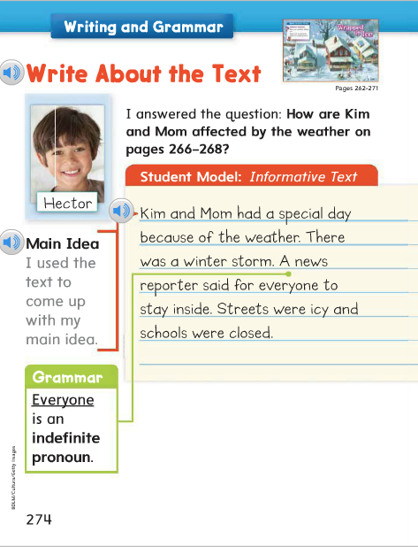
The pronouns anyone, everyone, anything, everything, and nothing name a person, place, thing, or number that is not particular, or specific.
Identify the special pronoun in the student model.

Slide 267
Week 3 – Day 4

Slide 268
Phonemic Awareness
Phoneme Categorization
Listen carefully as I say three words: knee, knot, rope.
Which of these words does not belong?
Knee and knot both start with the /n/ sound.
Rope does not start with the /n/ sound.
It does not belong.
Guided Practice:
Have children practice categorizing phonemes. Now I’ll say a group of words. Listen carefully, then tell me which word does not belong and why.
germ, hurt, toil know, cup, nice farm, card, join

Slide 269
Build with Silent Letters wr, kn, gn
wr
e
ck
What is the new word we made?
Let’s blend all the sounds and read the word.
Change the ck to n.

Slide 270
Build with Silent Letters wr, kn, gn
wr
e
n
What is the new word we made?
Let’s blend all the sounds and read the word.
Add ch the end of the word.

Slide 271
Build with Silent Letters wr, kn, gn
wr
e
n
ch
What is the new word we made?
Let’s blend all the sounds and read the word.
Remove the ch. Change the e to o and the n to ng.

Slide 272
Build with Silent Letters wr, kn, gn
wr
o
ng
What is the new word we made?
Let’s blend all the sounds and read the word.
Change the o to i.

Slide 273
Build with Silent Letters wr, kn, gn
wr
i
ng
What is the new word we made?
Let’s blend all the sounds and read the word.
Change the ng to st.

Slide 274
Build with Silent Letters wr, kn, gn
wr
i
st
What is the new word we made?
Let’s blend all the sounds and read the word.
Change the st to te.

Slide 275
Build with Silent Letters wr, kn, gn
wr
i
te
What is the new word we made?
Let’s blend all the sounds and read the word.
Change the st to te.

Slide 276
Build with Silent Letters wr, kn, gn
wr
i
te
What is the new word we made?
Let’s blend all the sounds and read the word.
Change the i to o.

Slide 277
Build with Silent Letters wr, kn, gn
wr
o
te
What is the new word we made?
Let’s blend all the sounds and read the word.
Change the wr to n.

Slide 278
Build with Silent Letters wr, kn, gn
n
o
te
What is the new word we made?
Let’s blend all the sounds and read the word.
Change the n to kn and remove the silent e.

Slide 279
Build with Silent Letters wr, kn, gn
kn
i
t
What is the new word we made?
Let’s blend all the sounds and read the word.
Change the i to igh.

Slide 280
Build with Silent Letters wr, kn, gn
kn
igh
t
What is the new word we made?
Let’s blend all the sounds and read the word.
Remove the t. Change the igh to ew.

Slide 281
Build with Silent Letters wr, kn, gn
kn
ew
What is the new word we made?
Let’s blend all the sounds and read the word.
Change the kn to gn and change the ew to ome.

Slide 282
Build with Silent Letters wr, kn, gn
gn
o
me
What is the new word we made?
Let’s blend all the sounds and read the word.
Change the kn to gn and change the ew to ome.

Slide 283
Structural Analysis
Compound Words
A compound word is a longer word made up of two smaller words.
The word snowflake is made up of the words snow and flake.
You can often use the two smaller words to figure out the meaning of the compound word.
snowflake

Slide 284
Structural Analysis
Compound Words
Have partners identify the two smaller words in each compound, then write sentences with each compound word.
meatball
birthday
popcorn
sundown
playground

Slide 285
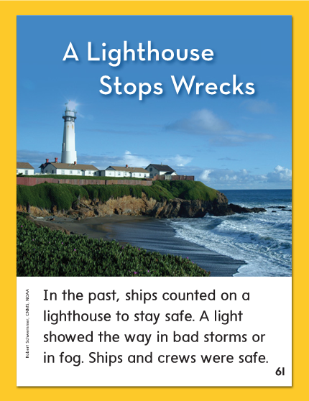

Slide 286
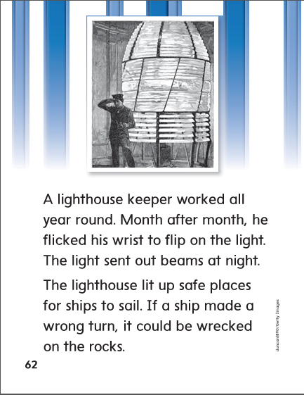

Slide 289
High Frequency
Words

Slide 290
Read, Spell, Write
been
The children have been here all day.

Slide 291
Read, Spell, Write
children
The children have been here all day.

Slide 292
Read, Spell, Write
month
This is the first month in the year.

Slide 293
Read, Spell, Write
question
Their group has a question it would like to ask.

Slide 294
Read, Spell, Write
their
Their group has a question it would like to ask.

Slide 295
Read, Spell, Write
year
This is the first month of the year.

Slide 296
Grammar
Special Pronouns
Remember that we use the pronouns nobody, somebody, and anybody when we aren’t talking about any special person.
Nobody heard me ______________.
Will somebody please ___________?

Slide 297
Week 3 – Day 5

Slide 298
Phonemic Awareness
Phoneme Segmentation:
I am going to say a word. I want you to say each sound in the word.
wrist mouse flight cheese know graze
Phoneme Substitution:
I will say a word. I want you to change the sound and say the new word.
Continue with:
gnaw/knew write/ wrote night/note blue/blow

Slide 299
Blend and Build Words with Long i: i, y, igh, ie
Read and say these words:
knee
write
gnaw

Slide 300
Blend and Build with wr, kn, gn
wr
o
ng
What is the new word we made?
Let’s blend all the sounds and read the word.
Change the ng to te.

Slide 301
Blend and Build with wr, kn, gn
wr
o
te
What is the new word we made?
Let’s blend all the sounds and read the word.
Change the o to i and change the te to st.

Slide 302
Blend and Build with wr, kn, gn
wr
i
st
What is the new word we made?
Let’s blend all the sounds and read the word.
Change the st to ng.

Slide 303
Blend and Build with wr, kn, gn
wr
i
ng
What is the new word we made?
Let’s blend all the sounds and read the word.
Change the i to e and change the ng to n.

Slide 304
Blend and Build with wr, kn, gn
wr
e
n
What is the new word we made?
Let’s blend all the sounds and read the word.
Add ch to the end of the word.

Slide 305
Blend and Build with wr, kn, gn
wr
e
n
ch
What is the new word we made?
Let’s blend all the sounds and read the word.
Add ch to the end of the word.

Slide 306
Word Automaticity
writes

Slide 307
knee

Slide 308
knock

Slide 309
wrong

Slide 310
wrote

Slide 311
gnat

Slide 312
knight

Slide 313
wrist

Slide 314
wrap

Slide 315
gnaw

Slide 316
wreck

Slide 317
gnu

Slide 318
kneepad

Slide 319
snowball

Slide 320
wristwatch

Slide 321
moonlight

Slide 322
baseball

Slide 323
daydream

Slide 324
homework

Slide 325
doghouse

Slide 326
caught

Slide 327
strawberry

Slide 328
suitcase

Slide 329
toothbrush

Slide 330
Structural Analysis
Compound Words
Have children explain what a compound word is and how to form one.
Have them practice reading these compound words:
kneepad
haircut
toenail
doghouse
football

Slide 331
High Frequency
Words

Slide 332
Read, Spell, Write
been
The children have been here all day.

Slide 333
Read, Spell, Write
children
The children have been here all day.

Slide 334
Read, Spell, Write
month
This is the first month in the year.

Slide 335
Read, Spell, Write
question
Their group has a question it would like to ask.

Slide 336
Read, Spell, Write
their
Their group has a question it would like to ask.

Slide 337
Read, Spell, Write
year
This is the first month of the year.

Slide 338
Grammar
Special Pronouns
Have children describe how this week’s special pronouns are alike.
Have children identify the special pronouns:
I like everything about playing outside. I will play anything that has running and jumping. Nobody likes when it rains. But if somebody thinks of a good indoors game, everyone can still have fun!

