Slide 1
Week 4 – Day 1

Slide 2
Phonemic Awareness
Syllable Addition
Listen as I say a word: pup. Now I will add the syllable pet to the end of pup and blend the sounds to make a new word: pup-pet.
The new word is puppet. Puppet has two syllables,
or word parts, pup and pet.
Guided Practice:
Have children practice adding syllables to words to form new words. I will say a word and a syllable to add to the word. You blend the word chunks and tell me the new word.
Add /ten/ to the end of kit. Add /ed/ to the end of taste.
Add /ing/ to the end of bake. Add /not/ to the end of can.

Slide 3
Introduce Three-Letter Blends
When three consonants appear together in a word, we often blend the three sounds together. These are the letters s, p, and l. I’ll blend the sounds to get /spl/.
s
p
l
spl

Slide 4
Introduce Three-Letter Blends
s
c
r
scr

Slide 5
Introduce Three-Letter Blends
s
p
r
spr

Slide 6
Introduce Three-Letter Blends
s
t
r
str

Slide 7
Introduce Three-Letter Blends
th
r
thr

Slide 8
Introduce Three-Letter Blends
sh
r
shr

Slide 9
Blend with Three-Letter Blends
str

Slide 10
Blend with Three-Letter Blends
str
ee

Slide 11
Blend with Three-Letter Blends
str
ee

Slide 12
Blend with Three-Letter Blends
str
ee
t

Slide 13
Blend with Three-Letter Blends
str
ee
t

Slide 14
Blend with Three-Letter Blends
scr

Slide 15
Blend with Three-Letter Blends
scr
a

Slide 16
Blend with Three-Letter Blends
scr
a

Slide 17
Blend with Three-Letter Blends
scr
a
p

Slide 18
Blend with Three-Letter Blends
scr
a
p

Slide 19
Blend with Three-Letter Blends
spl

Slide 20
Blend with Three-Letter Blends
spl
a

Slide 21
Blend with Three-Letter Blends
spl
a

Slide 22
Blend with Three-Letter Blends
spl
a
sh

Slide 23
Blend with Three-Letter Blends
spl
a
sh

Slide 24
Blend with Three-Letter Blends
spr

Slide 25
Blend with Three-Letter Blends
spr
ou

Slide 26
Blend with Three-Letter Blends
spr
ou

Slide 27
Blend with Three-Letter Blends
spr
ou
t

Slide 28
Blend with Three-Letter Blends
spr
ou
t

Slide 29
Blend with Three-Letter Blends
thr

Slide 30
Blend with Three-Letter Blends
thr
ee

Slide 31
Blend with Three-Letter Blends
thr
ee

Slide 32
Blend with Three-Letter Blends
shr

Slide 33
Blend with Three-Letter Blends
shr
u

Slide 34
Blend with Three-Letter Blends
shr
u

Slide 35
Blend with Three-Letter Blends
shr
u
g

Slide 36
Blend with Three-Letter Blends
shr
u
g

Slide 37
str ng ee scr
ew spl ay th
shr aw ink i_e
ue augh sp oa

Slide 38
str

Slide 39
stro

Slide 40
strong

Slide 41
strong str

Slide 42
strong stree

Slide 43
strong street

Slide 44
strong street scr

Slide 45
strong street scru

Slide 46
strong street scrub

Slide 47
strong street scrub
spr

Slide 48
strong street scrub
spray

Slide 49
strong street scrub
spray thr

Slide 50
strong street scrub
spray threw

Slide 51
strong street scrub
spray threw spl

Slide 52
strong street scrub
spray threw spli

Slide 53
strong street scrub
spray threw split

Slide 54
strong street scrub
spray threw split
thr

Slide 55
strong street scrub
spray threw split
thro_e

Slide 56
strong street scrub
spray threw split
throne

Slide 57
strong street scrub
spray threw split
throne str

Slide 58
strong street scrub
spray threw split
throne straw

Slide 59
strong street scrub
spray threw split
throne straw shr

Slide 60
strong street scrub
spray threw split
throne straw shrink

Slide 61
strong street scrub
spray threw split
throne straw shrink
scr

Slide 62
strong street scrub
spray threw split
throne straw shrink
scree

Slide 63
strong street scrub
spray threw split
throne straw shrink
screen

Slide 64
strong street scrub
spray threw split
throne straw shrink
screen spr

Slide 65
strong street scrub
spray threw split
throne straw shrink
screen sprea

Slide 66
strong street scrub
spray threw split
throne straw shrink
screen spread

Slide 67
strong street scrub
spray threw split
throne straw shrink
screen spread str

Slide 68
strong street scrub
spray threw split
throne straw shrink
screen spread stri_e

Slide 69
strong street scrub
spray threw split
throne straw shrink
screen spread strike

Slide 70
Internal Sounding Out
scrap

Slide 71
Internal Sounding Out
scrap throat

Slide 72
Internal Sounding Out
scrap throat strange

Slide 73
Internal Sounding Out
scrap throat strange
writers

Slide 74
Internal Sounding Out
scrap throat strange
writers glued

Slide 75
Internal Sounding Out
scrap throat strange
writers glued taught

Slide 76
Internal Sounding Out
scrap throat strange
writers glued taught
kneepad

Slide 77
Internal Sounding Out
scrap throat strange
writers glued taught
kneepad bedspread

Slide 78
Is

Slide 79
Is thread

Slide 80
Is thread as

Slide 81
Is thread as strong

Slide 82
Is thread as strong as

Slide 83
Is thread as strong as string?

Slide 84
Is thread as strong as string?
We

Slide 85
Is thread as strong as string?
We will

Slide 86
Is thread as strong as string?
We will stroll

Slide 87
Is thread as strong as string?
We will stroll down

Slide 88
Is thread as strong as string?
We will stroll down the

Slide 89
Is thread as strong as string?
We will stroll down the street.

Slide 90
Is thread as strong as string?
We will stroll down the street.
Three

Slide 91
Is thread as strong as string?
We will stroll down the street.
Three fish

Slide 92
Is thread as strong as string?
We will stroll down the street.
Three fish splashed

Slide 93
Is thread as strong as string?
We will stroll down the street.
Three fish splashed in

Slide 94
Is thread as strong as string?
We will stroll down the street.
Three fish splashed in the

Slide 95
Is thread as strong as string?
We will stroll down the street.
Three fish splashed in the stream.

Slide 96
Spelling / Dictation
1. _________
2. _________
3. _________
4. _________
5. _________

Slide 97
High Frequency
Words

Slide 98
Read, Spell, Write
before
My name comes before your name in ABC order.

Slide 99
Read, Spell, Write
front
Push the cart in front of you.

Slide 100
Read, Spell, Write
heard
Had you heard that the plane will fly tomorrow?

Slide 101
Read, Spell, Write
push
Push the cart in front of you.

Slide 102
Read, Spell, Write
tomorrow
Had you heard that the plane will fly tomorrow?

Slide 103
Read, Spell, Write
your
My name comes before your name in ABC order.

Slide 104
Have children read the sentences. Prompt them to identify the high-frequency words in connected text and to blend the decodable words.
My name comes before your name in ABC order.
Push the cart in front of you.
Had you heard that the plane will fly tomorrow?

Slide 105
Grammar
I and Me
The subject of a sentence is what a sentence is about. We use the pronoun I as the subject of a sentence. We use the pronoun me after a verb or a word such as for, at, of, to, or between.
I like to play ball.
Will likes to play ball with me.

Slide 106
Grammar
I and Me
Identify the pronouns I and me.
I can throw the ball.
My dad and I play catch.
My dad showed me how to catch the ball.
He helps me get ready for the game.

Slide 107
Week 4 – Day 2

Slide 108
Phonemic Awareness
Phoneme Segmentation
Listen as I say a word: strap.
I want to know how many sounds are in the word strap.
I will place a marker in a box for each sound I hear: /s/ /t/ /r/ /a/ /p/.
I will place five markers because I hear five sounds in strap.
/s/
/t/
/r/
/a/
/p/

Slide 109
Phonemic Awareness
Phoneme Segmentation
Listen as I say some words. Place one marker in a box for each sound you hear. Then tell me how many sounds are in each word.
scream spray sprang throne splash
scrap street throb thrill stripe

Slide 110
Blend with Three-Letter Blends
spr

Slide 111
Blend with Three-Letter Blends
spr
ay

Slide 112
Blend with Three-Letter Blends
spr
ay

Slide 113
Blend with Three-Letter Blends
scr

Slide 114
Blend with Three-Letter Blends
scr
ea

Slide 115
Blend with Three-Letter Blends
scr
ea

Slide 116
Blend with Three-Letter Blends
scr
ea
m

Slide 117
Blend with Three-Letter Blends
scr
ea
m

Slide 118
Blend with Three-Letter Blends
spl

Slide 119
Blend with Three-Letter Blends
spl
i

Slide 120
Blend with Three-Letter Blends
spl
i

Slide 121
Blend with Three-Letter Blends
spl
i
t

Slide 122
Blend with Three-Letter Blends
spl
i
t

Slide 123
Blend with Three-Letter Blends
str

Slide 124
Blend with Three-Letter Blends
str
o_e

Slide 125
Blend with Three-Letter Blends
str
o
ke

Slide 126
Blend with Three-Letter Blends
str
o
ke

Slide 127
Blend with Three-Letter Blends
thr

Slide 128
Blend with Three-Letter Blends
thr
ee

Slide 129
Blend with Three-Letter Blends
thr
ee

Slide 130
Blend with Three-Letter Blends
shr
ink

Slide 131
Blend with Three-Letter Blends
shr
ink

Slide 132
scr

Slide 133
scra

Slide 134
scratch

Slide 135
scratch str

Slide 136
scratch straw

Slide 137
scratch straw thr

Slide 138
scratch straw throa

Slide 139
scratch straw throat

Slide 140
scratch straw throat
str

Slide 141
scratch straw throat
stre

Slide 142
scratch straw throat
stretch

Slide 143
scratch straw throat
stretch spl

Slide 144
scratch straw throat
stretch spla

Slide 145
scratch straw throat
stretch splash

Slide 146
scratch straw throat
stretch splash thr

Slide 147
scratch straw throat
stretch splash throw

Slide 148
scratch straw throat
stretch splash throw
str

Slide 149
scratch straw throat
stretch splash throw
stra

Slide 150
scratch straw throat
stretch splash throw
strand

Slide 151
scratch straw throat
stretch splash throw
strand str

Slide 152
scratch straw throat
stretch splash throw
strand strea

Slide 153
scratch straw throat
stretch splash throw
strand stream

Slide 154
scratch straw throat
stretch splash throw
strand stream spr

Slide 155
scratch straw throat
stretch splash throw
strand stream spring

Slide 156
Build with Three-Letter Blends
scr
a
tch
What is the new word we made?
Let’s blend all the sounds and read the word.
Change tch to wl.

Slide 157
Build with Three-Letter Blends
scr
a
wl
What is the new word we made?
Let’s blend all the sounds and read the word.
Change wl to p.

Slide 158
Build with Three-Letter Blends
scr
a
p
What is the new word we made?
Let’s blend all the sounds and read the word.
Change scr to str.

Slide 159
Build with Three-Letter Blends
str
a
p
What is the new word we made?
Let’s blend all the sounds and read the word.
Change p to nd.

Slide 160
Build with Three-Letter Blends
str
a
nd
What is the new word we made?
Let’s blend all the sounds and read the word.
Change a to ea and nd to k.

Slide 161
Build with Three-Letter Blends
str
ea
k
What is the new word we made?
Let’s blend all the sounds and read the word.
Change k to m.

Slide 162
Build with Three-Letter Blends
str
ea
m
What is the new word we made?
Let’s blend all the sounds and read the word.
Change m to t.

Slide 163
Build with Three-Letter Blends
str
ee
t
What is the new word we made?
Let’s blend all the sounds and read the word.
Change ee to i and the t to ng.

Slide 164
Build with Three-Letter Blends
str
i
ng
What is the new word we made?
Let’s blend all the sounds and read the word.
Change the str to spr.

Slide 165
Build with Three-Letter Blends
spr
i
ng
What is the new word we made?
Let’s blend all the sounds and read the word.
Change the ng to nt.

Slide 166
Build with Three-Letter Blends
spr
i
nt
What is the new word we made?
Let’s blend all the sounds and read the word.
Change the spr to spl.

Slide 167
Build with Three-Letter Blends
spl
i
nt
What is the new word we made?
Let’s blend all the sounds and read the word.
Change the nt to t.

Slide 168
Build with Three-Letter Blends
spl
i
t
What is the new word we made?
Let’s blend all the sounds and read the word.
Change the nt to t.

Slide 169
Structural Analysis
Inflectional Endings –ed, -ing
When –ed is added to a verb, or action word, it tells about something that has already happened. When –ing is added to a verb, it tells about something that is happening now.
stretch
stretched
stretching

Slide 170
Structural Analysis
Inflectional Endings –ed, -ing
When –ed is added to a verb, or action word, it tells about something that has already happened. When –ing is added to a verb, it tells about something that is happening now.
scrape
scraped
scraping
Remember when the verb ends in e, you must drop the e and add either ed or ing.

Slide 171
Structural Analysis
Inflectional Endings –ed, -ing
When –ed is added to a verb, or action word, it tells about something that has already happened. When –ing is added to a verb, it tells about something that is happening now.
scrub
scrubbed
scrubbing
Remember when the verb ends in a consonant, and the vowel is short, you have to double the final consonant and add ed or ing.

Slide 172
str
spr
spl
scr
thr

Slide 173
strike
spray
three
split
scrape
splash
strike
spray
three
split
scrape
splash

Slide 174
High Frequency
Words

Slide 175
Read, Spell, Write
before
My name comes before your name in ABC order.

Slide 176
Read, Spell, Write
front
Push the cart in front of you.

Slide 177
Read, Spell, Write
heard
Had you heard that the plane will fly tomorrow?

Slide 178
Read, Spell, Write
push
Push the cart in front of you.

Slide 179
Read, Spell, Write
tomorrow
Had you heard that the plane will fly tomorrow?

Slide 180
Read, Spell, Write
your
My name comes before your name in ABC order.

Slide 181
Grammar
I and Me
The pronoun I is used as the subject of a sentence.
Me is used after a verb or a word such as for, at, of, with, to, or between.
I will tie a string around the box.
Gran spent the day with me.
Circle the pronoun in each sentence.

Slide 182
Grammar
I and Me
Have children work in pairs to complete each sentence.
My brother and ____ share a bedroom.
Mom helped _____ painted a stripe on my bike.
Circle the pronoun in each sentence.

Slide 183
Week 4 – Day 3

Slide 184
Phonemic Awareness
Phoneme Blending
Listen as I say the sounds in a word: /s/ /p/ /l/ /a/ /sh/.
Now I’ll blend the sounds together and say the word: /sssplllaaash/, splash.
Let’s say the word: splash.
Guided Practice:
I’m going to say some words, sound by sound. Blend the sounds together to say the word.
/s/ /p/ /l/ /i/ /t/ /s/ /p/ /r/ /i/ /ng/ /sh/ /r/ /u/ /g/
/s/ /k/ /r/ /u/ /b/ /s/ /t/ /r/ /i/ /p/ /th/ /r/ /o/

Slide 185
Blend with Three-Letter Blends
thr

Slide 186
Blend with Three-Letter Blends
thr
ea

Slide 187
Blend with Three-Letter Blends
thr
ea

Slide 188
Blend with Three-Letter Blends
thr
ea
d

Slide 189
Blend with Three-Letter Blends
thr
ea
d

Slide 190
Blend with Three-Letter Blends
scr

Slide 191
Blend with Three-Letter Blends
scr
i

Slide 192
Blend with Three-Letter Blends
scr
i

Slide 193
Blend with Three-Letter Blends
scr
i
pt

Slide 194
Blend with Three-Letter Blends
scr
i
pt

Slide 195
Blend with Three-Letter Blends
spl

Slide 196
Blend with Three-Letter Blends
spl
i

Slide 197
Blend with Three-Letter Blends
spl
i

Slide 198
Blend with Three-Letter Blends
spl
i
t

Slide 199
Blend with Three-Letter Blends
spl
i
t

Slide 200
Blend with Three-Letter Blends
spr

Slide 201
Blend with Three-Letter Blends
spr
ing

Slide 202
Blend with Three-Letter Blends
spr
ing

Slide 203
Blend with Three-Letter Blends
str

Slide 204
Blend with Three-Letter Blends
str
aw

Slide 205
Blend with Three-Letter Blends
str
aw

Slide 206
Blend with Three-Letter Blends
shr

Slide 207
Blend with Three-Letter Blends
shr
i

Slide 208
Blend with Three-Letter Blends
shr
i

Slide 209
Blend with Three-Letter Blends
shr
i
mp

Slide 210
Blend with Three-Letter Blends
shr
i
mp

Slide 211
str ee thr ing
shr ow i_e scr
ea sh aw tch
ay ng ill ub

Slide 212
str

Slide 213
stree

Slide 214
street

Slide 215
street str

Slide 216
street stro

Slide 217
street strong

Slide 218
street strong thr

Slide 219
street strong thri

Slide 220
street strong thrill

Slide 221
street strong thrill
spr

Slide 222
street strong thrill
spring

Slide 223
street strong thrill
spring shr

Slide 224
street strong thrill
spring shrink

Slide 225
street strong thrill
spring shrink str

Slide 226
street strong thrill
spring shrink strike

Slide 227
street strong thrill
spring shrink strike
thr

Slide 228
street strong thrill
spring shrink strike
throw

Slide 229
street strong thrill
spring shrink strike
thrown

Slide 230
street strong thrill
spring shrink strike
thrown str

Slide 231
street strong thrill
spring shrink strike
thrown stri_e

Slide 232
street strong thrill
spring shrink strike
thrown stripe

Slide 233
street strong thrill
spring shrink strike
thrown stripe scr

Slide 234
street strong thrill
spring shrink strike
thrown stripe scru

Slide 235
street strong thrill
spring shrink strike
thrown stripe scrub

Slide 236
street strong thrill
spring shrink strike
thrown stripe scrub
spl

Slide 237
street strong thrill
spring shrink strike
thrown stripe scrub
spla

Slide 238
street strong thrill
spring shrink strike
thrown stripe scrub
splash

Slide 239
street strong thrill
spring shrink strike
thrown stripe scrub
splash str

Slide 240
street strong thrill
spring shrink strike
thrown stripe scrub
splash strea

Slide 241
street strong thrill
spring shrink strike
thrown stripe scrub
splash stream

Slide 242
street strong thrill
spring shrink strike
thrown stripe scrub
splash stream scr

Slide 243
street strong thrill
spring shrink strike
thrown stripe scrub
splash stream scree

Slide 244
street strong thrill
spring shrink strike
thrown stripe scrub
splash stream screen

Slide 245
Internal Sounding Out
threat

Slide 246
Internal Sounding Out
threat thread

Slide 247
Internal Sounding Out
threat thread straw

Slide 248
Internal Sounding Out
threat thread straw
scratched

Slide 249
Internal Sounding Out
threat thread straw
scratched scratching

Slide 250
Internal Sounding Out
threat thread straw
scratched scratching
strolled

Slide 251
Internal Sounding Out
threat thread straw
scratched scratching
strolled strolling

Slide 252
Internal Sounding Out
threat thread straw
scratched scratching
strolled strolling throwing

Slide 253
Internal Sounding Out
threat thread straw
scratched scratching
strolled strolling throwing
trobbed

Slide 254
Internal Sounding Out
threat thread straw
scratched scratching
strolled strolling throwing
trobbed scrubbed

Slide 255
Internal Sounding Out
threat thread straw
scratched scratching
strolled strolling throwing
trobbed scrubbed spraying

Slide 256
He

Slide 257
He can

Slide 258
He can stretch

Slide 259
He can stretch the

Slide 260
He can stretch the string.

Slide 261
He can stretch the string.
Can

Slide 262
He can stretch the string.
Can you

Slide 263
He can stretch the string.
Can you scroll

Slide 264
He can stretch the string.
Can you scroll the

Slide 265
He can stretch the string.
Can you scroll the screen?

Slide 266
Structural Analysis
Inflectional Endings –ed, -ing
When –ed is added to a verb, or action word, it tells about something that has already happened. When –ing is added to a verb, it tells about something that is happening now.
scrape
scraped
scraping
Remember when the verb ends in e, you must drop the e and add either ed or ing.

Slide 267
Structural Analysis
Inflectional Endings –ed, -ing
Help children blend the words:
scratch
scratched
scratching

Slide 268
Structural Analysis
Inflectional Endings –ed, -ing
Help children blend the words:
knit
knitted
knitting

Slide 269
Structural Analysis
Inflectional Endings –ed, -ing
Help children blend the words:
spruce
spruced
sprucing

Slide 270
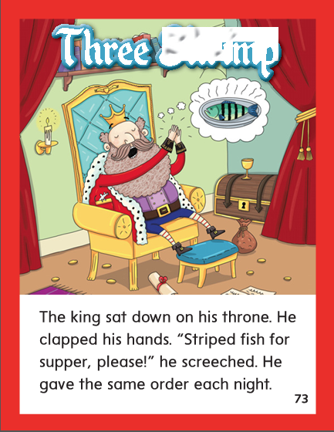

Slide 271
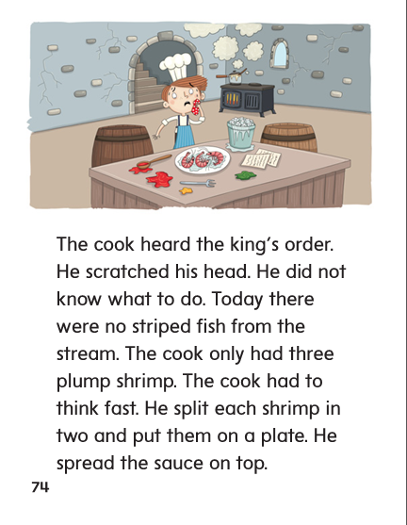

Slide 272
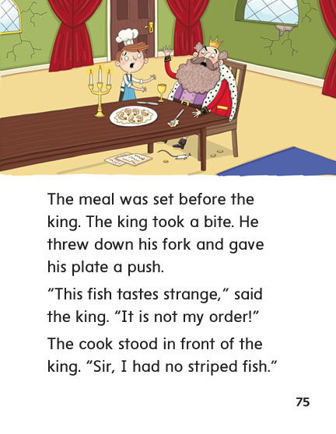

Slide 273
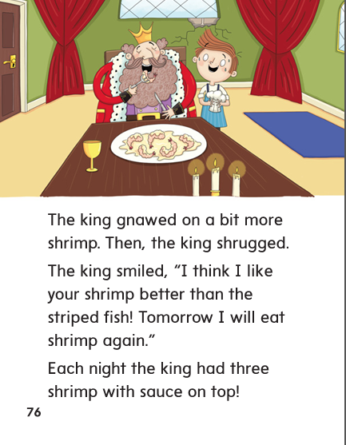

Slide 274
High Frequency
Words

Slide 275
Read, Spell, Write
before
My name comes before your name in ABC order.

Slide 276
Read, Spell, Write
front
Push the cart in front of you.

Slide 277
Read, Spell, Write
heard
Had you heard that the plane will fly tomorrow?

Slide 278
Read, Spell, Write
push
Push the cart in front of you.

Slide 279
Read, Spell, Write
tomorrow
Had you heard that the plane will fly tomorrow?

Slide 280
Read, Spell, Write
your
My name comes before your name in ABC order.

Slide 281
Build Fluency: Word Automaticity
Push on the front door.
We heard the band before we saw it.
Can your ship sail around the world?

Slide 282
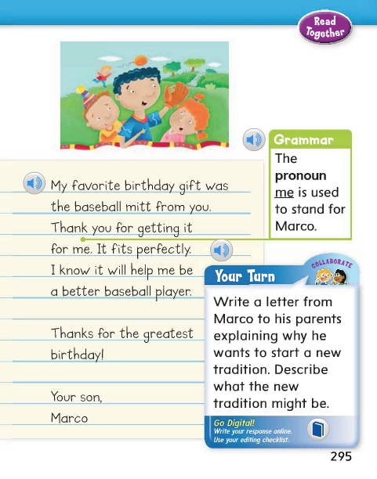
Remember that I is used as the subject and me is used after a verb or a word such as for, at, with, to, or between.
Listen for the pronoun I or me in this sentence:
Why was me used and not i?

Slide 283
Week 4 – Day 4

Slide 284
Phonemic Awareness
Phoneme Segmentation
Listen as I say a word: splash.
Now listen as I say the sounds in the word: /s/ /p/ /l/ /a/ sh/.
There are five sounds.
Let’s say them together: /s/ /p/ /l/ /a/ /sh/.
Guided Practice:
Listen as I say a word. Tell me the sounds you hear in the word. Let’s do the first two together.
strap split throne scrap
spread splash stripe scream

Slide 285
Build with Three-Letter Blends
str
a
n
ge
What is the new word we made?
Let’s blend all the sounds and read the word.
Drop the ge and change the n to nd.

Slide 286
Build with Three-Letter Blends
str
a
nd
What is the new word we made?
Let’s blend all the sounds and read the word.
Change the nd to p.

Slide 287
Build with Three-Letter Blends
str
a
p
What is the new word we made?
Let’s blend all the sounds and read the word.
Change the nd to p.

Slide 288
Build with Three-Letter Blends
str
a
p
What is the new word we made?
Let’s blend all the sounds and read the word.
Change the a to i.

Slide 289
Build with Three-Letter Blends
str
i
p
What is the new word we made?
Let’s blend all the sounds and read the word.
Change the i to i_e.

Slide 290
Build with Three-Letter Blends
str
i
pe
What is the new word we made?
Let’s blend all the sounds and read the word.
Change the p to k.

Slide 291
Build with Three-Letter Blends
str
i
ke
What is the new word we made?
Let’s blend all the sounds and read the word.
Change the k to v.

Slide 292
Build with Three-Letter Blends
str
i
ve
What is the new word we made?
Let’s blend all the sounds and read the word.
Change the str to thr.

Slide 293
Build with Three-Letter Blends
thr
i
ve
What is the new word we made?
Let’s blend all the sounds and read the word.
Drop the ve and change the i to ee.

Slide 294
Build with Three-Letter Blends
thr
ee
What is the new word we made?
Let’s blend all the sounds and read the word.
Add a t to the end of the word.

Slide 295
Build with Three-Letter Blends
thr
ea
t
What is the new word we made?
Let’s blend all the sounds and read the word.
Change the t to d.

Slide 296
Build with Three-Letter Blends
thr
ea
d
What is the new word we made?
Let’s blend all the sounds and read the word.
Change the ea to i and d to ll.

Slide 297
Build with Three-Letter Blends
thr
i
ll
What is the new word we made?
Let’s blend all the sounds and read the word.
Change the thr to shr.

Slide 298
Build with Three-Letter Blends
shr
i
ll
What is the new word we made?
Let’s blend all the sounds and read the word.
Change the i to e and the ll to d.

Slide 299
Build with Three-Letter Blends
shr
e
d
What is the new word we made?
Let’s blend all the sounds and read the word.
Change the i to e and the ll to d.

Slide 300
Structural Analysis
Inflectional Endings –ed, -ing
When –ed or –ing is added to a word that has a short vowel followed by one consonant, the consonant is doubled before adding the ending.
throb
throbbed
throbbing

Slide 301
Structural Analysis
Inflectional Endings –ed, -ing
Have children work in pairs to construct words that tell about actions in the past and actions happening now by adding –ed and –ing.
spray
scrape
glue
splash
trace

Slide 302
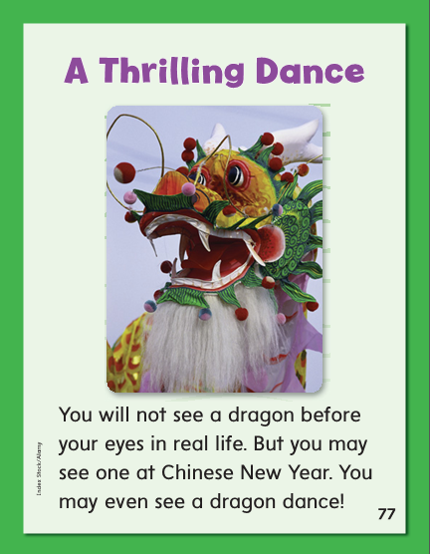

Slide 304
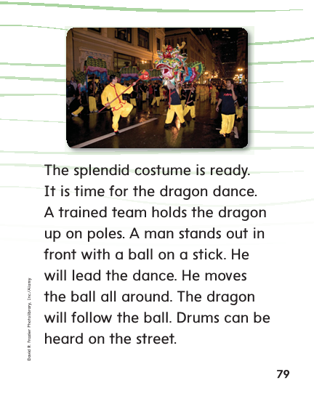

Slide 305
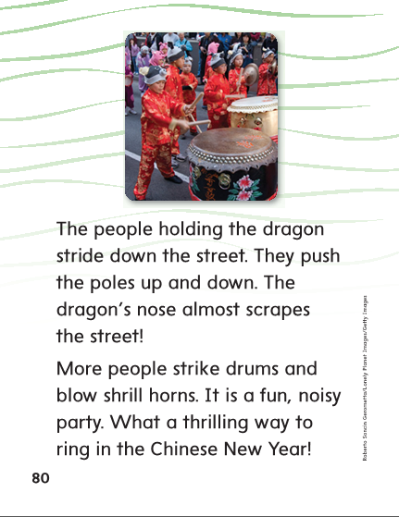

Slide 306
High Frequency
Words

Slide 307
Read, Spell, Write
before
My name comes before your name in ABC order.

Slide 308
Read, Spell, Write
front
Push the cart in front of you.

Slide 309
Read, Spell, Write
heard
Had you heard that the plane will fly tomorrow?

Slide 310
Read, Spell, Write
push
Push the cart in front of you.

Slide 311
Read, Spell, Write
tomorrow
Had you heard that the plane will fly tomorrow?

Slide 312
Read, Spell, Write
your
My name comes before your name in ABC order.

Slide 313
Grammar
I and Me
I is used as the subject of a sentence and me is used after a verb or a word such as for, at, of, with, to, or between.
Have children identify which sentences use I and me correctly. Have children make corrections where the words are used incorrectly.
Me like my new blue bedspread.
My friend and me played three games.

Slide 314
Week 4 – Day 5

Slide 315
Phonemic Awareness
Phoneme Blending:
Listen as I say a group of sounds. Then blend those sounds to form a word.
/s/ /p/ /l/ /a/ /sh/ /th/ /r/ /o/ /t/
/s/ /k/ /r/ /u/ /b/ /s/ /p/ /r/ /e/ /d/
Phoneme Substitution:
I will say a word. I want you to change the sound and say the new word.
map/strap bit/ split low/throw tap/scrap

Slide 316
Blend and Build Words with Long i: i, y, igh, ie
Read and say these words:
scrape
split
spring
string
throat
shrink

Slide 317
Blend and Build with Three-Letter Blends
str
ea
m
What is the new word we made?
Let’s blend all the sounds and read the word.
Change the str to scr.

Slide 318
Blend and Build with Three-Letter Blends
scr
ea
m
What is the new word we made?
Let’s blend all the sounds and read the word.
Change the m to n.

Slide 319
Blend and Build with Three-Letter Blends
scr
ee
n
What is the new word we made?
Let’s blend all the sounds and read the word.
Remove the n and change the scr to spr.

Slide 320
Blend and Build with Three-Letter Blends
spr
ee
What is the new word we made?
Let’s blend all the sounds and read the word.
Change the spr to thr.

Slide 321
Blend and Build with Three-Letter Blends
thr
ee
What is the new word we made?
Let’s blend all the sounds and read the word.
Change the ee to ew.

Slide 322
Blend and Build with Three-Letter Blends
thr
ew
What is the new word we made?
Let’s blend all the sounds and read the word.
Change the ew to ow.

Slide 323
Blend and Build with Three-Letter Blends
thr
ow
What is the new word we made?
Let’s blend all the sounds and read the word.
Change the ew to ow.

Slide 324
Word Automaticity
street

Slide 325
strong

Slide 326
thrill

Slide 327
spring

Slide 328
shrink

Slide 329
strike

Slide 330
thrown

Slide 331
stripe

Slide 332
scrub

Slide 333
splash

Slide 334
stream

Slide 335
screen

Slide 336
threat

Slide 337
thread

Slide 338
straw

Slide 339
scratched

Slide 340
scratching

Slide 341
strolled

Slide 342
strolling

Slide 343
throwing

Slide 344
throbbed

Slide 345
scrubbed

Slide 346
spraying

Slide 347
Structural Analysis
Inflectional Endings –ed, -ing
Have children explain how to add the endings –ed and –ing to words.
Then have them practice writing and reading words with inflectual endings.
scream
split
scrape

Slide 348
High Frequency
Words

Slide 349
Read, Spell, Write
before
My name comes before your name in ABC order.

Slide 350
Read, Spell, Write
front
Push the cart in front of you.

Slide 351
Read, Spell, Write
heard
Had you heard that the plane will fly tomorrow?

Slide 352
Read, Spell, Write
push
Push the cart in front of you.

Slide 353
Read, Spell, Write
tomorrow
Had you heard that the plane will fly tomorrow?

Slide 354
Read, Spell, Write
your
My name comes before your name in ABC order.

Slide 355
Grammar
I and Me
Have children describe how the pronouns I and me should be used.
Have children identify the pronouns:
I would like Drew to go to lunch with me.

Slide 356
Grammar
I and Me
How do I know the sentence should begin with I and not me?
Choose the correct word to complete each sentence.
Bella and I (I, me) sat on the bench.
Jack handed his book to (I, me).
The children asked (I, me) many questions.
(I, Me) hope my friend will play with (I, me).

