Slide 1
Week 5 – Day 1

Slide 2
Phonemic Awareness
Phoneme Reversal
Listen as I blend these sounds: /t/ /a/ /p/, /taaap/, tap.
Now I will say the sounds backward and blend them to make a new word.
Listen: /p/ /a/ /t/, /paaat/, pat.
Listen as I blend these sounds: /k//i/ /s/, /kiiiiis/, kiss.
Mow I will say the sounds backward and blend them to make a new word,
Listen: /s/ /i/ /k/, /siiiik/, sick.
Guided Practice:
Now I am going to say more sounds. Blend the sounds to say a word. Then say the sounds backward and blend them to make another word.
/m/ /u/ /g/ /p/ /a/ /k/ /s/ /u/ /b/
/n/ /e/ /t/ /s/ /t/ /o/ /p/

Slide 3
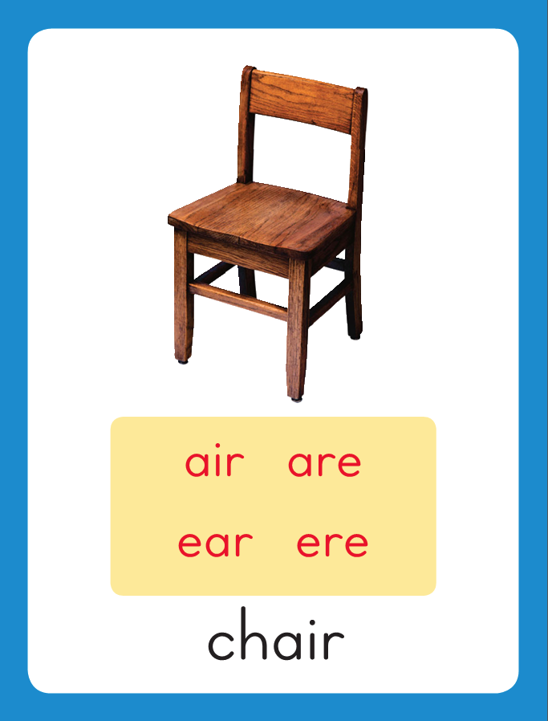
chair
This is the Chair Sound-Spelling Card. The sounds are /ar/. These sounds are at the end of the word chair. Listen: /char/, chair. The /ar/ sounds can be spelled with the letters air in chair, are as in care, and ear as in wear. Say the sounds with me: /ar/. I’ll say /ar/ as I write the letters that stand for the sounds several times.
care
wear

Slide 4
Have children practice connecting the letters air, are, and ear to the sounds /ar/ by writing them. Now do it with me. Say /ar/ as I write the letters air. This time, write the letters air five times as you say the /ar/ sounds. Repeat for /ar/ spelled are and ear.
air air air air air
are are are are are
ear ear ear ear ear

Slide 5
Blend with /ar/ air, are, ear
f

Slide 6
Blend with /ar/ air, are, ear
f
air

Slide 7
Blend with /ar/ air, are, ear
f
air

Slide 8
Blend with /ar/ air, are, ear
r

Slide 9
Blend with /ar/ air, are, ear
r
are

Slide 10
Blend with /ar/ air, are, ear
r
are

Slide 11
Blend with /ar/ air, are, ear
p

Slide 12
Blend with /ar/ air, are, ear
p
ear

Slide 13
Blend with /ar/ air, are, ear
p
ear

Slide 14
air sh are st
ch ear spr ar
ee ing i_e spl
thr ow wr kn

Slide 15
air

Slide 16
air f

Slide 17
air fair

Slide 18
air fair c

Slide 19
air fair care

Slide 20
air fair care
t

Slide 21
air fair care
tear

Slide 22
air fair care
tear w

Slide 23
air fair care
tear wear

Slide 24
air fair care
tear wear p

Slide 25
air fair care
tear wear pear

Slide 26
air fair care
tear wear pear
sh

Slide 27
air fair care
tear wear pear
share

Slide 28
air fair care
tear wear pear
share ch

Slide 29
air fair care
tear wear pear
share chair

Slide 30
air fair care
tear wear pear
share chair h

Slide 31
air fair care
tear wear pear
share chair hair

Slide 32
air fair care
tear wear pear
share chair hair
b

Slide 33
air fair care
tear wear pear
share chair hair
bare

Slide 34
air fair care
tear wear pear
share chair hair
bare bl

Slide 35
air fair care
tear wear pear
share chair hair
bare blare

Slide 36
air fair care
tear wear pear
share chair hair
bare blared

Slide 37
air fair care
tear wear pear
share chair hair
bare blared d

Slide 38
air fair care
tear wear pear
share chair hair
bare blared dare

Slide 39
air fair care
tear wear pear
share chair hair
bare blared dared

Slide 40
Internal Sounding Out
wear

Slide 41
Internal Sounding Out
wear wore

Slide 42
Internal Sounding Out
wear wore bear

Slide 43
Internal Sounding Out
wear wore bear
bar

Slide 44
Internal Sounding Out
wear wore bear
bar star

Slide 45
Internal Sounding Out
wear wore bear
bar star stare

Slide 46
Internal Sounding Out
wear wore bear
bar star stare
street

Slide 47
Internal Sounding Out
wear wore bear
bar star stare
street spring

Slide 48
Internal Sounding Out
wear wore bear
bar star stare
street spring splash

Slide 49
Internal Sounding Out
wear wore bear
bar star stare
street spring splash
three

Slide 50
Internal Sounding Out
wear wore bear
bar star stare
street spring splash
three write

Slide 51
Internal Sounding Out
wear wore bear
bar star stare
street spring splash
three write know

Slide 52
Her

Slide 53
Her red

Slide 54
Her red hair

Slide 55
Her red hair blew

Slide 56
Her red hair blew in

Slide 57
Her red hair blew in the

Slide 58
Her red hair blew in the air.

Slide 59
Her red hair blew in the air.
Did

Slide 60
Her red hair blew in the air.
Did that

Slide 61
Her red hair blew in the air.
Did that bear

Slide 62
Her red hair blew in the air.
Did that bear stare

Slide 63
Her red hair blew in the air.
Did that bear stare at

Slide 64
Her red hair blew in the air.
Did that bear stare at Claire?

Slide 65
Her red hair blew in the air.
Did that bear stare at Claire?
I

Slide 66
Her red hair blew in the air.
Did that bear stare at Claire?
I will

Slide 67
Her red hair blew in the air.
Did that bear stare at Claire?
I will share

Slide 68
Her red hair blew in the air.
Did that bear stare at Claire?
I will share my

Slide 69
Her red hair blew in the air.
Did that bear stare at Claire?
I will share my pear

Slide 70
Her red hair blew in the air.
Did that bear stare at Claire?
I will share my pear with

Slide 71
Her red hair blew in the air.
Did that bear stare at Claire?
I will share my pear with Blair.

Slide 72
Spelling / Dictation
1. _________
2. _________
3. _________
4. _________
5. _________

Slide 73
High Frequency
Words

Slide 74
Read, Spell, Write
favorite
I wonder what your favorite food is.

Slide 75
Read, Spell, Write
few
I chose a few books to surprise you.

Slide 76
Read, Spell, Write
gone
Claire has gone to the beach.

Slide 77
Read, Spell, Write
surprise
I chose a few books to surprise you.

Slide 78
Read, Spell, Write
wonder
I wonder what your favorite food is.

Slide 79
Read, Spell, Write
young
A kitten is a young cat.

Slide 80
Grammar
Adverbs that tell how
An adverb is a word that tells more about the action in a sentence.
An adverb can tell how an action happened.
Many adverbs end in –ly.
The cars in the Fourth of July parade drive slowly. The band plays loudly. Clowns run quickly around the floats.
Ask: How do the cars move?
How does the band play?
How do the clowns run?

Slide 81
Grammar
Adverbs that tell how
Work with a partner to identify the adverbs that tell how.
The teacher spoke softly.
She asked the children to neatly hang up their coats.
The children quietly put their things away.

Slide 82
Week 5 – Day 2

Slide 83
Phonemic Awareness
Phoneme Blending
Listen: /f/ /air/.
Now I blend the sounds together and say the word: /fair/, fair.
Guided Practice:
I am going to say some words sound by sound. Blend the sounds together to say the word.
/p/ /air/ /ch/ /air/ /h/ /air/ /b/ /air/
/r/ /are/ /c/ /are/ /s/ /k/ /are/ /sh/ /are/

Slide 84
chair
share
bear
What are these sounds?
What sounds do they stand for?

Slide 85
Blend with /ar/ air, are, ear
c

Slide 86
Blend with /ar/ air, are, ear
c
are

Slide 87
Blend with /ar/ air, are, ear
c
are

Slide 88
Blend with /ar/ air, are, ear
p

Slide 89
Blend with /ar/ air, are, ear
p
air

Slide 90
Blend with /ar/ air, are, ear
p
air

Slide 91
Blend with /ar/ air, are, ear
w

Slide 92
Blend with /ar/ air, are, ear
w
ear

Slide 93
Blend with /ar/ air, are, ear
w
ear

Slide 94
d

Slide 95
dare

Slide 96
dare p

Slide 97
dare pear

Slide 98
dare pear h

Slide 99
dare pear hair

Slide 100
dare pear hair
b

Slide 101
dare pear hair
bare

Slide 102
dare pear hair
bare sc

Slide 103
dare pear hair
bare scare

Slide 104
dare pear hair
bare scare t

Slide 105
dare pear hair
bare scare tear

Slide 106
dare pear hair
bare scare tear
b

Slide 107
dare pear hair
bare scare tear
bear

Slide 108
dare pear hair
bare scare tear
bear ch

Slide 109
dare pear hair
bare scare tear
bear chair

Slide 110
dare pear hair
bare scare tear
bear chair r

Slide 111
dare pear hair
bare scare tear
bear chair rare

Slide 112
dare pear hair
bare scare tear
bear chair rare
b

Slide 113
dare pear hair
bare scare tear
bear chair rare
bare

Slide 114
dare pear hair
bare scare tear
bear chair rare
barel

Slide 115
dare pear hair
bare scare tear
bear chair rare
barely

Slide 116
dare pear hair
bare scare tear
bear chair rare
barely air

Slide 117
dare pear hair
bare scare tear
bear chair rare
barely airf

Slide 118
dare pear hair
bare scare tear
bear chair rare
barely airfare

Slide 119
Build Words with /ar/ air, are, ear
r
are
What is the new word we made?
Let’s blend all the sounds and read the word.
Change the r to c.

Slide 120
Build Words with /ar/ air, are, ear
c
are
What is the new word we made?
Let’s blend all the sounds and read the word.
Change the c to d.

Slide 121
Build Words with /ar/ air, are, ear
d
are
What is the new word we made?
Let’s blend all the sounds and read the word.
Change the d to b.

Slide 122
Build Words with /ar/ air, are, ear
b
are
What is the new word we made?
Let’s blend all the sounds and read the word.
Change the b to st.

Slide 123
Build Words with /ar/ air, are, ear
st
are
What is the new word we made?
Let’s blend all the sounds and read the word.
Change the are to ar

Slide 124
Build Words with /ar/ air, are, ear
st
ar
What is the new word we made?
Let’s blend all the sounds and read the word.
Change the ar to air

Slide 125
Build Words with /ar/ air, are, ear
st
air
What is the new word we made?
Let’s blend all the sounds and read the word.
Change the st to ch.

Slide 126
Build Words with /ar/ air, are, ear
ch
air
What is the new word we made?
Let’s blend all the sounds and read the word.
Change the ch to h.

Slide 127
Build Words with /ar/ air, are, ear
h
air
What is the new word we made?
Let’s blend all the sounds and read the word.
Change the h to p.

Slide 128
Build Words with /ar/ air, are, ear
p
air
What is the new word we made?
Let’s blend all the sounds and read the word.
Change the air to ear.

Slide 129
Build Words with /ar/ air, are, ear
p
ear
What is the new word we made?
Let’s blend all the sounds and read the word.
Change the p to w.

Slide 130
Build Words with /ar/ air, are, ear
w
ear
What is the new word we made?
Let’s blend all the sounds and read the word.
Change the w to t.

Slide 131
Build Words with /ar/ air, are, ear
t
ear
What is the new word we made?
Let’s blend all the sounds and read the word.
Change the t to b.

Slide 132
Build Words with /ar/ air, are, ear
b
ear
What is the new word we made?
Let’s blend all the sounds and read the word.
Change the t to b.

Slide 133
Structural Analysis
R-controlled Vowel Syllables
There is an r-controlled vowel in each word.
Say the words, clapping for each syllable.
Draw a line between the syllables:
hairy
burning

Slide 134
Structural Analysis
R-controlled Vowel Syllables
When a vowel spelling is followed by the letter r,
the vowel and the r will be in the same syllable.
hair/y
burn/ing

Slide 135
Structural Analysis
R-controlled Vowel Syllables
Help children divide each word into syllables, read the words,
and then use each word in a sentence.
fairly
target
barely
repair

Slide 136
hair
care
pear

Slide 137
fair
share
bear
wear
pair
spare
fare
share
bear
wear
pair
spare

Slide 138
High Frequency
Words

Slide 139
Read, Spell, Write
favorite
I wonder what your favorite food is.

Slide 140
Read, Spell, Write
few
I chose a few books to surprise you.

Slide 141
Read, Spell, Write
gone
Claire has gone to the beach.

Slide 142
Read, Spell, Write
surprise
I chose a few books to surprise you.

Slide 143
Read, Spell, Write
wonder
I wonder what your favorite food is.

Slide 144
Read, Spell, Write
young
A kitten is a young cat.

Slide 145
Grammar
Adverbs that tell how
Adverbs can tell how an action takes place.
Here are some examples of adverbs:
slowly, quickly, loudly, softly, neatly, gladly
We slowly carried the heavy tree,
Then we gladly placed the tree in the hole.
“Happy Arbor Day!” Dad said loudly.
Circle the adverb that tells how in each sentence.

Slide 146
Grammar
Adverbs that tell how
Have students work in pairs to identify each adverb that tells how.
Ethan neatly made his bed.
Ethan loudly ran down the stairs.
He gladly wished his mom a Happy Mother’s Day.

Slide 147
Week 5 – Day 3

Slide 148
Phonemic Awareness
Phoneme Reversal
Listen carefully as I say a word: chair.
The word chair has these sounds: /ch/ /air/.
I’ll take away the first sound /ch/ to make a new word: /air/, air.
The new word is air.
Guided Practice:
Listen carefully as I say a word. Then say the word without the first sound.
plate stall broom hair
cloud strap scare bright

Slide 149
Blend with /ar/ air, are, ear
b

Slide 150
Blend with /ar/ air, are, ear
b
ear

Slide 151
Blend with /ar/ air, are, ear
b
ear

Slide 152
Blend with /ar/ air, are, ear
h

Slide 153
Blend with /ar/ air, are, ear
h
air

Slide 154
Blend with /ar/ air, are, ear
h
air

Slide 155
Blend with /ar/ air, are, ear
sc

Slide 156
Blend with /ar/ air, are, ear
sc
are

Slide 157
Blend with /ar/ air, are, ear
sc
are

Slide 158
Blend with /ar/ air, are, ear
r

Slide 159
Blend with /ar/ air, are, ear
r
e

Slide 160
Blend with /ar/ air, are, ear
r
e

Slide 161
Blend with /ar/ air, are, ear
r
e
p

Slide 162
Blend with /ar/ air, are, ear
r
e
p
air

Slide 163
Blend with /ar/ air, are, ear
r
e
p
air

Slide 164
Blend with /ar/ air, are, ear
r
e
p
air

Slide 165
are st air sc
sh ear ch oo
un com ly be
ful pre y are

Slide 166
c

Slide 167
care

Slide 168
care f

Slide 169
care fair

Slide 170
care fair d

Slide 171
care fair dare

Slide 172
care fair dare
st

Slide 173
care fair dare
stare

Slide 174
care fair dare
stare t

Slide 175
care fair dare
stare tear

Slide 176
care fair dare
stare tear air

Slide 177
care fair dare
stare tear air
w

Slide 178
care fair dare
stare tear air
wear

Slide 179
care fair dare
stare tear air
wear p

Slide 180
care fair dare
stare tear air
wear pear

Slide 181
care fair dare
stare tear air
wear pear sc

Slide 182
care fair dare
stare tear air
wear pear scare

Slide 183
care fair dare
stare tear air
wear pear scare
sh

Slide 184
care fair dare
stare tear air
wear pear scare
share

Slide 185
care fair dare
stare tear air
wear pear scare
share ch

Slide 186
care fair dare
stare tear air
wear pear scare
share chair

Slide 187
care fair dare
stare tear air
wear pear scare
share chair st

Slide 188
care fair dare
stare tear air
wear pear scare
share chair stairs

Slide 189
Internal Sounding Out
bare

Slide 190
Internal Sounding Out
bare barely

Slide 191
Internal Sounding Out
bare barely fair

Slide 192
Internal Sounding Out
bare barely fair
unfair

Slide 193
Internal Sounding Out
bare barely fair
unfair hair

Slide 194
Internal Sounding Out
bare barely fair
unfair hair hairy

Slide 195
Internal Sounding Out
bare barely fair
unfair hair hairy
beware

Slide 196
Internal Sounding Out
bare barely fair
unfair hair hairy
beware repair

Slide 197
Internal Sounding Out
bare barely fair
unfair hair hairy
beware repair scary

Slide 198
Internal Sounding Out
bare barely fair
unfair hair hairy
beware repair scary
rarely

Slide 199
Internal Sounding Out
bare barely fair
unfair hair hairy
beware repair scary
rarely prepare

Slide 200
Internal Sounding Out
bare barely fair
unfair hair hairy
beware repair scary
rarely prepare careful

Slide 201
Beware

Slide 202
Beware of

Slide 203
Beware of the

Slide 204
Beware of the mean

Slide 205
Beware of the mean
bears!

Slide 206
Beware of the mean
bears!
Put

Slide 207
Beware of the mean
bears!
Put a

Slide 208
Beware of the mean
bears!
Put a spare

Slide 209
Beware of the mean
bears!
Put a spare pair

Slide 210
Beware of the mean
bears!
Put a spare pair of

Slide 211
Beware of the mean
bears!
Put a spare pair of mittens

Slide 212
Beware of the mean
bears!
Put a spare pair of mittens on

Slide 213
Beware of the mean
bears!
Put a spare pair of mittens on the

Slide 214
Beware of the mean
bears!
Put a spare pair of mittens on the chair.

Slide 215
Structural Analysis
R-controlled Vowel Syllables
Say the words, clapping for each syllable.
rarely
unfair

Slide 216
Structural Analysis
R-controlled Vowel Syllables
Draw a line between the syllables.
Explain that when a vowel spelling is followed by the letter r, the vowel and the r will be in the same syllable.
rare/ly
un/fair

Slide 217
Structural Analysis
R-controlled Vowel Syllables
Read the words with the children.
Help them divide each word into syllables,
and then use each word in a sentence.
barely
compare
footware
airfare
rarely

Slide 218
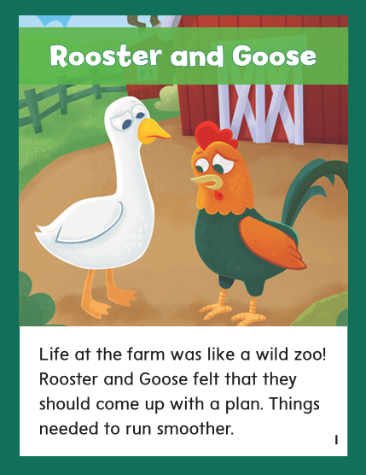

Slide 219
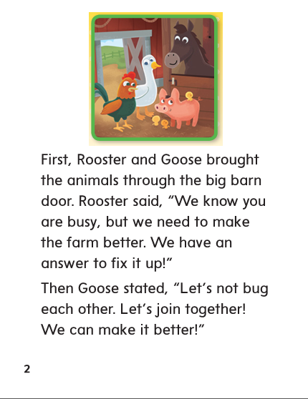

Slide 220
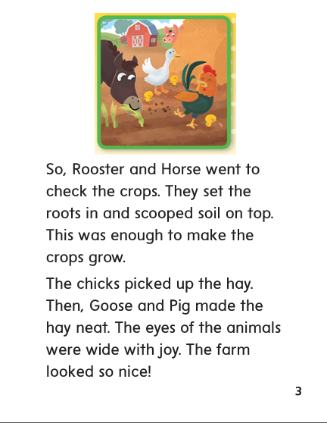

Slide 221
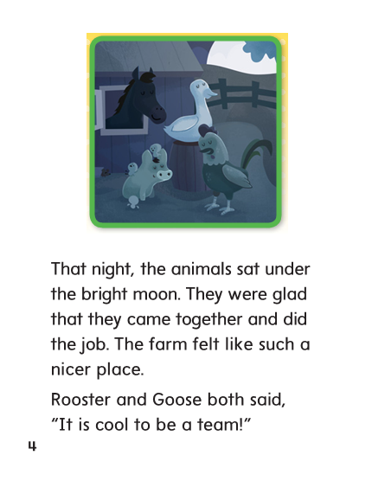

Slide 223
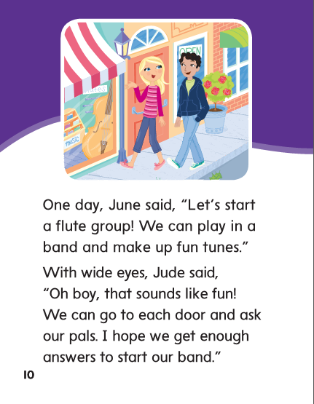

Slide 225
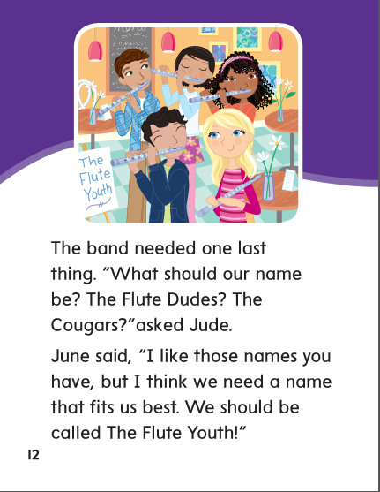

Slide 226
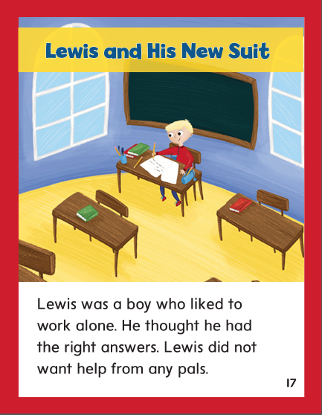

Slide 227
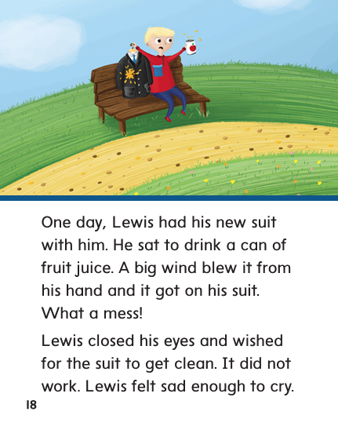

Slide 228
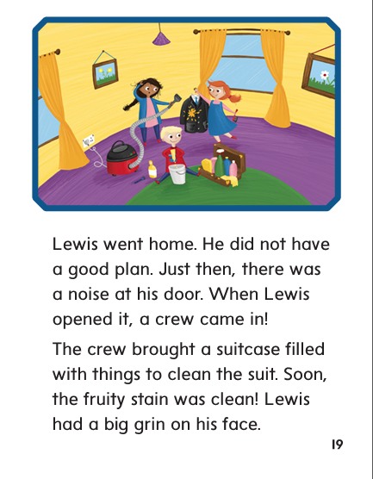

Slide 229
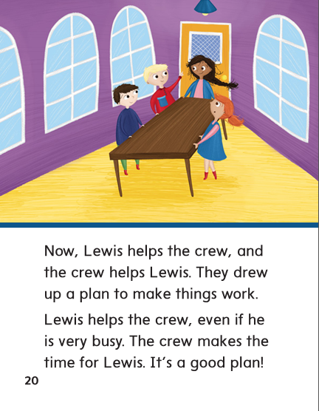

Slide 230
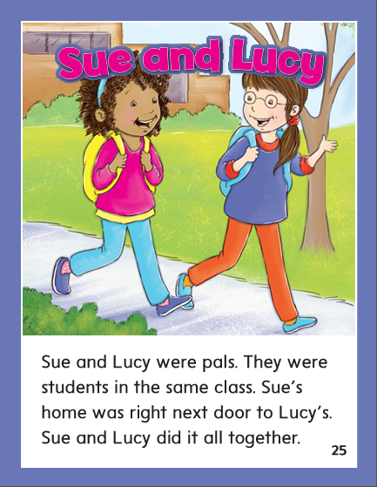

Slide 231
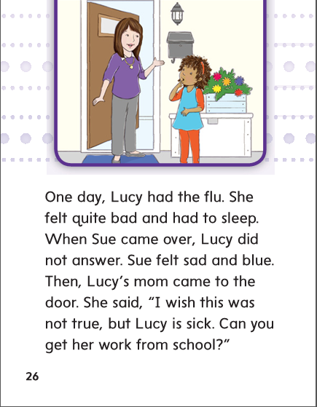

Slide 232
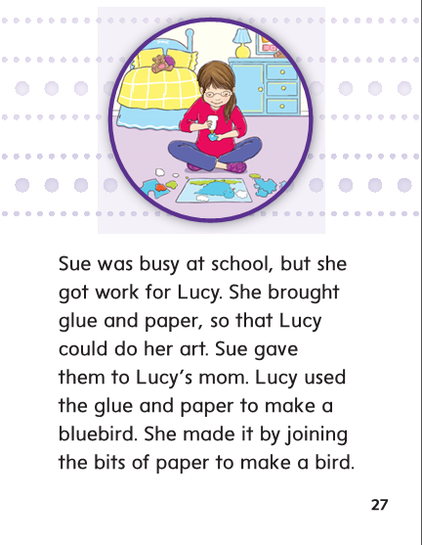

Slide 233
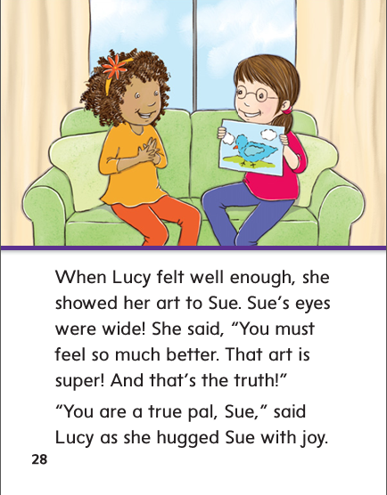

Slide 234
air
are
ear

Slide 235
fair
fair
fair
spare
spare
spare
bear
bear
bear
pair
pair
pair
share
share
share
wear
wear
wear

Slide 236
High Frequency
Words

Slide 237
Read, Spell, Write
favorite
I wonder what your favorite food is.

Slide 238
Read, Spell, Write
few
I chose a few books to surprise you.

Slide 239
Read, Spell, Write
gone
Claire has gone to the beach.

Slide 240
Read, Spell, Write
surprise
I chose a few books to surprise you.

Slide 241
Read, Spell, Write
wonder
I wonder what your favorite food is.

Slide 242
Read, Spell, Write
young
A kitten is a young cat.

Slide 243
Build Fluency: Word Automaticity
The young boy has a favorite toy bear.
Few of my friends have gone home.
I wonder what the surprise is!

Slide 244
Adverbs can tell how an
action takes place.
Name the adverb in this sentence that tells how:

Slide 245
Week 5 – Day 4

Slide 246
Phonemic Awareness
Phoneme Addition
Listen as I say a word. Then I will add a sound to make a new word.
The word is air. What word will I make if I add /p/ to the beginning of air?
That’s right, I will make the word /p/ /air/, pair.
Guided Practice:
I will say a word, then I’ll say a sound to add to the beginning of the word. Tell me the new word.
at, /k/ air, /ch/ room, /b/ ring /sp/ core, /s/

Slide 247
Blend words with /ar/ air, are, ear
t
ear
What is the new word we made?
Let’s blend all the sounds and read the word.
Change the t to w.

Slide 248
Blend words with /ar/ air, are, ear
w
ear
What is the new word we made?
Let’s blend all the sounds and read the word.
Change the w to p.

Slide 249
Blend words with /ar/ air, are, ear
p
ear
What is the new word we made?
Let’s blend all the sounds and read the word.
Change the p to b.

Slide 250
Blend words with /ar/ air, are, ear
b
ear
What is the new word we made?
Let’s blend all the sounds and read the word.
Change the ear to ar.

Slide 251
Blend words with /ar/ air, are, ear
b
ar
What is the new word we made?
Let’s blend all the sounds and read the word.
Change the ar to are.

Slide 252
Blend words with /ar/ air, are, ear
b
are
What is the new word we made?
Let’s blend all the sounds and read the word.
Change the b to c.

Slide 253
Blend words with /ar/ air, are, ear
c
are
What is the new word we made?
Let’s blend all the sounds and read the word.
Change the c to f.

Slide 254
Blend words with /ar/ air, are, ear
f
are
What is the new word we made?
Let’s blend all the sounds and read the word.
Change the f to fl.

Slide 255
Blend words with /ar/ air, are, ear
fl
are
What is the new word we made?
Let’s blend all the sounds and read the word.
Change the fl to gl.

Slide 256
Blend words with /ar/ air, are, ear
gl
are
What is the new word we made?
Let’s blend all the sounds and read the word.
Change the gl to sc.

Slide 257
Blend words with /ar/ air, are, ear
sc
are
What is the new word we made?
Let’s blend all the sounds and read the word.
Change the sc to sh.

Slide 258
Blend words with /ar/ air, are, ear
sh
are
What is the new word we made?
Let’s blend all the sounds and read the word.
Change the sh to sp.

Slide 259
Blend words with /ar/ air, are, ear
sp
are
What is the new word we made?
Let’s blend all the sounds and read the word.
Change the sp to st.

Slide 260
Blend words with /ar/ air, are, ear
st
are
What is the new word we made?
Let’s blend all the sounds and read the word.
Change the are to ar.

Slide 261
Blend words with /ar/ air, are, ear
st
ar
What is the new word we made?
Let’s blend all the sounds and read the word.
Change the ar to air.

Slide 262
Blend words with /ar/ air, are, ear
st
air
What is the new word we made?
Let’s blend all the sounds and read the word.
Change the st to p.

Slide 263
Blend words with /ar/ air, are, ear
p
air
What is the new word we made?
Let’s blend all the sounds and read the word.
Change the p to h.

Slide 264
Blend words with /ar/ air, are, ear
h
air
What is the new word we made?
Let’s blend all the sounds and read the word.
Change the p to h.

Slide 265
Structural Analysis
R-controlled Vowel Syllables
Review how to divide a word into syllables when
a vowel in a word is followed by the letter r.
dairy
dair/y

Slide 266
Structural Analysis
R-controlled Vowel Syllables
Have children work in pairs to divide the words into syllables.
Then have them write a sentence with each word.
barely
prepare
market
dirty
turkey

Slide 267
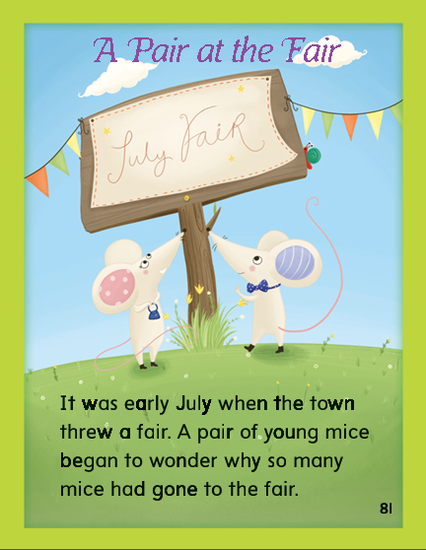

Slide 268
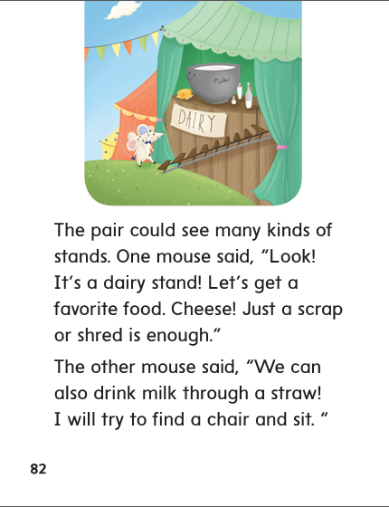

Slide 272
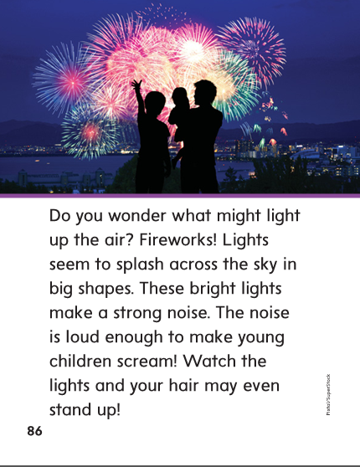

Slide 273
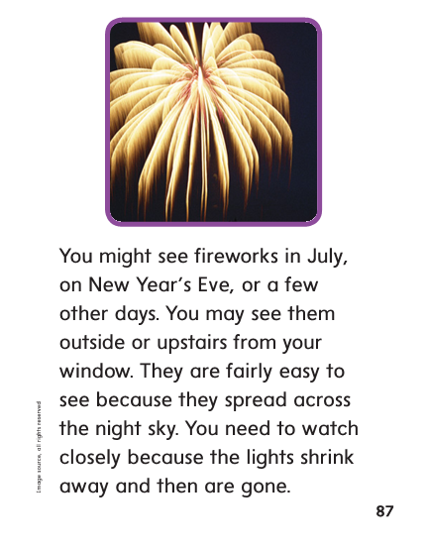

Slide 274
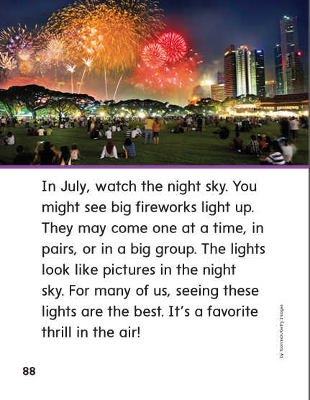

Slide 275
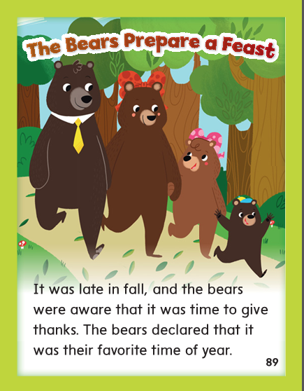

Slide 276
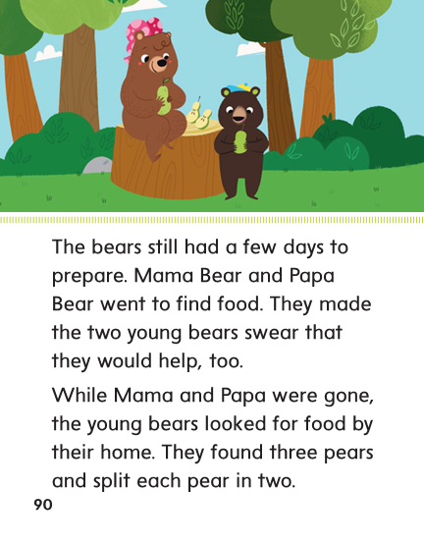

Slide 277
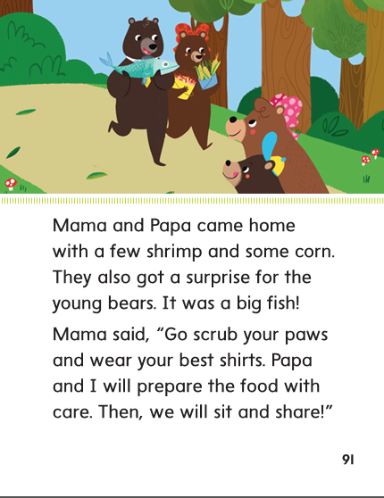

Slide 278
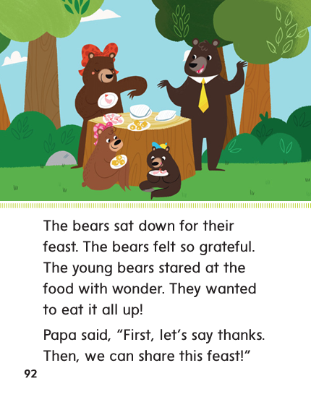

Slide 279
High Frequency
Words

Slide 280
Read, Spell, Write
favorite
I wonder what your favorite food is.

Slide 281
Read, Spell, Write
few
I chose a few books to surprise you.

Slide 282
Read, Spell, Write
gone
Claire has gone to the beach.

Slide 283
Read, Spell, Write
surprise
I chose a few books to surprise you.

Slide 284
Read, Spell, Write
wonder
I wonder what your favorite food is.

Slide 285
Read, Spell, Write
young
A kitten is a young cat.

Slide 286
Grammar
Adverbs that tell how
Some adverbs tell how an action takes place.
What are some words that tell how?
(slowly, quickly, loudly, softly, neatly, gladly)
How are the words alike?

Slide 287
Grammar
Adverbs that tell how
Identify the adverbs that tell how.
Mom said I should quickly change my shirt.
I slowly looked in the dresser.
I found a neatly folded shirt.
I gladly wear green on St. Patrick’s Day!

Slide 288
Week 5 – Day 5

Slide 289
Phonemic Awareness
Syllable Deletion:
Listen carefully as I say a word. Then delete a syllable and say the new word.
barely/bare unfair/fair armchair/arm airfare/air
Syllable Addition:
Listen as I say a word and a syllable to add to the word. What is the new word?
hair/hairy stare/staring box/boxes slow/slowly

Slide 290
Blend and Build Words with Dipthongs oi, oy
Read and say these words:
share
wear
air
beware
unfair

Slide 291
Blend and Build with /ar/ air, are, ear
c
are
What is the new word we made?
Let’s blend all the sounds and read the word.
Change the c to sc.

Slide 292
Blend and Build with /ar/ air, are, ear
sc
are
What is the new word we made?
Let’s blend all the sounds and read the word.
Change the sc to sp.

Slide 293
Blend and Build with /ar/ air, are, ear
sp
are
What is the new word we made?
Let’s blend all the sounds and read the word.
Change the sp to st.

Slide 294
Blend and Build with /ar/ air, are, ear
st
are
What is the new word we made?
Let’s blend all the sounds and read the word.
Change the st to sh.

Slide 295
Blend and Build with /ar/ air, are, ear
sh
are
What is the new word we made?
Let’s blend all the sounds and read the word.
Change the sh to f.

Slide 296
Blend and Build with /ar/ air, are, ear
f
are
What is the new word we made?
Let’s blend all the sounds and read the word.
Change the f to h.

Slide 297
Blend and Build with /ar/ air, are, ear
h
are
What is the new word we made?
Let’s blend all the sounds and read the word.
Change the are to air.

Slide 298
Blend and Build with /ar/ air, are, ear
h
air
What is the new word we made?
Let’s blend all the sounds and read the word.
Change the h to f.

Slide 299
Blend and Build with /ar/ air, are, ear
f
air
What is the new word we made?
Let’s blend all the sounds and read the word.
Change the f to p.

Slide 300
Blend and Build with /ar/ air, are, ear
p
air
What is the new word we made?
Let’s blend all the sounds and read the word.
Change the air to ear.

Slide 301
Blend and Build with /ar/ air, are, ear
p
ear
What is the new word we made?
Let’s blend all the sounds and read the word.
Change the p to w.

Slide 302
Blend and Build with /ar/ air, are, ear
w
ear
What is the new word we made?
Let’s blend all the sounds and read the word.
Change the w to b.

Slide 303
Blend and Build with /ar/ air, are, ear
b
ear
What is the new word we made?
Let’s blend all the sounds and read the word.
Change the w to b.

Slide 304
Word Automaticity
care

Slide 305
fair

Slide 306
dare

Slide 307
stare

Slide 308
tear

Slide 309
air

Slide 310
wear

Slide 311
pear

Slide 312
scare

Slide 313
share

Slide 314
chair

Slide 315
stairs

Slide 316
bare

Slide 317
barely

Slide 318
fair

Slide 319
unfair

Slide 320
hair

Slide 321
hairy

Slide 322
beware

Slide 323
repair

Slide 324
compare

Slide 325
footwear

Slide 326
rarely

Slide 327
prepare

Slide 328
scary

Slide 329
careful

Slide 330
Structural Analysis
R-controlled Vowel Syllables
Have children explain how to divide a word into syllables
when a vowel in the word is followed by the letter r.
Have the practice writing and reading words with
r-controlled vowel syllables.

Slide 331
High Frequency
Words

Slide 332
Read, Spell, Write
favorite
I wonder what your favorite food is.

Slide 333
Read, Spell, Write
few
I chose a few books to surprise you.

Slide 334
Read, Spell, Write
gone
Claire has gone to the beach.

Slide 335
Read, Spell, Write
surprise
I chose a few books to surprise you.

Slide 336
Read, Spell, Write
wonder
I wonder what your favorite food is.

Slide 337
Read, Spell, Write
young
A kitten is a young cat.

Slide 338
Grammar
Adverbs that tell how
Have children describe adverbs that tell how.
Have children identify the adverbs:
I lay quietly in bed. Then, I quickly jumped up. I’ll gladly get up today! Today is the first day of the new year! I get to loudly play drums at the big party.
What question can each adverb answer?
Have children work in pairs to write sentences using slowly, softly, and neatly.

