Slide 1
Week 1 – Day 1

Slide 2
Phonemic Awareness – Phoneme Blending
I am going to say three words.
Then I will blend the three sounds together to make a word.
The first sound is /l/.
The middle sound is /e/.
The last sound is /g/.
Listen as I put the sounds together: /llleeeg/, leg.
The word is leg.
Guided Practice:
Listen carefully to these sounds. Put them together to make a word.
/e/ /d/ /r/ /e/ /d/ /m/ /e/ /t/ /f/ /e/ /d/ /l/ /e/ /t/
/n/ /e/ /t/ /b/ /e/ /d/ /p/ /e/ /t/ /p/ /e/ /n/ /j/ /e/ /t/
/s/ /l/ /e/ /d/ /b/ /r/ /e/ /d/

Slide 3
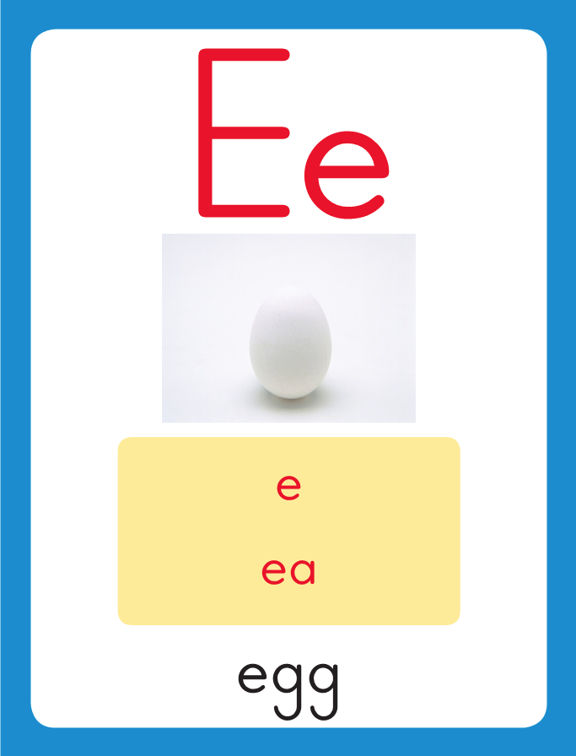
Introduce short e
This is the Egg Sound-Spelling Card.
The sound is /e/.
The /e/ sound is spelled with the letter e. Sometimes it is spelled with the letters ea.
Say it with me: /eee/.
This sound is at the beginning of the word egg.
Listen /eeeg/, egg.
I’ll say /e/ as I write the letter several times.

Slide 4
Introduce short e
Have children practice connecting the letter e to the sound /e/ by writing it.
Now do it with me. Say /e/ as I write the letter e.
This time, write the letter e five times as you say the /e/ sound.

Slide 5
Blending Words with Short e
s

Slide 6
Blending Words with Short e
s
e

Slide 7
Blending Words with Short e
s
e
t

Slide 8
Blending Words with Short e
s
e
t

Slide 9
Blending Words with Short e
b

Slide 10
Blending Words with Short e
b
e

Slide 11
Blending Words with Short e
b
e
g

Slide 12
Blending Words with Short e
b
e
g

Slide 13
Blending Words with Short e
n

Slide 14
Blending Words with Short e
n
e

Slide 15
Blending Words with Short e
n
e
ck

Slide 16
Blending Words with Short e
n
e
ck

Slide 17
Blending Words with Short e
s
w

Slide 18
Blending Words with Short e
s
w
ea

Slide 19
Blending Words with Short e
s
w
ea
t

Slide 20
e ll sm bl
cl e ck ea
br j fl ss
sl w ea g

Slide 21
r

Slide 22
re

Slide 23
red

Slide 24
red b

Slide 25
red be

Slide 26
red bed

Slide 27
red bed b

Slide 28
red bed be

Slide 29
red bed bell

Slide 30
red bed bell B

Slide 31
red bed bell Be

Slide 32
red bed bell Ben

Slide 33
red bed bell Ben
g

Slide 34
red bed bell Ben
ge

Slide 35
red bed bell Ben
get

Slide 36
red bed bell Ben
get w

Slide 37
red bed bell Ben
get we

Slide 38
red bed bell Ben
get wet

Slide 39
red bed bell Ben
get wet j

Slide 40
red bed bell Ben
get wet je

Slide 41
red bed bell Ben
get wet jet

Slide 42
red bed bell Ben
get wet jet v

Slide 43
red bed bell Ben
get wet jet ve

Slide 44
red bed bell Ben
get wet jet vet

Slide 45
red bed bell Ben
get wet jet vet
m

Slide 46
red bed bell Ben
get wet jet vet
me

Slide 47
red bed bell Ben
get wet jet vet
men

Slide 48
red bed bell Ben
get wet jet vet
men h

Slide 49
red bed bell Ben
get wet jet vet
men hea

Slide 50
red bed bell Ben
get wet jet vet
men head

Slide 51
red bed bell Ben
get wet jet vet
men head br

Slide 52
red bed bell Ben
get wet jet vet
men head brea

Slide 53
red bed bell Ben
get wet jet vet
men head bread

Slide 54
s

Slide 55
se

Slide 56
set

Slide 57
set s

Slide 58
set sa

Slide 59
set sat

Slide 60
set sat g

Slide 61
set sat ge

Slide 62
set sat get

Slide 63
set sat get g

Slide 64
set sat get go

Slide 65
set sat get got

Slide 66
set sat get got
w

Slide 67
set sat get got
we

Slide 68
set sat get got
well

Slide 69
set sat get got
well w

Slide 70
set sat get got
well wi

Slide 71
set sat get got
well will

Slide 72
set sat get got
well will sm

Slide 73
set sat get got
well will sme

Slide 74
set sat get got
well will smell

Slide 75
set sat get got
well will smell sl

Slide 76
set sat get got
well will smell sle

Slide 77
set sat get got
well will smell sled

Slide 78
set sat get got
well will smell sled
cl

Slide 79
set sat get got
well will smell sled
cla

Slide 80
set sat get got
well will smell sled
clap

Slide 81
set sat get got
well will smell sled
clap fl

Slide 82
set sat get got
well will smell sled
clap fla

Slide 83
set sat get got
well will smell sled
clap flag

Slide 84
set sat get got
well will smell sled
clap flag bl

Slide 85
set sat get got
well will smell sled
clap flag blo

Slide 86
set sat get got
well will smell sled
clap flag block

Slide 87
Ten

Slide 88
Ten men

Slide 89
Ten men met

Slide 90
Ten men met in

Slide 91
Ten men met in a

Slide 92
Ten men met in a jet.

Slide 93
Ten men met in a jet.
Did

Slide 94
Ten men met in a jet.
Did Jeff

Slide 95
Ten men met in a jet.
Did Jeff get

Slide 96
Ten men met in a jet.
Did Jeff get a

Slide 97
Ten men met in a jet.
Did Jeff get a red

Slide 98
Ten men met in a jet.
Did Jeff get a red sled?

Slide 99
Ten men met in a jet.
Did Jeff get a red sled?
Glenn

Slide 100
Ten men met in a jet.
Did Jeff get a red sled?
Glenn let

Slide 101
Ten men met in a jet.
Did Jeff get a red sled?
Glenn let Rex

Slide 102
Ten men met in a jet.
Did Jeff get a red sled?
Glenn let Rex get

Slide 103
Ten men met in a jet.
Did Jeff get a red sled?
Glenn let Rex get the

Slide 104
Ten men met in a jet.
Did Jeff get a red sled?
Glenn let Rex get the bread.

Slide 105
Spelling / Dictation
1.
2.
3.
4.
5.
leg
men
head
grass
bread

Slide 106
High Frequency
Words

Slide 107
Read, Spell, Write
again
Rex fell down again.

Slide 108
Read, Spell, Write
help
Can you help fix this mess?

Slide 109
Read, Spell, Write
new
Will you help the new kid?

Slide 110
Read, Spell, Write
there
There is my red pen!

Slide 111
Read, Spell, Write
use
Tell Ben to use a net.

Slide 112
Have children read the sentences. Prompt them to identify the high-frequency words in connected text and to blend the decodable words.
Rex fell down again.
Can you help fix this mess?
Will you help the new kid?
There is my red pen!
Tell Ben to use a net.

Slide 113
Grammar
A naming word is a noun. A noun names a person, place, or thing.
A frog can hop.
A crab swam.
Frog and crab are nouns. Every sentence has at least one noun.

Slide 114
Grammar
Work with a partner to identify the nouns.
My mom claps.
The glass fell.
A man helps the little fox.

Slide 115
Week 1 – Day 2

Slide 116
Phonemic Awareness – Phoneme Isolation
Listen carefully. I am going to say a word.
Then I will say the middle sound in that word.
What is the middle sound in /ssseeet/, set?
That’s right.
The middle sound in set is /e/.
Guided Practice:
I am going to say more words. Tell me the middle sound in each word.
men red hot sit leg
fell map head get beg

Slide 117
Introduce short e
What is this letter?
What sound does it stand for?
fell
This is the Egg Sound-Spelling Card.
The sound is /e/.
The /e/ sound is spelled with the letter e. Sometimes it is spelled with the letters ea.
Say it with me: /eee/.
This sound is at the beginning of the word egg.
Listen /eeeg/, egg.
I’ll say /e/ as I write the letter several times.
bread
What are these letters?
What sound do they stand for?

Slide 118
Blending Words with Short e
g

Slide 119
Blending Words with Short e
g
e

Slide 120
Blending Words with Short e
g
e
t

Slide 121
Blending Words with Short e
g
e
t

Slide 122
Blending Words with Short e
l

Slide 123
Blending Words with Short e
l
e

Slide 124
Blending Words with Short e
l
e
g

Slide 125
Blending Words with Short e
l
e
g

Slide 126
Blending Words with Short e
s
t

Slide 127
Blending Words with Short e
s
t
e

Slide 128
Blending Words with Short e
s
t
e
p

Slide 129
Blending Words with Short e
s
t
e
p

Slide 130
Blending Words with Short e
h

Slide 131
Blending Words with Short e
h
ea

Slide 132
Blending Words with Short e
h
ea
d

Slide 133
Blending Words with Short e
h
ea
d

Slide 134
Blending Words with Short e
d

Slide 135
Blending Words with Short e
d
ea

Slide 136
Blending Words with Short e
d
ea
f

Slide 137
Blending Words with Short e
d
ea
f

Slide 138
l

Slide 139
le

Slide 140
let

Slide 141
let t

Slide 142
let te

Slide 143
let ten

Slide 144
let ten b

Slide 145
let ten be

Slide 146
let ten beg

Slide 147
let ten beg n

Slide 148
let ten beg ne

Slide 149
let ten beg neck

Slide 150
let ten beg neck
pr

Slide 151
let ten beg neck
pre

Slide 152
let ten beg neck
press

Slide 153
let ten beg neck
press w

Slide 154
let ten beg neck
press we

Slide 155
let ten beg neck
press wet

Slide 156
let ten beg neck
press wet st

Slide 157
let ten beg neck
press wet ste

Slide 158
let ten beg neck
press wet stem

Slide 159
let ten beg neck
press wet stem j

Slide 160
let ten beg neck
press wet stem je

Slide 161
let ten beg neck
press wet stem jet

Slide 162
let ten beg neck
press wet stem jet
fl

Slide 163
let ten beg neck
press wet stem jet
fle

Slide 164
let ten beg neck
press wet stem jet
fled

Slide 165
let ten beg neck
press wet stem jet
fled r

Slide 166
let ten beg neck
press wet stem jet
fled re

Slide 167
let ten beg neck
press wet stem jet
fled red

Slide 168
let ten beg neck
press wet stem jet
fled red y

Slide 169
let ten beg neck
press wet stem jet
fled red ye

Slide 170
let ten beg neck
press wet stem jet
fled red yes

Slide 171
let ten beg neck
press wet stem jet
fled red yes sm

Slide 172
let ten beg neck
press wet stem jet
fled red yes sme

Slide 173
let ten beg neck
press wet stem jet
fled red yes smell

Slide 174
Build Words with Short e
y
e
s
What is the new word we made?
Let’s blend all the sounds and read the word.
Change the s to t.

Slide 175
Build Words with Short e
y
e
t
What is the new word we made?
Let’s blend all the sounds and read the word.
Change the y to b.

Slide 176
Build Words with Short e
b
e
t
What is the new word we made?
Let’s blend all the sounds and read the word.
Change the b to l.

Slide 177
Build Words with Short e
l
e
t
What is the new word we made?
Let’s blend all the sounds and read the word.
Change the t to g.

Slide 178
Build Words with Short e
l
e
g
What is the new word we made?
Let’s blend all the sounds and read the word.
Change the l to b.

Slide 179
Build Words with Short e
b
e
g
What is the new word we made?
Let’s blend all the sounds and read the word.
Change the e to a.

Slide 180
Build Words with Short e
b
a
g
What is the new word we made?
Let’s blend all the sounds and read the word.
Change the a to i.

Slide 181
Build Words with Short e
b
i
g
What is the new word we made?
Let’s blend all the sounds and read the word.
Change the g to t.

Slide 182
Build Words with Short e
b
i
t
What is the new word we made?
Let’s blend all the sounds and read the word.
Change the b to s.

Slide 183
Build Words with Short e
s
i
t
What is the new word we made?
Let’s blend all the sounds and read the word.
Change the i to e.

Slide 184
Build Words with Short e
s
e
t
What is the new word we made?
Let’s blend all the sounds and read the word.
Change the s to m.

Slide 185
Build Words with Short e
m
e
t
What is the new word we made?
Let’s blend all the sounds and read the word.
Change the m to w.

Slide 186
Build Words with Short e
w
e
t
What is the new word we made?
Let’s blend all the sounds and read the word.
Change the t to ll.

Slide 187
Build Words with Short e
w
e
ll
What is the new word we made?
Let’s blend all the sounds and read the word.
Change the t to ll.

Slide 188
Structural Analysis
Adding ed to an action word makes it tell
about something that has already happened.
yell
yelled
/d/
Listen for the /d/ sound at the end of yelled.

Slide 189
Structural Analysis
Adding ed to an action word makes it tell
about something that has already happened.
dress
dressed
sweat
sweated
/t/
/ed/

Slide 190
Structural Analysis
Add –ed to each word, say each new word aloud,
And then use each word in a sentence.
mess___
peck___
smell___
dread___
spell___

Slide 191
Structural Analysis
Add –ed to each word, say each new word aloud,
And then use each word in a sentence.
messed
pecked smelled dreaded spelled
/t/
/t/
/d/
/ed/
/d/

Slide 192
Spelling
peg
ten
lead

Slide 193
leg
men
bread
head
beg
hen

Slide 194
High Frequency
Words

Slide 195
Read, Spell, Write
again
Rex fell down again.

Slide 196
Read, Spell, Write
help
Can you help fix this mess?

Slide 197
Read, Spell, Write
new
Will you help the new kid?

Slide 198
Read, Spell, Write
there
There is my red pen!

Slide 199
Read, Spell, Write
use
Tell Ben to use a net.

Slide 200
Grammar
A naming word is a noun. A noun names a person, place, or thing.
The frogs swim.
The vet helps the cat.
Circle the nouns in the sentences.

Slide 201
Grammar
Work with a partner to identify the nouns.
The hen sits on the egg.
A dog slips.
My sis sells socks.
The snack is hot.
Choose two nouns and write a sentence for each.

Slide 202
Week 1 – Day 3

Slide 203
Phonemic Awareness – Phoneme Isolation
I’m going to put one marker in each box as I say each sound.
Then I will blend the sounds to form a word.
Place a marker for each sound you say: /m/ /e/ /t/.
This word has three sounds: /m/ /e/ /t/.
Listen as I blend these sounds to form a word /mmmeeet/, met.
The word is met.
/m/
/e/
/t/

Slide 204
Phonemic Awareness – Phoneme Isolation
Place a marker for each sound you hear.
I will say one sound at a time.
Then blend the sounds to say the word.
/m/
/e/
/n/
/l/ /e/ /g/ /g/ /e/ /t/ /r/ /e/ /d/ /b/ /e/ /d/
/p/ /e/ /n/ /s/ /m/ /e/ /l/ /d/ /r/ /e/ /s/ /s/ /t/ /e/ /p/

Slide 205
Blending Words with Short e
s
t

Slide 206
Blending Words with Short e
s
t
e

Slide 207
Blending Words with Short e
s
t
e
p

Slide 208
Blending Words with Short e
s
t
e
p

Slide 209
Blending Words with Short e
p

Slide 210
Blending Words with Short e
p
e

Slide 211
Blending Words with Short e
p
e
n

Slide 212
Blending Words with Short e
p
e
n

Slide 213
Blending Words with Short e
l

Slide 214
Blending Words with Short e
l
e

Slide 215
Blending Words with Short e
l
e
ss

Slide 216
Blending Words with Short e
l
e
ss

Slide 217
Blending Words with Short e
s
w

Slide 218
Blending Words with Short e
s
w
ea

Slide 219
Blending Words with Short e
s
w
ea
t

Slide 220
Blending Words with Short e
s
w
ea
t

Slide 221
e sm x ll
sp ea ss ed
ed sw a v
J ed ck ea
/t/
/d/

Slide 222
p

Slide 223
pe

Slide 224
pen

Slide 225
pen r

Slide 226
pen re

Slide 227
pen red

Slide 228
pen red R

Slide 229
pen red Re

Slide 230
pen red Rex

Slide 231
pen red Rex b

Slide 232
pen red Rex be

Slide 233
pen red Rex bell

Slide 234
pen red Rex bell
g

Slide 235
pen red Rex bell
ge

Slide 236
pen red Rex bell
get

Slide 237
pen red Rex bell
gets

Slide 238
pen red Rex bell
gets w

Slide 239
pen red Rex bell
gets we

Slide 240
pen red Rex bell
gets wet

Slide 241
pen red Rex bell
gets wet J

Slide 242
pen red Rex bell
gets wet Je

Slide 243
pen red Rex bell
gets wet Jen

Slide 244
pen red Rex bell
gets wet Jen t

Slide 245
pen red Rex bell
gets wet Jen te

Slide 246
pen red Rex bell
gets wet Jen ten

Slide 247
pen red Rex bell
gets wet Jen ten
b

Slide 248
pen red Rex bell
gets wet Jen ten
be

Slide 249
pen red Rex bell
gets wet Jen ten
bed

Slide 250
pen red Rex bell
gets wet Jen ten
bed d

Slide 251
pen red Rex bell
gets wet Jen ten
bed dea

Slide 252
pen red Rex bell
gets wet Jen ten
bed deaf

Slide 253
pen red Rex bell
gets wet Jen ten
bed deaf v

Slide 254
pen red Rex bell
gets wet Jen ten
bed deaf ve

Slide 255
pen red Rex bell
gets wet Jen ten
bed deaf vet

Slide 256
pen red Rex bell
gets wet Jen ten
bed deaf vet sm

Slide 257
pen red Rex bell
gets wet Jen ten
bed deaf vet sme

Slide 258
pen red Rex bell
gets wet Jen ten
bed deaf vet smell

Slide 259
Internal Sounding Out
press

Slide 260
Internal Sounding Out
press step

Slide 261
Internal Sounding Out
press step sled

Slide 262
Internal Sounding Out
press step sled
bread

Slide 263
Internal Sounding Out
press step sled
bread block

Slide 264
Internal Sounding Out
press step sled
bread block clock

Slide 265
Internal Sounding Out
yelled

Slide 266
Internal Sounding Out
yelled dressed

Slide 267
Internal Sounding Out
yelled dressed
headed

Slide 268
Internal Sounding Out
yelled dressed
headed packed

Slide 269
Internal Sounding Out
yelled dressed
headed packed
spelled

Slide 270
Internal Sounding Out
yelled dressed
headed packed
spelled smelled

Slide 271
Internal Sounding Out
yelled dressed
headed packed
spelled smelled
missed

Slide 272
Internal Sounding Out
yelled dressed
headed packed
spelled smelled
missed sweated

Slide 273
Tell

Slide 274
Tell Meg

Slide 275
Tell Meg to

Slide 276
Tell Meg to get

Slide 277
Tell Meg to get ten

Slide 278
Tell Meg to get ten eggs.

Slide 279
Tell Meg to get ten eggs.
The

Slide 280
Tell Meg to get ten eggs.
The red

Slide 281
Tell Meg to get ten eggs.
The red fox

Slide 282
Tell Meg to get ten eggs.
The red fox fled

Slide 283
Tell Meg to get ten eggs.
The red fox fled to

Slide 284
Tell Meg to get ten eggs.
The red fox fled to its

Slide 285
Tell Meg to get ten eggs.
The red fox fled to its den.

Slide 287
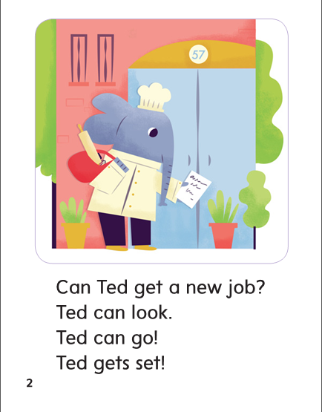

Slide 288
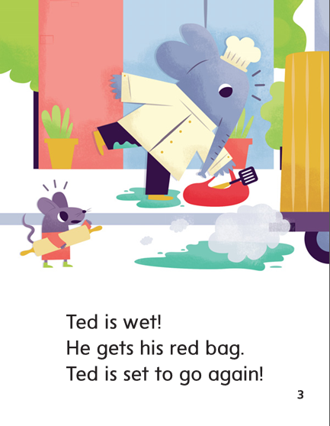

Slide 289
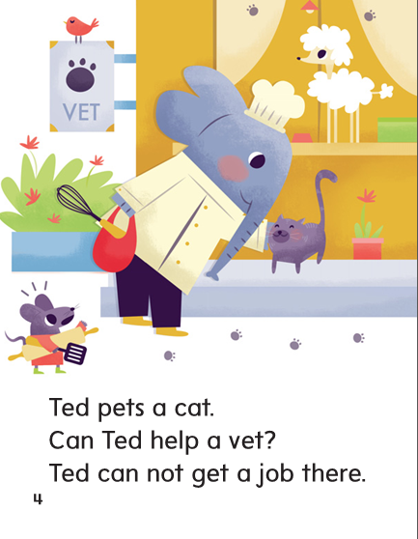

Slide 290
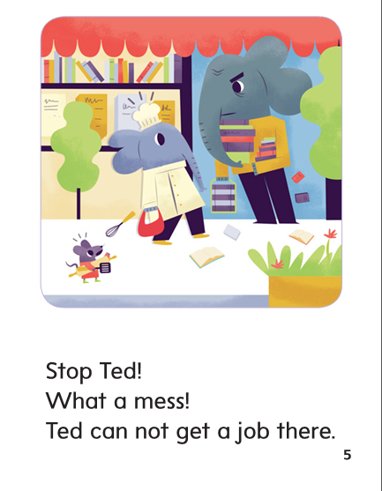

Slide 291
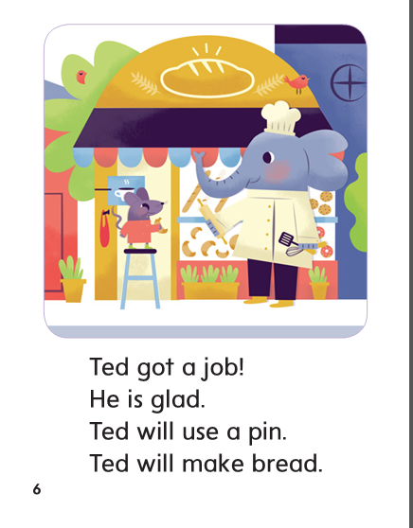

Slide 292
Structural Analysis
Adding ed to an action word makes it tell
about something that the action took place in the past.
dress
dressed
/t/
Listen for the /d/ sound at the end of yelled.

Slide 293
Structural Analysis
yell
yelled
head
headed
pack
packed
/d/
/ed/
/t/

Slide 294
Structural Analysis
grill
grilled
mix
mixed
lock
locked
/d/
/t/
/t/

Slide 295
Spelling
-eg
-en
-ead

Slide 296
leg
men
bread
head
beg
hen
grass
spin
there
again

Slide 297
High Frequency
Words

Slide 298
Read, Spell, Write
again
Rex fell down again.

Slide 299
Read, Spell, Write
help
Can you help fix this mess?

Slide 300
Read, Spell, Write
new
Will you help the new kid?

Slide 301
Read, Spell, Write
there
There is my red pen!

Slide 302
Read, Spell, Write
use
Tell Ben to use a net.

Slide 303
Grammar
A naming word is a noun. A noun names a person, place, or thing.
Hard hats keep the
men safe.
Which words name a person, place, or thing?

Slide 304
Grammar
Work with a partner to write sentences and identify the nouns.
Circle the nouns in each sentence.

Slide 305
Week 1 – Day 4

Slide 306
Phonemic Awareness – Phoneme Isolation
Listen carefully. I am going to say a word.
Then I will say the middle sound in that word.
What is the middle sound in /fffeeed/, fed?
That’s right. The middle sound in fed is /e/
Guided Practice:
I am going to say more words. Tell me the middle sound in each word.
met bed bad him yes
Bell deaf top ten neck

Slide 307
Build Words with Short e
l
e
ss
What is the new word we made?
Let’s blend all the sounds and read the word.
Change the l to m.

Slide 308
Build Words with Short e
m
e
ss
What is the new word we made?
Let’s blend all the sounds and read the word.

Slide 309
Build Words with Short e
s
e
t
What is the new word we made?
Let’s blend all the sounds and read the word.
Change the s to b.

Slide 310
Build Words with Short e
b
e
t
What is the new word we made?
Let’s blend all the sounds and read the word.
Change the s to b.

Slide 311
Build Words with Short e
b
e
t
What is the new word we made?
Let’s blend all the sounds and read the word.
Change the e to a.

Slide 312
Build Words with Short e
b
a
t
What is the new word we made?
Let’s blend all the sounds and read the word.
Change the t to d.

Slide 313
Build Words with Short e
b
a
d
What is the new word we made?
Let’s blend all the sounds and read the word.
Change the a to e.

Slide 314
Build Words with Short e
b
e
d
What is the new word we made?
Let’s blend all the sounds and read the word.
Change the b to f.

Slide 315
Build Words with Short e
f
e
d
What is the new word we made?
Let’s blend all the sounds and read the word.
Change the f to l.

Slide 316
Build Words with Short e
l
e
d
What is the new word we made?
Let’s blend all the sounds and read the word.
Change the d to t.

Slide 317
Build Words with Short e
l
e
t
What is the new word we made?
Let’s blend all the sounds and read the word.
Change the t to g.

Slide 318
Build Words with Short e
l
e
g
What is the new word we made?
Let’s blend all the sounds and read the word.
Change the g to d.

Slide 319
Build Words with Short e
l
e
d
What is the new word we made?
Let’s blend all the sounds and read the word.
Change the e to ea.

Slide 320
Build Words with Short e
l
ea
d
What is the new word we made?
Let’s blend all the sounds and read the word.
Change the l to r.

Slide 321
Build Words with Short e
r
ea
d
What is the new word we made?
Let’s blend all the sounds and read the word.
Change the r to h.

Slide 322
Build Words with Short e
h
ea
d
What is the new word we made?
Let’s blend all the sounds and read the word.
Change the h to d.

Slide 323
Build Words with Short e
d
ea
d
What is the new word we made?
Let’s blend all the sounds and read the word.
Change the last d to f.

Slide 324
Build Words with Short e
d
ea
f
What is the new word we made?
Let’s blend all the sounds and read the word.

Slide 325
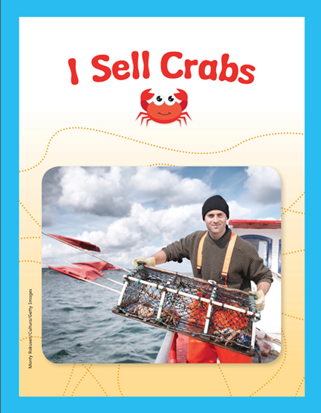

Slide 328
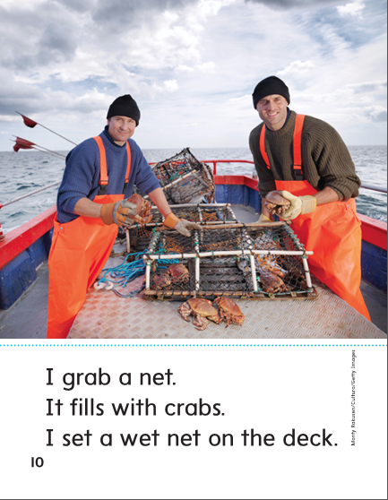

Slide 329
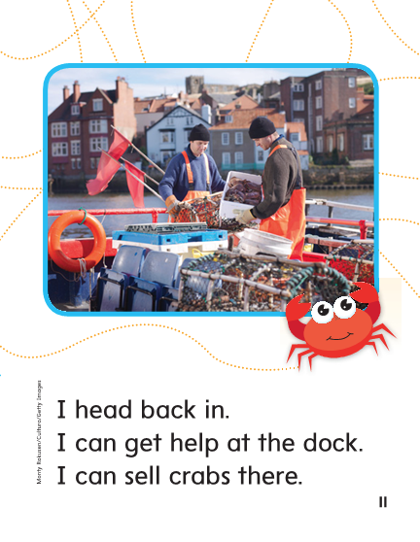

Slide 331
Structural Analysis
Remember that when –ed is added to action words,
the ending sound of the new word can be /t/, /d/, or /ed/.
spell
spelled
/d/
Listen for the /d/ sound at the end of yelled.

Slide 332
Structural Analysis
smell
trick
pack
sweat
dress
Construct words that tell about actions in the past.
Write sentences with each word.

Slide 333
High Frequency
Words

Slide 334
Read, Spell, Write
again
Rex fell down again.

Slide 335
Read, Spell, Write
help
Can you help fix this mess?

Slide 336
Read, Spell, Write
new
Will you help the new kid?

Slide 337
Read, Spell, Write
there
There is my red pen!

Slide 338
Read, Spell, Write
use
Tell Ben to use a net.

Slide 339
Grammar
A naming word is a noun. A noun names a person, place, or thing.
Name nouns you see around you.
My dad has a big red hat.
The man likes to dig up rocks.
Name the noun or nouns in these sentences.

Slide 340
Grammar
Identify the nouns.
rock sis up
dig yell mom
box bed clock

Slide 341
Week 1 – Day 5

Slide 342
Phonemic Awareness
Phoneme Blending
Listen as I say a group of sounds.
Then blend those sounds to form a word.
/m/ /e/ /n/ /l/ /e/ /s/ /b/ /e/ /d/ /n/ /e/ /k/
Phoneme Segmenting
Now I am going to say a word.
I want you to say each sound in the word.
red ten yell pen sled

Slide 343
Build Words with r-blends and s-blends
Read and say these words:
beg
fell
sled
men
bread

Slide 344
Build Words with r-blends and s-blends
l
e
g
What is the new word we made?
Let’s blend all the sounds and read the word.
Change the l to b.

Slide 345
Build Words with r-blends and s-blends
b
e
g
What is the new word we made?
Let’s blend all the sounds and read the word.
Change the b to p.

Slide 346
Build Words with r-blends and s-blends
p
e
g
What is the new word we made?
Let’s blend all the sounds and read the word.
Change the g to n.

Slide 347
Build Words with r-blends and s-blends
p
e
n
What is the new word we made?
Let’s blend all the sounds and read the word.
Change the p to m.

Slide 348
Build Words with r-blends and s-blends
m
e
n
What is the new word we made?
Let’s blend all the sounds and read the word.
Change the m to d.

Slide 349
Build Words with r-blends and s-blends
d
e
n
What is the new word we made?
Let’s blend all the sounds and read the word.
Change the d to t.

Slide 350
Build Words with r-blends and s-blends
t
e
ll
What is the new word we made?
Let’s blend all the sounds and read the word.
Change the t to b.

Slide 351
Build Words with r-blends and s-blends
b
e
ll
What is the new word we made?
Let’s blend all the sounds and read the word.
Change the b to s.

Slide 352
Build Words with r-blends and s-blends
s
e
ll
What is the new word we made?
Let’s blend all the sounds and read the word.
Change the s to w.

Slide 353
Build Words with r-blends and s-blends
w
e
ll
What is the new word we made?
Let’s blend all the sounds and read the word.
Add s to the beginning of the word.

Slide 354
Build Words with r-blends and s-blends
s
w
e
ll
What is the new word we made?
Let’s blend all the sounds and read the word.
Change the ll to t.

Slide 355
Build Words with r-blends and s-blends
s
w
ea
t
What is the new word we made?
Let’s blend all the sounds and read the word.
Change the ll to t.

Slide 356
Word Automaticity
pen

Slide 357
Jen

Slide 358
yelled

Slide 359
press

Slide 360
step

Slide 361
smelled

Slide 362
ten

Slide 363
red

Slide 364
bed

Slide 365
dressed

Slide 366
sled

Slide 367
bread

Slide 368
missed

Slide 369
bell

Slide 370
deaf

Slide 371
packed

Slide 372
sweated

Slide 373
gets

Slide 374
vet

Slide 375
smell

Slide 376
High Frequency
Words

Slide 377
Read, Spell, Write
again
Rex fell down again.

Slide 378
Read, Spell, Write
help
Can you help fix this mess?

Slide 379
Read, Spell, Write
new
Will you help the new kid?

Slide 380
Read, Spell, Write
there
There is my red pen!

Slide 381
Read, Spell, Write
use
Tell Ben to use a net.

Slide 382
Grammar
How do you know which word or words in a sentence are nouns?
A sled moves down the hill.
Identify the nouns.

Slide 383
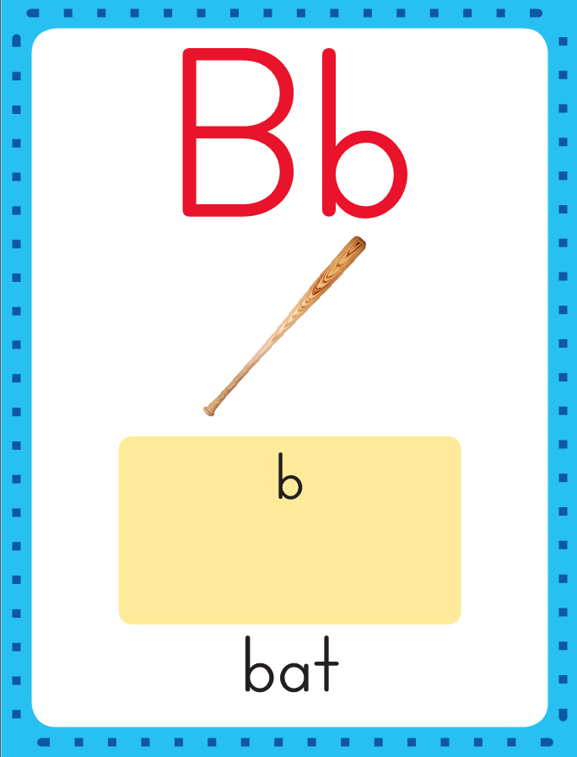
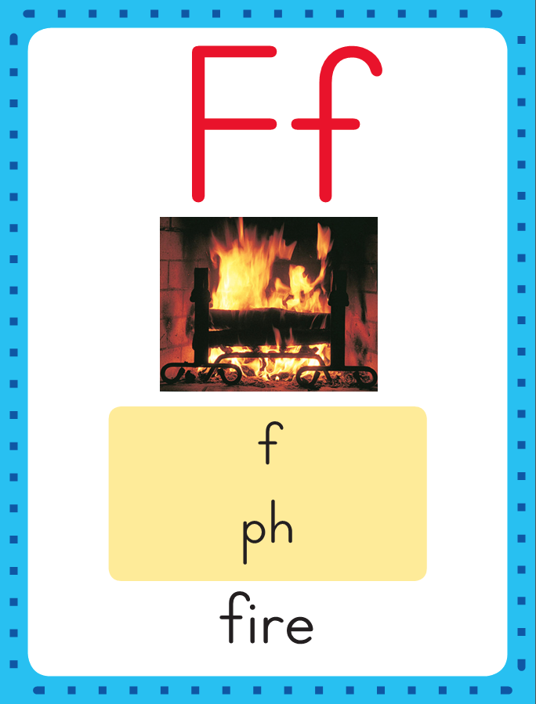
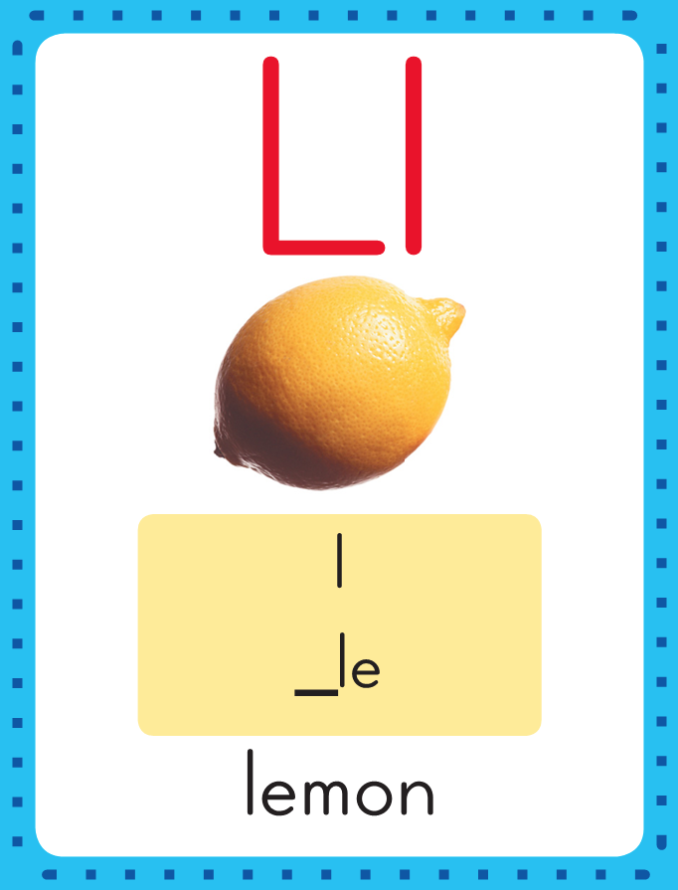
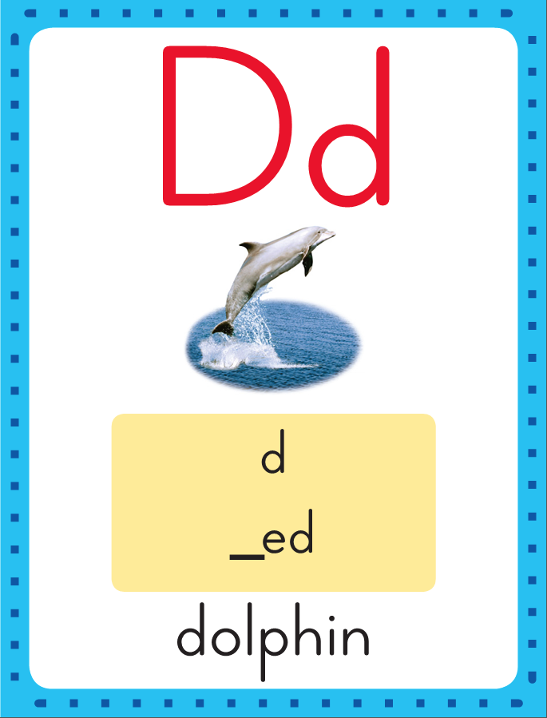
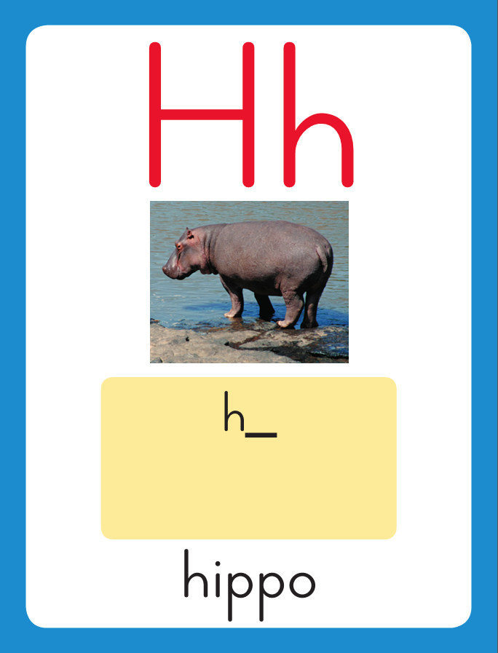
Grammar
Distribute one Sound-Spelling Card to each student.
Have each child name the pictured noun, tell whether it is a person, place, or thing, and then use the noun in a sentence.

