Slide 1
Week 1-Day 2

Slide 2
Oral Language
5
Essential Question: What do you do at school?
This week you have been talking and reading about what you do at school. Remember the children displaying their artwork in the photograph and the things Jack does at school. Discuss.

Slide 3
Oral Vocabulary Words

Slide 4
Oral Vocabulary Words

Slide 5
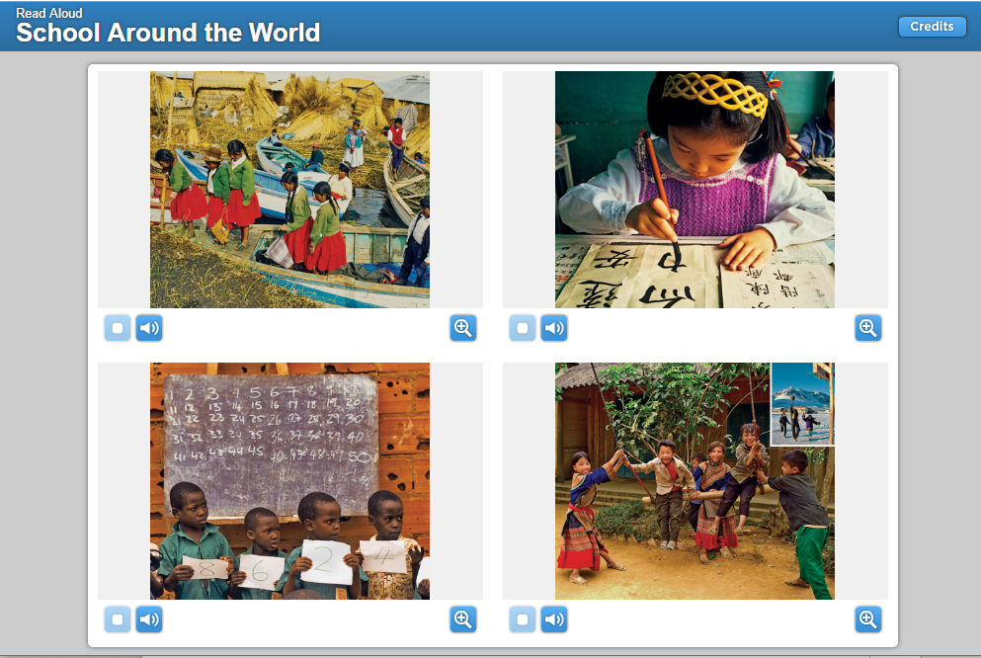
Listening Comprehension
5
When I read, I can visualize the information in the selection. That helps me better understand what I am reading. I will pay attention to the words and photographs. Then I’ll close my eyes and create a picture in my mind.

Slide 6
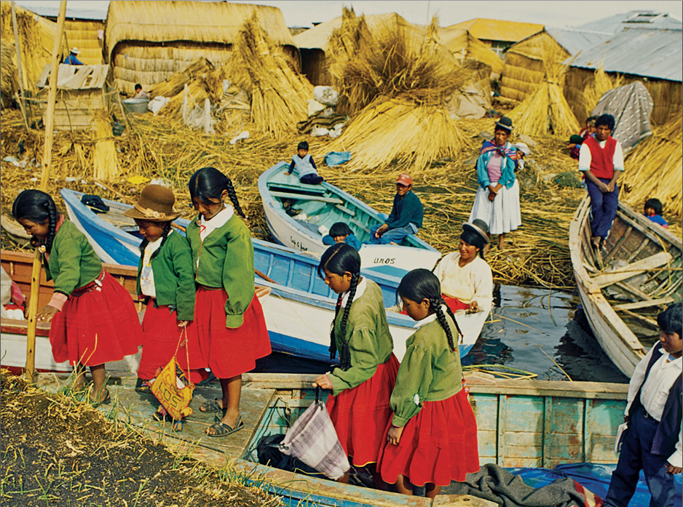
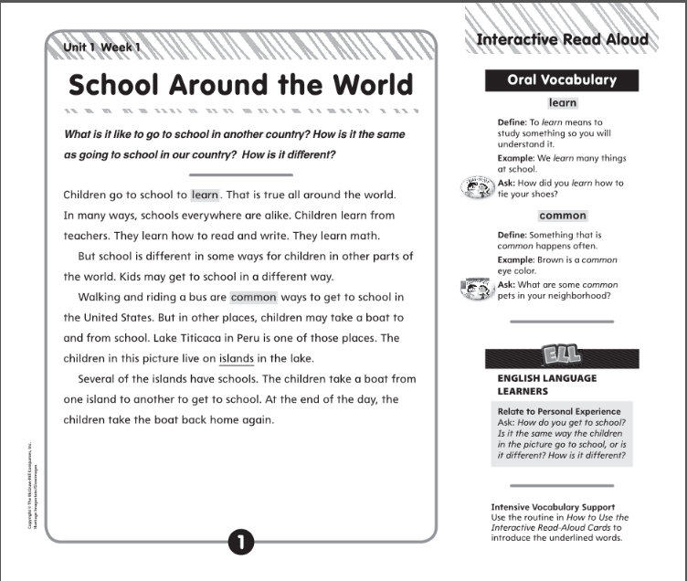

Slide 7
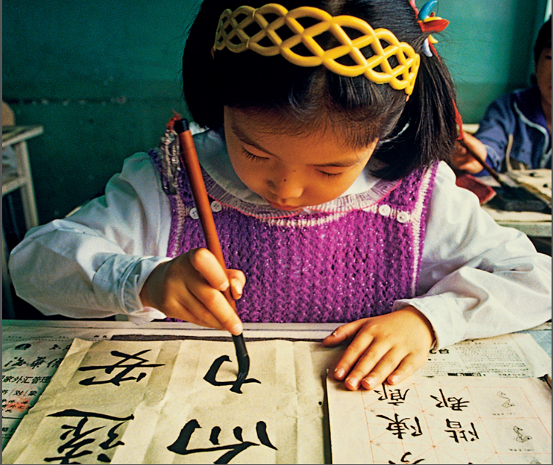
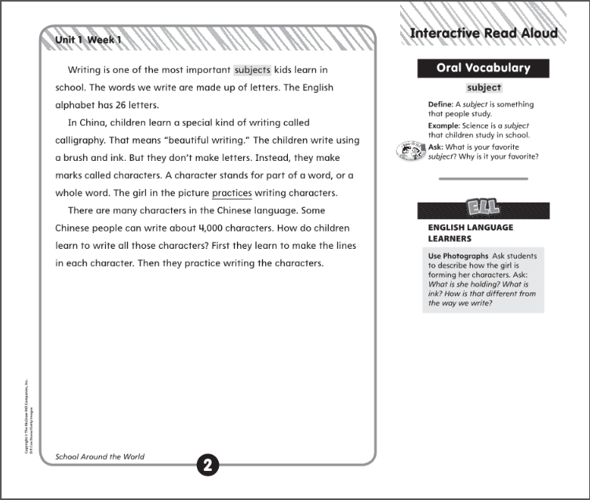

Slide 8
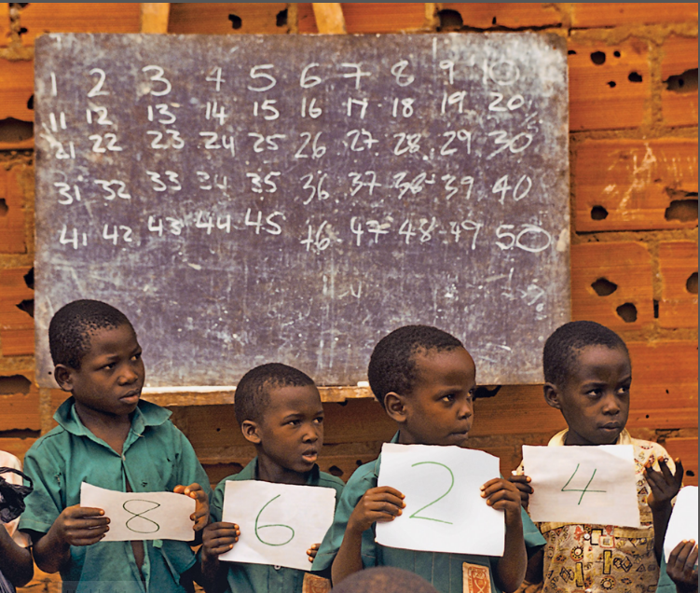
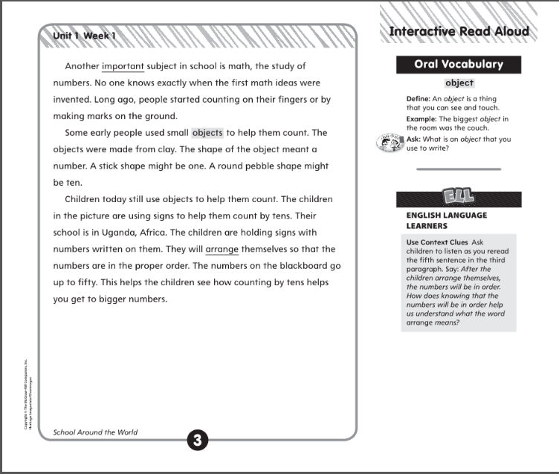

Slide 9
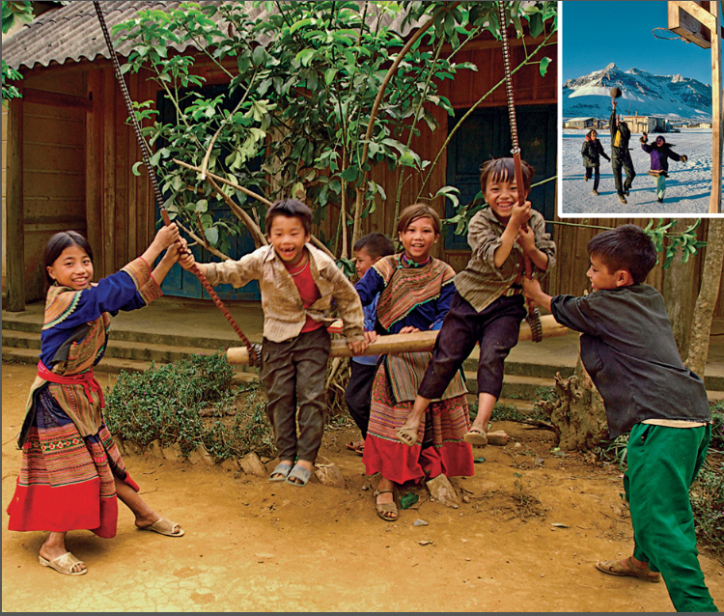
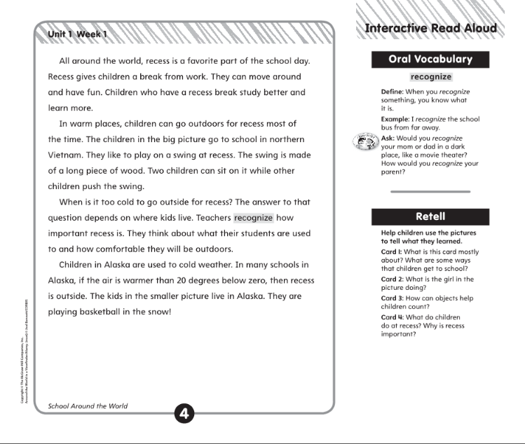
How are schools in other countries the same as our school? How are they different?

Slide 10
Phoneme Isolation
5
Listen carefully as I say a word: /aaat/.
What is the first sound in at? /aaa/
That’s right.
The word at has the /aaa/ sound at the beginning.
Have children practice isolating initial phonemes.
Do the first one together.
/aaas/
What is the first sound in as?
The words as has the /aaa/ sound at the beginning.
I’m going to say more words. Tell me the first sound you hear in each word.
as am up sit jump
mad ax an big not

Slide 11
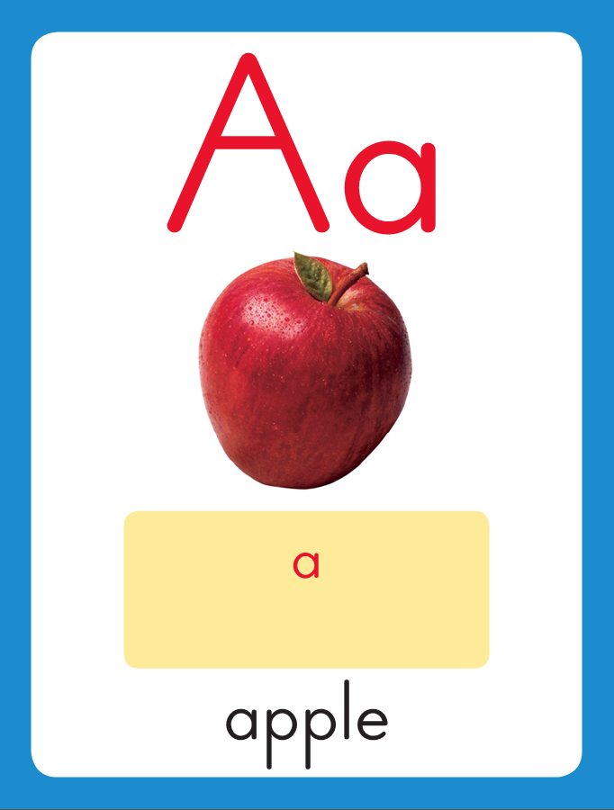
5
Introduce short a
This is the Apple Sound-Spelling Card.
The sound is /a/.
The /a/ sound is spelled with the letter a.
Say it with me: /aaa/.
This sound is at the beginning of the word apple.
Listen /aaapel/, apple
I’ll say /a/ as I write the letter several times.
an
sad

Slide 12
Introduce short a
What is this letter?
What sound does it stand for?

Slide 13
5
Blend Words with short a (I do)
s
Sound

Slide 14
s
a
Sound
Blend

Slide 15
s
a
t
Sound
Blend

Slide 16
s
a
t
Word

Slide 17
m
Sound

Slide 18
m
a
Sound
Blend

Slide 19
m
a
t
Sound
Blend

Slide 20
m
a
t
Word

Slide 21
c
Sound

Slide 22
c
a
Sound
Blend

Slide 23
c
a
n
Sound
Blend

Slide 24
c
a
n
Word

Slide 25
b
Sound

Slide 26
b
a
Sound
Blend

Slide 27
b
a
g
Sound
Blend

Slide 28
b
a
g
Word

Slide 29
a m c p n
r t s a d
h n p c a
m a t h s

Slide 30
Blend Words with short a (we do)
a

Slide 31
am

Slide 32
am c

Slide 33
am ca

Slide 34
am cap

Slide 35
am cap m

Slide 36
am cap ma

Slide 37
am cap man

Slide 38
am cap man p

Slide 39
am cap man pa

Slide 40
am cap man pan

Slide 41
am cap man pan
r

Slide 42
am cap man pan
ra

Slide 43
am cap man pan
ram

Slide 44
am cap man pan
ram n

Slide 45
am cap man pan
ram na

Slide 46
am cap man pan
ram nap

Slide 47
am cap man pan
ram nap r

Slide 48
am cap man pan
ram nap ra

Slide 49
am cap man pan
ram nap ran

Slide 50
am cap man pan
ram nap ran r

Slide 51
am cap man pan
ram nap ran ra

Slide 52
am cap man pan
ram nap ran rat

Slide 53
am cap man pan
ram nap ran rat
s

Slide 54
am cap man pan
ram nap ran rat
sa

Slide 55
am cap man pan
ram nap ran rat
sad

Slide 56
am cap man pan
ram nap ran rat
sad h

Slide 57
am cap man pan
ram nap ran rat
sad ha

Slide 58
am cap man pan
ram nap ran rat
sad has

Slide 59
am cap man pan
ram nap ran rat
sad has t

Slide 60
am cap man pan
ram nap ran rat
sad has ta

Slide 61
am cap man pan
ram nap ran rat
sad has tap

Slide 62
am cap man pan
ram nap ran rat
sad has tap p

Slide 63
am cap man pan
ram nap ran rat
sad has tap pa

Slide 64
am cap man pan
ram nap ran rat
sad has tap pat

Slide 65
Build Words with short a (I do)
White board
n
a
p
What is the new word we made?
Let’s blend all the sounds together and read the word.
Change the n to t.

Slide 66
t
a
p
What is the new word we made?
Let’s blend all the sounds together and read the word.
Change the p to n.

Slide 67
t
a
n
What is the new word we made?
Let’s blend all the sounds together and read the word.
Change the t to m.

Slide 68
Blend Words with short a (we do)
Your turn.
m
a
n
What is the new word we made?
Let’s blend all the sounds together and read the word.
Change the m to p.

Slide 69
Your turn.
White Boards
p
a
n
What is the new word we made?
Let’s blend all the sounds together and read the word.
Change the n to t.

Slide 70
Your turn.
p
a
t
What is the new word we made?
Let’s blend all the sounds together and read the word.
Change the p to r.

Slide 71
Your turn.
r
a
t
What is the new word we made?
Let’s blend all the sounds together and read the word.
Change the t to m.

Slide 72
Your turn.
r
a
m
What is the new word we made?
Let’s blend all the sounds together and read the word.
Remove the r.

Slide 73
Your turn.
a
m
What is the new word we made?
Let’s blend all the sounds together and read the word.
Change the m to t.

Slide 74
Your turn.
a
t
What is the new word we made?
Let’s blend all the sounds together and read the word.
Add an m at the beginning.

Slide 75
Your turn.
m
a
t
What is the new word we made?
Let’s blend all the sounds together and read the word.
Change the m to s.

Slide 76
Your turn.
s
a
t
What is the new word we made?
Let’s blend all the sounds together and read the word.
Change the t to p.

Slide 77
Your turn.
s
a
p
What is the new word we made?
Let’s blend all the sounds together and read the word.

Slide 78
Structural Analysis (I do)
5
tap
taps
Tell children that we add -s to an action word when it follows a naming word that names people or things like he, she, or it.

Slide 79
I tap my pencil.
He taps his pencil.
Say tap and taps again and have children listen for the /s/ sound at the end of taps.

Slide 80
Then write and say tag and tags. Point out that the letter s at the end of a word can also stand for the /z/ sound as in tags. Use each word in a sentence.
tag
tags

Slide 81
Structural Analysis (we do)
pat
Have children add –s to each word and then use each word in a sentence.

Slide 82
Structural Analysis (we do)
pat
pats
Have children add –s to each word and then use each word in a sentence.

Slide 83
Structural Analysis (we do)
nap
Have children add –s to each word and then use each word in a sentence.

Slide 84
Structural Analysis (we do)
nap
naps
Have children add –s to each word and then use each word in a sentence.

Slide 85
Structural Analysis (we do)
wag
Have children add –s to each word and then use each word in a sentence.

Slide 86
Structural Analysis (we do)
wag
wags
Have children add –s to each word and then use each word in a sentence.

Slide 87
Structural Analysis (we do)
pack
Have children add –s to each word and then use each word in a sentence.

Slide 88
Structural Analysis (we do)
pat
packs
Have children add –s to each word and then use each word in a sentence.

Slide 89
Spelling – Word Sort (-an, -ap, -at)
5
fan
lap
sat

Slide 90
Comprehension

Slide 91
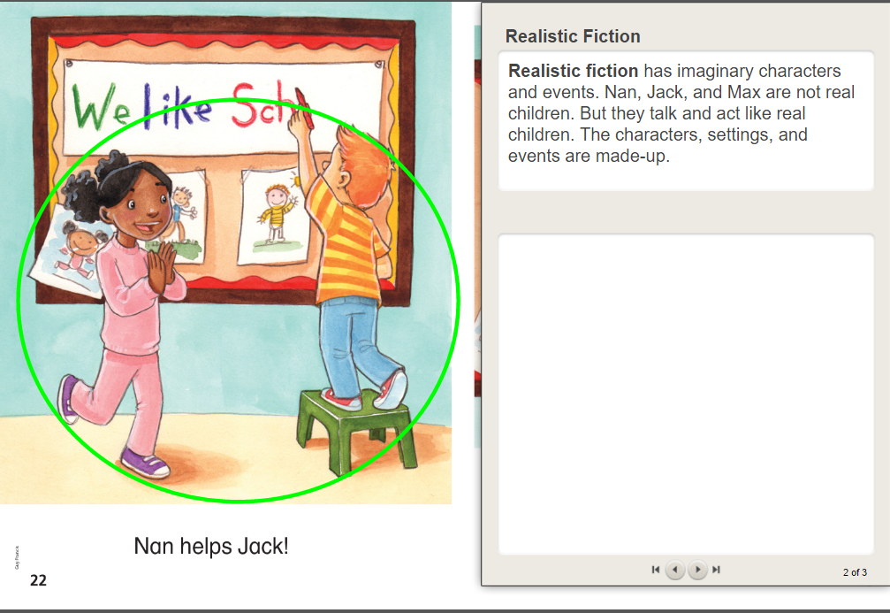

Slide 92
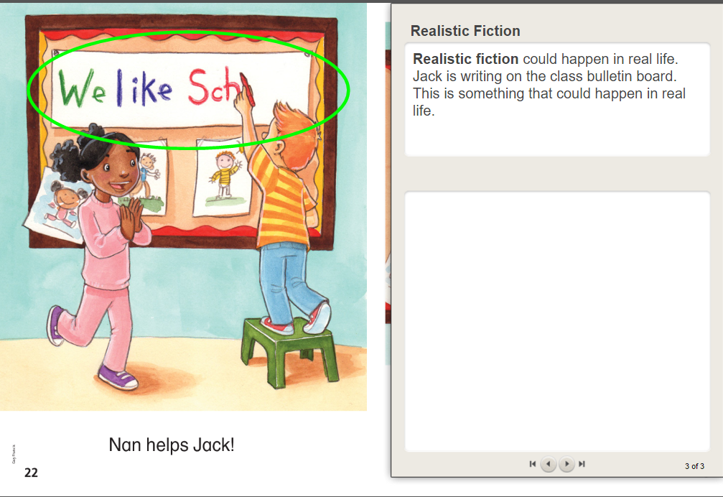

Slide 93
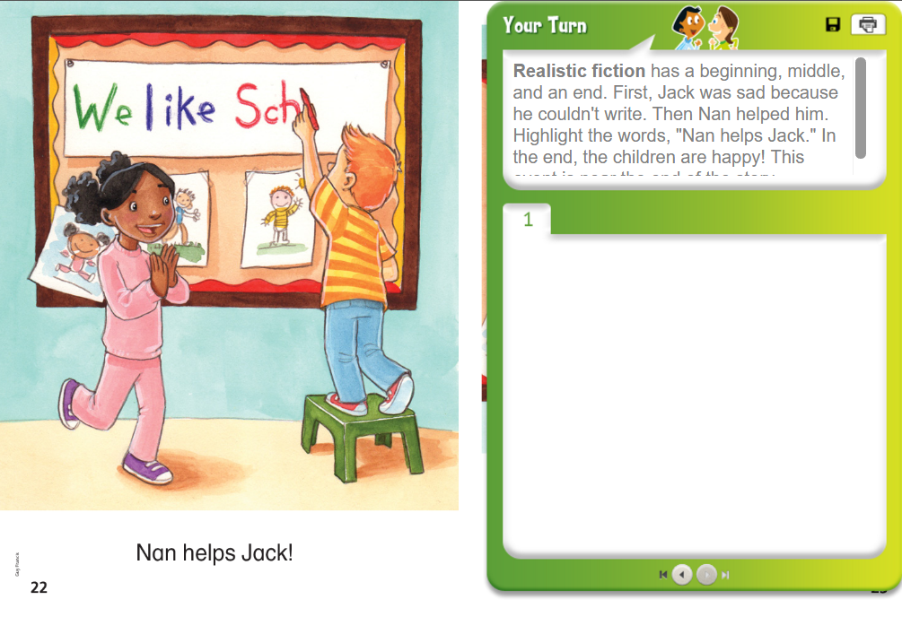

Slide 95
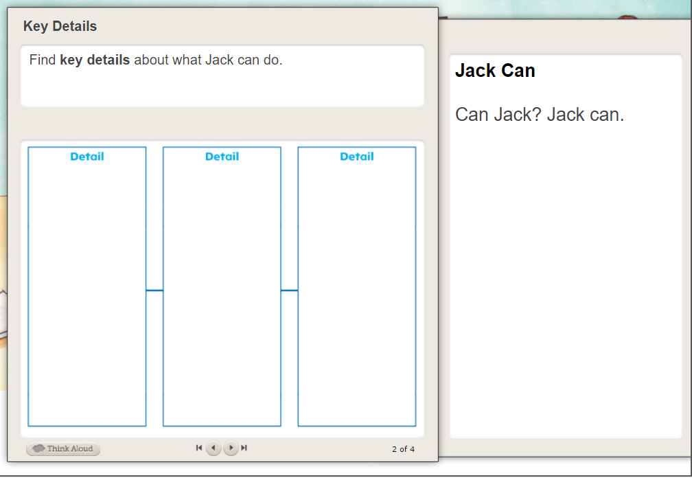

Slide 96
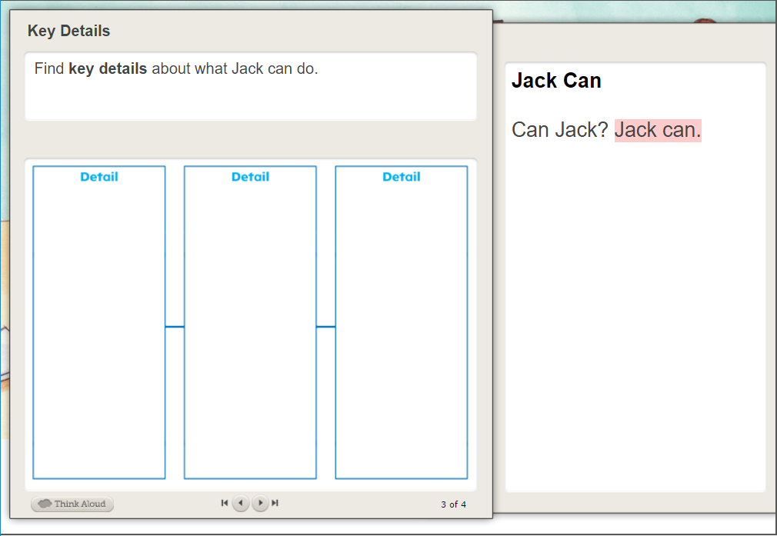

Slide 97
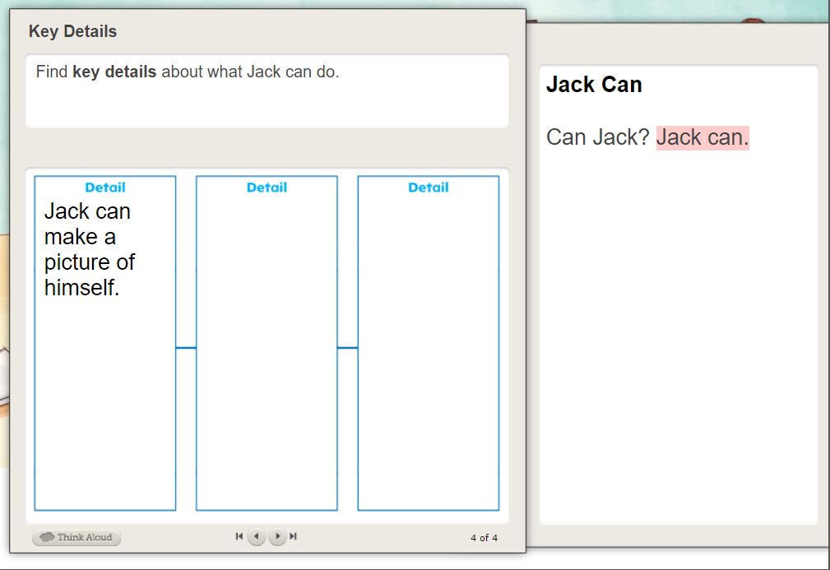

Slide 98
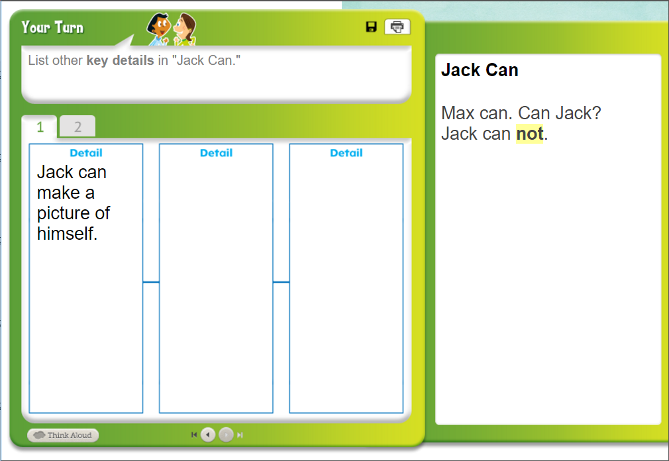
Jack can not reach.
Nan helps Jack reach.

Slide 99
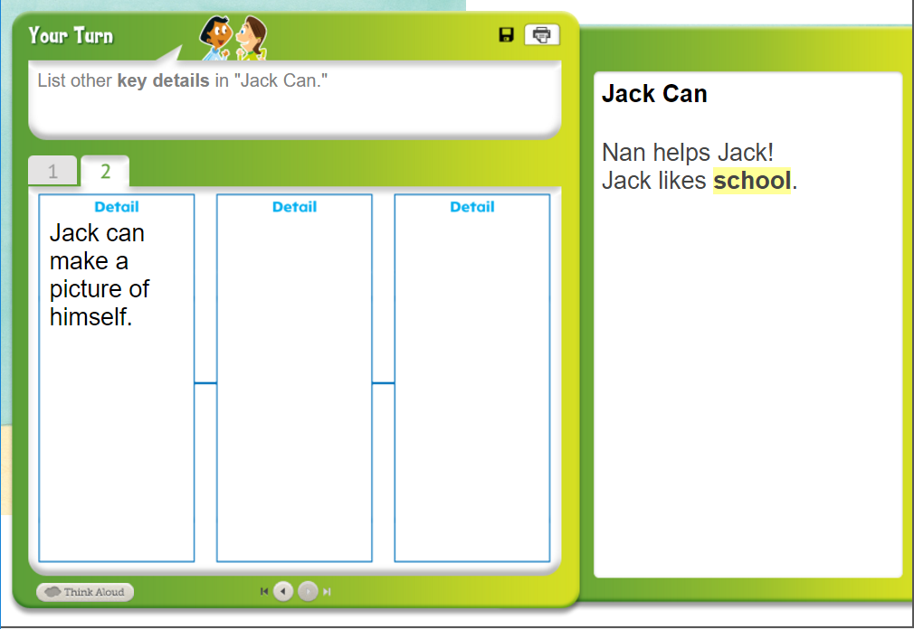

Slide 100
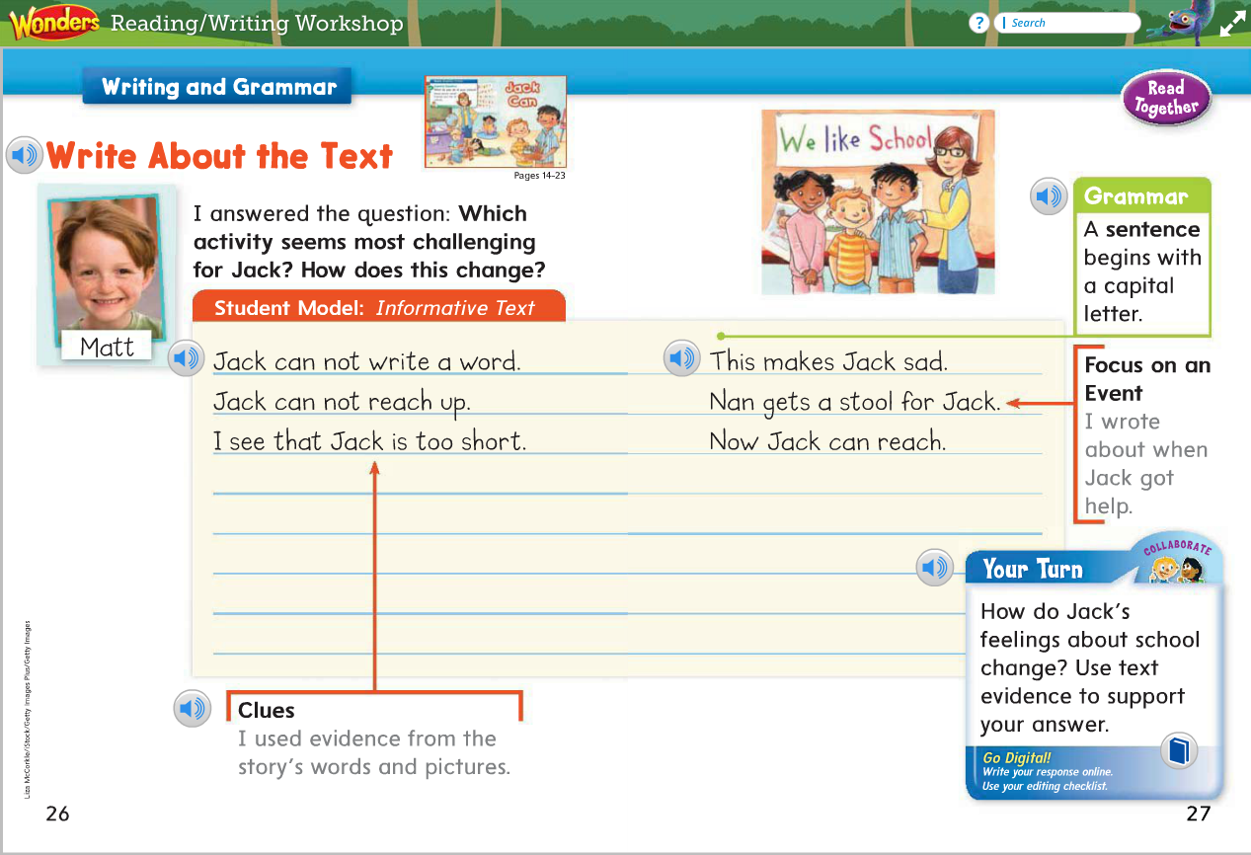
Language Arts – Interactive Writing
5

Slide 101
Find Text Evidence:
We need to find evidence in the text and illustrations and take notes. We’re looking for words and pictures that help us understand how Jack feels and how his feelings change.
Let’s reread our notes to figure out how Jack feels.
Interactive Writing
How do Jack’s feelings about school change?
Jack’s feelings about school change.
This is called a topic sentence. What are we writing about?
Guide children in forming complete sentences as you share the pen with them, using capital letters and periods.
Let’s reread what we wrote. Does our first sentence explain what we are writing about?
Did we tell what happens and how those events cause Jack’s feelings to change? Did we write complete sentences?

Slide 102
Grammar
Max ran to the cat.
The van can go.
Do these sentences tell the whole idea?

Slide 103
Grammar
Pam has a pal.
A map
Is this a sentence? Why or why not?

