Slide 1
Week 1- Day 4

Slide 2
Extend the Concept
Essential Question: What do you do at school?
This week you have been learning about what kids do at school. Discuss the question using information from what they have read and discussed. Use the Define/Example/Ask routine to review the oral vocabulary words learn, subjects, common, object, and recognize.
Discuss

Slide 3
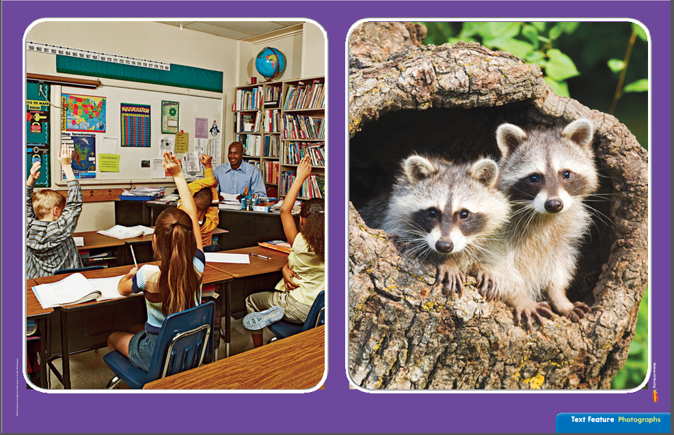
Text Feature: Photographs
Look for photographs as you read nonfiction selections to find the information in each photograph.
Nonfiction text often has photographs that go with the text. Photographs show real life. They are taken with a camera.
This photograph shows children in a classroom.
I can see that the children in the classroom are raising their hand.
How many raccoons are there?
What are they doing?

Slide 4
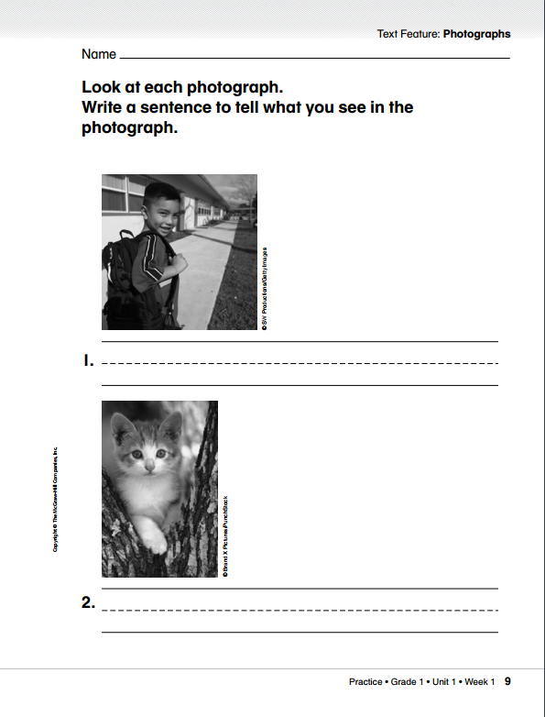
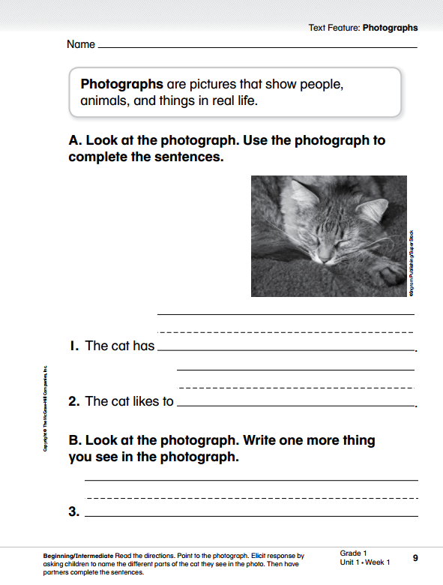

Slide 5
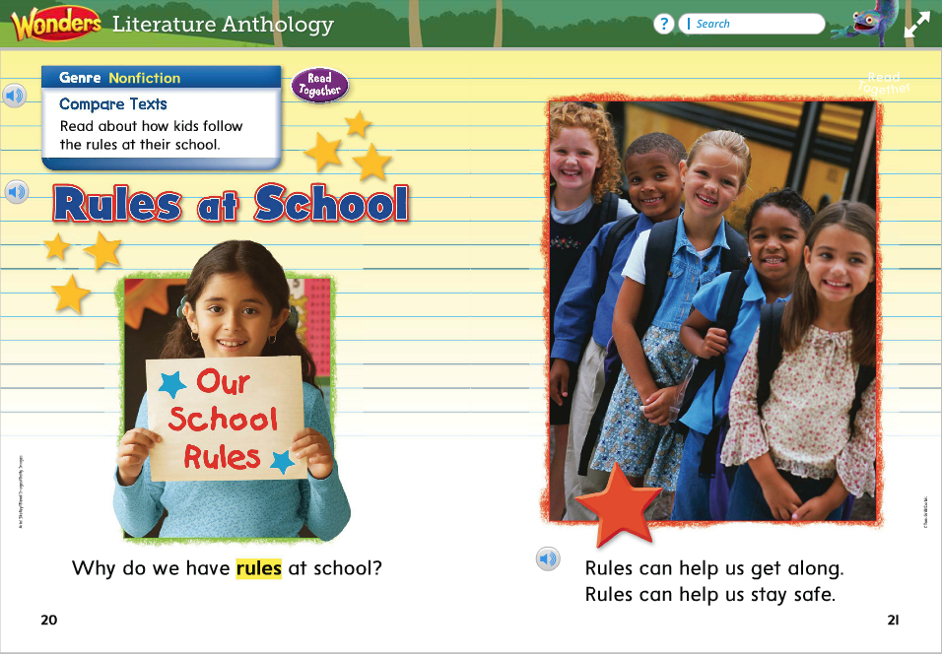
Essential Question:
What do you do at school?
Think about how the school in the photographs is like the school in Nat and Sam.
What do you see in the photograph?
How does the photograph help you understand the text on the page?
Which key detail tells you why rules are important?
5

Slide 6
When I look at this photograph, I see a boy raising his hand, He looks happy. Other children are behind him. They are raising their hands, too. I read the words: “we raise our hands.”
What does the photograph on page 23 help you understand about classroom rules?

Slide 7
Guide children to use key details to retell the selection.

Slide 9
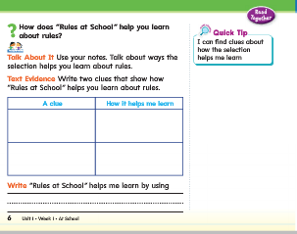

Slide 10
Phoneme Isolation
5
Show children how to isolate a phoneme in a word. Listen carefully as I say a word: /mmmaaat/, mat.
What sound do you hear in the middle of the word? That’s right! The word mat has the /aa/ sound in the middle.
I am going to say more words. Say the sound you hear in the middle of each word.
sat sit lap lip ran
mad map mop big bag

Slide 11
Build Words with Short a
5
c
a
t
What is the new word we made?
Let’s blend all the sounds together and read the word.
Change the c to s.

Slide 12
s
a
t
What is the new word we made?
Let’s blend all the sounds together and read the word.
Change the s to m.

Slide 13
m
a
t
What is the new word we made?
Let’s blend all the sounds together and read the word.
Change the m to r.

Slide 14
r
a
t
What is the new word we made?
Let’s blend all the sounds together and read the word.
Change the r to p.

Slide 15
p
a
t
What is the new word we made?
Let’s blend all the sounds together and read the word.
Change the t to n.

Slide 16
p
a
n
What is the new word we made?
Let’s blend all the sounds together and read the word.
Change the p to m.

Slide 17
m
a
n
What is the new word we made?
Let’s blend all the sounds together and read the word.
Change the m to r.

Slide 18
r
a
n
What is the new word we made?
Let’s blend all the sounds together and read the word.
Change the r to c.

Slide 19
c
a
n
What is the new word we made?
Let’s blend all the sounds together and read the word.
Change the n to p.

Slide 20
c
a
p
What is the new word we made?
Let’s blend all the sounds together and read the word.
Change the c to t.

Slide 21
t
a
p
What is the new word we made?
Let’s blend all the sounds together and read the word.

Slide 22
Decodable Reader

Slide 23
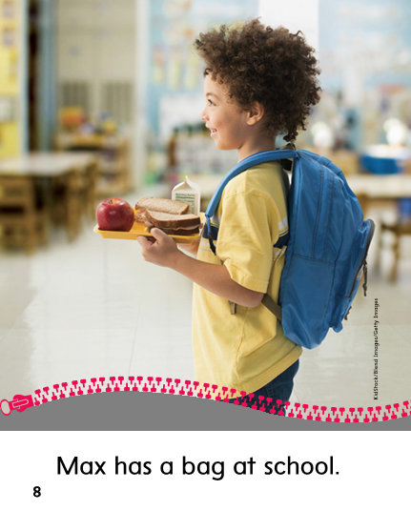
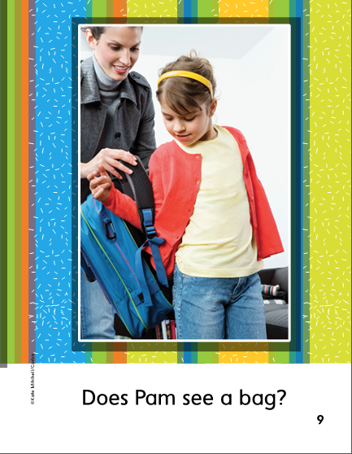

Slide 24
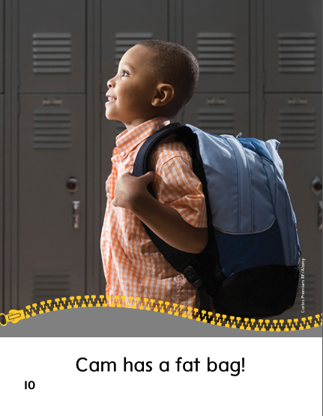
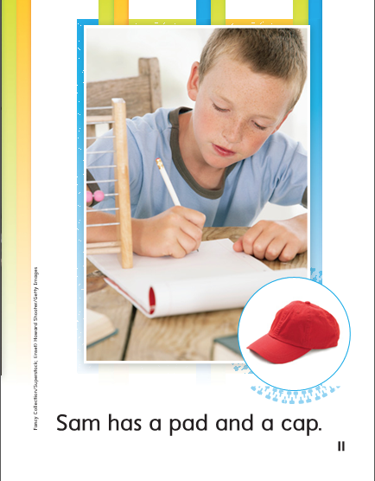

Slide 26
Spelling – Word Sort (-an, -ap, at)
5
man
can
nap
tap
cat
hat
not
does
Provide pairs of children with copies of the spelling word cards. While one partner reads the words one at a time, the other partner should orally segment the word and then write the word. After reading all the words, partners should switch roles.

Slide 27
Structural Analysis
5
tap taps
wag wags
Read these words with the children. Remind them that when –s is added to action words, the ending sound of the new word can be /s/ or /z/.

Slide 28
nap
pat
tag
pack
Have children work in pairs to construct action words ending with –s.
Then have them write sentences with each word.

Slide 29
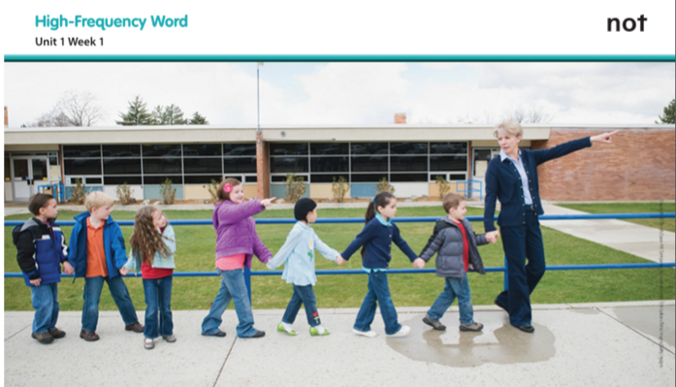
High-Frequency Words – Point to a word and call on a child to use it in a sentence.
5
does
not
school
what

Slide 30
Independent Writing
How do Nat’s feelings about school change?
Revise: Reread the prompt about Nat and Sam: How do Nat’s feelings about school change?
Have children read their drafts to see If they responded to the prompt.
Then check for:
Sentences: Did they use complete sentences with capital letters and punctuation?
Focus on a Single Event: Did their response focus on when Nat’s feelings about school changed?
Clues: Did they use clues from the text and illustrations in their response?
Peer Review: Have children work in pairs to do a peer review and read their partner’s draft. Ask partners to check for the three things mentions above.
Proofread/Edit:
Does each sentence begin with a capital letter?
Are only names and the word of each sentence capitalized?
Does every sentence end with a punctuation mark?
Peer Edit: Have partners exchange their drafts and take turns reviewing them against the checklist above.

Slide 31
Grammar
A sentence is a group of words that tells a whole idea.
How can you tell where a sentence begins and ends?
Complete the following sentence frames to make complete sentences:
A cat __________. _____________ at school.
Identify the complete sentence.
With me.
You cannot play with the bat.

Slide 32
Grammar
Have children work together to fix the sentences.
my dad is not sad.
The cat is tan.

Slide 33
Integrate Ideas
Today you will do a research project with a partner
to tell about activities they do at school.
Choose a Topic
Find Resources
Keep Track of Ideas
Create the Project:
Page for a Class Book

Slide 34
Project:
Page for a Class Book
Characteristics of a book…
Information – The book should give information about activities children do at school.
Text – A book has text that gives information.
Image – A book can have illustrations related to the text.
Each pair will create one page of a book. The page will tell about an activity they do at school. The pages will be put together into a book that everyone can share.
Have partners create a page about one activity they do at school.
- Guide them to include a drawing or photograph
- Prompt them to write a sentence about their activity

