Slide 1
Week 1 – Day 5

Slide 2
Phoneme Blending
5
Guide children to blend phonemes to form words. Listen as I say a group of sounds.
Then blend those sounds to form a word.
/m/ /a/ /t/ /k/ /a/ /t/ /d/ /a/ /d/
/s/ /a/ /t/ /b/ /a/ /d/ /m/ /a/ /n/

Slide 3
Phoneme Segmentation
Guide children to segment phonemes to words. Now I am going to say a word.
I want you to say each sound in the word.
at mat man sat sad

Slide 4
5
sat
can
man
nap
Have children read and say these words

Slide 5
white board
r
a
m
What is the new word we made?
Let’s blend all the sounds together and read the word.
Change the m to t.

Slide 6
r
a
t
What is the new word we made?
Let’s blend all the sounds together and read the word.
Change the r to c.

Slide 7
c
a
t
What is the new word we made?
Let’s blend all the sounds together and read the word.
Change the c to m.

Slide 8
m
a
t
What is the new word we made?
Let’s blend all the sounds together and read the word.
Change the t to p.

Slide 9
m
a
p
What is the new word we made?
Let’s blend all the sounds together and read the word.
Change the p to n.

Slide 10
m
a
n
What is the new word we made?
Let’s blend all the sounds together and read the word.
Change the m to f.

Slide 11
f
a
n
What is the new word we made?
Let’s blend all the sounds together and read the word.
Change the f to t.

Slide 12
t
a
n
What is the new word we made?
Let’s blend all the sounds together and read the word.
Change the n to p.

Slide 13
t
a
p
What is the new word we made?
Let’s blend all the sounds together and read the word.
Change the t to n.

Slide 14
n
a
p
What is the new word we made?
Let’s blend all the sounds together and read the word.
Change the n to c.

Slide 15
c
a
p
What is the new word we made?
Let’s blend all the sounds together and read the word.
Change the p to n.

Slide 16
c
a
n
What is the new word we made?
Let’s blend all the sounds together and read the word.
Change the c to p.

Slide 17
p
a
n
What is the new word we made?
Let’s blend all the sounds together and read the word.

Slide 18
Help the children practice word automaticity. Point to each word as children chorally read it. Test how many words children can read in one minute.
dad

Slide 19
fans

Slide 20
van

Slide 21
at

Slide 22
pats

Slide 23
am

Slide 24
man

Slide 25
pack

Slide 26
hat

Slide 27
can

Slide 28
map

Slide 29
jams

Slide 30
sags

Slide 31
cab

Slide 32
tap

Slide 33
Structural Analysis
5
Have children explain when the –s ending is used with action words.
Then have children practice writing action words with –s such as tap, nap, pack, and wag.

Slide 34
Spelling Word Sort
-an
-ap
-at

Slide 35
Spelling Test
5
__________
__________
__________
__________
__________
__________
__________
__________

Slide 36
High-Frequency Words – Have children write a sentence with each word.
5
does
not
school
what

Slide 37
Independent Writing
5
Prompt:
Think about which event shows Nat’s feelings about school have changed.
Think about which clues helped them understand how Nat felt.
Prepare: what they will say about their finished writing and drawing to the class.
Present: children will take turns giving presentations of their responses
Evaluate: Have children discuss their own presentations and evaluate their performance using the presentation rubric.
Publish: Display their writing and drawings on a bulletin board.

Slide 38
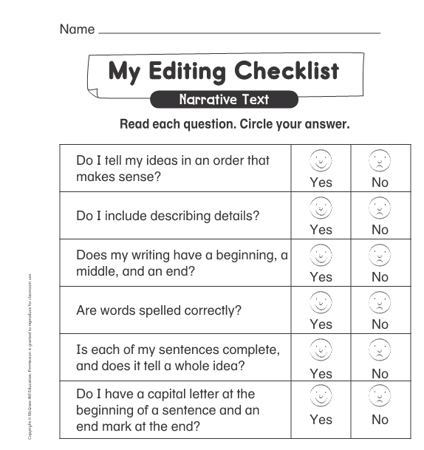

Slide 39
Grammar
Review: Define what a sentence is.
Have children tell how they know this is a complete sentence.
Sam and Yan like to play at school.
Practice: Work with a partner to turn each incomplete sentence into a complete idea.
I have a
ran to

Slide 40
Grammar
Review: Remind children that a sentence begins with a capital letter.
Practice: Have children fix the sentences.
i like to play with Jan and Pam.
we like to play tag.

Slide 41
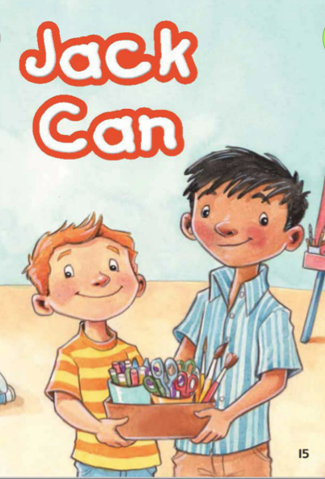
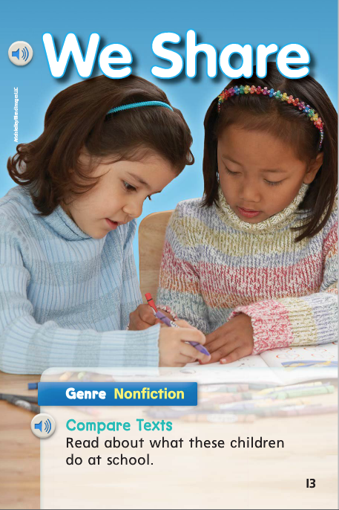
Text Connections
Essential Question: What do you do at your school?
You will need to think about all the selections you have read and the information you have learned about what children do at school.

Slide 42
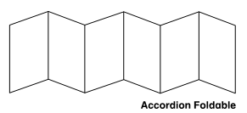
Guide children to review the selections and their completed graphic organizers. Have children work with partners to compare information from all the week’s reads.
What do you do at school?

Slide 43
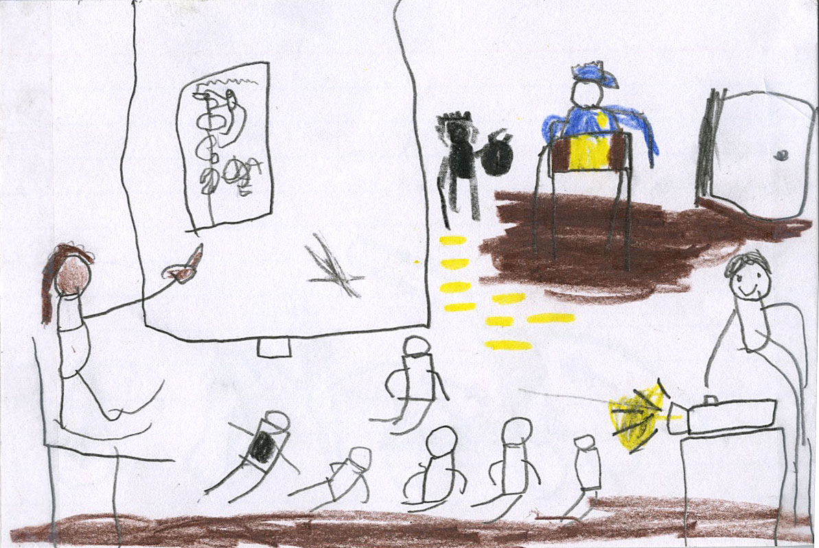
Research and Inquiry
Create a checklist and review their pages for a class book:
Does their page describe an activity children do at school?
Why did they choose that activity?
Do they wish to make any changes or add information that relates to the school activity?
Have they taken notes about what they would like to talk about when presenting their book pages to the class?
Carlos
Name ___________________
Guide partners to practice sharing their book pages with each other,
My teacher teaches us about monkeys. I like to help with the projector. Sometimes, Jorge has to sit in time out.

