Slide 1
Week 2 – Day 1

Slide 2
Phonemic Awareness
Identify and Generate Rhyme
Listen carefully as I say two words: bugs, rug.
Bug and rug rhyme because they both end with the same sounds.
Bug and rug end with /ug/.
What is another word that rhymes with bug and rug?
To figure that out, I think of words that end in /ug/.
Tug rhymes with bug and rug beause tug ends with /ug/.
Guided Practice:
I will say three words. Tell me which two words rhyme. Then say another word that rhymes with them.
plum, gum, tag bus, run, fun nut, win, but
net, up, pup hug, bug, hut tub, block, rub

Slide 3
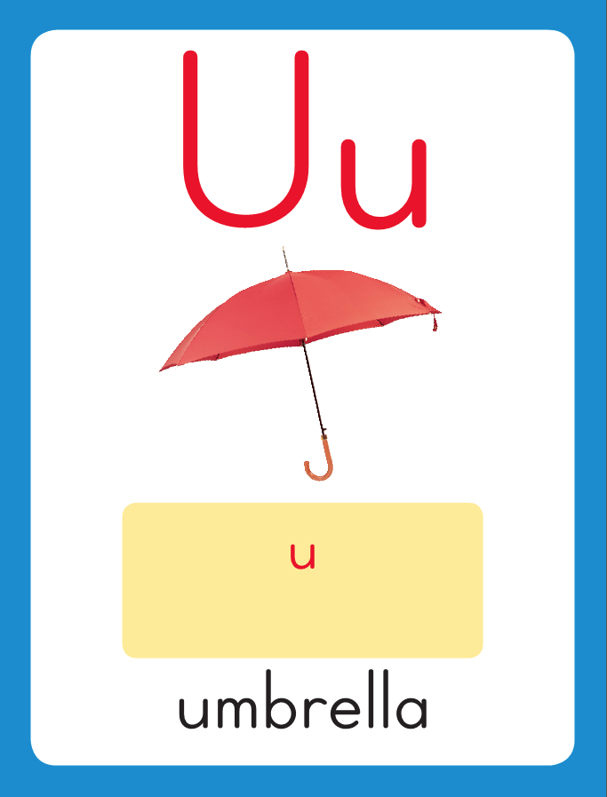
Introduce short u
This is the Umbrella Sound-Spelling Card.
The sound is /u/.
The /u/ sound is spelled with the letter u. Sometimes it is spelled with the letters ea.
Say it with me: /uuu/.
This sound is at the beginning of the word umbrella.
Listen /uuu/, umbrella.
I’ll say /u/ as I write the letter several times.

Slide 4
Introduce short u
Have children practice connecting the letter u to the sound /u/ by writing it.
Now do it with me. Say /u/ as I write the letter u.
This time, write the letter u five times as you say the /u/ sound.

Slide 5
Blending Words with Short u
f

Slide 6
Blending Words with Short u
f
u

Slide 7
Blending Words with Short u
f
u
n

Slide 8
Blending Words with Short u
f
u
n

Slide 9
Blending Words with Short u
h

Slide 10
Blending Words with Short u
h
u

Slide 11
Blending Words with Short u
h
u
g

Slide 12
Blending Words with Short u
h
u
g

Slide 13
Blending Words with Short u
n

Slide 14
Blending Words with Short u
n
u

Slide 15
Blending Words with Short u
n
u
t

Slide 16
Blending Words with Short u
n
u
t

Slide 17
Blending Words with Short u
f

Slide 18
Blending Words with Short u
f
u

Slide 19
Blending Words with Short u
f
u
zz

Slide 20
Blending Words with Short u
f
u
zz

Slide 21
Blending Words with Short u
p
l

Slide 22
Blending Words with Short u
p
l
u

Slide 23
Blending Words with Short u
p
l
u
m

Slide 24
Blending Words with Short u
p
l
u
m

Slide 25
u tr ff ck
ll ea pl st
sk dr u ed
a cl ss i
/t/

Slide 26
m

Slide 27
mu

Slide 28
mud

Slide 29
mud b

Slide 30
mud bu

Slide 31
mud bug

Slide 32
mud bug b

Slide 33
mud bug bu

Slide 34
mud bug but

Slide 35
mud bug but h

Slide 36
mud bug but hu

Slide 37
mud bug but hut

Slide 38
mud bug but hut
f

Slide 39
mud bug but hut
fu

Slide 40
mud bug but hut
fun

Slide 41
mud bug but hut
fun c

Slide 42
mud bug but hut
fun cu

Slide 43
mud bug but hut
fun cub

Slide 44
mud bug but hut
fun cub u

Slide 45
mud bug but hut
fun cub up

Slide 46
mud bug but hut
fun cub up u

Slide 47
mud bug but hut
fun cub up us

Slide 48
mud bug but hut
fun cub up us
d

Slide 49
mud bug but hut
fun cub up us
du

Slide 50
mud bug but hut
fun cub up us
duck

Slide 51
mud bug but hut
fun cub up us
duck y

Slide 52
mud bug but hut
fun cub up us
duck yu

Slide 53
mud bug but hut
fun cub up us
duck yuck

Slide 54
mud bug but hut
fun cub up us
duck yuck st

Slide 55
mud bug but hut
fun cub up us
duck yuck stu

Slide 56
mud bug but hut
fun cub up us
duck yuck stuff

Slide 57
Internal Sounding Out
rug

Slide 58
Internal Sounding Out
rug rag

Slide 59
Internal Sounding Out
rug rag luck

Slide 60
Internal Sounding Out
rug rag luck lock

Slide 61
Internal Sounding Out
rug rag luck lock
truck

Slide 62
Internal Sounding Out
rug rag luck lock
truck track

Slide 63
Internal Sounding Out
rug rag luck lock
truck track yelled

Slide 64
Internal Sounding Out
rug rag luck lock
truck track yelled
drum

Slide 65
Internal Sounding Out
rug rag luck lock
truck track yelled
drum skill

Slide 66
Internal Sounding Out
rug rag luck lock
truck track yelled
drum skill puffed

Slide 67
Russ

Slide 68
Russ is

Slide 69
Russ is as

Slide 70
Russ is as snug

Slide 71
Russ is as snug as

Slide 72
Russ is as snug as a

Slide 73
Russ is as snug as a bug

Slide 74
Russ is as snug as a bug in

Slide 75
Russ is as snug as a bug in his

Slide 76
Russ is as snug as a bug in his bed.

Slide 77
Russ is as snug as a bug in his bed.
Gus

Slide 78
Russ is as snug as a bug in his bed.
Gus plays

Slide 79
Russ is as snug as a bug in his bed.
Gus plays drums

Slide 80
Russ is as snug as a bug in his bed.
Gus plays drums and

Slide 81
Russ is as snug as a bug in his bed.
Gus plays drums and hums

Slide 82
Russ is as snug as a bug in his bed.
Gus plays drums and hums in

Slide 83
Russ is as snug as a bug in his bed.
Gus plays drums and hums in the

Slide 84
Russ is as snug as a bug in his bed.
Gus plays drums and hums in the sun.

Slide 85
A

Slide 86
A hen

Slide 87
A hen clucks,

Slide 88
A hen clucks, but

Slide 89
A hen clucks, but a

Slide 90
A hen clucks, but a duck

Slide 91
A hen clucks, but a duck quacks!

Slide 92
Spelling / Dictation
1.
2.
3.
4.
5.
bug
run
cut
rug
fun

Slide 93
High Frequency
Words

Slide 94
Read, Spell, Write
could
Could you pass the nuts, please?

Slide 95
Read, Spell, Write
live
Does a fox live in a den?

Slide 96
Read, Spell, Write
one
There is one frog on the log.

Slide 97
Read, Spell, Write
then
What did you do then?

Slide 98
Read, Spell, Write
three
Three black dogs run in the grass.

Slide 99
Have children read the sentences. Prompt them to identify the high-frequency words in connected text and to blend the decodable words.
I could pull a big sled.
Does a fox live in a den?
There is one frog on the log.
What did you do then?
Three black dos run in the grass.

Slide 100
Grammar
A singular noun names one person, one place, or one thing.
Some nouns name more than one person, place, or thing.
These are plural nouns. Usually you make a noun plural by adding –s to the end.
The cat is big.
The three cats nap.

Slide 101
Grammar
If a noun ends in –x, -s, or –ss, you add –es to make the plural form.
box - boxes
bus - buses
boss - bosses

Slide 102
Grammar
Identify the noun that completes each sentence
and identify it as singular or plural.
The six (duck/ducks have many (brick/bricks).

Slide 103
Grammar
Identify the noun that completes each sentence
and identify it as singular or plural.
A frog got a lot of (kiss/kisses).

Slide 104
Week 1 – Day 2

Slide 105
Phonemic Awareness – Phoneme Identity
Listen as I say three words: mud, cub, fun.
I hear the same sound in the middle of mud, cub, and fun.
Listen: /muuud/, /kuuub/,/fuuun/.
The middle sound is /u/.
Guided Practice:
Listen as I say three words. Tell me the sound you hear in all three words.
Let’s do the first one together.
Listen: /suuub/, /yuuum/, /fuuus/.
sub, yum, fuss bus, nut, huff yes, fell, bed
bat, man, cap hum, but, run hot, log, sock

Slide 106
Introduce short i
What is this letter?
What sound does it stand for?
us
This is the Umbrella Sound-Spelling Card.
The sound is /u/.
The /u/ sound is spelled with the letter u. Sometimes it is spelled with the letters ea.
Say it with me: /uuu/.
This sound is at the beginning of the word umbrella.
Listen /uuu/, umbrella.
I’ll say /u/ as I write the letter several times.
bug
What are these letters?
What sound do they stand for?

Slide 107
Blending Words with Short u
s

Slide 108
Blending Words with Short u
s
u

Slide 109
Blending Words with Short u
s
u
n

Slide 110
Blending Words with Short u
s
u
n

Slide 111
Blending Words with Short u
b

Slide 112
Blending Words with Short u
b
u

Slide 113
Blending Words with Short u
b
u
zz

Slide 114
Blending Words with Short u
b
u
zz

Slide 115
Blending Words with Short u
l

Slide 116
Blending Words with Short u
l
u

Slide 117
Blending Words with Short u
l
u
ck

Slide 118
Blending Words with Short u
l
u
ck

Slide 119
Blending Words with Short u
c
l

Slide 120
Blending Words with Short u
c
l
u

Slide 121
Blending Words with Short u
c
l
u
b

Slide 122
Blending Words with Short u
c
l
u
b

Slide 123
Blending Words with Short u
t
r

Slide 124
Blending Words with Short u
t
r
u

Slide 125
Blending Words with Short u
t
r
u
ck

Slide 126
Blending Words with Short u
t
r
u
ck

Slide 127
t

Slide 128
tu

Slide 129
tub

Slide 130
tub r

Slide 131
tub ru

Slide 132
tub rug

Slide 133
tub rug h

Slide 134
tub rug hu

Slide 135
tub rug hug

Slide 136
tub rug hug c

Slide 137
tub rug hug cu

Slide 138
tub rug hug cup

Slide 139
tub rug hug cup
m

Slide 140
tub rug hug cup
mu

Slide 141
tub rug hug cup
mug

Slide 142
tub rug hug cup
mug sn

Slide 143
tub rug hug cup
mug snu

Slide 144
tub rug hug cup
mug snug

Slide 145
tub rug hug cup
mug snug dr

Slide 146
tub rug hug cup
mug snug dru

Slide 147
tub rug hug cup
mug snug drum

Slide 148
tub rug hug cup
mug snug drum
pl

Slide 149
tub rug hug cup
mug snug drum
plu

Slide 150
tub rug hug cup
mug snug drum
pluck

Slide 151
tub rug hug cup
mug snug drum
pluck str

Slide 152
tub rug hug cup
mug snug drum
pluck stru

Slide 153
tub rug hug cup
mug snug drum
pluck struck

Slide 154
tub rug hug cup
mug snug drum
pluck struck h

Slide 155
tub rug hug cup
mug snug drum
pluck struck hu

Slide 156
tub rug hug cup
mug snug drum
pluck struck huff

Slide 157
Build Words with Short u
c
u
t
What is the new word we made?
Let’s blend all the sounds and read the word.
Change the c to h.

Slide 158
Build Words with Short u
h
u
t
What is the new word we made?
Let’s blend all the sounds and read the word.
Change the t to m.

Slide 159
Build Words with Short u
h
u
m
What is the new word we made?
Let’s blend all the sounds and read the word.
Change the m to ff.

Slide 160
Build Words with Short u
h
u
ff
What is the new word we made?
Let’s blend all the sounds and read the word.
Change the h to p.

Slide 161
Build Words with Short u
p
u
ff
What is the new word we made?
Let’s blend all the sounds and read the word.
Change the ff to p.

Slide 162
Build Words with Short u
p
u
p
What is the new word we made?
Let’s blend all the sounds and read the word.
Change the first p to c.

Slide 163
Build Words with Short u
c
u
p
What is the new word we made?
Let’s blend all the sounds and read the word.
Change the first p to b.

Slide 164
Build Words with Short u
c
u
b
What is the new word we made?
Let’s blend all the sounds and read the word.
Put an l after the c.

Slide 165
Build Words with Short u
c
l
u
b
What is the new word we made?
Let’s blend all the sounds and read the word.
Change the b to ck.

Slide 166
Build Words with Short u
c
l
u
ck
What is the new word we made?
Let’s blend all the sounds and read the word.
Change the c to p.

Slide 167
Build Words with Short u
p
l
u
ck
What is the new word we made?
Let’s blend all the sounds and read the word.
Change the ck to m.

Slide 168
Build Words with Short u
p
l
u
m
What is the new word we made?
Let’s blend all the sounds and read the word.
Change the m to g.

Slide 169
Build Words with Short u
p
l
u
g
What is the new word we made?
Let’s blend all the sounds and read the word.

Slide 170
Structural Analysis
He’s is a contraction.
A contraction is when you put two words together to make one word.
he is - he’s
He’s is a shorter way of writing and saying he is.
The apostrophe (‘) stands for the missing letter i in is.
You leave out one or more letters when you make a contraction.

Slide 171
Structural Analysis
A contraction is when you put two words together to make one word.
she is - she’s it is - it’s
The apostrophe (‘) stands for the missing letter i in is.
You leave out one or more letters when you make a contraction.

Slide 172
Structural Analysis
he’s
she’s
it’s
/z/
/s/
Use each word in a sentence.

Slide 173
Structural Analysis
he is ______
she is ______
it is ______
Write the contraction for each word and
then use the contraction in a sentence.

Slide 174
bun
hut
dug

Slide 175
run
run
run
nut
nut
nut
bug
bug
bug
fun
fun
fun
cut
cut
cut
rug
rug
rug

Slide 176
High Frequency
Words

Slide 177
Read, Spell, Write
could
Could you pass the nuts, please?

Slide 178
Read, Spell, Write
live
Does a fox live in a den?

Slide 179
Read, Spell, Write
one
There is one frog on the log.

Slide 180
Read, Spell, Write
then
What did you do then?

Slide 181
Read, Spell, Write
three
Three black dogs run in the grass.

Slide 182
Grammar
A singular noun names one person, one place, or one thing.
Some nouns name more than one person, place, or thing.
These are plural nouns. Usually you make a noun plural by adding –s to the end.
When a noun ends with –x, -s, or –ss, you add –es.
The kids make a school out of blocks.
Identify each noun and tell if it is singular or plural.

Slide 183
Grammar
If a noun ends in –x, -s, or –ss, you add –es to make the plural form.
box - boxes
bus - buses
boss - bosses

Slide 184
Grammar
Identify the noun that completes each sentence
and identify it as singular or plural.
The six (duck/ducks have many (brick/bricks).

Slide 185
Grammar
Identify the noun that completes each sentence
and identify it as singular or plural.
A frog got a lot of (kiss/kisses).

Slide 186
Week 1 – Day 3

Slide 187
Phonemic Awareness – Phoneme Blending
I am going to put one marker in each box as I say each sound.
Then I will blend the sounds to form a word.
Place a marker for each sound as you say: /m/ /u/ /g/.
/m/
/u/
/g/
This word has three sounds: /m/ /u/ /g/.
Listen as I blend these sounds to form a word: /mmmuuug/, mug.
The word is mug.

Slide 188
Phonemic Awareness – Phoneme Blending
/m/
/u/
/g/
/u/ /p/ /f/ /u/ /n/ /p/ /l/ /u/ /m/
/k/ /u/ /p/ /d/ /r/ /u/ /m/ /s/ /t/ /u/ /k/

Slide 189
Blending Words with Short u
s
n

Slide 190
Blending Words with Short u
s
n
u

Slide 191
Blending Words with Short u
s
n
u
g

Slide 192
Blending Words with Short u
s
n
u
g

Slide 193
Blending Words with Short u
p
l

Slide 194
Blending Words with Short u
p
l
u

Slide 195
Blending Words with Short u
p
l
u
m

Slide 196
Blending Words with Short u
p
l
u
m

Slide 197
Blending Words with Short u
d

Slide 198
Blending Words with Short u
d
u

Slide 199
Blending Words with Short u
d
u
ck

Slide 200
Blending Words with Short u
d
u
ck

Slide 201
Blending Words with Short u
u

Slide 202
Blending Words with Short u
u
p

Slide 203
Blending Words with Short u
u
p

Slide 204
u st ck ff
dr pl o tr
sn a fl ss

Slide 205
y

Slide 206
yu

Slide 207
yuck

Slide 208
yuck m

Slide 209
yuck mu

Slide 210
yuck mud

Slide 211
yuck mud h

Slide 212
yuck mud hu

Slide 213
yuck mud huff

Slide 214
yuck mud huff st

Slide 215
yuck mud huff stu

Slide 216
yuck mud huff stuff

Slide 217
yuck mud huff stuff
dr

Slide 218
yuck mud huff stuff
dru

Slide 219
yuck mud huff stuff
drum

Slide 220
yuck mud huff stuff
drum sn

Slide 221
yuck mud huff stuff
drum snu

Slide 222
yuck mud huff stuff
drum snug

Slide 223
yuck mud huff stuff
drum snug b

Slide 224
yuck mud huff stuff
drum snug bu

Slide 225
yuck mud huff stuff
drum snug bug

Slide 226
yuck mud huff stuff
drum snug bug pl

Slide 227
yuck mud huff stuff
drum snug bug plu

Slide 228
yuck mud huff stuff
drum snug bug plug

Slide 229
yuck mud huff stuff
drum snug bug plug
c

Slide 230
yuck mud huff stuff
drum snug bug plug
cu

Slide 231
yuck mud huff stuff
drum snug bug plug
cub

Slide 232
yuck mud huff stuff
drum snug bug plug
cub f

Slide 233
yuck mud huff stuff
drum snug bug plug
cub fu

Slide 234
yuck mud huff stuff
drum snug bug plug
cub fun

Slide 235
yuck mud huff stuff
drum snug bug plug
cub fun h

Slide 236
yuck mud huff stuff
drum snug bug plug
cub fun hu

Slide 237
yuck mud huff stuff
drum snug bug plug
cub fun hut

Slide 238
yuck mud huff stuff
drum snug bug plug
cub fun huts

Slide 239
yuck mud huff stuff
drum snug bug plug
cub fun huts st

Slide 240
yuck mud huff stuff
drum snug bug plug
cub fun huts stu

Slide 241
yuck mud huff stuff
drum snug bug plug
cub fun huts stuck

Slide 242
yuck mud huff stuff
drum snug bug plug
cub fun huts stuck
p

Slide 243
yuck mud huff stuff
drum snug bug plug
cub fun huts stuck
pu

Slide 244
yuck mud huff stuff
drum snug bug plug
cub fun huts stuck
puff

Slide 245
yuck mud huff stuff
drum snug bug plug
cub fun huts stuck
puff gr

Slide 246
yuck mud huff stuff
drum snug bug plug
cub fun huts stuck
puff gru

Slide 247
yuck mud huff stuff
drum snug bug plug
cub fun huts stuck
puff gruff

Slide 248
yuck mud huff stuff
drum snug bug plug
cub fun huts stuck
puff gruff dr

Slide 249
yuck mud huff stuff
drum snug bug plug
cub fun huts stuck
puff gruff dre

Slide 250
yuck mud huff stuff
drum snug bug plug
cub fun huts stuck
puff gruff dress

Slide 251
yuck mud huff stuff
drum snug bug plug
cub fun huts stuck
puff gruff dress pl

Slide 252
yuck mud huff stuff
drum snug bug plug
cub fun huts stuck
puff gruff dress plu

Slide 253
yuck mud huff stuff
drum snug bug plug
cub fun huts stuck
puff gruff dress pluck

Slide 254
Internal Sounding Out
it’s

Slide 255
Internal Sounding Out
it’s she’s

Slide 256
Internal Sounding Out
it’s she’s he’s

Slide 257
Internal Sounding Out
it’s she’s he’s
let’s

Slide 258
Internal Sounding Out
it’s she’s he’s
let’s what’s

Slide 259
Internal Sounding Out
it’s she’s he’s
let’s what’s
buzz

Slide 260
Internal Sounding Out
it’s she’s he’s
let’s what’s
buzz track

Slide 261
Internal Sounding Out
it’s she’s he’s
let’s what’s
buzz track truck

Slide 262
Internal Sounding Out
it’s she’s he’s
let’s what’s
buzz track truck
clock

Slide 263
Internal Sounding Out
it’s she’s he’s
let’s what’s
buzz track truck
clock cluck

Slide 264
Internal Sounding Out
it’s she’s he’s
let’s what’s
buzz track truck
clock cluck puffed

Slide 265
Gus

Slide 266
Gus dug

Slide 267
Gus dug in

Slide 268
Gus dug in the

Slide 269
Gus dug in the mud

Slide 270
Gus dug in the mud with

Slide 271
Gus dug in the mud with us.

Slide 272
Gus dug in the mud with us.
Bud

Slide 273
Gus dug in the mud with us.
Bud huffs

Slide 274
Gus dug in the mud with us.
Bud huffs and

Slide 275
Gus dug in the mud with us.
Bud huffs and puffs

Slide 276
Gus dug in the mud with us.
Bud huffs and puffs as

Slide 277
Gus dug in the mud with us.
Bud huffs and puffs as he

Slide 278
Gus dug in the mud with us.
Bud huffs and puffs as he runs

Slide 279
Gus dug in the mud with us.
Bud huffs and puffs as he runs up

Slide 280
Gus dug in the mud with us.
Bud huffs and puffs as he runs up a

Slide 281
Gus dug in the mud with us.
Bud huffs and puffs as he runs up a hill.

Slide 282
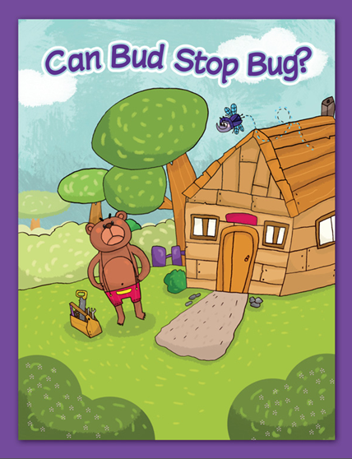

Slide 283
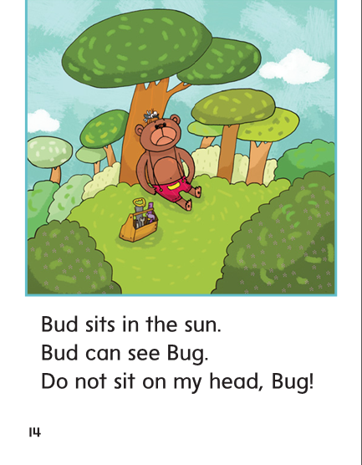

Slide 284
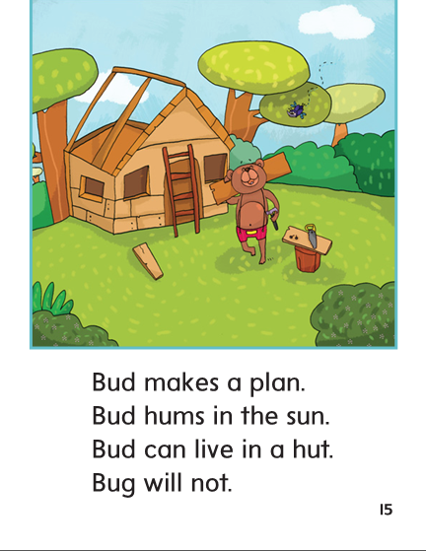

Slide 285
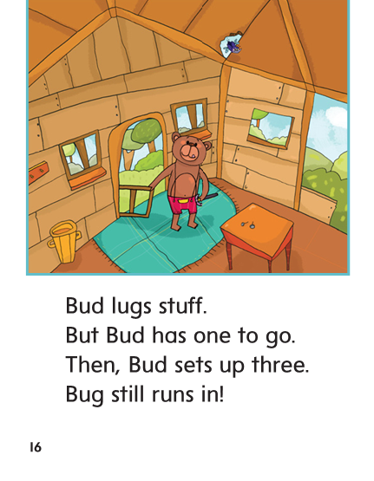

Slide 286
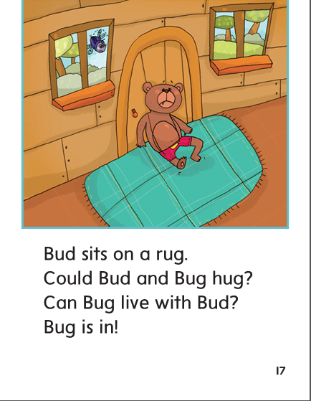

Slide 287
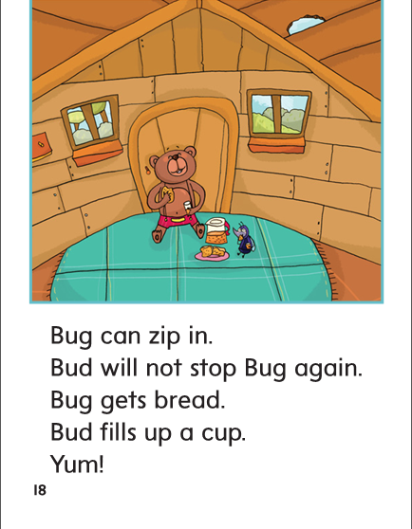

Slide 288
Structural Analysis
The ‘s at the end shows that she’s is a contraction.
A contraction is a word you make by putting two words together.
she is
she i s
she’s
The apostrophe (‘) stands for the missing letter i in is.
You leave out one or more letters when you make a contraction.

Slide 289
Structural Analysis
The ‘s at the end shows that she’s is a contraction.
A contraction is a word you make by putting two words together.
let us
let u s
let’s
The apostrophe (‘) stands for the missing letter i in is.
You leave out one or more letters when you make a contraction.

Slide 290
Structural Analysis
he’s
it’s
/z/
/s/
What two words do each contraction stand for?

Slide 291
-un
-ut
-ug

Slide 292
run
could
run
nut
one
nut
bug
bug
fun
fun
cut
could
cut
rug
one
rug

Slide 293
High Frequency
Words

Slide 294
Read, Spell, Write
could
Could you pass the nuts, please?

Slide 295
Read, Spell, Write
live
Does a fox live in a den?

Slide 296
Read, Spell, Write
one
There is one frog on the log.

Slide 297
Read, Spell, Write
then
What did you do then?

Slide 298
Read, Spell, Write
three
Three black dogs run in the grass.

Slide 299
Build Fluency: Word Automaticity
I had one dog.
Then I got three cats.
Could my dog live with three cats?

Slide 300
Grammar
A singular noun names one person, one place, or one thing.
Some nouns name more than one person, place, or thing.
These are plural nouns. Usually you make a noun plural by adding –s to the end.
When a noun ends with –x, -s, or –ss, you add –es.
Then, they go up to the roof.
Last, they pound the nails.
Which word names one thing?
Which word names more than one?

Slide 301
Week 1 – Day 4

Slide 302
Phonemic Awareness – Phoneme Identity
Listen carefully as I say three words: duck, jug, sub.
What sound do you hear that is the same in /duuuk/, /juuug/, and /suuub/?
That’s right. The middle sound is /u/.
Guided Practice:
I am going to say more words. Tell me the sound you hear that is the same in each group of words.
fun, luck, mug hop, lock, dot run, huff, mud
ten, well, went cup, cub, dug fuzz, fun, hut

Slide 303
Build Words with Short u
h
u
m
What is the new word we made?
Let’s blend all the sounds and read the word.
Change the h to y.

Slide 304
Build Words with Short u
y
u
m
What is the new word we made?
Let’s blend all the sounds and read the word.
Change the m to ck.

Slide 305
Build Words with Short u
y
u
ck
What is the new word we made?
Let’s blend all the sounds and read the word.
Change the y to t.

Slide 306
Build Words with Short u
t
u
ck
What is the new word we made?
Let’s blend all the sounds and read the word.
Change the u to i.

Slide 307
Build Words with Short u
t
i
ck
What is the new word we made?
Let’s blend all the sounds and read the word.
Change the t to p.

Slide 308
Build Words with Short u
p
i
ck
What is the new word we made?
Let’s blend all the sounds and read the word.
Change the i to a.

Slide 309
Build Words with Short u
p
a
ck
What is the new word we made?
Let’s blend all the sounds and read the word.
Change the a to u.

Slide 310
Build Words with Short u
p
u
ck
What is the new word we made?
Let’s blend all the sounds and read the word.
Change the p to m.

Slide 311
Build Words with Short u
m
u
ck
What is the new word we made?
Let’s blend all the sounds and read the word.
Change the ck to d.

Slide 312
Build Words with Short u
m
u
d
What is the new word we made?
Let’s blend all the sounds and read the word.
Change the u to a.

Slide 313
Build Words with Short u
m
a
d
What is the new word we made?
Let’s blend all the sounds and read the word.
Change the m to d.

Slide 314
Build Words with Short u
d
a
d
What is the new word we made?
Let’s blend all the sounds and read the word.
Change the a to i.

Slide 315
Build Words with Short u
d
i
d
What is the new word we made?
Let’s blend all the sounds and read the word.
Change the last d to g.

Slide 316
Build Words with Short u
d
i
g
What is the new word we made?
Let’s blend all the sounds and read the word.
Change the i to u.

Slide 317
Build Words with Short u
d
u
g
What is the new word we made?
Let’s blend all the sounds and read the word.
Change the d to l.

Slide 318
Build Words with Short u
l
u
g
What is the new word we made?
Let’s blend all the sounds and read the word.
Add a p in front of the l.

Slide 319
Build Words with Short u
p
l
u
g
What is the new word we made?
Let’s blend all the sounds and read the word.
Change the p to s.

Slide 320
Build Words with Short u
s
l
u
g
What is the new word we made?
Let’s blend all the sounds and read the word.

Slide 321
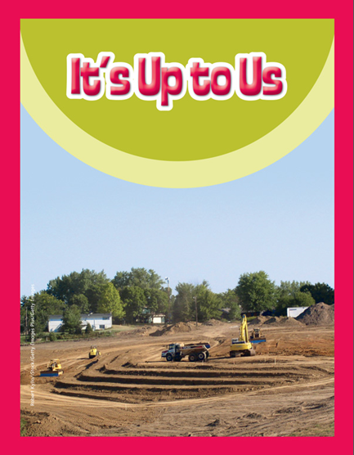

Slide 327
Structural Analysis
The word it’s is a contraction. The apostrophe (‘) replaces the letters removed when the two words (it and is) are put together to make one word.
it’s

Slide 328
Structural Analysis
The word it’s is a contraction. The apostrophe (‘) replaces the letters removed when the two words (it and is) are put together to make one word.
it is
she is
he is
let us
Work in pairs to construct contractions.
Write a sentence for each contraction.

Slide 329
High Frequency
Words

Slide 330
Read, Spell, Write
could
Could you pass the nuts, please?

Slide 331
Read, Spell, Write
live
Does a fox live in a den?

Slide 332
Read, Spell, Write
one
There is one frog on the log.

Slide 333
Read, Spell, Write
then
What did you do then?

Slide 334
Read, Spell, Write
three
Three black dogs run in the grass.

Slide 335
Grammar
You add –s to most singular nouns to name more than one person, place, or thing, but sometimes you must add –es to form the plural.
You add –es to nouns that end with –x, -s, or –ss.
What are some plural nouns?
bus - buses
clock - clocks
egg - eggs
mess - messes
Let’s form the plural for each noun.

Slide 336
Grammar
Have partners form the plural for each noun.
class__
box__
mutt__
drum__

Slide 337
Week 1 – Day 5

Slide 338
Phonemic Awareness
Phoneme Blending
Listed as I say a group of sounds. Then blend those sounds to form a word.
/s/ /u/ /n/ /b/ /u/ /g/ /d/ /r/ /u/ /m/ /f/ /l/ /u/ /f/
Phoneme Segmentation
Now I am going to say a word. I want you to say each sound in the word.
fun luck cluck plus truck spun

Slide 339
Build Words with r-blends and s-blends
Read and say these words:
fun
rub
snug
drum

Slide 340
Build Words with Short u
g
u
m
What is the new word we made?
Let’s blend all the sounds and read the word.
Change the g to h.

Slide 341
Build Words with Short u
h
u
m
What is the new word we made?
Let’s blend all the sounds and read the word.
Change the m to g.

Slide 342
Build Words with Short u
h
u
g
What is the new word we made?
Let’s blend all the sounds and read the word.
Change the h to p.

Slide 343
Build Words with Short u
p
u
g
What is the new word we made?
Let’s blend all the sounds and read the word.
Add an I after the p.

Slide 344
Build Words with Short u
p
l
u
g
What is the new word we made?
Let’s blend all the sounds and read the word.
Change the g to s.

Slide 345
Build Words with Short u
p
l
u
s
What is the new word we made?
Let’s blend all the sounds and read the word.
Change the s to ck.

Slide 346
Build Words with Short u
p
l
u
ck
What is the new word we made?
Let’s blend all the sounds and read the word.
Remove the l.

Slide 347
Build Words with Short u
p
u
ck
What is the new word we made?
Let’s blend all the sounds and read the word.
Change the ck to ff.

Slide 348
Build Words with Short u
p
u
ff
What is the new word we made?
Let’s blend all the sounds and read the word.
Change the p to h.

Slide 349
Build Words with Short u
h
u
ff
What is the new word we made?
Let’s blend all the sounds and read the word.
Change the ff to t.

Slide 350
Build Words with Short u
h
u
t
What is the new word we made?
Let’s blend all the sounds and read the word.
Change the h to b.

Slide 351
Build Words with Short u
b
u
t
What is the new word we made?
Let’s blend all the sounds and read the word.
Change the t to n.

Slide 352
Build Words with Short u
b
u
n
What is the new word we made?
Let’s blend all the sounds and read the word.
Change the b to f.

Slide 353
Build Words with Short u
f
u
n
What is the new word we made?
Let’s blend all the sounds and read the word.
Change the f to s.

Slide 354
Build Words with Short u
s
u
n
What is the new word we made?
Let’s blend all the sounds and read the word.
Change the n to b.

Slide 355
Build Words with Short u
s
u
b
What is the new word we made?
Let’s blend all the sounds and read the word.

Slide 356
Word Automaticity
yuck

Slide 357
bug

Slide 358
puff

Slide 359
it’s

Slide 360
cliff

Slide 361
mud

Slide 362
plug

Slide 363
gruff

Slide 364
she’s

Slide 365
track

Slide 366
huff

Slide 367
cub

Slide 368
fluff

Slide 369
he’s

Slide 370
truck

Slide 371
stuff

Slide 372
fun

Slide 373
pluck

Slide 374
what’s

Slide 375
clock

Slide 376
drum

Slide 377
huts

Slide 378
plus

Slide 379
let’s

Slide 380
cluck

Slide 381
snug

Slide 382
stuck

Slide 383
dress

Slide 384
buzz

Slide 385
puffed

Slide 386
Structural Analysis
What is a contraction and do you form one?
he is
she is
it is
let us
Practice writing and reading the following contractions:

Slide 387
High Frequency
Words

Slide 388
Read, Spell, Write
could
Could you pass the nuts, please?

Slide 389
Read, Spell, Write
live
Does a fox live in a den?

Slide 390
Read, Spell, Write
one
There is one frog on the log.

Slide 391
Read, Spell, Write
then
What did you do then?

Slide 392
Read, Spell, Write
three
Three black dogs run in the grass.

Slide 393
Grammar
Explain the difference between a singular noun and plural noun.
How are plural nouns formed?
Identify the plural nouns.
The hen put the
eggs in boxes.

Slide 394
Grammar
How do I know if each noun is singular or plural?
Read each noun aloud. Choose two nouns and write two sentences using the plural form of each noun.
map
box
bug
bus
hut

