Slide 1
Week 4 – Day 1

Slide 2
Phonemic Awareness – Phoneme Categorization
Listen carefully as I say three words: mop, cob, sit.
Two of these words have the same middle sound; one does not.
That word does not belong in the group.
Which word does not belong?
The words mop and cob have the /o/ sound in the middle.
The word sit does not have the /o/ sound in the middle.
Sit does not belong.
Guided Practice:
I am going to say a group of words. Listen for the middle sound. Tell me which word does not belong and why.
mom, sat, pond sip, not, him
dot, hop, big sad, doll, bag

Slide 3
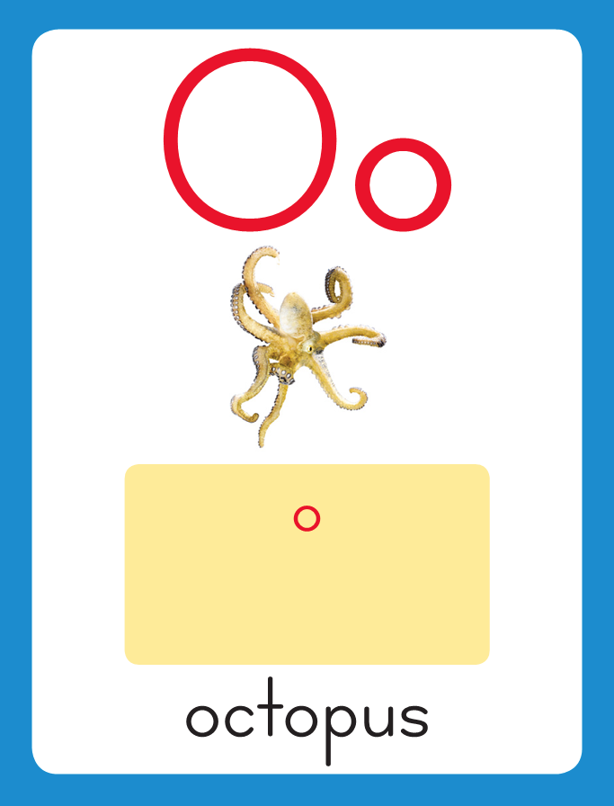
Introduce short o
This is the Octopus Sound-Spelling Card.
The sound is /o/.
The /o/ sound is spelled with the letter o.
Say it with me: /o/.
This sound is at the beginning of the word octopus.
Listen /oooktopus/, octopus.
I’ll say /o/ as I write the letter several times.

Slide 4
Introduce short o
Have children practice connecting the letter o to the sound /o/ by writing it.
Now do it with me. Say /o/ as I write the letter o.
This time, write the letter o five times as you say the /o/ sound.

Slide 5
Blending Words with Short o
n

Slide 6
Blending Words with Short o
n
o

Slide 7
Blending Words with Short o
n
o
t

Slide 8
Blending Words with Short o
n
o
t

Slide 9
Blending Words with Short o
d

Slide 10
Blending Words with Short o
d
o

Slide 11
Blending Words with Short o
d
o
t

Slide 12
Blending Words with Short o
d
o
t

Slide 13
Blending Words with Short o
j

Slide 14
Blending Words with Short o
j
o

Slide 15
Blending Words with Short o
j
o
b

Slide 16
Blending Words with Short o
j
o
b

Slide 17
Blending Words with Short o
p

Slide 18
Blending Words with Short o
p
o

Slide 19
Blending Words with Short o
p
o
t

Slide 20
Blending Words with Short o
p
o
t

Slide 21
o ll x ss
b g ck a
fl i nd cl

Slide 22
m

Slide 23
mo

Slide 24
mom

Slide 25
mom l

Slide 26
mom lo

Slide 27
mom lot

Slide 28
mom lot g

Slide 29
mom lot go

Slide 30
mom lot got

Slide 31
mom lot got h

Slide 32
mom lot got ho

Slide 33
mom lot got hop

Slide 34
mom lot got hop
h

Slide 35
mom lot got hop
ho

Slide 36
mom lot got hop
hot

Slide 37
mom lot got hop
hot b

Slide 38
mom lot got hop
hot bo

Slide 39
mom lot got hop
hot box

Slide 40
mom lot got hop
hot box o

Slide 41
mom lot got hop
hot box on

Slide 42
mom lot got hop
hot box on l

Slide 43
mom lot got hop
hot box on lo

Slide 44
mom lot got hop
hot box on log

Slide 45
mom lot got hop
hot box on log
d

Slide 46
mom lot got hop
hot box on log
do

Slide 47
mom lot got hop
hot box on log
dog

Slide 48
mom lot got hop
hot box on log
dog d

Slide 49
mom lot got hop
hot box on log
dog do

Slide 50
mom lot got hop
hot box on log
dog doll

Slide 51
mom lot got hop
hot box on log
dog doll r

Slide 52
mom lot got hop
hot box on log
dog doll ro

Slide 53
mom lot got hop
hot box on log
dog doll rock

Slide 54
mom lot got hop
hot box on log
dog doll rock s

Slide 55
mom lot got hop
hot box on log
dog doll rock so

Slide 56
mom lot got hop
hot box on log
dog doll rock sock

Slide 57
t

Slide 58
to

Slide 59
toss

Slide 60
toss fl

Slide 61
toss flo

Slide 62
toss floss

Slide 63
toss floss f

Slide 64
toss floss fo

Slide 65
toss floss fox

Slide 66
toss floss fox f

Slide 67
toss floss fox fi

Slide 68
toss floss fox fix

Slide 69
toss floss fox fix
l

Slide 70
toss floss fox fix
lo

Slide 71
toss floss fox fix
lost

Slide 72
toss floss fox fix
lost p

Slide 73
toss floss fox fix
lost po

Slide 74
toss floss fox fix
lost pond

Slide 75
toss floss fox fix
lost pond fl

Slide 76
toss floss fox fix
lost pond fli

Slide 77
toss floss fox fix
lost pond flip

Slide 78
toss floss fox fix
lost pond flip fl

Slide 79
toss floss fox fix
lost pond flip flo

Slide 80
toss floss fox fix
lost pond flip flop

Slide 81
toss floss fox fix
lost pond flip flop
pl

Slide 82
toss floss fox fix
lost pond flip flop
plo

Slide 83
toss floss fox fix
lost pond flip flop
plop

Slide 84
toss floss fox fix
lost pond flip flop
plop bl

Slide 85
toss floss fox fix
lost pond flip flop
plop blo

Slide 86
toss floss fox fix
lost pond flip flop
plop block

Slide 87
toss floss fox fix
lost pond flip flop
plop block bl

Slide 88
toss floss fox fix
lost pond flip flop
plop block bla

Slide 89
toss floss fox fix
lost pond flip flop
plop block black

Slide 90
It

Slide 91
It is

Slide 92
It is not

Slide 93
It is not hot.

Slide 94
It is not hot.
Tom

Slide 95
It is not hot.
Tom can

Slide 96
It is not hot.
Tom can hop

Slide 97
It is not hot.
Tom can hop a

Slide 98
It is not hot.
Tom can hop a lot.

Slide 99
It is not hot.
Tom can hop a lot.
Bob

Slide 100
It is not hot.
Tom can hop a lot.
Bob lost

Slide 101
It is not hot.
Tom can hop a lot.
Bob lost a

Slide 102
It is not hot.
Tom can hop a lot.
Bob lost a sock.

Slide 103
Spelling / Dictation
1.
2.
3.
4.
5.

Slide 104
High Frequency
Words

Slide 105
Read, Spell, Write
fun
It is fun to play.

Slide 106
Read, Spell, Write
make
I can make a doll.

Slide 107
Read, Spell, Write
they
They will win.

Slide 108
Read, Spell, Write
too
Do you like dogs, too?

Slide 109
Have children read the sentences. Prompt them to identify the high-frequency words in connected text and to blend the decodable words.
It is fun to play.
I can make a doll.
They will win.
Do you like dogs, too?

Slide 110
Grammar
A question is a sentence that asks something and ends with a question mark.
Rob can hop.
Can Rob hop?
How is the word order in the statement different from the word order in the question?
Rob can hop!
How is the exclamation different from the statement – Rob can hop.

Slide 111
Grammar
Work together to read the sentences and identify the questions and exclamations.
Did Cam fix the fan?
The pan is hot!
The cat is very big!
Will Liz come to school?

Slide 112
Week 4 – Day 2

Slide 113
Phonemic Awareness – Phoneme Segmentation
I am going to say a word.
Then I will say the sounds in the word.
The word is flop.
Listen: /f/ /l/ /o/ /p/.
The first sound is /fff/.
The second sound is /lll/.
The next sound is /ooo/.
The last sound is /p/.
I’ll place a marker in a box for each sound I hear:
/s/
/f/
/l/
/o/
/p/

Slide 114
Guided Practice
Let’s do some together. I am going to say some more words.
Stretch the sounds in the word with me.
Place a marker for each sound you hear.
/o/ /n/ /l/ /o/ /t/ /s/ /l/ /o/ /t/
/l/ /o/ /ck/ /c/ /l/ /o/ /k/ /b/ /l/ /o/ /k/
/j/ /o/ /b/ /p/ /o/ /t/ /m/ /o/ /m/
/p/ /l/ /o/ /p/ /d/ /o/ /g/ /f/ /o/ /x/

Slide 115
Introduce short o
What is this letter?
What sound does it stand for?
on
This is the Octopus Sound-Spelling Card.
The sound is /o/.
The /o/ sound is spelled with the letter o.
Say it with me: /o/.
This sound is at the beginning of the word octopus.
Listen /oooktopus/, octopus.
I’ll say /o/ as I write the letter several times.
dog

Slide 116
Blending Words with Short o
h

Slide 117
Blending Words with Short o
h
o

Slide 118
Blending Words with Short o
h
o
p

Slide 119
Blending Words with Short o
h
o
p

Slide 120
Blending Words with Short o
p

Slide 121
Blending Words with Short o
p
o

Slide 122
Blending Words with Short o
p
o
p

Slide 123
Blending Words with Short o
p
o
p

Slide 124
Blending Words with Short o
b

Slide 125
Blending Words with Short o
b
o

Slide 126
Blending Words with Short o
b
o
x

Slide 127
Blending Words with Short o
b
o
x

Slide 128
Blending Words with Short o
t

Slide 129
Blending Words with Short o
t
o

Slide 130
Blending Words with Short o
t
o
ss

Slide 131
Blending Words with Short o
t
o
ss

Slide 132
l

Slide 133
lo

Slide 134
lot

Slide 135
lot m

Slide 136
lot mo

Slide 137
lot mom

Slide 138
lot mom p

Slide 139
lot mom po

Slide 140
lot mom pot

Slide 141
lot mom pot r

Slide 142
lot mom pot ro

Slide 143
lot mom pot rock

Slide 144
lot mom pot rock
d

Slide 145
lot mom pot rock
do

Slide 146
lot mom pot rock
dog

Slide 147
lot mom pot rock
dog d

Slide 148
lot mom pot rock
dog do

Slide 149
lot mom pot rock
dog doll

Slide 150
lot mom pot rock
dog doll s

Slide 151
lot mom pot rock
dog doll so

Slide 152
lot mom pot rock
dog doll sock

Slide 153
lot mom pot rock
dog doll sock bl

Slide 154
lot mom pot rock
dog doll sock blo

Slide 155
lot mom pot rock
dog doll sock block

Slide 156
lot mom pot rock
dog doll sock block
fl

Slide 157
lot mom pot rock
dog doll sock block
flo

Slide 158
lot mom pot rock
dog doll sock block
flop

Slide 159
lot mom pot rock
dog doll sock block
flop cl

Slide 160
lot mom pot rock
dog doll sock block
flop clo

Slide 161
lot mom pot rock
dog doll sock block
flop clock

Slide 162
lot mom pot rock
dog doll sock block
flop clock g

Slide 163
lot mom pot rock
dog doll sock block
flop clock go

Slide 164
lot mom pot rock
dog doll sock block
flop clock got

Slide 165
lot mom pot rock
dog doll sock block
flop clock got h

Slide 166
lot mom pot rock
dog doll sock block
flop clock got ho

Slide 167
lot mom pot rock
dog doll sock block
flop clock got hog

Slide 168
Build Words with Short o
p
o
t
What is the new word we made?
Let’s blend all the sounds and read the word.
Change the t to d.

Slide 169
Build Words with Short o
p
o
d
What is the new word we made?
Let’s blend all the sounds and read the word.
Change the d to p.

Slide 170
Build Words with Short o
p
o
p
What is the new word we made?
Let’s blend all the sounds and read the word.
Change the d to p.

Slide 171
Build Words with Short o
p
l
o
p
What is the new word we made?
Let’s blend all the sounds and read the word.
Change the first p to s.

Slide 172
Build Words with Short o
s
l
o
p
What is the new word we made?
Let’s blend all the sounds and read the word.
Change the p to t.

Slide 173
Build Words with Short o
s
l
o
t
What is the new word we made?
Let’s blend all the sounds and read the word.
Take off the s.

Slide 174
Build Words with Short o
l
o
t
What is the new word we made?
Let’s blend all the sounds and read the word.
Change the l to g.

Slide 175
Build Words with Short o
g
o
t
What is the new word we made?
Let’s blend all the sounds and read the word.
Change the g to h.

Slide 176
Build Words with Short o
h
o
t
What is the new word we made?
Let’s blend all the sounds and read the word.
Change the o to a.

Slide 177
Build Words with Short o
h
a
t
What is the new word we made?
Let’s blend all the sounds and read the word.
Change the t to ck.

Slide 178
Build Words with Short o
h
a
ck
What is the new word we made?
Let’s blend all the sounds and read the word.
Change the h to s.

Slide 179
Build Words with Short o
s
a
ck
What is the new word we made?
Let’s blend all the sounds and read the word.
Change the a to o.

Slide 180
Build Words with Short o
s
o
ck
What is the new word we made?
Let’s blend all the sounds and read the word.
Change the s to r.

Slide 181
Build Words with Short o
r
o
ck
What is the new word we made?
Let’s blend all the sounds and read the word.

Slide 182
Structural Analysis
Alphabetical Order
a b c d e f g h I j k l m n o p q r s t u v w x y z
cat box dog
box cat dog
We can put the words in alphabetical order by looking at the first letter of each word.
B comes before c, and c comes before d.

Slide 183
Structural Analysis
Alphabetical Order
a b c d e f g h I j k l m n o p q r s t u v w x y z
at cat zip
____ ____ ____
We can put the words in alphabetical order by looking at the first letter of each word.
B comes before c, and c comes before d.

Slide 184
Structural Analysis
Alphabetical Order
a b c d e f g h I j k l m n o p q r s t u v w x y z
hop fox sock
____ ____ ____
We can put the words in alphabetical order by looking at the first letter of each word.
B comes before c, and c comes before d.

Slide 185
Spelling – Word Sort
top
Read each word, listen for short o and the ending sound.

Slide 186
hog

Slide 187
lot

Slide 188
hop

Slide 189
log

Slide 190
hot

Slide 191
mop
dog
got

Slide 192
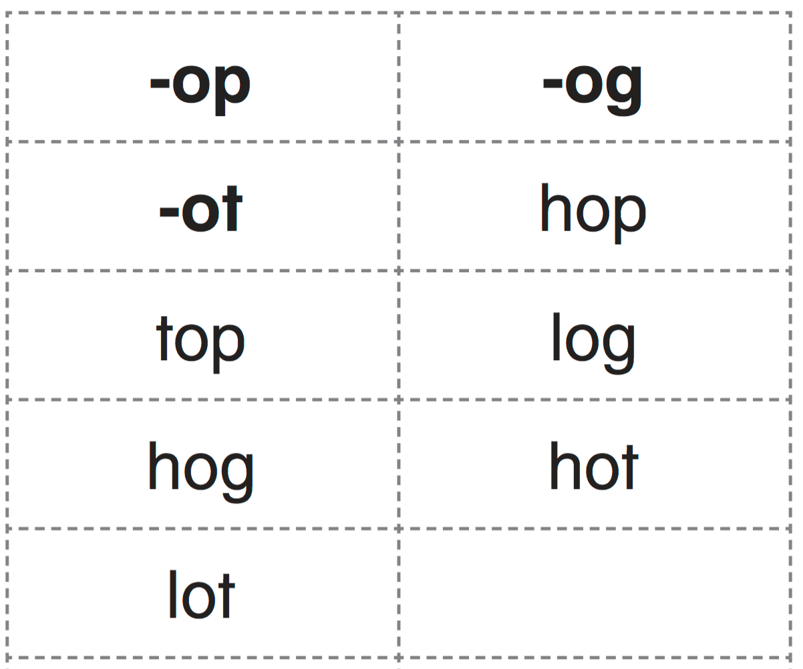

Slide 193
High Frequency
Words

Slide 194
Read, Spell, Write
fun
It is fun to play.

Slide 195
Read, Spell, Write
make
I can make a doll.

Slide 196
Read, Spell, Write
they
They will win.

Slide 197
Read, Spell, Write
too
Do you like dos, too?

Slide 198
Week 4 – Day 3

Slide 199
Phonemic Awareness – Phoneme Deletion
Listen carefully as I say a word: flock.
The word flock has four sounds.
Say the sounds with me: /f/ /l/ /o/ /k/.
I’ll take away the first sound /f/ to make a new word: /l/ /o/ /k/, lock.
The new word has only three sounds.
Guided Practice:
Let’s do some together. Listen as I say a word. Then say the word without its first sound.
slid clock slap flop glad
block plot flight plate cloud

Slide 200
Blending Words with Short o
l

Slide 201
Blending Words with Short o
l
o

Slide 202
Blending Words with Short o
l
o
ck

Slide 203
Blending Words with Short o
l
o
ck

Slide 204
Blending Words with Short o
l

Slide 205
Blending Words with Short o
l
o

Slide 206
Blending Words with Short o
l
o
t

Slide 207
Blending Words with Short o
l
o
t

Slide 208
Blending Words with Short o
c
l

Slide 209
Blending Words with Short o
c
l
o

Slide 210
Blending Words with Short o
c
l
o
ck

Slide 211
Blending Words with Short o
c
l
o
ck

Slide 212
Blending Words with Short o
p
l

Slide 213
Blending Words with Short o
p
l
o

Slide 214
Blending Words with Short o
p
l
o
t

Slide 215
Blending Words with Short o
p
l
o
t

Slide 216
h

Slide 217
ho

Slide 218
hot

Slide 219
hot n

Slide 220
hot no

Slide 221
hot not

Slide 222
hot not p

Slide 223
hot not po

Slide 224
hot not pot

Slide 225
hot not pot j

Slide 226
hot not pot jo

Slide 227
hot not pot job

Slide 228
hot not pot job
h

Slide 229
hot not pot job
ho

Slide 230
hot not pot job
hog

Slide 231
hot not pot job
hog f

Slide 232
hot not pot job
hog fo

Slide 233
hot not pot job
hog fog

Slide 234
hot not pot job
hog fog d

Slide 235
hot not pot job
hog fog do

Slide 236
hot not pot job
hog fog dock

Slide 237
hot not pot job
hog fog dock t

Slide 238
hot not pot job
hog fog dock to

Slide 239
hot not pot job
hog fog dock toss

Slide 240
hot not pot job
hog fog dock toss
r

Slide 241
hot not pot job
hog fog dock toss
ro

Slide 242
hot not pot job
hog fog dock toss
rock

Slide 243
hot not pot job
hog fog dock toss
rock o

Slide 244
hot not pot job
hog fog dock toss
rock on

Slide 245
hot not pot job
hog fog dock toss
rock on o

Slide 246
hot not pot job
hog fog dock toss
rock on ox

Slide 247
hot not pot job
hog fog dock toss
rock on ox b

Slide 248
hot not pot job
hog fog dock toss
rock on ox bo

Slide 249
hot not pot job
hog fog dock toss
rock on ox box

Slide 250
d

Slide 251
do

Slide 252
dog

Slide 253
dogs

Slide 254
dogs d

Slide 255
dogs do

Slide 256
dogs doll

Slide 257
dogs dolls

Slide 258
dogs dolls d

Slide 259
dogs dolls do

Slide 260
dogs dolls dot

Slide 261
dogs dolls dots

Slide 262
dogs dolls dots
j

Slide 263
dogs dolls dots
jo

Slide 264
dogs dolls dots
jog

Slide 265
dogs dolls dots
jogs

Slide 266
dogs dolls dots
jogs s

Slide 267
dogs dolls dots
jogs so

Slide 268
dogs dolls dots
jogs sock

Slide 269
dogs dolls dots
jogs socks

Slide 270
dogs dolls dots
jogs socks h

Slide 271
dogs dolls dots
jogs socks ho

Slide 272
dogs dolls dots
jogs socks hop

Slide 273
dogs dolls dots
jogs socks hops

Slide 274
dogs dolls dots
jogs socks hops
l

Slide 275
dogs dolls dots
jogs socks hops
lo

Slide 276
dogs dolls dots
jogs socks hops
lot

Slide 277
dogs dolls dots
jogs socks hops
lots

Slide 278
dogs dolls dots
jogs socks hops
lots pl

Slide 279
dogs dolls dots
jogs socks hops
lots plo

Slide 280
dogs dolls dots
jogs socks hops
lots plop

Slide 281
dogs dolls dots
jogs socks hops
lots plops

Slide 282
dogs dolls dots
jogs socks hops
lots plops m

Slide 283
dogs dolls dots
jogs socks hops
lots plops mo

Slide 284
dogs dolls dots
jogs socks hops
lots plops mop

Slide 285
dogs dolls dots
jogs socks hops
lots plops mops

Slide 286
l

Slide 287
lo

Slide 288
log

Slide 289
logs

Slide 290
logs l

Slide 291
logs lo

Slide 292
logs lock

Slide 293
logs locks

Slide 294
logs locks s

Slide 295
logs locks so

Slide 296
logs locks sob

Slide 297
logs locks sobs

Slide 298
logs locks sobs
fl

Slide 299
logs locks sobs
fli

Slide 300
logs locks sobs
flip

Slide 301
logs locks sobs
flip fl

Slide 302
logs locks sobs
flip flo

Slide 303
logs locks sobs
flip flop

Slide 304
logs locks sobs
flip flop sl

Slide 305
logs locks sobs
flip flop sli

Slide 306
logs locks sobs
flip flop slip

Slide 307
logs locks sobs
flip flop slip
sl

Slide 308
logs locks sobs
flip flop slip
slo

Slide 309
logs locks sobs
flip flop slip
slop

Slide 310
logs locks sobs
flip flop slip
slop bl

Slide 311
logs locks sobs
flip flop slip
slop bla

Slide 312
logs locks sobs
flip flop slip
slop black

Slide 313
logs locks sobs
flip flop slip
slop black bl

Slide 314
logs locks sobs
flip flop slip
slop black blo

Slide 315
logs locks sobs
flip flop slip
slop black block

Slide 316
A

Slide 317
A dog

Slide 318
A dog hops

Slide 319
A dog hops on

Slide 320
A dog hops on a

Slide 321
A dog hops on a rock

Slide 322
A dog hops on a rock to

Slide 323
A dog hops on a rock to sit.

Slide 324
A dog hops on a rock to sit.
My

Slide 325
A dog hops on a rock to sit.
My dog

Slide 326
A dog hops on a rock to sit.
My dog flops

Slide 327
A dog hops on a rock to sit.
My dog flops down

Slide 328
A dog hops on a rock to sit.
My dog flops down and

Slide 329
A dog hops on a rock to sit.
My dog flops down and naps

Slide 330
A dog hops on a rock to sit.
My dog flops down and naps if

Slide 331
A dog hops on a rock to sit.
My dog flops down and naps if it

Slide 332
A dog hops on a rock to sit.
My dog flops down and naps if it is

Slide 333
A dog hops on a rock to sit.
My dog flops down and naps if it is hot.

Slide 334
Decodable Reader

Slide 335
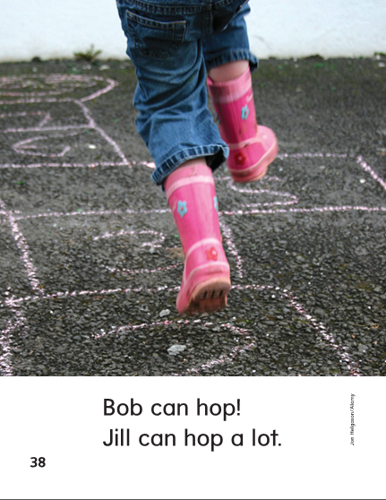

Slide 336
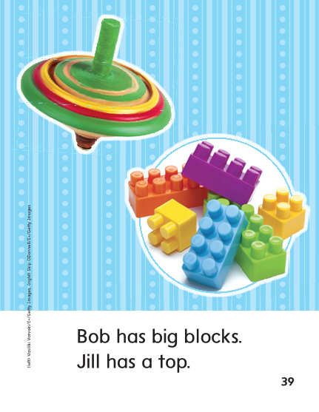

Slide 337
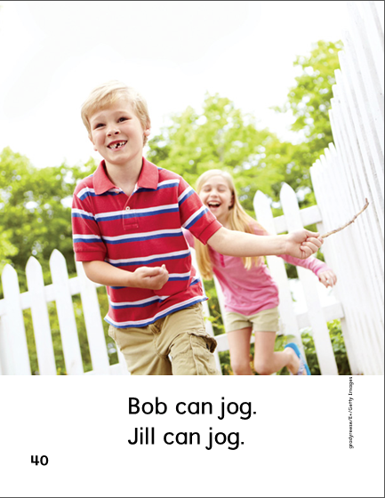

Slide 340
Structural Analysis
Alphabetical Order
a b c d e f g h I j k l m n o p q r s t u v w x y z
fox sock can hit
____ ____ ____ ____
We can put the words in alphabetical order by looking at the first letter of each word.

Slide 341
Structural Analysis
Alphabetical Order
a b c d e f g h I j k l m n o p q r s t u v w x y z
We can put the words in alphabetical order by looking at the first letter of each word.
top 1. ______
box 2. ______
mop 3. ______
Log 4. ______
clock 5. ______

Slide 342
-op
-og
-ot
x

Slide 343
hop
lot
they
log
top
too
hot
hog
flip
black

Slide 344
Grammar
Correct each sentence.
The dog did a flip
Can Nat flip
A question always ends with a question mark.
An exclamation always ends with an exclamation.

Slide 345
Week 4 – Day 4

Slide 346
Phonemic Awareness – Identify and Generate Rhyme
I am going to say two words.
If the two words rhyme, clap.
Listen: lot, hot
Do lot and hot rhyme?
Yes, let’s clap!
They rhyme because they both end in /ot/.
What other words rhyme with lot and hot?
Guided Practice:
Now let’s try it together. I will say two words. If the two words rhyme, clap. Think about the sounds the two words have in common at the end, and then say another word that rhymes with them.
mop, top pot, pit dog, hog lock, sock plot, plate

Slide 347
Build Words with Short o
f
l
o
p
What is the new word we made?
Let’s blend all the sounds and read the word.
Change the f to s.

Slide 348
Blending Words with Short o
s
l
o
p
What is the new word we made?
Let’s blend all the sounds and read the word.
Change the p to t.

Slide 349
Blending Words with Short o
s
l
o
t
What is the new word we made?
Let’s blend all the sounds and read the word.
Remove the s.

Slide 350
Blending Words with Short o
l
o
t
What is the new word we made?
Let’s blend all the sounds and read the word.
Change l to n.

Slide 351
Blending Words with Short o
n
o
t
What is the new word we made?
Let’s blend all the sounds and read the word.
Change n to h.

Slide 352
Blending Words with Short o
h
o
t
What is the new word we made?
Let’s blend all the sounds and read the word.
Change h to t.

Slide 353
Blending Words with Short o
t
o
t
What is the new word we made?
Let’s blend all the sounds and read the word.
Change t to p.

Slide 354
Blending Words with Short o
t
o
p
What is the new word we made?
Let’s blend all the sounds and read the word.
Change t to m.

Slide 355
Blending Words with Short o
m
o
p
What is the new word we made?
Let’s blend all the sounds and read the word.
Change o to a.

Slide 356
Blending Words with Short o
m
a
p
What is the new word we made?
Let’s blend all the sounds and read the word.
Change r to m.

Slide 357
Blending Words with Short o
r
a
p
What is the new word we made?
Let’s blend all the sounds and read the word.
Change p to ck.

Slide 358
Blending Words with Short o
r
a
ck
What is the new word we made?
Let’s blend all the sounds and read the word.
Change a to o.

Slide 359
Blending Words with Short o
r
o
ck
What is the new word we made?
Let’s blend all the sounds and read the word.
Change r to s.

Slide 360
Blending Words with Short o
s
o
ck
What is the new word we made?
Let’s blend all the sounds and read the word.
Change o to i.

Slide 361
Blending Words with Short o
s
i
ck
What is the new word we made?
Let’s blend all the sounds and read the word.
Change s to l.

Slide 362
Blending Words with Short o
l
i
ck
What is the new word we made?
Let’s blend all the sounds and read the word.
Change i to o.

Slide 363
Blending Words with Short o
l
o
ck
What is the new word we made?
Let’s blend all the sounds and read the word.
Add a b to the beginning of the word.

Slide 364
Blending Words with Short o
b
l
o
ck
What is the new word we made?
Let’s blend all the sounds and read the word.
Change the b to c.

Slide 365
Blending Words with Short o
c
l
o
ck
What is the new word we made?
Let’s blend all the sounds and read the word.

Slide 367
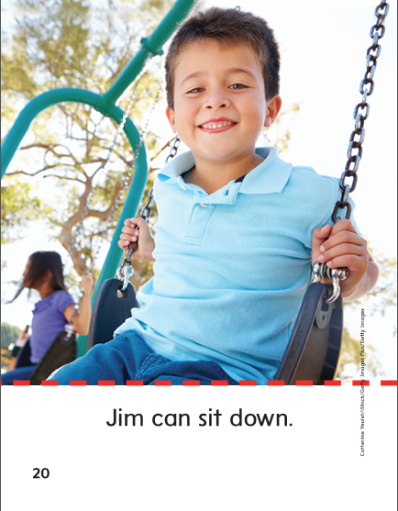

Slide 369
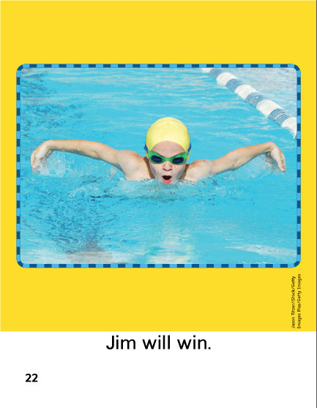

Slide 371
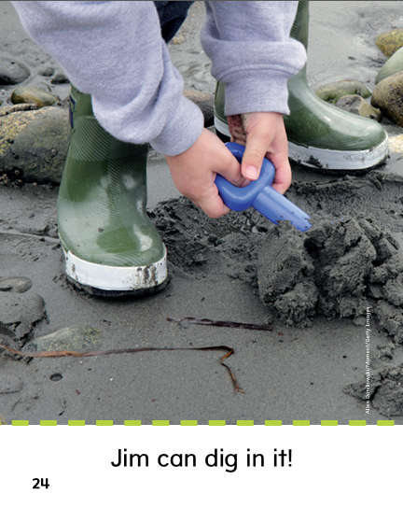

Slide 372
Structural Analysis
Alphabetical Order
a b c d e f g h I j k l m n o p q r s t u v w x y z
pop doll fox top
____ ____ ____ ____
We can put the words in alphabetical order by looking at the first letter of each word.

Slide 373
Structural Analysis
Alphabetical Order
a b c d e f g h I j k l m n o p q r s t u v w x y z
We can put the words in alphabetical order by looking at the first letter of each word.
hot 1. ______
not 2. ______
ox 3. ______
dog 4. ______
lock 5. ______

Slide 374
Grammar
Identify which are exclamations and which are questions.
Lock it!
What can Sal fix?
Nick jogs a lot!
Can Max pull?

Slide 375
Grammar
Work together to fix the sentences.
what has a fin
toss it

Slide 376
Week 4 – Day 5

Slide 377
Phonemic Awareness – Phoneme Blending
Listen as I say a group of sounds.
Then blend those sounds to form a word.
/m/ /o/ /p/ /t/ /o/ /p/
/h/ /o/ /t/ /s/ /o/ /k/
Phonemic Awareness – Phoneme Segmentation
Now I am going to say a word.
I want you to say each sound in the word.
hot lock flock block plop

Slide 378
Blend and Build Words with Short o
lot
Read and say the word.

Slide 379
Blend and Build Words with Short o
not
Read and say the word.

Slide 380
Blend and Build Words with Short o
box
Read and say the word.

Slide 381
Blend and Build Words with Short o
block
Read and say the word.

Slide 382
Blending Words with Short o
m
o
p
What is the new word we made?
Let’s blend all the sounds and read the word.
Change o to a.

Slide 383
Blending Words with Short o
m
a
p
What is the new word we made?
Let’s blend all the sounds and read the word.
Change m to t.

Slide 384
Blending Words with Short o
t
a
p
What is the new word we made?
Let’s blend all the sounds and read the word.
Change a to i.

Slide 385
Blending Words with Short o
t
i
p
What is the new word we made?
Let’s blend all the sounds and read the word.
Change i to o.

Slide 386
Blending Words with Short o
t
o
p
What is the new word we made?
Let’s blend all the sounds and read the word.
Change p to t.

Slide 387
Blending Words with Short o
t
o
t
What is the new word we made?
Let’s blend all the sounds and read the word.
Change first t to h.

Slide 388
Blending Words with Short o
h
o
t
What is the new word we made?
Let’s blend all the sounds and read the word.
Change first o to i.

Slide 389
Blending Words with Short o
h
i
t
What is the new word we made?
Let’s blend all the sounds and read the word.
Change first o to i.

Slide 390
Blending Words with Short o
l
i
t
What is the new word we made?
Let’s blend all the sounds and read the word.
Change first i to o.

Slide 391
Blending Words with Short o
l
o
t
What is the new word we made?
Let’s blend all the sounds and read the word.
Change first t to ck.

Slide 392
Blending Words with Short o
l
o
ck
What is the new word we made?
Let’s blend all the sounds and read the word.
Add a f to the beginning of the word.

Slide 393
Blending Words with Short o
f
l
o
ck
What is the new word we made?
Let’s blend all the sounds and read the word.
Change the f to c.

Slide 394
Blending Words with Short o
c
l
o
ck
What is the new word we made?
Let’s blend all the sounds and read the word.
Change the o to a.

Slide 395
Blending Words with Short o
c
l
a
ck
What is the new word we made?
Let’s blend all the sounds and read the word.
Change the c to b.

Slide 396
Blending Words with Short o
b
l
a
ck
What is the new word we made?
Let’s blend all the sounds and read the word.
Change the a to o.

Slide 397
Blending Words with Short o
b
l
o
ck
What is the new word we made?
Let’s blend all the sounds and read the word.

Slide 398
Word Automaticity
hot

Slide 399
dock

Slide 400
dogs

Slide 401
lots

Slide 402
flip

Slide 403
not

Slide 404
toss

Slide 405
dolls

Slide 406
plops

Slide 407
flop

Slide 408
pot

Slide 409
rock

Slide 410
dots

Slide 411
mops

Slide 412
slip

Slide 413
job

Slide 414
on

Slide 415
jogs

Slide 416
logs

Slide 417
slop

Slide 418
hog

Slide 419
ox

Slide 420
socks

Slide 421
locks

Slide 422
black

Slide 423
fog

Slide 424
box

Slide 425
hops

Slide 426
sobs

Slide 427
block

Slide 428
Structural Analysis
Alphabetical Order
a b c d e f g h I j k l m n o p q r s t u v w x y z
hop top log flip black
___ ___ ___ ___ ___
Have children explain how to put words in ABC order.
Practice alphabetizing these spelling words:

Slide 429
Grammar
Ask children to tell the difference between a question and an exclamation.
Identify which are exclamations and which are questions.
Lily quit!
Did Lily quit?

Slide 430
Grammar
Have partners arrange the words to make a question.
Then rearrange the words to make an exclamation.
Rob can win

Slide 431
Grammar
Work together to fix the sentences.
did Tim play
the kids hop and jog up the hill

