Slide 1
Week 5 – Day 1

Slide 2
Phonemic Awareness
Phoneme Segmentation
Listen as I say a word: chin.
I want to know how many sounds are in the word chin.
I will place a marker in a box for each sound I hear.
Listen: /ch/ /i/ /n/.
The first sound is /ch/. The middle sound is /i/. The last sound is /n/.
I will place three markers because I hear three sounds in the word.
Say the three sounds in chin with me: /ch/ /i/ /n/.
/ch/
/i/
/n/

Slide 3
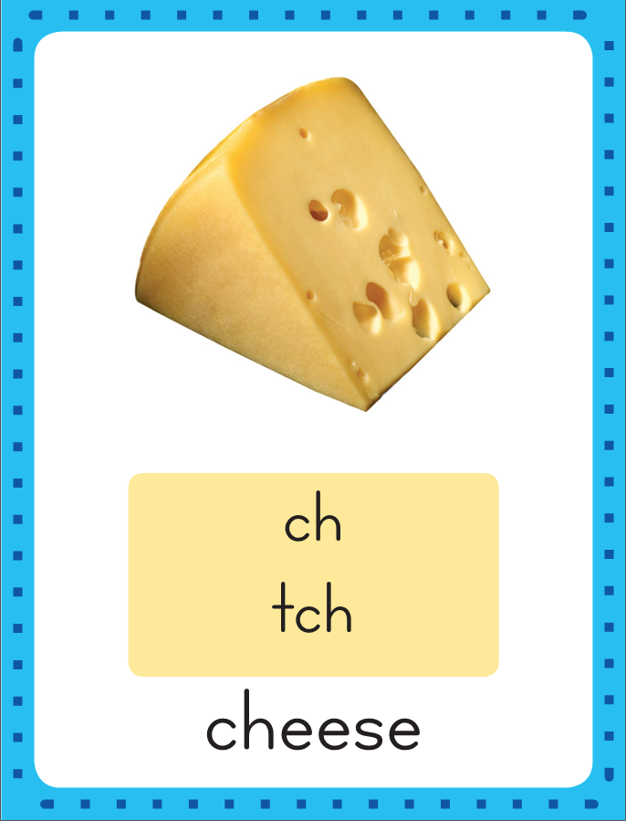
Introduce Consonant Digraphs ch, -tch, wh, ph
This is the Cheese Sound-Spelling Card.
The sound is /ch/.
The /ch/ sound is spelled with the letters ch.
Say it with me: /ch/.
This sound is at the beginning of the word cheese: /ch/ /e/ /z/.
Sometimes at the end of a word the /ch/ sound is spelled –tch, as in match. I’ll say the sound /ch/ as I write the letters ch and tch several times.

Slide 4
Introduce Consonant Digraphs ch, -tch, wh, ph
Have children practice connecting the letters c and h to /ch/ by writing them.
Now do it with me. Say /ch/ as I write the letters ch.
This time, write the letter ch five times as you say the /ch/ sound.

Slide 5
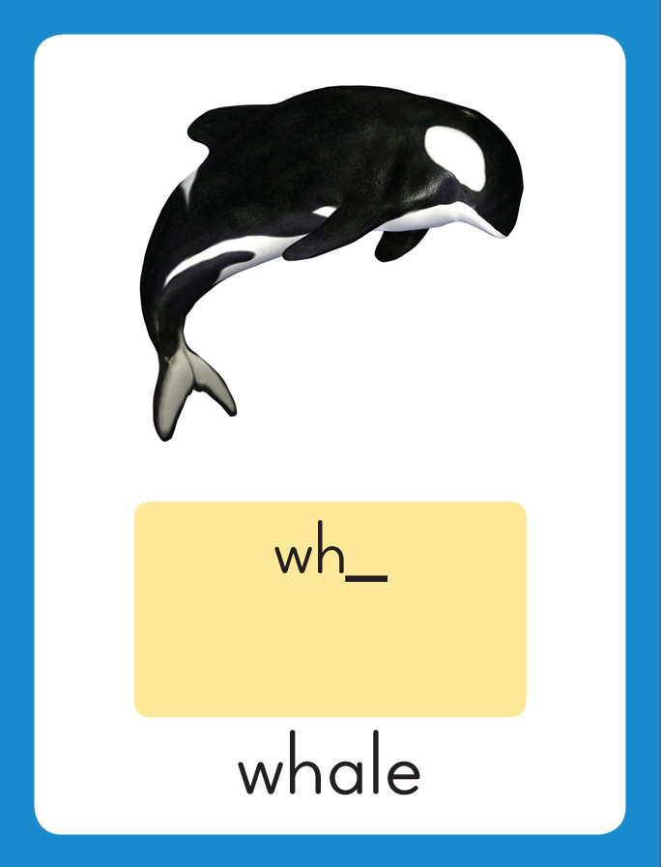
Introduce Consonant Digraphs ch, -tch, wh, ph
This is the Whale Sound-Spelling Card.
The sound is /wh/.
The /wh/ sound is spelled with the letters wh.
Say it with me: /wh/.
This sound is at the beginning of the word whale: /wh/ /a/ /l/.
I’ll say the sound /wh/ as I write the letters wh several times.

Slide 6
Introduce Consonant Digraphs ch, -tch, wh, ph
Have children practice connecting the letters w and h to /wh/ by writing them.
Now do it with me. Say /wh/ as I write the letters wh.
This time, write the letter wh five times as you say the /wh/ sound.

Slide 7
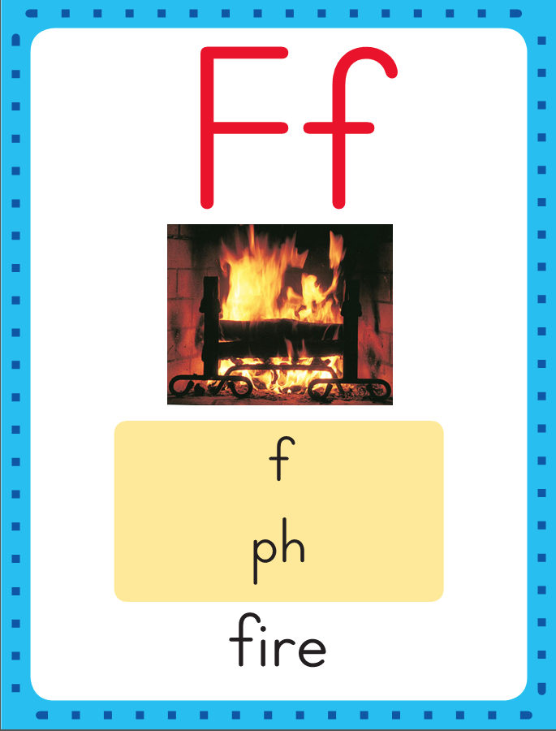
Introduce Consonant Digraphs ch, -tch, wh, ph
This is the Fire Sound-Spelling Card.
The sound is /f/.
The /f/ sound can be spelled with the letters ph.
Say it with me: /f/.
This sound is at the beginning of the word photo: /f/ /o/ /t/ /o/.. I’ll say the sound /f/ as I write the letters ph several times.

Slide 8
Introduce Consonant Digraphs ch, -tch, wh, ph
Have children practice connecting the letters p and h to /ph/ by writing them.
Now do it with me. Say /ph/ as I write the letters ph.
This time, write the letter ph five times as you say the /ph/ sound.

Slide 9
Introduce Consonant Digraphs ch, -tch, wh, ph
wh

Slide 10
Introduce Consonant Digraphs ch, -tch, wh, ph
wh
i

Slide 11
Introduce Consonant Digraphs ch, -tch, wh, ph
wh
i
z

Slide 12
Introduce Consonant Digraphs ch, -tch, wh, ph
wh
i
z

Slide 13
Introduce Consonant Digraphs ch, -tch, wh, ph
ch

Slide 14
Introduce Consonant Digraphs ch, -tch, wh, ph
ch
o

Slide 15
Introduce Consonant Digraphs ch, -tch, wh, ph
ch
o
p

Slide 16
Introduce Consonant Digraphs ch, -tch, wh, ph
ch
o
p

Slide 17
Introduce Consonant Digraphs ch, -tch, wh, ph
m

Slide 18
Introduce Consonant Digraphs ch, -tch, wh, ph
m
u

Slide 19
Introduce Consonant Digraphs ch, -tch, wh, ph
m
u
ch

Slide 20
Introduce Consonant Digraphs ch, -tch, wh, ph
m
u
ch

Slide 21
Introduce Consonant Digraphs ch, -tch, wh, ph
p

Slide 22
Introduce Consonant Digraphs ch, -tch, wh, ph
p
i

Slide 23
Introduce Consonant Digraphs ch, -tch, wh, ph
p
i
tch

Slide 24
Introduce Consonant Digraphs ch, -tch, wh, ph
p
i
tch

Slide 25
Introduce Consonant Digraphs ch, -tch, wh, ph
gr

Slide 26
Introduce Consonant Digraphs ch, -tch, wh, ph
gr
a

Slide 27
Introduce Consonant Digraphs ch, -tch, wh, ph
gr
a
ph

Slide 28
Introduce Consonant Digraphs ch, -tch, wh, ph
gr
a
ph

Slide 29
ch a ph e
u wh i ck
tch o ss ng
gr ff a st

Slide 30
s

Slide 31
su

Slide 32
such

Slide 33
such ch

Slide 34
such cha

Slide 35
such chat

Slide 36
such chat ch

Slide 37
such chat che

Slide 38
such chat check

Slide 39
such chat check l

Slide 40
such chat check lu

Slide 41
such chat check lun

Slide 42
such chat check lunch

Slide 43
such chat check lunch
wh

Slide 44
such chat check lunch
whi

Slide 45
such chat check lunch
which

Slide 46
such chat check lunch
which c

Slide 47
such chat check lunch
which ca

Slide 48
such chat check lunch
which catch

Slide 49
such chat check lunch
which catch r

Slide 50
such chat check lunch
which catch ri

Slide 51
such chat check lunch
which catch rich

Slide 52
such chat check lunch
which catch rich ch

Slide 53
such chat check lunch
which catch rich chi

Slide 54
such chat check lunch
which catch rich chin

Slide 55
such chat check lunch
which catch rich chin
gr

Slide 56
such chat check lunch
which catch rich chin
gra

Slide 57
such chat check lunch
which catch rich chin
graph

Slide 58
such chat check lunch
which catch rich chin
graph i

Slide 59
such chat check lunch
which catch rich chin
graph in

Slide 60
such chat check lunch
which catch rich chin
graph inch

Slide 61
such chat check lunch
which catch rich chin
graph inch M

Slide 62
such chat check lunch
which catch rich chin
graph inch Mi

Slide 63
such chat check lunch
which catch rich chin
graph inch Mitch

Slide 64
such chat check lunch
which catch rich chin
graph inch Mitch St

Slide 65
such chat check lunch
which catch rich chin
thin bring grand stuff

Slide 66
such chat check lunch
which catch rich chin
graph inch Mitch Steph

Slide 67
Internal Sounding Out
whip

Slide 68
Internal Sounding Out
whip whiz

Slide 69
Internal Sounding Out
whip whiz bunch

Slide 70
Internal Sounding Out
whip whiz bunch bench

Slide 71
Internal Sounding Out
whip whiz bunch bench
chest

Slide 72
Internal Sounding Out
whip whiz bunch bench
chest chess

Slide 73
Internal Sounding Out
whip whiz bunch bench
chest chess wing

Slide 74
Internal Sounding Out
whip whiz bunch bench
chest chess wing shop

Slide 75
Internal Sounding Out
whip whiz bunch bench
chest chess wing shop
graph

Slide 76
Internal Sounding Out
whip whiz bunch bench
chest chess wing shop
graph inch

Slide 77
Internal Sounding Out
whip whiz bunch bench
chest chess wing shop
graph inch Mitch

Slide 78
Internal Sounding Out
whip whiz bunch bench
chest chess wing shop
graph inch Mitch Steph

Slide 79
Chet

Slide 80
Chet will

Slide 81
Chet will pitch.

Slide 82
Chet will pitch.
Steph

Slide 83
Chet will pitch.
Steph will

Slide 84
Chet will pitch.
Steph will catch.

Slide 85
Chet will pitch.
Steph will catch.
Which

Slide 86
Chet will pitch.
Steph will catch.
Which lunch

Slide 87
Chet will pitch.
Steph will catch.
Which lunch will

Slide 88
Chet will pitch.
Steph will catch.
Which lunch will Mitch

Slide 89
Chet will pitch.
Steph will catch.
Which lunch will Mitch pick?

Slide 90
Spelling / Dictation
1.
2.
3.
4.
5.
catch
graph
shop
with
chin

Slide 91
High Frequency
Words

Slide 92
Read, Spell, Write
around
The top spins around.

Slide 93
Read, Spell, Write
by
I sat by Chad at lunch.

Slide 94
Read, Spell, Write
many
Many kids like to run

Slide 95
Read, Spell, Write
place
This is a good place to sit.

Slide 96
Read, Spell, Write
walk
Walk with me.

Slide 97
Have children read the sentences. Prompt them to identify the high-frequency words in connected text and to blend the decodable words.
The top spins around.
I sat by Chad at lunch.
Many kids like to run.
This is a good place to sit.
Walk with me.

Slide 98
Grammar
Remember a noun names a person, place, or thing. You add –s or –es to most nouns to name more than one, but other nouns change spelling completely.
One More Than One
man men
woman women
child children
person people
mouse mice
tooth teeth
Read each pair of words and have the children repeat.

Slide 99
Grammar
Remember a noun names a person, place, or thing. You add –s or –es to most nouns to name more than one, but other nouns change spelling completely.
Two children play catch.
Men and women are eating lunch.
A few people run on the track.
Read each sentence aloud. Have children identify the plural noun in the sentence.

Slide 100
Week 5 – Day 2

Slide 101
Phonemic Awareness
Phoneme Addition
Listen carefully. I am going to say a word: at.
Now I am going to repeat the word and add
the sound /ch/ to the beginning to make a new word: /ch/ /at/, chat.
The new word is chat,
Guided Practice:
I am going to say more sounds and words.
Add the sound to the beginning of the word to et a new word.
Tell me the word.
ill, /ch/ eat, /wh/ in, /ch/
ant, /ch/ am, /wh/ at, /ch/

Slide 102
Introduce Consonant Digraphs ch, -tch, wh, ph
chat
lunch
patch
What sound do they stand for?
What are these letters?

Slide 103
Introduce Consonant Digraphs ch, -tch, wh, ph
when
What are these letters?
What sound do they stand for?

Slide 104
Introduce Consonant Digraphs ch, -tch, wh, ph
Phil
What are these letters?
What sound do they stand for?

Slide 105
Introduce Consonant Digraphs ch, -tch, wh, ph
ch

Slide 106
Introduce Consonant Digraphs ch, -tch, wh, ph
ch
i

Slide 107
Introduce Consonant Digraphs ch, -tch, wh, ph
ch
i
ll

Slide 108
Introduce Consonant Digraphs ch, -tch, wh, ph
ch
i
ll

Slide 109
Introduce Consonant Digraphs ch, -tch, wh, ph
ch

Slide 110
Introduce Consonant Digraphs ch, -tch, wh, ph
ch
e

Slide 111
Introduce Consonant Digraphs ch, -tch, wh, ph
ch
e
ss

Slide 112
Introduce Consonant Digraphs ch, -tch, wh, ph
ch
e
ss

Slide 113
Introduce Consonant Digraphs ch, -tch, wh, ph
f

Slide 114
Introduce Consonant Digraphs ch, -tch, wh, ph
f
e

Slide 115
Introduce Consonant Digraphs ch, -tch, wh, ph
f
e
tch

Slide 116
Introduce Consonant Digraphs ch, -tch, wh, ph
f
e
tch

Slide 117
Introduce Consonant Digraphs ch, -tch, wh, ph
wh

Slide 118
Introduce Consonant Digraphs ch, -tch, wh, ph
wh
i

Slide 119
Introduce Consonant Digraphs ch, -tch, wh, ph
wh
i
z

Slide 120
Introduce Consonant Digraphs ch, -tch, wh, ph
wh
i
z

Slide 121
Introduce Consonant Digraphs ch, -tch, wh, ph
S
t

Slide 122
Introduce Consonant Digraphs ch, -tch, wh, ph
S
t
e

Slide 123
Introduce Consonant Digraphs ch, -tch, wh, ph
S
t
e
ph

Slide 124
Introduce Consonant Digraphs ch, -tch, wh, ph
S
t
e
ph

Slide 125
wh

Slide 126
wha

Slide 127
whack

Slide 128
whack wh

Slide 129
whack whi

Slide 130
whack which

Slide 131
whack which wh

Slide 132
whack which whe

Slide 133
whack which when

Slide 134
whack which when
gr

Slide 135
whack which when
gra

Slide 136
whack which when
graph

Slide 137
whack which when
graph ch

Slide 138
whack which when
graph chi

Slide 139
whack which when
graph chick

Slide 140
whack which when
graph chick ch

Slide 141
whack which when
graph chick che

Slide 142
whack which when
graph chick chest

Slide 143
whack which when
graph chick chest
l

Slide 144
whack which when
graph chick chest
lu

Slide 145
whack which when
graph chick chest
lun

Slide 146
whack which when
graph chick chest
lunch

Slide 147
whack which when
graph chick chest
lunch c

Slide 148
whack which when
graph chick chest
lunch ca

Slide 149
whack which when
graph chick chest
lunch catch

Slide 150
whack which when
graph chick chest
lunch catch p

Slide 151
whack which when
graph chick chest
lunch catch pi

Slide 152
whack which when
graph chick chest
lunch catch pitch

Slide 153
Build Words with ch, tch, wh, ph
l
u
n
ch
What is the new word we made?
Let’s blend all the sounds and read the word.
Change the l to m.

Slide 154
Build Words with ch, tch, wh, ph
m
u
n
ch
What is the new word we made?
Let’s blend all the sounds and read the word.
Change the m to b.

Slide 155
Build Words with ch, tch, wh, ph
b
u
n
ch
What is the new word we made?
Let’s blend all the sounds and read the word.
Change the b to p.

Slide 156
Build Words with ch, tch, wh, ph
p
u
n
ch
What is the new word we made?
Let’s blend all the sounds and read the word.
Change the u to i.

Slide 157
Build Words with ch, tch, wh, ph
p
i
n
ch
What is the new word we made?
Let’s blend all the sounds and read the word.
Remove the p.

Slide 158
Build Words with ch, tch, wh, ph
i
n
ch
What is the new word we made?
Let’s blend all the sounds and read the word.
Remove the n.

Slide 159
Build Words with ch, tch, wh, ph
i
tch
What is the new word we made?
Let’s blend all the sounds and read the word.
Add a d in front of the i.

Slide 160
Build Words with ch, tch, wh, ph
d
i
tch
What is the new word we made?
Let’s blend all the sounds and read the word.
Change the d to h.

Slide 161
Build Words with ch, tch, wh, ph
h
i
tch
What is the new word we made?
Let’s blend all the sounds and read the word.
Change the h to p.

Slide 162
Build Words with ch, tch, wh, ph
p
i
tch
What is the new word we made?
Let’s blend all the sounds and read the word.
Change the i to a.

Slide 163
Build Words with ch, tch, wh, ph
p
a
tch
What is the new word we made?
Let’s blend all the sounds and read the word.
Change the tch to t.

Slide 164
Build Words with ch, tch, wh, ph
p
a
t
What is the new word we made?
Let’s blend all the sounds and read the word.
Change the p to h.

Slide 165
Build Words with ch, tch, wh, ph
h
a
t
What is the new word we made?
Let’s blend all the sounds and read the word.
Change the h to ch.

Slide 166
Build Words with ch, tch, wh, ph
ch
a
t
What is the new word we made?
Let’s blend all the sounds and read the word.
Change the t to p.

Slide 167
Build Words with ch, tch, wh, ph
ch
a
p
What is the new word we made?
Let’s blend all the sounds and read the word.
Change the a to o.

Slide 168
Build Words with ch, tch, wh, ph
ch
o
p
What is the new word we made?
Let’s blend all the sounds and read the word.
Change the o to i.

Slide 169
Build Words with ch, tch, wh, ph
ch
i
p
What is the new word we made?
Let’s blend all the sounds and read the word.
Change the ch to wh.

Slide 170
Build Words with ch, tch, wh, ph
wh
i
p
What is the new word we made?
Let’s blend all the sounds and read the word.
Change the p to m.

Slide 171
Build Words with ch, tch, wh, ph
wh
i
m
What is the new word we made?
Let’s blend all the sounds and read the word.
Change the m to z.

Slide 172
Build Words with ch, tch, wh, ph
wh
i
z
What is the new word we made?
Let’s blend all the sounds and read the word.
Change the z to ch.

Slide 173
Build Words with ch, tch, wh, ph
wh
i
ch
What is the new word we made?
Let’s blend all the sounds and read the word.

Slide 174
Structural Analysis
Read aloud patch and patches.
We add –es to some naming words to make them mean “more than one.”
The letters –es at the end of patches mean there is more than one patch.
We add –es when the word ends in ch, tch, sh, x, z, or ss.
patch
patches
Say patch and patches again.
Listen for the /z/ sound at the end of patches.
Remember that the letter s can sometimes stand for the /z/ sound.

Slide 175
Structural Analysis
Add –es to each word and then use each word in a sentence.
lunch
ranch
match
ditch
box
wish
kiss
buzz

Slide 176
chat
pitch
wham
Phil

Slide 177
whip
shop
whip
whale
with
whale
catch
catch
match
match
chin
shop
chin
graph
with
graph

Slide 178
High Frequency
Words

Slide 179
Read, Spell, Write
around
The top spins around.

Slide 180
Read, Spell, Write
by
I sat by Chad at lunch.

Slide 181
Read, Spell, Write
many
Many kids like to run

Slide 182
Read, Spell, Write
place
This is a good place to sit.

Slide 183
Read, Spell, Write
walk
Walk with me.

Slide 184
Grammar
Remember that the spelling of some nouns changes when the noun is plural.
A man walked by.
Then two men walked by.
A woman claps.
Three women stand up.
Read each sentence aloud. Have children tell which nouns name more than one.
Have partners say a sentence about people at school using irregular plural nouns.

Slide 185
Week 5 – Day 3

Slide 186
Phonemic Awareness
Phoneme Blending
Listen as I say the sounds in a word: /wh/ /i/ /ch/.
Now I will blend the sounds together and say the word: /whiiich/, which.
Let’s say the word together: which.
Listen as I say the sounds in a word: /ch/ /a/ /t/.
Now I will blend the sounds together and say the word: /chaat/, chat.
Let’s say the word together: chat.
Listen as I say the sounds in a word: /b/ /e/ /n/ /ch/.
Now I will blend the sounds together and say the word: /beench/, bench.
Let’s say the word together: bench.
Guided Practice:
Let’s do some together. I am going to say some words, sound by sound. Listen as I say a word. Blend the sounds together to say a word.
/b/ /a/ /ch/ /ch/ /o/ /p/ /wh/ /e/ /n/
/ch/ /i/ /p/ /d/ /i/ /ch/ /wh/ /i/ /s/ /k/
/m/ /a/ /ch/ /f/ /e/ /ch/ /g/ /r/ /a/ /f/

Slide 187
Blending Words with ch, -tch, wh, ph
p

Slide 188
Blending Words with ch, -tch, wh, ph
p
i

Slide 189
Blending Words with ch, -tch, wh, ph
p
i
tch

Slide 190
Blending Words with ch, -tch, wh, ph
p
i
tch

Slide 191
Blending Words with ch, -tch, wh, ph
ch

Slide 192
Blending Words with ch, -tch, wh, ph
ch
e

Slide 193
Blending Words with ch, -tch, wh, ph
ch
e
ck

Slide 194
Blending Words with ch, -tch, wh, ph
ch
e
ck

Slide 195
Blending Words with ch, -tch, wh, ph
c
r

Slide 196
Blending Words with ch, -tch, wh, ph
c
r
u

Slide 197
Blending Words with ch, -tch, wh, ph
c
r
u
n

Slide 198
Blending Words with ch, -tch, wh, ph
c
r
u
n
ch

Slide 199
Blending Words with ch, -tch, wh, ph
c
r
u
n
ch

Slide 200
Blending Words with ch, -tch, wh, ph
wh

Slide 201
Blending Words with ch, -tch, wh, ph
wh
i

Slide 202
Blending Words with ch, -tch, wh, ph
wh
i
ff

Slide 203
Blending Words with ch, -tch, wh, ph
wh
i
ff

Slide 204
Blending Words with ch, -tch, wh, ph
g
r

Slide 205
Blending Words with ch, -tch, wh, ph
g
r
a

Slide 206
Blending Words with ch, -tch, wh, ph
g
r
a
ph

Slide 207
Blending Words with ch, -tch, wh, ph
g
r
a
ph

Slide 208
ch wh a ph
es tch sh u
ck i sk nk

Slide 209
ch

Slide 210
cha

Slide 211
chat

Slide 212
chat l

Slide 213
chat lu

Slide 214
chat lun

Slide 215
chat lunch

Slide 216
chat lunch ch

Slide 217
chat lunch che

Slide 218
chat lunch check

Slide 219
chat lunch check
p

Slide 220
chat lunch check
pi

Slide 221
chat lunch check
pitch

Slide 222
chat lunch check
pitch c

Slide 223
chat lunch check
pitch ca

Slide 224
chat lunch check
pitch catch

Slide 225
chat lunch check
pitch catch s

Slide 226
chat lunch check
pitch catch su

Slide 227
chat lunch check
pitch catch such

Slide 228
chat lunch check
pitch catch such
wh

Slide 229
chat lunch check
pitch catch such
whi

Slide 230
chat lunch check
pitch catch such
which

Slide 231
chat lunch check
pitch catch such
which wh

Slide 232
chat lunch check
pitch catch such
which whe

Slide 233
chat lunch check
pitch catch such
which when

Slide 234
chat lunch check
pitch catch such
which when gr

Slide 235
chat lunch check
pitch catch such
which when gra

Slide 236
chat lunch check
pitch catch such
which when graph

Slide 237
Internal Blending Out
rich

Slide 238
Internal Blending Out
rich chat

Slide 239
Internal Blending Out
rich chat cat

Slide 240
Internal Blending Out
rich chat cat
catch

Slide 241
Internal Blending Out
rich chat cat
catch whiz

Slide 242
Internal Blending Out
rich chat cat
catch whiz whip

Slide 243
Internal Blending Out
bench

Slide 244
Internal Blending Out
benches

Slide 245
Internal Blending Out
benches bunch

Slide 246
Internal Blending Out
benches bunches

Slide 247
Internal Blending Out
benches bunches
lunch

Slide 248
Internal Blending Out
benches bunches
lunches

Slide 249
Internal Blending Out
benches bunches
lunches inch

Slide 250
Internal Blending Out
benches bunches
lunches inches

Slide 251
Internal Blending Out
benches bunches
lunches inches
patch

Slide 252
Internal Blending Out
benches bunches
lunches inches
patches

Slide 253
Internal Blending Out
benches bunches
lunches inches
patches wish

Slide 254
Internal Blending Out
benches bunches
lunches inches
patches wishes

Slide 255
Internal Blending Out
benches bunches
lunches inches
patches wishes
dish

Slide 256
Internal Blending Out
benches bunches
lunches inches
patches wishes
dishes

Slide 257
Internal Blending Out
benches bunches
lunches inches
patches wishes
dishes sketch

Slide 258
Internal Blending Out
benches bunches
lunches inches
patches wishes
dishes sketches

Slide 259
When

Slide 260
When will

Slide 261
When will the

Slide 262
When will the chick

Slide 263
When will the chick hatch?

Slide 264
When will the chick hatch?
A

Slide 265
When will the chick hatch?
A chunk

Slide 266
When will the chick hatch?
A chunk of

Slide 267
When will the chick hatch?
A chunk of lunch

Slide 268
When will the chick hatch?
A chunk of lunch fell

Slide 269
When will the chick hatch?
A chunk of lunch fell on

Slide 270
When will the chick hatch?
A chunk of lunch fell on Steph’s

Slide 271
When will the chick hatch?
A chunk of lunch fell on Steph’s chin.

Slide 272
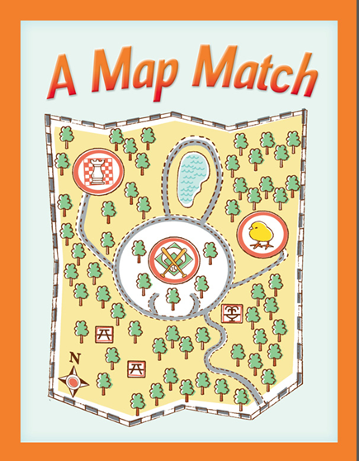

Slide 273
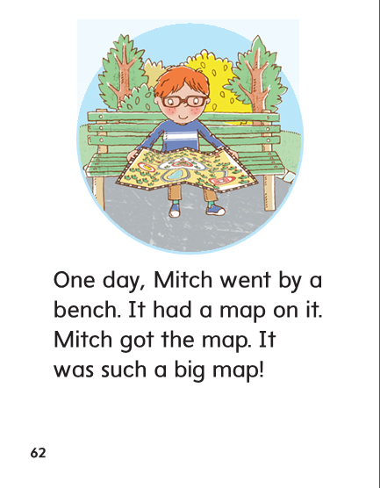

Slide 274
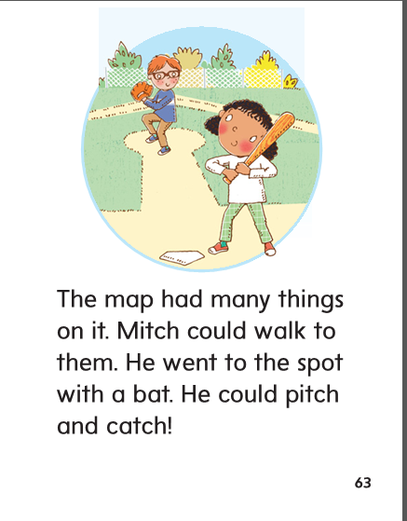

Slide 275
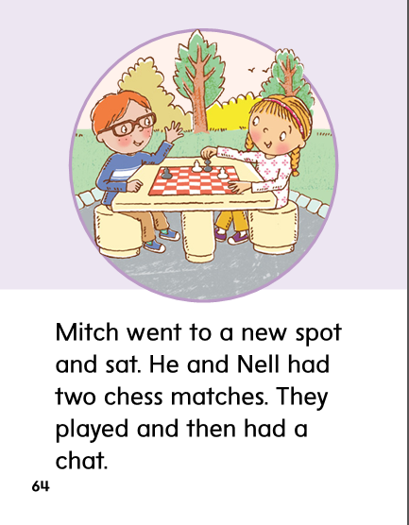

Slide 276
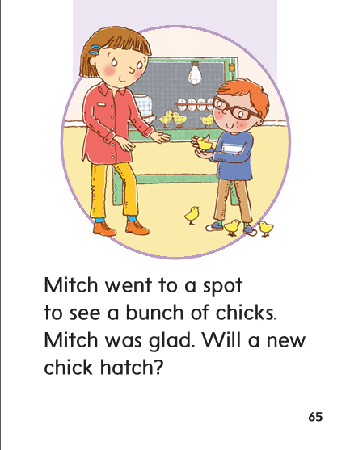

Slide 277
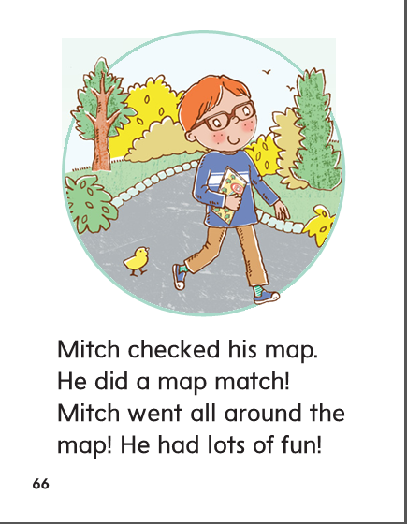

Slide 279
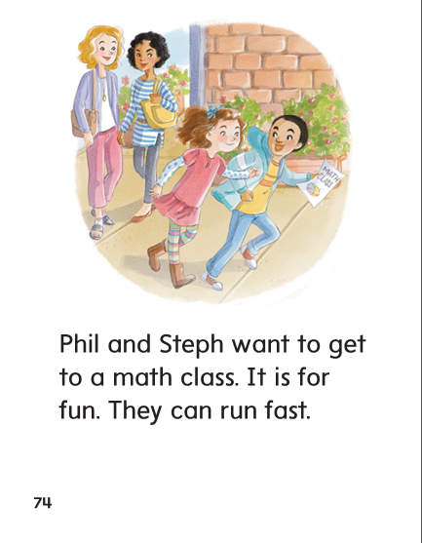

Slide 280
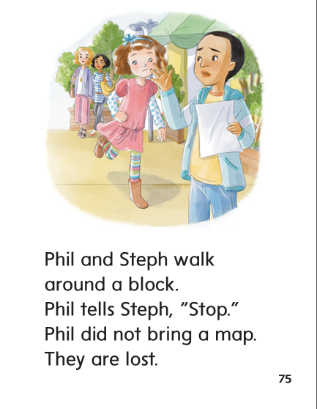

Slide 281
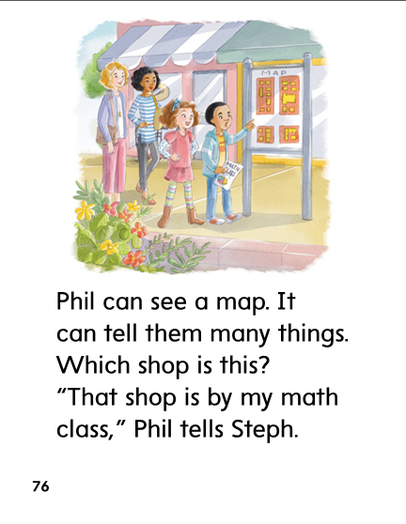

Slide 282
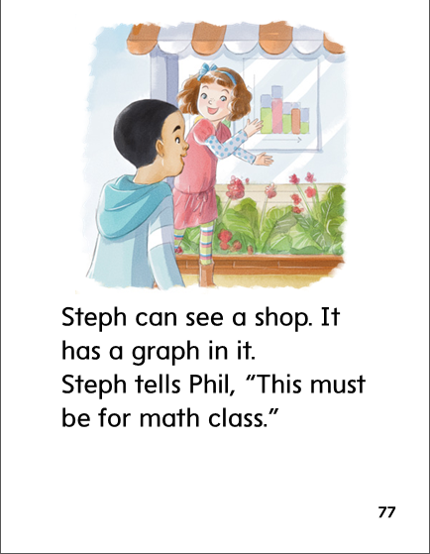

Slide 283
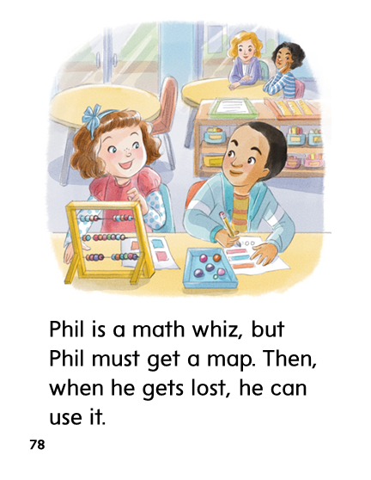

Slide 284
Structural Analysis
Remember when –es is added to a naming word, it changes the meaning of the word to mean there is more than one. It also adds a syllable. Read the words and have the children read them. Have them clap out the syllables.
inch
inches
stitch
stitches

Slide 285
Structural Analysis
Help children blend the words. Point out that the letters –es at the end of a word can stand for /ez/.
bench
benches
sketch
sketches

Slide 286
ch
-tch
wh
ph

Slide 287
whip
shop
whip
whale
with
whale
catch
catch
match
match
chin
shop
chin
graph
with
graph

Slide 288
High Frequency
Words

Slide 289
Read, Spell, Write
around
The top spins around.

Slide 290
Read, Spell, Write
by
I sat by Chad at lunch.

Slide 291
Read, Spell, Write
many
Many kids like to run

Slide 292
Read, Spell, Write
place
This is a good place to sit.

Slide 293
Read, Spell, Write
walk
Walk with me.

Slide 294
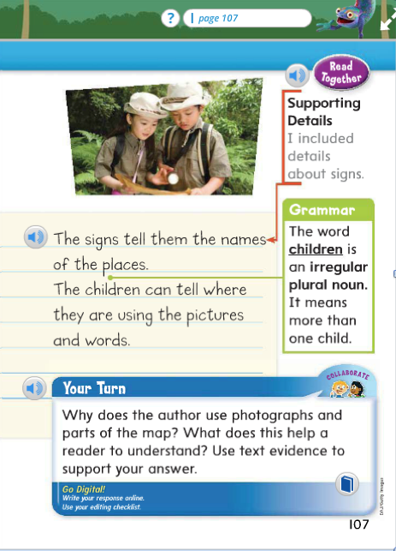
Structural Analysis
What are the plural nouns in this sentence?
Which noun did not have –s added to name more than one?

Slide 295
Week 5 – Day 4

Slide 296
Phonemic Awareness
Phoneme Addition
Listen carefully. I am going to say a word: bun.
Now I am going to repeat the word and add
the sound /ch/ to the end of the word to make a new word:
/bun/ /ch/, bunch.
The new word is bunch.
Guided Practice:
I am going to say more sounds and words.
Add the /ch/ sound to the end of the word to get a new word.
Tell me the word.
pin, /ch/ wren, /ch/ ran, /ch/
pun, /ch/ in, /ch/ bran, /ch/

Slide 297
Build Words with ch, -tch, wh, ph
c
a
tch
What is the new word we made?
Let’s blend all the sounds and read the word.
Change the c to h.

Slide 298
Build Words with ch, -tch, wh, ph
h
a
tch
What is the new word we made?
Let’s blend all the sounds and read the word.
Change the h to l.

Slide 299
Build Words with ch, -tch, wh, ph
l
a
tch
What is the new word we made?
Let’s blend all the sounds and read the word.
Change the l to m.

Slide 300
Build Words with ch, -tch, wh, ph
m
a
tch
What is the new word we made?
Let’s blend all the sounds and read the word.
Change the m to p.

Slide 301
Build Words with ch, -tch, wh, ph
p
a
tch
What is the new word we made?
Let’s blend all the sounds and read the word.
Change the a to i.

Slide 302
Build Words with ch, -tch, wh, ph
p
i
tch
What is the new word we made?
Let’s blend all the sounds and read the word.
Change the p to d.

Slide 303
Build Words with ch, -tch, wh, ph
d
i
tch
What is the new word we made?
Let’s blend all the sounds and read the word.
Change the d to h.

Slide 304
Build Words with ch, -tch, wh, ph
h
i
tch
What is the new word we made?
Let’s blend all the sounds and read the word.
Remove the h.

Slide 305
Build Words with ch, -tch, wh, ph
i
tch
What is the new word we made?
Let’s blend all the sounds and read the word.
Add an n after the i.

Slide 306
Build Words with ch, -tch, wh, ph
i
n
ch
What is the new word we made?
Let’s blend all the sounds and read the word.
Add a p before the n.

Slide 307
Build Words with ch, -tch, wh, ph
p
i
n
ch
What is the new word we made?
Let’s blend all the sounds and read the word.
Change the i to u.

Slide 308
Build Words with ch, -tch, wh, ph
p
u
n
ch
What is the new word we made?
Let’s blend all the sounds and read the word.
Change the p to h.

Slide 309
Build Words with ch, -tch, wh, ph
h
u
n
ch
What is the new word we made?
Let’s blend all the sounds and read the word.
Change the h to l.

Slide 310
Build Words with ch, -tch, wh, ph
l
u
n
ch
What is the new word we made?
Let’s blend all the sounds and read the word.
Change the l to m.

Slide 311
Build Words with ch, -tch, wh, ph
m
u
n
ch
What is the new word we made?
Let’s blend all the sounds and read the word.
Change the m to cr.

Slide 312
Build Words with ch, -tch, wh, ph
cr
u
n
ch
What is the new word we made?
Let’s blend all the sounds and read the word.

Slide 314
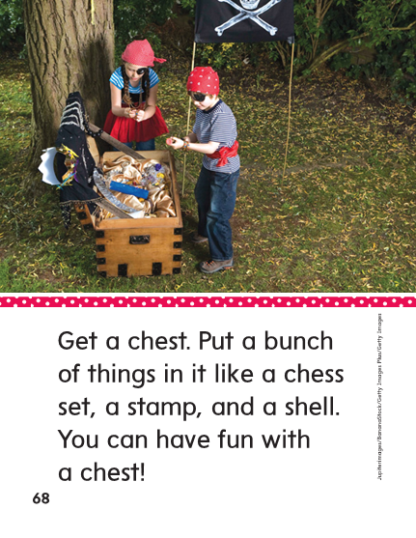

Slide 315
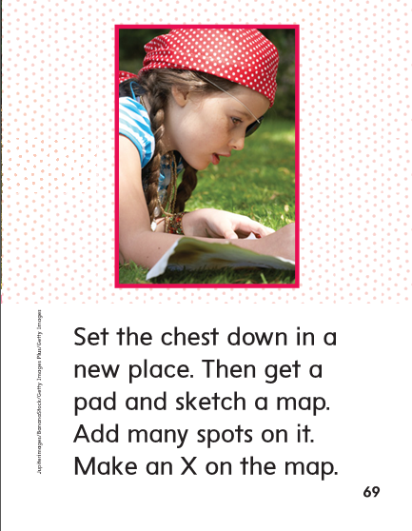

Slide 316
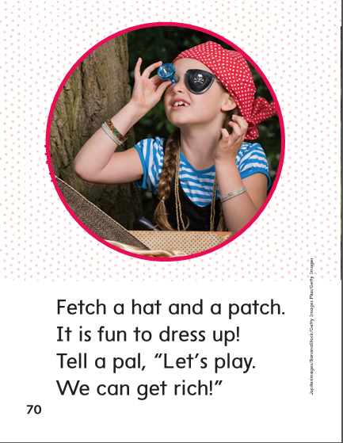

Slide 318
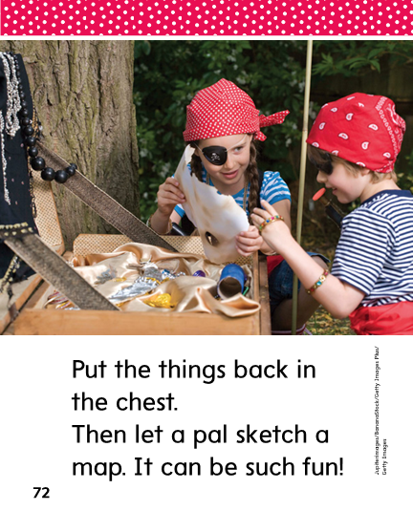

Slide 321
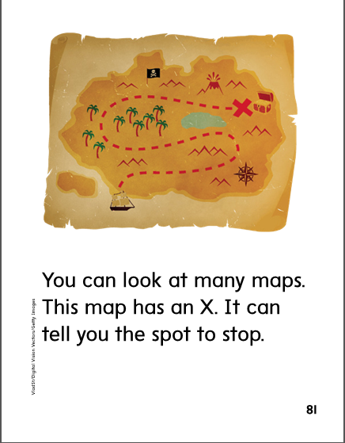

Slide 322
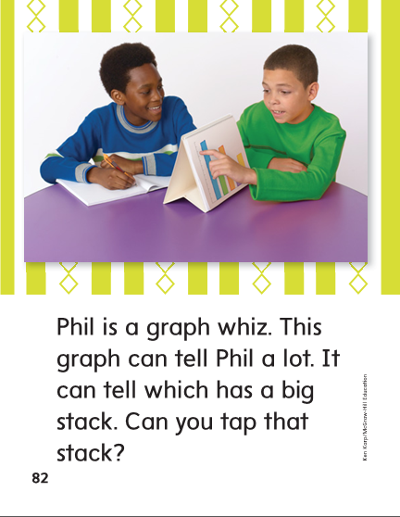

Slide 323
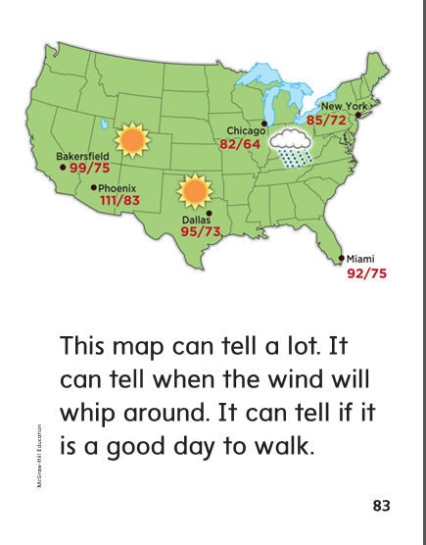

Slide 325
Structural Analysis
Review that the –es ending means there is more than one.
When –es is added, a syllable is added.
branch
branches
batch
batches
dress
dresses

Slide 326
Structural Analysis
box
bunch
brush
patch
mess
Have children work in pairs to add –es to make the words plural and read the words aloud.

Slide 327
High Frequency
Words

Slide 328
Read, Spell, Write
around
The top spins around.

Slide 329
Read, Spell, Write
by
I sat by Chad at lunch.

Slide 330
Read, Spell, Write
many
Many kids like to run

Slide 331
Read, Spell, Write
place
This is a good place to sit.

Slide 332
Read, Spell, Write
walk
Walk with me.

Slide 333
Grammar
Say the following sentences and have children tell you
the correct noun to complete each sentence.
Two (man, men) sit at the desk.
Three (women, woman) run around the block.
I have two hands and two (foot, feet).
Six (child, children) play on the swings.

Slide 334
Week 5 – Day 5

Slide 335
Phonemic Awareness
Phoneme Blending
Listen as I say a group of sounds. Then blend the sounds to form a word.
/ch/ /a/ /th/ /wh/ /e/ /n/ /p/ /u/ /n/ /ch/
/k/ /a/ /ch/ /g/ /r/ /a/ /f/ /wh/ /i/ /p/
Phoneme Segmentation
I am going to say a word. Tell me the sounds you hear in the word.
chill graph patch pinch fetch
which itch chest when inch

Slide 336
Blend and Build Words with End Blends
Read and say these words:
chop
rich
itch
when
graph

Slide 337
Blend and Build Words with End Blends
wh
i
z
What is the new word we made?
Let’s blend all the sounds and read the word.
Change the z to p.

Slide 338
Blend and Build Words with End Blends
wh
i
p
What is the new word we made?
Let’s blend all the sounds and read the word.
Change the wh to ch.

Slide 339
Blend and Build Words with End Blends
ch
i
p
What is the new word we made?
Let’s blend all the sounds and read the word.
Change the ch to h.

Slide 340
Blend and Build Words with End Blends
h
i
p
What is the new word we made?
Let’s blend all the sounds and read the word.
Change the h to s.

Slide 341
Blend and Build Words with End Blends
s
i
p
What is the new word we made?
Let’s blend all the sounds and read the word.
Change the s to sn.

Slide 342
Blend and Build Words with End Blends
s
n
i
p
What is the new word we made?
Let’s blend all the sounds and read the word.
Change the p to tch.

Slide 343
Blend and Build Words with End Blends
s
n
i
tch
What is the new word we made?
Let’s blend all the sounds and read the word.
Change the i to a.

Slide 344
Blend and Build Words with End Blends
s
n
a
tch
What is the new word we made?
Let’s blend all the sounds and read the word.
Change the sn to h.

Slide 345
Blend and Build Words with End Blends
h
a
tch
What is the new word we made?
Let’s blend all the sounds and read the word.
Change the tch to t.

Slide 346
Blend and Build Words with End Blends
h
a
t
What is the new word we made?
Let’s blend all the sounds and read the word.
Change the h to ch.

Slide 347
Blend and Build Words with End Blends
ch
a
t
What is the new word we made?
Let’s blend all the sounds and read the word.
Change the at to in.

Slide 348
Blend and Build Words with End Blends
ch
i
n
What is the new word we made?
Let’s blend all the sounds and read the word.
Change the ch to p.

Slide 349
Blend and Build Words with End Blends
p
i
n
What is the new word we made?
Let’s blend all the sounds and read the word.
Add ch to the end of the word.

Slide 350
Blend and Build Words with End Blends
p
i
n
ch
What is the new word we made?
Let’s blend all the sounds and read the word.
Change the i to u.

Slide 351
Blend and Build Words with End Blends
p
u
n
ch
What is the new word we made?
Let’s blend all the sounds and read the word.
Change the p to l.

Slide 352
Blend and Build Words with End Blends
l
u
n
ch
What is the new word we made?
Let’s blend all the sounds and read the word.
Change the l to cr.

Slide 353
Blend and Build Words with End Blends
c
r
u
n
ch
What is the new word we made?
Let’s blend all the sounds and read the word.

Slide 354
Word Automaticity
chat

Slide 355
such

Slide 356
chat

Slide 357
benches

Slide 358
patches

Slide 359
lunch

Slide 360
which

Slide 361
cat

Slide 362
bunches

Slide 363
wishes

Slide 364
check

Slide 365
when

Slide 366
catch

Slide 367
lunches

Slide 368
dishes

Slide 369
pitch

Slide 370
graph

Slide 371
whiz

Slide 372
inches

Slide 373
sketches

Slide 374
catch

Slide 375
rich

Slide 376
whip

Slide 377
Structural Analysis
Have children explain when the –es ending is used.
Then have children practice adding –es to form these plural nouns.
lunch
patch
crutch
box
dish
kiss

Slide 378
Structural Analysis
Have children practice writing and reading more words with closed syllables.
basket
finish
helping
fishing
jumping

Slide 379
High Frequency
Words

Slide 380
Read, Spell, Write
around
The top spins around.

Slide 381
Read, Spell, Write
by
I sat by Chad at lunch.

Slide 382
Read, Spell, Write
many
Many kids like to run

Slide 383
Read, Spell, Write
place
This is a good place to sit.

Slide 384
Read, Spell, Write
walk
Walk with me.

Slide 385
Grammar
Have children describe what plural nouns are and how they are used.
Have them tell the difference between regular plural nouns and irregular plural nouns..
The children have fun playing chess with the men.
Mice have four small feet.
Have children tell you the plural nouns.

Slide 386
Grammar
How do I know if a word is a plural noun?
Two _____________ use a map.
I see three ______________ playing at school.
Have children work in pairs to complete each sentence with an irregular plural noun.

