Slide 1
Week 5 – Day 1

Slide 2
Phonemic Awareness – Phoneme Categorization
Listen carefully as I say three words: bread, brake, drum.
Two of these words begin with the same two sounds. One does not.
Bread and brake begin with /br/.
Drum does not begin with /br/.
Drum does not belong.
Repeat with skate, spin, spot
grin, truck, grape.
Guided Practice:
I am going to say a group of words. Listen for the middle sound. Tell me which word does not belong and why.
crack, crumb, proud snow, snap, stay stop, smile, tick
small, sweet, smoke grow, frog, fruit drop, drink, praise

Slide 3
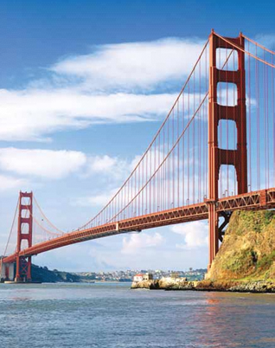
Introduce r-blends
br
bridge

Slide 4
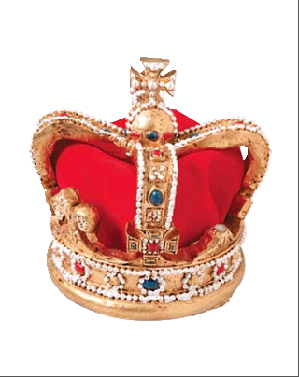
Introduce r-blends
cr
crown

Slide 5
Introduce r-blends
dr
drink

Slide 6
Introduce r-blends
fr
fruit

Slide 7
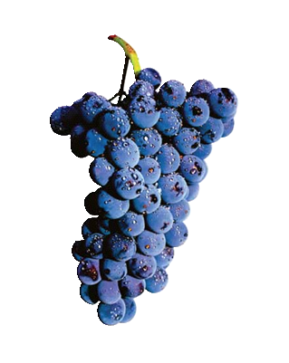
Introduce r-blends
gr
grapes

Slide 8
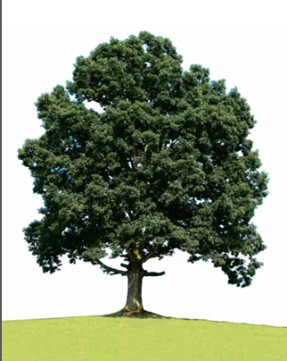
Introduce r-blends
tr
tree

Slide 9
Introduce s-blends
sm
small

Slide 10
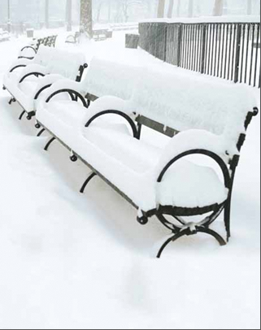
Introduce s-blends
sn
snow

Slide 11
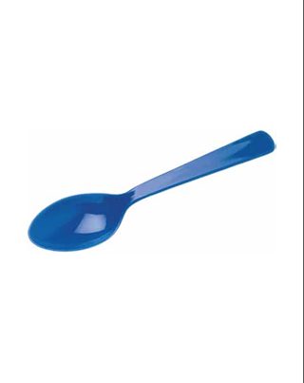
Introduce s-blends
sp
spoon

Slide 12
Introduce s-blends
st
star

Slide 13
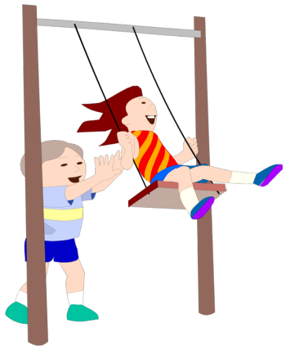
Introduce s-blends
sw
swing

Slide 14
Have children practice connecting b and r to /br/ by writing them.
Say /br/ as I write b and r. Write b and r five times as you say /br/.
Repeat with /cr/, /dr/, /fr/, /gr/, /tr/ and /sm/, /sn/, /sp/, /st/, /sw/
br br br br br
cr cr cr cr cr
fr fr fr fr fr

Slide 15
Blend with r-Blends and s-Blends
s
t

Slide 16
Blend with r-Blends and s-Blends
s
t
o

Slide 17
Blend with r-Blends and s-Blends
s
t
o
p

Slide 18
Blend with r-Blends and s-Blends
s
t
o
p

Slide 19
Blend with r-Blends and s-Blends
c
r

Slide 20
Blend with r-Blends and s-Blends
c
r
a

Slide 21
Blend with r-Blends and s-Blends
c
r
a
ck

Slide 22
Blend with r-Blends and s-Blends
c
r
a
ck

Slide 23
Blend with r-Blends and s-Blends
t
r

Slide 24
Blend with r-Blends and s-Blends
t
r
i

Slide 25
Blend with r-Blends and s-Blends
t
r
i
p

Slide 26
Blend with r-Blends and s-Blends
t
r
i
p

Slide 27
Blend with r-Blends and s-Blends
s
n

Slide 28
Blend with r-Blends and s-Blends
s
n
a

Slide 29
Blend with r-Blends and s-Blends
s
n
a
p

Slide 30
Blend with r-Blends and s-Blends
s
n
a
p

Slide 31
Blend with r-Blends and s-Blends
d
r

Slide 32
Blend with r-Blends and s-Blends
d
r
o

Slide 33
Blend with r-Blends and s-Blends
d
r
o
p

Slide 34
Blend with r-Blends and s-Blends
d
r
o
p

Slide 35
fr st o sw
i tr gr a
ck sn o bl
sk a dr cr

Slide 36
fr

Slide 37
fro

Slide 38
frog

Slide 39
frog st

Slide 40
frog sti

Slide 41
frog stick

Slide 42
frog stick sw

Slide 43
frog stick swi

Slide 44
frog stick swim

Slide 45
frog stick swim tr

Slide 46
frog stick swim tra

Slide 47
frog stick swim trap

Slide 48
frog stick swim trap
gr

Slide 49
frog stick swim trap
gri

Slide 50
frog stick swim trap
grin

Slide 51
frog stick swim trap
grin sk

Slide 52
frog stick swim trap
grin ski

Slide 53
frog stick swim trap
grin skin

Slide 54
frog stick swim trap
grin skin br

Slide 55
frog stick swim trap
grin skin bra

Slide 56
frog stick swim trap
grin skin brag

Slide 57
frog stick swim trap
grin skin brag gr

Slide 58
frog stick swim trap
grin skin brag gra

Slide 59
frog stick swim trap
grin skin brag grab

Slide 60
frog stick swim trap
grin skin brag grab
sn

Slide 61
frog stick swim trap
grin skin brag grab
sna

Slide 62
frog stick swim trap
grin skin brag grab
snack

Slide 63
frog stick swim trap
grin skin brag grab
snack sp

Slide 64
frog stick swim trap
grin skin brag grab
snack spi

Slide 65
frog stick swim trap
grin skin brag grab
snack spin

Slide 66
frog stick swim trap
grin skin brag grab
snack spin br

Slide 67
frog stick swim trap
grin skin brag grab
snack spin bri

Slide 68
frog stick swim crab
stack crib block slap
slip clip flag plop

Slide 69
frog stick swim trap
grin skin brag grab
snack spin brick tr

Slide 70
frog stick swim trap
grin skin brag grab
snack spin brick tro

Slide 71
frog stick swim trap
grin skin brag grab
snack spin brick trot

Slide 72
r

Slide 73
ra

Slide 74
rag

Slide 75
rag dr

Slide 76
rag dra

Slide 77
rag drag

Slide 78
rag drag s

Slide 79
rag drag sa

Slide 80
rag drag sack

Slide 81
rag drag sack st

Slide 82
rag drag sack sta

Slide 83
rag drag sack stack

Slide 84
rag drag sack stack
cr

Slide 85
rag drag sack stack
cra

Slide 86
rag drag sack stack
crab

Slide 87
rag drag sack stack
crab cr

Slide 88
rag drag sack stack
crab cri

Slide 89
rag drag sack stack
crab crib

Slide 90
rag drag sack stack
crab crib bl

Slide 91
rag drag sack stack
crab crib blo

Slide 92
rag drag sack stack
crab crib block

Slide 93
rag drag sack stack
crab crib block sl

Slide 94
rag drag sack stack
crab crib block sla

Slide 95
rag drag sack stack
crab crib block slap

Slide 96
rag drag sack stack
crab crib block slap
sl

Slide 97
rag drag sack stack
crab crib block slap
sli

Slide 98
rag drag sack stack
crab crib block slap
slip

Slide 99
rag drag sack stack
crab crib block slap
slip cl

Slide 100
rag drag sack stack
crab crib block slap
slip cli

Slide 101
rag drag sack stack
crab crib block slap
slip clip

Slide 102
rag drag sack stack
crab crib block slap
slip clip fl

Slide 103
rag drag sack stack
crab crib block slap
slip clip fla

Slide 104
rag drag sack stack
crab crib block slap
slip clip flag

Slide 105
rag drag sack stack
crab crib block slap
slip clip flag pl

Slide 106
rag drag sack stack
crab crib block slap
slip clip flag plo

Slide 107
rag drag sack stack
crab crib block slap
slip clip flag plop

Slide 108
Fran

Slide 109
Fran and

Slide 110
Fran and Scott

Slide 111
Fran and Scott see

Slide 112
Fran and Scott see a

Slide 113
Fran and Scott see a big

Slide 114
Fran and Scott see a big frog.

Slide 115
Fran and Scott see a big frog.
Stan

Slide 116
Fran and Scott see a big frog.
Stan spills

Slide 117
Fran and Scott see a big frog.
Stan spills his

Slide 118
Fran and Scott see a big frog.
Stan spills his glass

Slide 119
Fran and Scott see a big frog.
Stan spills his glass in

Slide 120
Fran and Scott see a big frog.
Stan spills his glass in the

Slide 121
Fran and Scott see a big frog.
Stan spills his glass in the grass.

Slide 122
I

Slide 123
I can

Slide 124
I can swim,

Slide 125
I can swim, skip,

Slide 126
I can swim, skip, and

Slide 127
I can swim, skip, and spin.

Slide 128
I can swim, skip, and spin. Can

Slide 129
I can swim, skip, and spin. Can you?

Slide 130
Spelling / Dictation
1.
2.
3.
4.
5.

Slide 131
High Frequency
Words

Slide 132
Read, Spell, Write
jump
I jump into the pool.

Slide 133
Read, Spell, Write
move
Can you move this big box?

Slide 134
Read, Spell, Write
run
We will run to school.

Slide 135
Read, Spell, Write
two
Brad has two black cats?

Slide 136
Have children read the sentences. Prompt them to identify the high-frequency words in connected text and to blend the decodable words.
I like to jump.
Can you move this big box?
We will run to school.
Brad has two black cats?

Slide 137
Grammar
A sentence is a group of words that tells a whole idea.
Brad can skip up the hill.
Brad – who?
skip up a hill – what?

Slide 138
Grammar
Have children identify which are sentences and which are not.
I like yams!
The sits here.
Is the cat?

Slide 139
Week 5 – Day 2

Slide 140
Phonemic Awareness – Phoneme Segmentation
I will say the sounds in this word: spot.
I will put one marker in each box as I say each sound.
/s/
/p/
/o/
/t/
Spot has four sounds.
Say the sounds with me: /s/ /p/ /o/ /t/.

Slide 141
Phonemic Awareness – Phoneme Segmentation
Have children place markers in boxes as they segment the following words. Do the first one together. Now I will say more words. Place markers in the boxes as you say the sounds in the word.
/s/
/n/
/a/
/ck/
Let’s do the first one together:
snack still drum trip
skin cross swim grass

Slide 142
Review r-Blends and s-Blends
s
t

Slide 143
Review r-Blends and s-Blends
s
t

Slide 144
Review r-Blends and s-Blends
s
k

Slide 145
Review r-Blends and s-Blends
s
k

Slide 146
Review r-Blends and s-Blends
s
m

Slide 147
Review r-Blends and s-Blends
s
m

Slide 148
Review r-Blends and s-Blends
s
n

Slide 149
Review r-Blends and s-Blends
s
n

Slide 150
Review r-Blends and s-Blends
s
p

Slide 151
Review r-Blends and s-Blends
s
p

Slide 152
Review r-Blends and s-Blends
s
w

Slide 153
Review r-Blends and s-Blends
s
w

Slide 154
Review r-Blends and s-Blends
b
r

Slide 155
Review r-Blends and s-Blends
b
r

Slide 156
Review r-Blends and s-Blends
c
r

Slide 157
Review r-Blends and s-Blends
c
r

Slide 158
Review r-Blends and s-Blends
d
r

Slide 159
Review r-Blends and s-Blends
d
r

Slide 160
Review r-Blends and s-Blends
f
r

Slide 161
Review r-Blends and s-Blends
f
r

Slide 162
Review r-Blends and s-Blends
g
r

Slide 163
Review r-Blends and s-Blends
g
r

Slide 164
Review r-Blends and s-Blends
p
r

Slide 165
Review r-Blends and s-Blends
p
r

Slide 166
Review r-Blends and s-Blends
t
r

Slide 167
Review r-Blends and s-Blends
t
r

Slide 168
Review r-Blends and s-Blends
st br sk cr
sm fr sp gr
sw dr sn tr

Slide 169
Blend with r-Blends and s-Blends
s
k

Slide 170
Blend with r-Blends and s-Blends
s
k
i

Slide 171
Blend with r-Blends and s-Blends
s
k
i
p

Slide 172
Blend with r-Blends and s-Blends
s
k
i
p

Slide 173
Blend with r-Blends and s-Blends
s
p

Slide 174
Blend with r-Blends and s-Blends
s
p
i

Slide 175
Blend with r-Blends and s-Blends
s
p
i
n

Slide 176
Blend with r-Blends and s-Blends
s
p
i
n

Slide 177
Blend with r-Blends and s-Blends
s
w

Slide 178
Blend with r-Blends and s-Blends
s
w
i

Slide 179
Blend with r-Blends and s-Blends
s
w
i
m

Slide 180
Blend with r-Blends and s-Blends
s
w
i
m

Slide 181
Blend with r-Blends and s-Blends
c
r

Slide 182
Blend with r-Blends and s-Blends
c
r
a

Slide 183
Blend with r-Blends and s-Blends
c
r
a
b

Slide 184
Blend with r-Blends and s-Blends
c
r
a
b

Slide 185
Blend with r-Blends and s-Blends
g
r

Slide 186
Blend with r-Blends and s-Blends
g
r
i

Slide 187
Blend with r-Blends and s-Blends
g
r
i
n

Slide 188
Blend with r-Blends and s-Blends
g
r
i
n

Slide 189
Blend with r-Blends and s-Blends
s
n

Slide 190
Blend with r-Blends and s-Blends
s
n
i

Slide 191
Blend with r-Blends and s-Blends
s
n
i
ff

Slide 192
Blend with r-Blends and s-Blends
s
n
i
ff

Slide 193
Blend with r-Blends and s-Blends
f
r

Slide 194
Blend with r-Blends and s-Blends
f
r
o

Slide 195
Blend with r-Blends and s-Blends
f
r
o
g

Slide 196
Blend with r-Blends and s-Blends
f
r
o
g

Slide 197
Blend with r-Blends and s-Blends
t
r

Slide 198
Blend with r-Blends and s-Blends
t
r
i

Slide 199
Blend with r-Blends and s-Blends
t
r
i
p

Slide 200
Blend with r-Blends and s-Blends
t
r
i
p

Slide 201
Blend with r-Blends and s-Blends
s
n

Slide 202
Blend with r-Blends and s-Blends
s
n
a

Slide 203
Blend with r-Blends and s-Blends
s
n
a
ck

Slide 204
Blend with r-Blends and s-Blends
s
n
a
ck

Slide 205
Blend with r-Blends and s-Blends
s
t

Slide 206
Blend with r-Blends and s-Blends
s
t
a

Slide 207
Blend with r-Blends and s-Blends
s
t
a
ck

Slide 208
Blend with r-Blends and s-Blends
s
t
a
ck

Slide 209
Blend with r-Blends and s-Blends
s
k

Slide 210
Blend with r-Blends and s-Blends
s
k
i

Slide 211
Blend with r-Blends and s-Blends
s
k
i
n

Slide 212
Blend with r-Blends and s-Blends
s
k
i
n

Slide 213
Blend with r-Blends and s-Blends
g
r

Slide 214
Blend with r-Blends and s-Blends
g
r
i

Slide 215
Blend with r-Blends and s-Blends
g
r
i
p

Slide 216
Blend with r-Blends and s-Blends
g
r
i
p

Slide 217
Blend with r-Blends and s-Blends
d
r

Slide 218
Blend with r-Blends and s-Blends
d
r
i

Slide 219
Blend with r-Blends and s-Blends
d
r
i
ll

Slide 220
Blend with r-Blends and s-Blends
d
r
i
ll

Slide 221
Build Words with r-blends and s-blends
b
r
i
ck
What is the new word we made?
Let’s blend all the sounds and read the word.
Change the b to t.

Slide 222
Build Words with r-blends and s-blends
t
r
i
ck
What is the new word we made?
Let’s blend all the sounds and read the word.
Change the ck to p.

Slide 223
Build Words with r-blends and s-blends
t
r
i
p
What is the new word we made?
Let’s blend all the sounds and read the word.
Change the i to a.

Slide 224
Build Words with r-blends and s-blends
t
r
a
p
What is the new word we made?
Let’s blend all the sounds and read the word.
Change the p to ck.

Slide 225
Build Words with r-blends and s-blends
t
r
a
ck
What is the new word we made?
Let’s blend all the sounds and read the word.
Change the t to c.

Slide 226
Build Words with r-blends and s-blends
c
r
a
ck
What is the new word we made?
Let’s blend all the sounds and read the word.
Remove the c.

Slide 227
Build Words with r-blends and s-blends
r
a
ck
What is the new word we made?
Let’s blend all the sounds and read the word.
Change the r to t.

Slide 228
Build Words with r-blends and s-blends
t
a
ck
What is the new word we made?
Let’s blend all the sounds and read the word.
Add an s to the front of the word.

Slide 229
Build Words with r-blends and s-blends
s
t
a
ck
What is the new word we made?
Let’s blend all the sounds and read the word.
Change the t to n.

Slide 230
Build Words with r-blends and s-blends
s
n
a
ck
What is the new word we made?
Let’s blend all the sounds and read the word.
Change the ck to p.

Slide 231
Build Words with r-blends and s-blends
s
n
a
p
What is the new word we made?
Let’s blend all the sounds and read the word.
Change the a to i.

Slide 232
Build Words with r-blends and s-blends
s
n
i
p
What is the new word we made?
Let’s blend all the sounds and read the word.
Change the n to k.

Slide 233
Build Words with r-blends and s-blends
s
k
i
p
What is the new word we made?
Let’s blend all the sounds and read the word.
Change the p to n.

Slide 234
Build Words with r-blends and s-blends
s
k
i
n
What is the new word we made?
Let’s blend all the sounds and read the word.
Change the sk to gr.

Slide 235
Build Words with r-blends and s-blends
g
r
i
n
What is the new word we made?
Let’s blend all the sounds and read the word.
Change the n to ll.

Slide 236
Build Words with r-blends and s-blends
g
r
i
ll
What is the new word we made?
Let’s blend all the sounds and read the word.
Change the g to d.

Slide 237
Build Words with r-blends and s-blends
d
r
i
ll
What is the new word we made?
Let’s blend all the sounds and read the word.
Change the ll to p.

Slide 238
Build Words with r-blends and s-blends
d
r
i
p
What is the new word we made?
Let’s blend all the sounds and read the word.
Change the i to o.

Slide 239
Build Words with r-blends and s-blends
d
r
o
p
What is the new word we made?
Let’s blend all the sounds and read the word.
Change the d to c.

Slide 240
Build Words with r-blends and s-blends
c
r
o
p
What is the new word we made?
Let’s blend all the sounds and read the word.

Slide 241
Structural Analysis
Listen for the /z/ sound at the end of Stan’s.
An apostrophe s at the end of a naming word means that
something belongs to someone or something.
Stan
Stan’s
Stan’s frog

Slide 242
Structural Analysis
Listen for the /z/ sound at the end of Stan’s.
An apostrophe s at the end of a naming word means that
something belongs to someone or something.
Stan
Stan’s
Stan’s frog

Slide 243
Structural Analysis
Blend each word and use it in a sentence that tells what belongs to whom.
Fran’s _______
Brad’s _______
frog’s _______
cat’s _______

Slide 244
Spelling
spot
grin
drill

Slide 245
spill
drip
grass
grab
spin
drop

Slide 246
High Frequency
Words

Slide 247
Read, Spell, Write
jump
I jump into the pool.

Slide 248
Read, Spell, Write
move
Can you move this big box?

Slide 249
Read, Spell, Write
run
We will run to school.

Slide 250
Read, Spell, Write
two
Brad has two black cats?

Slide 251
Grammar
A sentence is a group of words that tells a whole idea.
A sentence begins with a capital letter and ends with a punctuation mark.
Stan ran to the hill.
Did you hit him?
Swim as fast as you can!

Slide 252
Grammar
Have children identify which is a statement, which is a question,
and which is an exclamation.
Rob throws the ball.
Kip said, “Quack, quack!”
Can a dog clap?

Slide 253
Week 5 – Day 3

Slide 254
Phonemic Awareness – Phoneme Deletion
Listen carefully as I say this word: /s/ /t/ /o/ /p/, stop.
I will take away one sound to make a new word.
I will take away /s/.
Listen: /t/ /o/ /p/.
Guided Practice:
Let’s do some together. I will say a word. Then I will tell you to take away one sound. Say the new word.
brat without /b/ trip without /t/ skit without /s/
Stick without /t/ snap without /s/ grills without /r/

Slide 255
Blend with r-Blends and s-Blends
c
r

Slide 256
Blend with r-Blends and s-Blends
c
r
o

Slide 257
Blend with r-Blends and s-Blends
c
r
o
p

Slide 258
Blend with r-Blends and s-Blends
c
r
o
p

Slide 259
Blend with r-Blends and s-Blends
s
w

Slide 260
Blend with r-Blends and s-Blends
s
w
i

Slide 261
Blend with r-Blends and s-Blends
s
w
i
m

Slide 262
Blend with r-Blends and s-Blends
s
w
i
m

Slide 263
Blend with r-Blends and s-Blends
b
r

Slide 264
Blend with r-Blends and s-Blends
b
r
i

Slide 265
Blend with r-Blends and s-Blends
b
r
i
ck

Slide 266
Blend with r-Blends and s-Blends
b
r
i
ck

Slide 267
Blend with r-Blends and s-Blends
g
r

Slide 268
Blend with r-Blends and s-Blends
g
r
i

Slide 269
Blend with r-Blends and s-Blends
g
r
i
p

Slide 270
Blend with r-Blends and s-Blends
g
r
i
p

Slide 271
Blend with r-Blends and s-Blends
s
t

Slide 272
Blend with r-Blends and s-Blends
s
t
i

Slide 273
Blend with r-Blends and s-Blends
s
t
i
ck

Slide 274
Blend with r-Blends and s-Blends
s
t
i
ck

Slide 275
tr dr o sw
st i cr sn
a br ss gr
sl o sk fr

Slide 276
tr

Slide 277
tra

Slide 278
trap

Slide 279
trap dr

Slide 280
trap dri

Slide 281
trap drip

Slide 282
trap drip sn

Slide 283
trap drip sna

Slide 284
trap drip snack

Slide 285
trap drip snack sk

Slide 286
trap drip snack ski

Slide 287
trap drip snack skill

Slide 288
trap drip snack skill
sw

Slide 289
trap drip snack skill
swi

Slide 290
trap drip snack skill
swim

Slide 291
trap drip snack skill
swim cr

Slide 292
trap drip snack skill
swim cro

Slide 293
trap drip snack skill
swim cross

Slide 294
trap drip snack skill
swim cross sk

Slide 295
trap drip snack skill
swim cross ski

Slide 296
trap drip snack skill
swim cross skip

Slide 297
trap drip snack skill
swim cross skip st

Slide 298
trap drip snack skill
swim cross skip sto

Slide 299
trap drip snack skill
swim cross skip stop

Slide 300
trap drip snack skill
swim cross skip stop
br

Slide 301
trap drip snack skill
swim cross skip stop
bra

Slide 302
trap drip snack skill
swim cross skip stop
brass

Slide 303
trap drip snack skill
swim cross skip stop
brass Br

Slide 304
trap drip snack skill
swim cross skip stop
brass Bra

Slide 305
trap drip snack skill
swim cross skip stop
brass Brad

Slide 306
trap drip snack skill
swim cross skip stop
brass Brad’s

Slide 307
trap drip snack skill
swim cross skip stop
brass Brad’s fr

Slide 308
trap drip snack skill
swim cross skip stop
brass Brad’s fro

Slide 309
trap drip snack skill
swim cross skip stop
brass Brad’s frog

Slide 310
trap drip snack skill
swim cross skip stop
brass Brad’s frog’s

Slide 311
T

Slide 312
Ti

Slide 313
Tim

Slide 314
Tim’s

Slide 315
Tim’s c

Slide 316
Tim’s ca

Slide 317
Tim’s cat

Slide 318
Tim’s cat’s

Slide 319
Tim’s cat’s Fr

Slide 320
Tim’s cat’s Fra

Slide 321
Tim’s cat’s Fran

Slide 322
Tim’s cat’s Fran’s

Slide 323
Tim’s cat’s Fran’s
m

Slide 324
Tim’s cat’s Fran’s
ma

Slide 325
Tim’s cat’s Fran’s
man

Slide 326
Tim’s cat’s Fran’s
man’s

Slide 327
Tim’s cat’s Fran’s
man’s S

Slide 328
Tim’s cat’s Fran’s
man’s Sa

Slide 329
Tim’s cat’s Fran’s
man’s Sam

Slide 330
Tim’s cat’s Fran’s
man’s Sam’s

Slide 331
Tim’s cat’s Fran’s
man’s Sam’s d

Slide 332
Tim’s cat’s Fran’s
man’s Sam’s do

Slide 333
Tim’s cat’s Fran’s
man’s Sam’s dog

Slide 334
Tim’s cat’s Fran’s
man’s Sam’s dog’s

Slide 335
Tim’s cat’s Fran’s
man’s Sam’s dog’s
c

Slide 336
Tim’s cat’s Fran’s
man’s Sam’s dog’s
ca

Slide 337
Tim’s cat’s Fran’s
man’s Sam’s dog’s
cab

Slide 338
Tim’s cat’s Fran’s
man’s Sam’s dog’s
cab cr

Slide 339
Tim’s cat’s Fran’s
man’s Sam’s dog’s
cab cra

Slide 340
Tim’s cat’s Fran’s
man’s Sam’s dog’s
cab crab

Slide 341
Tim’s cat’s Fran’s
man’s Sam’s dog’s
cab crab gr

Slide 342
Tim’s cat’s Fran’s
man’s Sam’s dog’s
cab crab gra

Slide 343
Tim’s cat’s Fran’s
man’s Sam’s dog’s
cab crab grab

Slide 344
Tim’s cat’s Fran’s
man’s Sam’s dog’s
cab crab grab sl

Slide 345
Tim’s cat’s Fran’s
man’s Sam’s dog’s
cab crab grab sli

Slide 346
Tim’s cat’s Fran’s
man’s Sam’s dog’s
cab crab grab slid

Slide 347
Brad’s

Slide 348
Brad’s frog

Slide 349
Brad’s frog swims

Slide 350
Brad’s frog swims and

Slide 351
Brad’s frog swims and hops.

Slide 352
Brad’s frog swims and hops.
Gram

Slide 353
Brad’s frog swims and hops.
Gram claps

Slide 354
Brad’s frog swims and hops.
Gram claps at

Slide 355
Brad’s frog swims and hops.
Gram claps at Fran’s

Slide 356
Brad’s frog swims and hops.
Gram claps at Fran’s tricks.

Slide 358
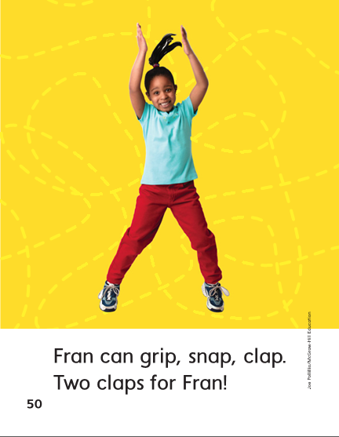

Slide 359
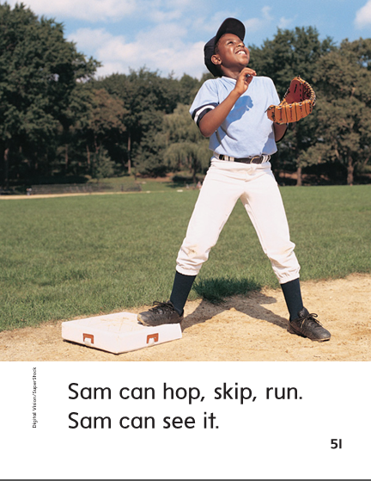

Slide 361
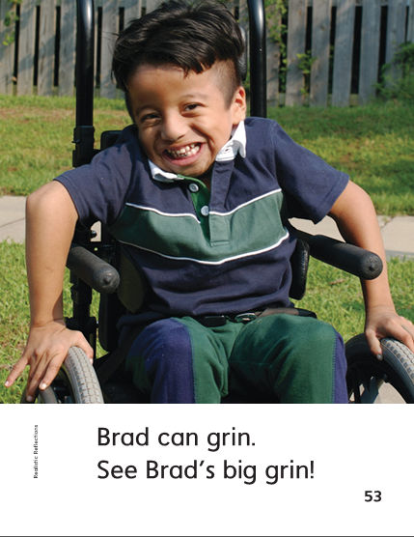

Slide 363
Structural Analysis
‘s can show that something belongs to someone.
What belongs to Brad?
Brad
Brad’s
Brad’s dog runs and jumps.

Slide 364
Structural Analysis
Blend these words. Use the words in sentence pairs like this:
Skip has a hat.
Skip’s hat is red.
Pam – Pam’s
frog – frog’s
pig – pig’s

Slide 365
Spelling
sp
gr
dr

Slide 366
spill
drip
grass
grab
spin
drop
hop
lot
two
move
Write additional words with /sp/, /dr/, or /gr/ endings

Slide 367
High Frequency
Words

Slide 368
Read, Spell, Write
jump
I jump into the pool.

Slide 369
Read, Spell, Write
move
Can you move this big box?

Slide 370
Read, Spell, Write
run
We will run to school.

Slide 371
Read, Spell, Write
two
Brad has two black cats?

Slide 372
Building Fluency
Stan likes to move.
He can run and jump.
He can do two tricks, too!

Slide 373
Grammar
A sentence is a group of words that tells a whole idea.
A sentence begins with a capital letter and ends with a punctuation mark.
Stan ran to the hill.
Did you hit him?
Swim as fast as you can!

Slide 374
Grammar
Have children identify which is a statement, which is a question,
and which is an exclamation.
Rob throws the ball.
Kip said, “Quack, quack!”
Can a dog clap?

Slide 375
Week 5 – Day 4

Slide 376
Phonemic Awareness – Phoneme Categorization
Listen as I say these words: crawl, drop, crib.
I hear /kr/ at the beginning of crawl and crib.
I do not hear /kr/ at the beginning of drop.
Drop does not belong.
Guided Practice:
I will say three words. Tell me which word does not belong and why.
grin, gross, truth skip, slot, scare black, trip, trot
spot, spin, swam crop, brag, crash trap, frog, try

Slide 377
Build Words with r-blends and s-blends
b
r
i
ck
What is the new word we made?
Let’s blend all the sounds and read the word.
Change the b to t.

Slide 378
Build Words with r-blends and s-blends
t
r
i
ck
What is the new word we made?
Let’s blend all the sounds and read the word.
Change the i to a.

Slide 379
Build Words with r-blends and s-blends
t
r
a
ck
What is the new word we made?
Let’s blend all the sounds and read the word.
Change the ck to p.

Slide 380
Build Words with r-blends and s-blends
t
r
a
p
What is the new word we made?
Let’s blend all the sounds and read the word.
Remove the r.

Slide 381
Build Words with r-blends and s-blends
t
a
p
What is the new word we made?
Let’s blend all the sounds and read the word.
Change the a to i.

Slide 382
Build Words with r-blends and s-blends
t
i
p
What is the new word we made?
Let’s blend all the sounds and read the word.
Change the t to tr.

Slide 383
Build Words with r-blends and s-blends
t
r
i
p
What is the new word we made?
Let’s blend all the sounds and read the word.
Remove the t.

Slide 384
Build Words with r-blends and s-blends
r
i
p
What is the new word we made?
Let’s blend all the sounds and read the word.
Change the r to gr.

Slide 385
Build Words with r-blends and s-blends
g
r
i
p
What is the new word we made?
Let’s blend all the sounds and read the word.
Change the p to n.

Slide 386
Build Words with r-blends and s-blends
g
r
i
n
What is the new word we made?
Let’s blend all the sounds and read the word.
Change the n to ll.

Slide 387
Build Words with r-blends and s-blends
g
r
i
ll
What is the new word we made?
Let’s blend all the sounds and read the word.
Change the g to d.

Slide 388
Build Words with r-blends and s-blends
d
r
i
ll
What is the new word we made?
Let’s blend all the sounds and read the word.
Change the ll to p.

Slide 389
Build Words with r-blends and s-blends
d
r
i
p
What is the new word we made?
Let’s blend all the sounds and read the word.
Change the i to o.

Slide 390
Build Words with r-blends and s-blends
d
r
o
p
What is the new word we made?
Let’s blend all the sounds and read the word.
Change the d to c.

Slide 391
Build Words with r-blends and s-blends
c
r
o
p
What is the new word we made?
Let’s blend all the sounds and read the word.

Slide 393
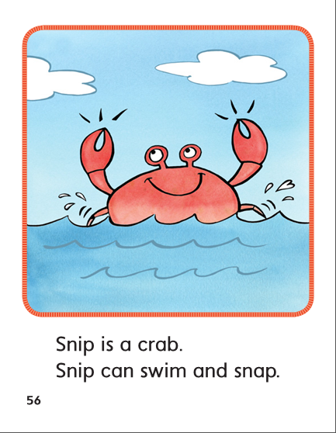

Slide 394
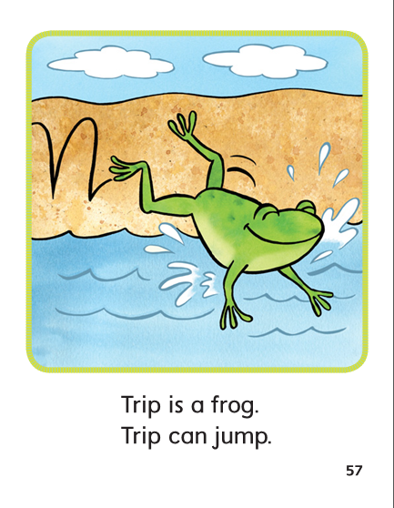

Slide 395
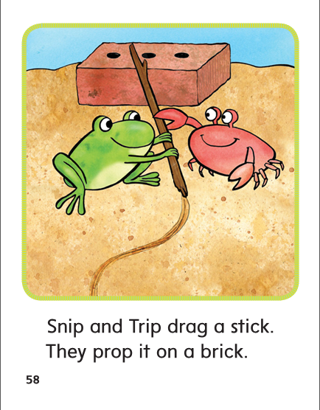

Slide 396
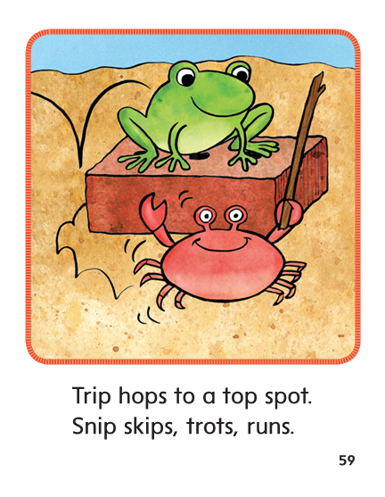

Slide 397
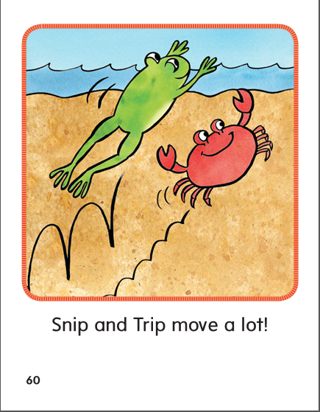

Slide 398
Structural Analysis
Remember when ‘s is added to the end of a noun, it means that something belongs to someone or something.
What belongs to Pam?
Pam’s cat
Max
Fran
frog
Mom
dog
Add ‘s to these words and read them aloud. Use the new words in sentences.

Slide 399
High Frequency
Words

Slide 400
Read, Spell, Write
jump
I jump into the pool.

Slide 401
Read, Spell, Write
move
Can you move this big box?

Slide 402
Read, Spell, Write
run
We will run to school.

Slide 403
Read, Spell, Write
two
Brad has two black cats?

Slide 404
Week 5 – Day 5

Slide 405
Phonemic Awareness
Phoneme Blending
Listen as I say a group of sounds.
Then blend those sounds to form a word.
/s/ /t/ /i/ /k/ /d/ /r/ /o/ /p/ /s/ /k/ /i/ /p/ /f/ /r/ /o/ /g/
Phoneme Segmenting
I am going to say a word. I want you to say each sound in the word.
swim grab crib spot brick

Slide 406
Build Words with r-blends and s-blends
Read and say these words:
drop
stop
spill
trick

Slide 407
Build Words with r-blends and s-blends
s
l
a
m
What is the new word we made?
Let’s blend all the sounds and read the word.
Change the l to w.

Slide 408
Build Words with r-blends and s-blends
s
w
a
m
What is the new word we made?
Let’s blend all the sounds and read the word.
Change the a to i.

Slide 409
Build Words with r-blends and s-blends
s
w
i
m
What is the new word we made?
Let’s blend all the sounds and read the word.
Change the sw to tr.

Slide 410
Build Words with r-blends and s-blends
t
r
i
m
What is the new word we made?
Let’s blend all the sounds and read the word.
Change the m to ck.

Slide 411
Build Words with r-blends and s-blends
t
r
i
ck
What is the new word we made?
Let’s blend all the sounds and read the word.
Change the t to b.

Slide 412
Build Words with r-blends and s-blends
b
r
i
ck
What is the new word we made?
Let’s blend all the sounds and read the word.
Change the br to st.

Slide 413
Build Words with r-blends and s-blends
s
t
i
ck
What is the new word we made?
Let’s blend all the sounds and read the word.
Change the i to a.

Slide 414
Build Words with r-blends and s-blends
s
t
a
ck
What is the new word we made?
Let’s blend all the sounds and read the word.
Change the st to tr.

Slide 415
Build Words with r-blends and s-blends
t
r
a
ck
What is the new word we made?
Let’s blend all the sounds and read the word.
Change the ck to p.

Slide 416
Build Words with r-blends and s-blends
t
r
a
p
What is the new word we made?
Let’s blend all the sounds and read the word.
Change the a to i.

Slide 417
Build Words with r-blends and s-blends
t
r
i
p
What is the new word we made?
Let’s blend all the sounds and read the word.
Change the tr to sk.

Slide 418
Build Words with r-blends and s-blends
s
k
i
p
What is the new word we made?
Let’s blend all the sounds and read the word.
Change the p to n.

Slide 419
Build Words with r-blends and s-blends
s
k
i
n
What is the new word we made?
Let’s blend all the sounds and read the word.
Change the n to ll.

Slide 420
Build Words with r-blends and s-blends
s
k
i
ll
What is the new word we made?
Let’s blend all the sounds and read the word.
Change the sk to dr.

Slide 421
Build Words with r-blends and s-blends
d
r
i
ll
What is the new word we made?
Let’s blend all the sounds and read the word.

Slide 422
Word Automaticity
frog

Slide 423
brick

Slide 424
block

Slide 425
stick

Slide 426
grab

Slide 427
drag

Slide 428
slap

Slide 429
swim

Slide 430
spin

Slide 431
flag

Slide 432
skin

Slide 433
stack

Slide 434
stop

Slide 435
drip

Slide 436
cross

Slide 437
slid

Slide 438
skid

Slide 439
Brad’s

Slide 440
frog’s

Slide 441
man’s

Slide 442
Kid’s

Slide 443
dog’s

Slide 444
Sam’s

Slide 445
Tim’s

Slide 446
cat’s

Slide 447
Structural Analysis
Possessives
Discuss what an apostrophe s at the end of a word means.
Practice writing and reading possessive nouns.
Use the words in sentences.
man’s mom’s
Tim’s frog’s
dog’s cat’s
Fran’s Brad’s

Slide 448
High Frequency
Words

Slide 449
Read, Spell, Write
jump
I jump into the pool.

Slide 450
Read, Spell, Write
move
Can you move this big box?

Slide 451
Read, Spell, Write
run
We will run to school.

Slide 452
Read, Spell, Write
two
Brad has two black cats?

Slide 453
Grammar
Name the three kinds of sentences.
How do I know when a group of words forms a sentence?
Work in pairs to write a statement, a question, and an exclamation.

Slide 454
Grammar
Remember all sentences begin with a capital letter and end with a punctuation mark.
Fix the sentences.
will you fill my glass
the class has a big flag

