Slide 1
Wonders Alphabet Chant
Using hand signals

Slide 2
Aa

Slide 3
Bb

Slide 4
Cc

Slide 5
Dd

Slide 6
Ee

Slide 7
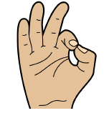
Ff

Slide 8
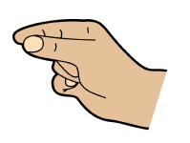
Gg

Slide 9
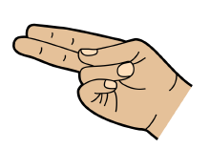
Hh

Slide 10
Ii

Slide 11
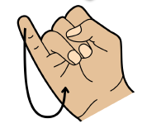
Jj

Slide 12
Kk

Slide 13
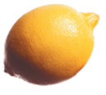
Ll

Slide 14
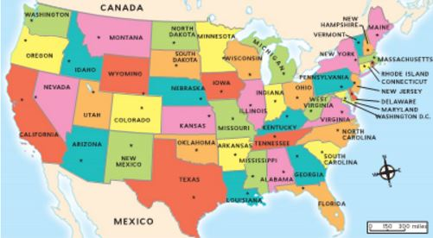
Mm

Slide 15
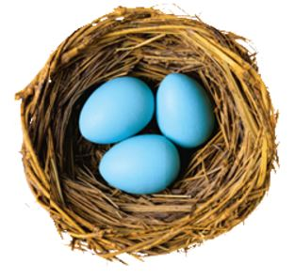
Nn

Slide 16
Oo

Slide 17
Pp

Slide 18
Qq

Slide 19
Rr

Slide 20
Ss

Slide 21
Tt

Slide 22
Uu

Slide 23
Vv

Slide 24
Ww

Slide 25
Xx

Slide 26
Yy

Slide 27
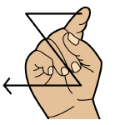
Zz

